Slide 1
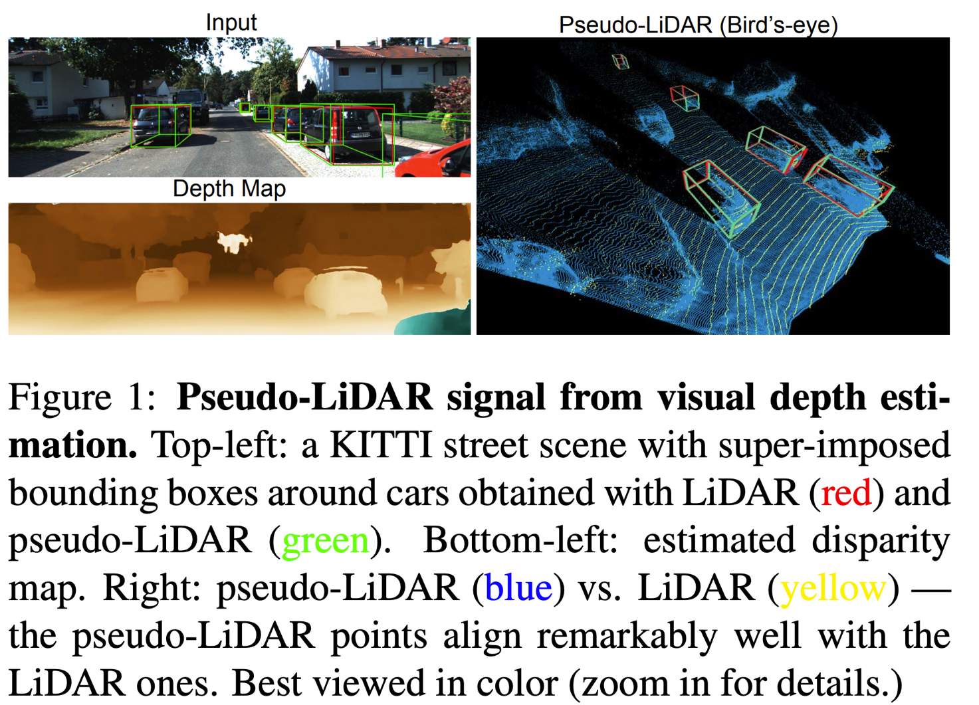
Pseudo LIDAR

Slide 2
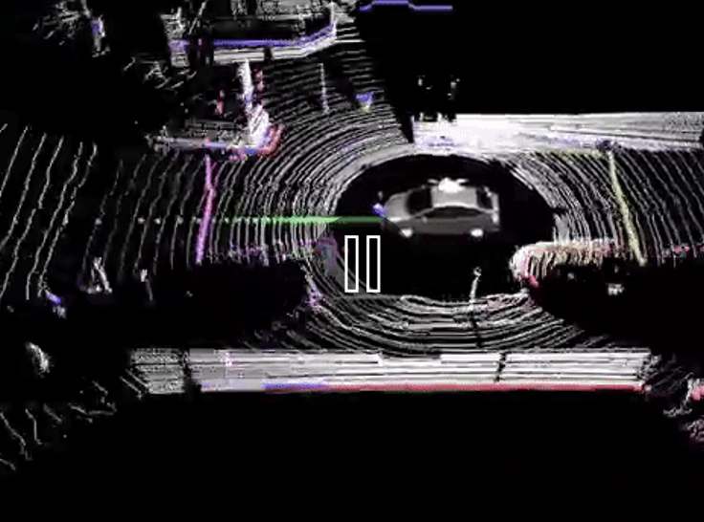
What is LIDAR?
Based on time of flight (time it takes light to go out, bounce off and object and come back). Returns 3D coordinates relative to the sensor.

Slide 3
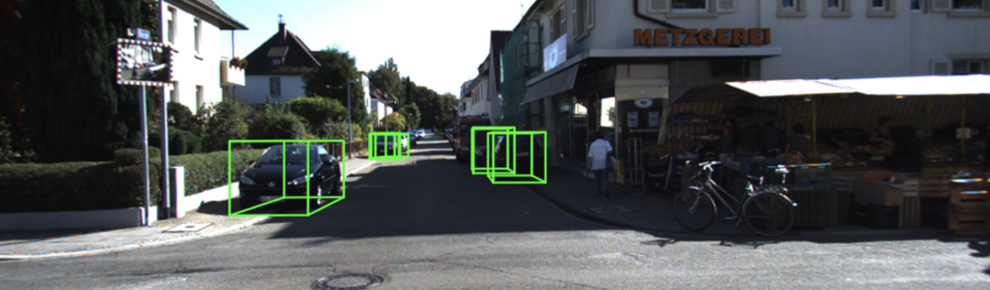
3D Object detection

Slide 4

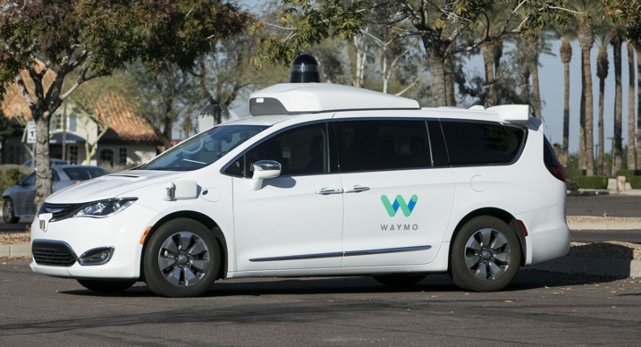
Stereo vs. lidar
(Tesla vs. Waymo)

Slide 5

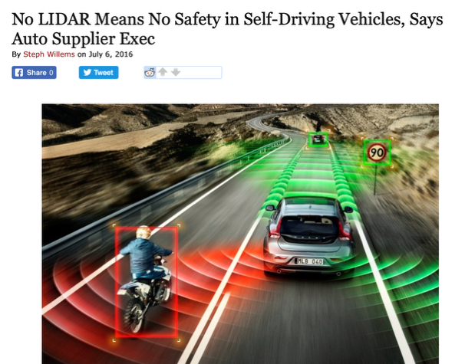







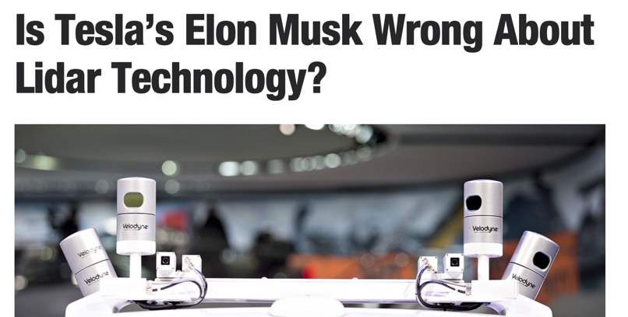

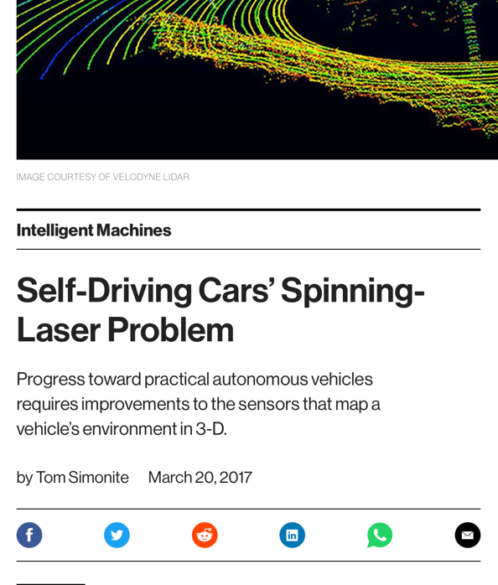





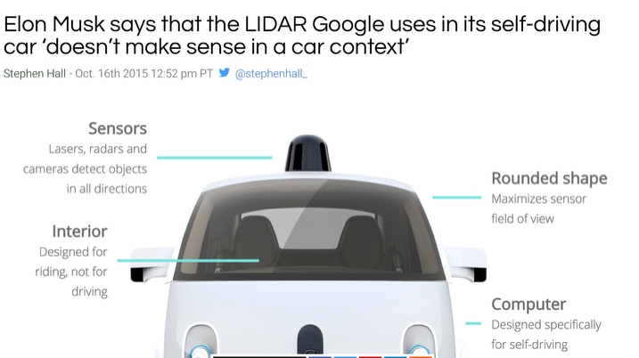

Slide 6

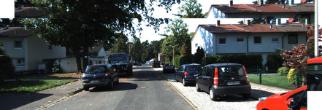
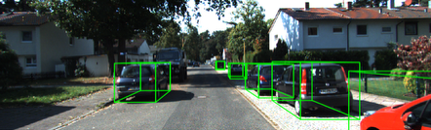
LiDAR Pipeline
[Ku. et al. 2018, Yang et al. 2018, Shi et al. 2019]
LiDAR point cloud
Frontal Image(s)
Predicted B-Boxes
Deep Object Detection

Slide 7


Stereo Pipeline
[Chen et al. 2018]
Stereo Images
Disparity Estimation
Disparity Map
Stereo Images
+ Depth Map
Predicted B-Boxes
Deep Object Detection

Slide 8
3D object detectioN (Acc.)
KITTI benchmark [Geiger et al. 2013] (Average Precision Bird-Eye-View)
IoU=0.5
IoU=0.7

Slide 9

Depth map

Slide 10
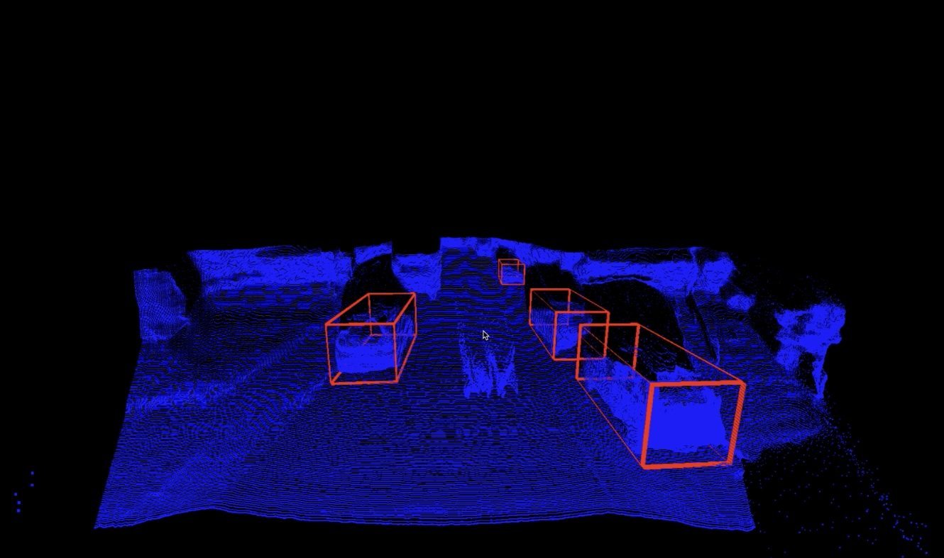
Point cloud

Slide 11
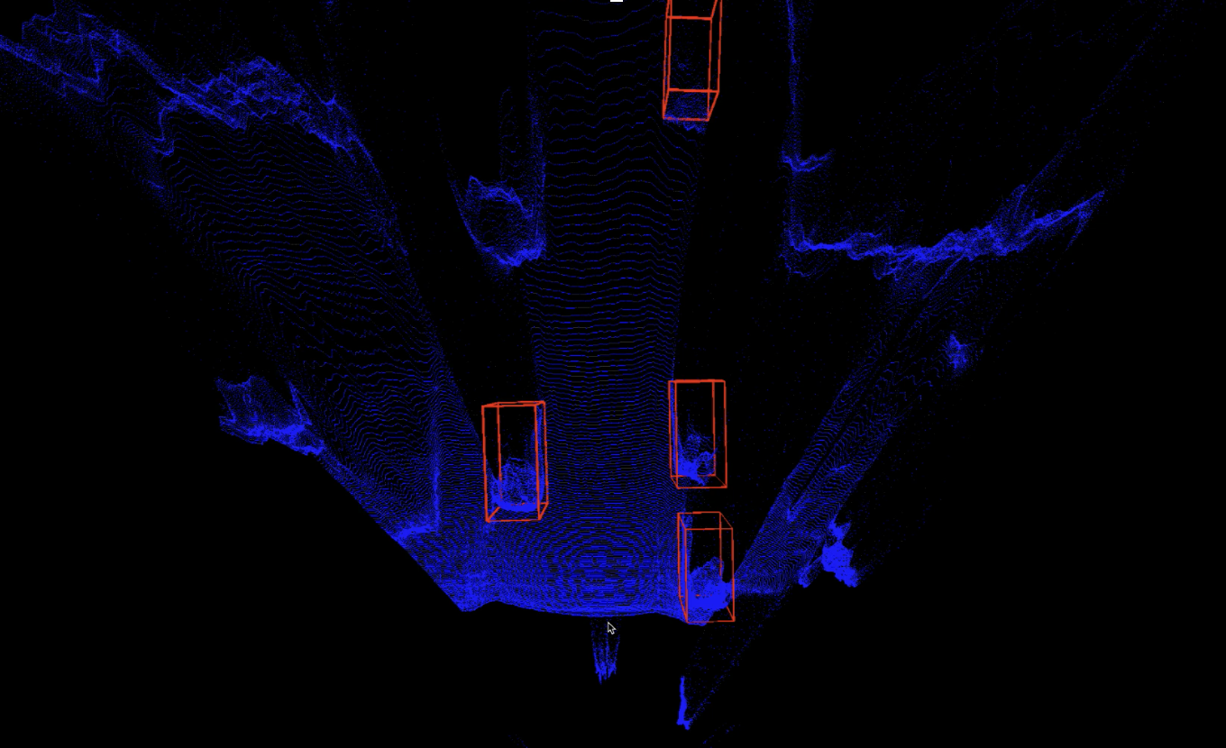
Point cloud

Slide 12
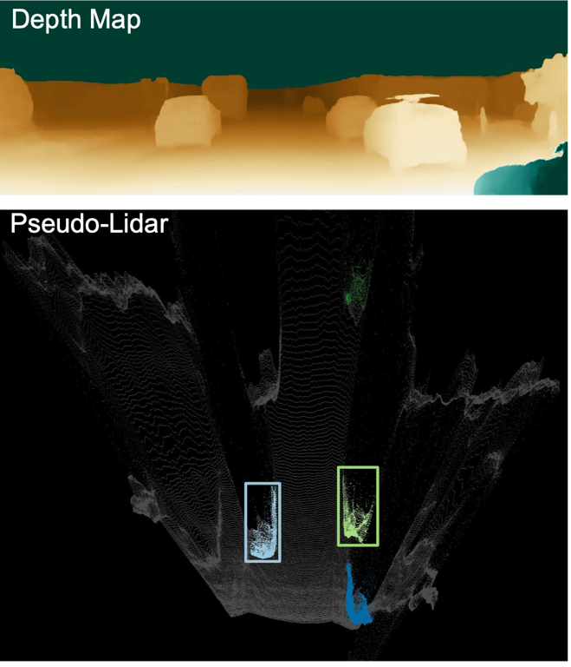
Filters on depth maps

Slide 13
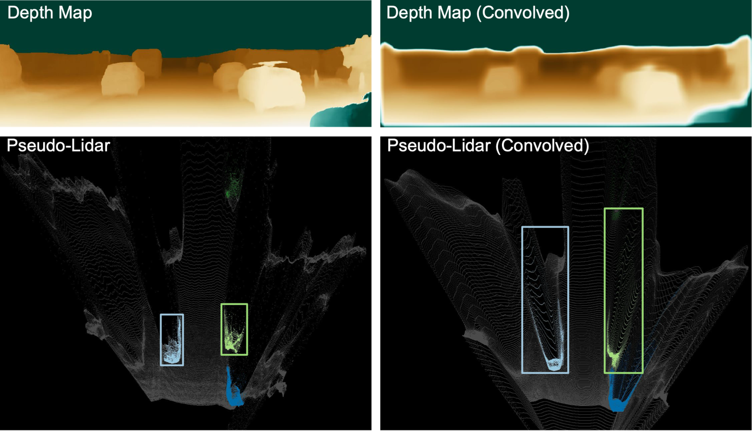
Filters on depth maps

Slide 14
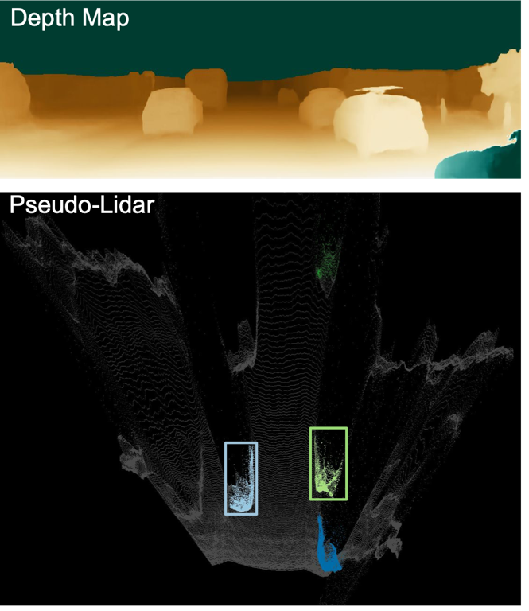
conjecture
Frontal Depth Maps are ill suited for ConvNets
Convert to Bird-Eye-View first!

Slide 15
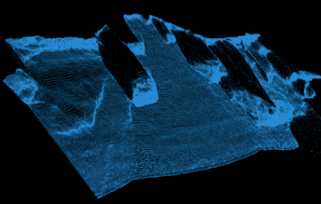
Pseudo-LiDar Pipeline
Disparity Estimation
Stereo Images
Disparity Map
Pseudo-Lidar (Voxels)
Frontal Image(s)
Predicted B-Boxes
Deep Object Detection

Slide 16
3D object detection (Acc.)
KITTI benchmark [Geiger et al. 2013] (Average Precision Bird-Eye-View)
IoU=0.5
IoU=0.7

Slide 17
3D object detection (Acc.)
KITTI benchmark [Geiger et al. 2013] (Average Precision Bird-Eye-View)
IoU=0.5
IoU=0.7

Slide 18
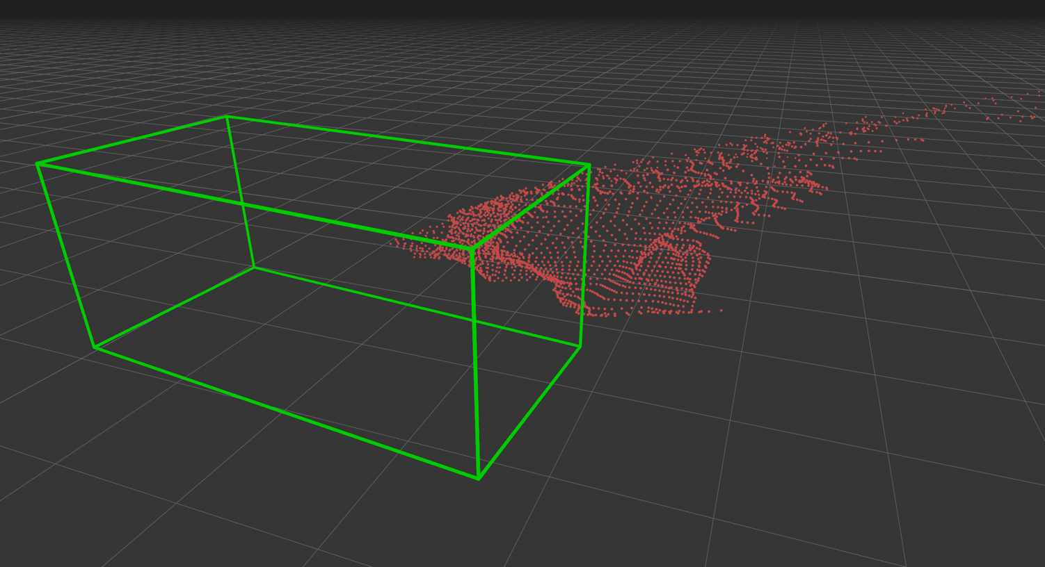

Slide 19
DisparitY
Stereo Images
Disparity Estimation
Disparity Map

Slide 20
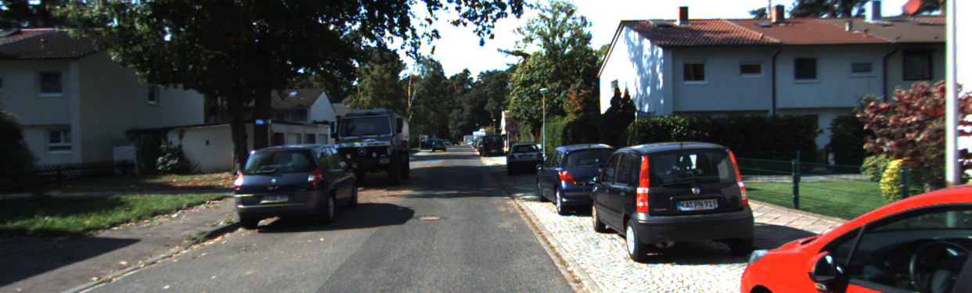
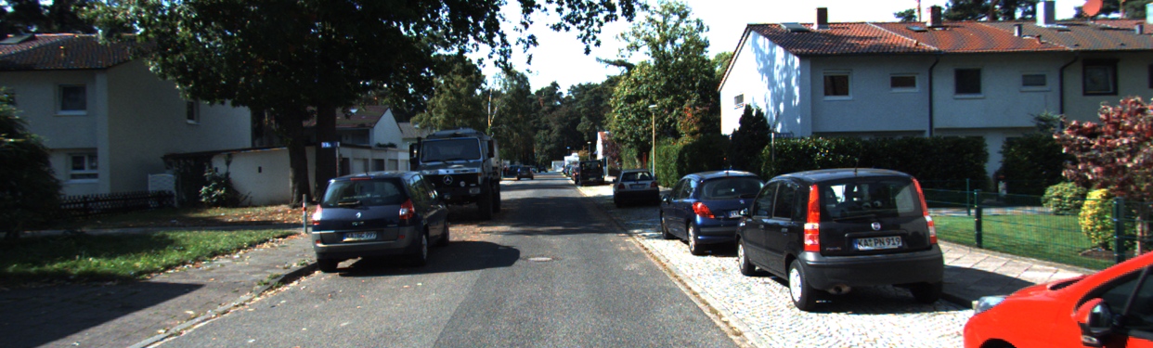
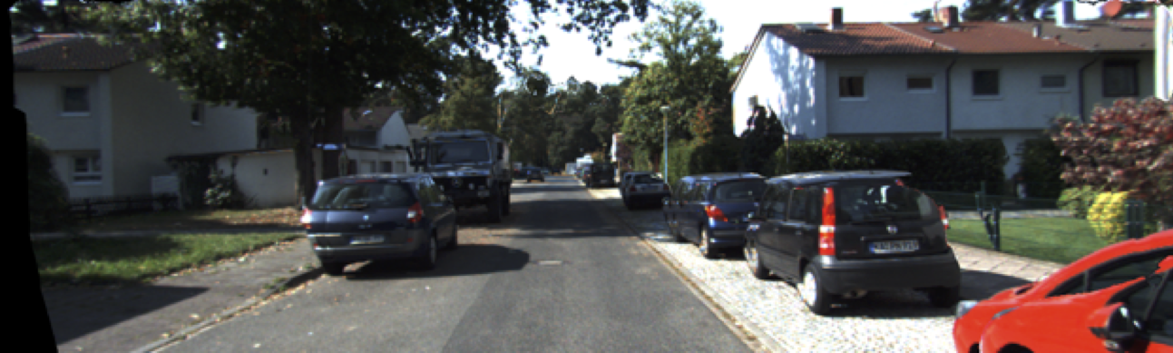
height
width
disparity

Slide 21

4D convolution
softmax
disparity map

Slide 22


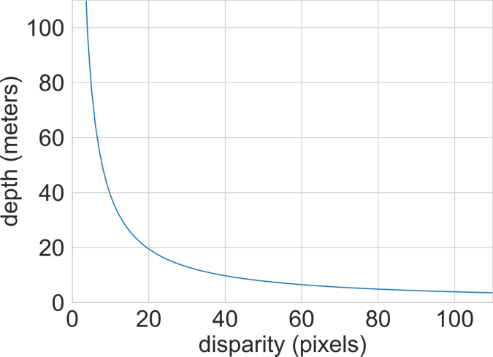
Disparity vs depth
Median error in meters
distance in meters

Slide 23

Stereo Depth Network
Disparity Cube
Depth Cube
Depth Map
Stereo Images
softmax
interpolation
resolution
1 pixel
resolution
1 m
L1-loss on depth

Slide 24
Stereo Depth Network
Depth Cube
Depth Map
softmax
height
L1-loss on depth
width
depth
(1m)

Slide 25

Disparity vs depth
Median error in meters
distance in meters

Slide 26
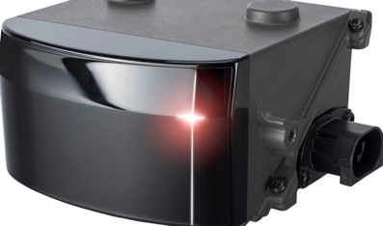
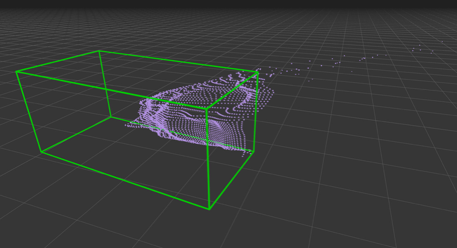
Locally Linear Depth Correction
from (cheap) 4-beam LiDAR signal*
*(we downsampled 64 KITTI beams to 4 beams)

Slide 27
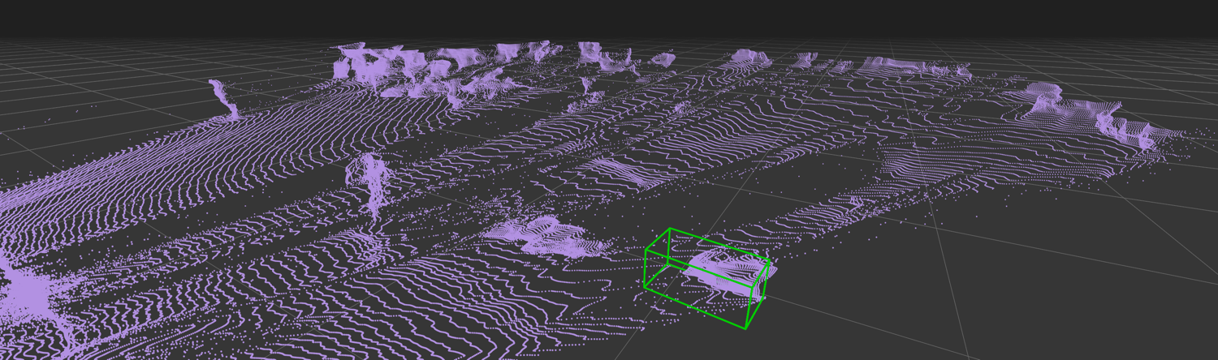
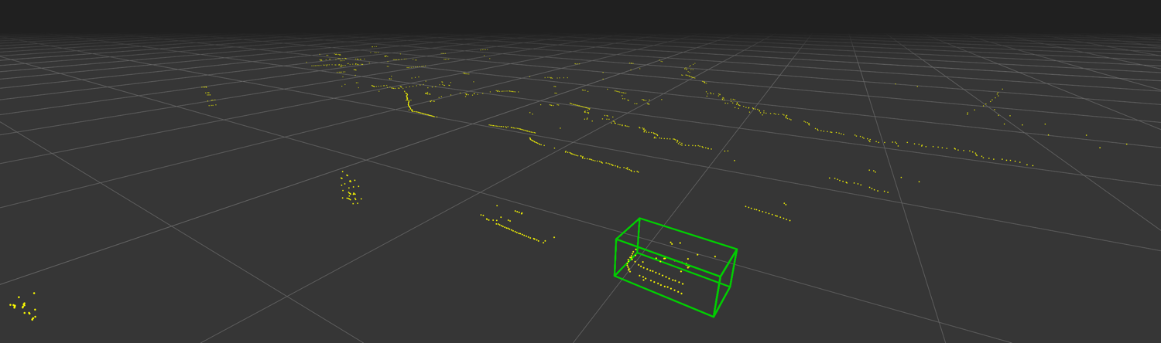
pseudo-LiDAR
4-Beam LiDAR

Slide 28
3D object detectioN (Acc.)
KITTI benchmark [Geiger et al. 2013]
IoU=0.5
IoU=0.7

Slide 30
What advantages do stereo cameras have compared to expensive LiDAR sensors?
Cheaper hardware setup
Passive sensing (no emitter)
High spatial resolution possible
depth accuracy inversely proportional to distance

Slide 31
What is monocular and stereo depth?
Monocular: depth from one image (how?)
Stereo: depth from two aligned views

Slide 32
What are Siamese networks?
Twin networks sharing weights
Compare two inputs directly
Used for disparity estimation
Output: similarity or match score

Slide 33
The authors mention they remove points higher than 1 meter above the vehicle. What is the benefit of this and what if there's an overpass or a truck higher than 1 meter that's actually important to detect?
Reduces noise from sky/trees
Focuses on drivable space
Improves detection consistency
Can miss tall objects like trucks

Slide 34
How did the authors choose the ROI for BEV cropping?
They inherit this from the current LIDAR algorithms… (e.g. AVOD, Frustum PointNet), They have their own assumptions about the spatial region over which they operate

Slide 35
Why does performance degrade sharply beyond 30 m, and can multi-scale fusion or hierarchical depth priors reduce that collapse?
Stereo depth error increases
Small objects occupy few pixels

Slide 36
How would the system react to an optical illusion photo where a small nearby object looks like a large distant one? Would it misjudge the object’s depth or scale?

Slide 37
So, is the main insight here that because LiDAR-based pipelines are the highest-performing, other forms of 3D data should be converted to LiDAR? Can we generalise and say that whenever a particular representation X is "default" or most developed, you can get further with a new representation Y by working on Y->X conversion rather than developing technology for Y from scratch?

Slide 38
What would the implications of this gap be for self driving task activities such as material identification, occlusion inference, or mirror detection, and how would multimodal fusion work to fill these gaps?

Slide 40
“Normalized Camera”
Pinhole at (0,0,0), point P at (X,Y,Z)
Virtual film at Z = 1 plane.
Point X,Y,Z is imaged at intersection of:
Line from (0,0,0) to (X,Y,Z), and
the Z = 1 plane
Intersection point (x,y), has coordinates
(X/Z, Y/Z, 1)
This is called the “normalized camera model”
What happens when focal length is not 1?
Camera Center of Projection

Slide 41
Pinhole, (Center of projection), at (0,0,0)
(X,Y,Z)
f
Z-axis
Image plane

Slide 42
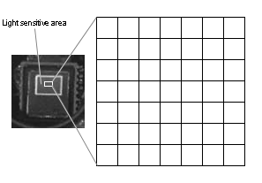
…but the cow is not a sphere
We don’t just want to know where, mathematically, the point ends up on the image plane… we want to know the pixel coordinates of the point.
Why might this be hard?!

Slide 43
Intrinsic Camera Parameters
The pixels may be rectangular:
x = αX/Z
Y = βY/Z
CCD sensor array

Slide 44
Intrinsic Camera Parameters
Chip not centered, or 0,0 may not be center of the chip.
x = αX/Z + x₀
Y = βY/Z + y₀
CCD sensor array

Slide 45
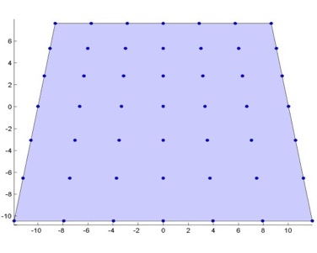
Intrinsic Camera Parameters
cheap CMOS chip
image
cheap lens
cheap
glue
cheap camera
x = αX/Z – α cot(θ) Y/Z + x₀
y = β/sin(θ) Y/Z + y₀
Ugly relationship between (X,Y,Z) and (x,y).

Slide 46
Homogeneous Coordinates
Represent 2d point using 3 numbers, instead of the usual 2 numbers.
Mapping 2d→ 2d homogeneous:
(x,y) → (x,y,1)
(x,y) → (sx, sy, s)
Mapping 2d homogeneous to 2d
(a,b,w) → (a/w, b/w)
The coordinates of a 3D point (X,Y,Z) *already is* the 2D (but homogeneous) coordinates of its projection.
Will make some things simpler and linear.

Slide 47
Why?!
x = αX/Z – α cot(θ) Y/Z + x₀
y = β/sin(θ) Y/Z + y₀

Slide 48
1080 x 1920 (1920 heigh)
xo, yo = 540, 960
We see 8 meters wide at 10 m distance
1350 0 540 X
0 1350 960 Y
0 0 1 Z
Xf + 540Z
Yf + 960Z
Z
Xf/Z + 540
Yf/Z + 960
1
When X is -4, and Z is 10, I want x = 0 x = Xf/Z + 540
0 = -4f/10 + 540
4f/10 = 540
4f = 5400
f = 1350

Slide 49
Homogenous Coordinates!
Equation of a line on the plane?
Equation of a plane through the origin in 3D?

Slide 50
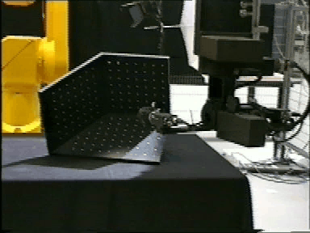
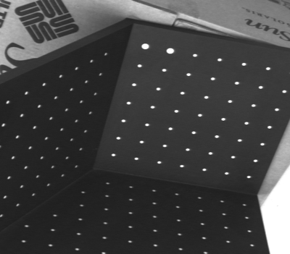
Given enough examples of 3D points and their 2D projections, we can solve for the 5 intrinsic parameters…
Example calibration object…

Slide 51
Practical Linear Algebra 1:
Given many examples of the equation at the right, solve for the matrix of values fx, fy, s, x0, y0
How can we solve for this?

Slide 52
… and all this assumes that we know X,Y,Z
Given enough examples of 3D points and their 2D projections, we can solve for the 5 intrinsic parameters…
Exactly Known!
(0,0,0)

Slide 53
More commonly, we can put a collection of points (usually in a grid) in the world with known relative position, but with unknown position relative to the camera.
Then we need to solve for the intrinsic calibration parameters, and the extrinsic parameters (the unknown relative position of the grid).
How do we represent the unknown relative position of the grid?

Slide 54
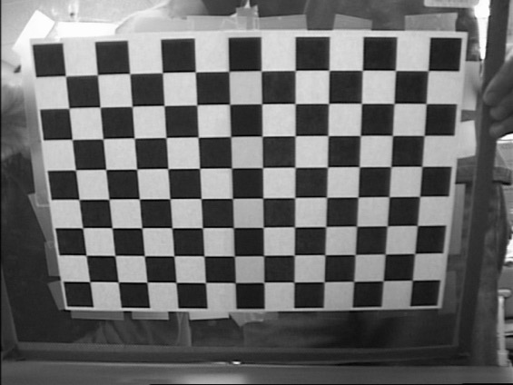
The grid defines its own coordinate system
That coordinate system has a
Euclidean transformation that relates its coordinates to the camera coordinates… that is, there is some R, T such that:
X
Z
Y
With enough example points, could we solve for R,T?

Slide 55
An aside…Representation of Rotation with a Rotation Matrix
Rotation matrix R has two properties:
Property 1:
R is orthonormal, i.e.
In other words,
Property 2: Determinant of R is 1.
Therefore, although the following matrix is orthonormal,
it is not a rotation matrix because its determinant is -1.
this is a reflection matrix

Slide 56
Representation of Rotation -- Euler Angles
Euler angles
pitch: rotation about x axis :
yaw: rotation about y axis:
roll: rotation about z axis:
Z
Y
X

Slide 57
Putting it all together…
+
P is a 4X3 matrix, that defines projection of points (used in graphics). P has 11 degrees of freedom, (the scale of the matrix doesn’t matter). 5 intrinsic parameters, 3 rotation, 3 translation

Slide 58
Given many examples of:
World points (X,Y,Z), and
Their image points (x,y)
Solve for P.
Then
Rotation + intrinsic, all mixed up.
translation

Slide 59
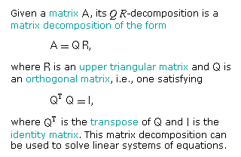
Then take the QR decomposition of this part of the matrix to get the rotation and the intrinsic parameters.
(from mathworld).

