Slide 1
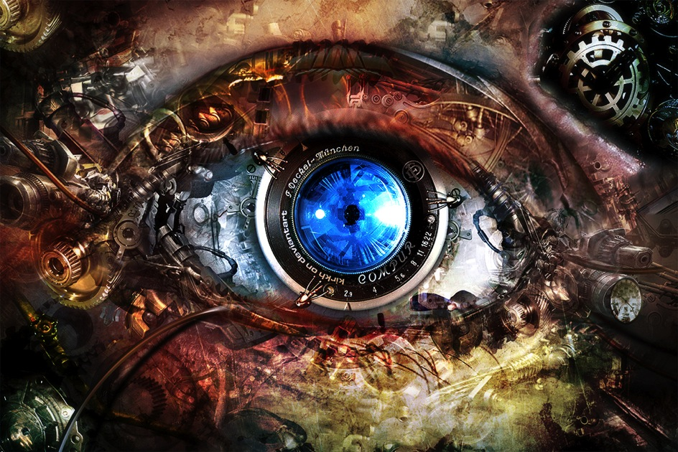
CSE 4527/6527: Computer Vision

Slide 2
Today’s Class
Introductions
What is Computer Vision?
Computer Vision at George Washington University
Specifics of this course
Questions
Slides adapted from James Hays

Slide 3
The goal of computer vision
Extract information from visual data
Notes:
Fairly broadly speaking, the goal of CV is to extract information out of visual data.
But what kind of information?
Ideally information that the system can use to perform some action: for a robot, it might be navigating the world, or picking up and manipulating things etc. For an internet company, it might be blocking the content, or describing it in words to a human purveyor. For an AR system, it might be to render a particular object in a certain way.

Slide 4
The goal of computer vision
Extract enough information from visual data to make good decisions
Notes:
So the goal of CV is to extract enough information from visual data to make good decisions or take good actions.
What enough is, will depend on what decision we want to take.

Slide 5
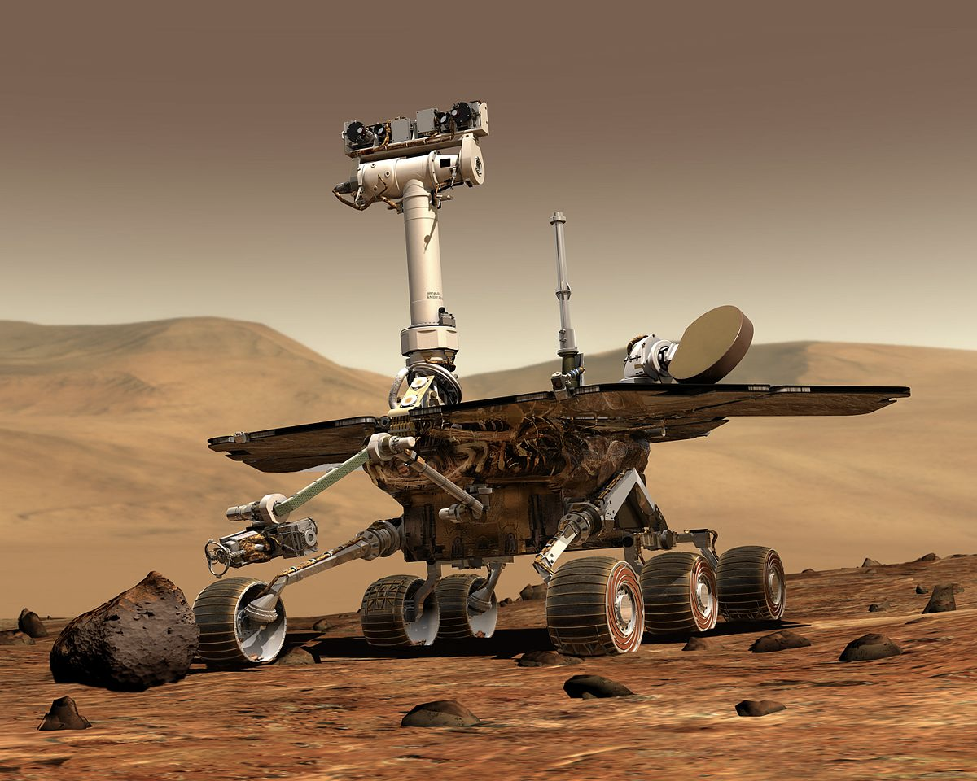
Example 1: Robotics
Notes:
Need computer vision to perceive the world
Why do we need perception?
Example 1: robots in environments humans can’t go, like Mars Rover.
Navigating requires understanding environment so as to not bump into nasty things, fall into crevasses etc.
Vision useful tool because can ”see” a very large part of the environment, and potentially very far away.

Slide 6
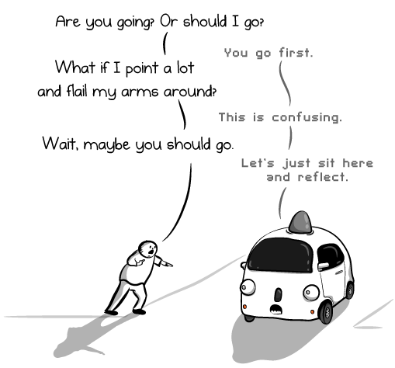
Example 1: Robotics
http://theoatmeal.com/blog/google_self_driving_car
Notes:
For robots in human environments, need to perceive not just obstacles or navigational stuff but also where humans are, what they are doing, and even what they intend to do. For example, self driving cars need to not only find out if there are pedestrians, but also figure out the intent of the pedestrian: is she going to cross? Should we wait? Etc.

Slide 7
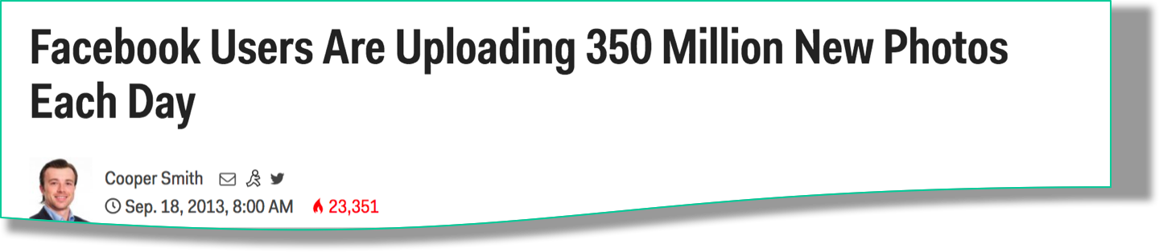
Example 2: Internet Vision
Notes:
Example 2: The internet is full of visual data. Need to understand this visual data to: prune out or flag objectionable content, understand what people like or hate or are looking for, and use that for nefarious purposes like selling things, or help visually impaired people consume this visual content. Example: is this livestream video the video of a crime? Should this be reported and the people apprehended? Is this just news coverage?

Slide 8
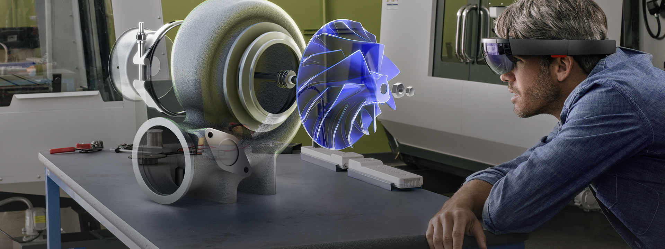
Example 3: AR
Notes:
Example 3: A big promise nowadays is AR (Augmented Reality), where we can see virtual things interacting with the real world. This can be used for education, for visualizing in engineering and STEM fields, for playing games and so on. But for virtual things to interact correctly with the real world, need to perceive the real world properly. Is this a table? Should things bounce off of it, or sink into it? Where’s the surface of the table?

Slide 9
The goal(s) of computer vision
What is the image about?
What objects are in the image?
Where are they?
How are they oriented?
What is the layout of the scene in 3D?
What is the shape of each object?
…
Notes:
If we want to check for objectionable content, then we may just want to know what the image is about.
In a self driving car, we may want to know if there are any pedestrians, or other cars, in the visual field, and if so, where are they so that we don’t run into them.
We may also want to know how they are oriented in space and where they are moving.
To navigate the scene successfully, both robots and self driving cars will need to know what the layout of the scene is in 3D.
If we are building a robot that has to pick things up, it probably needs to know the location and orientation fairly precisely, but it will also need to know the shape of the object and where it can be grasped.
And so on.
As humans, we do this fairly easily, and so many of you may not understand why this is so hard. Give example.

Slide 10
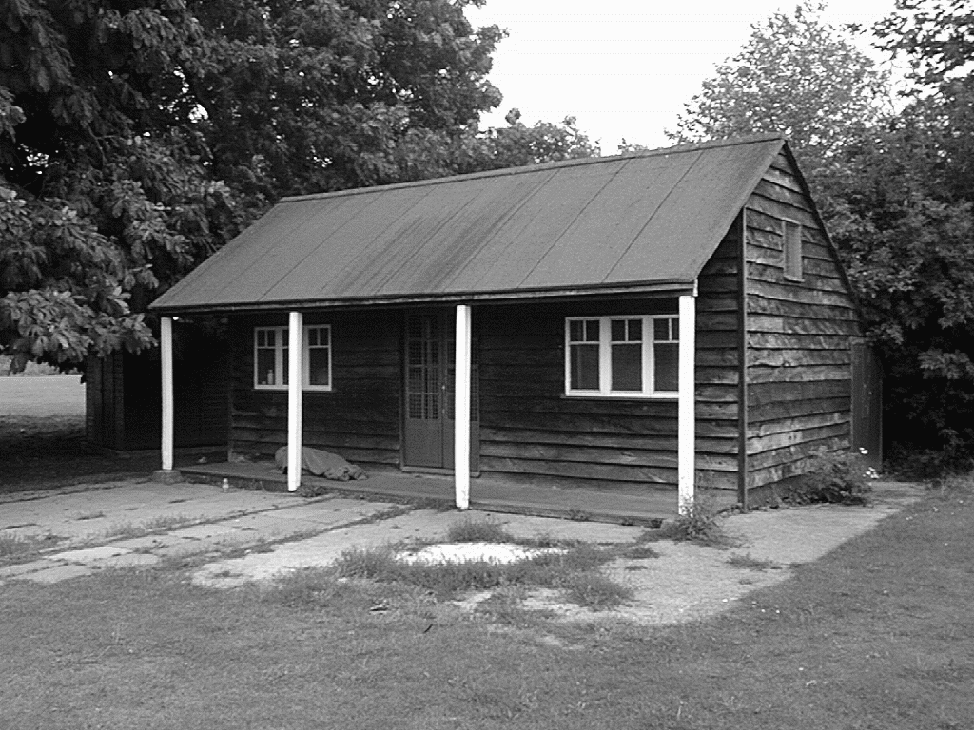
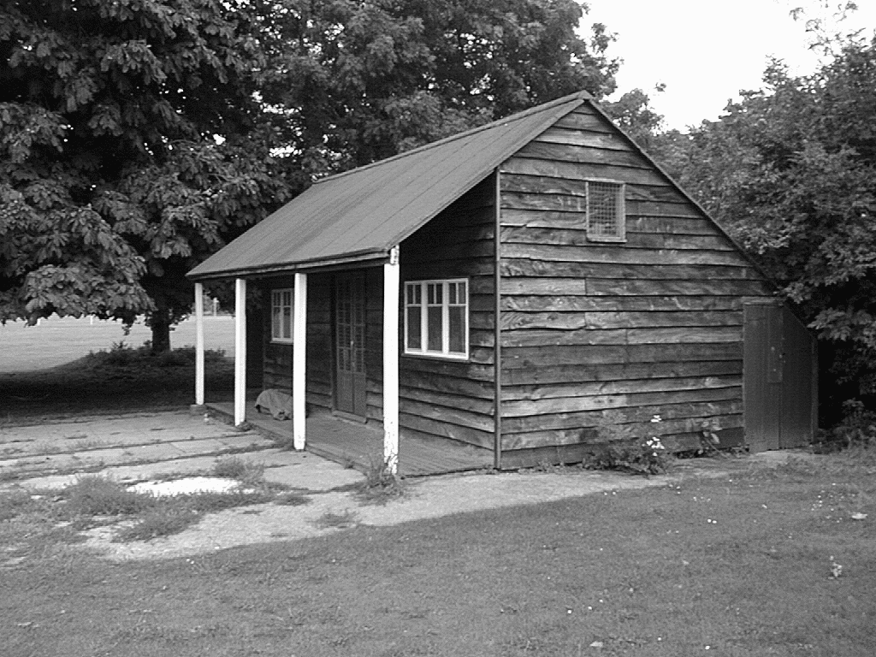
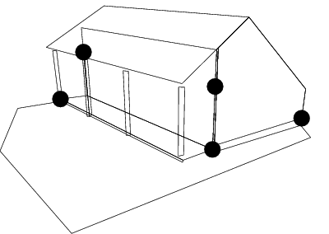
The goal(s) of computer vision
Reconstruction
  Understand the 3D layout of the scene and objects
Left View
Right View
[Hartley & Zisserman]

Slide 11
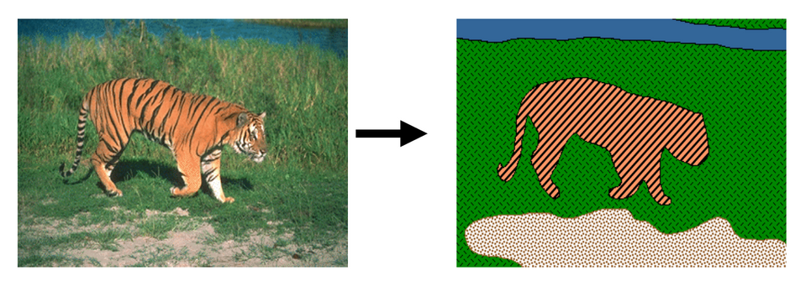
The goal(s) of computer vision
Grouping (“Reorganization”)
  Divide the scene into objects
[Blobworld]

Slide 12
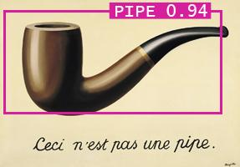
The goal(s) of computer vision
Recognition
  Understand the semantic properties of the scene and objects
Picture credit: Magritte , Jon Barron

Slide 13
The goal(s) of computer vision
Reconstruction
Recognition
Reorganization

Slide 14
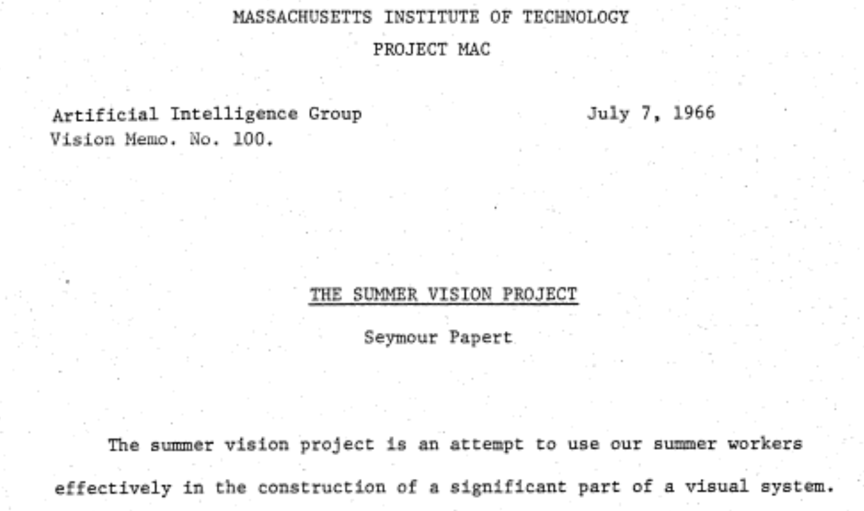
The “summer vision project”

Slide 15
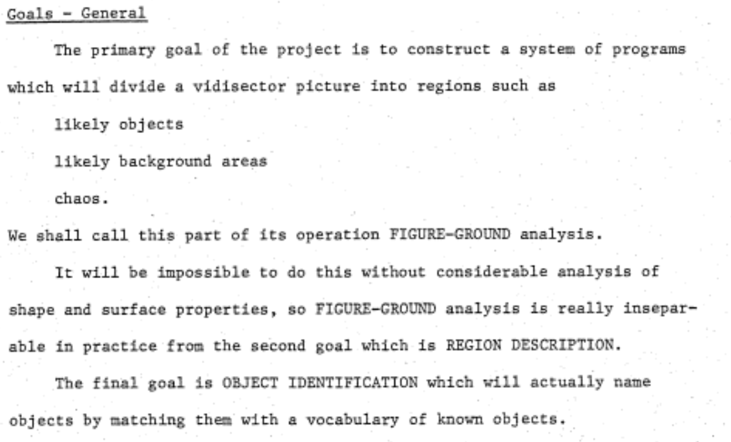
The “summer vision project”

Slide 16
The big reveal
“… in the 1960s almost no one realized that machine vision was difficult… The common and almost despairing feeling of the early investigators like B.K.P. Horn and T.O. Binford was that practically anything could happen in an image and furthermore that practically everything did."
--- Marr, 1982

Slide 17
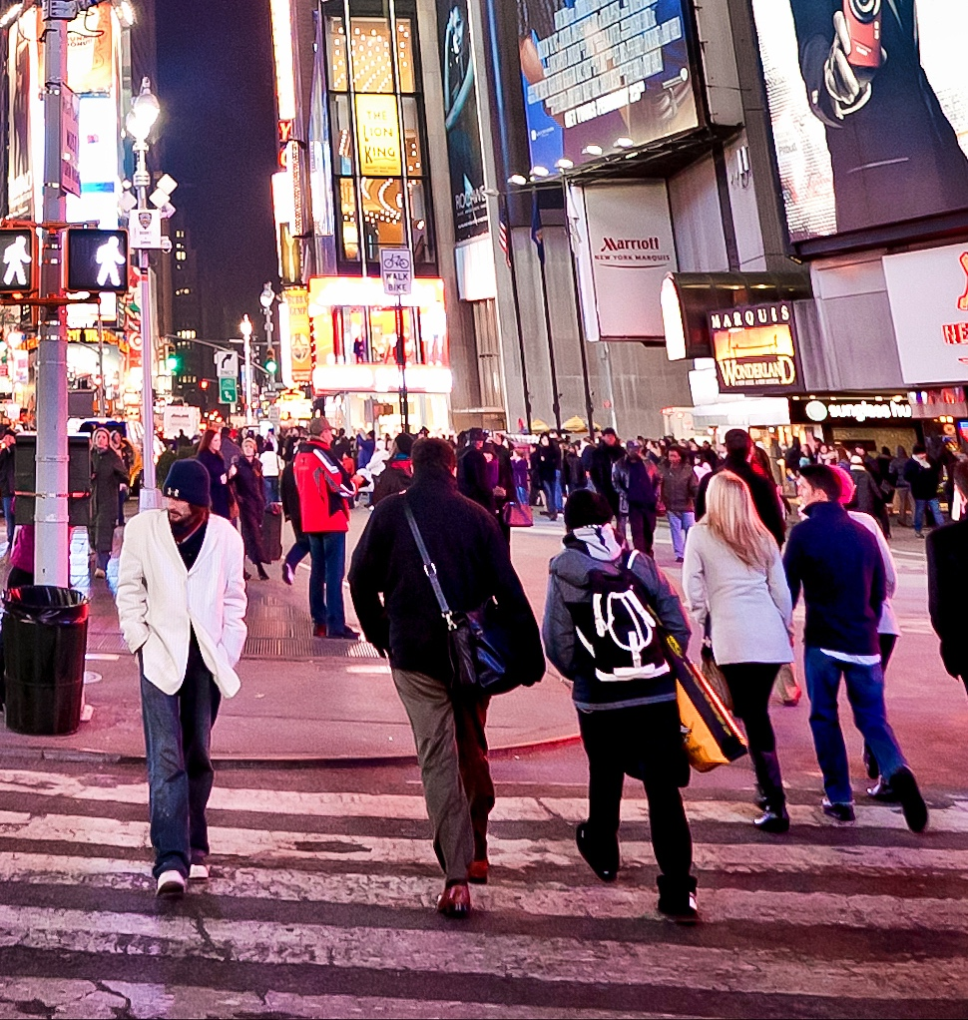
Vision is hard
71 | 109 | 61 | 71 | 86
66 | 96 | 77 | 76 | 77
63 | 98 | 82 | 79 | 64
65 | 105 | 73 | 92 | 83
90 | 107 | 80 | 96 | 113
"I stand at the window and see a house, trees, sky. Theoretically I might say there were 327 brightnesses and nuances of colour. Do I have "327"? No. I have sky, house, and trees."
-- Max Wertheimer

Slide 18



Tool 1: Geometry / Physics

Slide 19

Tool 1: Geometry / Physics
Farther objects are higher and smaller
Parallel lines converge
Notes:
To handle these problems there are a couple of tools that we vision researchers have.
The first is that of geometry and physics.
We know very well the physics and maths behind image formation, and we understand the impacts this has.
For example, we know that farther objects in an image often tend to be higher and smaller, and parallel lines often converge.
In this course we will understand how these effects come into being.

Slide 20
Tool 1: Geometry / Physics

Slide 21
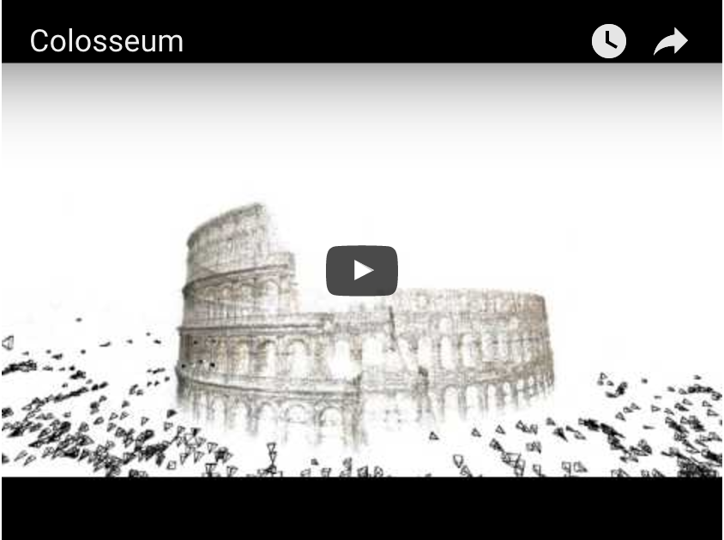
Tool 1: Geometry / Physics
Building Rome in a Day.
Sameer Agarwal, Noah Snavely, Ian Simon, Steven M. Seitz and Richard Szeliski.
ICCV, 2009, Kyoto, Japan.
Notes:
We’ve taken such geometric reasoning quite a distance. For example, in this paper from 2009, they used this geometry to reconstruct major tourist destinations from nothing but user uploaded photographs on the internet.

Slide 22
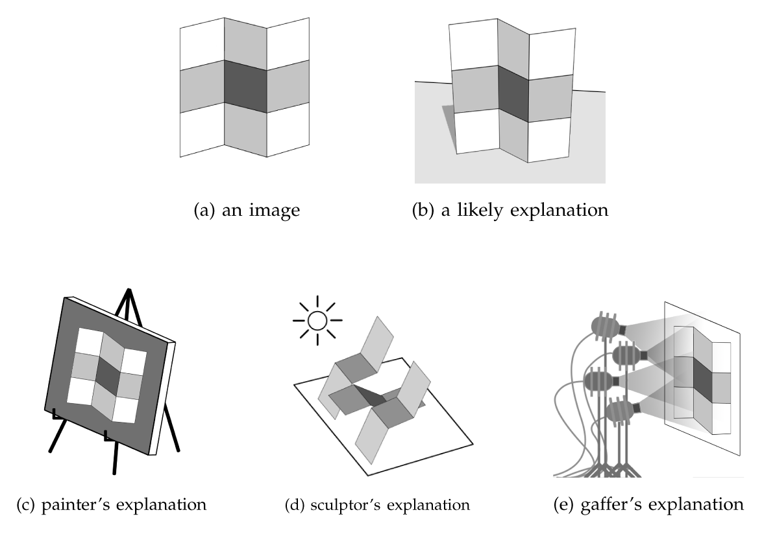
Tool 1: Geometry / Physics - Priors
Notes:
Beyond the physics of image formation, we also know certain properties about the physical world that can constrain potentially ambiguous solutions.
For example, consider this image.
The geometry of image formation doesn’t tell us much here.
This image could have been created in a bunch of ways.
It could be created by a painter simply painting this pattern on a canvas.
It could be created by a sculptor or sheet metal worker, who cuts and bends metals to reproduce this effect.
Or it could be created by a gaffer, who will move the lights around in a complicated way until this pattern is found.
However, we perceive this image to be of a single piece of metal, with a painted stripe, bent in an S-shape.
Why?
It is because in the real world, complicated pieces of sculpting, painting or lighting are rare.
This hypothesis is the simplest one in a physical sense.
Thus, here we are using a “prior”: an asumption that simpler hypotheses are more likely.

Slide 23
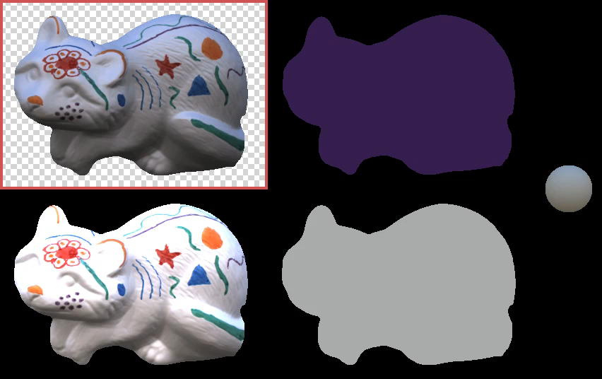
Tool 1: Geometry / Physics - Priors
Shape, Illumination and Reflectance from Shading. J. T. Barron and J. Malik, TPAMI, 2015.
Notes:
You can use such priors to understand the shape of an object from a single image.
That is what the authors of this paper did.
On the top right is the shape of the object, and on the bottom left is the paint.

Slide 24
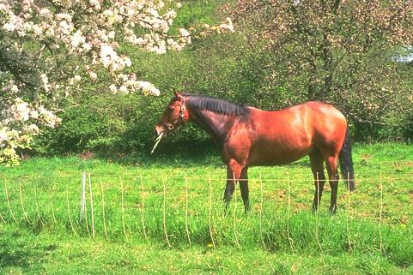
Tool 1: Geometry / Physics - Priors

Slide 25
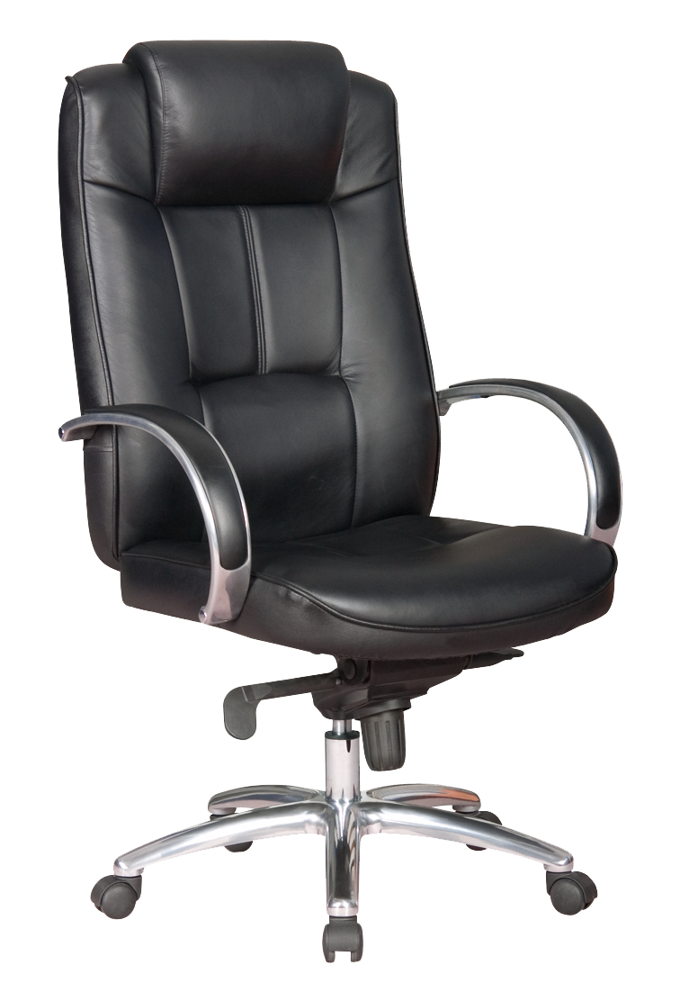
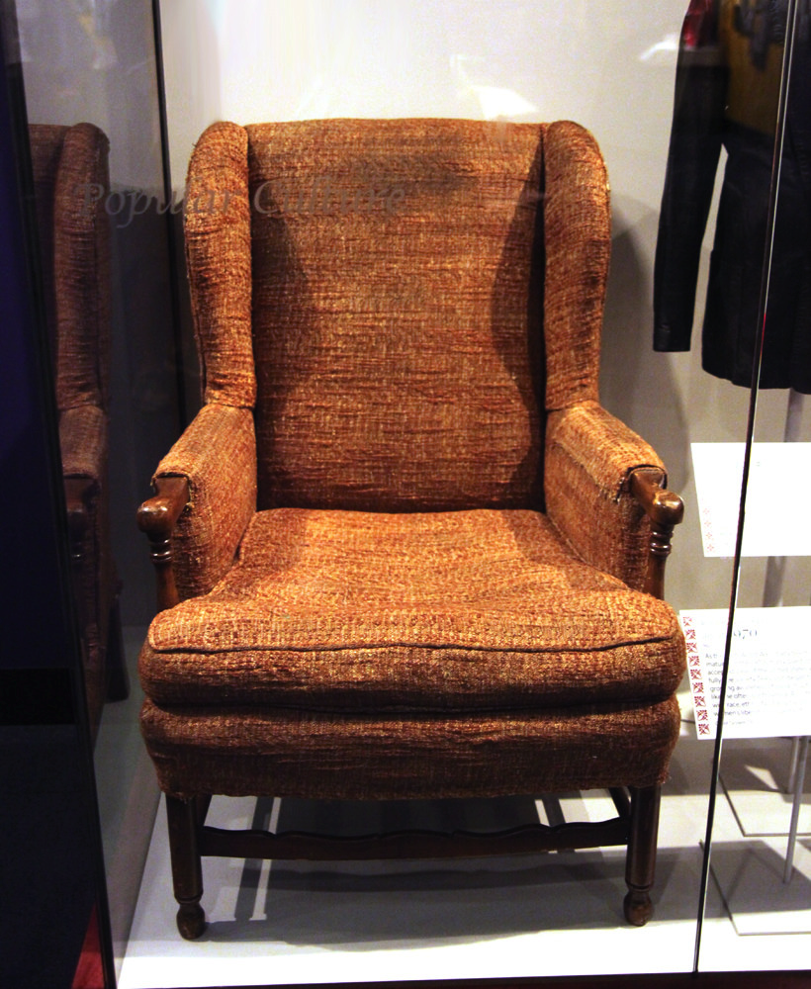
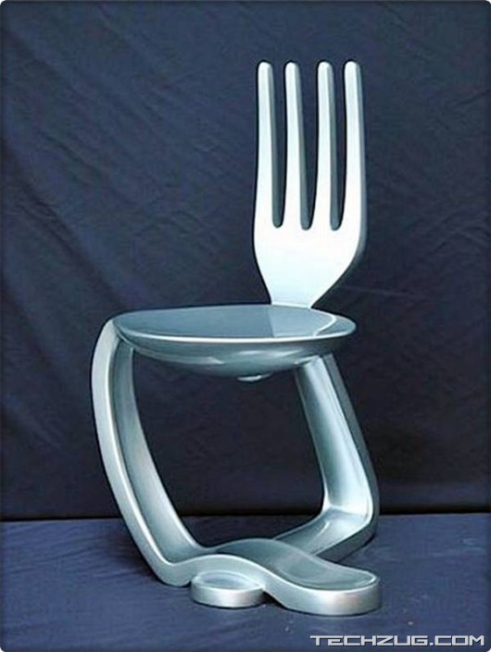
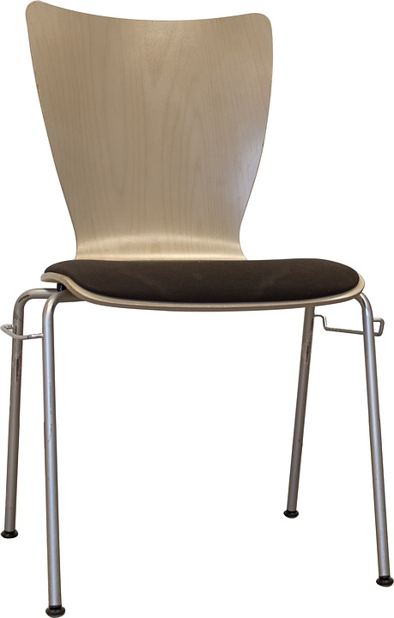
Vision is hard: Concepts have variance
Notes:
In addition, there is also a lot of variation among instances of the same kind of object.
This here, for example, is a very weird kind of chair.
It looks nothing like a chair, but it offers exactly the same functionality as a chair.
Our vision systems need to ignore, or be invariant to, such vast variations, and recognize things for what they really are.

Slide 26
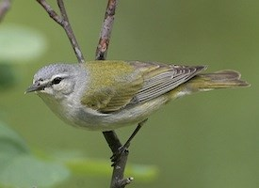

Vision is hard: Concepts are subtle
Tenessee Warbler
Orange Crowned Warbler
https://www.allaboutbirds.org
Notes:
At the same time, two things might look very similar, but be completely different. For example, these are two different species of birds even though they look very similar.

Slide 27


Vision is hard: Intra-class variance and inter-class similarities
Expectation
Reality

Slide 28
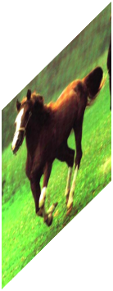
Tool 2: Data + Machine Learning
Convolutional Networks
Horse
Yann LeCun, Léon Bottou, Yoshua Bengio, and Patrick Haffner. Gradient-based learning applied to document recognition. Proceedings of the IEEE 86.11 (1998): 2278-2324.
Alex Krizhevsky, Ilya Sutskever, and Geoffrey E. Hinton. Imagenet classification with deep convolutional neural networks. In NIPS 2012.
Notes:
The second major tool we have is machine learning.
A major breakthrough in the past decade has been the re-discovery of black-box machine learning techniques, in particular convolutional networks.
You give these things a dataset of input, output pairs, and they learn to map inputs to outputs.
They seem to be especially effective on images.
Note that I said “Re-discovered”. These were techniques that were invented in the 80’s, or even before that. But it turns out that where they really shine is data. The more data you have, the better they are.

Slide 29
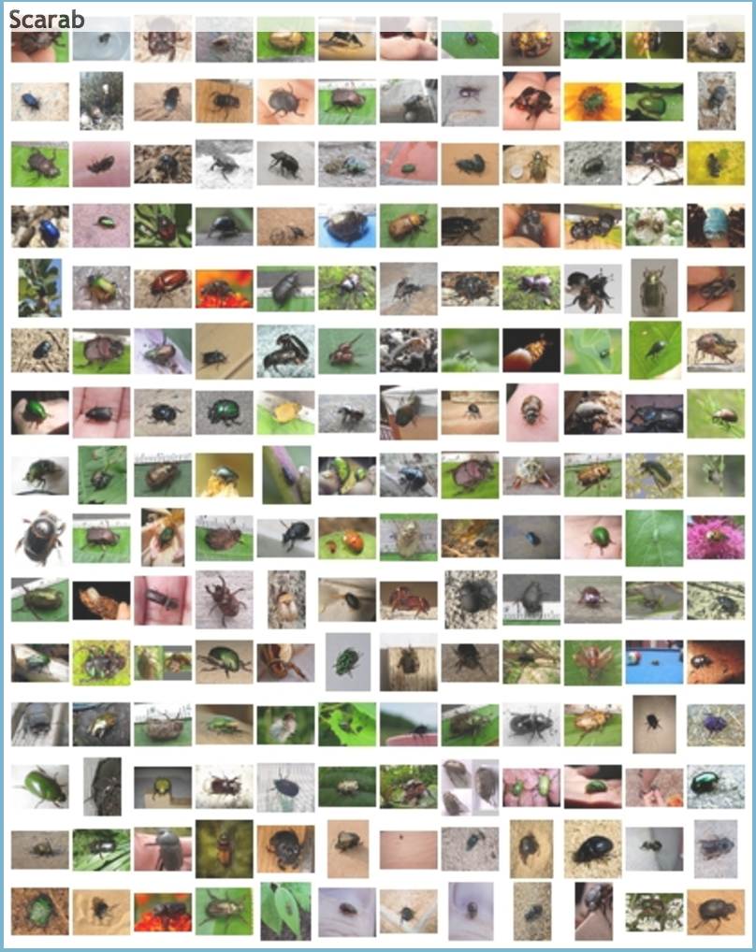
Tool 2: Data + Machine Learning
ImageNet
ImageNet Large Scale Visual Recognition Challenge.
Olga Russakovsky*, Jia Deng*, Hao Su, Jonathan Krause, Sanjeev Satheesh, Sean Ma, Zhiheng Huang, Andrej Karpathy, Aditya Khosla, Michael Bernstein, Alexander C. Berg and Li Fei-Fei. IJCV, 2015
Notes:
Which means that the key to getting them to work this past decade was the availability of large labeled datasets.
To get these datasets, we had to take the freely available massive collection of images on the web and get them annotated by human beings. This annotation takes a lot of effort: it is tedious effort for the people labeling the image, and it is effort for the people designing the annotation interface, collecting the data, curating it and so on.
ImageNet was one of the datasets collected at this scale, and it is what led to the sudden rediscovery of convolutional networks.
ImageNet contains a million images, and each image is associated with a single label, which is 1 out of 1000 classes.
Using this dataset and with convolutional networks, you can teach machines to label each image with the same set of 1000 classes.

Slide 30
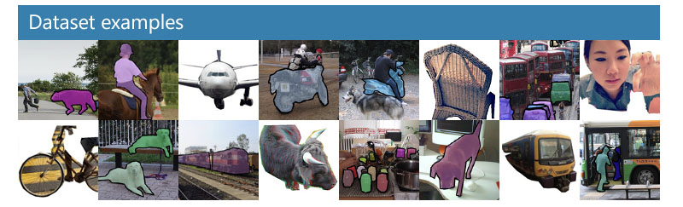
Tool 2: Data + Machine Learning
mscoco
Microsoft COCO: Common Objects in Context
Tsung-Yi Lin, Michael Maire, Serge Belongie, Lubomir Bourdev, Ross Girshick, James Hays, Pietro Perona, Deva Ramanan, C. Lawrence Zitnick, Piotr Dollár
ECCV, 2014
Notes:
People have taken this farther, and instead of just getting class labels (“is this a cat or not”), they asked humans to mark the precise boundaries of objects. And now from this massive amount of data, you can teach machines how to do the same task.

Slide 31
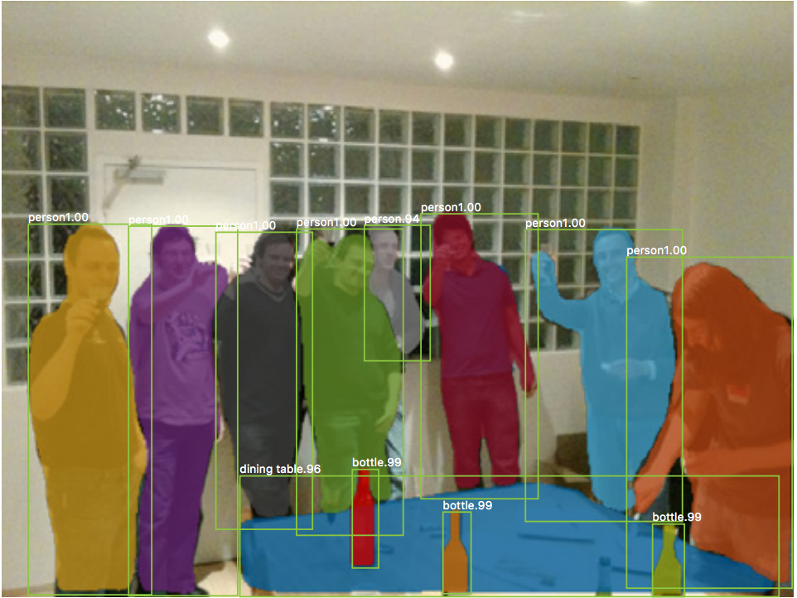
Tool 2: Data + Machine Learning
Mask R-CNN. Kaiming He, Georgia Gkioxari, Piotr Dollar, Ross Girshick. ICCV 2017
Notes:
Here’s the top performing modern system that marks the boundaries of a bunch of objects, trained on the same kind of data.
In this course, we will go into some of these machine learning models and their key ideas.

Slide 32
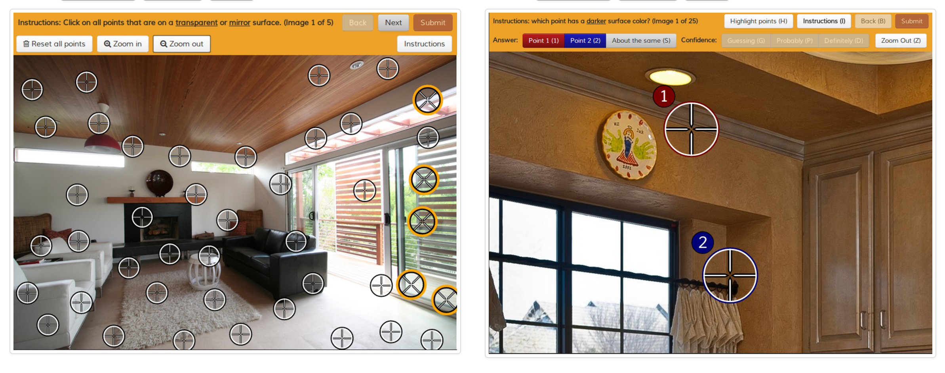
Tool 2: Data + Machine Learning
Intrinsic Images in the Wild
Sean Bell, Kavita Bala, Noah Snavely
Cornell University
ACM Transactions on Graphics (SIGGRAPH 2014)
Notes:
This approach of collecting data, getting humans to label them, and then teaching machines to do the same thing using this data, jas proven to be surprisingly general. You can also get people to label which image patch is in shadow or which is in light, and then use it to teach computers to do the same thing.

Slide 33
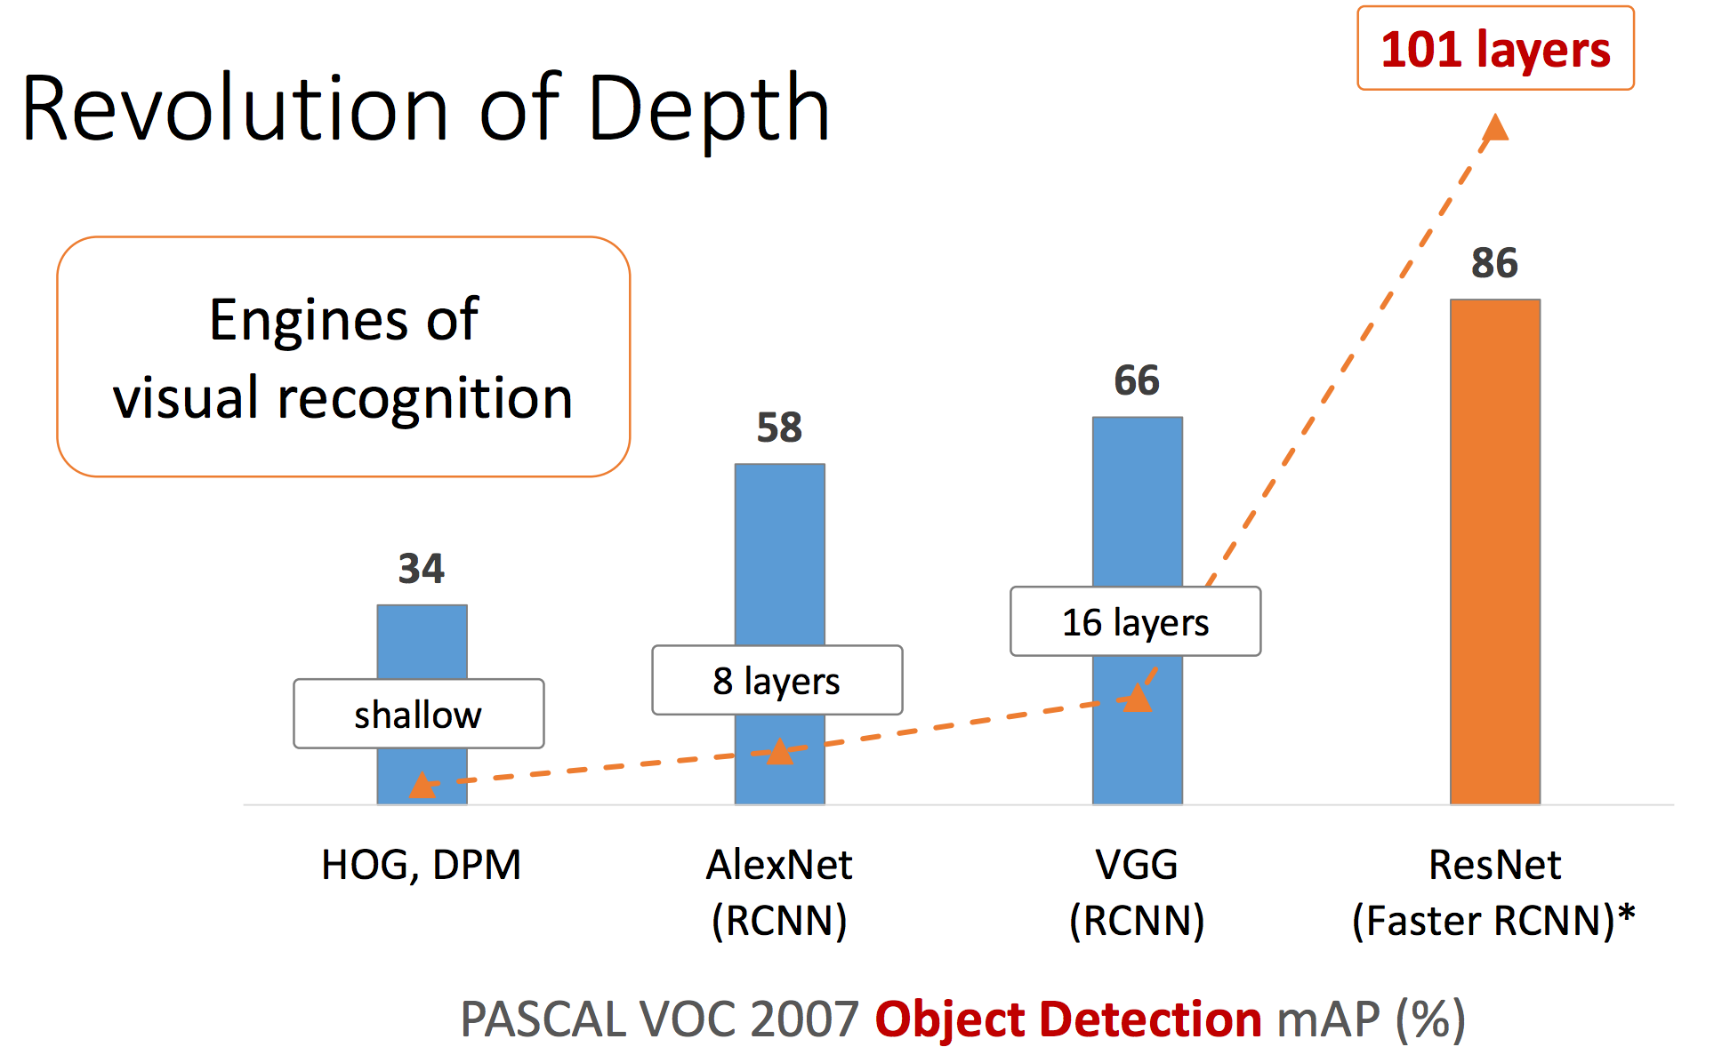
What Next: Better, Faster, Stronger
Deep Residual Learning for Image Recognition
Kaiming He, Xiangyu Zhang, Shaoqing Ren, and Jian Sun. CVPR 2016.
Notes:
So what next? What’s driving the field in the coming years?
The first obvious thing is to just make the existing systems better and better.
For instance, a line of work has been developing stronger and stronger convolutional networks that extract more and more signal out of the data.

Slide 34
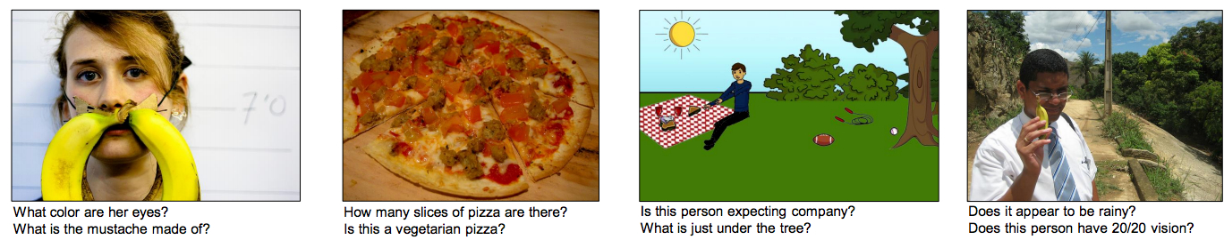
What Next: Better, Faster, Stronger
VQA: Visual Question Answering
S. Antol, A. Agarwal, J. Lu, M. Mitchell, D. Batra, C. L. Zitnick, D. Parikh.
ICCV 2015
Notes:
A different direction is to get computer vision systems to do more.
For example, a recent line of work asks: can we get computers to answer really arbitrary questions about images?
In this case, perhaps the computer needs to not only identify objects in the scene, but reason about the relationships between the objects and perhaps even understand what is actually going on.

Slide 35
Lessons from infant development
Infants spend a long time observing and randomly playing with the world…
…then take a long time to learn first few visual concepts…
…but then learn novel concepts with very little data

Slide 36
This course
Geometry / Physics of image formation
  Image projection, lighting.
Machine learning in computer vision: basics, hand-designed feature vectors, convolutional networks
Combining machine learning and geometric reasoning
Current frontiers: unsupervised learning and more

Slide 37
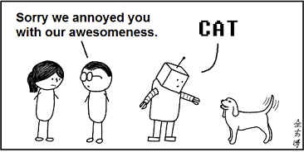
Welcome!
pic credit: abstruse goose

Slide 38

Administrative Interlude
Me: Robert Pless
  Office hours, Wed 2-3 or by appt.
Website: http://robertpless.com/classes/ComputerVision
Book: http://szeliski.org/Book/
  Available for free online as pdf.
  Can also be purchased from Amazon
Computer Vision, Robert Pless

Slide 39
Course Organization:
Project Based Course:
80%: 4-5 Projects
20%: 2 in class quizes
Projects will be turned in as a web page (can be any webpage; wordpress, google site, etc.).
Projects can be done in any language; I will do in class demos in matlab.
Evaluated on quality of results, validity and insight of the explanations, and creativity.
Computer Vision, Robert Pless

Slide 40
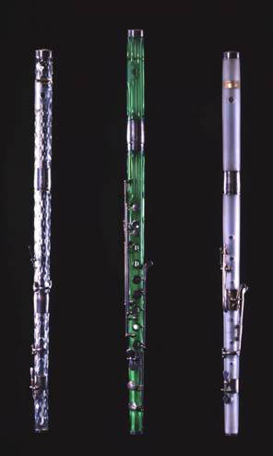
Vision @ GWU
Murray Leow (BME)
  Glass at Risk: simple tools for detecting unstable glass in 19th century cultural heritage collections
  Next generation breast and catheter imaging.
Chung Hyuk Park (BME)
  ASSISTIVE ROBOTICS &TELE-MEDICINE (ART-MED) LAB
Svetlana Roudenko (Math)
  Compressed Sensing for Medical Imaging
Robert Pless (CS)
  You’ll hear all about my work this semester…
Computer Vision, Robert Pless

Slide 41

Computer Vision, Robert Pless

Slide 42
Back from interlude…
Computer Graphics: Models to Images
Comp. Photography: Images to Images
Computer Vision: Images to Models

Slide 43
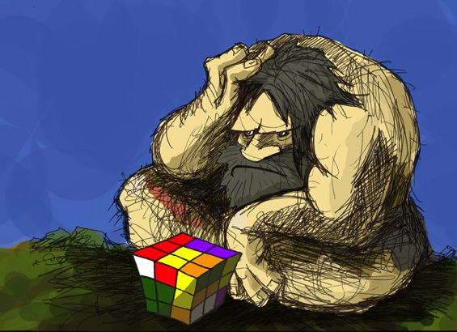
What do you need to make a camera from scratch?

Slide 44
Mapping between image and world coordinates
  Pinhole camera model
  Projective geometry
    Vanishing points and lines
  Projection matrix

Slide 45
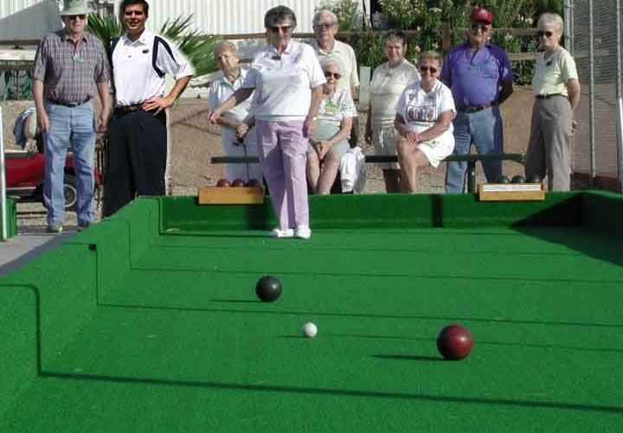
Camera and World Geometry
How tall is this woman?
How high is the camera?
What is the camera rotation?
Which ball is closer?

Slide 46
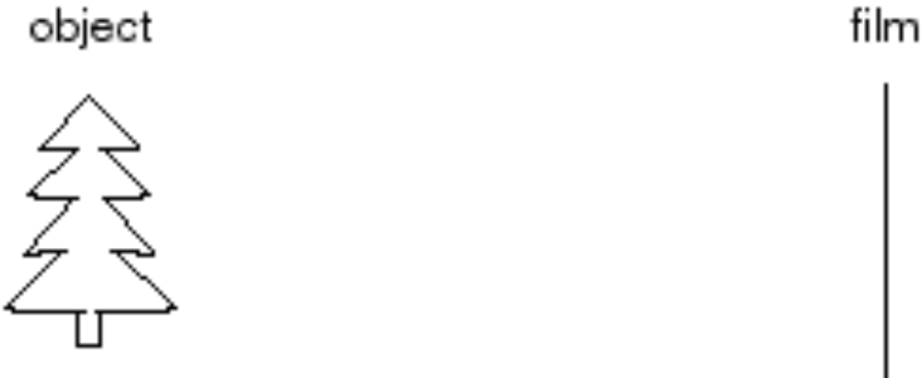
Image formation
Let’s design a camera
  Idea 1: put a piece of film in front of an object
  Do we get a reasonable image?
Slide source: Seitz

Slide 47
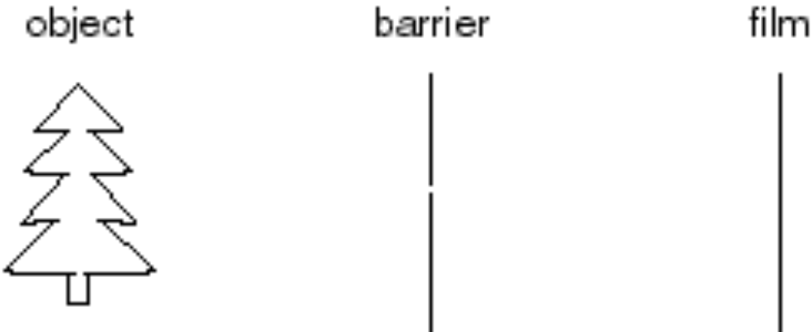
Pinhole camera
Idea 2: add a barrier to block off most of the rays
  This reduces blurring
  The opening known as the aperture
Slide source: Seitz
Notes:
Q: How does this transform the image? A: It gets inverted

Slide 48
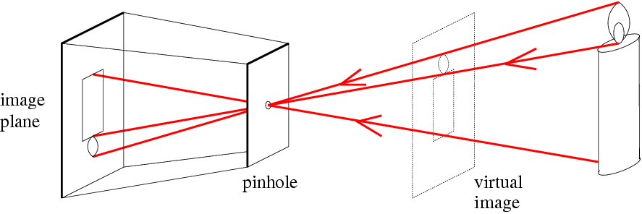
Pinhole camera
f
c
f = focal length
c = center of the camera
Figure from Forsyth

Slide 49
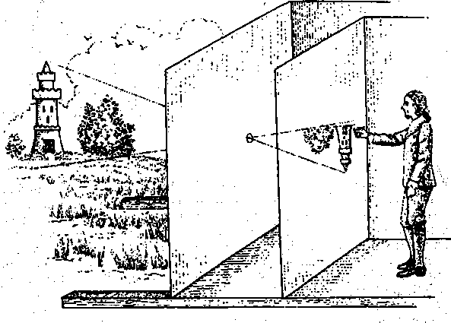
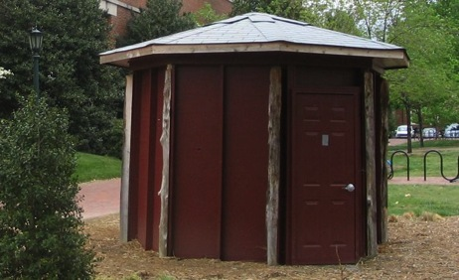
Camera obscura: the pre-camera
Known during classical period in China and Greece (e.g. Mo-Ti, China, 470BC to 390BC)
Illustration of Camera Obscura
Freestanding camera obscura at UNC Chapel Hill
Photo by Seth Ilys

Slide 50
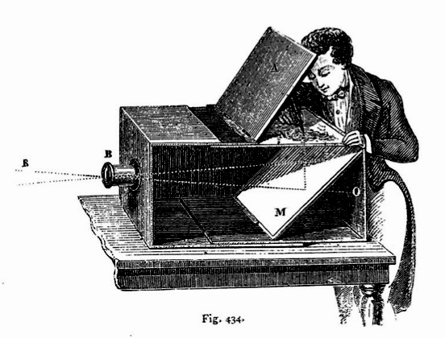
Camera Obscura used for Tracing
Lens Based Camera Obscura, 1568

Slide 51
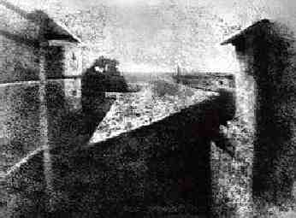
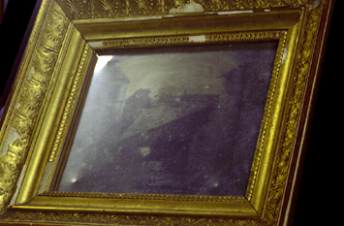
First Photograph
Oldest surviving photograph
  Took 8 hours on pewter plate
Photograph of the first photograph
Joseph Niepce, 1826
Stored at UT Austin
Niepce later teamed up with Daguerre, who eventually created Daguerrotypes

Slide 52
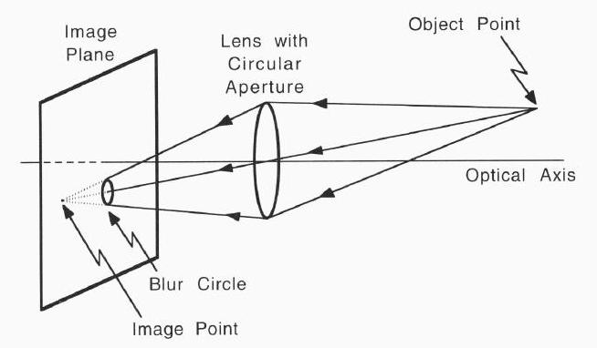
Non pinhole cameras?!
Computer Vision, Robert Pless

Slide 53
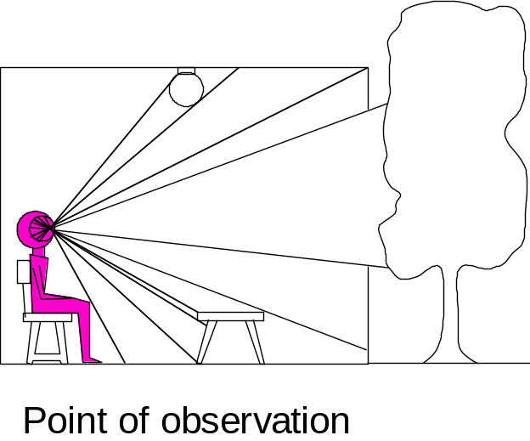
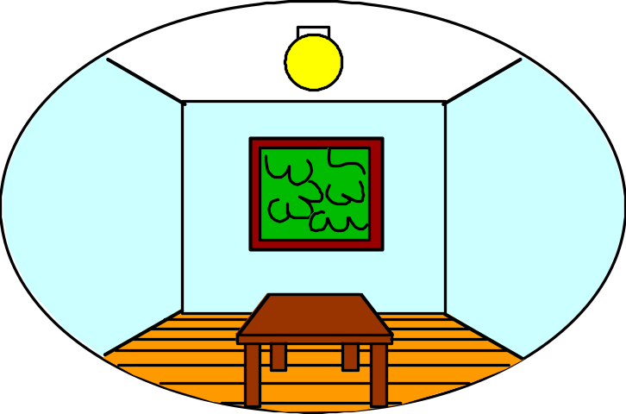
Dimensionality Reduction Machine (3D to 2D)
3D world
2D image
Figures © Stephen E. Palmer, 2002

Slide 54
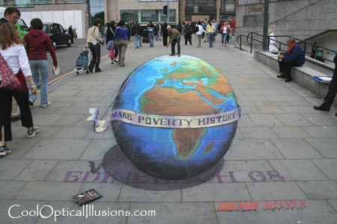
Projection can be tricky…
Slide source: Seitz

Slide 55
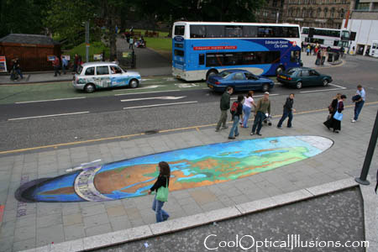
Projection can be tricky…
Slide source: Seitz

Slide 56
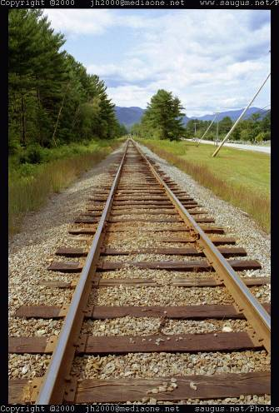
Vanishing points and lines
Parallel lines in the world intersect in the image at a “vanishing point”
Notes:
Go to board, sketch out various properties of vanishing points/lines

Slide 57
Vanishing points and lines
Vanishing Point
Vanishing Point
o
o
Vanishing Line
Notes:
Go to board, sketch out various properties of vanishing points/lines
Parallel lines intersect at a point
The intersection of red lines and blue lines form a parallelogram
Sets of parallel lines on the same plane form a vanishing line
Sets of parallel planes form a vanishing line
Not all lines that intersect are parallel

Slide 58
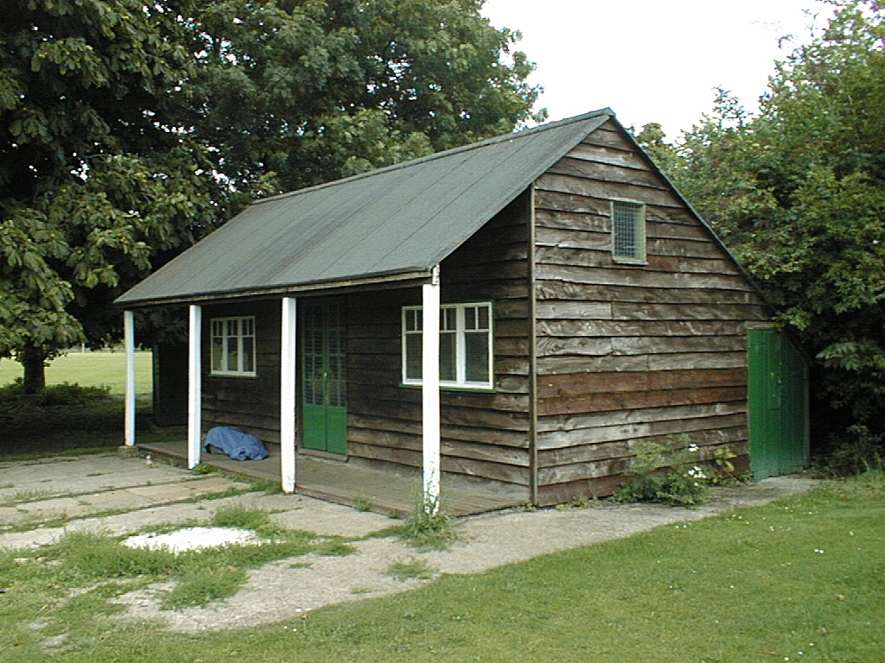
Vanishing points and lines
Vertical vanishing
point
(at infinity)
Vanishing
line
Vanishing
point
Vanishing
point
Slide from Efros, Photo from Criminisi

Slide 59
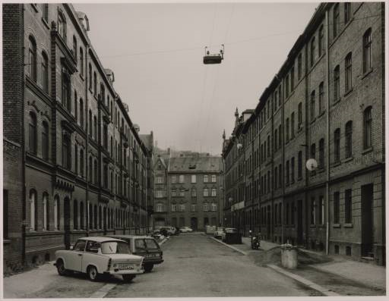
Vanishing points

Slide 60
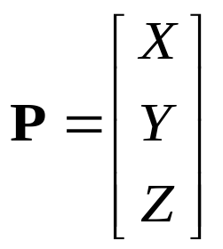


Projection: world coordinates→image coordinates
.
Optical Center (u₀, v₀)
.
.
f
Z
Y
.
v
Camera Center (t_{x}, t_{y}, t_{z})
u

