Slide 1
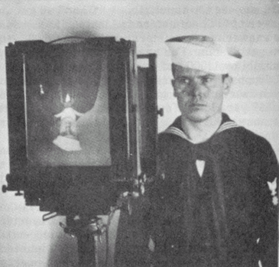

Slide 2
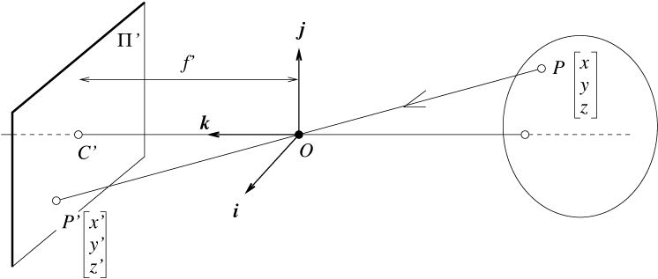
Lecture 2, Pinhole Camera Model
Last time we talked through the pinhole projection.
This time we are going to look at the coordinate systems in the pinhole camera model.

Slide 3
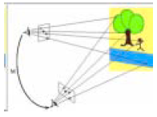
Some context
Our goal is to understand the process of stereo vision, which requires understanding:
How cameras capture the world
Representing where cameras are in the world (and relative to each other)
Finding similar points on each image

Slide 4
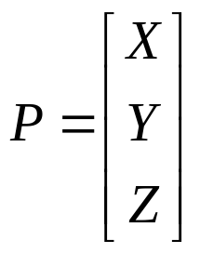
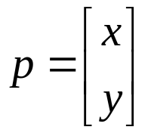
“Normalized Camera”
Pinhole at (0,0,0), point P at (X,Y,Z)
Virtual film at Z = 1 plane.
Point X,Y,Z is imaged at intersection of:
  Line from (0,0,0) to (X,Y,Z), and
  the Z = 1 plane
Intersection point (x,y), has coordinates
  (X/Z, Y/Z, 1)
This is called the “normalized camera model”
What happens when focal length is not 1?
Camera Center of Projection

Slide 5
(X,Y,Z)
Pinhole,
(Center of projection), at (0,0,0)
f
Z-axis
Image plane

Slide 6
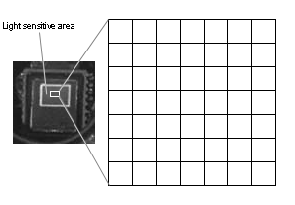
…but the cow is not a sphere
We don’t just want to know where, mathematically, the point ends up on the image plane… we want to know the pixel coordinates of the point.
Why might this be hard?!

Slide 7
Intrinsic Camera Parameters
The pixels may be rectangular:
x = αX/Z
Y = βY/Z
CCD sensor array

Slide 8
Intrinsic Camera Parameters
Chip not centered, or 0,0 may not be center of the chip.
x = αX/Z + x₀
Y = βY/Z + y₀
CCD sensor array

Slide 9
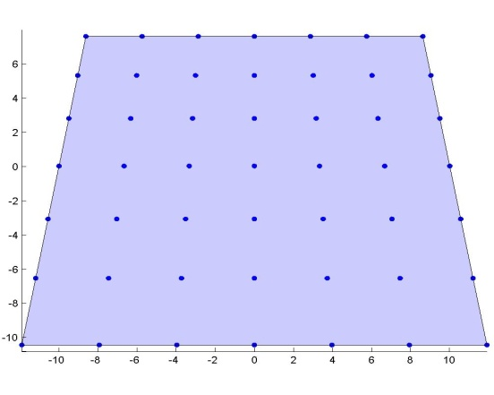
Intrinsic Camera Parameters
cheap CMOS chip
cheap lens
image
cheap
glue
cheap camera
x = αX/Z – α cot(θ) Y/Z + x₀
y = β/sin(θ) Y/Z + y₀
Ugly relationship between (X,Y,Z) and (x,y).

Slide 10
Homogeneous Coordinates
Represent 2d point using 3 numbers, instead of the usual 2 numbers.
Mapping 2d→ 2d homogeneous:
  (x,y) → (x,y,1)
  (x,y) → (sx, sy, s)
Mapping 2d homogeneous to 2d
  (a,b,w) → (a/w, b/w)
The coordinates of a 3D point (X,Y,Z) *already is* the 2D (but homogeneous) coordinates of its projection.
Will make some things simpler and linear.

Slide 11
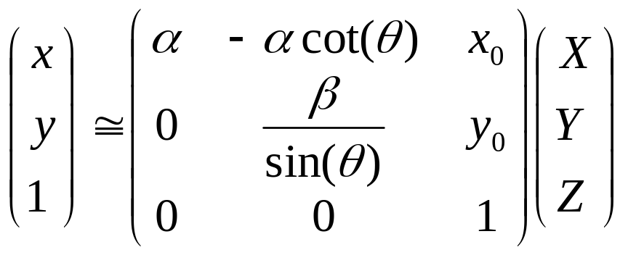
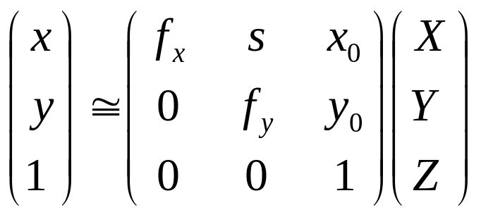
Why?!
x = αX/Z – α cot(θ) Y/Z + x₀
y = β/sin(θ) Y/Z + y₀

Slide 12
Homogenous Coordinates!
Equation of a line on the plane?
Equation of a plane through the origin in 3D?

Slide 13
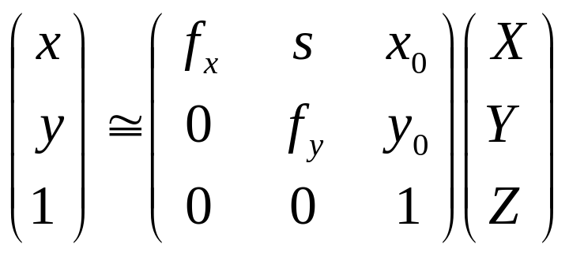
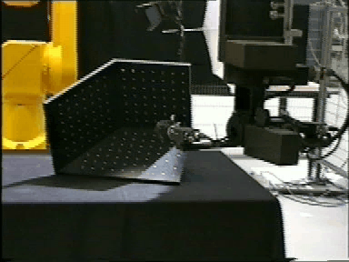
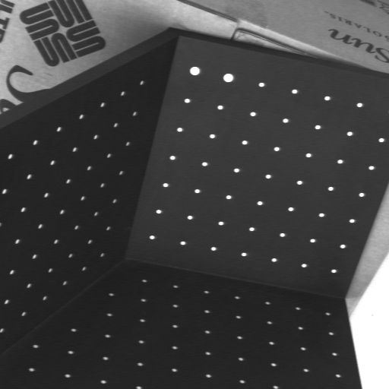
Given enough examples of 3D points and their 2D projections, we can solve for the 5 intrinsic parameters…
Example calibration object…

Slide 14
Practical Linear Algebra 1:
Given many examples of the equation at the right, solve for the matrix of values fx, fy, s, x0, y0
How can we solve for this?

Slide 15
… and all this assumes that we know X,Y,Z
Given enough examples of 3D points and their 2D projections, we can solve for the 5 intrinsic parameters…
Exactly Known!
(0,0,0)

Slide 16
More commonly, we can put a collection of points (usually in a grid) in the world with known relative position, but with unknown position relative to the camera.
Then we need to solve for the intrinsic calibration parameters, and the extrinsic parameters (the unknown relative position of the grid).
How do we represent the unknown relative position of the grid?

Slide 17
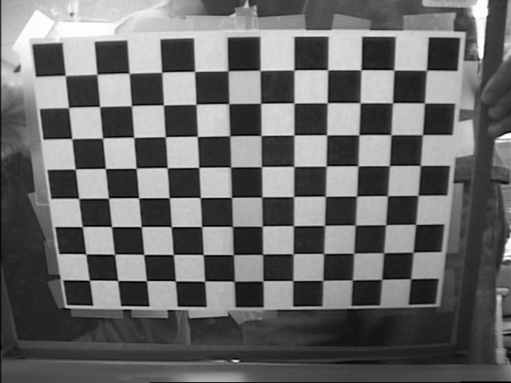
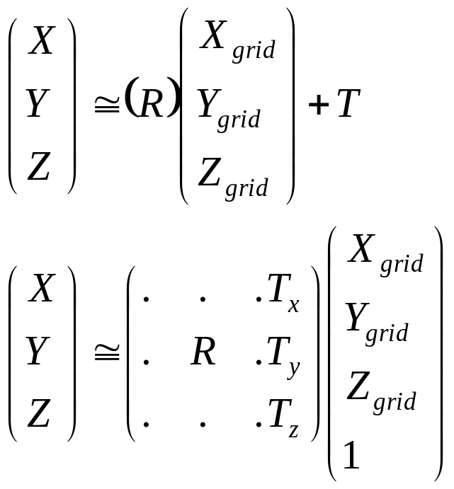
The grid defines its own coordinate system
That coordinate system has a
Euclidean transformation that relates its coordinates to the camera coordinates… that is, there is some R, T such that:
X
Z
Y
With enough example points, could we solve for R,T?

Slide 18
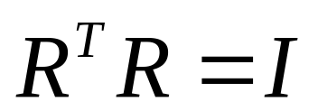
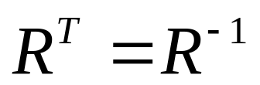
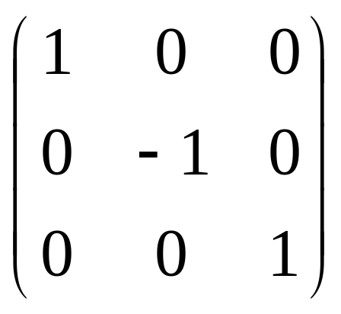
An aside…Representation of Rotation with a Rotation Matrix
Rotation matrix R has two properties:
Property 1:
    R is orthonormal, i.e.
In other words,
Property 2: Determinant of R is 1.
Therefore, although the following matrix is orthonormal,
it is not a rotation matrix because its determinant is -1.
this is a reflection matrix

Slide 19



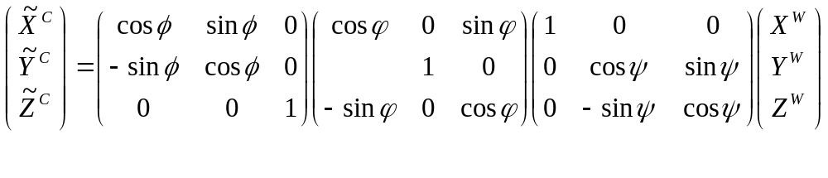
Representation of Rotation -- Euler Angles
Euler angles
  pitch: rotation about x axis :
  yaw: rotation about y axis:
  roll: rotation about z axis:
Z
Y
X

Slide 20
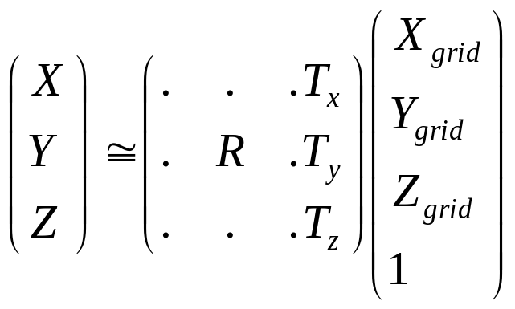
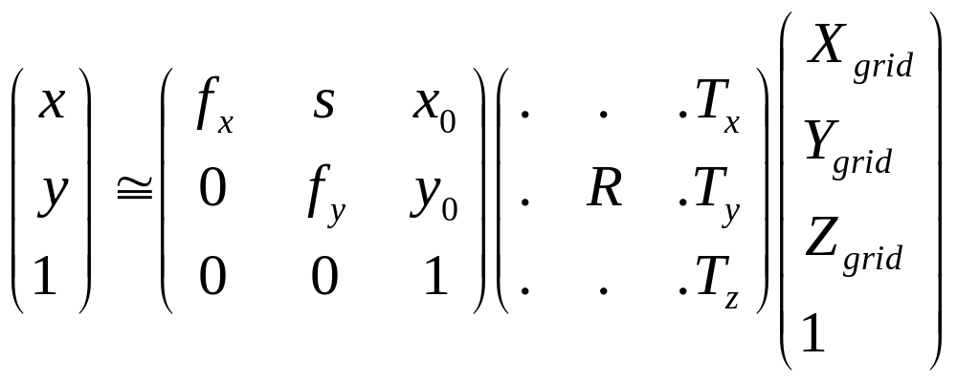
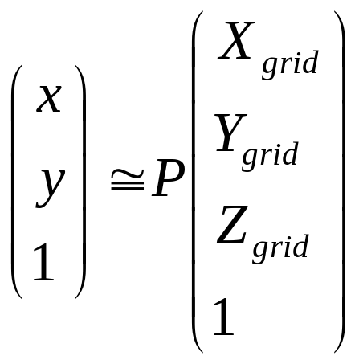
Putting it all together…
+
P is a 4X3 matrix, that defines projection of points (used in graphics). P has 11 degrees of freedom, (the scale of the matrix doesn’t matter). 5 intrinsic parameters, 3 rotation, 3 translation

Slide 21
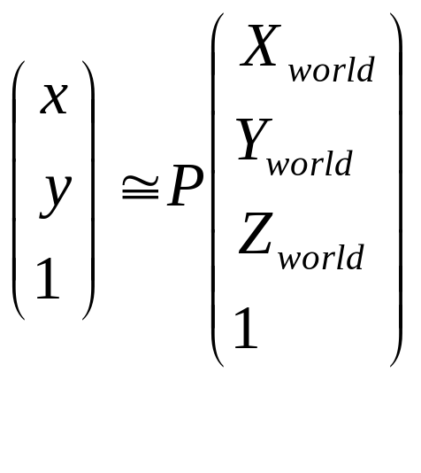
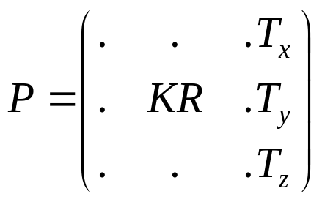
Given many examples of:
  World points (X,Y,Z), and
  Their image points (x,y)
Solve for P.
Then
Rotation + intrinsic, all mixed up.
translation

Slide 22
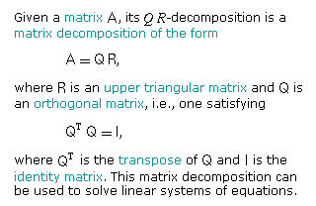
Then take the QR decomposition of this part of the matrix to get the rotation and the intrinsic parameters.
(from mathworld).

Slide 24
Other common trick, use many planes, then you have to solve for multiple different R,T, one for each plane…
Counting:
For each grid, we have 3 unknowns (translation),
3 unknowns (rotation).
+ 5 extra unknowns defining the intrinsic calibration.
Method. For a collection of planes, calculate the homography between the image and the real world plane.

Slide 25
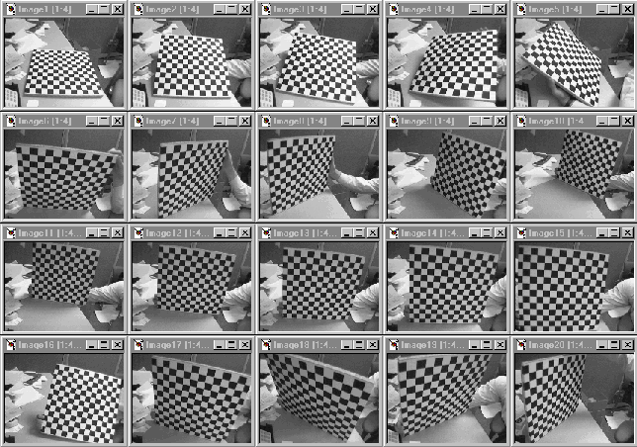

Slide 26
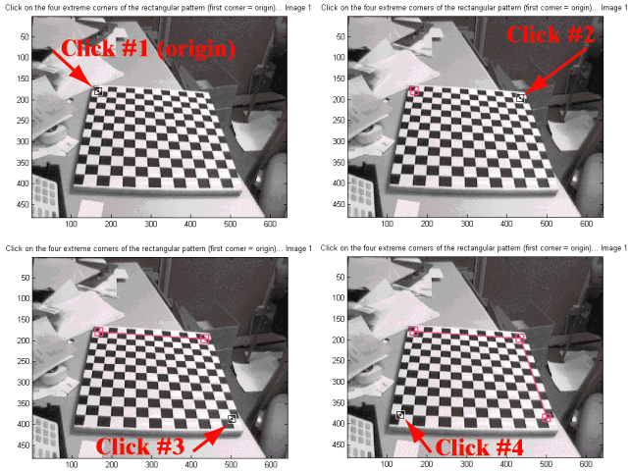

Slide 27
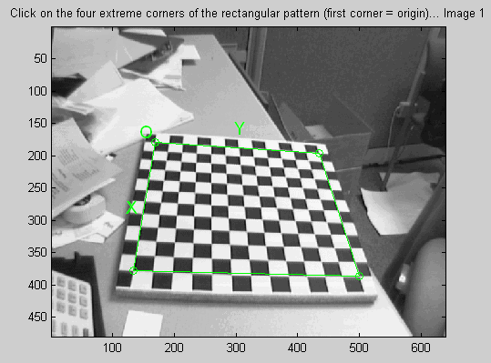

Slide 28
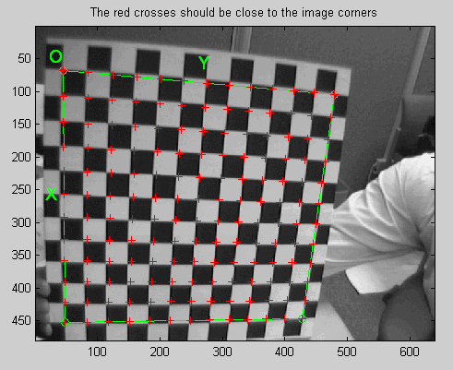

Slide 29
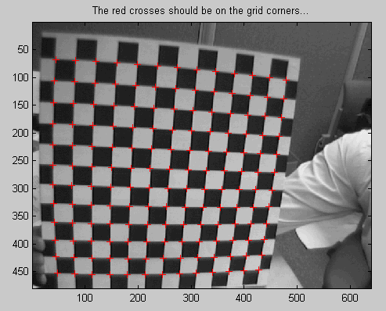

Slide 30
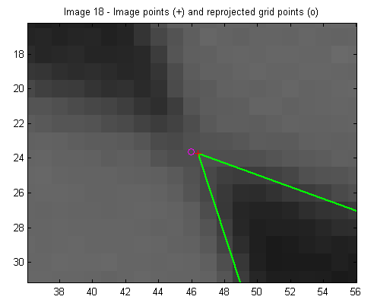
Corners..

Slide 31
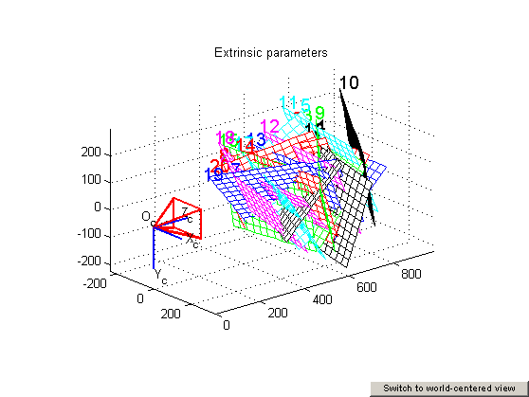

Slide 32
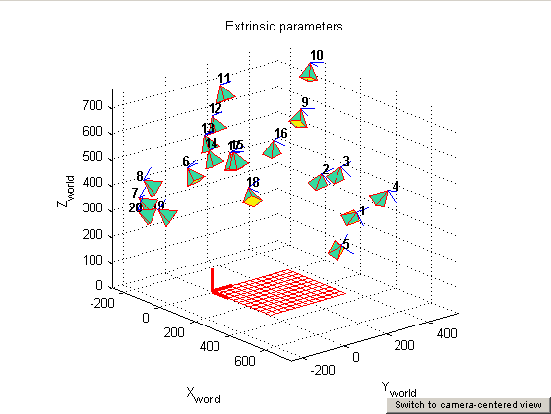

Slide 33
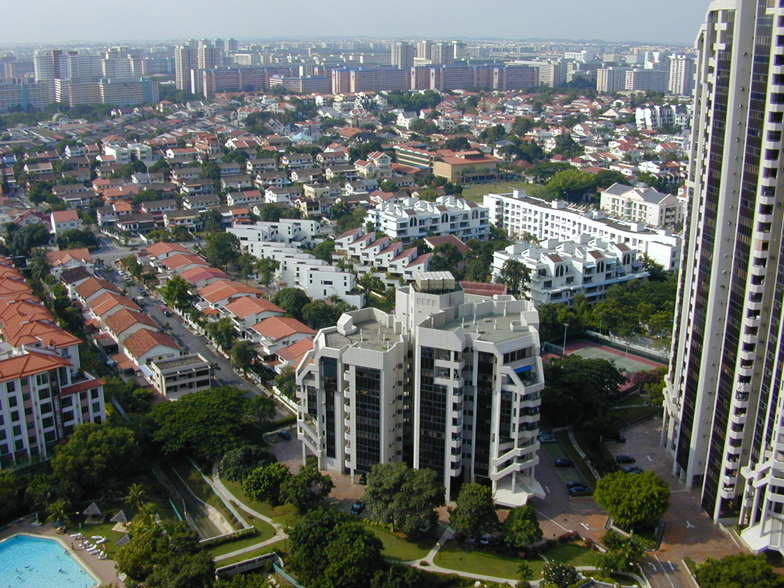
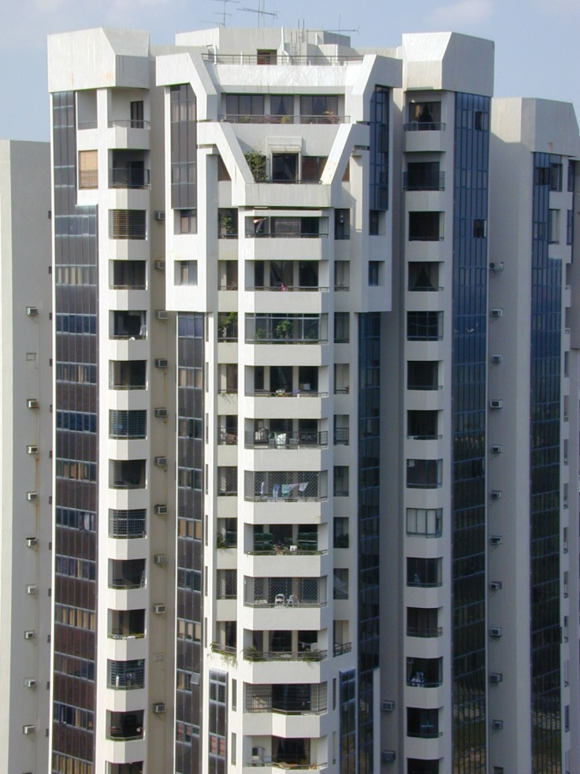
What is left?
Barrel and Pincushion Distortion
wideangle
tele

Slide 34
What other calibration is there?

Slide 35
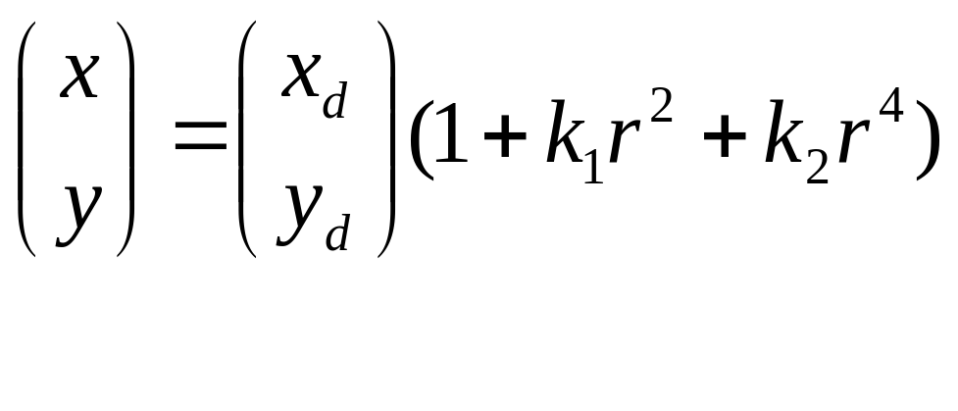
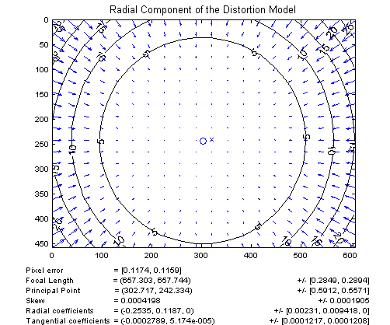
Models of Radial Distortion
distance from center

Slide 36
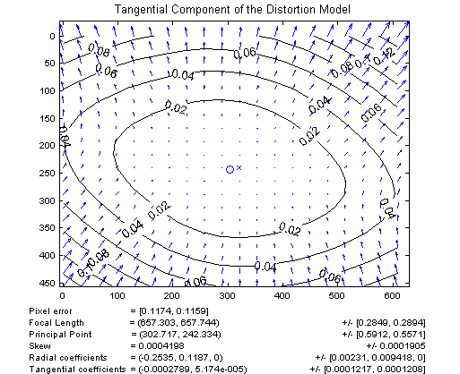
More distortion.

Slide 37
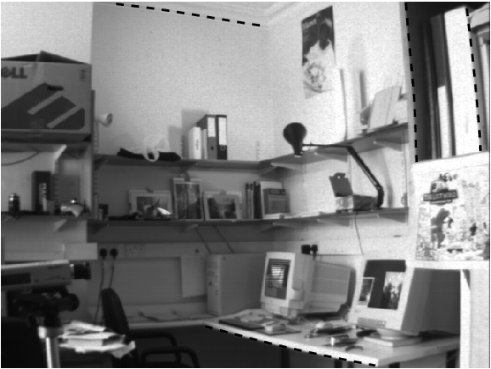
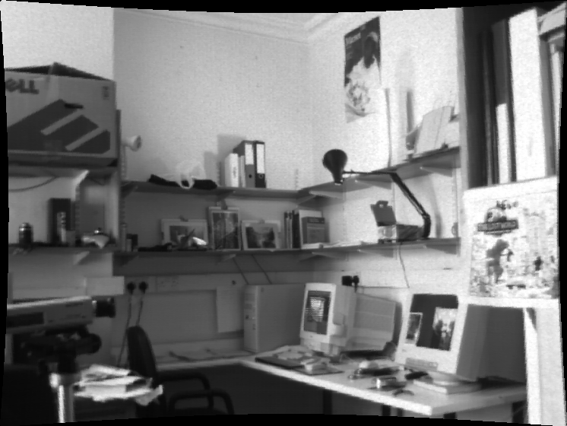
Distortion Corrected…

Slide 38
Applications?

Slide 39
Cheap applications
Can you use this? If you know the 3D coordinates of a virtual point, then you can draw it on your image…
Often hard to know the 3D coordinate of a point; but there are some (profitable) special cases…

Slide 40
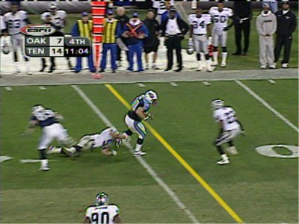
Applications
First-down line
courtesy of Sportvision

Slide 41
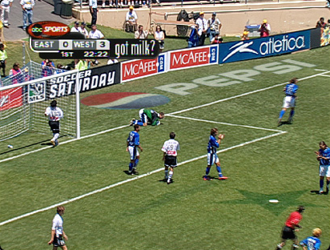
Applications
Virtual advertising
courtesy of Princeton Video Image

Slide 42
Recap
Three main concepts:
1) Projection,
2) Homogeneous coordinates
3) Camera calibration matrix

Slide 44
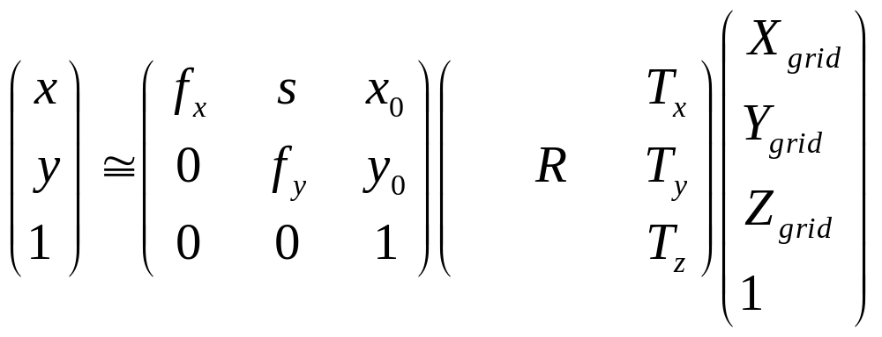
Another Special Case, the world is a plane.
Projection from the world to the image:
Ignore z-coordinate (it is 0 anyway), drop the 3rd column of the P matrix, then you get a mapping between the plane and the image which is an arbitrary 3 x 3 matrix. This is called a “homography”.
0
Irrelevant

Slide 45
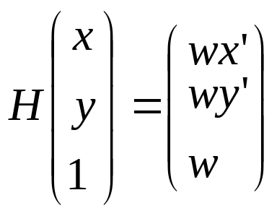
Homography: (x’,y’,1) ~ H (x,y,1)
Not a constraint. Unlike the fundamental matrix, tells you exactly where the point goes.
Point (x,y) in one frame corresponds to point (x’,y’) in the other frame. If we need to think about multiple points, we may put subscripts on them.
Being careful about the homogenous coordinate, we write:

Slide 46
Homography is a “simple” example of a 3D to 2D transformation
It is also the “most complicated” linear 2D to 2D transformation.
What other 2D → 2D transformations are there?

Slide 47
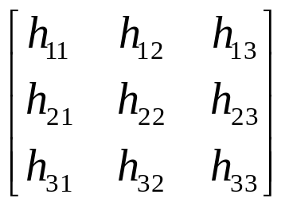
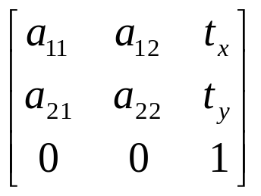
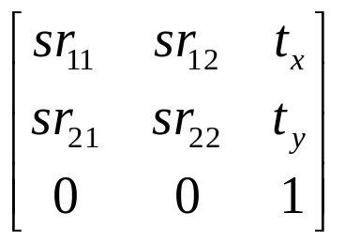
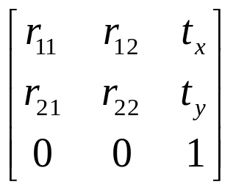
Homography is most general, encompasses other transformations
Views of a plane from different viewpoints, any view of a scene from the same viewpoint.
Projective
8 dof
Affine
6 dof
Images of a “far away” object under any rotation
Similarity
4 dof
Camera looking at an assembly line w/ zoom.
Euclidean
3 dof
Camera looking at an assembly line.

Slide 48
Invariants…
Concurrency, collinearity, order of contact (intersection, tangency, inflection, etc.), cross ratio
Projective
8 dof
Parallellism, ratio of areas, ratio of lengths on parallel lines (e.g midpoints).
Affine
6 dof
Similarity
4 dof
Ratios of any edge lengths, angles.
Euclidean
3 dof
Absolute lengths, areas.

Slide 49
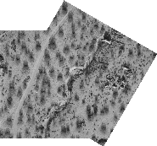
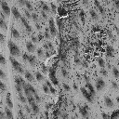

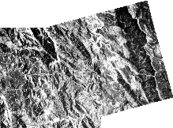


Image registration
Determining the 2d transformation that brings one image into alignment (registers it) with another.

Slide 50






Image Warping
What kind of warps are these?
Notes:
Interpolation is basic tool that we have to deal with it. There are many interpolation
methods -- for example, nearest neighbor, bilinear, and bicubic.
Next is the image warping. This is the example of image warping. The left image
is the original image. And we apply the motion parameters here. After warping
or transforming, we will get this as the result.
The motion parameters here is of the projective model. Therefore, we can see that
the resulting image contain many effects together like the rotation, translation,
zooming in here, shrinking around here, chirping and keystoning.

Slide 51
How to solve for these mappings?
Given:
Solve for:

Slide 52





Unwrapping a matrix.
Write out the lines of this matrix equation.
And remember which variables are unknown.

Slide 53


Unwrapping a matrix.

Slide 54

Looks like another matrix equation:

Slide 55

Looks like another matrix equation:
Data from different points

Slide 56
Why does this suck?
Maybe you have error in finding corresponding points, and want to use many many corresponding points. Then your number of unknowns keeps growing…
Is there a better way?
What is x’?

Slide 57


The game of “finding the linear constraint…”
x’ = wx’ / w
Non-linear
Linear (in a,b,c,g,h)

Slide 58


Slide 59


And just add two more rows for each corresponding point

Slide 60
Ax=b
Matlab: x = A\b
Then make your homography matrix by rearranging x into a 3 x 3 matrix
Size of A? b?

Slide 61



Slide 62




H₁₂
H₂₃
(H₁₂)⁻¹
H₃₄
(H₃₄H₂₃H₁₂)
(H₃₄H₂₃H₁₂)⁻¹= ((H₁₂)⁻¹(H₂₃)⁻¹(H₃₄)⁻¹)
Chaining, inverses, and pre-computation can all be done on the matrices…

Slide 63


Slide 64
More than Geometry: image processing
The above gave different ways of transforming the coordinates of one image into the coordinates of another.
Graphics question.
  Given one image, the homography H, make the second image.
    (why would you want to do this? One application is image tweening…).
  Process:
    Take pixel (x,y) of image 1, and put its color at pixel H(x,y,1) in new image. Repeat.
  Problems?

Slide 65
Backward Transformation
Because of the above, some techniques estimate the parameters of the “backwards” transformation, H⁻¹:
  From the destination image to the source image
Remember, you don’t have to work hard to find the backwards transformation. It’s just the matrix inverse.

Slide 66
Mapping Pixel Values - Going Backwards
p = H⁻¹(p’)
p’
“Source” image, I_{s}
“Destination” image, I_{d}
I_{d}(p’) = I_{s}(H⁻¹(p’))
Intensity at destination pixel p’ = the intensity at the source pixel H⁻¹(p’)

Slide 67

If you project backward from a real pixel, you also won’t land exactly on a pixel??!!?
(but there is a good way of making up a value)
H⁻¹(p’)
Pixel centers…

Slide 68
If you project backward from a real pixel, you also won’t land exactly on a pixel??!!?
(but there is a good way of making up a value)

Slide 69
Use linear interpolation along the top and bottom horizontal lines to determine I_{A} and I_{B}:
I_{A} = (1 – f)•I(x_{i}, y_{j}) + f•I(x_{i+1}, y_{j})
I_{B} = (1 – f)•I(x_{i}, y_{j+1})+ f•I(x_{i+1}, y_{j+1})
Use linear interpolation along the vertical line between I_{A} and I_{B} to determine I(x,y):
I(x,y) = (1 – g)•zA + g•zB
Or,
I(x,y) =
(1 – f)•(1 – g)•I(x_{i}, y_{j}) + f•(1 – g)•I(x_{i+1}, y_{j}) +
(1 – f)• g •I(x_{i}, y_{j+1}) + f• g •I(x_{i+1}, y_{j+1})

Slide 70


Beyond geometry…

