Slide 1
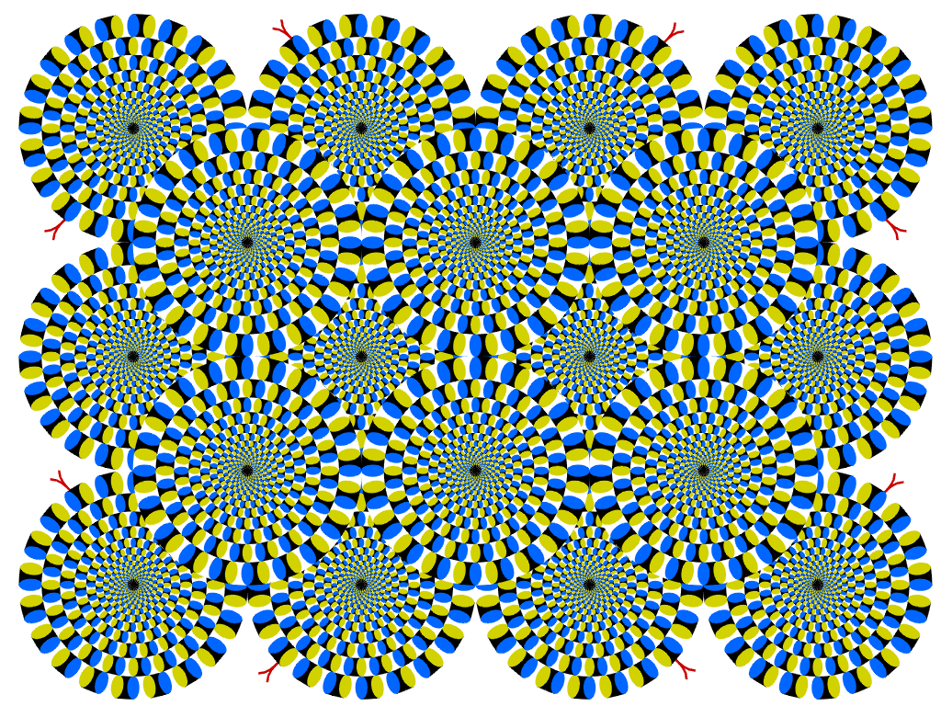
Motion illusion, rotating snakes
Many slides by Derek Hoiem and James Hays

Slide 2
ProjectLive3D

Slide 3
Next two classes: views of filtering
Image filters in spatial domain
  Filter is a mathematical operation of a grid of numbers
  Smoothing, sharpening, measuring texture
Image filters in the frequency domain
  Filtering is a way to modify the frequencies of images
  Denoising, sampling, image compression
Templates and Image Pyramids
  Filtering is a way to match a template to the image
  Detection, coarse-to-fine registration

Slide 4
Image filtering
Image filtering: compute function of local neighborhood at each position
Really important!
  Enhance images
    Denoise, resize, increase contrast, etc.
  Extract information from images
    Texture, edges, distinctive points, etc.
  Detect patterns
    Template matching

Slide 5
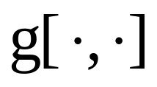

Example: box filter
1
1
1
1
1
1
1
1
1
Slide credit: David Lowe (UBC)

Slide 6
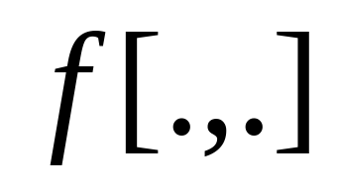
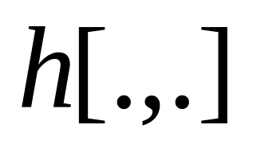
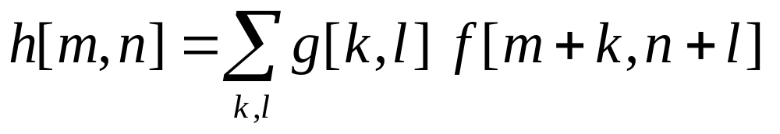
Image filtering
1
1
1
1
1
1
1
1
1
0 | 0 | 0 | 0 | 0 | 0 | 0 | 0 | 0 | 0
0 | 0 | 0 | 0 | 0 | 0 | 0 | 0 | 0 | 0
0 | 0 | 0 | 90 | 90 | 90 | 90 | 90 | 0 | 0
0 | 0 | 0 | 90 | 90 | 90 | 90 | 90 | 0 | 0
0 | 0 | 0 | 90 | 90 | 90 | 90 | 90 | 0 | 0
0 | 0 | 0 | 90 | 0 | 90 | 90 | 90 | 0 | 0
0 | 0 | 0 | 90 | 90 | 90 | 90 | 90 | 0 | 0
0 | 0 | 0 | 0 | 0 | 0 | 0 | 0 | 0 | 0
0 | 0 | 90 | 0 | 0 | 0 | 0 | 0 | 0 | 0
0 | 0 | 0 | 0 | 0 | 0 | 0 | 0 | 0 | 0
 | 0
0 | 0 | 0 | 0 | 0 | 0 | 0 | 0 | 0 | 0
0 | 0 | 0 | 0 | 0 | 0 | 0 | 0 | 0 | 0
0 | 0 | 0 | 90 | 90 | 90 | 90 | 90 | 0 | 0
0 | 0 | 0 | 90 | 90 | 90 | 90 | 90 | 0 | 0
0 | 0 | 0 | 90 | 90 | 90 | 90 | 90 | 0 | 0
0 | 0 | 0 | 90 | 0 | 90 | 90 | 90 | 0 | 0
0 | 0 | 0 | 90 | 90 | 90 | 90 | 90 | 0 | 0
0 | 0 | 0 | 0 | 0 | 0 | 0 | 0 | 0 | 0
0 | 0 | 90 | 0 | 0 | 0 | 0 | 0 | 0 | 0
0 | 0 | 0 | 0 | 0 | 0 | 0 | 0 | 0 | 0
Credit: S. Seitz
Notes:
ones, divide by 9

Slide 7
Image filtering
1
1
1
1
1
1
1
1
1
0 | 0 | 0 | 0 | 0 | 0 | 0 | 0 | 0 | 0
0 | 0 | 0 | 0 | 0 | 0 | 0 | 0 | 0 | 0
0 | 0 | 0 | 90 | 90 | 90 | 90 | 90 | 0 | 0
0 | 0 | 0 | 90 | 90 | 90 | 90 | 90 | 0 | 0
0 | 0 | 0 | 90 | 90 | 90 | 90 | 90 | 0 | 0
0 | 0 | 0 | 90 | 0 | 90 | 90 | 90 | 0 | 0
0 | 0 | 0 | 90 | 90 | 90 | 90 | 90 | 0 | 0
0 | 0 | 0 | 0 | 0 | 0 | 0 | 0 | 0 | 0
0 | 0 | 90 | 0 | 0 | 0 | 0 | 0 | 0 | 0
0 | 0 | 0 | 0 | 0 | 0 | 0 | 0 | 0 | 0
 | 0 | 10
0 | 0 | 0 | 0 | 0 | 0 | 0 | 0 | 0 | 0
0 | 0 | 0 | 0 | 0 | 0 | 0 | 0 | 0 | 0
0 | 0 | 0 | 90 | 90 | 90 | 90 | 90 | 0 | 0
0 | 0 | 0 | 90 | 90 | 90 | 90 | 90 | 0 | 0
0 | 0 | 0 | 90 | 90 | 90 | 90 | 90 | 0 | 0
0 | 0 | 0 | 90 | 0 | 90 | 90 | 90 | 0 | 0
0 | 0 | 0 | 90 | 90 | 90 | 90 | 90 | 0 | 0
0 | 0 | 0 | 0 | 0 | 0 | 0 | 0 | 0 | 0
0 | 0 | 90 | 0 | 0 | 0 | 0 | 0 | 0 | 0
0 | 0 | 0 | 0 | 0 | 0 | 0 | 0 | 0 | 0
Credit: S. Seitz
Notes:
ones, divide by 9

Slide 8
Image filtering
1
1
1
1
1
1
1
1
1
0 | 0 | 0 | 0 | 0 | 0 | 0 | 0 | 0 | 0
0 | 0 | 0 | 0 | 0 | 0 | 0 | 0 | 0 | 0
0 | 0 | 0 | 90 | 90 | 90 | 90 | 90 | 0 | 0
0 | 0 | 0 | 90 | 90 | 90 | 90 | 90 | 0 | 0
0 | 0 | 0 | 90 | 90 | 90 | 90 | 90 | 0 | 0
0 | 0 | 0 | 90 | 0 | 90 | 90 | 90 | 0 | 0
0 | 0 | 0 | 90 | 90 | 90 | 90 | 90 | 0 | 0
0 | 0 | 0 | 0 | 0 | 0 | 0 | 0 | 0 | 0
0 | 0 | 90 | 0 | 0 | 0 | 0 | 0 | 0 | 0
0 | 0 | 0 | 0 | 0 | 0 | 0 | 0 | 0 | 0
 | 0 | 10 | 20
0 | 0 | 0 | 0 | 0 | 0 | 0 | 0 | 0 | 0
0 | 0 | 0 | 0 | 0 | 0 | 0 | 0 | 0 | 0
0 | 0 | 0 | 90 | 90 | 90 | 90 | 90 | 0 | 0
0 | 0 | 0 | 90 | 90 | 90 | 90 | 90 | 0 | 0
0 | 0 | 0 | 90 | 90 | 90 | 90 | 90 | 0 | 0
0 | 0 | 0 | 90 | 0 | 90 | 90 | 90 | 0 | 0
0 | 0 | 0 | 90 | 90 | 90 | 90 | 90 | 0 | 0
0 | 0 | 0 | 0 | 0 | 0 | 0 | 0 | 0 | 0
0 | 0 | 90 | 0 | 0 | 0 | 0 | 0 | 0 | 0
0 | 0 | 0 | 0 | 0 | 0 | 0 | 0 | 0 | 0
Credit: S. Seitz
Notes:
ones, divide by 9

Slide 9
Image filtering
1
1
1
1
1
1
1
1
1
0 | 0 | 0 | 0 | 0 | 0 | 0 | 0 | 0 | 0
0 | 0 | 0 | 0 | 0 | 0 | 0 | 0 | 0 | 0
0 | 0 | 0 | 90 | 90 | 90 | 90 | 90 | 0 | 0
0 | 0 | 0 | 90 | 90 | 90 | 90 | 90 | 0 | 0
0 | 0 | 0 | 90 | 90 | 90 | 90 | 90 | 0 | 0
0 | 0 | 0 | 90 | 0 | 90 | 90 | 90 | 0 | 0
0 | 0 | 0 | 90 | 90 | 90 | 90 | 90 | 0 | 0
0 | 0 | 0 | 0 | 0 | 0 | 0 | 0 | 0 | 0
0 | 0 | 90 | 0 | 0 | 0 | 0 | 0 | 0 | 0
0 | 0 | 0 | 0 | 0 | 0 | 0 | 0 | 0 | 0
 | 0 | 10 | 20 | 30
0 | 0 | 0 | 0 | 0 | 0 | 0 | 0 | 0 | 0
0 | 0 | 0 | 0 | 0 | 0 | 0 | 0 | 0 | 0
0 | 0 | 0 | 90 | 90 | 90 | 90 | 90 | 0 | 0
0 | 0 | 0 | 90 | 90 | 90 | 90 | 90 | 0 | 0
0 | 0 | 0 | 90 | 90 | 90 | 90 | 90 | 0 | 0
0 | 0 | 0 | 90 | 0 | 90 | 90 | 90 | 0 | 0
0 | 0 | 0 | 90 | 90 | 90 | 90 | 90 | 0 | 0
0 | 0 | 0 | 0 | 0 | 0 | 0 | 0 | 0 | 0
0 | 0 | 90 | 0 | 0 | 0 | 0 | 0 | 0 | 0
0 | 0 | 0 | 0 | 0 | 0 | 0 | 0 | 0 | 0
Credit: S. Seitz
Notes:
ones, divide by 9

Slide 10
Image filtering
1
1
1
1
1
1
1
1
1
0 | 0 | 0 | 0 | 0 | 0 | 0 | 0 | 0 | 0
0 | 0 | 0 | 0 | 0 | 0 | 0 | 0 | 0 | 0
0 | 0 | 0 | 90 | 90 | 90 | 90 | 90 | 0 | 0
0 | 0 | 0 | 90 | 90 | 90 | 90 | 90 | 0 | 0
0 | 0 | 0 | 90 | 90 | 90 | 90 | 90 | 0 | 0
0 | 0 | 0 | 90 | 0 | 90 | 90 | 90 | 0 | 0
0 | 0 | 0 | 90 | 90 | 90 | 90 | 90 | 0 | 0
0 | 0 | 0 | 0 | 0 | 0 | 0 | 0 | 0 | 0
0 | 0 | 90 | 0 | 0 | 0 | 0 | 0 | 0 | 0
0 | 0 | 0 | 0 | 0 | 0 | 0 | 0 | 0 | 0
 | 0 | 10 | 20 | 30 | 30
Credit: S. Seitz
Notes:
ones, divide by 9

Slide 11
Image filtering
1
1
1
1
1
1
1
1
1
0 | 0 | 0 | 0 | 0 | 0 | 0 | 0 | 0 | 0
0 | 0 | 0 | 0 | 0 | 0 | 0 | 0 | 0 | 0
0 | 0 | 0 | 90 | 90 | 90 | 90 | 90 | 0 | 0
0 | 0 | 0 | 90 | 90 | 90 | 90 | 90 | 0 | 0
0 | 0 | 0 | 90 | 90 | 90 | 90 | 90 | 0 | 0
0 | 0 | 0 | 90 | 0 | 90 | 90 | 90 | 0 | 0
0 | 0 | 0 | 90 | 90 | 90 | 90 | 90 | 0 | 0
0 | 0 | 0 | 0 | 0 | 0 | 0 | 0 | 0 | 0
0 | 0 | 90 | 0 | 0 | 0 | 0 | 0 | 0 | 0
0 | 0 | 0 | 0 | 0 | 0 | 0 | 0 | 0 | 0
 | 0 | 10 | 20 | 30 | 30
?
Credit: S. Seitz
Notes:
ones, divide by 9

Slide 12
Image filtering
1
1
1
1
1
1
1
1
1
0 | 0 | 0 | 0 | 0 | 0 | 0 | 0 | 0 | 0
0 | 0 | 0 | 0 | 0 | 0 | 0 | 0 | 0 | 0
0 | 0 | 0 | 90 | 90 | 90 | 90 | 90 | 0 | 0
0 | 0 | 0 | 90 | 90 | 90 | 90 | 90 | 0 | 0
0 | 0 | 0 | 90 | 90 | 90 | 90 | 90 | 0 | 0
0 | 0 | 0 | 90 | 0 | 90 | 90 | 90 | 0 | 0
0 | 0 | 0 | 90 | 90 | 90 | 90 | 90 | 0 | 0
0 | 0 | 0 | 0 | 0 | 0 | 0 | 0 | 0 | 0
0 | 0 | 90 | 0 | 0 | 0 | 0 | 0 | 0 | 0
0 | 0 | 0 | 0 | 0 | 0 | 0 | 0 | 0 | 0
 | 0 | 10 | 20 | 30 | 30
 |  |  |  | 50
?
Credit: S. Seitz
Notes:
ones, divide by 9

Slide 13
Image filtering
1
1
1
1
1
1
1
1
1
0 | 0 | 0 | 0 | 0 | 0 | 0 | 0 | 0 | 0
0 | 0 | 0 | 0 | 0 | 0 | 0 | 0 | 0 | 0
0 | 0 | 0 | 90 | 90 | 90 | 90 | 90 | 0 | 0
0 | 0 | 0 | 90 | 90 | 90 | 90 | 90 | 0 | 0
0 | 0 | 0 | 90 | 90 | 90 | 90 | 90 | 0 | 0
0 | 0 | 0 | 90 | 0 | 90 | 90 | 90 | 0 | 0
0 | 0 | 0 | 90 | 90 | 90 | 90 | 90 | 0 | 0
0 | 0 | 0 | 0 | 0 | 0 | 0 | 0 | 0 | 0
0 | 0 | 90 | 0 | 0 | 0 | 0 | 0 | 0 | 0
0 | 0 | 0 | 0 | 0 | 0 | 0 | 0 | 0 | 0
 | 0 | 10 | 20 | 30 | 30 | 30 | 20 | 10
 | 0 | 20 | 40 | 60 | 60 | 60 | 40 | 20
 | 0 | 30 | 60 | 90 | 90 | 90 | 60 | 30
 | 0 | 30 | 50 | 80 | 80 | 90 | 60 | 30
 | 0 | 30 | 50 | 80 | 80 | 90 | 60 | 30
 | 0 | 20 | 30 | 50 | 50 | 60 | 40 | 20
 | 10 | 20 | 30 | 30 | 30 | 30 | 20 | 10
 | 10 | 10 | 10 | 0 | 0 | 0 | 0 | 0
Credit: S. Seitz

Slide 14
Box Filter
What does it do?
Replaces each pixel with an average of its neighborhood
Achieve smoothing effect (remove sharp features)
1
1
1
1
1
1
1
1
1
Slide credit: David Lowe (UBC)

Slide 15
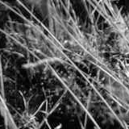
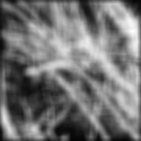
Smoothing with box filter

Slide 16
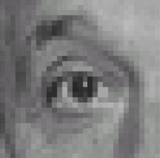
Practice with linear filters
0
0
0
?
0
1
0
0
0
0
Original
Source: D. Lowe

Slide 17
Practice with linear filters
0
0
0
0
1
0
0
0
0
Original
Filtered
(no change)
Source: D. Lowe

Slide 18
Practice with linear filters
0
0
0
?
0
0
1
0
0
0
Original
Source: D. Lowe

Slide 19
Practice with linear filters
0
0
0
0
0
1
0
0
0
Original
Shifted left
By 1 pixel
Source: D. Lowe

Slide 20

Practice with linear filters
0
0
0
-
1
1
1
?
0
2
0
1
1
1
0
0
0
1
1
1
(Note that filter sums to 1)
Original
Source: D. Lowe

Slide 21
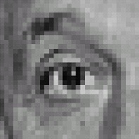
Practice with linear filters
0
0
0
-
1
1
1
0
2
0
1
1
1
0
0
0
1
1
1
Original
Sharpening filter
  Accentuates differences with local average
Source: D. Lowe

Slide 22
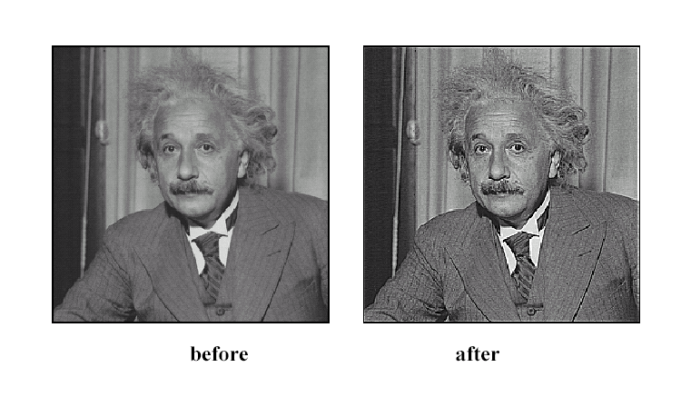
Sharpening
Source: D. Lowe

Slide 23
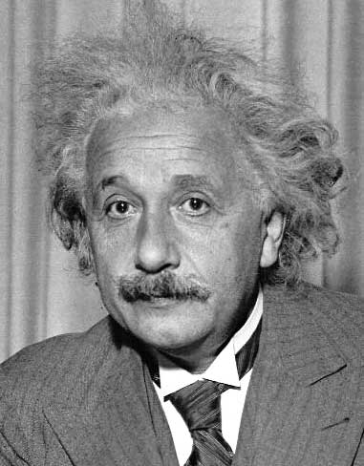
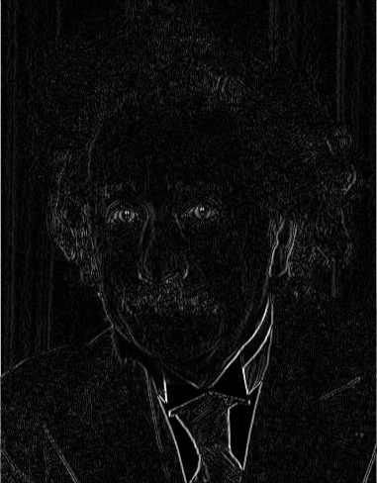
Other filters
1
0
-1
2
0
-2
1
0
-1
Sobel
Vertical Edge
(absolute value)

Slide 24
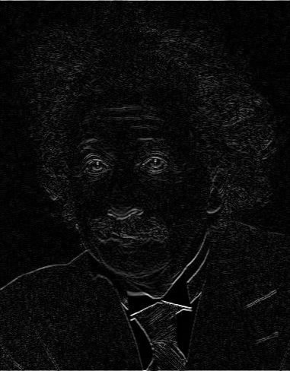
Other filters
1
2
1
0
0
0
-1
-2
-1
Sobel
Horizontal Edge
(absolute value)
Notes:
Questions at this point?

Slide 25
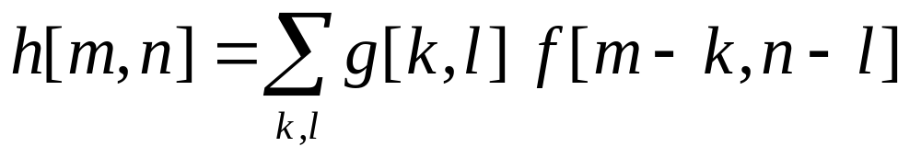
Filtering vs. Convolution
g=filter
f=image
2d filtering
  h=filter2(g,f); or h=imfilter(f,g);
2d convolution
  h=conv2(g,f);

Slide 26
Key properties of linear filters
Linearity:
filter(f₁ + f₂) = filter(f₁) + filter(f₂)
Shift invariance: same behavior regardless of pixel location
filter(shift(f)) = shift(filter(f))
Any linear, shift-invariant operator can be represented as a convolution
Source: S. Lazebnik
Notes:
f is image

Slide 27
More properties
Commutative: a * b = b * a
  Conceptually no difference between filter and signal
Associative: a * (b * c) = (a * b) * c
  Often apply several filters one after another: (((a * b₁) * b₂) * b₃)
  This is equivalent to applying one filter: a * (b₁ * b₂ * b₃)
Distributes over addition: a * (b + c) = (a * b) + (a * c)
Scalars factor out: ka * b = a * kb = k (a * b)
Identity: unit impulse e = [0, 0, 1, 0, 0],
a * e = a
Source: S. Lazebnik

Slide 28
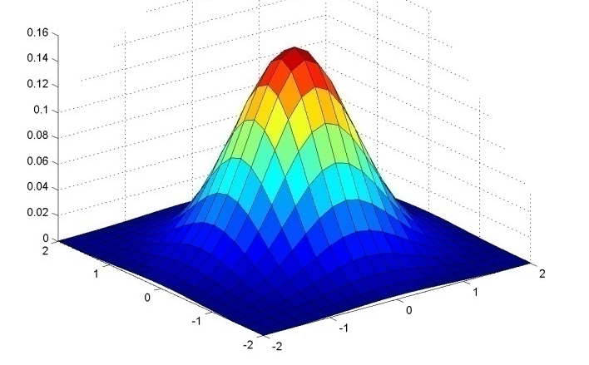
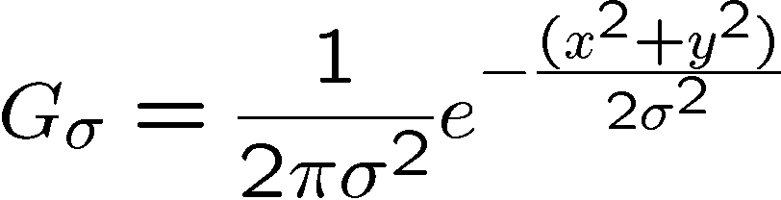
Important filter: Gaussian
Weight contributions of neighboring pixels by nearness
0.003 0.013 0.022 0.013 0.003
0.013 0.059 0.097 0.059 0.013
0.022 0.097 0.159 0.097 0.022
0.013 0.059 0.097 0.059 0.013
0.003 0.013 0.022 0.013 0.003
5 x 5, σ = 1
Slide credit: Christopher Rasmussen

Slide 29

Smoothing with Gaussian filter

Slide 30
Smoothing with box filter

Slide 31
Gaussian filters
Remove “high-frequency” components from the image (low-pass filter)
  Images become more smooth
Convolution with self is another Gaussian
  So can smooth with small-width kernel, repeat, and get same result as larger-width kernel would have
  Convolving two times with Gaussian kernel of width σ is same as convolving once with kernel of width σ√2
Separable kernel
  Factors into product of two 1D Gaussians
Source: K. Grauman
Notes:
Linear vs. quadratic in mask size

Slide 32
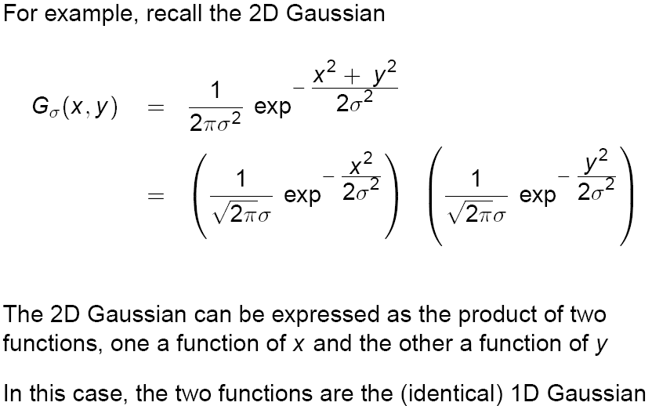
Separability of the Gaussian filter
Source: D. Lowe

Slide 33
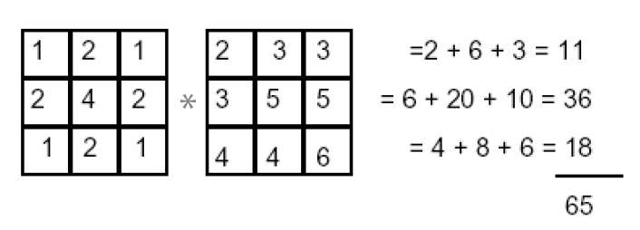
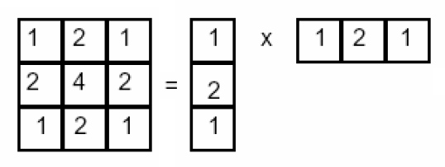
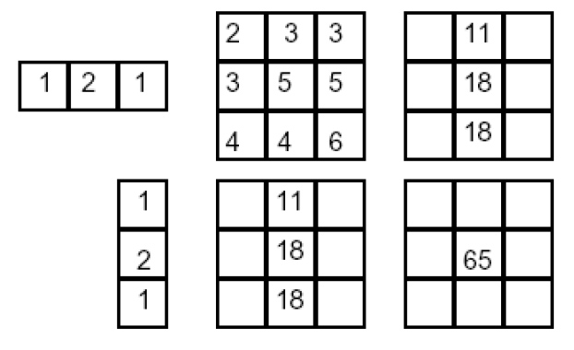
Separability example
2D convolution
(center location only)
The filter factors
into a product of 1D
filters:
Perform convolution
along rows:
*
=
Followed by convolution
along the remaining column:
*
=
Source: K. Grauman

Slide 34
Separability
Why is separability useful in practice?

Slide 35
Some practical matters

Slide 36
Practical matters
How big should the filter be?
Values at edges should be near zero
Rule of thumb for Gaussian: set filter half-width to about 3 σ

Slide 37
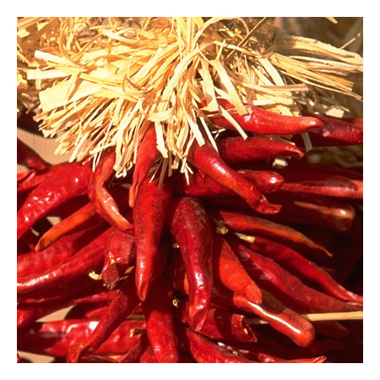
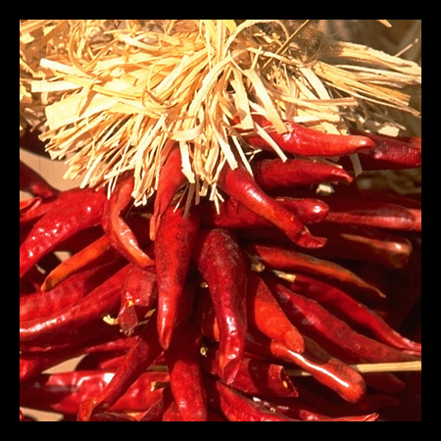

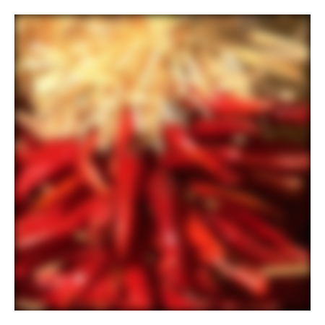
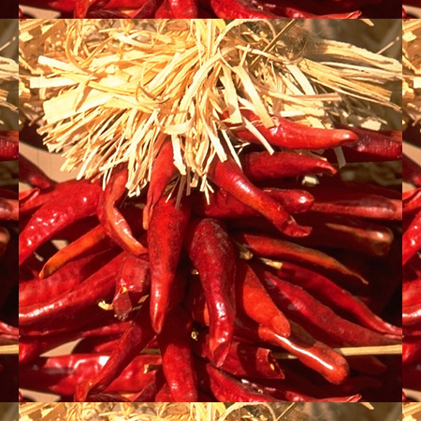
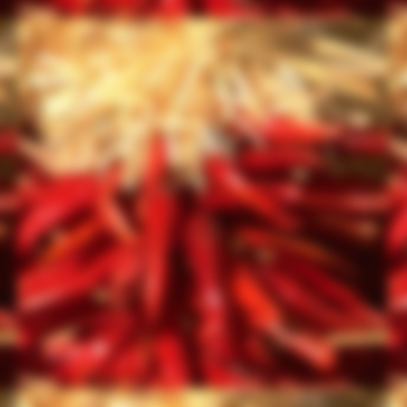
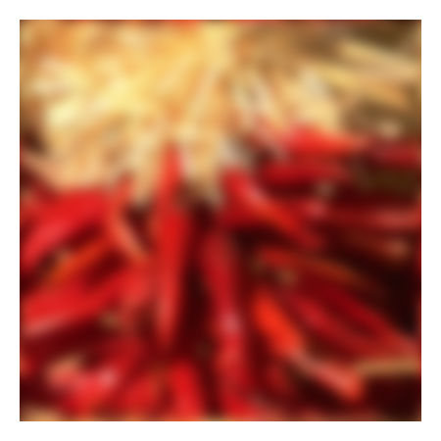
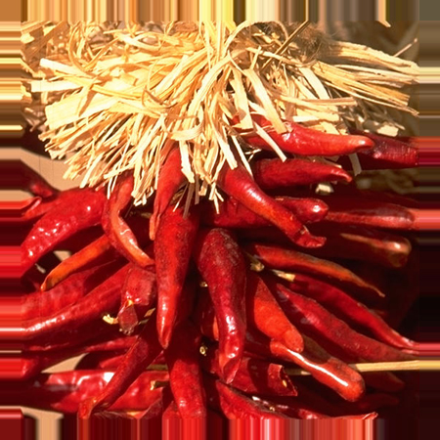


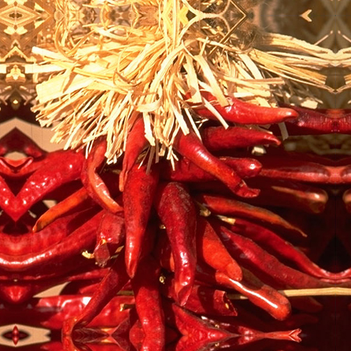


Practical matters
What about near the edge?
  the filter window falls off the edge of the image
  need to extrapolate
  methods:
    clip filter (black)
    wrap around
    copy edge
    reflect across edge
Source: S. Marschner

Slide 38
Practical matters
Q?
  methods (MATLAB):
    clip filter (black): imfilter(f, g, 0)
    wrap around: imfilter(f, g, ‘circular’)
    copy edge: imfilter(f, g, ‘replicate’)
    reflect across edge: imfilter(f, g, ‘symmetric’)
Source: S. Marschner

Slide 39
Practical matters
What is the size of the output?
MATLAB: filter2(g, f, shape)
  shape = ‘full’: output size is sum of sizes of f and g
  shape = ‘same’: output size is same as f
  shape = ‘valid’: output size is difference of sizes of f and g
full
same
valid
g
g
g
g
f
f
f
g
g
g
g
g
g
g
g
Source: S. Lazebnik

Slide 40
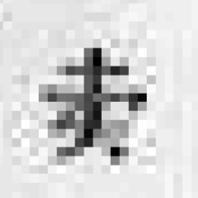
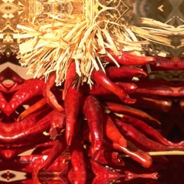
Take-home messages
Image is a matrix of numbers
Linear filtering is sum of dot product at each position
  Can smooth, sharpen, translate (among many other uses)
Be aware of details for filter size, extrapolation, cropping
=
0.92 | 0.93 | 0.94 | 0.97 | 0.62 | 0.37 | 0.85 | 0.97 | 0.93 | 0.92 | 0.99
0.95 | 0.89 | 0.82 | 0.89 | 0.56 | 0.31 | 0.75 | 0.92 | 0.81 | 0.95 | 0.91
0.89 | 0.72 | 0.51 | 0.55 | 0.51 | 0.42 | 0.57 | 0.41 | 0.49 | 0.91 | 0.92
0.96 | 0.95 | 0.88 | 0.94 | 0.56 | 0.46 | 0.91 | 0.87 | 0.90 | 0.97 | 0.95
0.71 | 0.81 | 0.81 | 0.87 | 0.57 | 0.37 | 0.80 | 0.88 | 0.89 | 0.79 | 0.85
0.49 | 0.62 | 0.60 | 0.58 | 0.50 | 0.60 | 0.58 | 0.50 | 0.61 | 0.45 | 0.33
0.86 | 0.84 | 0.74 | 0.58 | 0.51 | 0.39 | 0.73 | 0.92 | 0.91 | 0.49 | 0.74
0.96 | 0.67 | 0.54 | 0.85 | 0.48 | 0.37 | 0.88 | 0.90 | 0.94 | 0.82 | 0.93
0.69 | 0.49 | 0.56 | 0.66 | 0.43 | 0.42 | 0.77 | 0.73 | 0.71 | 0.90 | 0.99
0.79 | 0.73 | 0.90 | 0.67 | 0.33 | 0.61 | 0.69 | 0.79 | 0.73 | 0.93 | 0.97
0.91 | 0.94 | 0.89 | 0.49 | 0.41 | 0.78 | 0.78 | 0.77 | 0.89 | 0.99 | 0.93
1
1
1
1
1
1
1
1
1

Slide 41
Practice questions
Write down a 3x3 filter that returns a positive value if the average value of the 4-adjacent neighbors is less than the center and a negative value otherwise
Write down a filter that will compute the gradient in the x-direction:
gradx(y,x) = im(y,x+1)-im(y,x) for each x, y

Slide 42
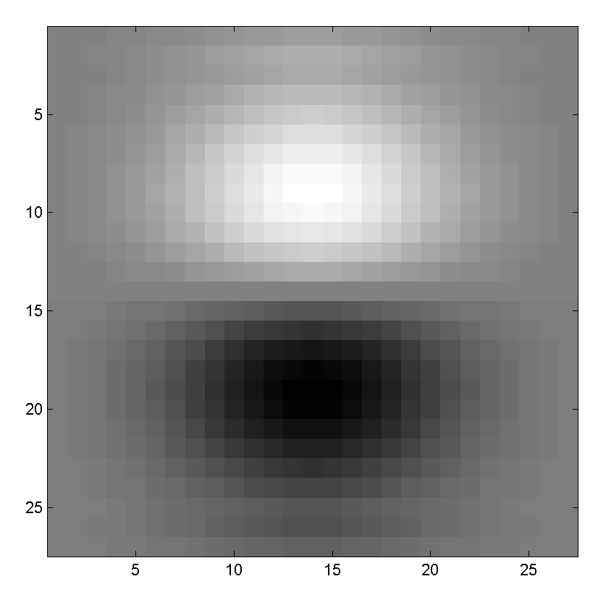
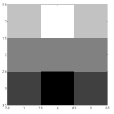
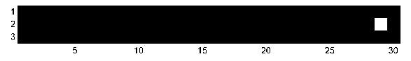
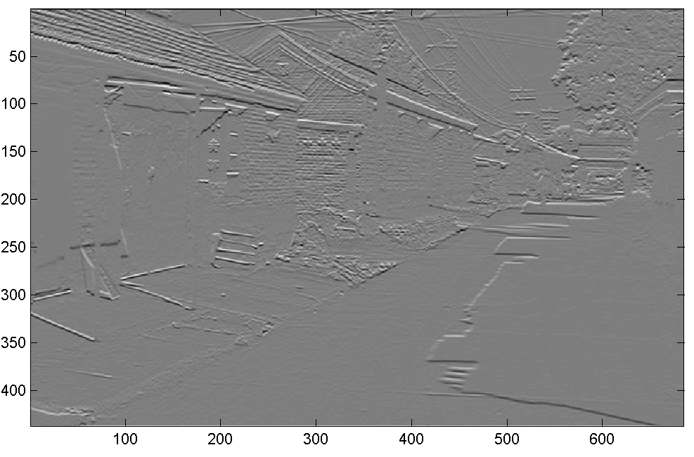
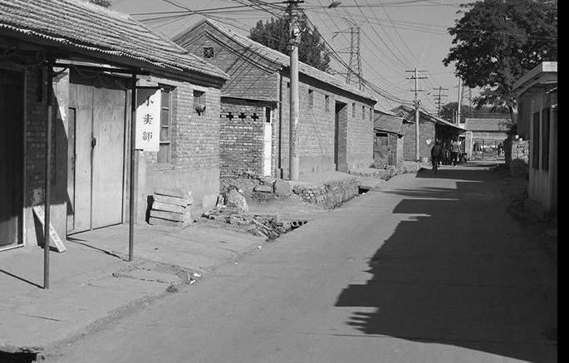
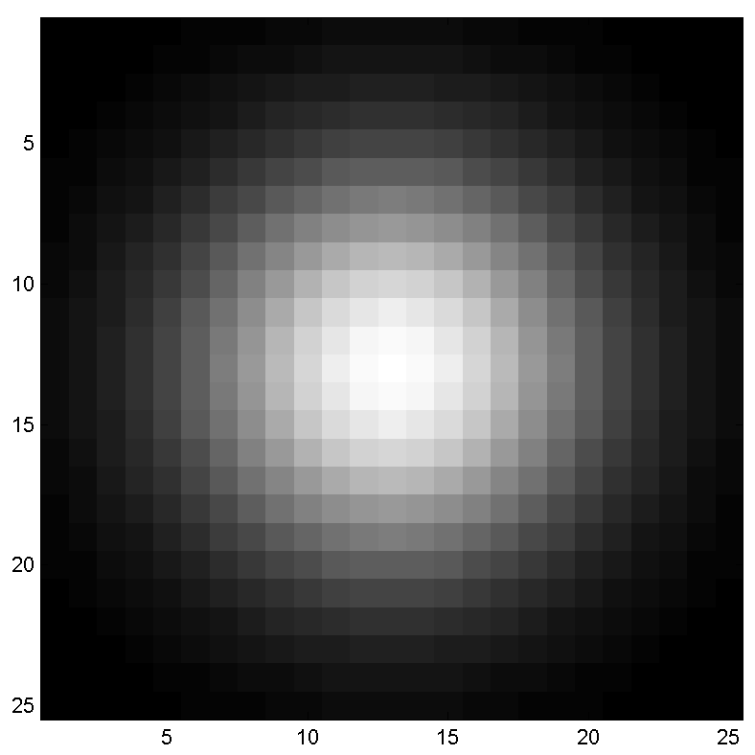
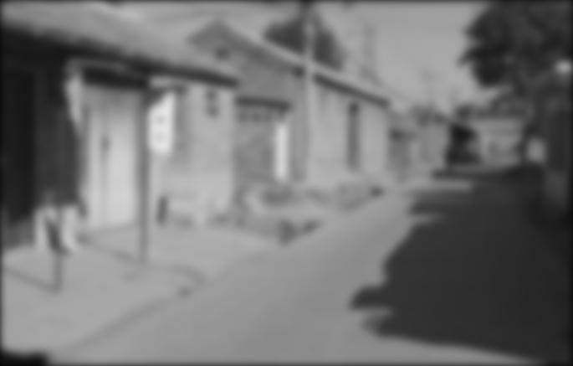
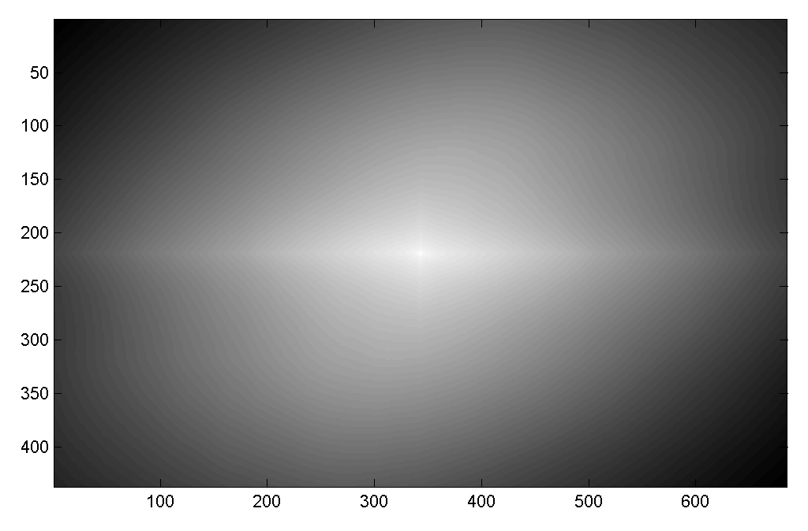

Practice questions
Filtering Operator
a) _ = D * B
b) A = _ * _
c) F = D * _
d) _ = D * D
3. Fill in the blanks:
A
B
E
G
F
C
H
I
D

Slide 43
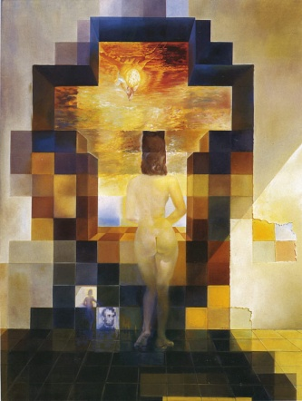
Next: Thinking in Frequency

Slide 44
Why does the Gaussian give a nice smooth image, but the square filter give edgy artifacts?
Gaussian
Box filter
Notes:
Things we can’t understand without thinking in frequency

Slide 45
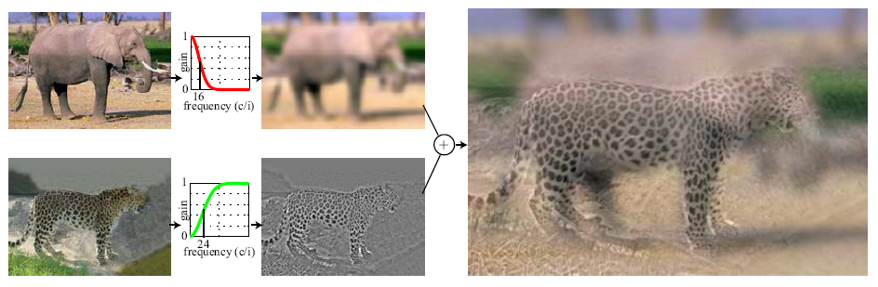
Hybrid Images
A. Oliva, A. Torralba, P.G. Schyns,
“Hybrid Images,” SIGGRAPH 2006

Slide 46
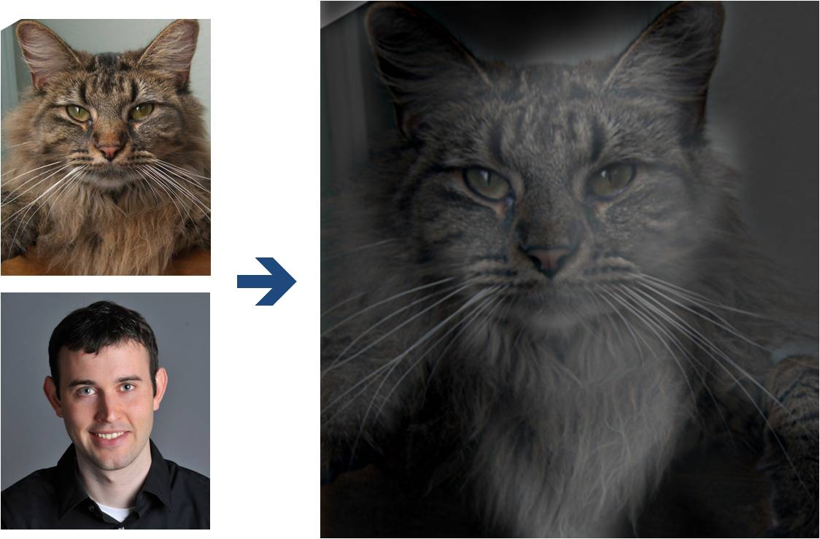
Why do we get different, distance-dependent interpretations of hybrid images?
?
Slide: Hoiem

Slide 47
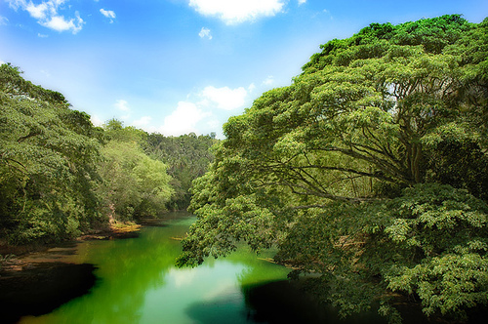
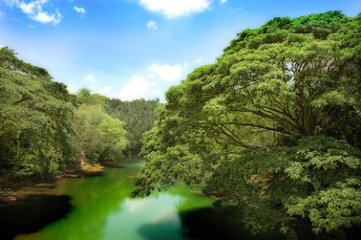
Why does a lower resolution image still make sense to us? What do we lose?
Image: http://www.flickr.com/photos/igorms/136916757/
Slide: Hoiem

Slide 48
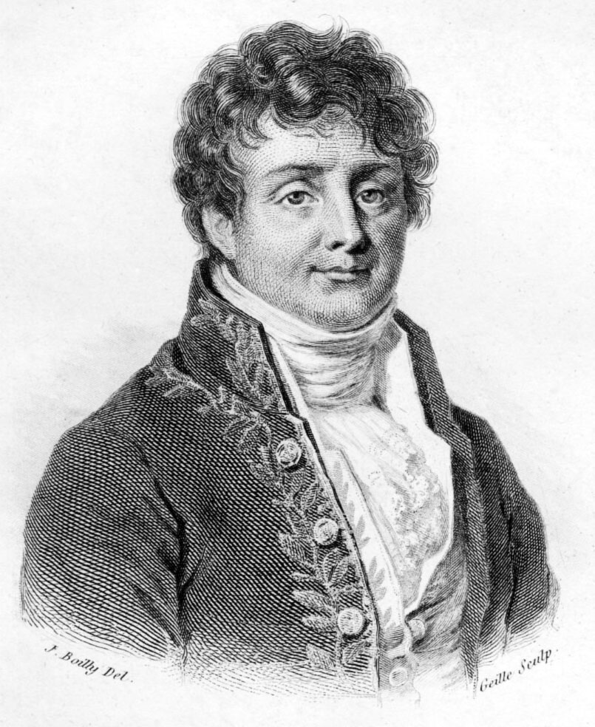
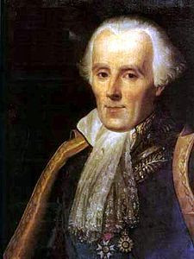
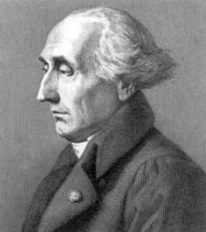

Jean Baptiste Joseph Fourier (1768-1830)
...the manner in which the author arrives at these equations is not exempt of difficulties and...his analysis to integrate them still leaves something to be desired on the score of generality and even rigour.
had crazy idea (1807):
Any univariate function can be rewritten as a weighted sum of sines and cosines of different frequencies.
Don’t believe it?
  Neither did Lagrange, Laplace, Poisson and other big wigs
  Not translated into English until 1878!
But it’s (mostly) true!
  called Fourier Series
  there are some subtle restrictions
Laplace
Legendre
Lagrange

Slide 49
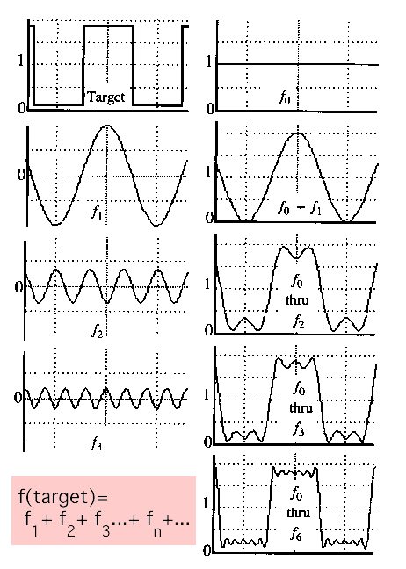
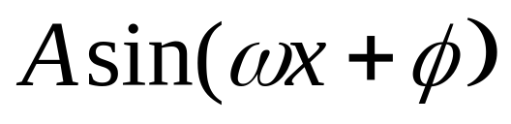
A sum of sines
Our building block:
Add enough of them to get any signal f(x) you want!

Slide 50
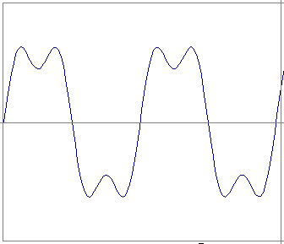
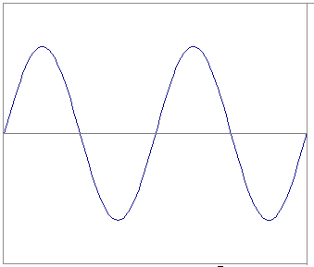


Frequency Spectra
example : g(t) = sin(2πf t) + (1/3)sin(2π(3f) t)
=
+
Slides: Efros

Slide 51

Frequency Spectra

Slide 52
Frequency Spectra
=
+
=

Slide 53


Frequency Spectra
=
+
=

Slide 54


Frequency Spectra
=
+
=

Slide 55



Frequency Spectra
=
+
=

Slide 56


Frequency Spectra
=
+
=

Slide 57


Frequency Spectra
=

Slide 58

Example: Music
We think of music in terms of frequencies at different magnitudes
Slide: Hoiem

Slide 59

Other signals
We can also think of all kinds of other signals the same way
xkcd.com

Slide 60






Fourier analysis in images
Intensity Image
Fourier Image
http://sharp.bu.edu/~slehar/fourier/fourier.html#filtering

Slide 61


Signals can be composed
+
=
http://sharp.bu.edu/~slehar/fourier/fourier.html#filtering
More: http://www.cs.unm.edu/~brayer/vision/fourier.html

Slide 62


Fourier Transform
Fourier transform stores the magnitude and phase at each frequency
  Magnitude encodes how much signal there is at a particular frequency
  Phase encodes spatial information (indirectly)
  For mathematical convenience, this is often notated in terms of real and complex numbers
Amplitude:
Phase:

Slide 63



Computing the Fourier Transform
Continuous
Discrete
k = -N/2..N/2
Fast Fourier Transform (FFT): NlogN

Slide 64


The Convolution Theorem
The Fourier transform of the convolution of two functions is the product of their Fourier transforms
The inverse Fourier transform of the product of two Fourier transforms is the convolution of the two inverse Fourier transforms
Convolution in spatial domain is equivalent to multiplication in frequency domain!

Slide 65
Properties of Fourier Transforms
Linearity
Fourier transform of a real signal is symmetric about the origin
The energy of the signal is the same as the energy of its Fourier transform
See Szeliski Book (3.4)

Slide 66


Filtering in spatial domain
1
0
-1
2
0
-2
1
0
-1
*
=

Slide 67


Filtering in frequency domain
FFT
FFT
=
Inverse FFT
Slide: Hoiem

Slide 68
Fourier Matlab demo

Slide 69
FFT in Matlab
Filtering with fft
Displaying with fft
im = double(imread(‘…'))/255;
im = rgb2gray(im); % “im” should be a gray-scale floating point image
[imh, imw] = size(im);
hs = 50; % filter half-size
fil = fspecial('gaussian', hs*2+1, 10);
fftsize = 1024; % should be order of 2 (for speed) and include padding
im_fft = fft2(im, fftsize, fftsize); % 1) fft im with padding
fil_fft = fft2(fil, fftsize, fftsize); % 2) fft fil, pad to same size as image
im_fil_fft = im_fft .* fil_fft; % 3) multiply fft images
im_fil = ifft2(im_fil_fft); % 4) inverse fft2
im_fil = im_fil(1+hs:size(im,1)+hs, 1+hs:size(im, 2)+hs); % 5) remove padding
figure(1), imagesc(log(abs(fftshift(im_fft)))), axis image, colormap jet
Slide: Hoiem

Slide 70



Project 1: Hybrid Images
A. Oliva, A. Torralba, P.G. Schyns,
“Hybrid Images,” SIGGRAPH 2006
Gaussian Filter!
Laplacian Filter!
unit impulse
Gaussian
Laplacian of Gaussian

