Slide 1
FACES!
Is there something more we could capture from this variance image?
And what is the variance of a set of images, anyway?
Computer Vision, Robert Pless

Slide 2
PCA
Incredibly useful linear algebra tool.
Used in machine learning, for
  Dimensionality reduction
  Clustering
  Recognition
  …
Computer Vision, Robert Pless

Slide 3
PCA idea:
Given: a collection of sample images, {I₁,…I_{n}}
Find:
A mean image μ,
and a collection of principle components {B₁, B₂, …B_{k}}, such that:
Each sample image I_{i} can be approximated as:
I_{i} = μ + c_{1,i} B_{1,i} + c_{2,i} B₂ + … c_{κ,i} B_{κ}
c₁, c₂, … c_{k} are coefficents.
Each image has different coefficients.
But the whole *set* of images shares the same principle components.
Computer Vision, Robert Pless

Slide 4
I = μ + c₁ B₁ + c₂ B₂ + … c_{κ} B_{κ}
This literally means that I want to recreate I_{i} by adding other images together.
This creates a “space of images” spanned by a mean image and set of principle components.
That space of images is formed by choosing all possible combinations of the coefficients c₁, c₂, … c_{k}
Computer Vision, Robert Pless

Slide 5
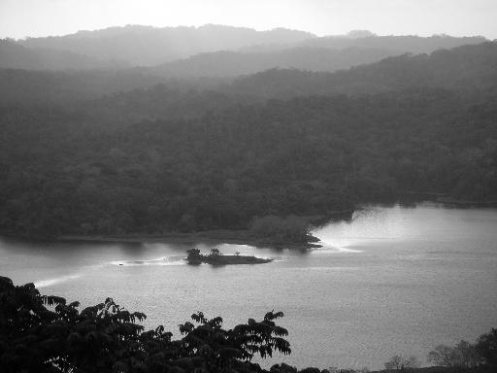
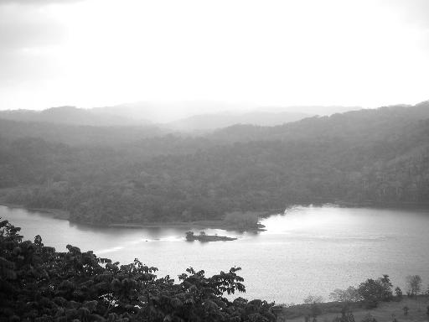
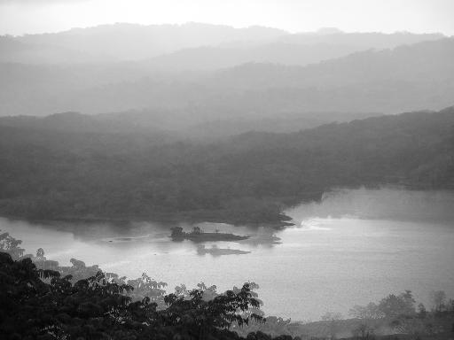
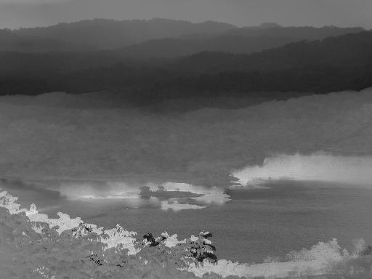
Grounding Example 1
I₁
I₂
I_{i} = μ + 1 B₁
μ
B₁
Computer Vision, Robert Pless

Slide 6
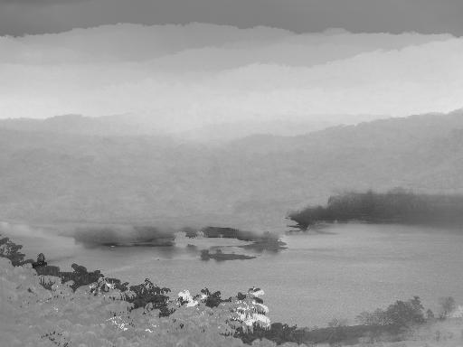
Grounding Example 1 (do matlab instead!)
I₁
I₂
I₂ = μ + -1 B₁
μ
B₁
Computer Vision, Robert Pless

Slide 7
I_{i} = μ + c_{1,i} B₁ + c_{2,i} B₂ + … c_{κ,i} B_{κ}
What set of principle images {B₁, B₂, …B_{k}} is best?
A reasonable goal is to minimize the reconstruction error, so we’d like to choose {B₁, B₂, …B_{k}} so that:
Σ_{i}(I_{i}- (μ + c_{1,i} B₁ + c_{2,i} B₂ + … c_{k,i} B_{k})), which is
Σ_{i}(I_{i}- (reconstructed I₁))² is minimized.
In 2-d what is this?
Computer Vision, Robert Pless

Slide 8

SVD
D
U
S
V
=

Slide 9
I_{i} = μ + c_{1,i} B₁ + c_{2,i} B₂ + … c_{κ,i} B_{κ}
Basis creates mapping between images and (a few) coefficients…
“Dimensionality reduction algorithm”.
I_{i} → c_{1,I}, c_{2,i} ,… ,c_{κ,I}
Computer Vision, Robert Pless

Slide 10
How to actually do this…
Principle component analysis.
  Images are in a 3D matrix I(x,y,t).
  Compute the mean image and subtract it from each image.
  Change that matrix into a data matrix D(p,t),
    listing the pixel values in each frame.
  Do the “SVD” decomposition:
  D = U S V
Frame 2 coefficients.
Frame 1 coefficients.
D
U
S
V
coefficients
=
Images
Basis Images
Computer Vision, Robert Pless

Slide 11
D
U
S
V
=
S is a diagonal matrix, so it only has diagonal elements, called singular values.
These numbers are the relative importance of each of the principle components.
If we want we can make the principle components be the columns of U * S, and have the columns of V be the coefficients.
Alternatively, we can keep the columns of U, and make the coefficients be S * the columns of V. This is more common.
Computer Vision, Robert Pless

Slide 12
D
U
S
V
coefficients.
=
Images
Basis Images
Special properties:
U,V are both orthonormal matrices.
This is cool:
Given a new image W, to get its coefficients v_{w}, you can use:
v_{w}=U^{T}W
Then U v_{w} approximately reconstructs W. Why?
U v_{w}
= U (U^{T}W)
= (U U^{T})W
= I W
= W.
Computer Vision, Robert Pless

Slide 13
D
U
S
V
coefficients
=
Basis Images
These coefficients define the appearance of the image.
The U matrix defines the space of possible images within this video.
Given a new set of coefficients ( a new column of V ), we can make a new image.
New image = U v
(this will give us a column vector of the pixel values…
you have to rearrange it into the shape of the image).
Given a new image W we can find its coefficients
v = U^{T}W
Computer Vision, Robert Pless

Slide 14
PCA Math – Going back to slide 1
Principle component analysis.
  Images are in a 3D matrix I(x,y,t).
  Change that matrix into a data matrix D(p,t), listing the pixel values in each frame.
  Do the “SVD” decomposition:
  D = U S V
Frame 2 coefficients.
Frame 1 coefficients.
D
U
S
V
coefficients
=
Images
Basis Images
Computer Vision, Robert Pless

Slide 15
Calculating the SVD consists of finding the eigenvalues and eigenvectors of DD^{T} and D^{T}D.
The eigenvectors of D^{T}D make up the columns of V,
The eigenvectors of DD^{T} make up the columns of U
So who remembers eigenvectors?
mathy types: “oh, of course, they are the vectors v such that Mv = λv”.
(some matlab hacking to come…).
Computer Vision, Robert Pless

Slide 16
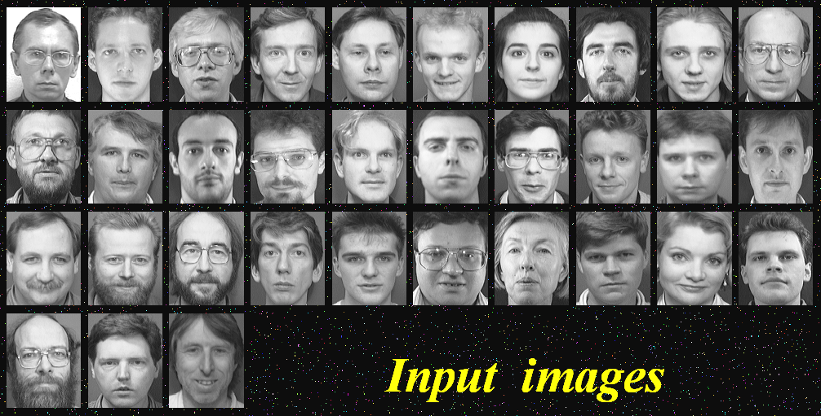
PCA for faces
Images courtesy of OpenCV tutorial at CVPR-2001
Computer Vision, Robert Pless

Slide 17
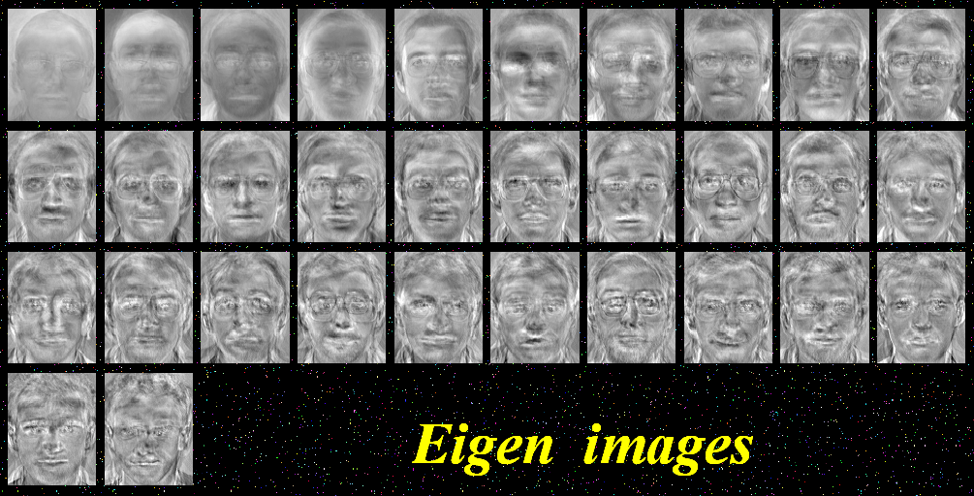
PCA reconstruction
Images courtesy of OpenCV tutorial at CVPR-2001
Computer Vision, Robert Pless

Slide 18
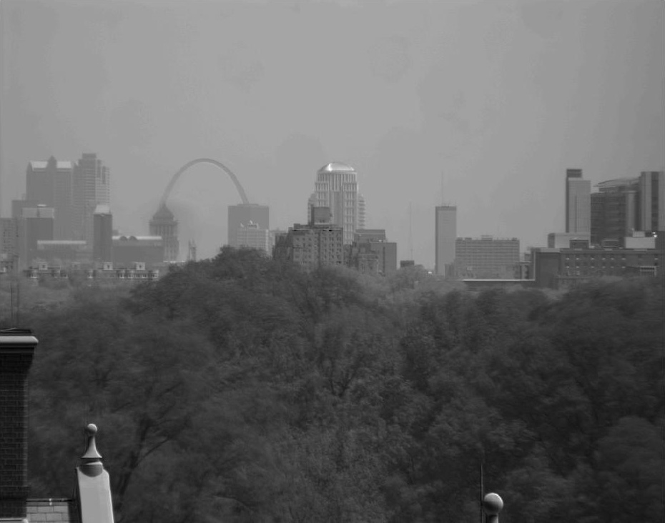
Computer Vision, Robert Pless

Slide 19
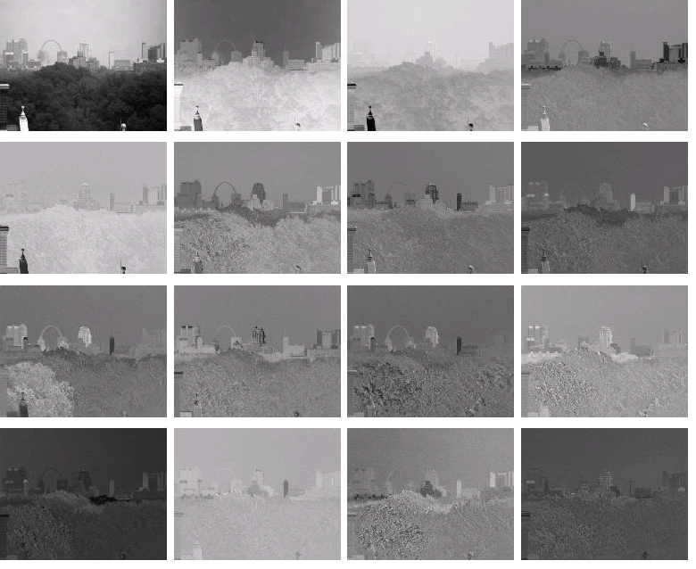

Slide 20
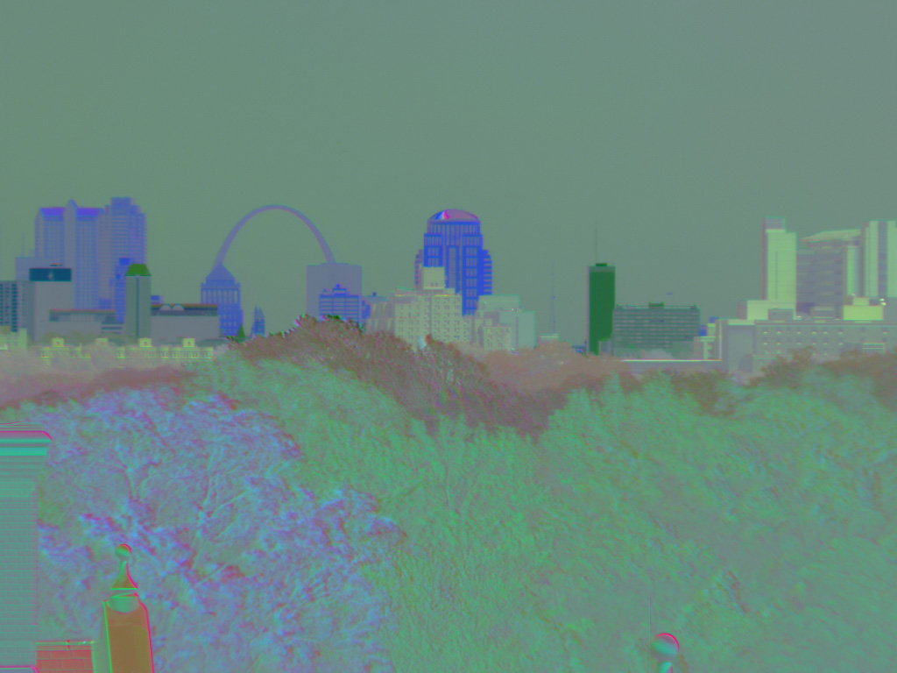

Slide 21
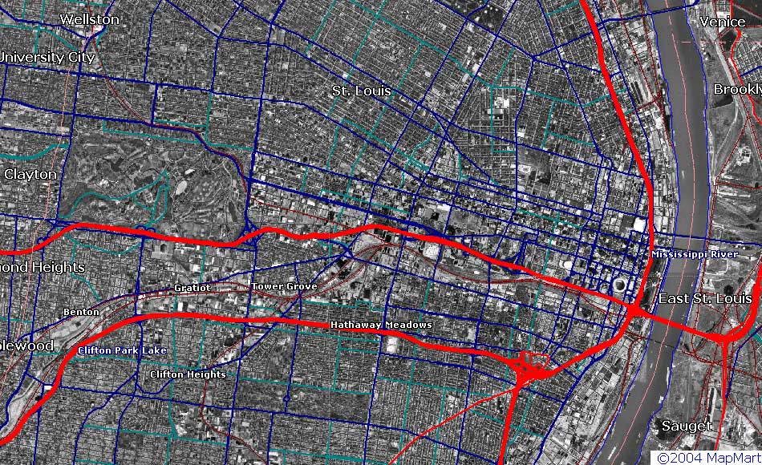
Wash U. (Camera Location)
Med School
St. Louis University
Downtown/Arch

Slide 22

Recognition
PCA
Project images into low-D space
this represents the image DB
individuals (obj., people) in the database live in that volume
often, they “undulate” or “weave” through it, depending on pose, lighting, expressions, etc.
(1) match new images to classes
(2) represent object classes efficiently
Image coefficient space
We need to
Computer Vision, Robert Pless

Slide 23
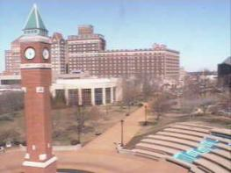

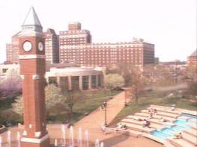
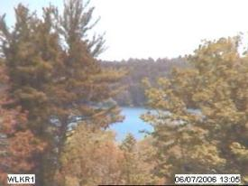
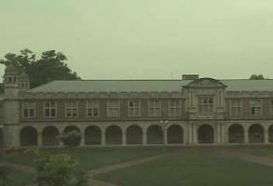
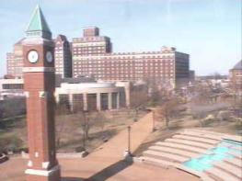
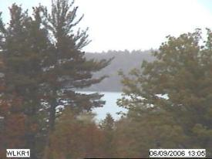
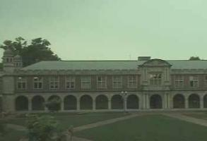
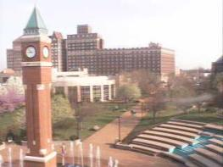
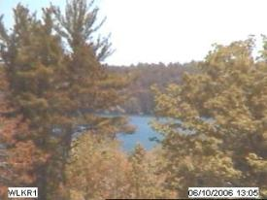
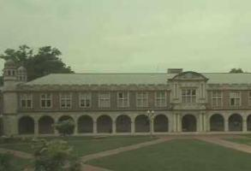
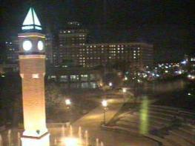
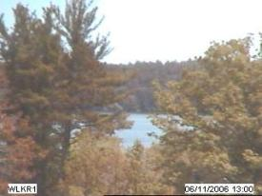
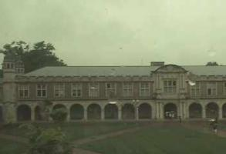
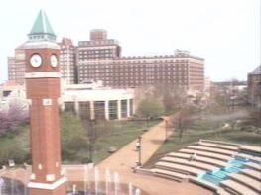
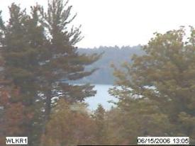
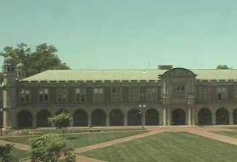
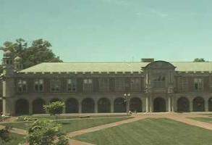
scene tensor factorization
[
]
[
]
[
]
≈
[
]
[
]
[
]
[
]
Dawn
Dusk
Dawn
Dusk

Slide 24
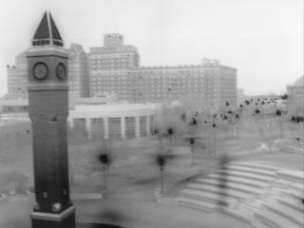
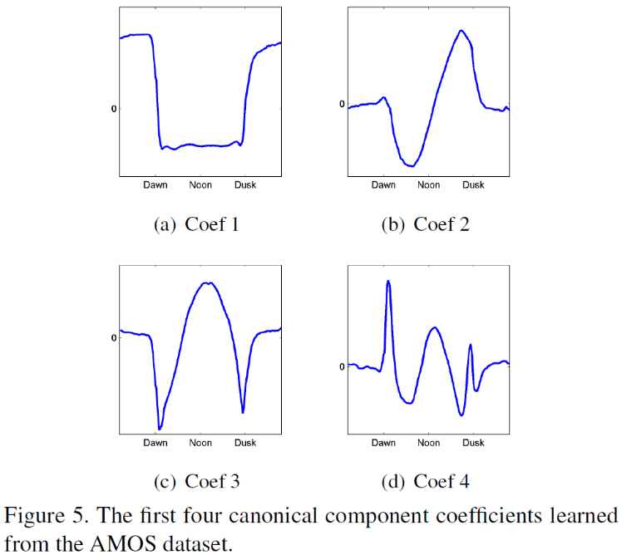
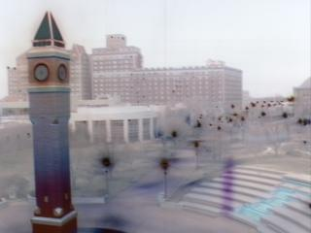
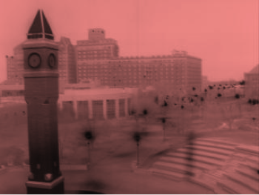
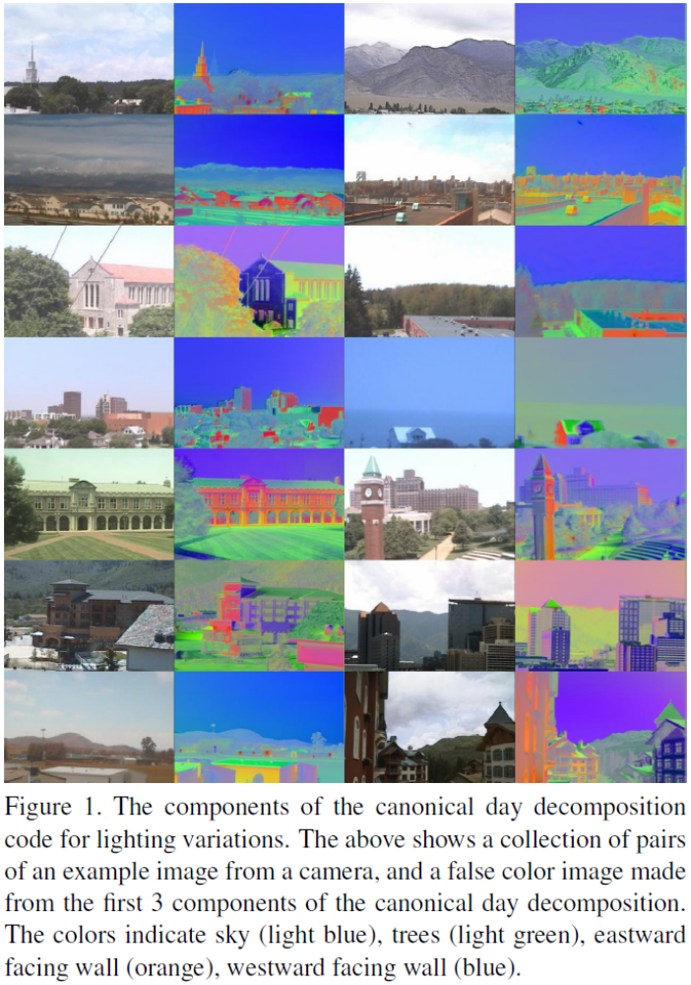
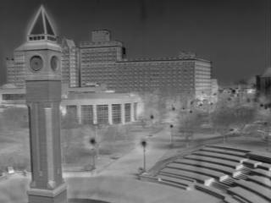
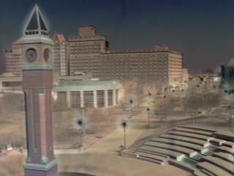
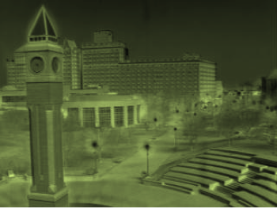
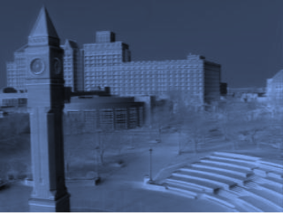
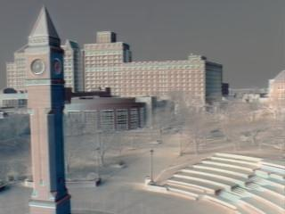
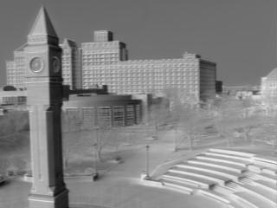
consistent labeling using tensor factorization
R
G
B
Dawn
Dusk

Slide 25
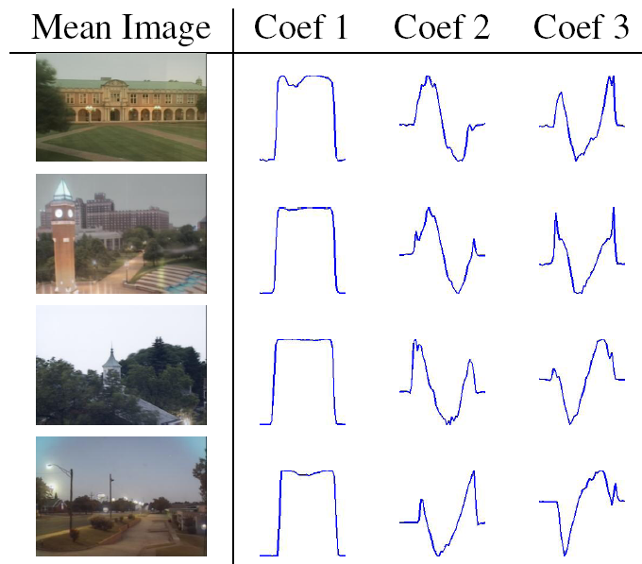
Camera 1
Camera 2
Camera 3
Camera 4
1 day
Jacobs, Roman, Pless. Consistent temporal variations in many outdoor scenes. CVPR 2007

Slide 26
examples of consistent labeling

Slide 27
Applications of image decompositions…

Slide 28
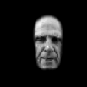
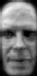

A face recognition algorithm
Set up the image database as K-vectors of coefficients
When a new image arrives…
“eigenfaces”
1. subtract the median image (to center at the origin)
2. project onto the K eigenvectors to get the K most important coefficients
3. Use some technique (neural net, nearest neighbors, SVM) to determine which class of object (which face) this K-vector is. (MACHINE LEARNING…)
match
Computer Vision, Robert Pless

