Slide 1
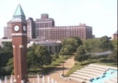
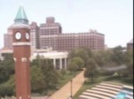
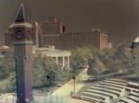
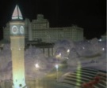
use PCA to convert images to a low-dimensional time-series
difference from mean at time t
= + f₁( t ) + f₂( t ) + ...
image at
time t
mean image
component 1
component 2
coefficient 1
coefficient 2
Notes:
localization

Slide 2


visualizing a year of images
For each year construct a summary image:
January
December
23:59 GMT
00:00 GMT
each pixel color is the average color of one image
each pixel color is a PCA coefficient value of one image

Slide 3
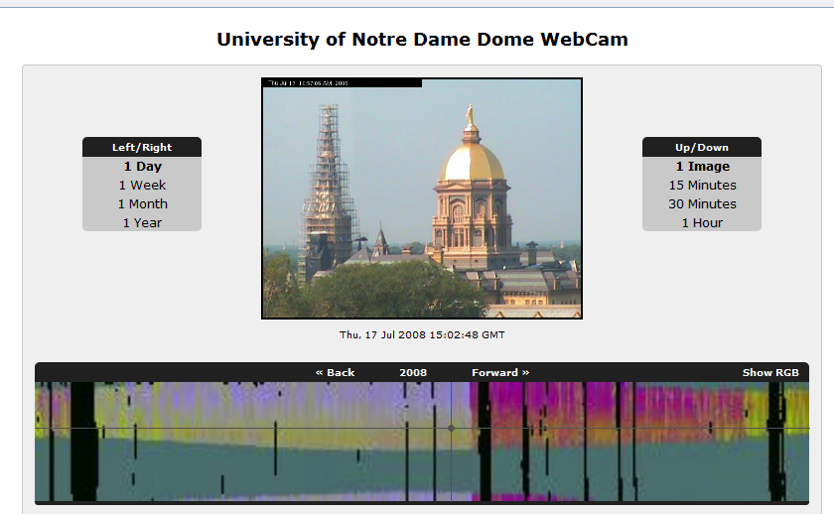

Slide 4
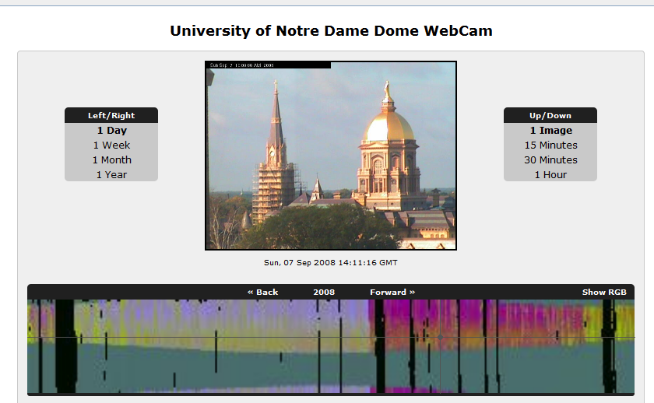

Slide 5




What else could you do?
training data from one camera
single camera predictor
vapor pressure
vapor pressure

Slide 6
linear signal extraction (scalar case)
Training principal component regression model:
Compute PCA coefficients of the images
  Learn linear regression model, Ax = y
Predicting signal given a new image:
Project image onto PCA basis
Perform linear projection of coefficients

Slide 7
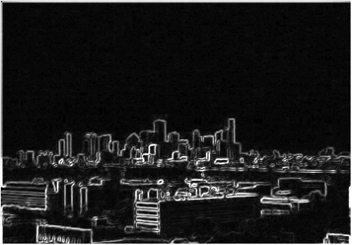
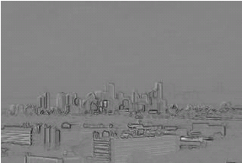
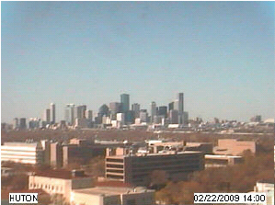
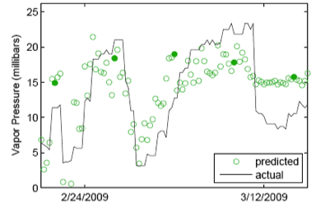

A

Slide 8



the vector signal case
single camera predictor
wind velocity
wind velocity

Slide 9
handling vector signals
multiple-output linear regression
  Ax = y
canonical correlation analysis (CCA)
  Ax = By
  A and B, are chosen to maximize correlation
  B : allows the output space to rotate
  no longer predicting east-west wind velocity components

Slide 10
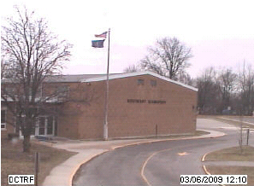
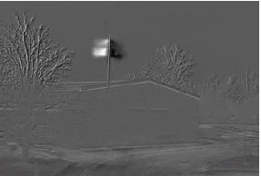
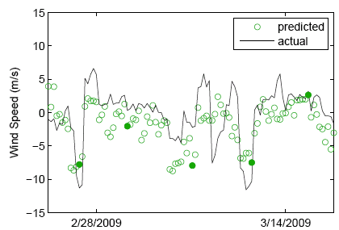

A
first component of rotated output space

Slide 11
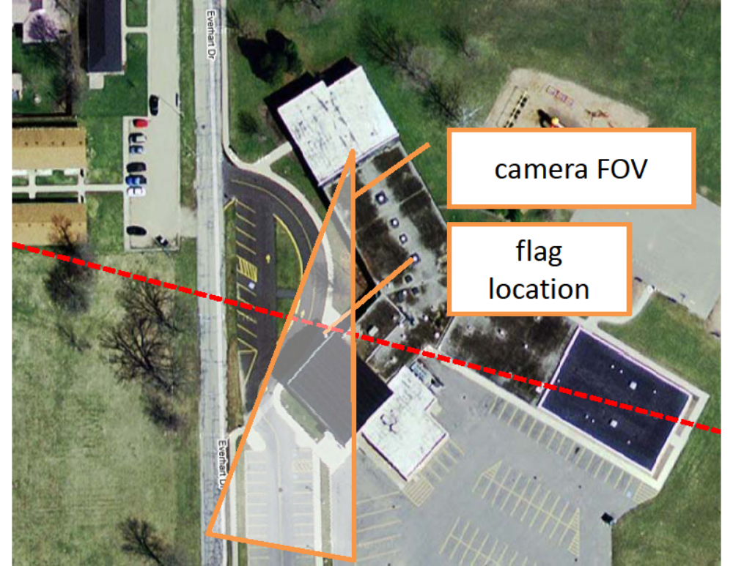
What can the wind tell us about the camera?
B

Slide 12
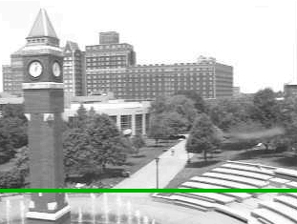
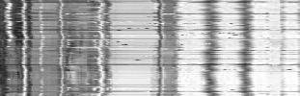
even small motions cause problems
x-t slice

Slide 13
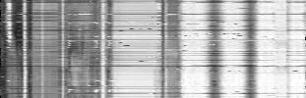
even small motions cause problems
x-t slice

Slide 14
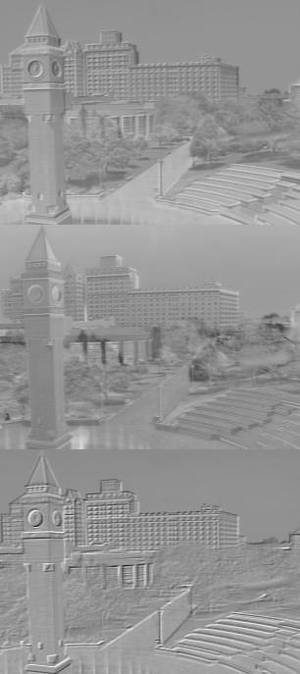
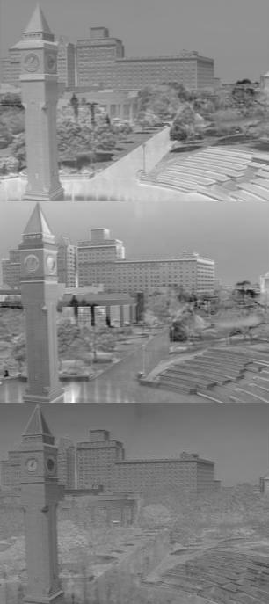
impact of alignment on PCA
principal component 1
principal component 2
principal component 3
unaligned
aligned

Slide 15
Can we do PCA across many cameras?

Slide 16
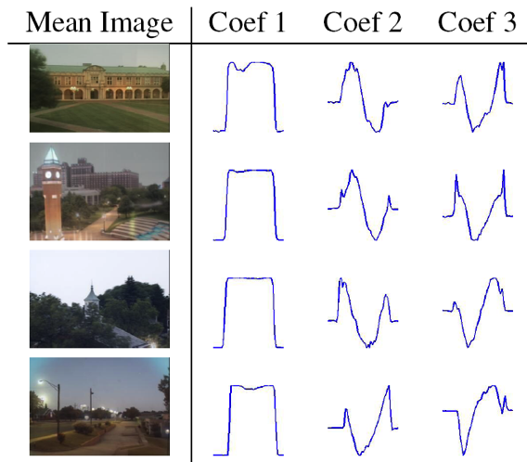
coefficients are similar across cameras
Camera 1
Camera 2
Camera 3
Camera 4
1 day

Slide 17
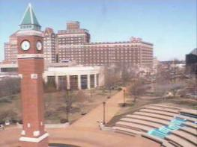
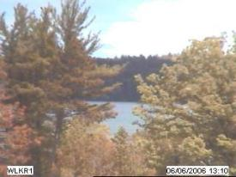
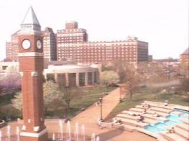
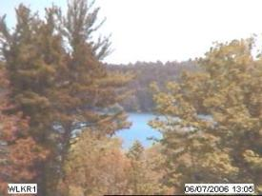
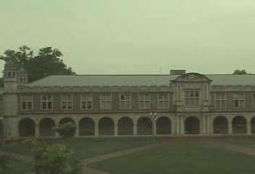
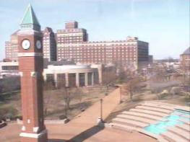
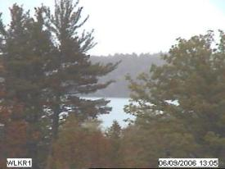
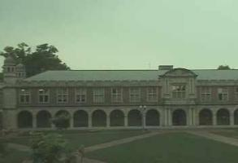
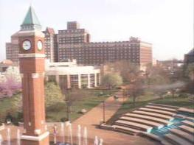
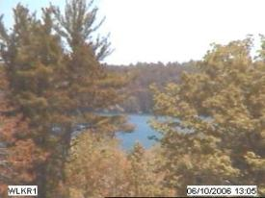
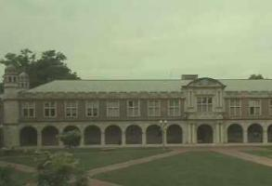
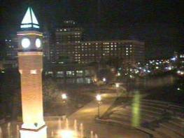
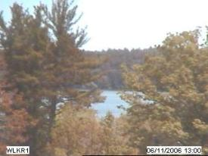
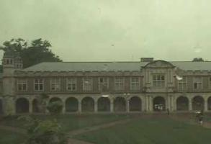
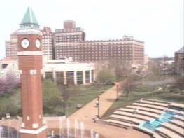
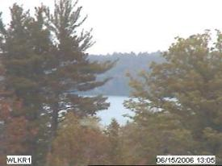
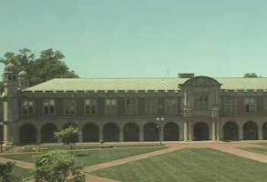
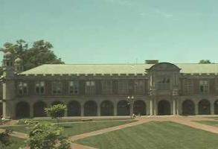
Consistent scene factorization
[
]
≈
[
]
[
]
[
]
[
]
[
]
[
]
Dawn
Dusk
Dawn
Dusk

Slide 18
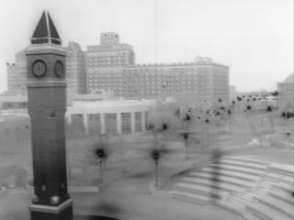
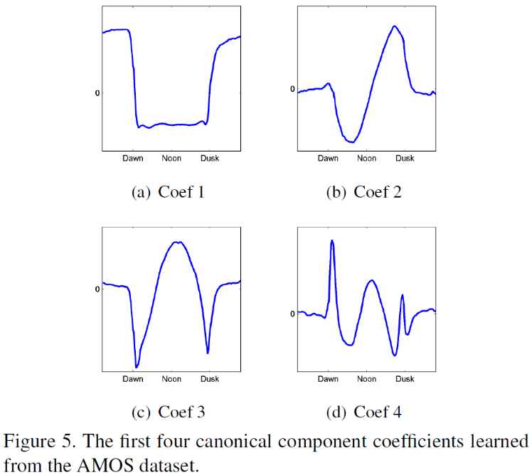
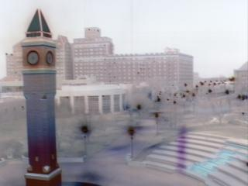
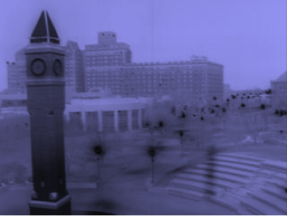
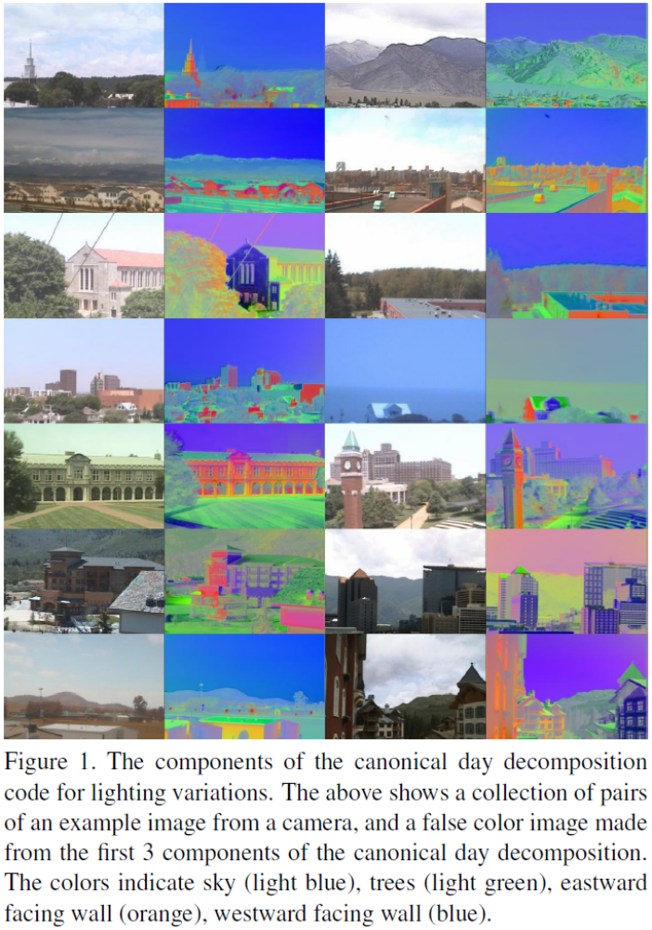
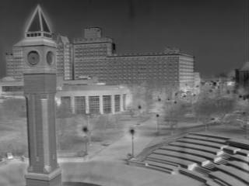
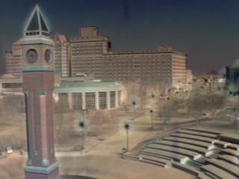
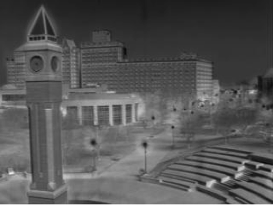
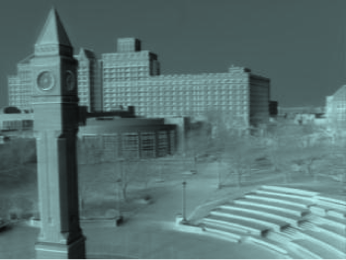
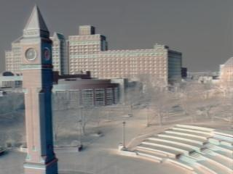
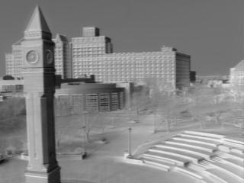
consistent labeling using consistent factorization
R
G
B
Dawn
Dusk

Slide 19
examples of consistent labeling

