Slide 1
Intrinsic image: An image which records the variation in only one physical quantity: e.g. reflectance or illumination [Barrow and Tenenbaum 1978]

Slide 2
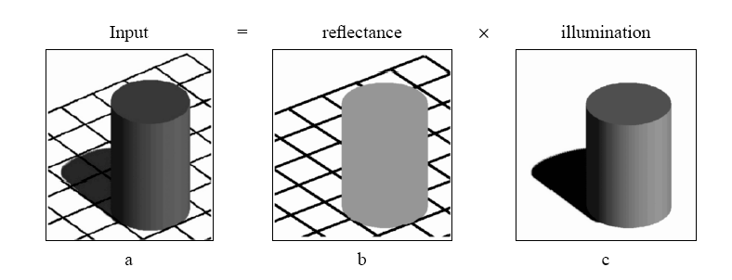
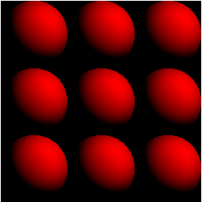
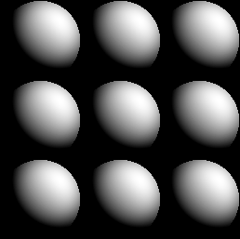
History
Input image
Reflectance (color)
information
Shading (shape)
information

Slide 3
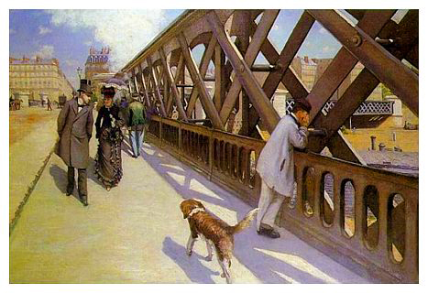
Le Pont de l'Europe (1876)
Gustave Caillebotte (1848-94)

Slide 4




Classic ill-posed problem
Denote
  the input image
  the reflectance image
  the illumination image
  Number of Unknowns is twice the number of equations.

Slide 5
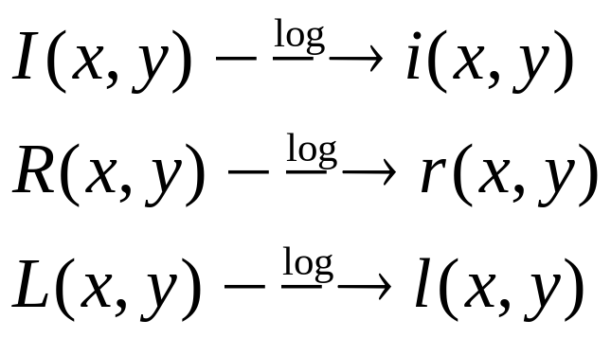

Log domain :

Slide 6
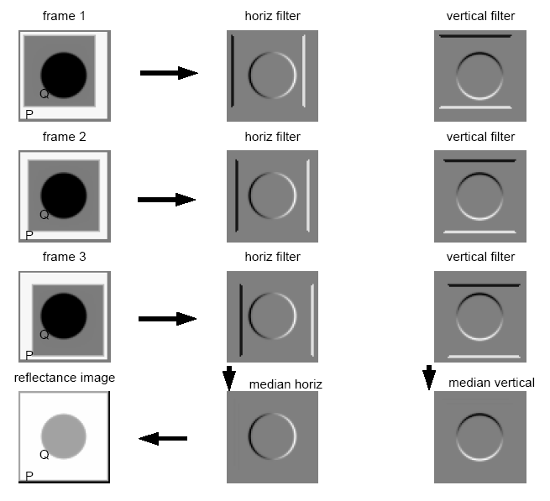
estimation algorithm
Notes:
Solve for the image that gives these derivatives.

Slide 7
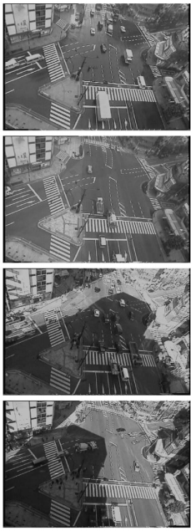
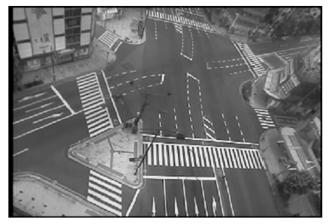
Derivatives in the log domain are independent of lighting (except at shadow boundaries).

Slide 8


estimation algorithm – cont.
Ones we have estimated
Pop quiz: how to make original images?

Slide 9

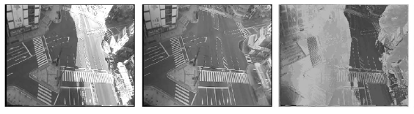

Slide 10
Can we do this with a single image?
Best paper, CVPR 2009.
Potential final project.

Slide 11
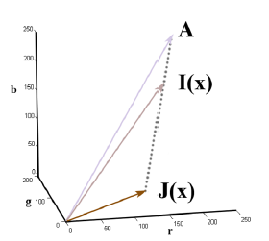
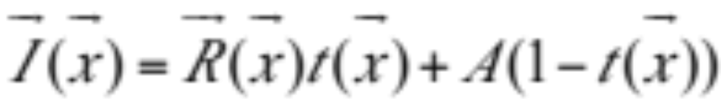
I(x) Observed intensity
R(x) Scene radiance (p(L . N))
A The global atmospheric light
t(x) atmospheric transparency

Slide 12
Observation on haze-free outdoor images:
In most of the non-sky patches, at least one color channel has very low intensity at some pixels

Slide 13
Mainly due to three factors
Shadows
Colorful objects or surfaces
Dark objects

Slide 14




haze-free image
The dark channel of haze-free image

Slide 15
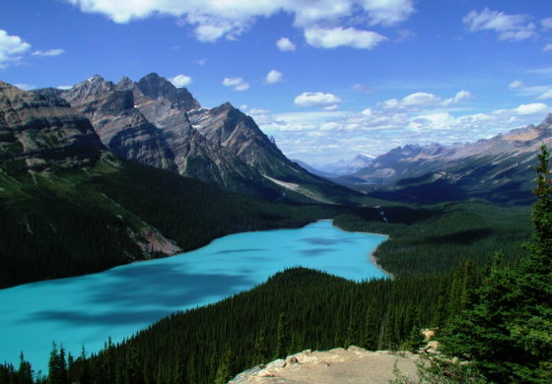
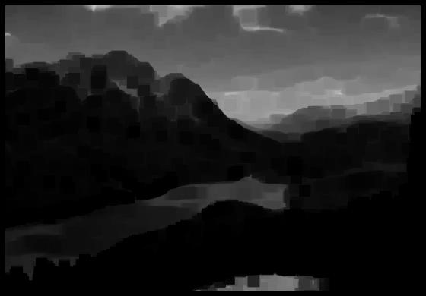

Slide 16
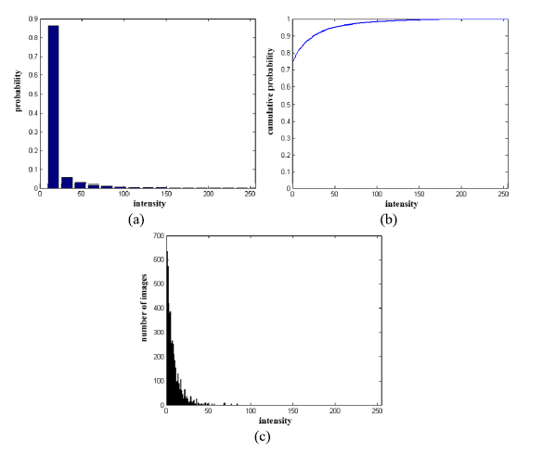
Statistics of the dark channel
Except for the sky region, the intensity of is low and tends to be zero

Slide 17
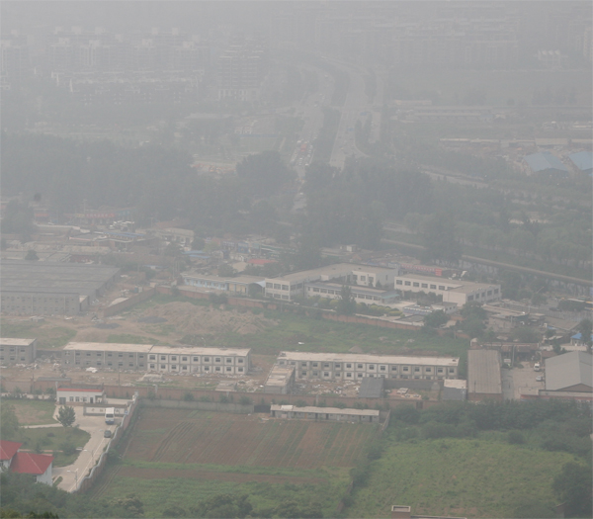
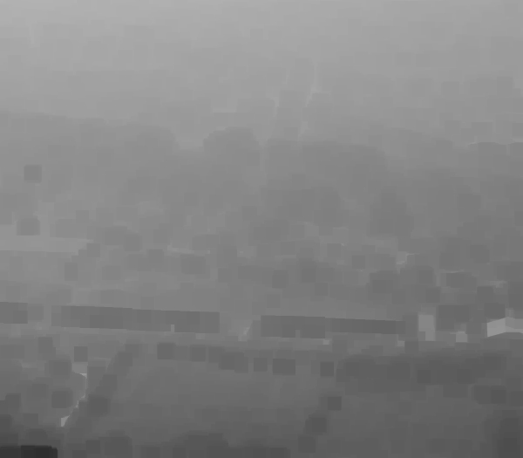
haze image
The dark channel of haze image
Visually, the intensity of the dark channel is rough
approximation of the thickness of the haze

Slide 18
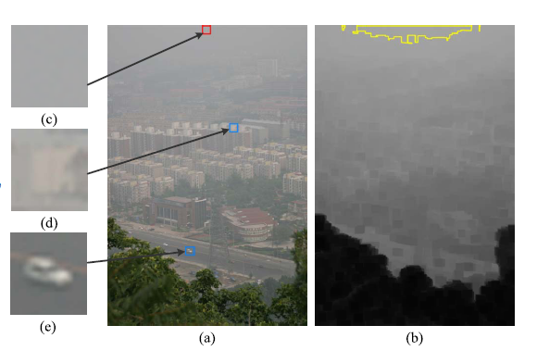
Estimate A
Pick the top 0.1% brightest pixels in the dark channel

Slide 19
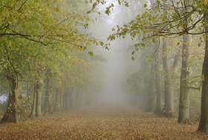

Slide 20
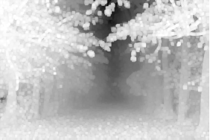

Slide 21
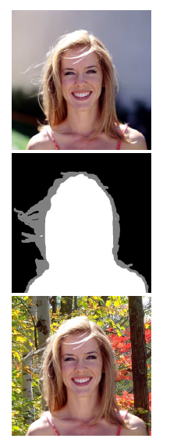
Soft Matting
Image matting equation:

Slide 22
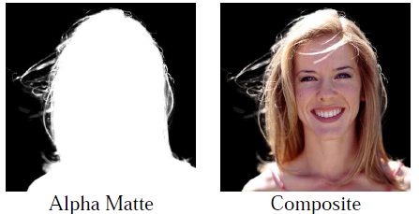
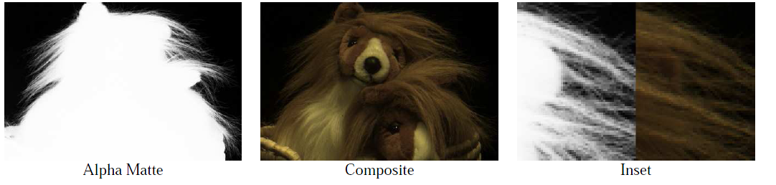
A. Levin, D. Lischinski, and Y. Weiss. A closed form solution
to natural image matting. CVPR, 1:61–68, 2006. 4, 5, 7

Slide 24
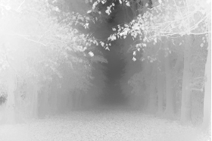

Slide 25
Result
The patch size is set to 15x15
Soft matting: Preconditioned Conjugate Gradient (PCG) algorithm
Local min operator using Marcel van Herk’s fast algorithm

Slide 26
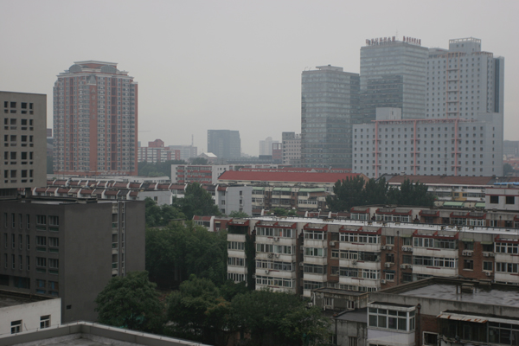

Slide 27
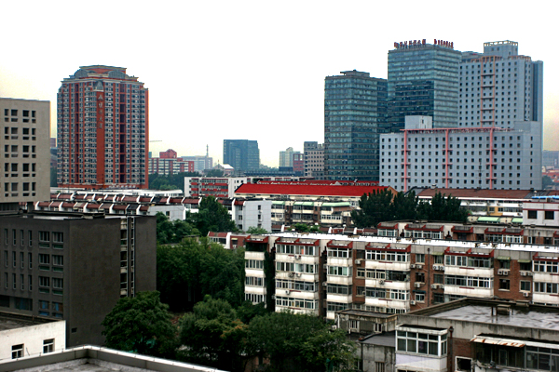

Slide 28
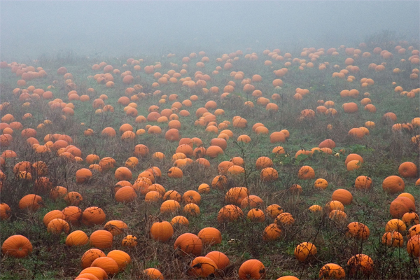

Slide 29
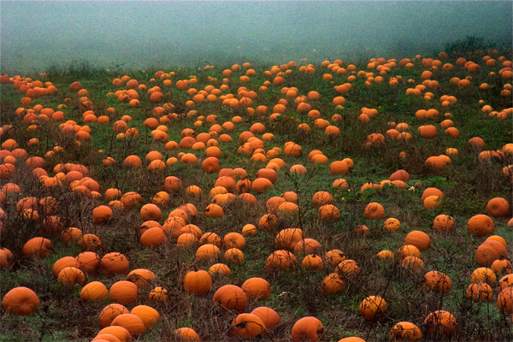

Slide 30
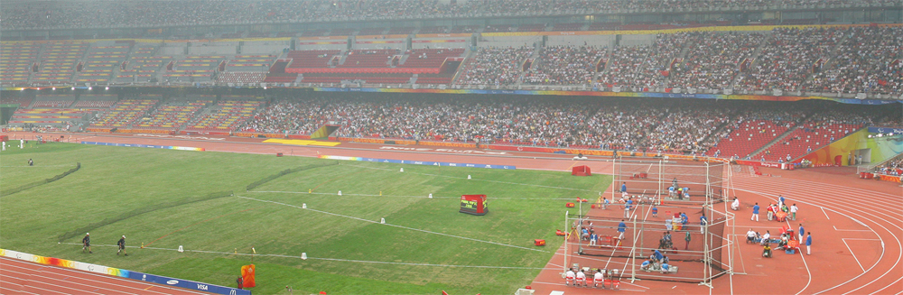

Slide 31
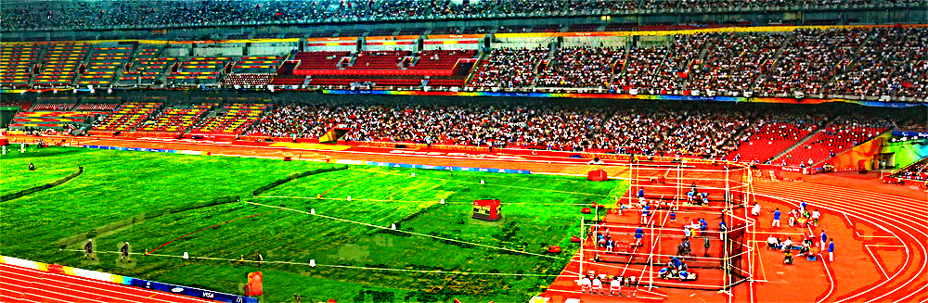
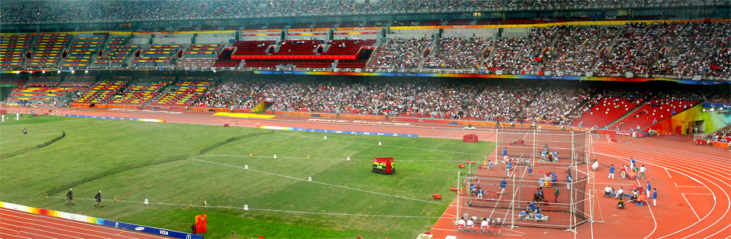
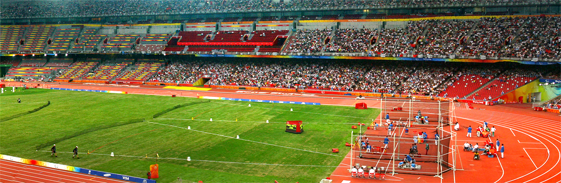
Tan's result
Fattal's result
Dark channel

Slide 32
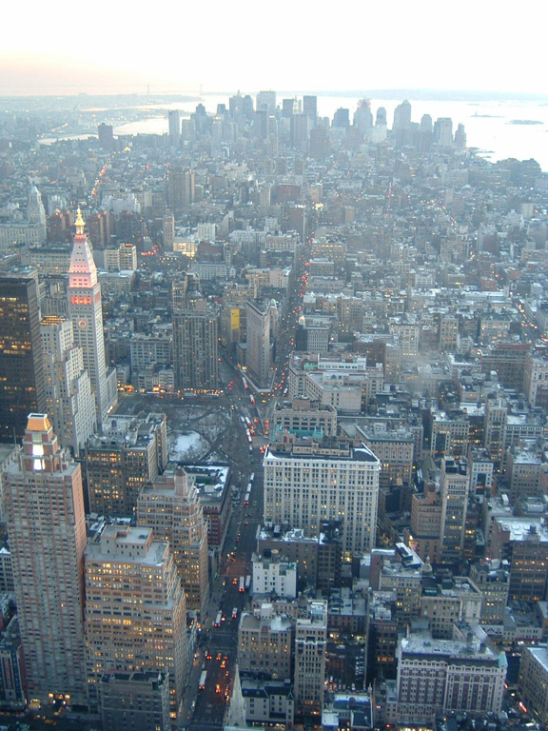

Slide 33
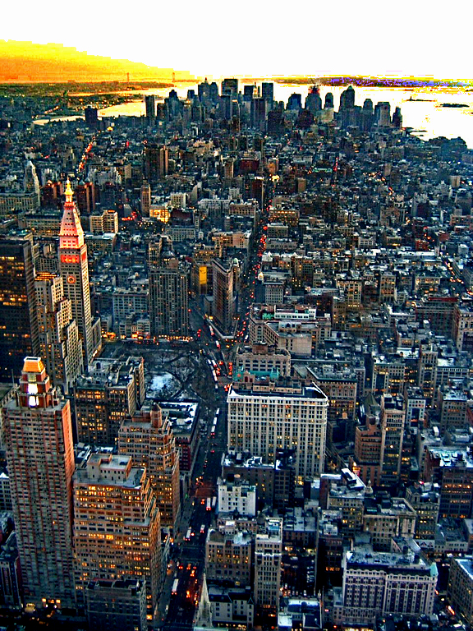
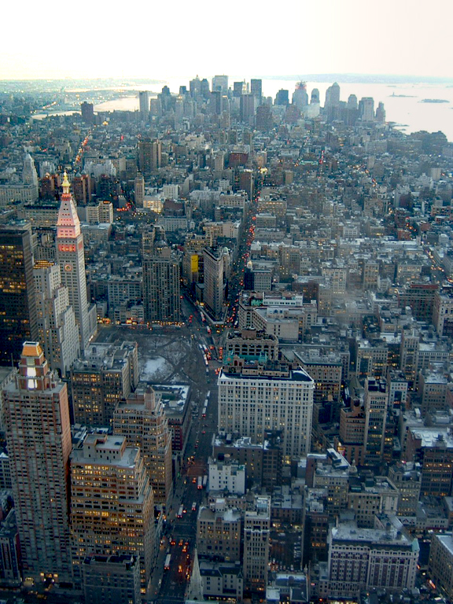
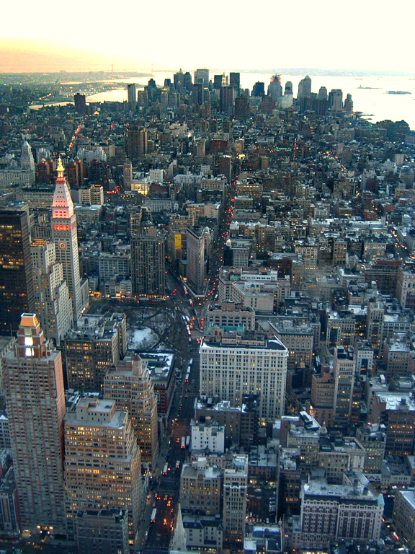
Tan's result
Fattal's result
Dark channel

Slide 34
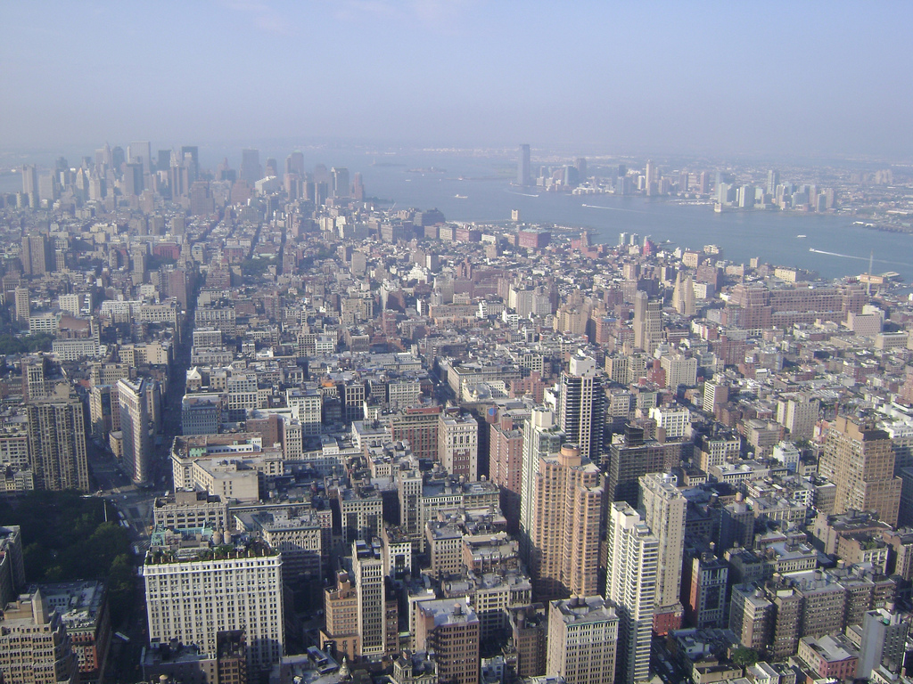

Slide 35
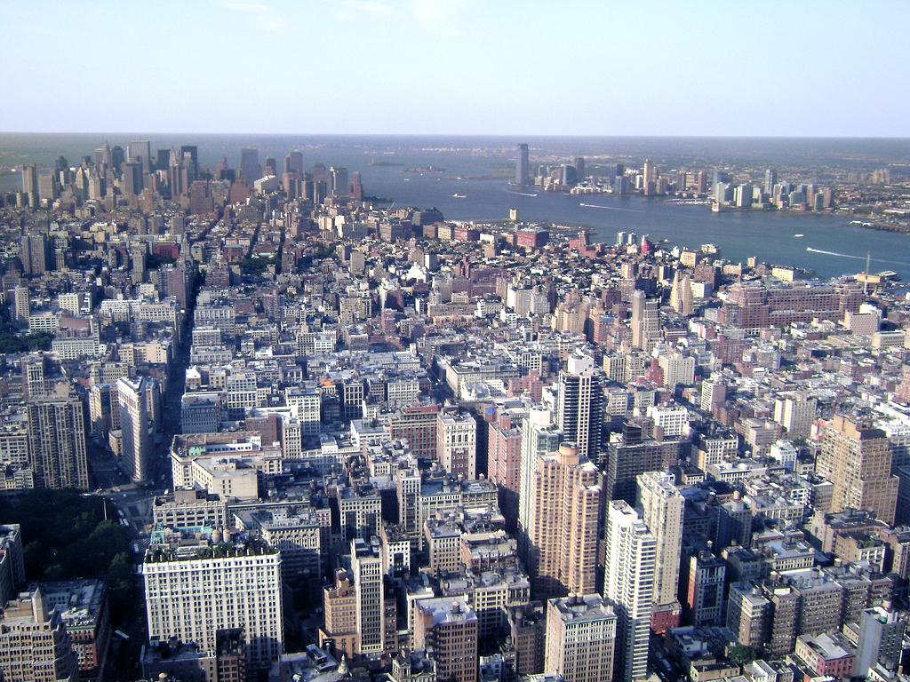
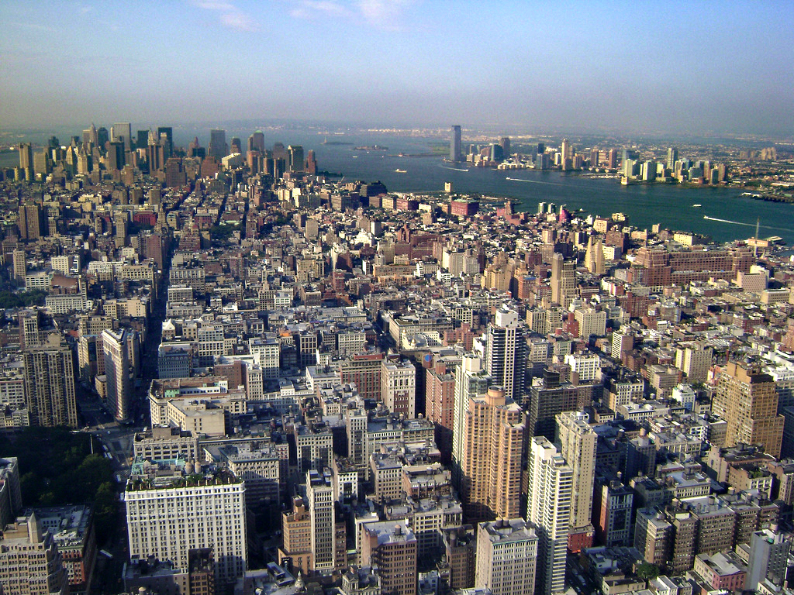
Kopf et al's result
Dark channel

Slide 36
