Slide 1
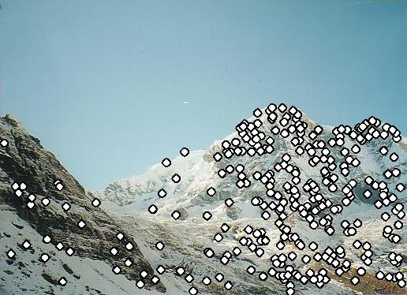
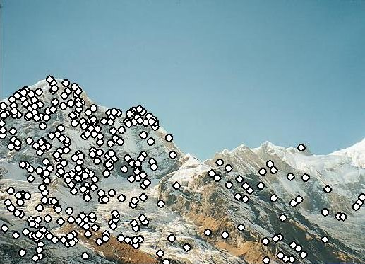
Feature matching
“What stuff in the left image matches with stuff on the right?”
Slides from Steve Seitz and Rick Szeliski

Slide 2
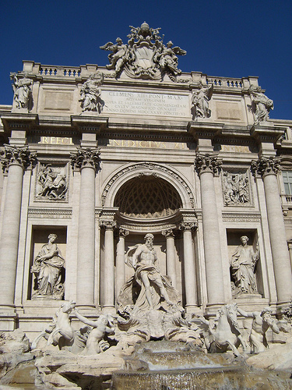
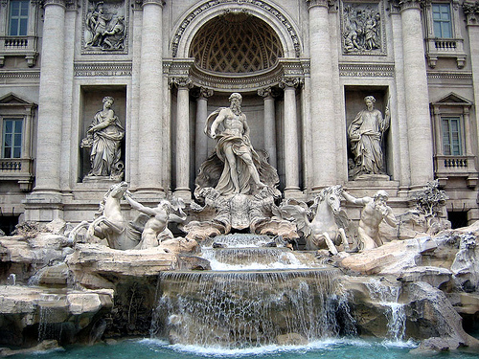
Image matching
by Diva Sian
by swashford
TexPoint fonts used in EMF.
Read the TexPoint manual before you delete this box.: AAAAAA

Slide 3
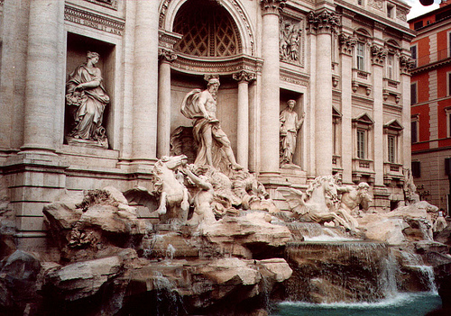
Harder case
by Diva Sian
by scgbt

Slide 4
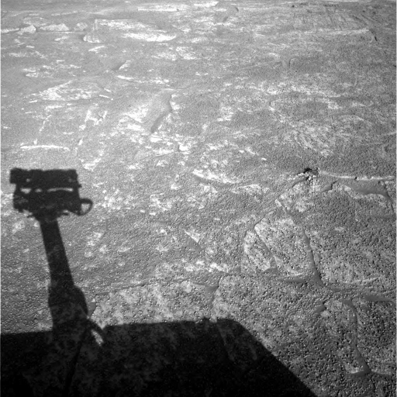
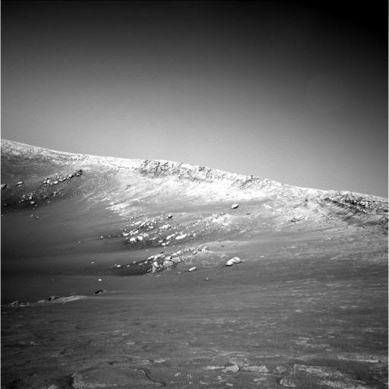
Harder still?
NASA Mars Rover images

Slide 5
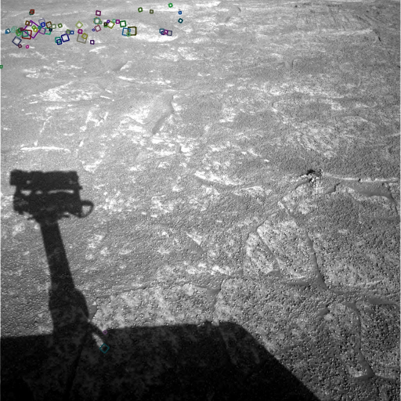
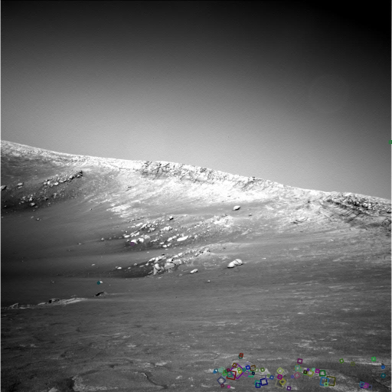
Answer below (look for tiny colored squares…)
NASA Mars Rover images
with SIFT feature matches
Figure by Noah Snavely

Slide 6


Image Matching -- Invarants
At an interesting point, let’s define a coordinate system (x,y axis)
2) Use the coordinate system to pull out a patch at that point

Slide 7


Image Matching

Slide 8
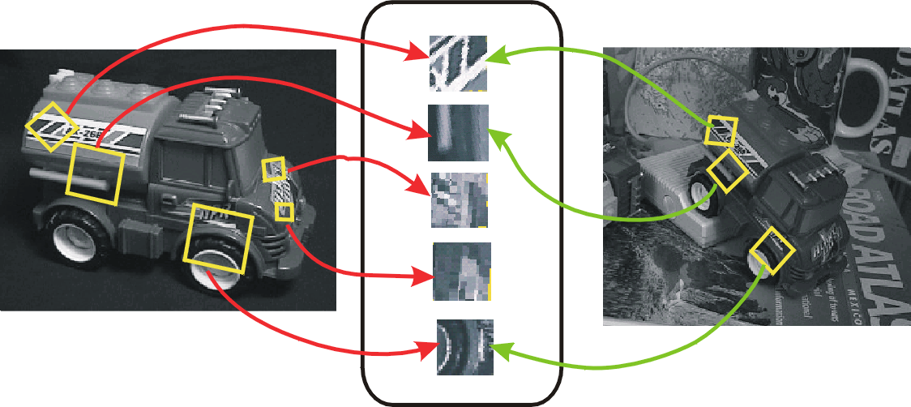
Invariant local features
-Algorithm for finding points and representing their patches should produce similar results even when conditions vary
-Buzzword is “invariance”
  geometric invariance: translation, rotation, scale
  photometric invariance: brightness, exposure, …
Feature Descriptors

Slide 9
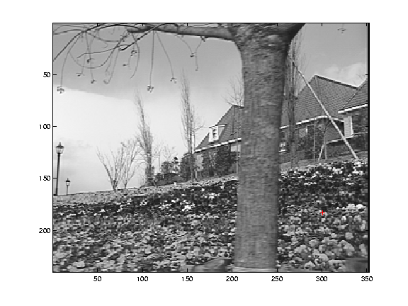
What makes a good feature?
Say we have 2 images of this scene we’d like to align by matching local features
What would be the good local features (ones easy to match)?

Slide 10
Want uniqueness
Look for image regions that are unusual
  Lead to unambiguous matches in other images
How to define “unusual”?

Slide 11
Local measures of uniqueness
Suppose we only consider a small window of pixels
  What defines whether a feature is a good or bad candidate?
Slide adapted from Darya Frolova, Denis Simakov, Weizmann Institute.
Notes:
High level idea is that corners are good. You want to find windows that contain strong gradients AND gradients oriented in more than one direction

Slide 12
Feature detection
Local measure of feature uniqueness
  How does the window change when you shift it?
  Shifting the window in any direction causes a big change
“flat” region:
no change in all directions
“edge”:
no change along the edge direction
“corner”:
significant change in all directions
Slide adapted from Darya Frolova, Denis Simakov, Weizmann Institute.

Slide 13
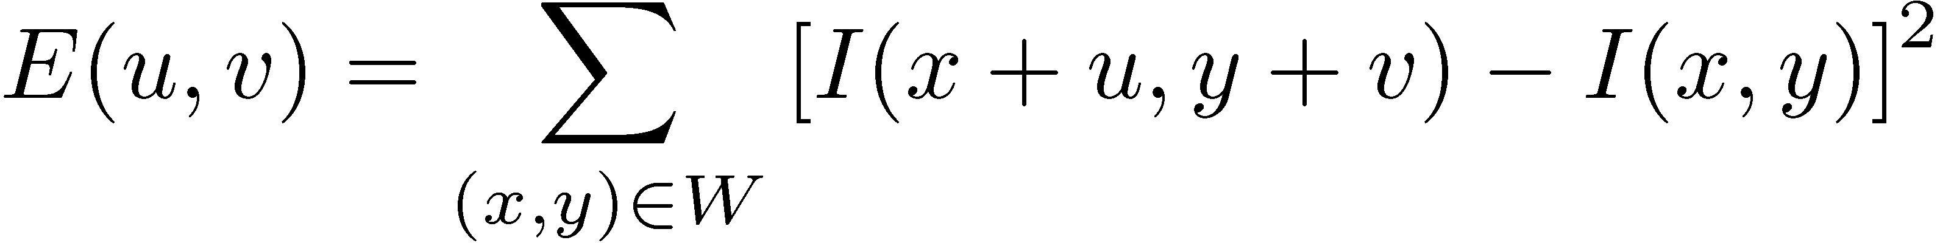
Feature detection: the math
Consider shifting the window W by (u,v)
  how do the pixels in W change?
  compare each pixel before and after by
  summing up the squared differences (SSD)
  this defines an SSD “error” of E(u,v):
W

Slide 14
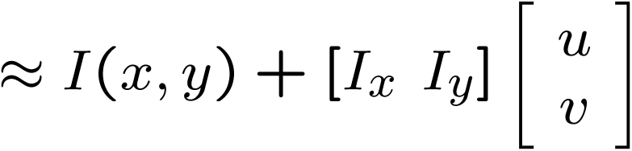

Small motion assumption
Taylor Series expansion of I:
If the motion (u,v) is small, then first order approx is good
Plugging this into the formula on the previous slide…

Slide 15
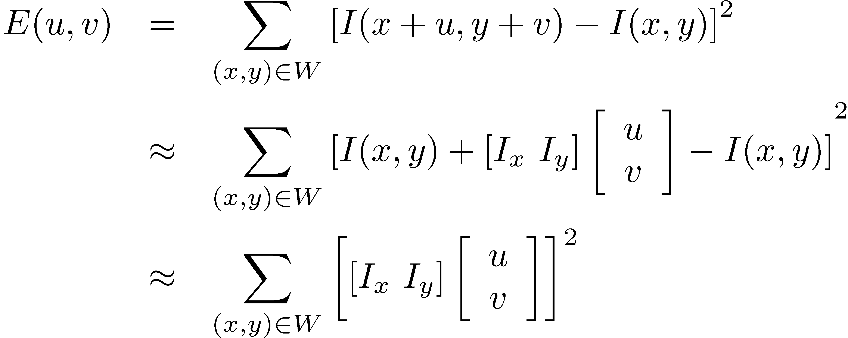
Feature detection: the math
Consider shifting the window W by (u,v)
  how do the pixels in W change?
  compare each pixel before and after by
  summing up the squared differences
  this defines an “error” of E(u,v):
W

Slide 16
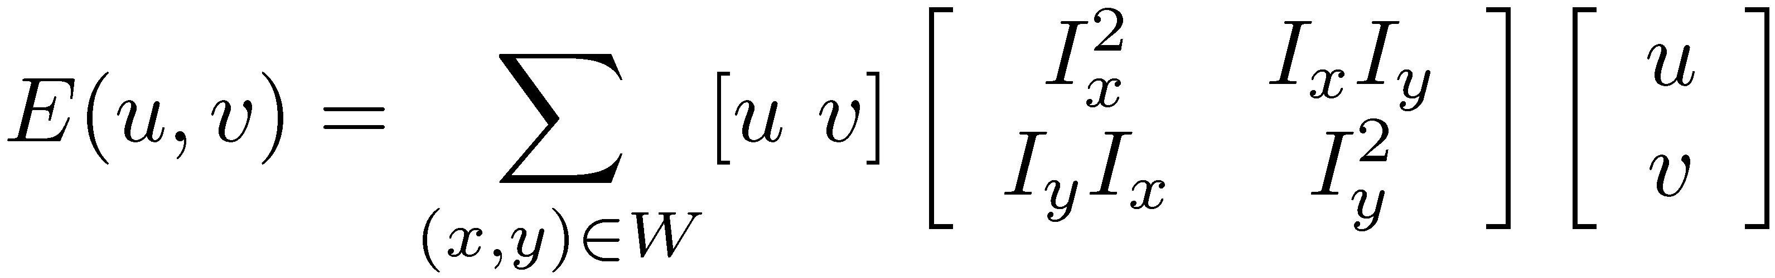


Feature detection: the math
This can be rewritten:
For the example above
  You can move the center of the green window to anywhere on the blue unit circle
  Which directions will result in the largest and smallest E values?
  We can find these directions by looking at the eigenvectors of H

Slide 17

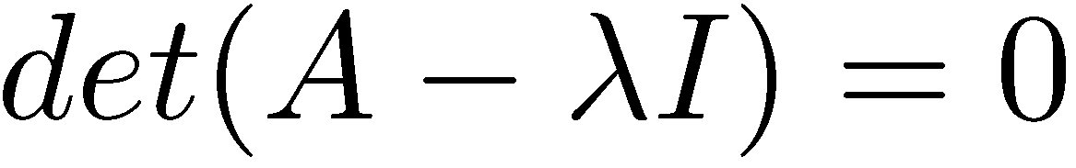
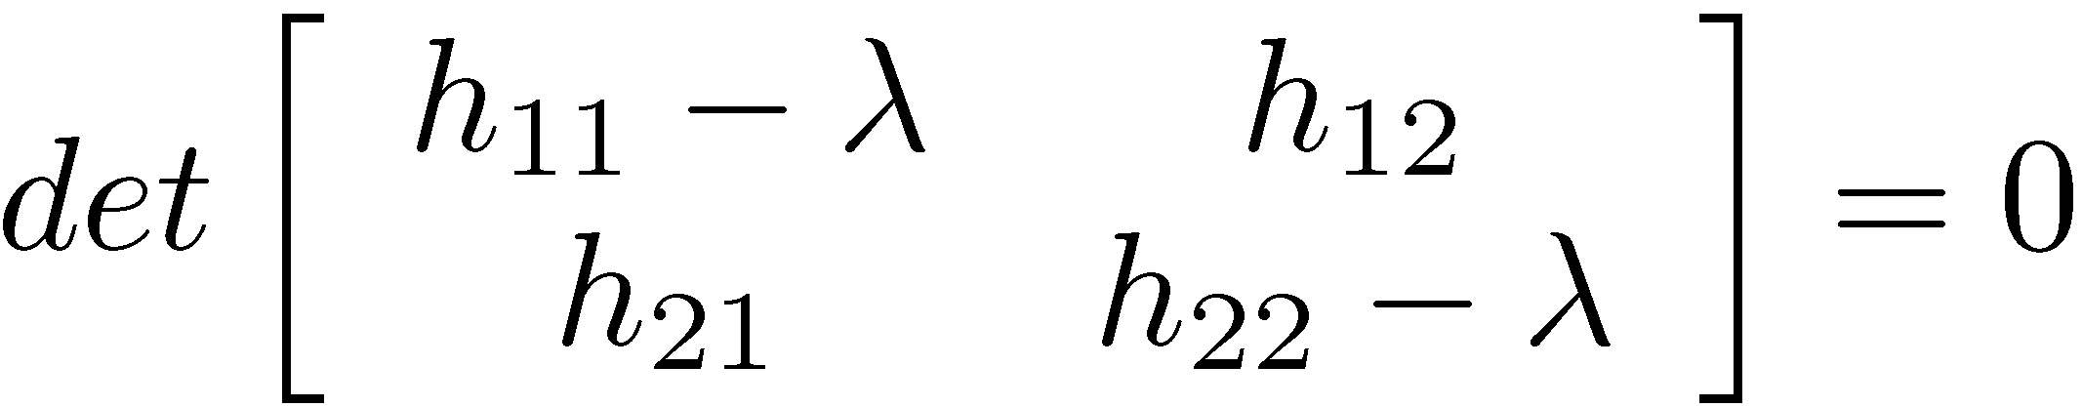
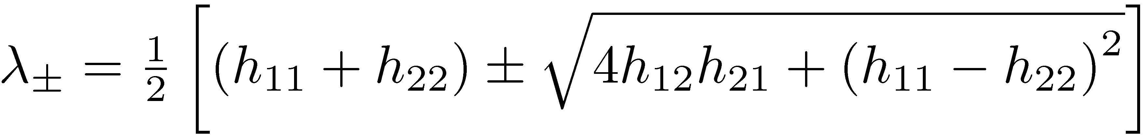
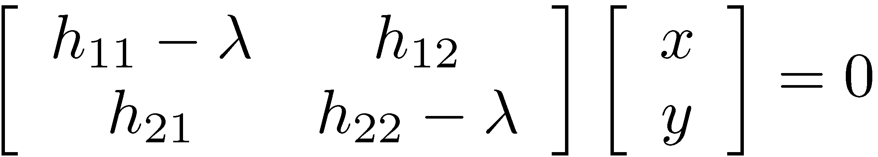
Quick eigenvalue/eigenvector review
The eigenvectors of a matrix A are the vectors x that satisfy:
The scalar λ is the eigenvalue corresponding to x
  The eigenvalues are found by solving:
  In our case, A = H is a 2x2 matrix, so we have
  The solution:
Once you know λ, you find x by solving

Slide 18
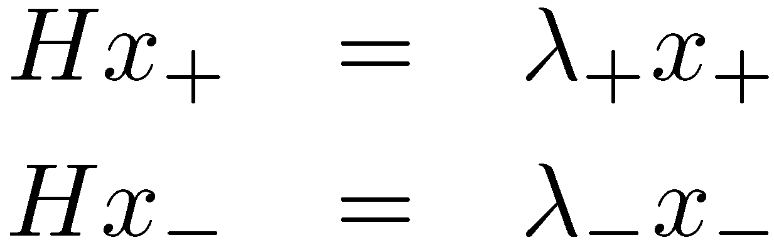
Feature detection: the math
x₋
x₊
Eigenvalues and eigenvectors of H
  Define shifts with the smallest and largest change (E value)
  x₊ = direction of largest increase in E.
  λ₊ = amount of increase in direction x₊
  x₋ = direction of smallest increase in E.
  λ- = amount of increase in direction x₊

Slide 19
Feature detection: the math
How are λ₊, x₊, λ₋, and x₊ relevant for feature detection?
  What’s our feature scoring function?

Slide 20


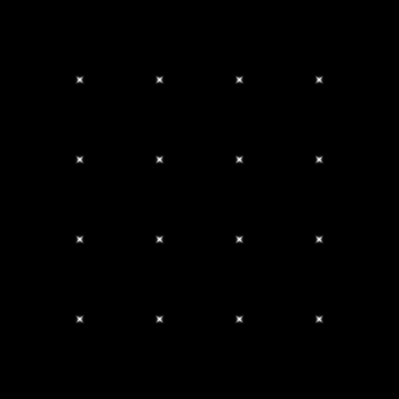

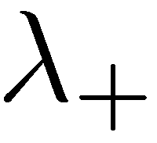

Feature detection: the math
How are λ₊, x₊, λ₋, and x₊ relevant for feature detection?
  What’s our feature scoring function?
Want E(u,v) to be large for small shifts in all directions
  the minimum of E(u,v) should be large, over all unit vectors [u v]
  this minimum is given by the smaller eigenvalue (λ₋) of H

Slide 21
Feature detection summary
Here’s what you do
  Compute the gradient at each point in the image
  Create the H matrix from the entries in the gradient
  Compute the eigenvalues.
  Find points with large response (λ₋ > threshold)
  Choose those points where λ₋ is a local maximum as features

Slide 22

Feature detection summary
Here’s what you do
  Compute the gradient at each point in the image
  Create the H matrix from the entries in the gradient
  Compute the eigenvalues.
  Find points with large response (λ₋ > threshold)
  Choose those points where λ₋ is a local maximum as features

Slide 23
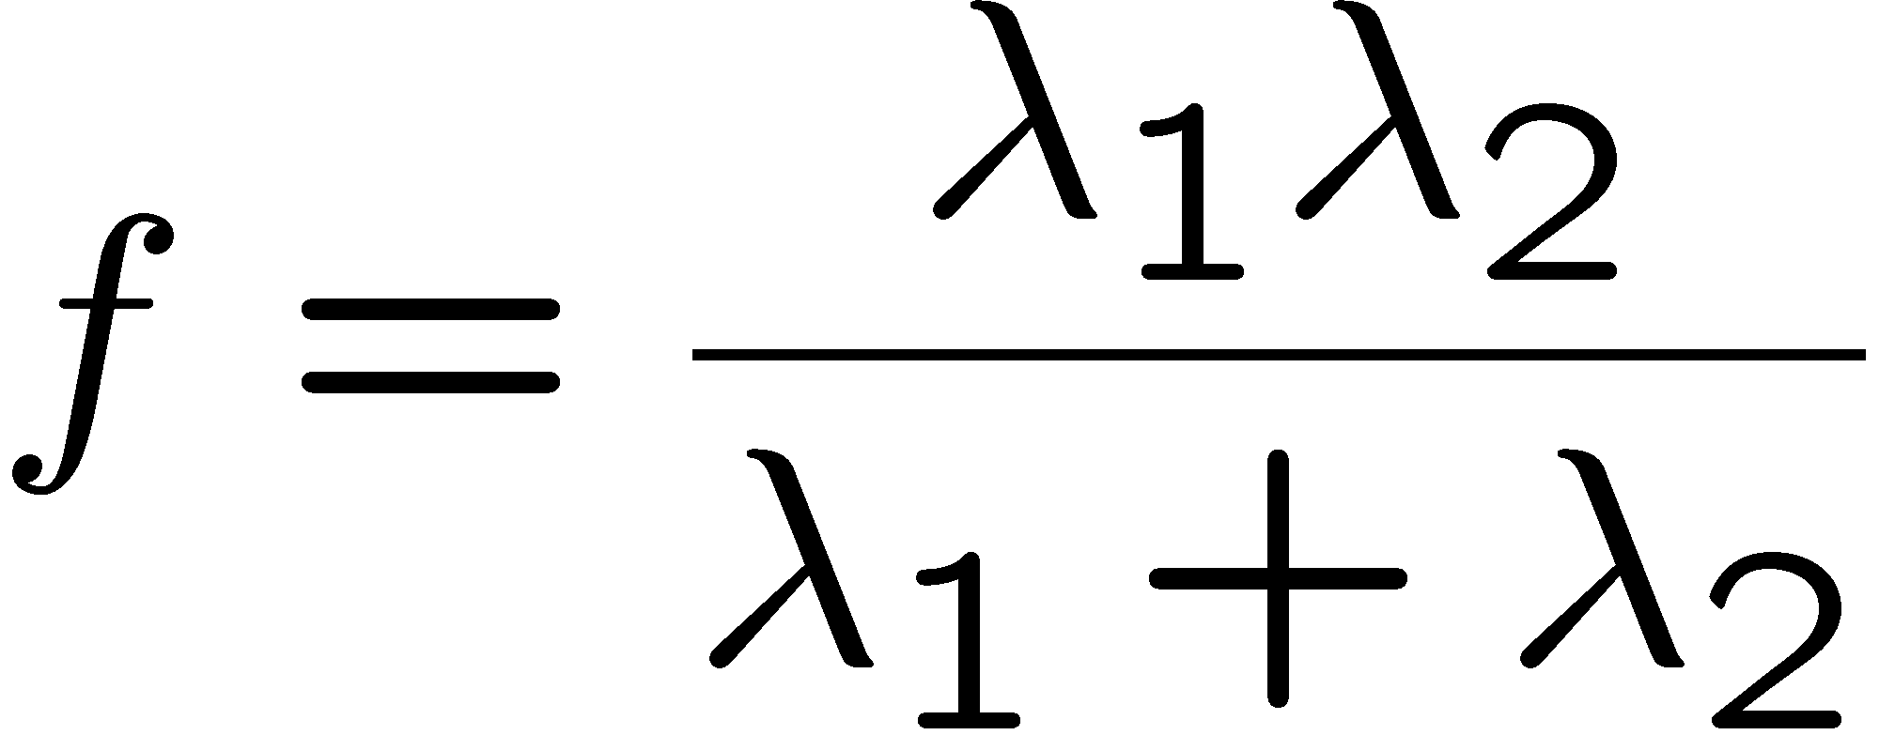
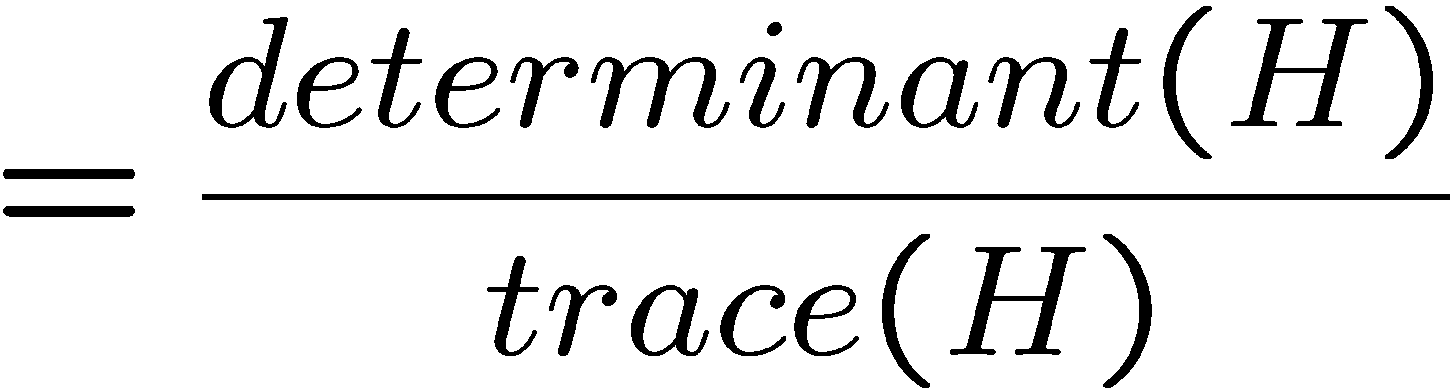
The Harris operator
λ₋ is a variant of the “Harris operator” for feature detection
  The trace is the sum of the diagonals, i.e., trace(H) = h₁₁ + h₂₂
  Very similar to λ₋ but less expensive (no square root)
  Called the “Harris Corner Detector” or “Harris Operator”
  Lots of other detectors, this is one of the most popular

Slide 24

The Harris operator
Harris
operator

Slide 25
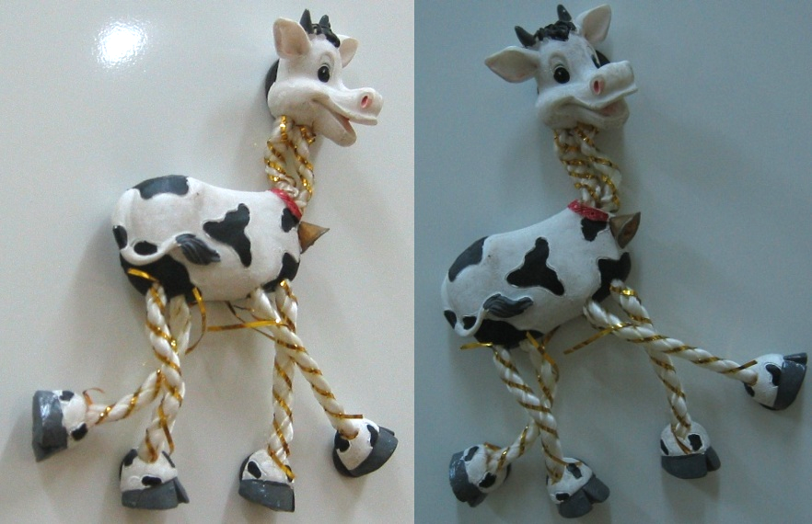
Harris detector example

Slide 26
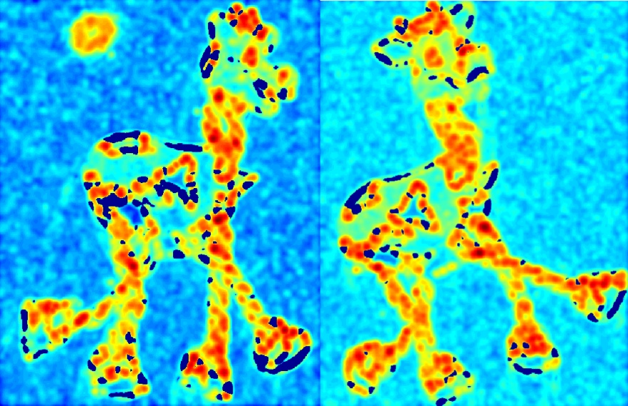
f value (red high, blue low)

Slide 27
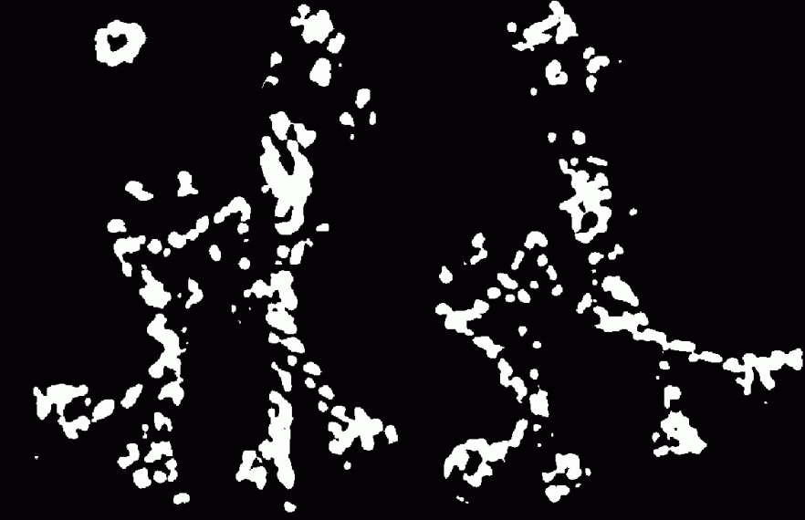
Threshold (f > value)

Slide 28
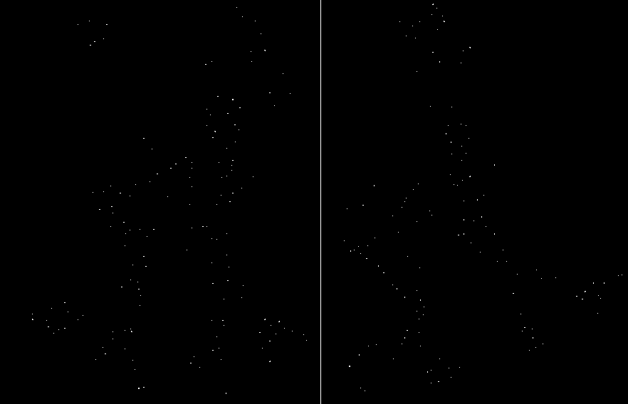
Find local maxima of f

Slide 29
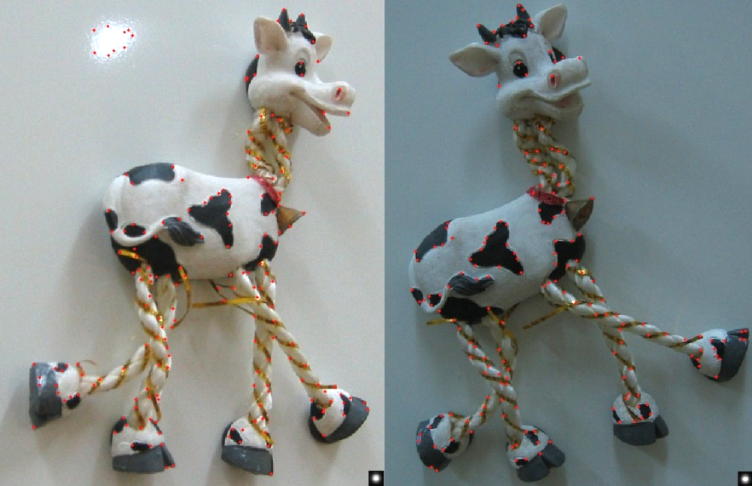
Harris features (in red)
The tops of the horns are detected in both images

Slide 30
Invariance
Suppose you rotate the image by some angle
  Will you still pick up the same features?
What if you change the brightness?
Scale?
Notes:
Rotation: yes (with some caveats—image resampling errors…)
Change brightness: probably, but will have to adjust thresholds
Scale: no, generally.

Slide 31
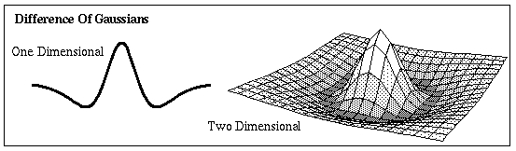
Scale invariant detection
Suppose you’re looking for corners
Key idea: find scale that gives local maximum of f
  f is a local maximum in both position and scale
  Common definition of f: Laplacian
  (or difference between two Gaussian filtered images with different sigmas)
Notes:
Show other scales and how the feature looks less corner like

Slide 32
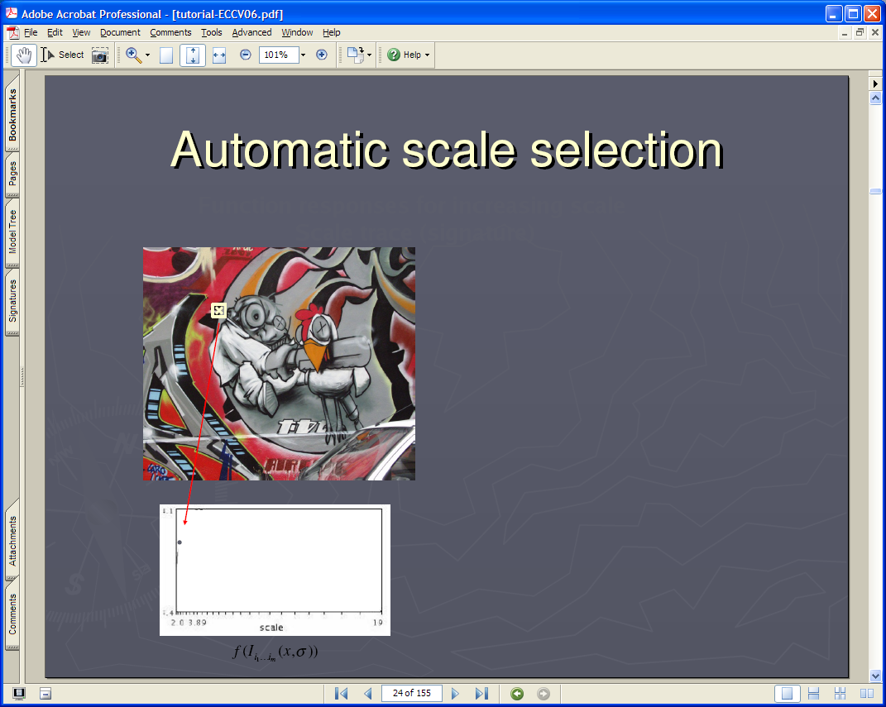
Lindeberg et al, 1996
Lindeberg et al., 1996
Slide from Tinne Tuytelaars
Slide from Tinne Tuytelaars

Slide 33


Slide 34


Slide 35


Slide 36
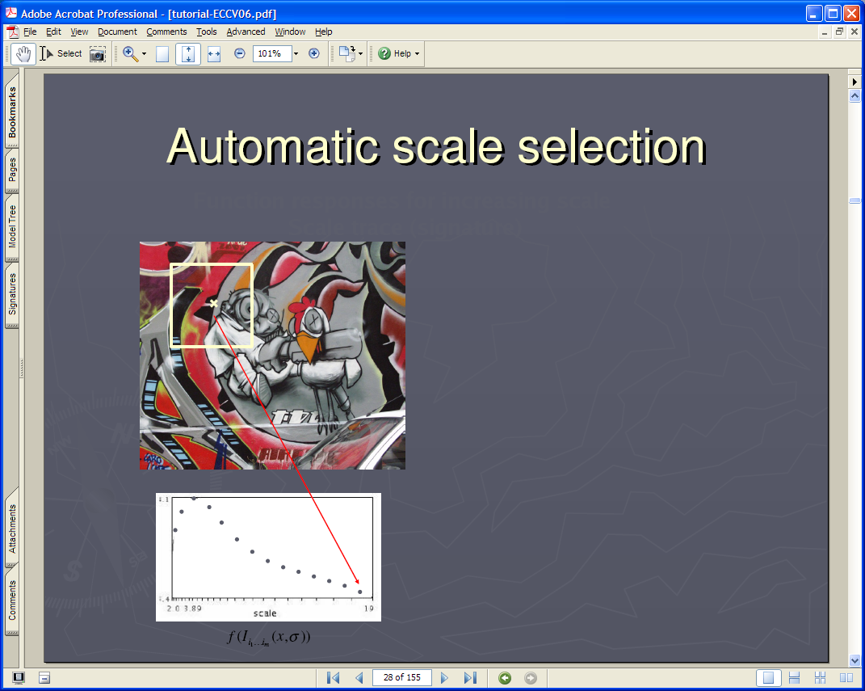

Slide 37


Slide 38
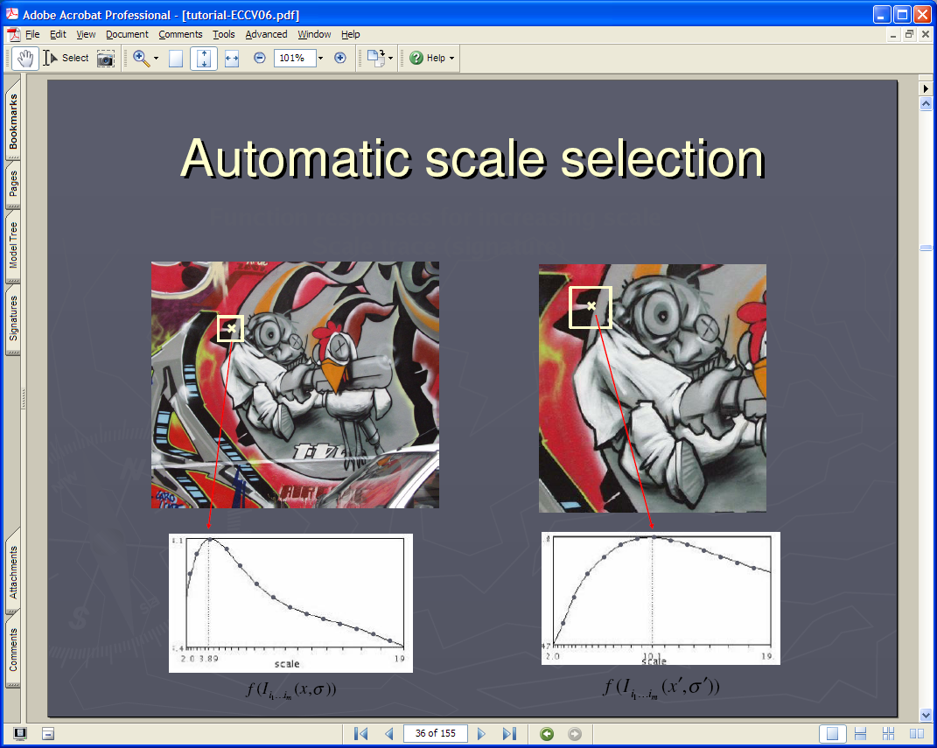

Slide 39
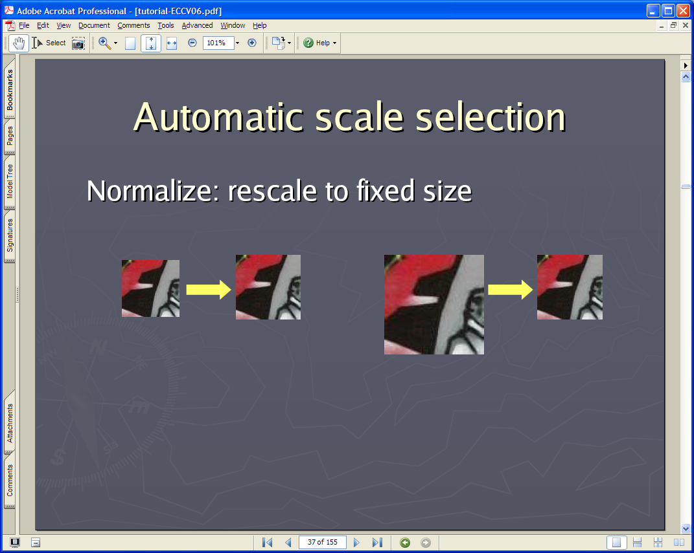

Slide 40
Feature descriptors
We know how to detect good points
Next question: How to match them?
?

Slide 41
Feature descriptors
We know how to detect good points
Next question: How to match them?
Lots of possibilities (this is a popular research area)
  Simple option: match square windows around the point
  State of the art approach: SIFT
    David Lowe, UBC http://www.cs.ubc.ca/~lowe/keypoints/
?

Slide 42
Invariance
Suppose we are comparing two images I₁ and I₂
  I₂ may be a transformed version of I₁
  What kinds of transformations are we likely to encounter in practice?

Slide 43
Invariance
Suppose we are comparing two images I₁ and I₂
  I₂ may be a transformed version of I₁
  What kinds of transformations are we likely to encounter in practice?
We’d like to find the same features regardless of the transformation
  This is called transformational invariance
  Most feature methods are designed to be invariant to
    Translation, 2D rotation, scale
  They can usually also handle
    Limited 3D rotations (SIFT works up to about 60 degrees)
    Limited affine transformations (2D rotation, scale, shear)
    Limited illumination/contrast changes

Slide 44
How to achieve invariance
Need both of the following:
Make sure your detector is invariant
  Harris is invariant to translation and rotation
  Scale is trickier
    common approach is to detect features at many scales using a Gaussian pyramid (e.g., MOPS)
    More sophisticated methods find “the best scale” to represent each feature (e.g., SIFT)
2. Design an invariant feature descriptor
  A descriptor captures the information in a region around the detected feature point
  The simplest descriptor: a square window of pixels
    What’s this invariant to?
  Let’s look at some better approaches…

Slide 45
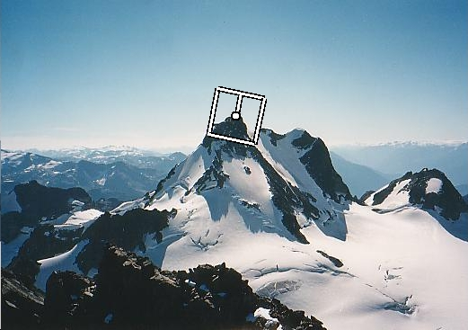
Rotation invariance for feature descriptors
Find dominant orientation of the image patch
  This is given by x₊, the eigenvector of H corresponding to λ₊
    λ₊ is the larger eigenvalue
  Rotate the patch according to this angle
Figure by Matthew Brown

Slide 46
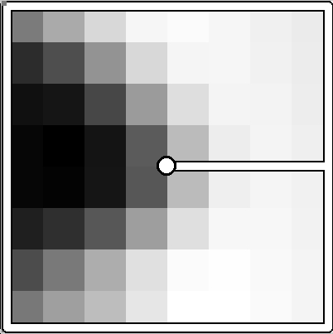
Multiscale Oriented PatcheS descriptor
Take 40x40 square window around detected feature
  Scale to 1/5 size (using prefiltering)
  Rotate to horizontal
  Sample 8x8 square window centered at feature
  Intensity normalize the window by subtracting the mean, dividing by the standard deviation in the window (both window I and aI+b will match)
40 pixels
8 pixels
CSE 576: Computer Vision
Adapted from slide by Matthew Brown

Slide 47
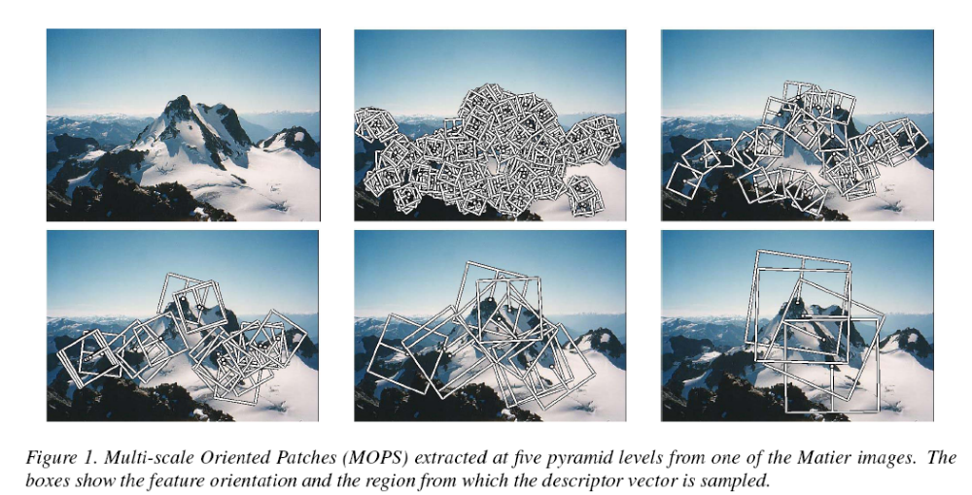
Detections at multiple scales

Slide 48
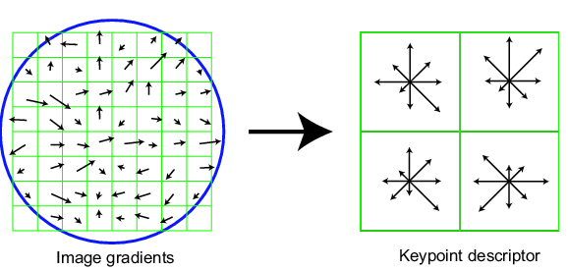
Scale Invariant Feature Transform
Basic idea:
  Take 16x16 square window around detected feature
  Compute edge orientation (angle of the gradient - 90°) for each pixel
  Throw out weak edges (threshold gradient magnitude)
  Create histogram of surviving edge orientations
0
2π
angle histogram
Adapted from slide by David Lowe

Slide 49
SIFT descriptor
Full version
  Divide the 16x16 window into a 4x4 grid of cells (2x2 case shown below)
  Compute an orientation histogram for each cell
  16 cells * 8 orientations = 128 dimensional descriptor
Adapted from slide by David Lowe

Slide 50
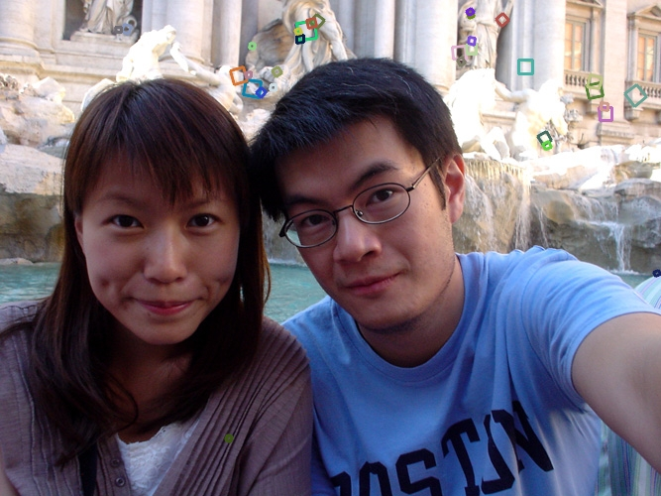
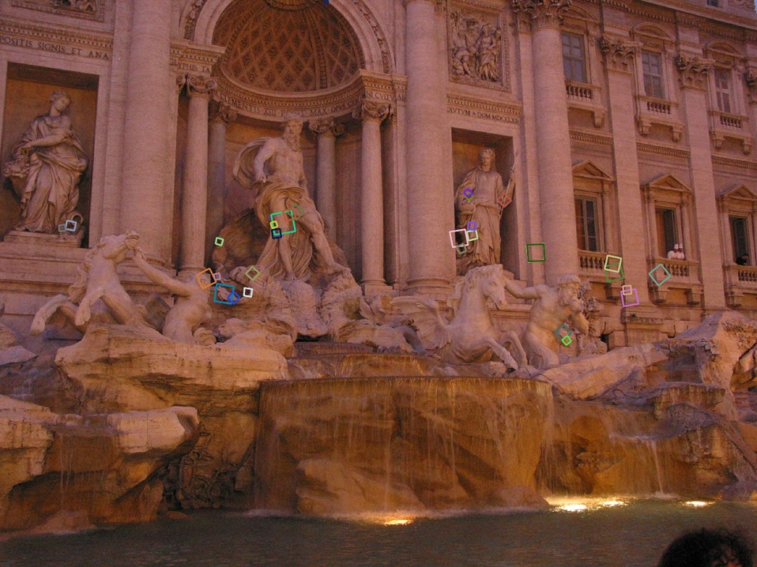
Properties of SIFT
Extraordinarily robust matching technique
  Can handle changes in viewpoint
    Up to about 60 degree out of plane rotation
  Can handle significant changes in illumination
    Sometimes even day vs. night (below)
  Fast and efficient—can run in real time
  Lots of code available
    http://people.csail.mit.edu/albert/ladypack/wiki/index.php/Known_implementations_of_SIFT

Slide 51
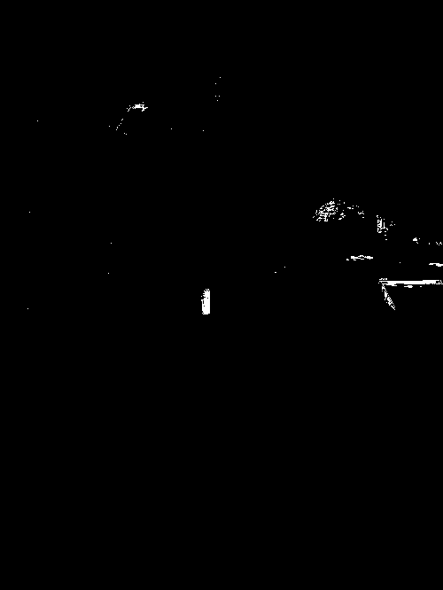
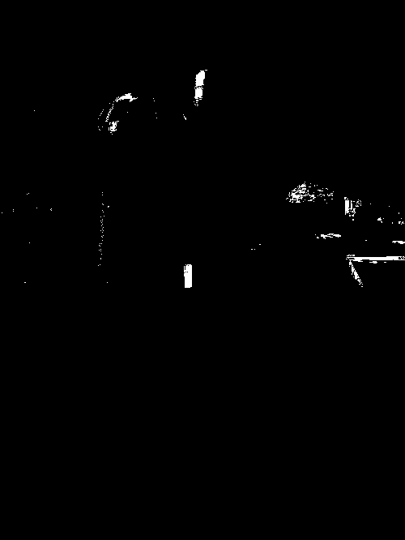
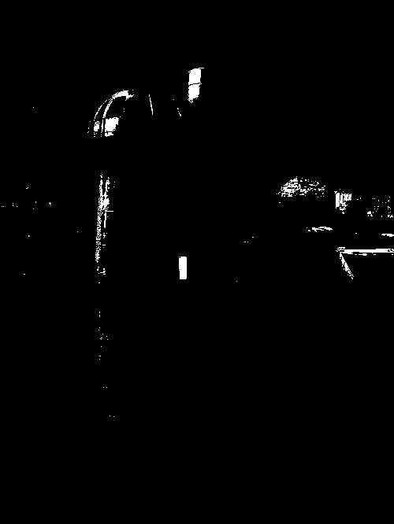
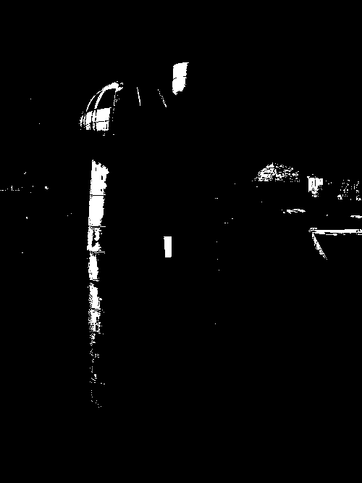
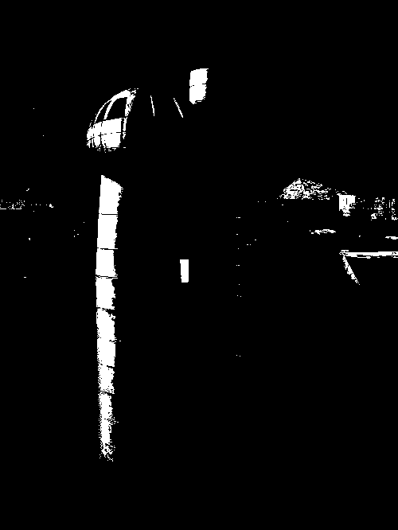
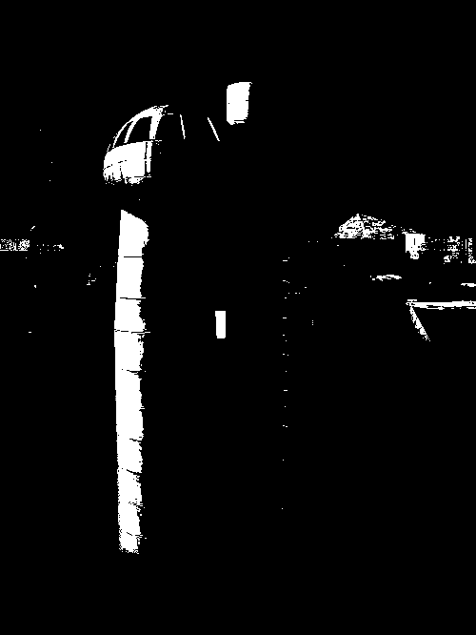
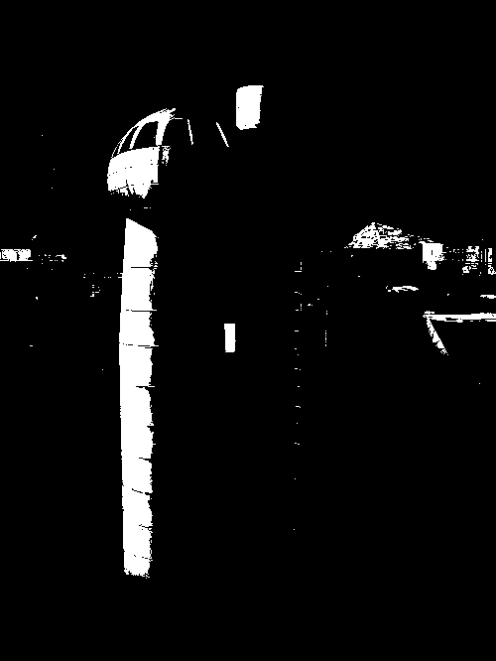



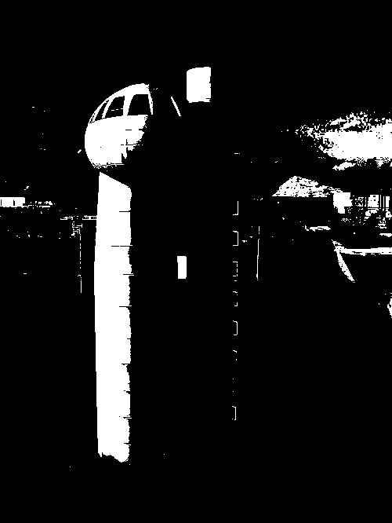
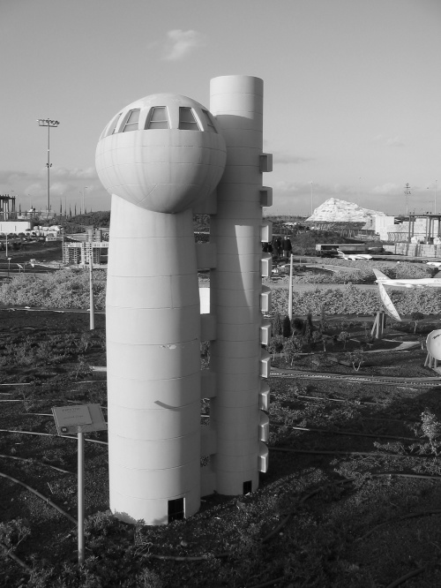
Maximally Stable Extremal Regions
J.Matas et.al. “Distinguished Regions for Wide-baseline Stereo”. BMVC 2002.
Maximally Stable Extremal Regions
  Threshold image intensities: I > thresh
  for several increasing values of thresh
  Extract connected components
  (“Extremal Regions”)
  Find a threshold when region is “Maximally Stable”, i.e. local minimum
  of the relative growth
  Approximate each region with
  an ellipse

Slide 52
Feature matching
Given a feature in I₁, how to find the best match in I₂?
  Define distance function that compares two descriptors
  Test all the features in I₂, find the one with min distance

Slide 53
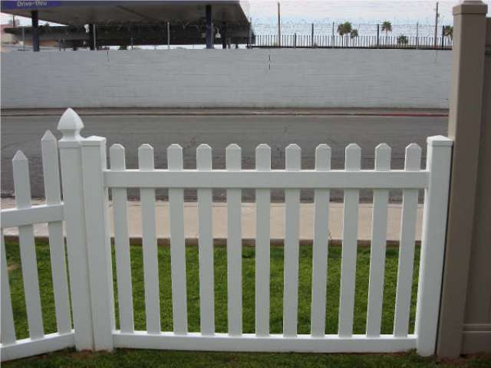
Feature distance
How to define the difference between two features f₁, f₂?
  Simple approach is SSD(f₁, f₂)
    sum of square differences between entries of the two descriptors
    can give good scores to very ambiguous (bad) matches
f₁
f₂
I₁
I₂

Slide 54
Feature distance
How to define the difference between two features f₁, f₂?
  Better approach: ratio distance = SSD(f₁, f₂) / SSD(f₁, f₂’)
    f₂ is best SSD match to f₁ in I₂
    f₂’ is 2nd best SSD match to f₁ in I₂
    gives small values for ambiguous matches
f₁
f₂'
f₂
I₁
I₂

Slide 55
Evaluating the results
How can we measure the performance of a feature matcher?
50
75
200
feature distance

Slide 56
True/false positives
The distance threshold affects performance
  True positives = # of detected matches that are correct
    Suppose we want to maximize these—how to choose threshold?
  False positives = # of detected matches that are incorrect
    Suppose we want to minimize these—how to choose threshold?
50
true match
75
200
false match
feature distance

Slide 57
Evaluating the results
How can we measure the performance of a feature matcher?
1
0.7
# true positives
# matching features (positives)
true
positive
rate
0
1
false positive rate
0.1
# false positives
# unmatched features (negatives)

Slide 58
Evaluating the results
How can we measure the performance of a feature matcher?
ROC curve (“Receiver Operator Characteristic”)
1
0.7
# true positives
# matching features (positives)
true
positive
rate
0
1
false positive rate
0.1
# false positives
# unmatched features (negatives)
ROC Curves
  Generated by counting # current/incorrect matches, for different threholds
  Want to maximize area under the curve (AUC)
  Useful for comparing different feature matching methods
  For more info: http://en.wikipedia.org/wiki/Receiver_operating_characteristic

Slide 59


More on feature detection/description

Slide 60
Lots of applications
Features are used for:
  Image alignment (e.g., mosaics)
  3D reconstruction
  Motion tracking
  Object recognition
  Indexing and database retrieval
  Robot navigation
  … other

Slide 61


Object recognition (David Lowe)

