Slide 1
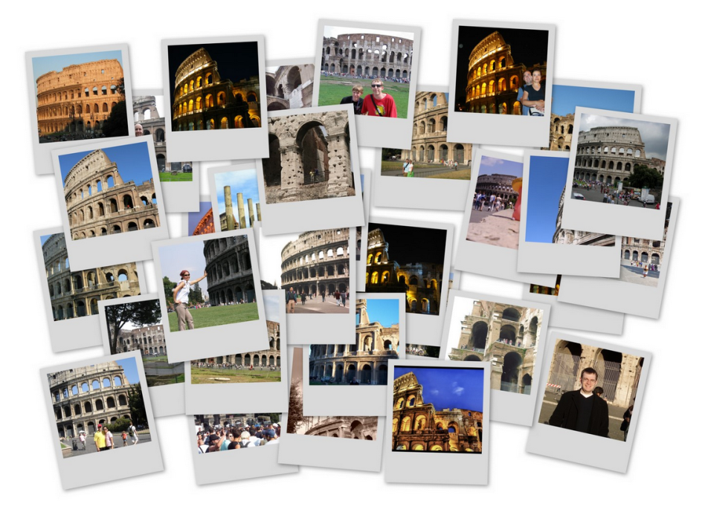
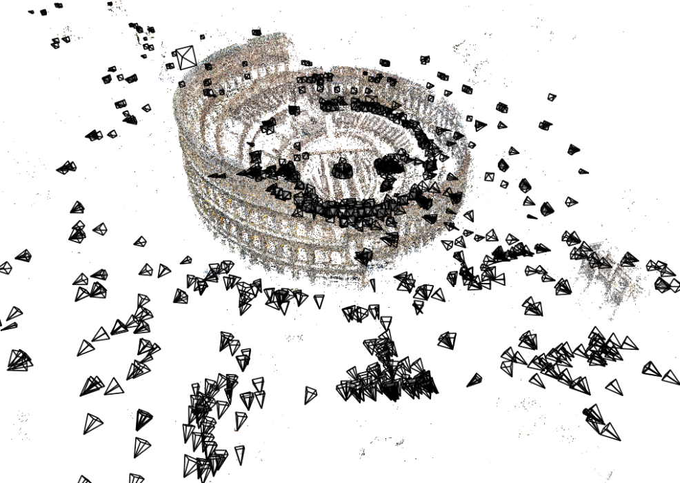
Noah Snavely

Slide 2
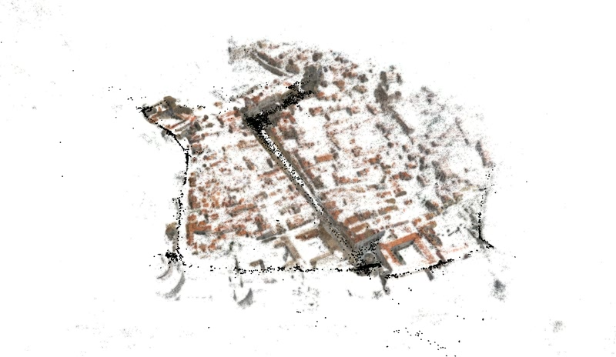
Large-scale structure from motion
Dubrovnik, Croatia. 4,619 images (out of an initial 57,845).
Total reconstruction time: 23 hours
Number of cores: 352

Slide 3
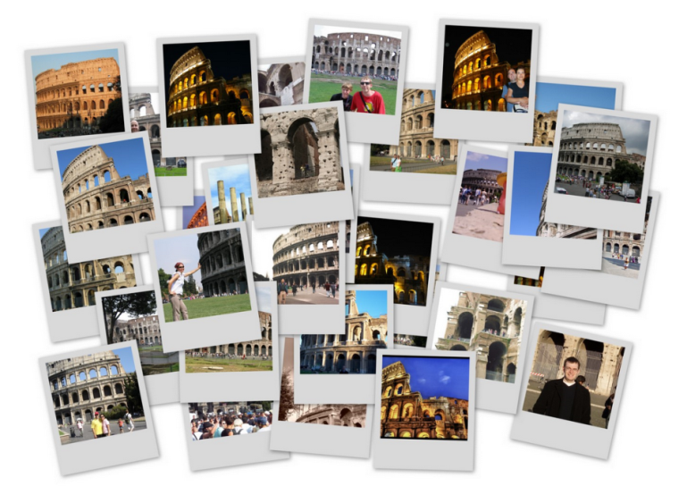

Structure from motion
Given many images, how can we
  a) figure out where they were all taken from?
  b) build a 3D model of the scene?
  This is (roughly) the structure from motion problem

Slide 4
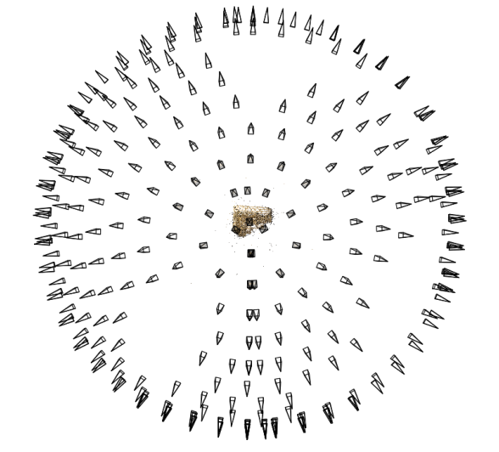
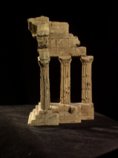
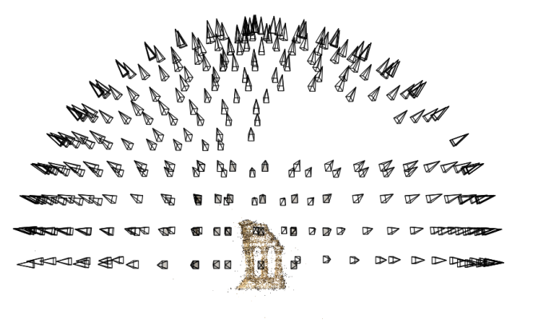
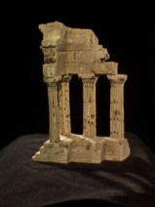
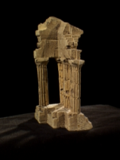
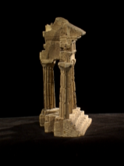
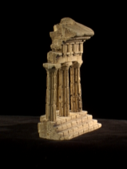
Structure from motion
Reconstruction (side)
(top)
Input: images with points in correspondence p_{i,j} = (u_{i,j},v_{i,j})
Output
  structure: 3D location x_{i} for each point p_{i}
  motion: camera parameters R_{j} , t_{j} possibly K_{j}
Objective function: minimize reprojection error

Slide 5
Camera calibration and triangulation
Suppose we know 3D points
  And have matches between these points and an image
  How can we compute the camera parameters?
Suppose we have know camera parameters, each of which observes a point
  How can we compute the 3D location of that point?

Slide 6
Structure from motion
SfM solves both of these problems at once
A kind of chicken-and-egg problem
  (but solvable)

Slide 7
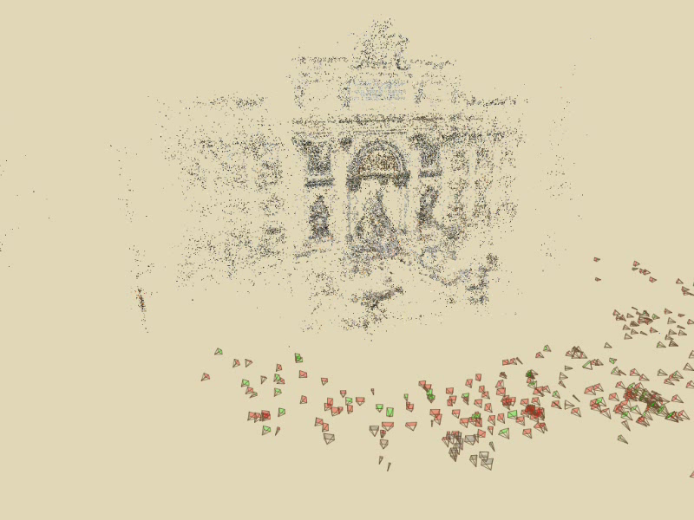
Photo Tourism
Notes:
Here’s how the same set of photos appear in our photo explorer. Our system takes the set of photos and automatically determines the relative positions and orientations from which each photo was taken. We can then load the photos into our immersive 3D browser where the user can visualize and explore the photos using spatial relationships.

Slide 8
First step: how to get correspondence?
Feature detection and matching

Slide 9
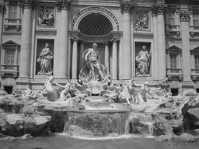
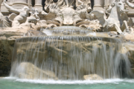
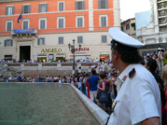
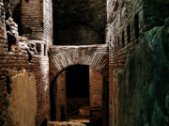
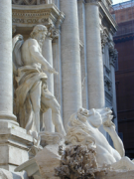
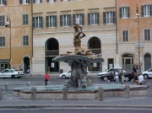
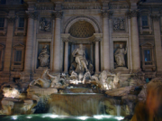
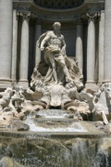
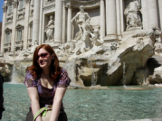
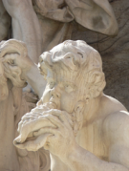
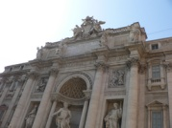
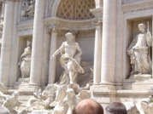
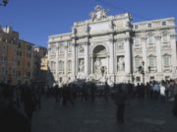
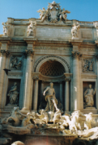
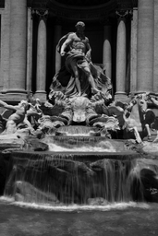
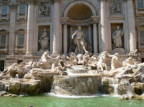
Feature detection
Detect features using SIFT [Lowe, IJCV 2004]
Notes:
So, we begin by detecting SIFT features in each photo.
[We detect SIFT features in each photo, resulting in a set of feature locations and 128-byte feature descriptors…]

Slide 10


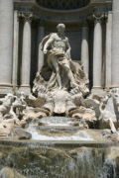

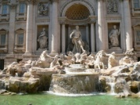
Feature detection
Detect features using SIFT [Lowe, IJCV 2004]

Slide 11
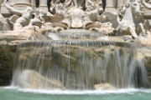



Feature matching
Match features between each pair of images
Notes:
Next, we match features across each pair of photos using approximate nearest neighbor matching.

Slide 12


Feature matching
Refine matching using RANSAC to estimate fundamental matrix between each pair
Notes:
The matches are refined by using RANSAC, which is a robust model-fitting technique, to estimate a fundamental matrix between each pair of matching images and keeping only matches consistent with that fundamental matrix.
We then link connected components of pairwise feature matches together to form correspondences across multiple images.
Once we have correspondences, we run structure from motion to recover the camera and scene geometry. Structure from motion solves the following problem:

Slide 13
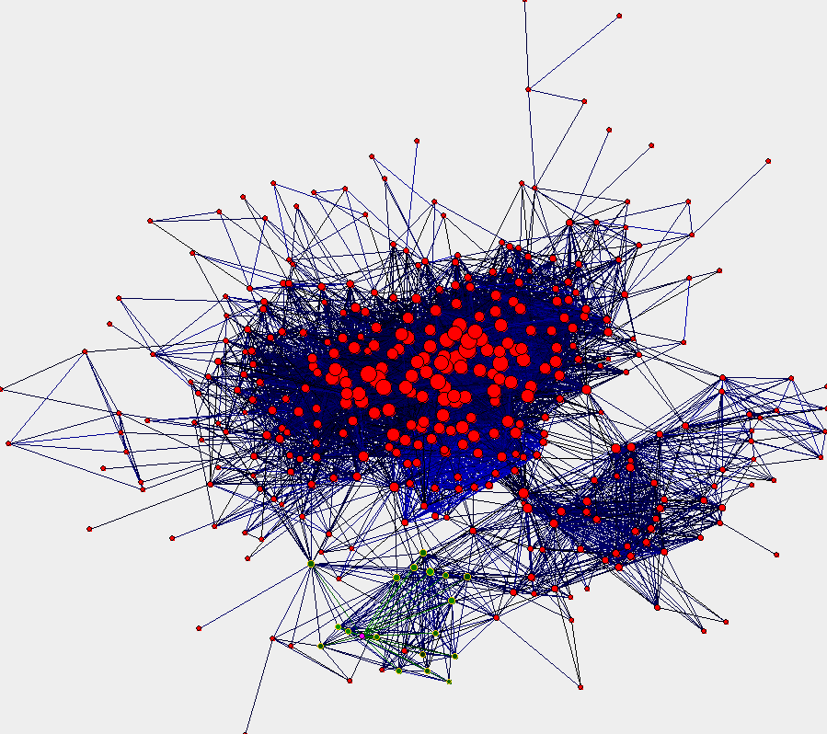
Image connectivity graph
(graph layout produced using the Graphviz toolkit: http://www.graphviz.org/)

Slide 14
x₄
x₁
x₃
x₂
x₅
x₇
x₆
p_{1,1}
p_{1,2}
p_{1,3}
Image 1
Image 3
R₁,t₁
R₃,t₃
Image 2
R₂,t₂

Slide 15
Structure from motion
p₄
p₁
p₃
minimize
p₂
f (R, T, P)
p₅
p₇
p₆
Camera 1
Camera 3
R₁,t₁
R₃,t₃
Camera 2
R₂,t₂
Notes:
Structure from motion solves the following problem:
Given a set of images of a static scene with 2D points in correspondence, shown here as color-coded points, find…
a set of 3D points P and
a rotation R and position t of the cameras that explain the observed correspondences. In other words, when we project a point into any of the cameras, the reprojection error between the projected and observed 2D points is low.
This problem can be formulated as an optimization problem where we want to find the rotations R, positions t, and 3D point locations P that minimize sum of squared reprojection errors f. This is a non-linear least squares problem and can be solved with algorithms such as Levenberg-Marquart. However, because the problem is non-linear, it can be susceptible to local minima. Therefore, it’s important to initialize the parameters of the system carefully. In addition, we need to be able to deal with erroneous correspondences.

Slide 16
Problem size
Trevi Fountain collection
  466 input photos
  + > 100,000 3D points
  = very large optimization problem

Slide 17
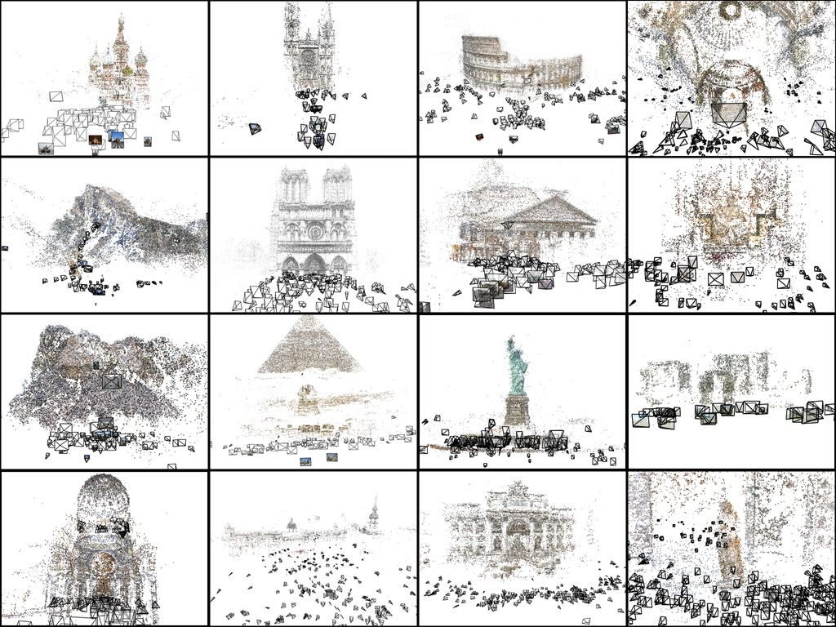

Slide 18
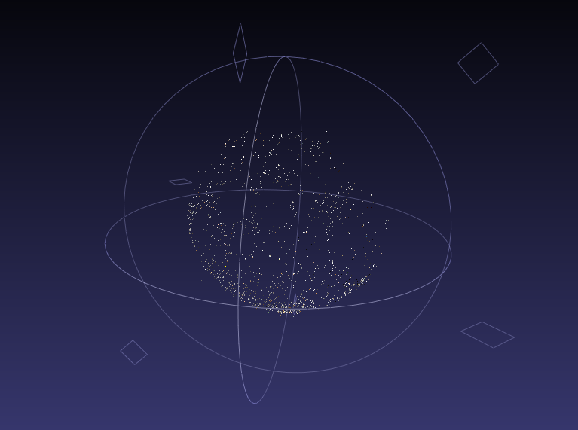

Slide 19
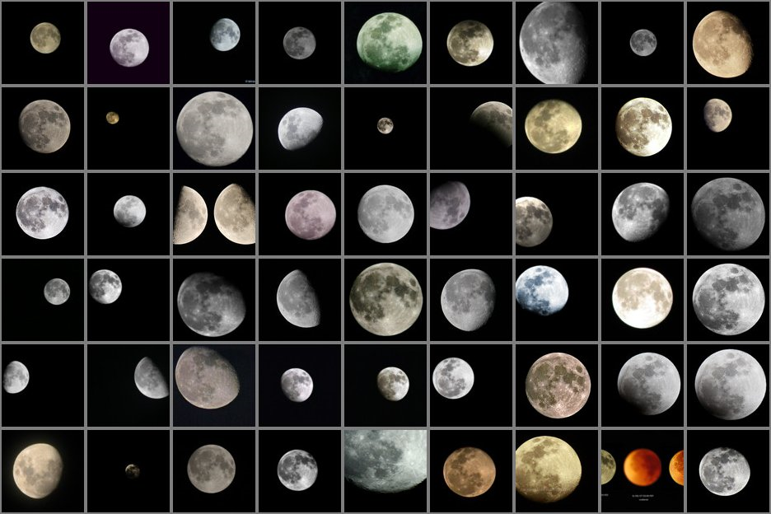

Slide 20
x₄
x₁
x₃
x₂
x₅
x₇
x₆
p_{1,1}
p_{1,2}
p_{1,3}
Image 1
Image 3
R₁,t₁
R₃,t₃
Image 2
R₂,t₂

Slide 21
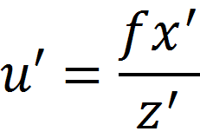
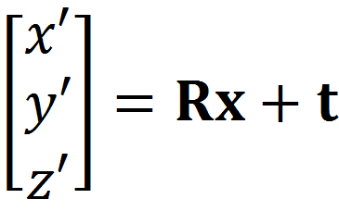
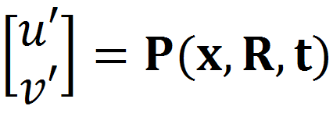
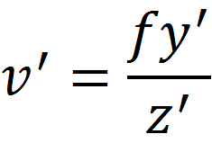
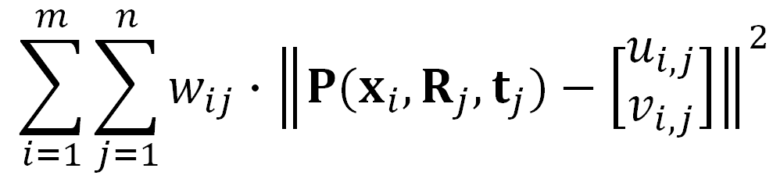

SfM objective function
Given point x and rotation and translation R, t
Minimize sum of squared reprojection errors:
predicted
image location
observed
image location

Slide 22
Solving structure from motion
Minimizing g is difficult
  g is non-linear due to rotations, perspective division
  lots of parameters: 3 for each 3D point, 6 for each camera
  difficult to initialize
  gauge ambiguity: error is invariant to a similarity transform (translation, rotation, uniform scale)
Many techniques use non-linear least-squares (NLLS) optimization (bundle adjustment)
  Levenberg-Marquardt is one common algorithm for NLLS
  Lourakis, The Design and Implementation of a Generic Sparse Bundle Adjustment Software Package Based on the Levenberg-Marquardt Algorithm, http://www.ics.forth.gr/~lourakis/sba/
  http://en.wikipedia.org/wiki/Levenberg-Marquardt_algorithm

Slide 23
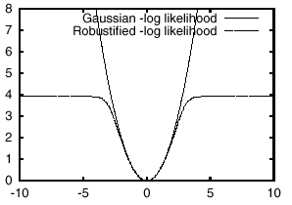
Extensions to SfM
Can also solve for intrinsic parameters (focal length, radial distortion, etc.)
Can use a more robust function than squared error, to avoid fitting to outliers
For more information, see: Triggs, et al, “Bundle Adjustment – A Modern Synthesis”, Vision Algorithms 2000.

Slide 24





Incremental structure from motion
Notes:
To help get good initializations for all of the parameters of the system, we reconstruct the scene incrementally, starting from two photographs and the points they observe.

Slide 25
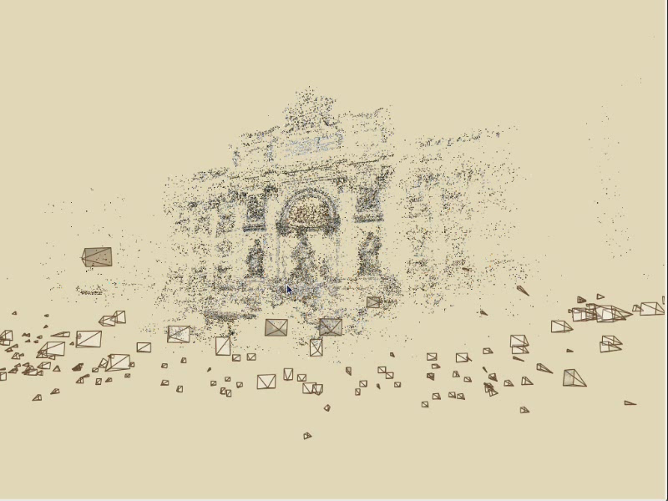
Photo Explorer

Slide 26
Questions?

