Slide 1
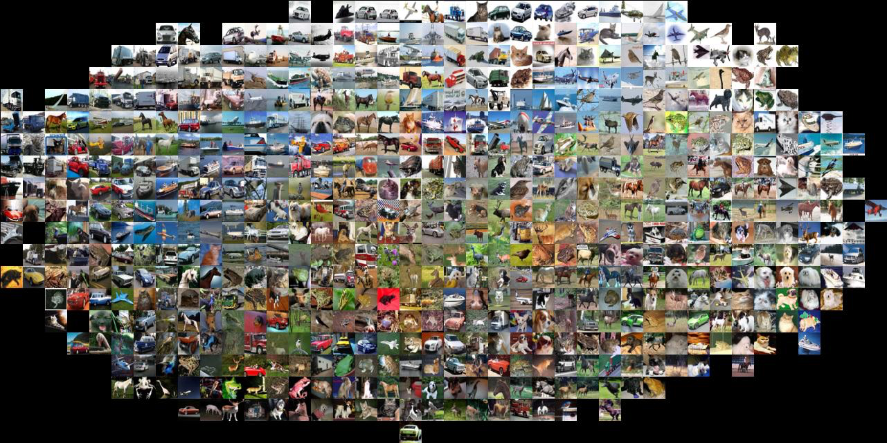
Lecture 33: Recognition Basics
CS5670: Computer Vision
Noah Snavely
Slides from Andrej Karpathy and Fei-Fei Li
http://vision.stanford.edu/teaching/cs231n/

Slide 2
Announcements
Quiz moved to Tuesday
Project 4 due tomorrow, April 28, by 11:59pm
Project 5 to be assigned soon
Take-home final: Assigned Tuesday May 9 (in class), due May 11 (by 5pm)

Slide 3
Today
Image classification pipeline
Training, validation, testing
Nearest neighbor classification
Score function and loss function
Building up to CNNs for learning
  Next 2-3 lectures on deep learning

Slide 4
Where to from here?
Scene Understanding
  Big data – lots of images
  Crowd sourcing – lots of people
  Deep Learning – lots of compute

Slide 5


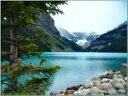

Image categorization
Training
Training Images
Training Labels
Image Features
Classifier Training
Trained Classifier

Slide 6
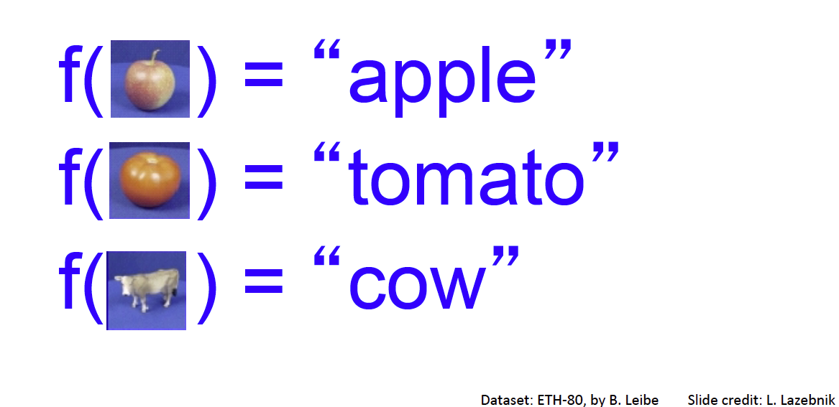
Categorization

Slide 7
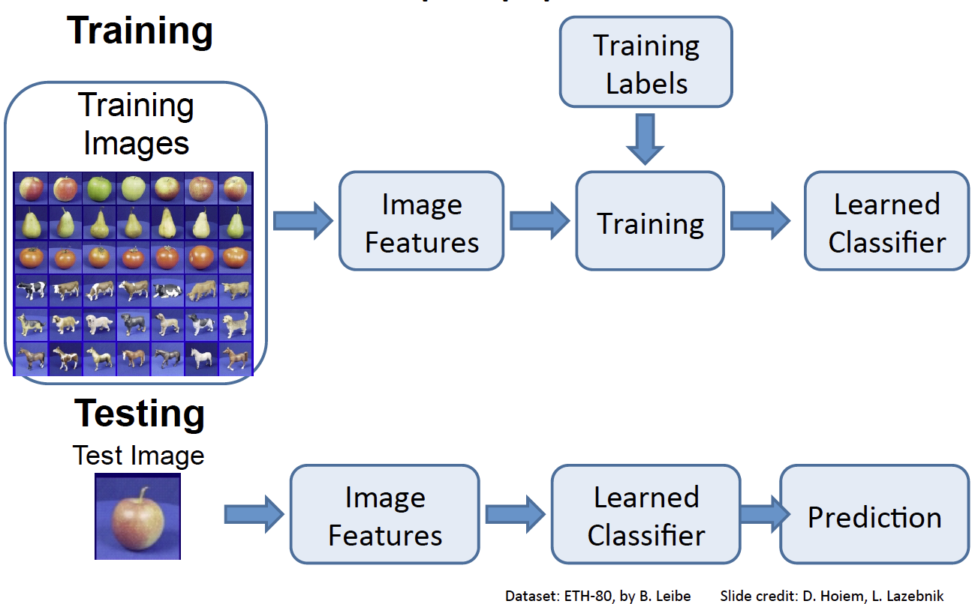

Slide 8
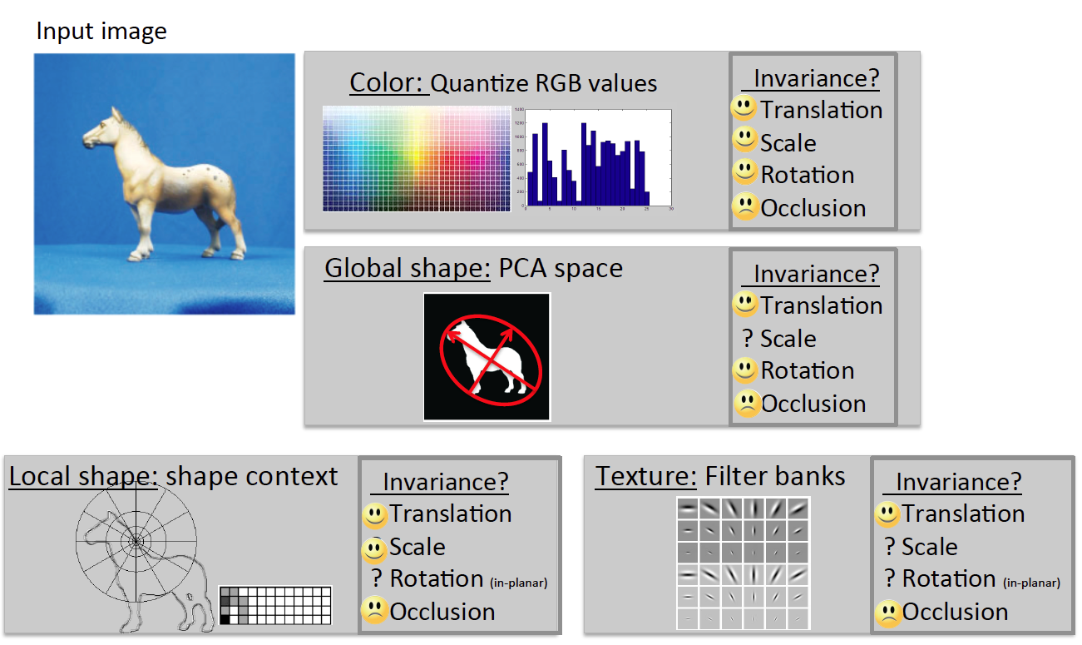

Slide 9
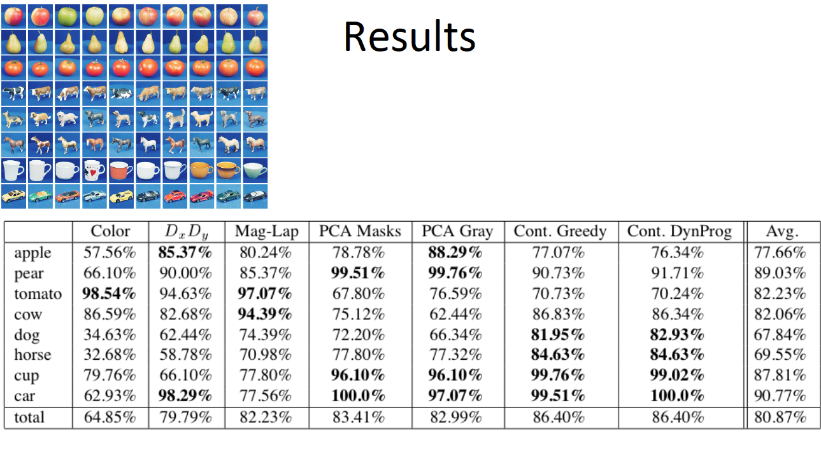

Slide 10
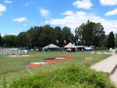
Image Categorization
Training
Training Images
Training Labels
Image Features
Classifier Training
Trained Classifier
Testing
Image Features
Trained Classifier
Prediction
Outdoor
Test Image

Slide 11

Crowdsourcing
Unlabeled Images
Show images,
Collect and filter labels
Training Labels
Training Images
Image Features
Classifier Training
Trained Classifier
Training

Slide 12
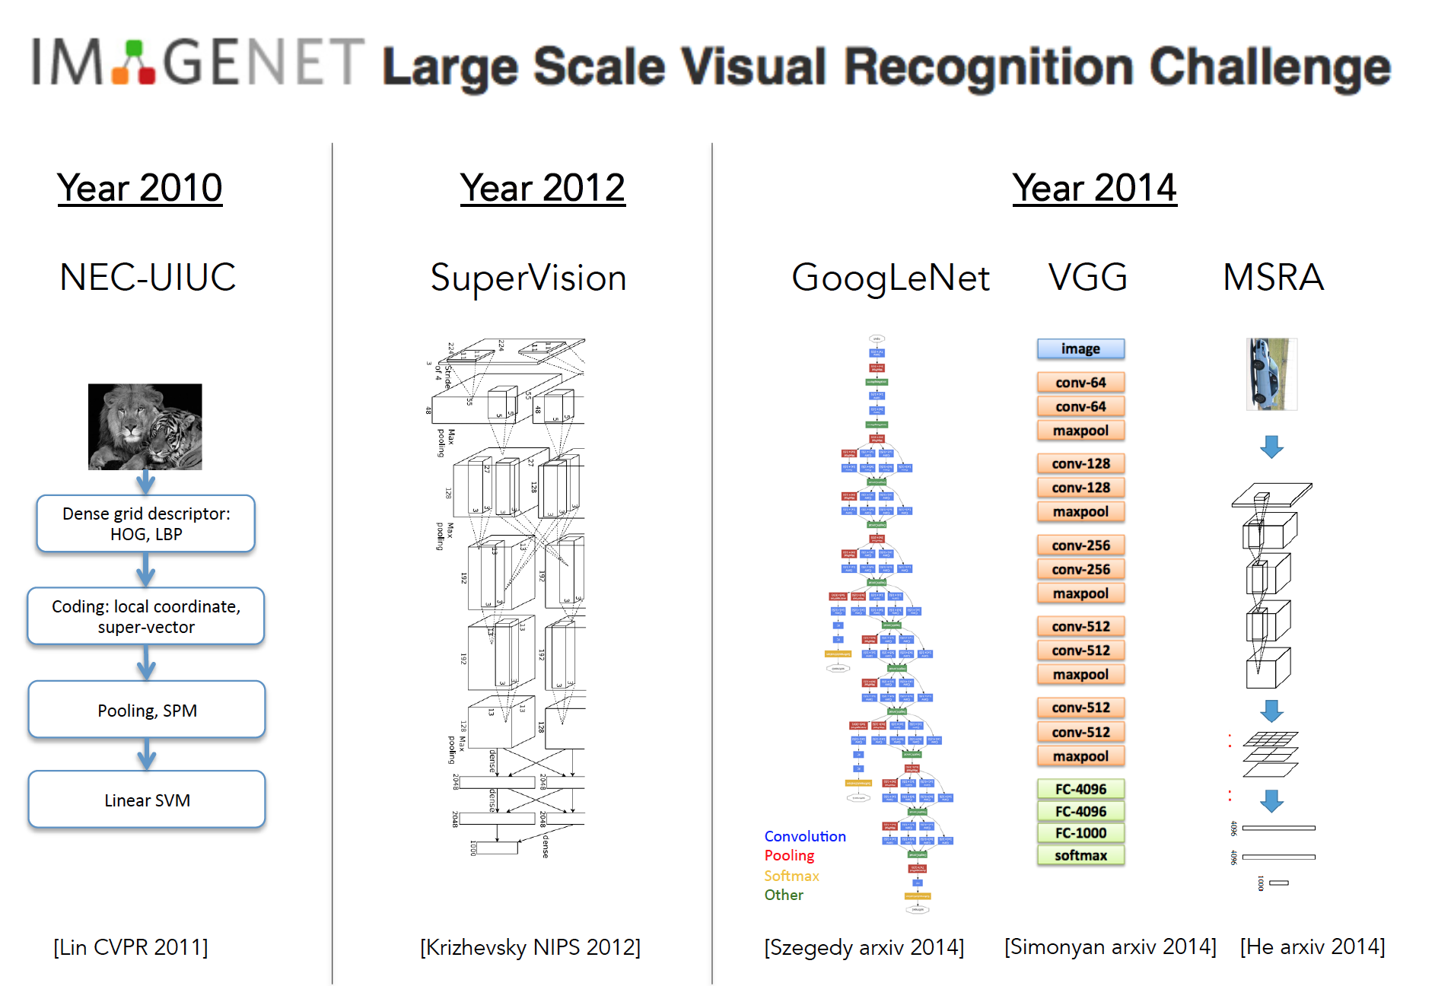

Slide 13
Deep Learning or CNNs
Since 2012, huge impact…, best results
Can soak up all the data for better prediction

Slide 14
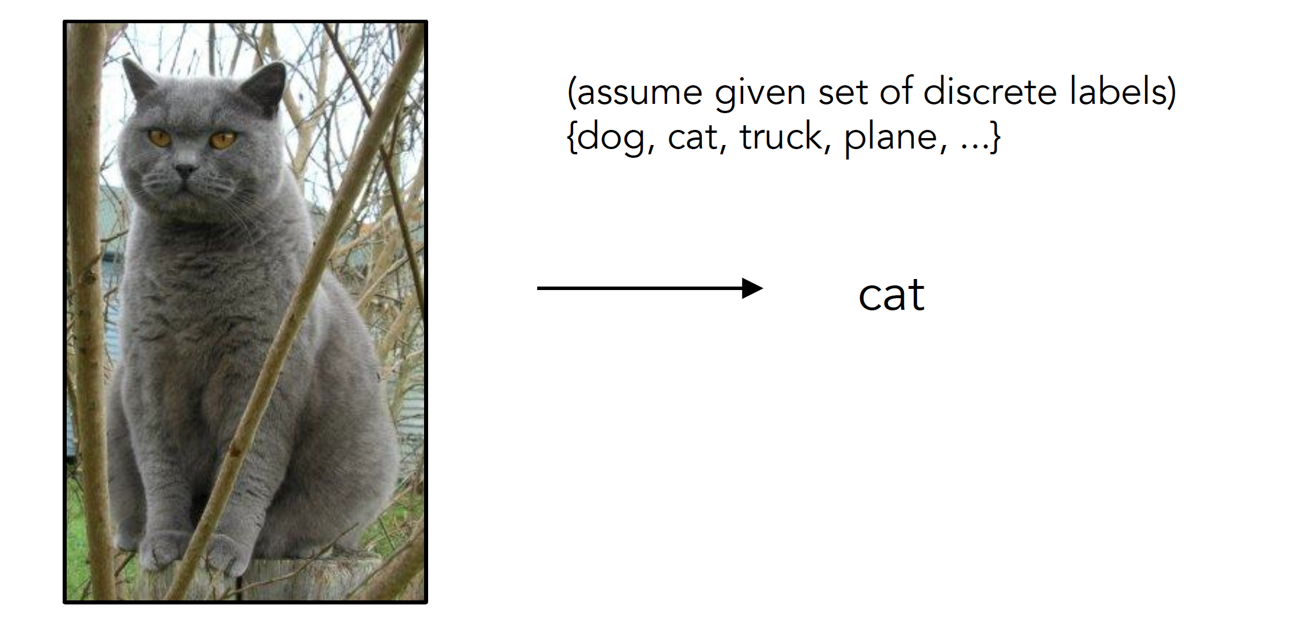
Image Classification
Slides from Andrej Karpathy and Fei-Fei Li
http://vision.stanford.edu/teaching/cs231n/

Slide 15
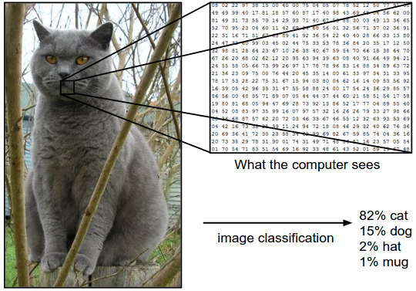
Image Classification: Problem

Slide 16
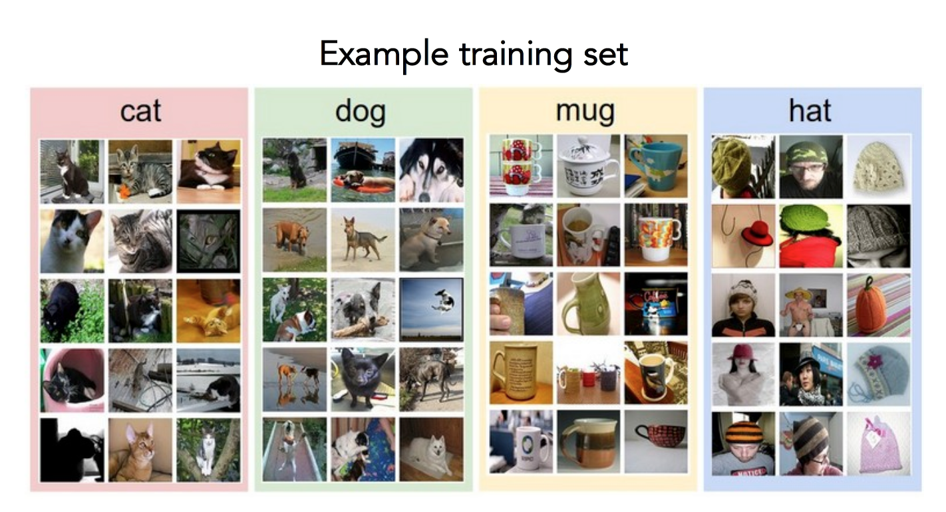
Data-driven approach
Collect a database of images with labels
Use ML to train an image classifier
Evaluate the classifier on test images
Slides from Andrej Karpathy and Fei-Fei Li
http://vision.stanford.edu/teaching/cs231n/

Slide 17
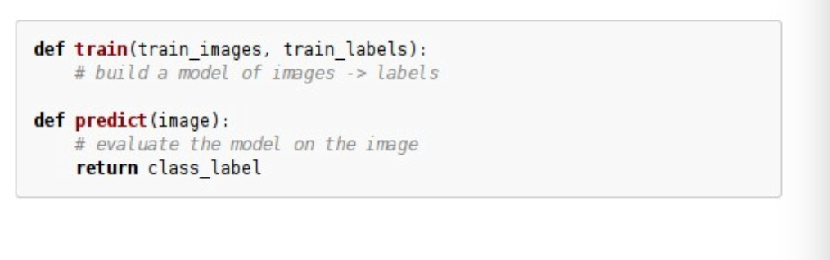
Data-driven approach
Collect a database of images with labels
Use ML to train an image classifier
Evaluate the classifier on test images
Slides from Andrej Karpathy and Fei-Fei Li
http://vision.stanford.edu/teaching/cs231n/

Slide 18
Train and Test
Split dataset between training images and test images
Be careful about inflation of results

Slide 19
Classifiers
Nearest Neighbor
kNN
SVM
…

Slide 20
First: Nearest Neighbor (NN) Classifier
Train
  Remember all training images and their labels
Predict
  Find the closest (most similar) training image
  Predict its label as the true label

Slide 21
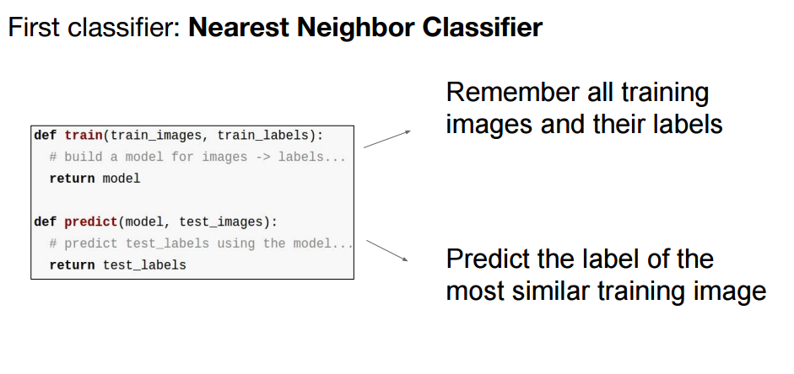

Slide 22
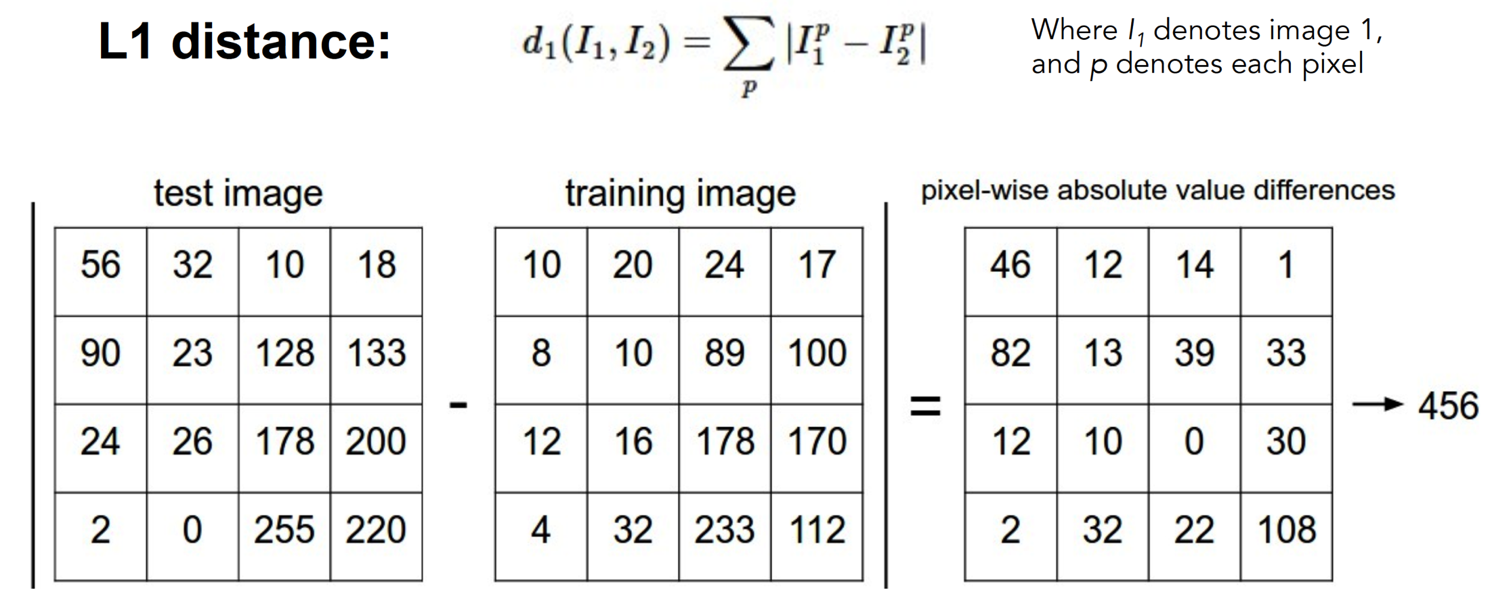
How to find the most similar training image? What is the distance metric?
Slides from Andrej Karpathy and Fei-Fei Li
http://vision.stanford.edu/teaching/cs231n/

Slide 23
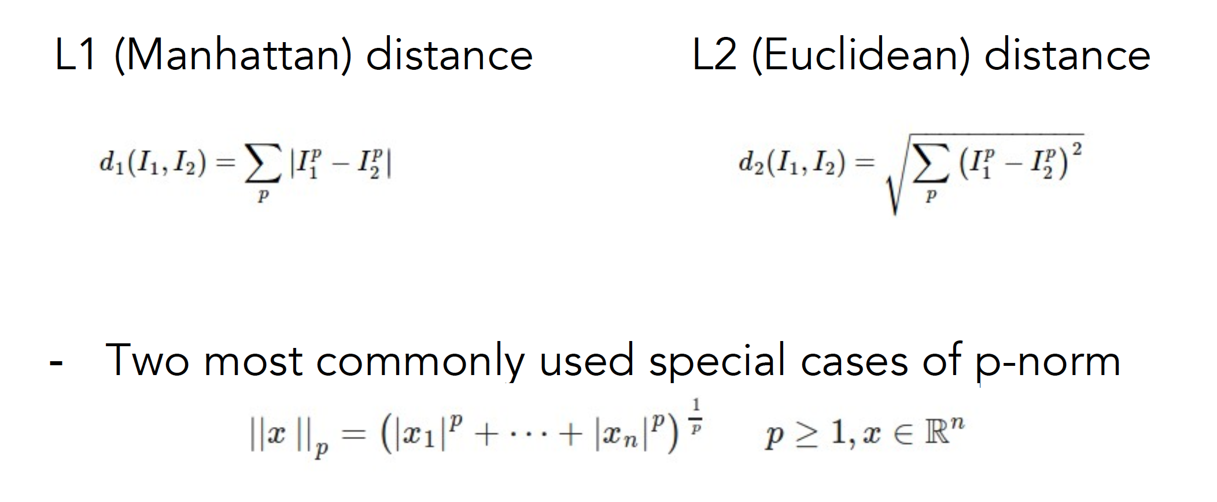
Choice of distance metric
Hyperparameter
Slides from Andrej Karpathy and Fei-Fei Li
http://vision.stanford.edu/teaching/cs231n/

Slide 24
Visualization: L2 distance
Notes:
Background plays an unrealistically large role

Slide 25
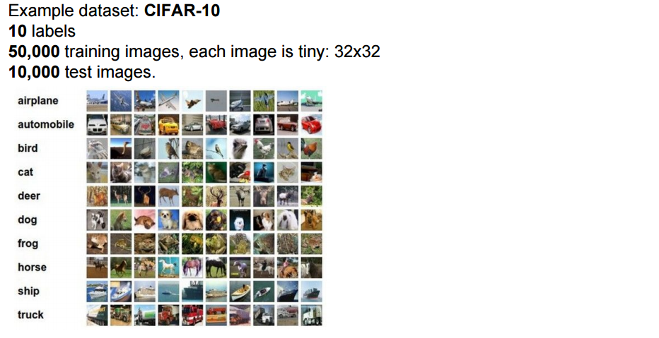
CIFAR-10 and NN results

Slide 26
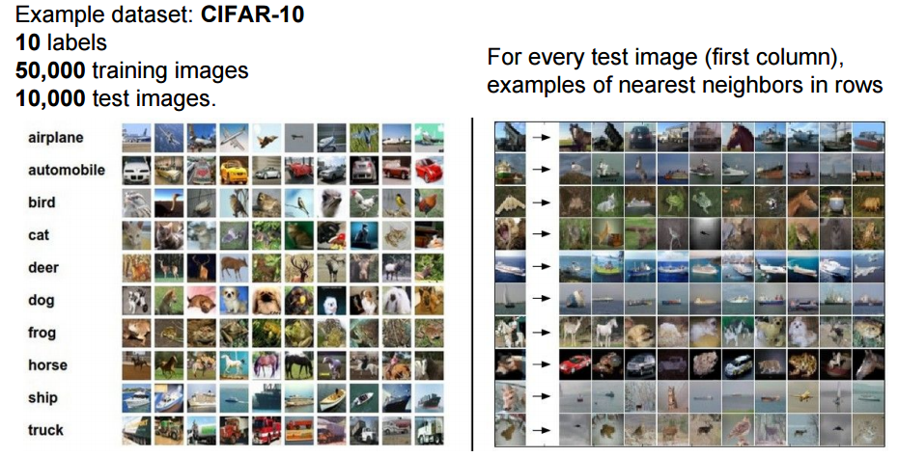
CIFAR-10 and NN results
Slides from Andrej Karpathy and Fei-Fei Li
http://vision.stanford.edu/teaching/cs231n/

Slide 27
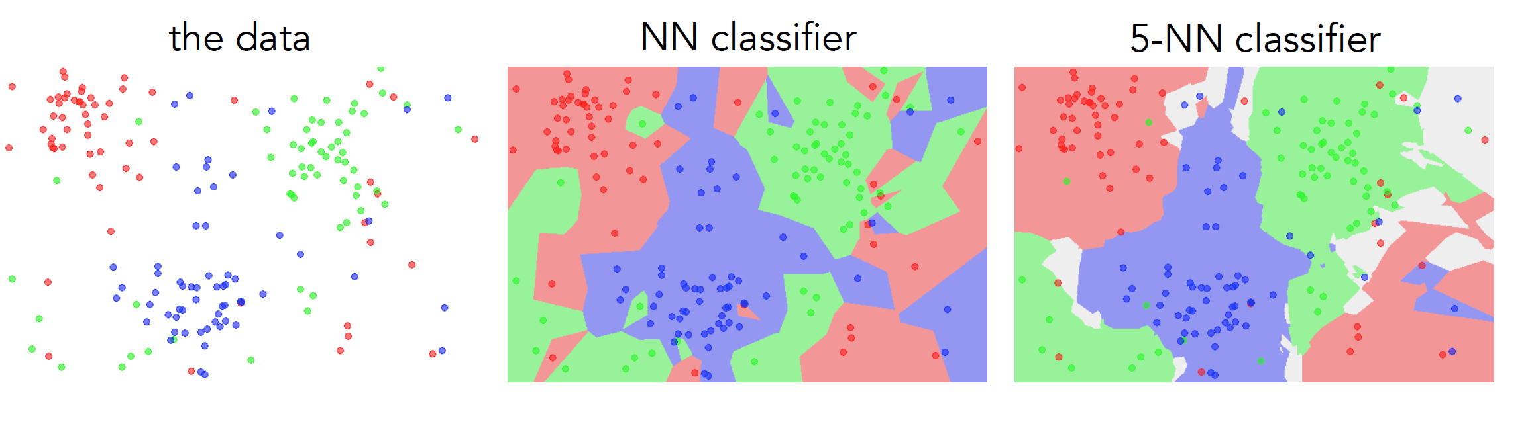
k-nearest neighbor
Find the k closest points from training data
Labels of the k points “vote” to classify

Slide 28
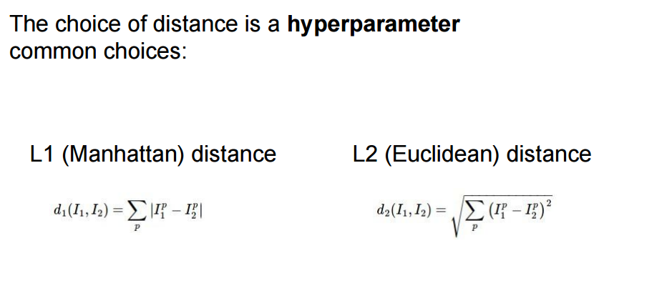
Hyperparameters

Slide 29
Hyperparameters
What is the best distance to use?
What is the best value of k to use?
i.e., how do we set the hyperparameters?
Very problem-dependent
Must try them all and see what works best

Slide 30
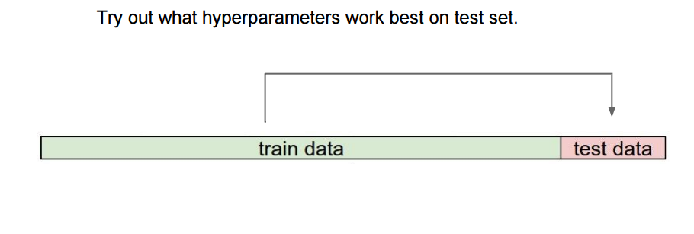

Slide 31
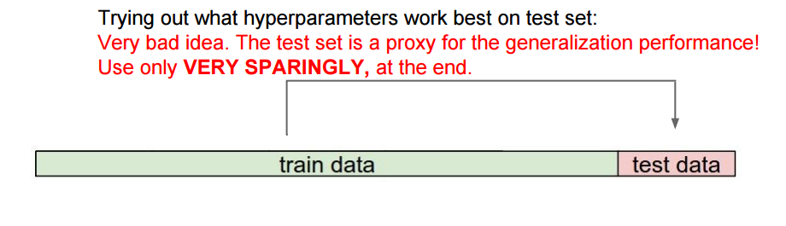

Slide 32
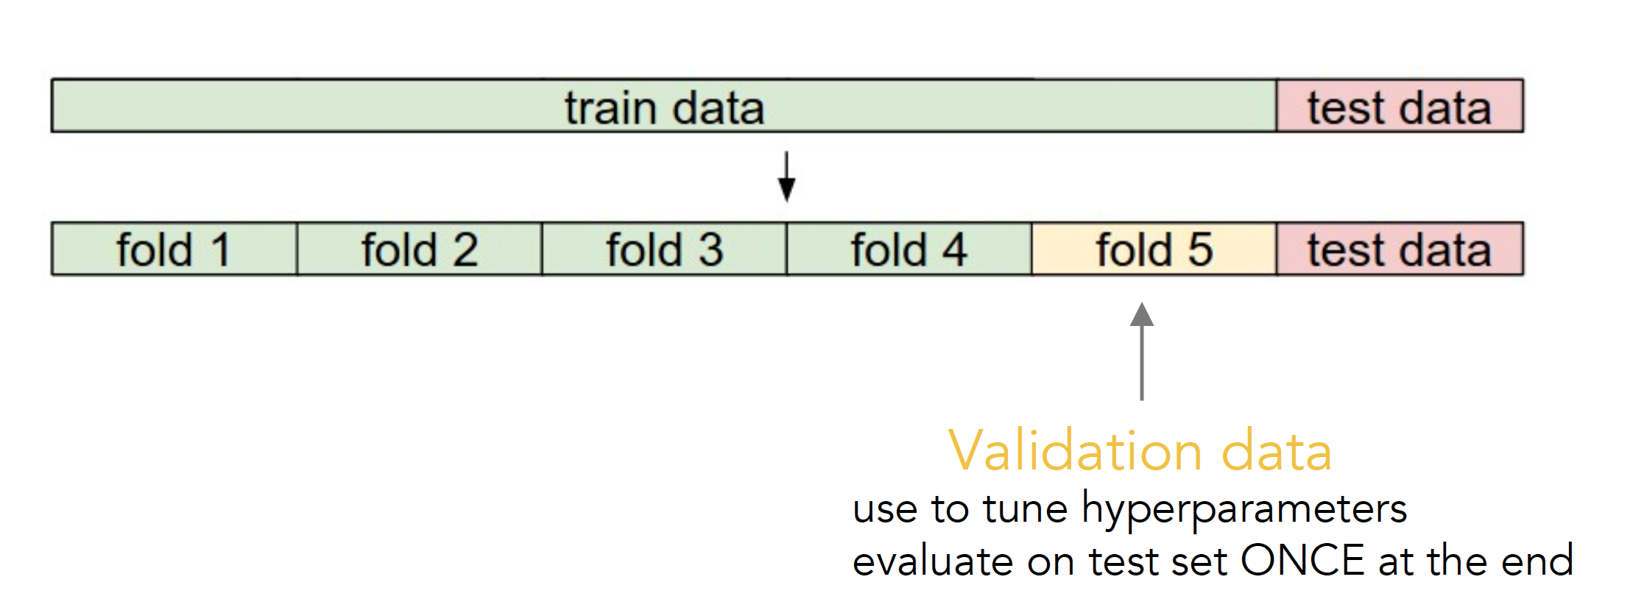
Validation
Slides from Andrej Karpathy and Fei-Fei Li
http://vision.stanford.edu/teaching/cs231n/

Slide 33
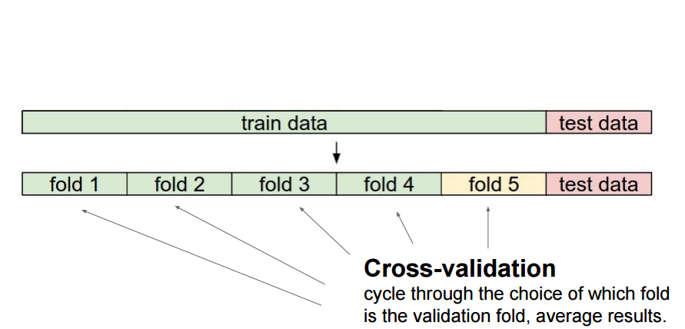
Cross-validation
Slides from Andrej Karpathy and Fei-Fei Li
http://vision.stanford.edu/teaching/cs231n/

Slide 34
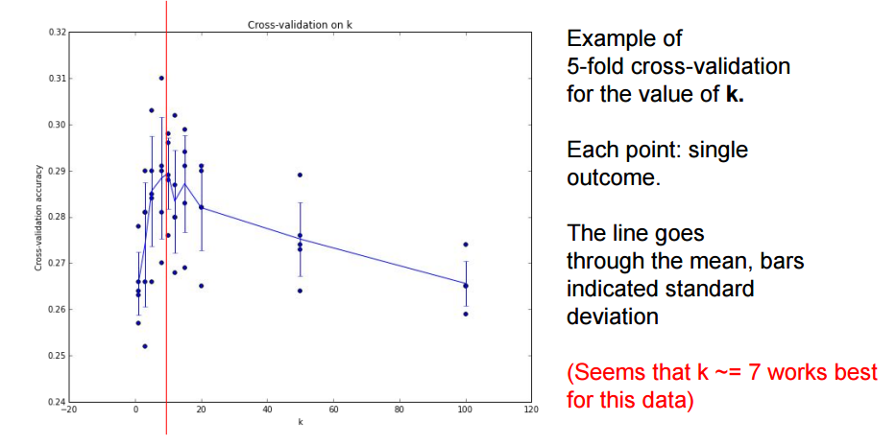

Slide 35
How to pick hyperparameters?
Methodology
  Train and test
  Train, validate, test
Train for original model
Validate to find hyperparameters
Test to understand generalizability

Slide 36
kNN -- Complexity and Storage
N training images, M test images
Training: O(1)
Testing: O(MN)
Hmm…
  Normally need the opposite
  Slow training (ok), fast testing (necessary)

Slide 37
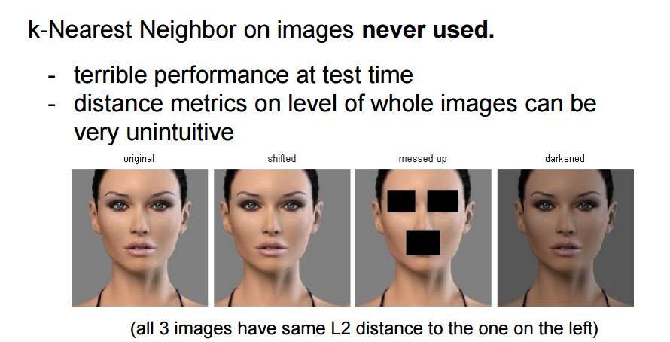

Slide 38
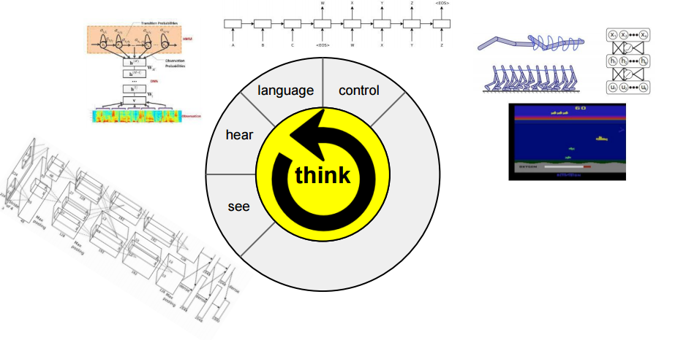
Instead
Image classification using linear classifiers

Slide 39
Instead
Image classification using linear classifiers
Need
  Score function: raw data to class scores
  Loss function: agreement between predicted scores and ground truth labels

Slide 40
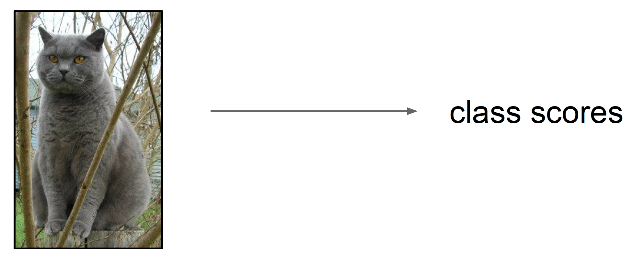
Score function
Slides from Andrej Karpathy and Fei-Fei Li
http://vision.stanford.edu/teaching/cs231n/

Slide 41
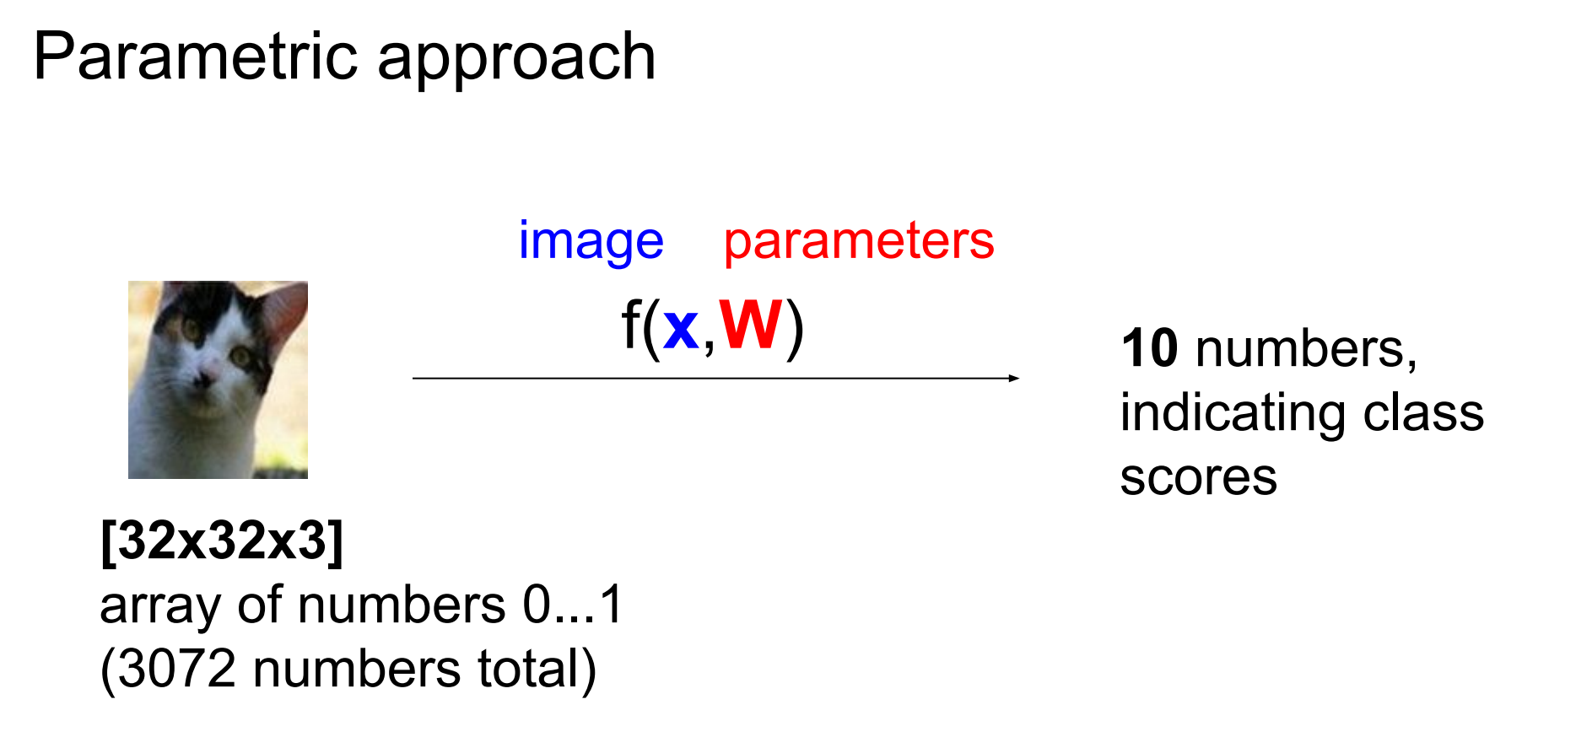
Score function: f

Slide 42
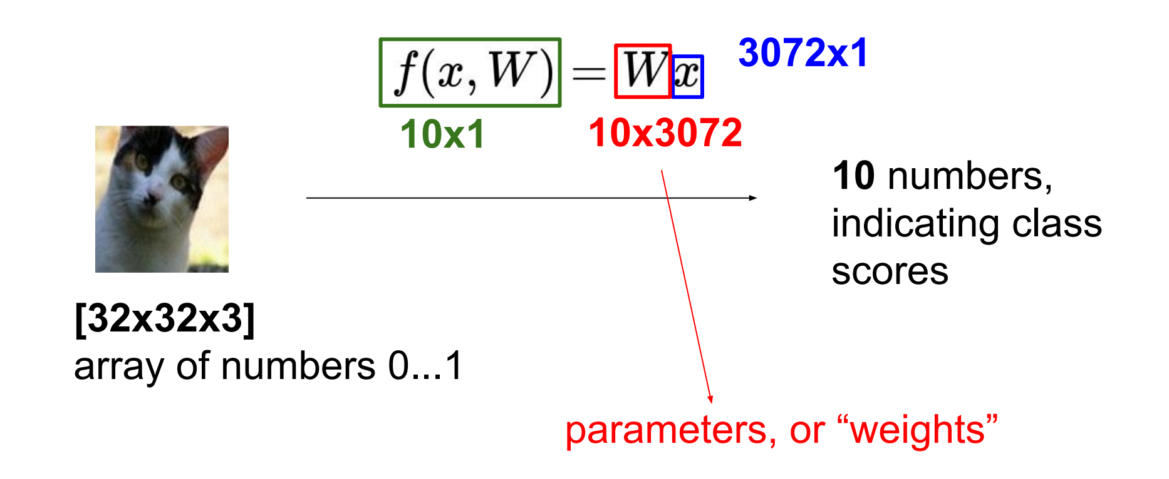
Parametric approach: Linear classifier

Slide 43
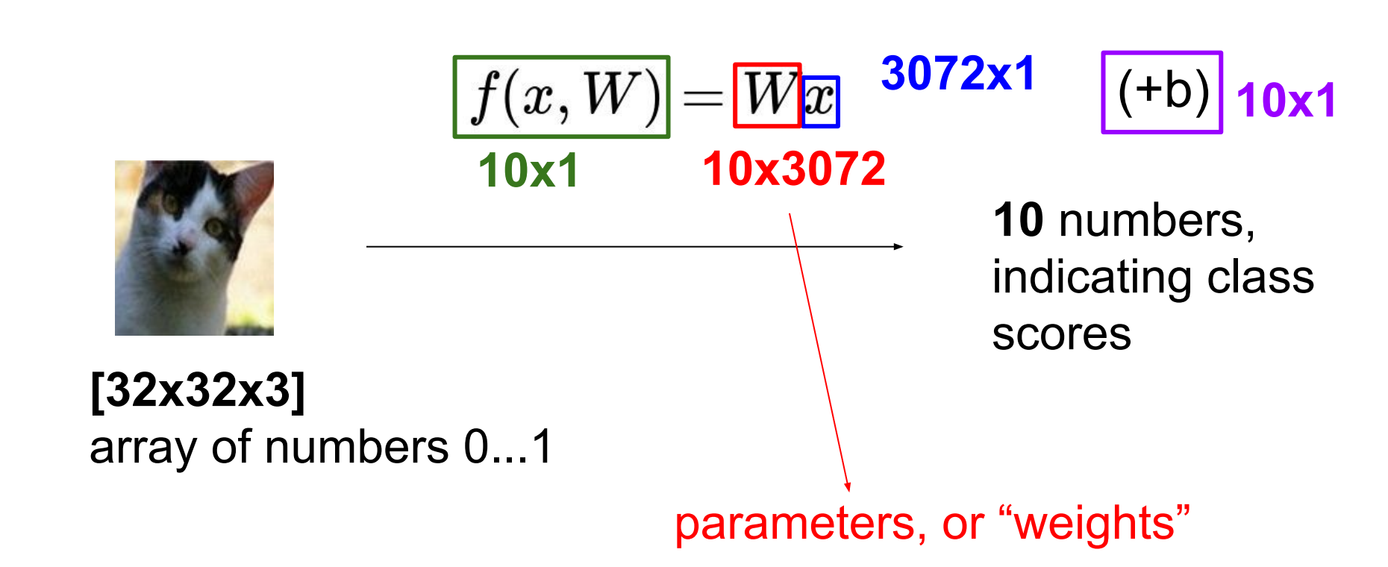
Parametric approach: Linear classifier

Slide 44
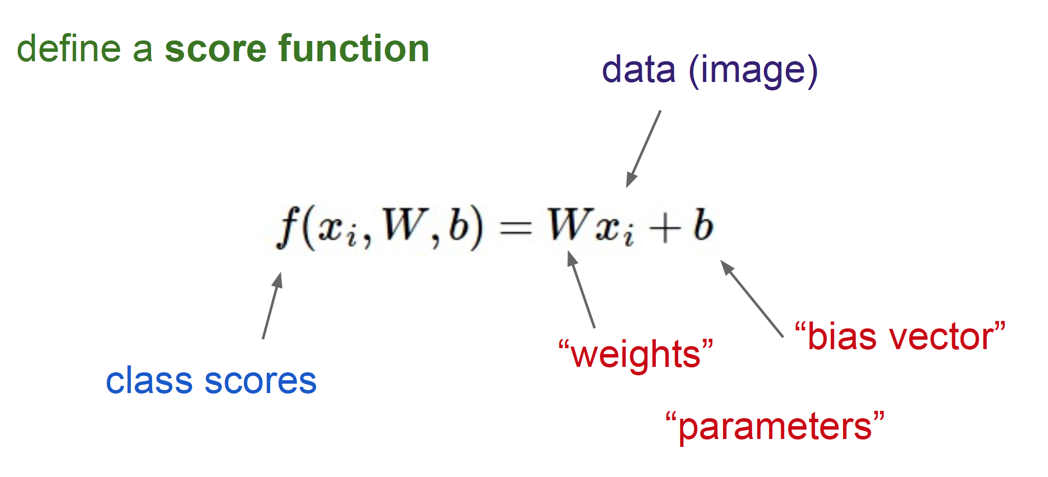
Linear Classifier

Slide 45
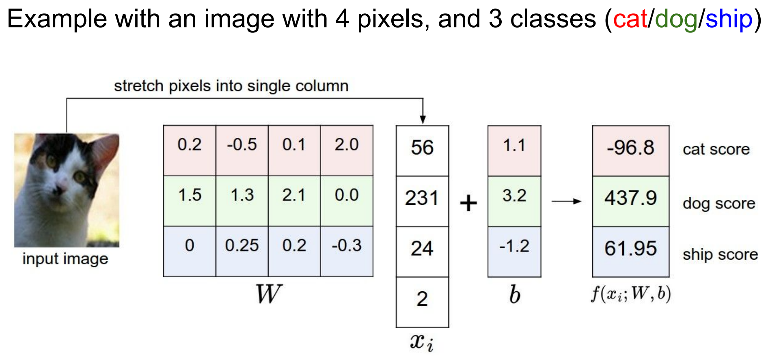

Slide 46
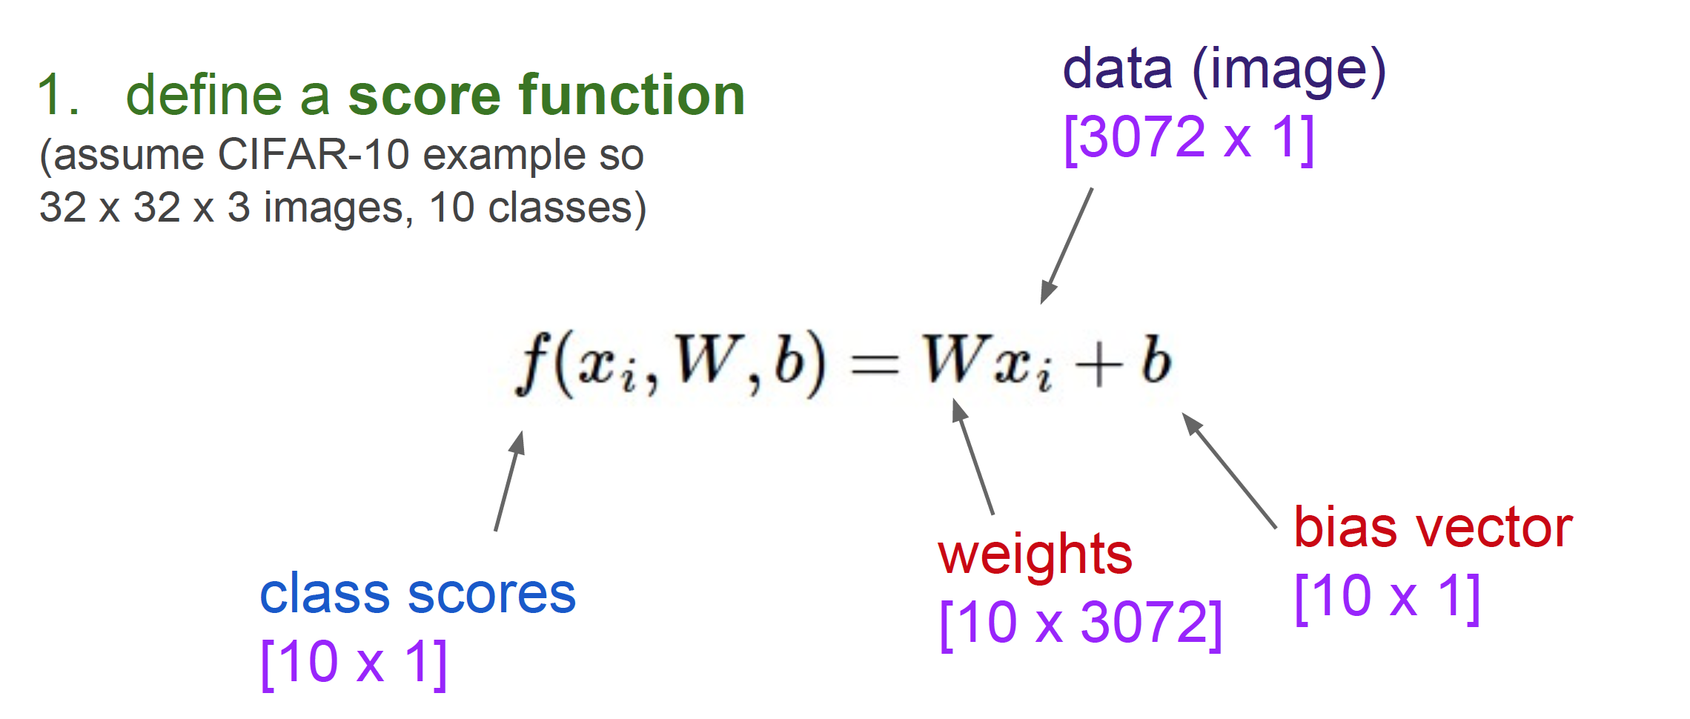
Linear Classifier

Slide 47
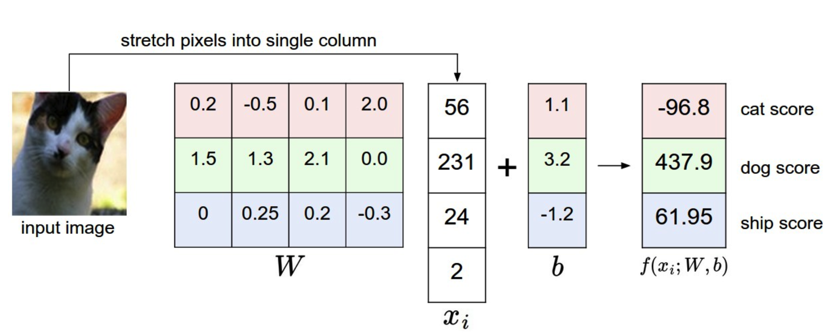
Computing scores
Notes:
This is a bad cat score

Slide 48

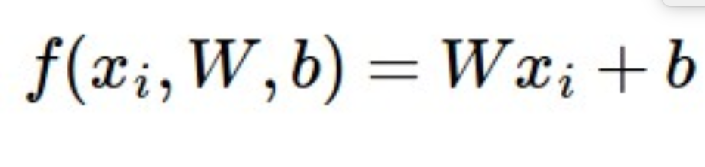
Interpretation: Template matching
Notes:
Each row of W is a template for that class

Slide 49
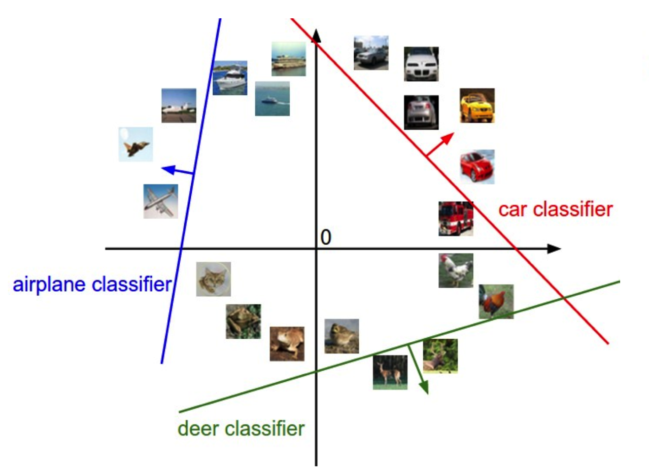
Geometric Interpretation

Slide 50
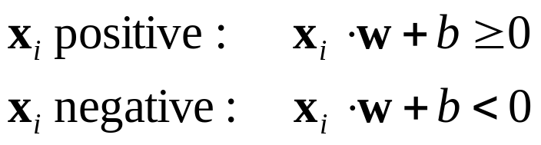
Linear classifiers
Find linear function (hyperplane) to separate positive and negative examples
Which hyperplane
is best?

Slide 51
Support vector machines
Find hyperplane that maximizes the margin between the positive and negative examples
C. Burges, A Tutorial on Support Vector Machines for Pattern Recognition, Data Mining and Knowledge Discovery, 1998

Slide 52
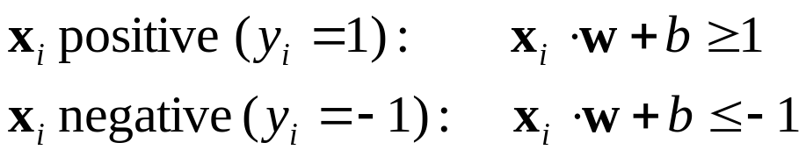

Support vector machines
Find hyperplane that maximizes the margin between the positive and negative examples
For support, vectors,
Support vectors
Margin

Slide 53
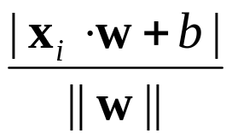
Support vector machines
Find hyperplane that maximizes the margin between the positive and negative examples
For support, vectors,
Distance between point and hyperplane:
Therefore, the margin is 2 / ||w||
Support vectors
Margin
Notes:
This is a generalization of binary SVMs to multiple classes

Slide 54
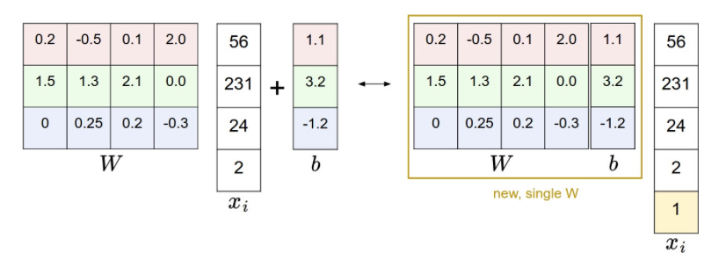
Bias Trick

Slide 55
Summary
Data-driven: Train, validate, test
  Need labeled data
Classifier
  Nearest neighbor, kNN

Slide 56
Loss function, cost/objective function
Given ground truth labels (yi), scores f (xi, W)
  how unhappy are you with the scores?
Loss function or objective/cost function
Want to minimize the loss function

Slide 57
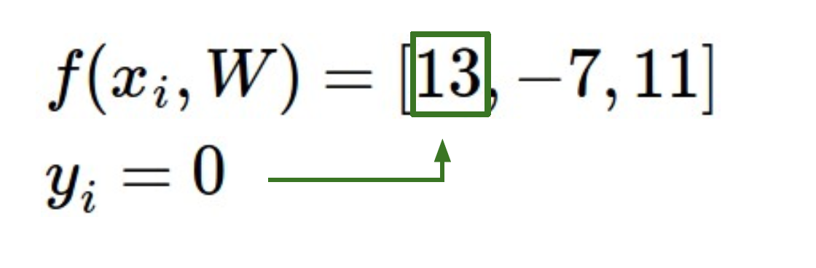
Loss function, cost/objective function
Given ground truth labels (yi) and scores f(xi, W)
  how unhappy are you with the scores?

Slide 58

Intuition

Slide 59
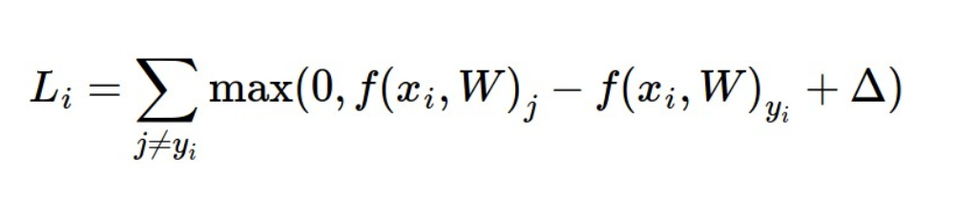
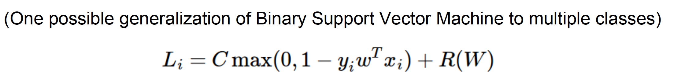
Loss fn: Multi-class SVM loss
Given ground truth labels (yi) and scores f(xi, W)
  how unhappy are you with the scores?
Notes:
Yi = 0 f (xi, W) = [13, -7, 11]. Let Delta be 10.

Slide 60
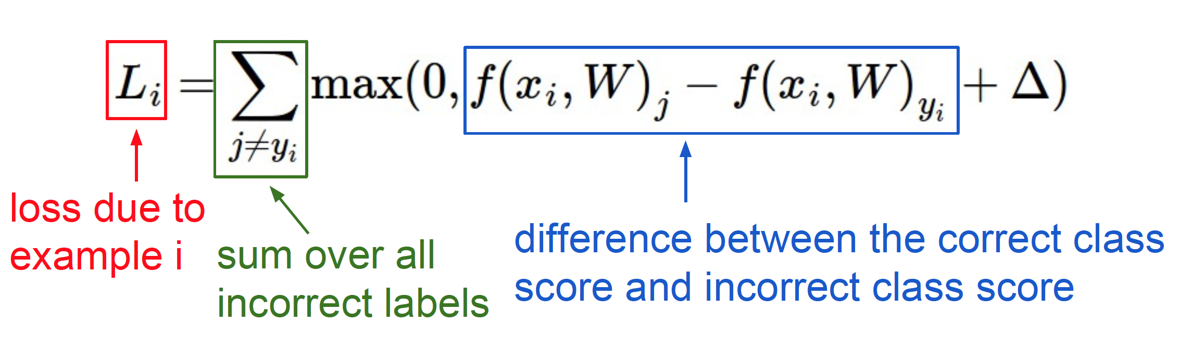
Loss fn: interpretation

Slide 61
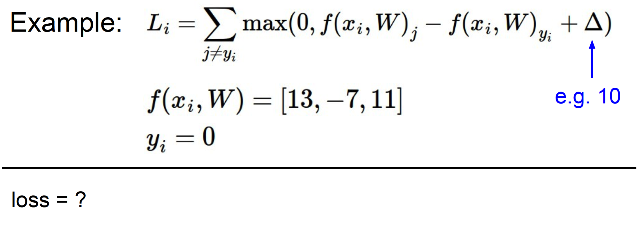
Example: loss

Slide 62
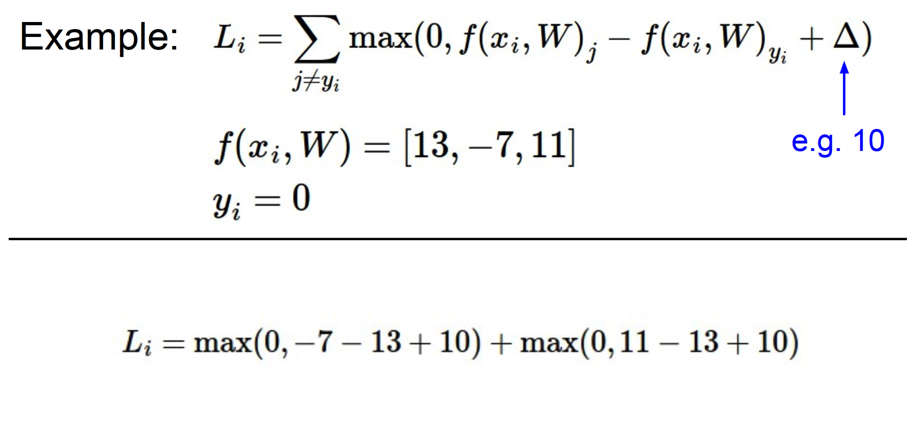
Example: loss

Slide 63
Need more..
Regularization
  Ambiguity: W is not unique
  If loss is 0, k W also has 0 loss
  Add a regularization penalty
    Try to keep the weights low
    Also, weights can blow up if you don’t have it

Slide 64
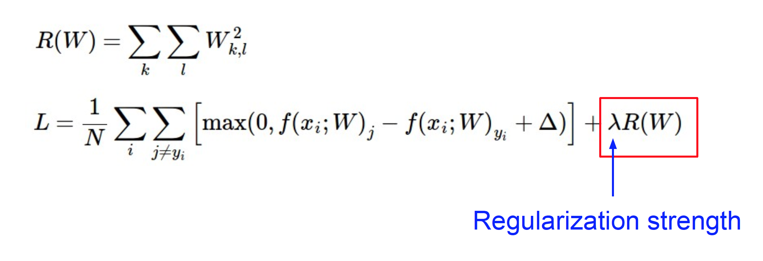
Important: regularization
Determine by cross-validation
Notes:
In addition to the motivation we provided above there are many desirable properties to include the regularization penalty. For example, it turns out that including the L2 penalty leads to the appealing max margin property in SVMs (See CS229 lecture notes for full details if you are interested

Slide 65
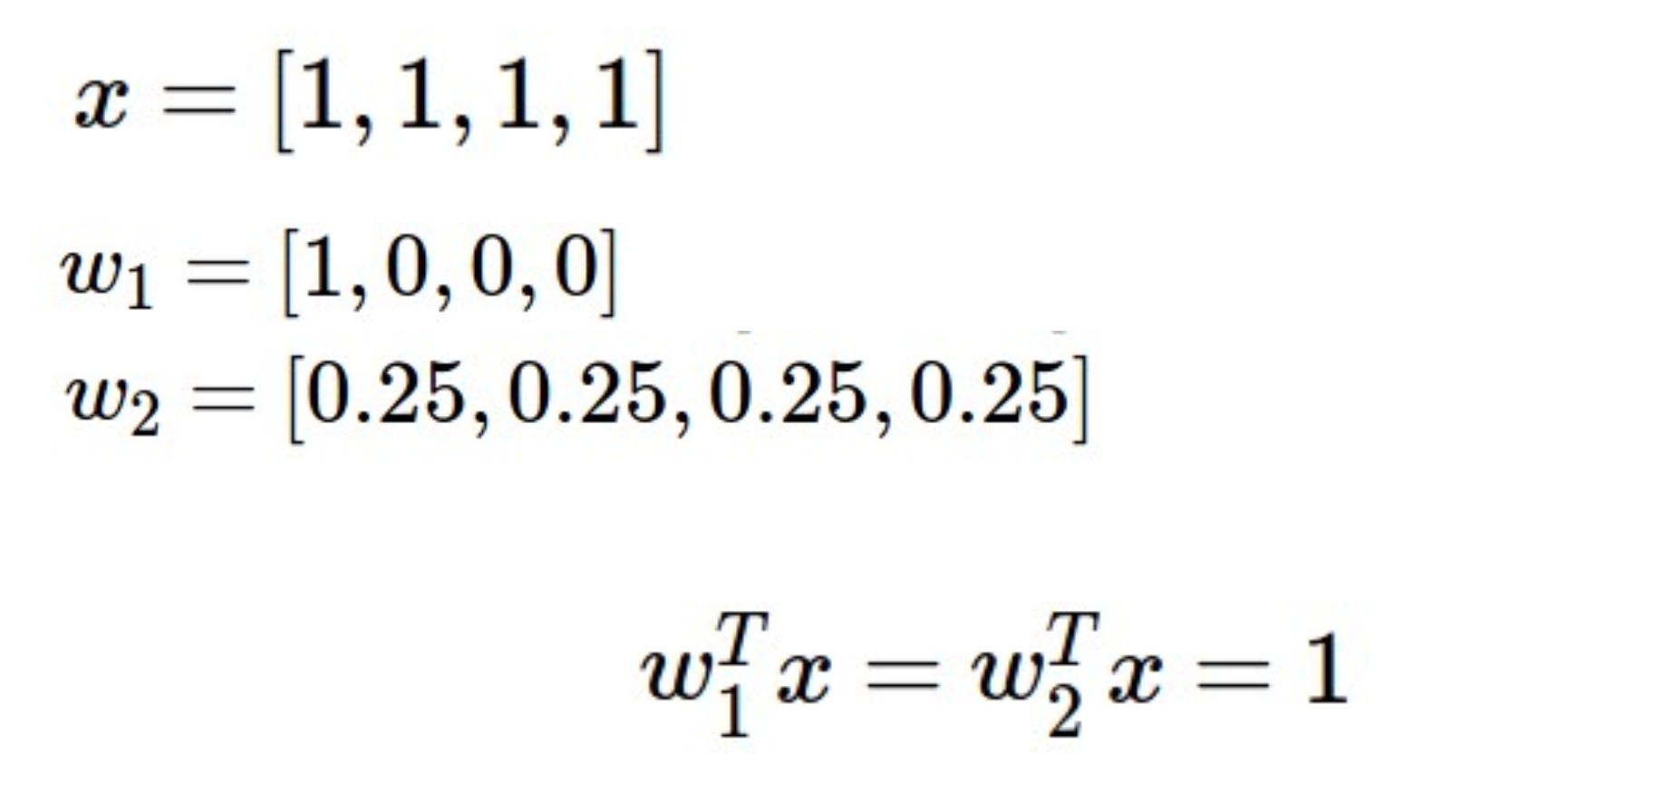
Example: regularization
Notes:
The most appealing property is that penalizing large weights tends to improve generalization, because it means that no input dimension can have a very large influence on the scores all by itself.
Regularization penalty is 1 vs. ¼. Downweights any one feature and makes it more diffuse.

Slide 66
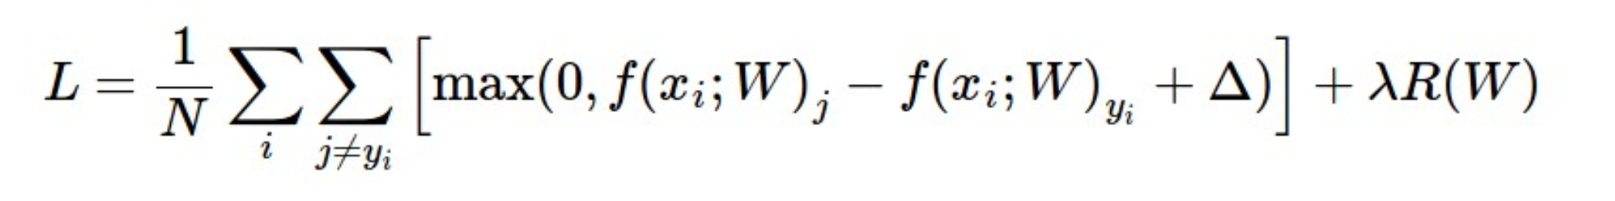
Final loss function
Can set delta to 1
Notes:
In addition to the motivation we provided above there are many desirable properties to include the regularization penalty, many of which we will come back to in later sections. For example, it turns out that including the L2 penalty leads to the appealing max margin property in SVMs (See CS229 lecture notes for full details if you are interested).

Slide 67
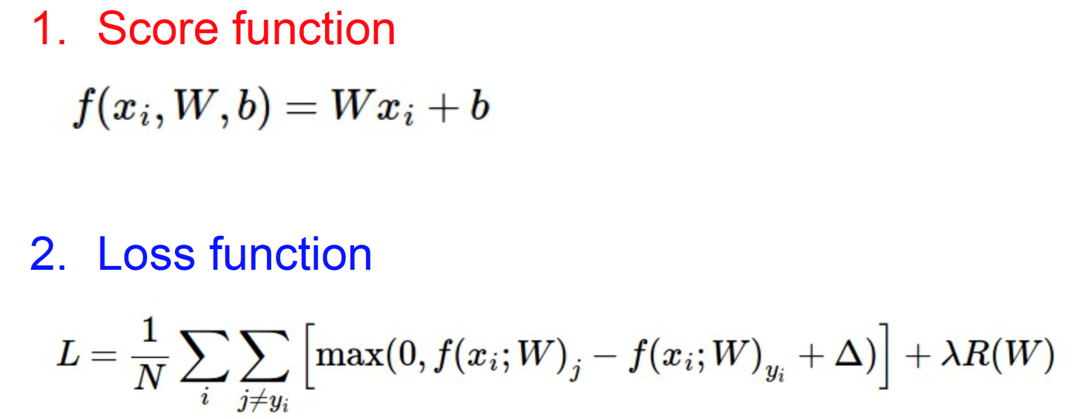

Summary

Slide 68
http://vision.stanford.edu/teaching/cs231n/linear-classify-demo/

Slide 69
Summary
Have score function and loss function
  Will generalize the score function
Find W and b to minimize loss
  Minimize loss using gradient descent
Now to CNNs

Slide 70
ILSVRC-500 (2012) dataset – similar to PASCAL
Leading algorithms
What happens under the hood
on classification+localization?
Notes:
In order to do this, we need a couple of things first. We begin by introducing a subset of 500 classes of ILSVRC which is suitable for studying localization. We show that is has many of the same challenges as the PASCAL VOC dataset. We’ll use these 500 classes for our analysis. Then we’ll briefly discuss some of the winning algorithms of the 2012 challenge. Given these, we will point out

Slide 71
SuperVision (SV)
Alex Krizhevsky, Ilya Sutskever, Geoffrey Hinton (Krizhevsky NIPS12)
Image classification: Deep convolutional neural networks
7 hidden “weight” layers, 650K neurons, 60M parameters, 630M connections
Rectified Linear Units, max pooling, dropout trick
Randomly extracted 224x224 patches for more data
Trained with SGD on two GPUs for a week, fully supervised
Localization: Regression on (x,y,w,h)
http://image-net.org/challenges/LSVRC/2012/supervision.pdf
Notes:
Very impressive results given poor localization

Slide 72
OXFORD_VGG (VGG)
Karen Simonyan, Yusuf Aytar, Andrea Vedaldi, Andrew Zisserman
Image classification: Fisher vector + linear SVM (Sanchez CVPR11)
Root-SIFT (Arandjelovic CVPR12), color statistics, augmentation with patch location (x,y) (Sanchez PRL12)
Fisher vectors: 1024 Gaussians, 135K dimensions
No SPM, product quantization to compress
Semi-supervised learning to find additional bounding boxes
1000 one-vs-rest SVM trained with Pegasos SGD
  135M parameters!
Localization: Deformable part-based models (Felzenszwalb PAMI10), without parts (root-only)
http://image-net.org/challenges/LSVRC/2012/oxford_vgg.pdf
Notes:
For a single category and the set of corresponding images, can compute as follows. Correlated with object scale, but also takes into account the distribution of locations

Slide 73


Slide 74


