Slide 1
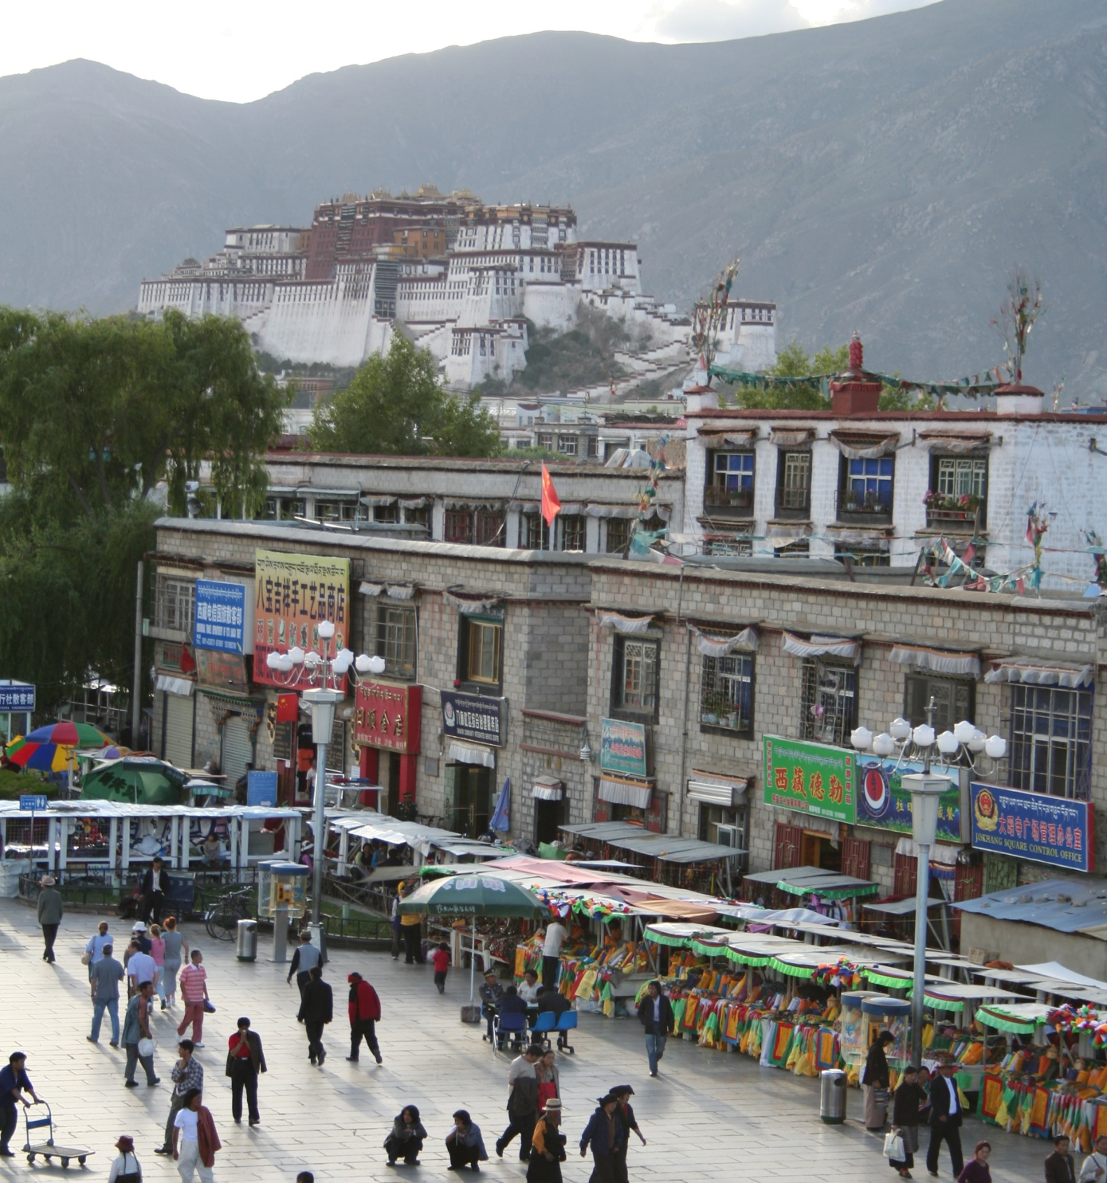
Introduction to Recognition
Slides from: Noah Snavely
mountain
tree
building
banner
street lamp
vendor
people

Slide 2
Where we go from here
What we know: Geometry
  What is the shape of the world? How does that shape appear in images?
What’s next: Recognition
  What are we looking at?

Slide 3
What do we mean by “object recognition”?
Next 15 slides adapted from
Li, Fergus, & Torralba’s excellent short course on category and object recognition

Slide 4
Verification: is that a lamp?

Slide 5
Detection: are there people?

Slide 6
Identification: is that Potala Palace?

Slide 7
Object categorization
mountain
tree
building
banner
street lamp
vendor
people

Slide 8
Scene and context categorization
outdoor
city
…

Slide 9
Activity / Event Recognition
what are these people doing?

Slide 10
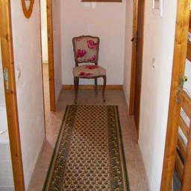

Object recognition
Is it really so hard?
Find the chair in this image
Output of normalized correlation
This is a chair

Slide 11
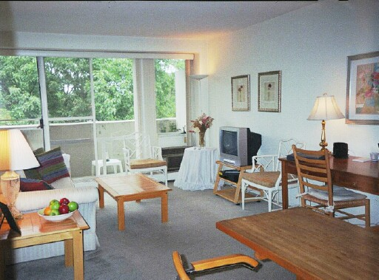
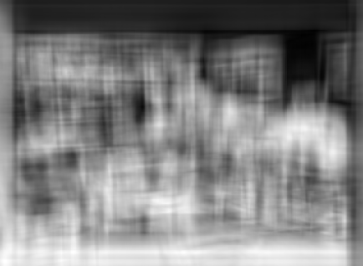
Object recognition
Is it really so hard?
Find the chair in this image
Pretty much garbage
Simple template matching is not going to make it

Slide 12
Object recognition
Is it really so hard?
Find the chair in this image
A “popular method is that of template matching, by point to point correlation of a model pattern with the image pattern. These techniques are inadequate for three-dimensional scene analysis for many reasons, such as occlusion, changes in viewing angle, and articulation of parts.” Nivatia & Binford, 1977.

Slide 13


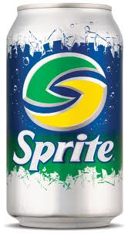
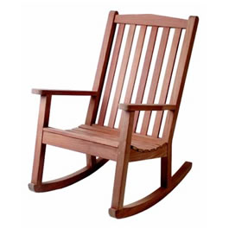
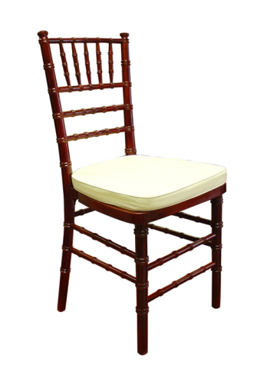
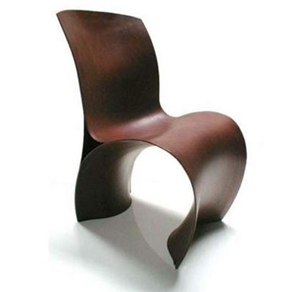
Why not use SIFT matching for everything?
Works well for object instances
Not great for generic object categories

Slide 14
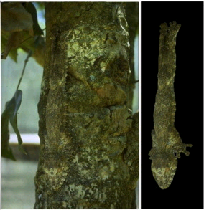
And it can get a lot harder
Brady, M. J., & Kersten, D. (2003). Bootstrapped learning of novel objects. J Vis, 3(6), 413-422

Slide 15
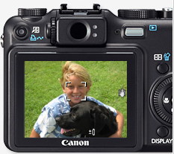
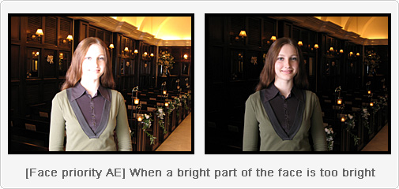
Applications: Computational photography

Slide 16
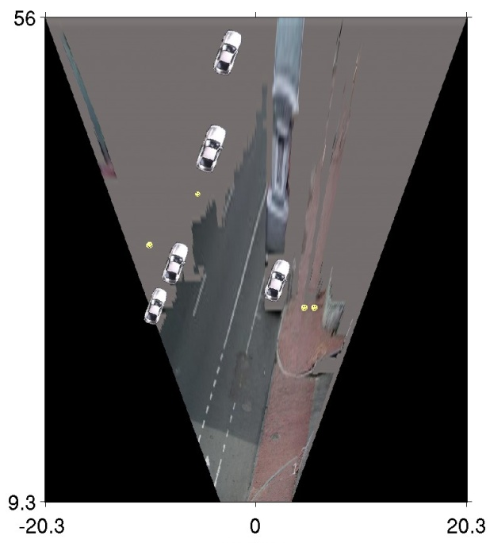
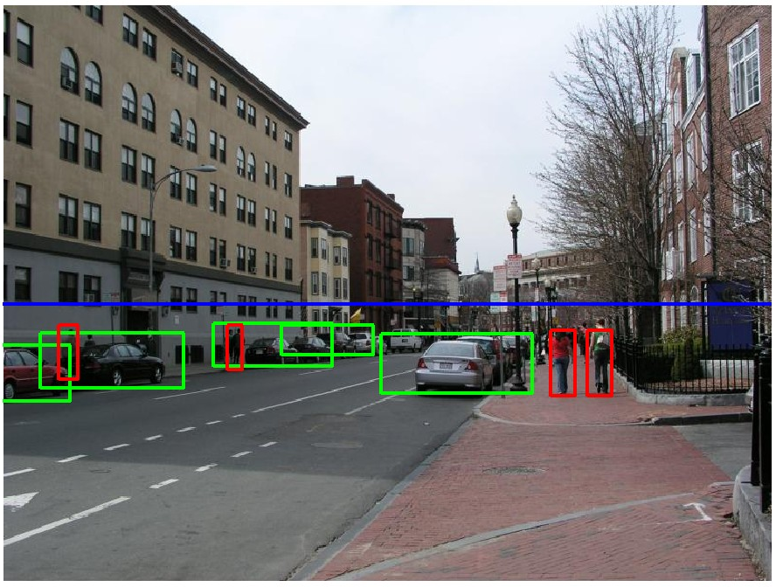
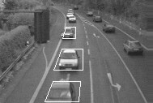
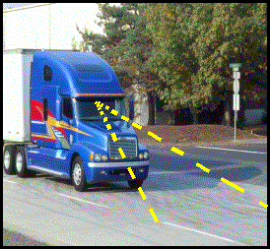
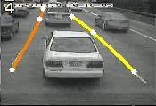
Applications: Assisted driving
Pedestrian and car detection
meters
Ped
Ped
Car
meters
Lane detection
Collision warning systems with adaptive cruise control,
Lane departure warning systems,
Rear object detection systems,

Slide 17
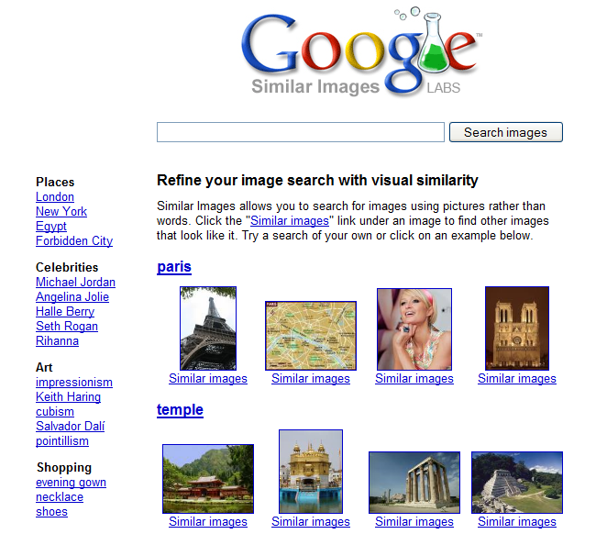
Applications: image search

Slide 18
How do human do recognition?
We don’t completely know yet
But we have some experimental observations.

Slide 19
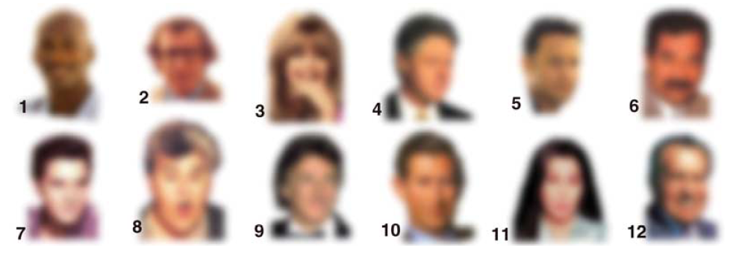
Observation 1
We can recognize familiar faces even in low-resolution images

Slide 20
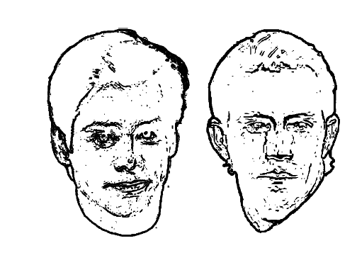
Observation 2:
Jim Carrey
Kevin Costner
High frequency information is not enough

Slide 21
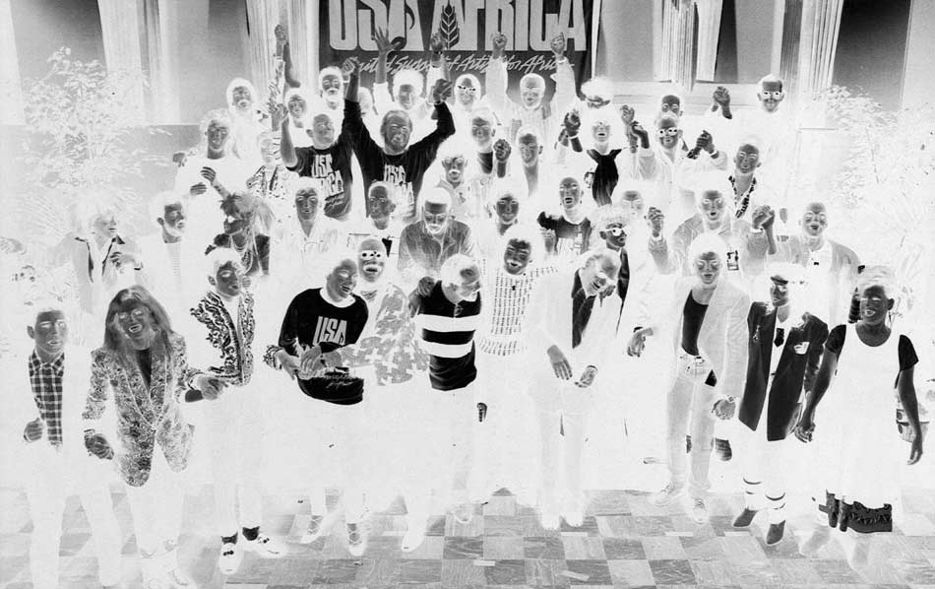
Observation 3:

Slide 22
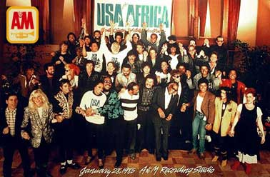
Observation 3:
Negative contrast is difficult

Slide 23
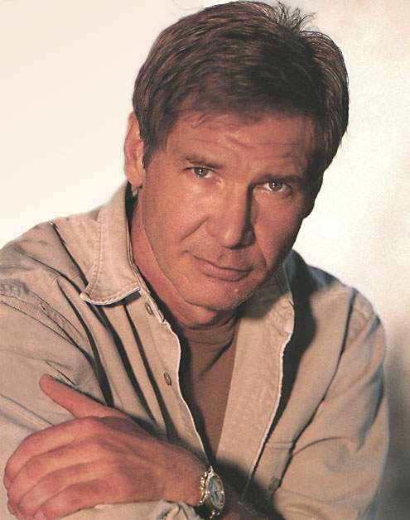
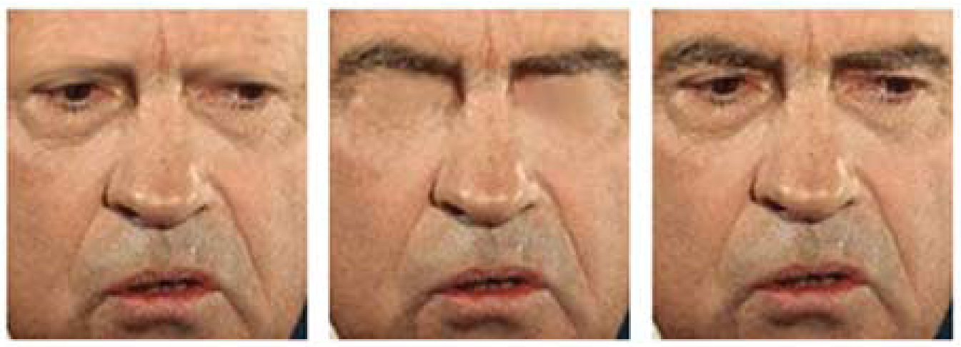
What is the single most important facial features for recognition?

Slide 24
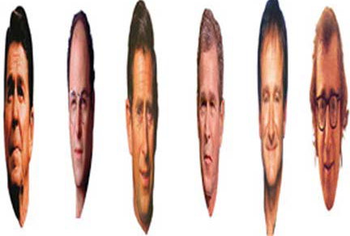
Observation 4:
Image Warping is OK

Slide 25
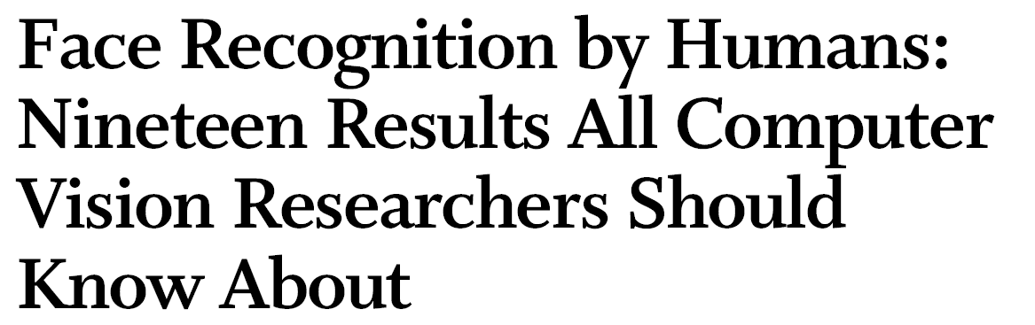
The list goes on
http://web.mit.edu/bcs/sinha/papers/19results_sinha_etal.pdf

Slide 26
Why is this hard?
Variability:
Camera position
Illumination
Shape parameters
Svetlana Lazebnik
Notes:
One could argue that invariance is the key challenge to computer vision. But is this still true with big data?

Slide 27
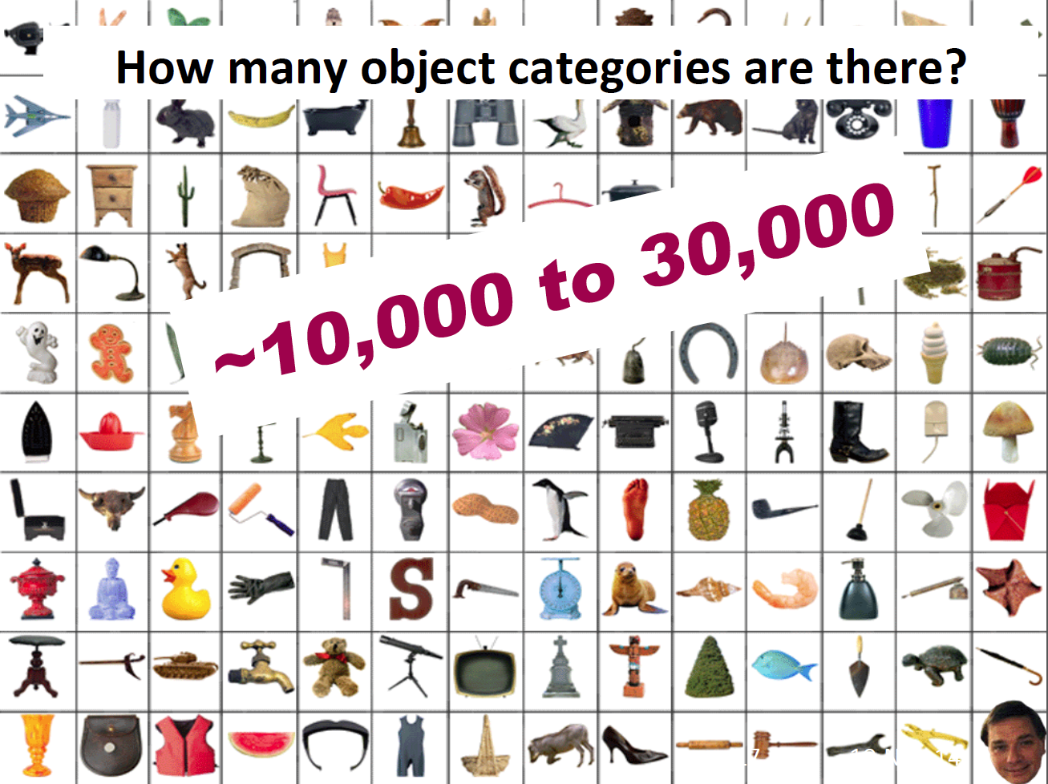

Slide 28
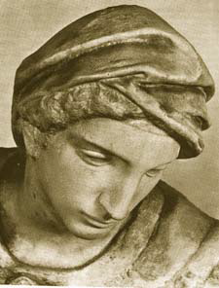
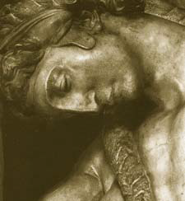
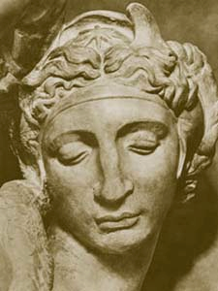
Challenge: variable viewpoint
Michelangelo 1475-1564

Slide 29
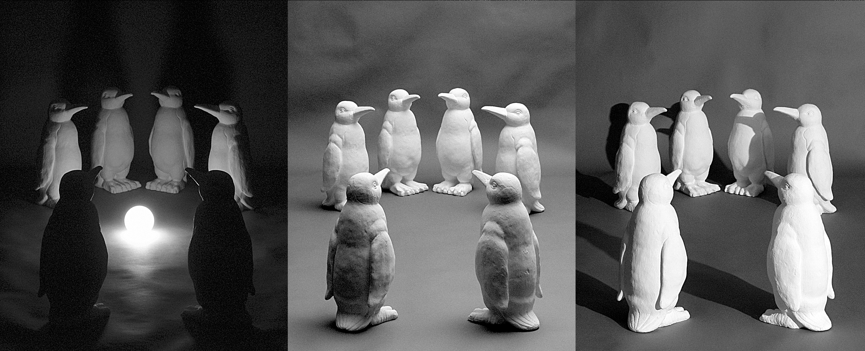
Challenge: variable illumination
image credit: J. Koenderink

Slide 30
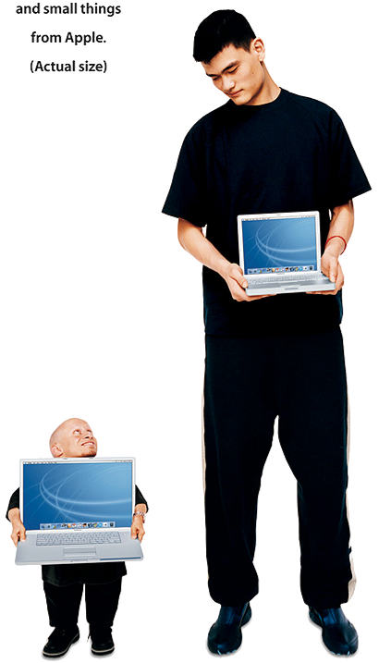
Challenge: scale

Slide 31
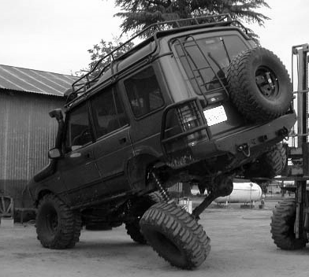
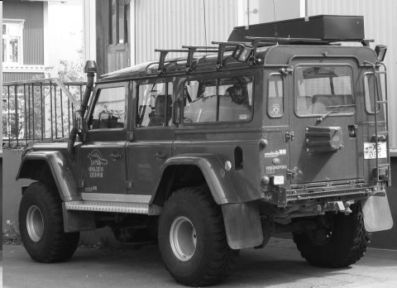
Challenge: deformation

Slide 32
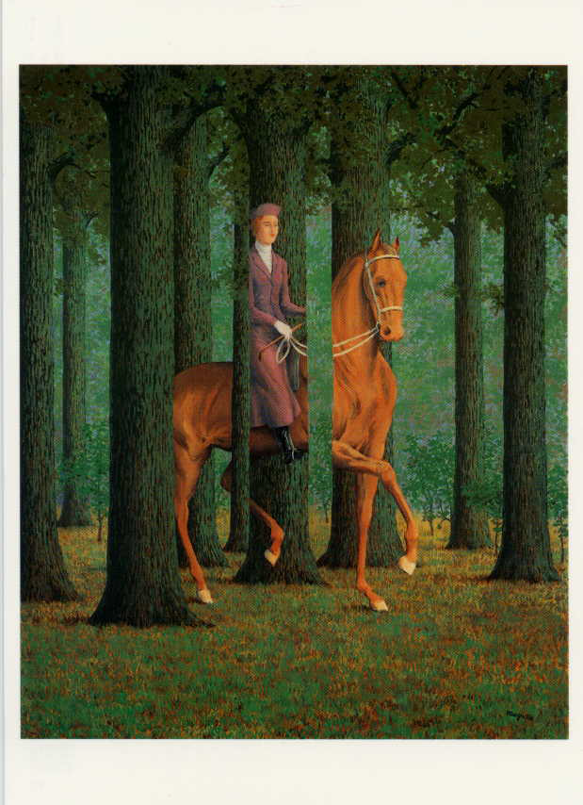
Challenge: Occlusion
Magritte, 1957

Slide 33
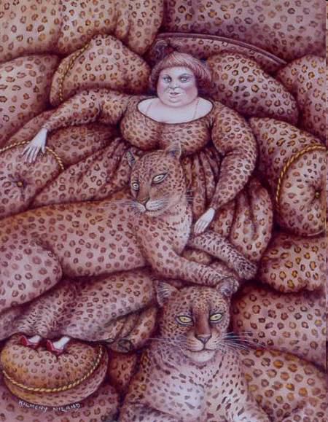
Challenge: background clutter
Kilmeny Niland. 1995

Slide 34
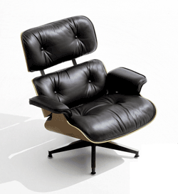
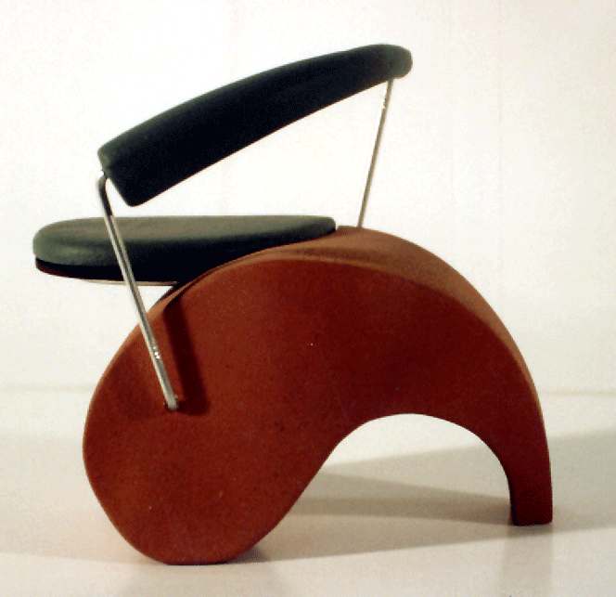
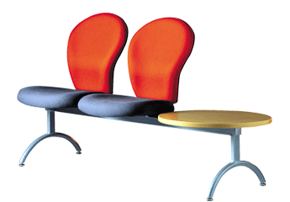
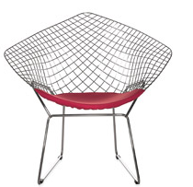
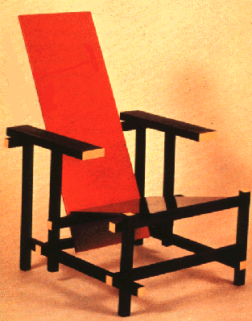
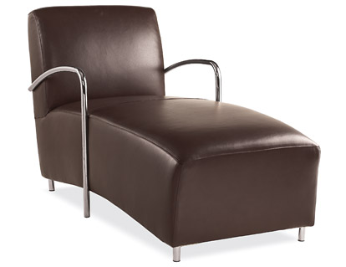
Challenge: intra-class variations
Svetlana Lazebnik
Notes:
Note English language issues. Try to not let language confound things.

Slide 35
History of ideas in recognition
1960s – early 1990s: the geometric era
Svetlana Lazebnik

Slide 36
θ
Variability:
Camera position
Illumination
Alignment
Shape: assumed known
Roberts (1965); Lowe (1987); Faugeras & Hebert (1986); Grimson & Lozano-Perez (1986); Huttenlocher & Ullman (1987)
Svetlana Lazebnik

Slide 37
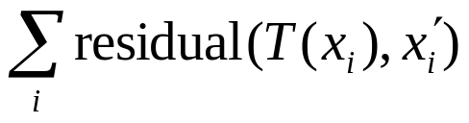
Instance Recognition
Alignment: fitting a model to a transformation between pairs of features (matches) in two images
x_{i}
x_{i}
Find transformation T
that minimizes
'
T
Svetlana Lazebnik

Slide 38
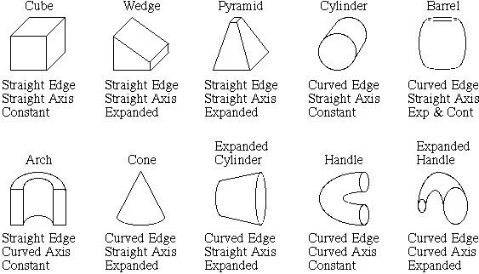
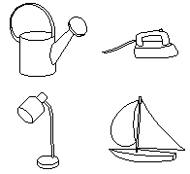
Recognition by components
Biederman (1987)
Primitives (geons)
Objects
http://en.wikipedia.org/wiki/Recognition_by_Components_Theory
Svetlana Lazebnik

Slide 39
History of ideas in recognition
1960s – early 1990s: the geometric era
1990s: appearance-based models
Svetlana Lazebnik

Slide 40
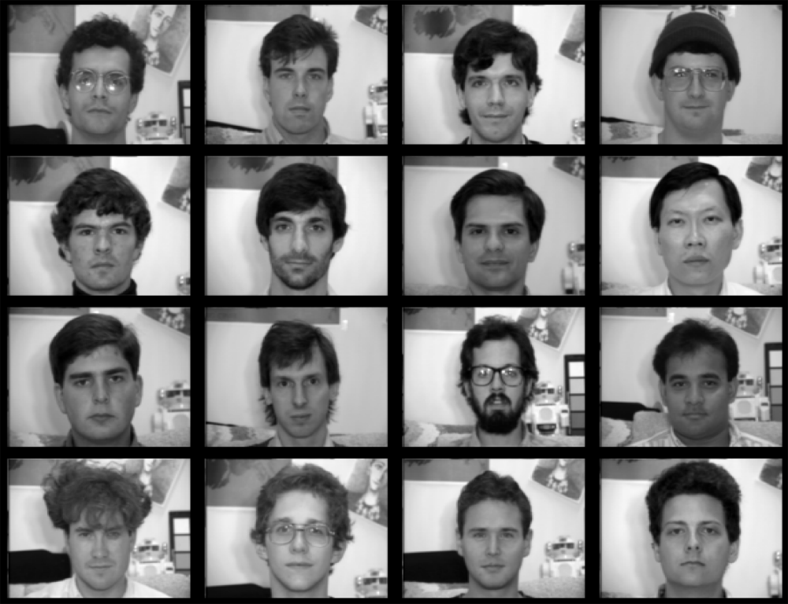
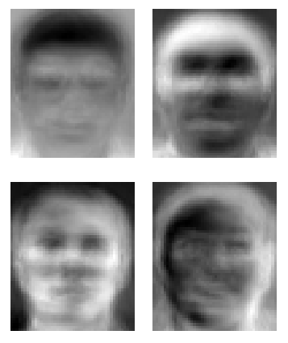
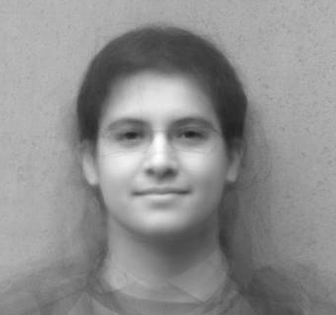
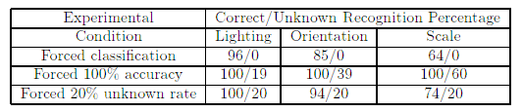
Eigenfaces (Turk & Pentland, 1991)
Svetlana Lazebnik
Notes:
An image can be compressed and reconstructed by starting from the mean, and adding a small number of scaled signed images. The scaled signed images come from doing PCA (or eigenvalue analysis) and adding the eigenfaces.

Slide 41
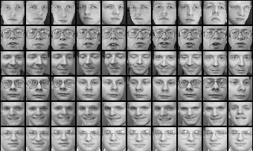
Limitations of global appearance models
Requires global registration of patterns
Not robust to clutter, occlusion, geometric transformations
Svetlana Lazebnik

Slide 42
History of ideas in recognition
1960s – early 1990s: the geometric era
1990s: appearance-based models
1990s – present: sliding window approaches
Svetlana Lazebnik

Slide 43
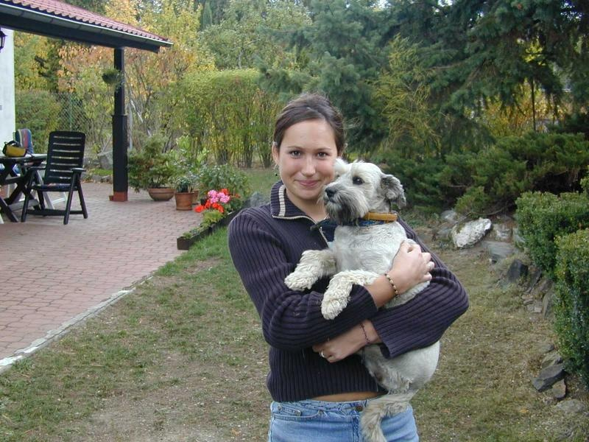
Sliding window approaches

Slide 44





Sliding window approaches
Turk and Pentland, 1991
Belhumeur, Hespanha, & Kriegman, 1997
Schneiderman & Kanade 2004
Viola and Jones, 2000
Schneiderman & Kanade, 2004
Agrawal and Roth, 2002
Poggio et al. 1993

Slide 45
History of ideas in recognition
1960s – early 1990s: the geometric era
1990s: appearance-based models
Mid-1990s: sliding window approaches
Late 1990s: local features
Svetlana Lazebnik

Slide 46






Local features for object instance recognition
D. Lowe (1999, 2004)

Slide 47
History of ideas in recognition
1960s – early 1990s: the geometric era
1990s: appearance-based models
Mid-1990s: sliding window approaches
Late 1990s: local features
Early 2000s: parts-and-shape models

Slide 48

Parts-and-shape models
Model:
  Object as a set of parts
  Relative locations between parts
  Appearance of part
Figure from [Fischler & Elschlager 73]

Slide 49


Representing people

Slide 50

Discriminatively trained part-based models
P. Felzenszwalb, R. Girshick, D. McAllester, D. Ramanan, "Object Detection with Discriminatively Trained Part-Based Models," PAMI 2009

Slide 51
History of ideas in recognition
1960s – early 1990s: the geometric era
1990s: appearance-based models
Mid-1990s: sliding window approaches
Late 1990s: local features
Early 2000s: parts-and-shape models
Mid-2000s: bags of features
Svetlana Lazebnik

Slide 52


Bag-of-features models
Svetlana Lazebnik

Slide 53



Bag-of-features models
Bag of ‘words’
Object
Svetlana Lazebnik

Slide 54
History of ideas in recognition
1960s – early 1990s: the geometric era
1990s: appearance-based models
Mid-1990s: sliding window approaches
Late 1990s: local features
Early 2000s: parts-and-shape models
Mid-2000s: bags of features
Present trends: data-driven methods, deep learning
Svetlana Lazebnik

