Slide 1
Lecture 3: Camera Rotations and Homographies

Slide 2
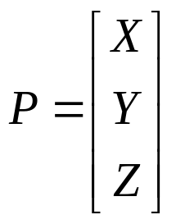
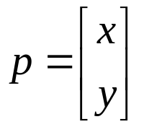
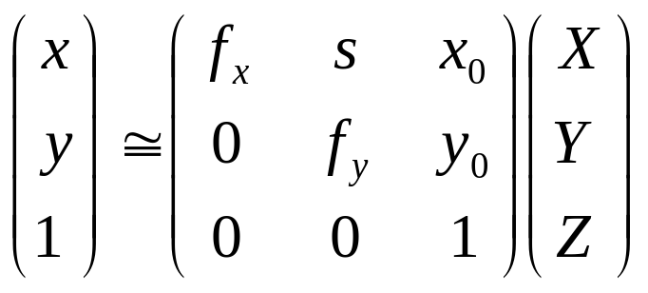
Recap: Normalized Camera
A camera is normalized if the units are chosen so that the focal length is 1. Then image coordinates (x,y) = X/Z,Y/Z
In general, mapping from world points to image points uses the “calibration matrix”. This takes a 3D world point X,Y,Z and returns its 2d homogeneous pixel coordinates.
Camera Center of Projection
(0,0,0)
Computer Vision, Robert Pless

Slide 3
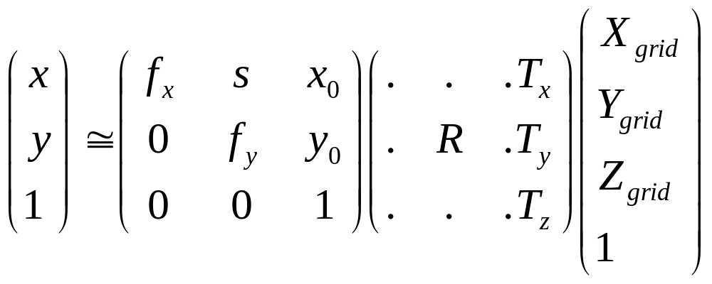

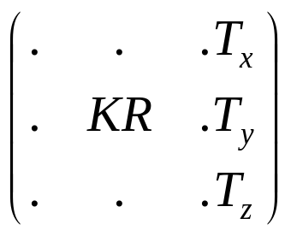
Complete projection matrix:
Computer Vision, Robert Pless

Slide 4
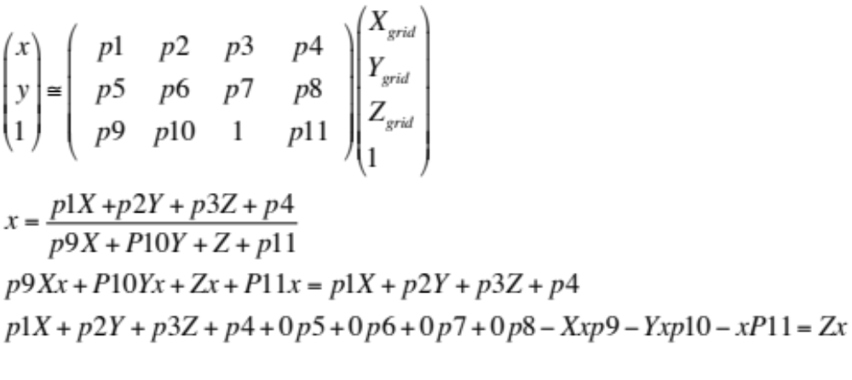


Slide 5
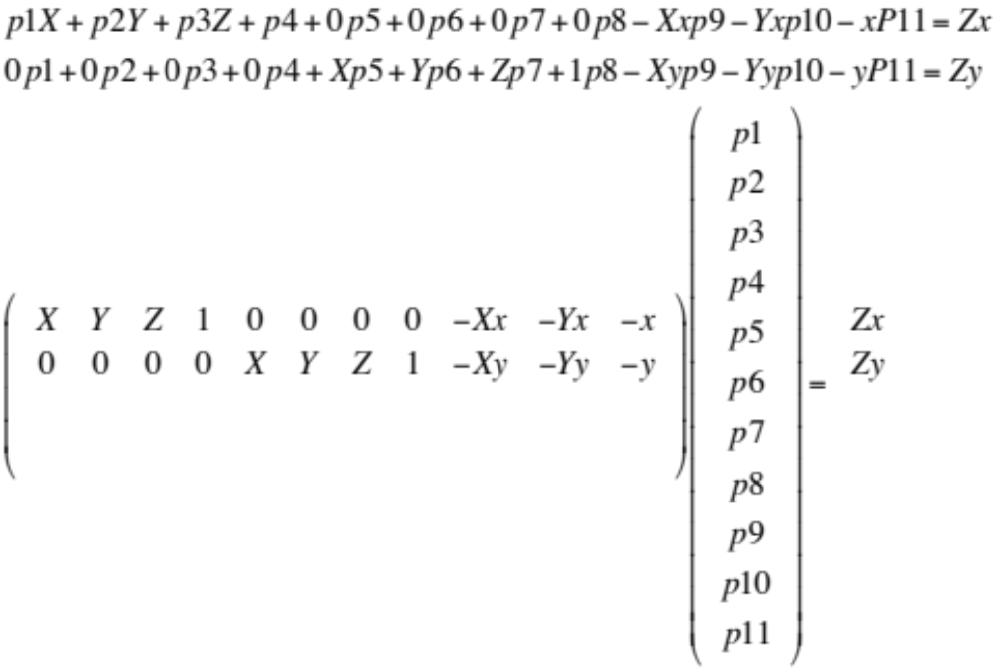

Slide 6
Let’s consider a special case. Suppose we take two pictures of the world, from a camera at the same location. But the camera has rotated between the two pictures.

Slide 7
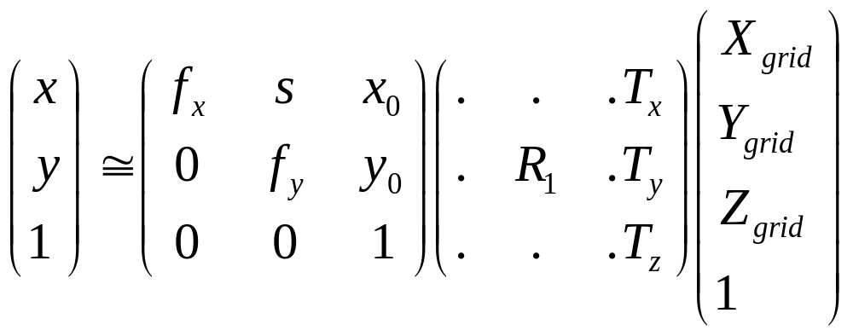
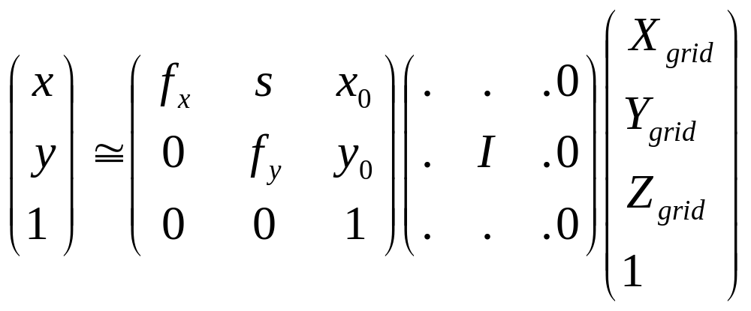
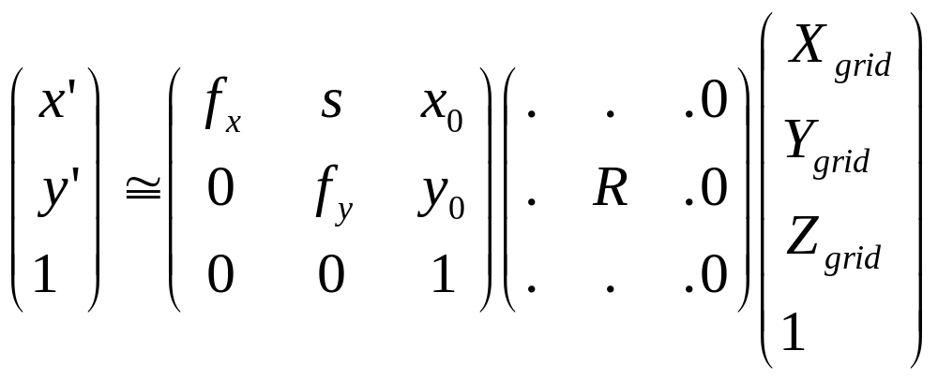
First image, points in 3D, measured in camera coordinate system.
Second image, camera has rotated.

Slide 8
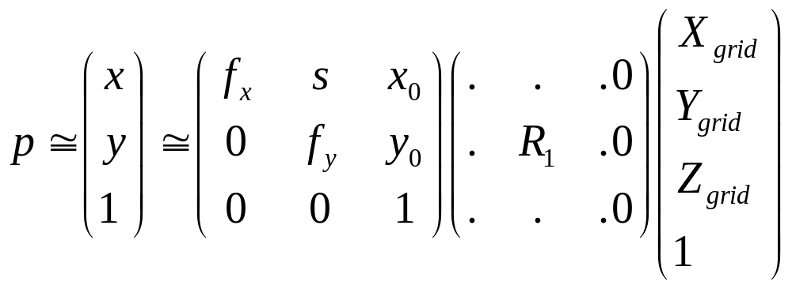
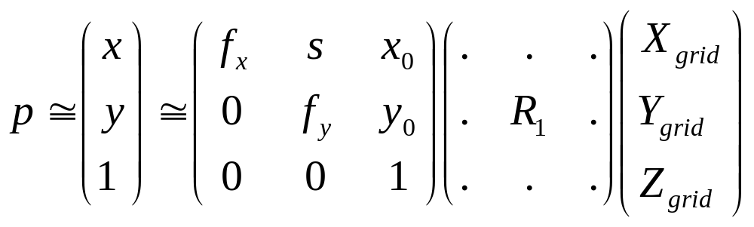



…mostly on chalkboard
On image 1
  p = KP
  And image 2,
  p’ = KRP
  p = K((KR)⁻¹)p’
  = KR⁻¹K⁻¹p’

Slide 9
p =KR⁻¹K⁻¹p’, so what?
Given a few examples of corresponding points p,p’, we can solve for a mapping KR⁻¹K⁻¹ of all points.

Slide 10
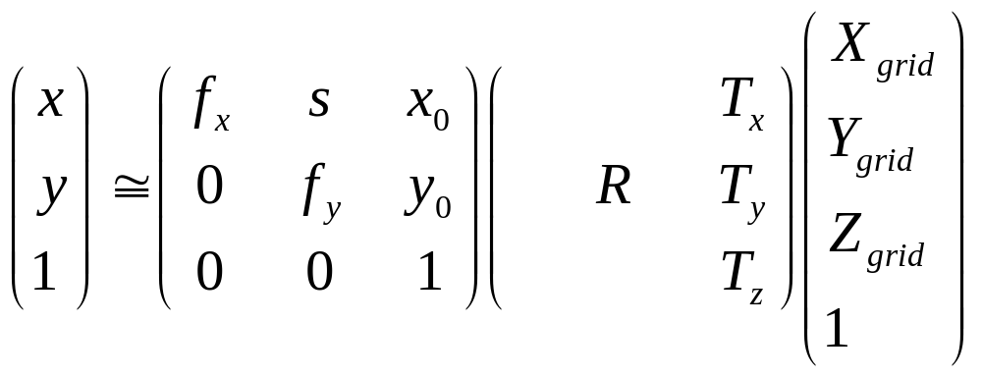
Another Special Case:… Suppose the world is a plane.
Projection from the world to the image:
Ignore z-coordinate (it is 0 anyway), drop the 3rd column of the 3x4 matrix, then you get a mapping between the plane and the image which is an arbitrary 3 x 3 matrix. Given 2 images:
p = KGP,
p’ = KG’P, so p’ = KG’(G⁻¹K⁻¹)p… p’ = (some 3x3) p
0
Irrelevant
Computer Vision, Robert Pless

Slide 11
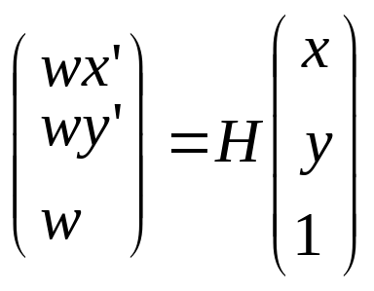
Homography: (x’,y’,1) ~ H (x,y,1)
Tells you exactly where the point goes.
Point (x,y) in one frame corresponds to point (x’,y’) in the other frame. If we need to think about multiple points, we may put subscripts on them.
Being careful about the homogenous coordinate, we write:
Computer Vision, Robert Pless

Slide 12
Homography is a “simple” example of a 3D to 2D transformation
It is also the “most complicated” linear 2D to 2D transformation.
What other 2D → 2D transformations are there?
Computer Vision, Robert Pless

Slide 13
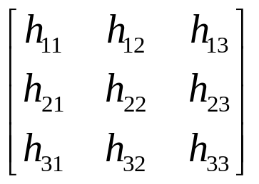
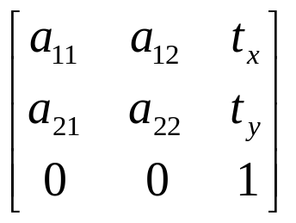
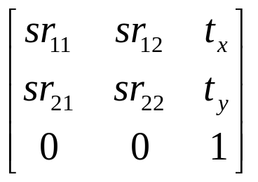
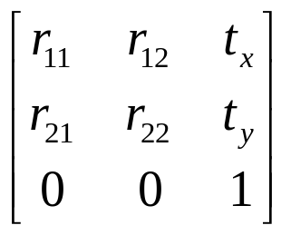
Homography is most general, encompasses other transformations
Views of a plane from different viewpoints, any view of a scene from the same viewpoint.
Projective
8 dof
Affine
6 dof
Images of a “far away” object under any rotation
Similarity
4 dof
Camera looking at an assembly line w/ zoom.
Euclidean
3 dof
Camera looking at an assembly line.
Computer Vision, Robert Pless

Slide 14
Invariants…
Concurrency, collinearity, order of contact (intersection, tangency, inflection, etc.), cross ratio
Projective
8 dof
Parallellism, ratio of areas, ratio of lengths on parallel lines (e.g midpoints).
Affine
6 dof
Similarity
4 dof
Ratios of any edge lengths, angles.
Euclidean
3 dof
Absolute lengths, areas.
Computer Vision, Robert Pless

Slide 15
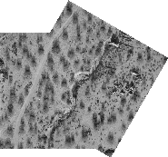


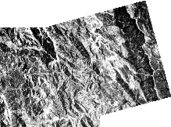


Image registration
Determining the 2d transformation that brings one image into alignment (registers it) with another.
Computer Vision, Robert Pless

Slide 16





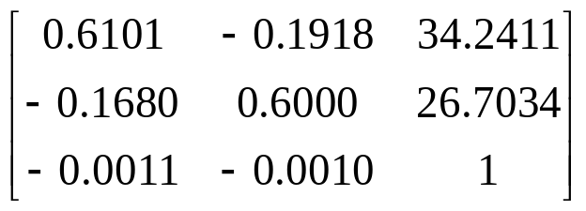
Image Warping
What kind of warps are these?
Computer Vision, Robert Pless
Notes:
Interpolation is basic tool that we have to deal with it. There are many interpolation
methods -- for example, nearest neighbor, bilinear, and bicubic.
Next is the image warping. This is the example of image warping. The left image
is the original image. And we apply the motion parameters here. After warping
or transforming, we will get this as the result.
The motion parameters here is of the projective model. Therefore, we can see that
the resulting image contain many effects together like the rotation, translation,
zooming in here, shrinking around here, chirping and keystoning.

Slide 17
How to solve for these mappings?
Given:
Solve for:
Computer Vision, Robert Pless

Slide 18
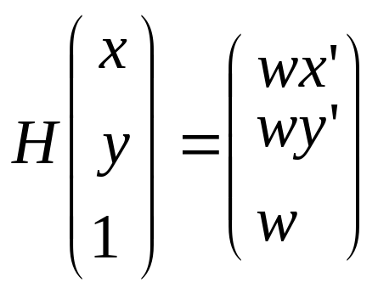
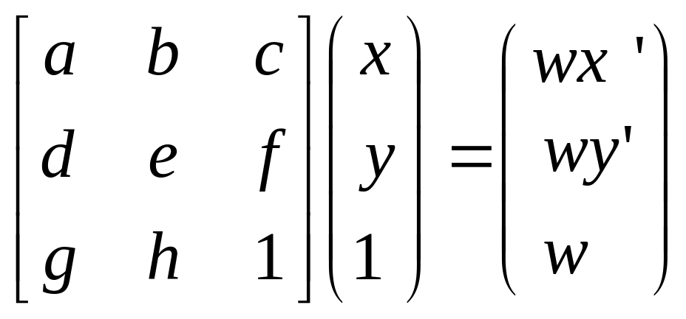
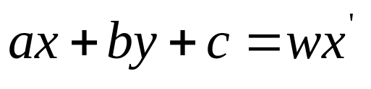
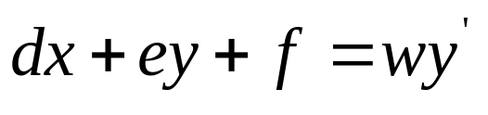

Unwrapping a matrix.
Write out the lines of this matrix equation.
And remember which variables are unknown.
Computer Vision, Robert Pless

Slide 19
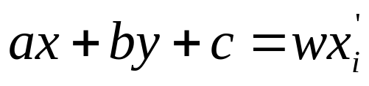
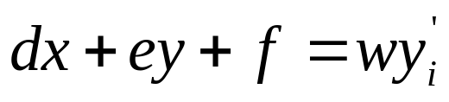
Unwrapping a matrix.
Computer Vision, Robert Pless

Slide 20
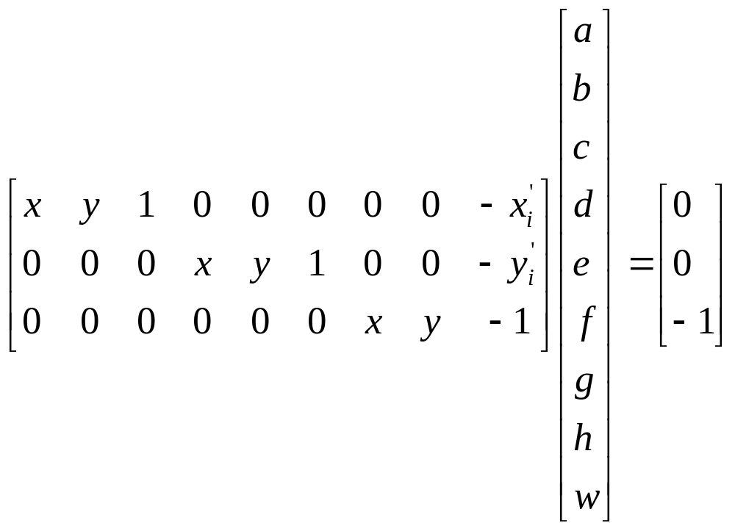
Looks like another matrix equation:
Computer Vision, Robert Pless

Slide 21
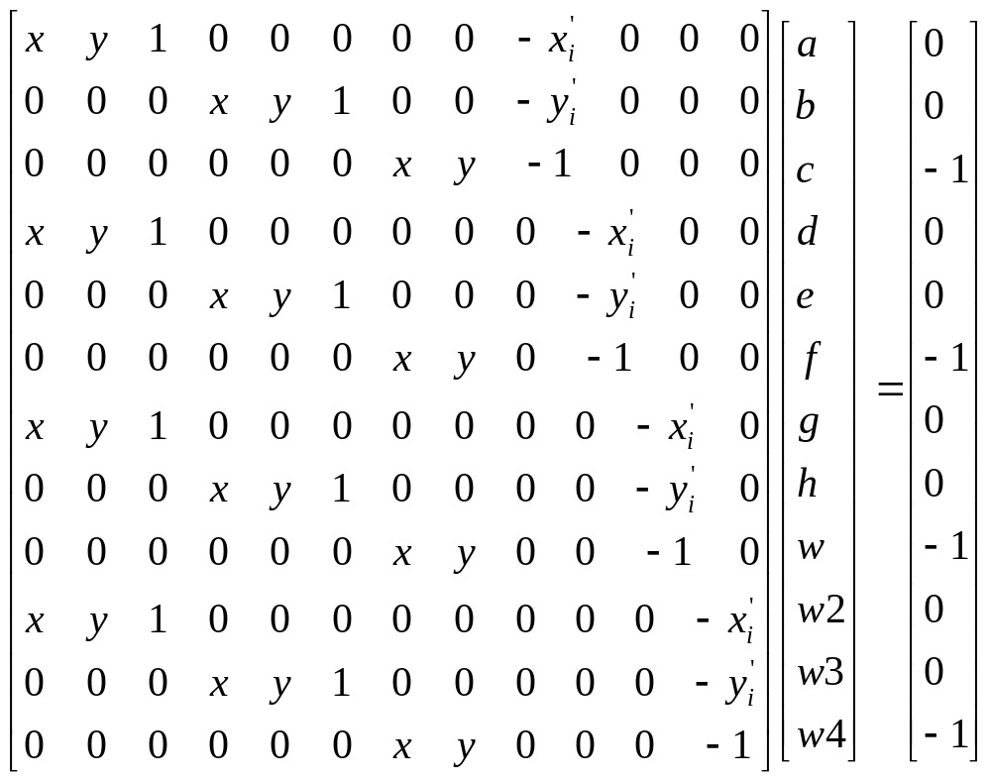
Looks like another matrix equation:
Data from different points
Computer Vision, Robert Pless

Slide 22
Challenges…
Maybe you have error in finding corresponding points, and want to use many many corresponding points. Then your number of unknowns keeps growing…
Is there a better way?
At the end of the day, how do we compute a real coordinate x’?
Computer Vision, Robert Pless

Slide 23
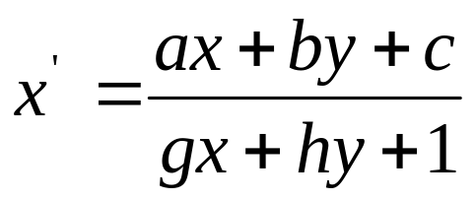
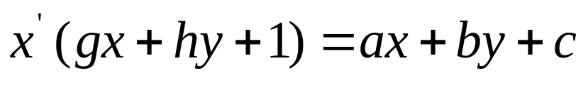
The game of “finding the linear constraint…”
x’ = wx’ / w
Non-linear
Linear (in a,b,c,g,h)
Computer Vision, Robert Pless

Slide 24
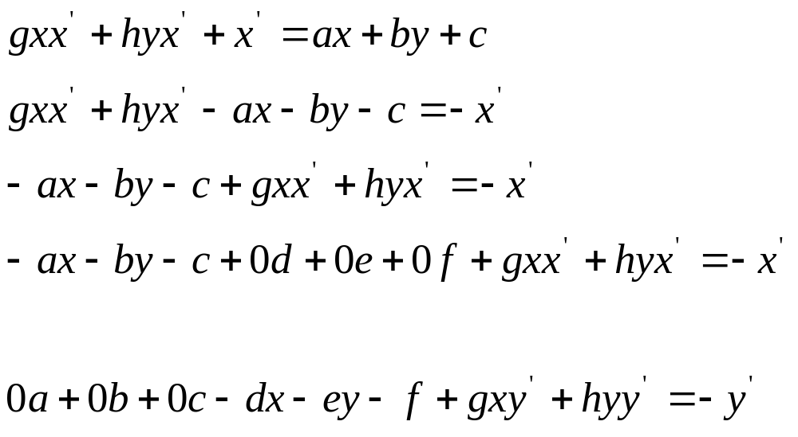
Computer Vision, Robert Pless

Slide 25
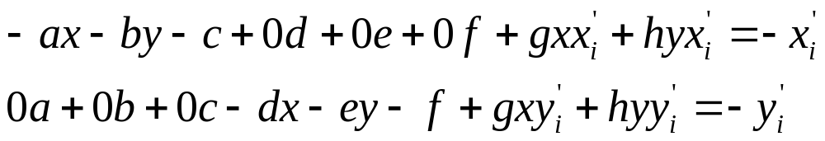
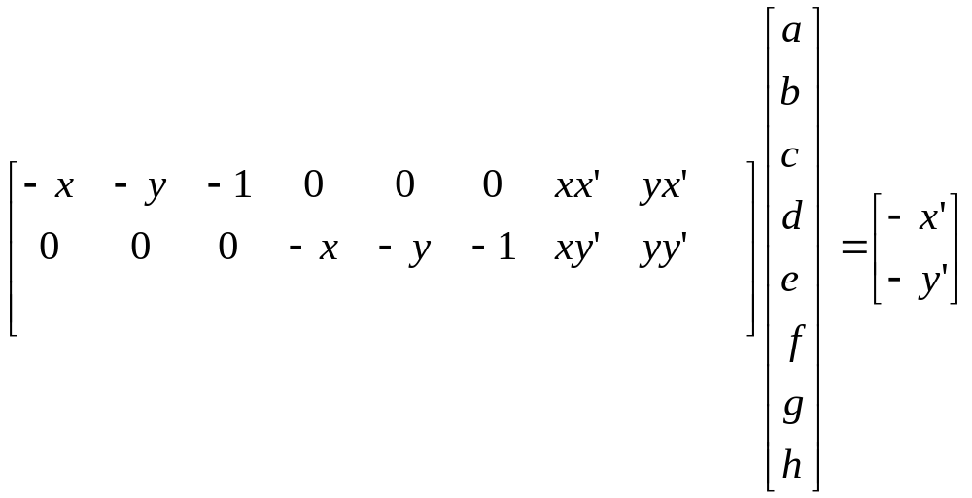
And just add two more rows for each corresponding point
Computer Vision, Robert Pless

Slide 26
Ax=b
Matlab: x = A\b
Then make your homography matrix by rearranging x into a 3 x 3 matrix
Size of A? b?
Computer Vision, Robert Pless

Slide 27
How to warp images?

