Slide 1
A Classical Problem: Given two images of a scene, taken by cameras at two different viewpoints, can you determine how the camera has moved, and/or, what the 3D structure of the scene is.
Images
Cameras
intersecting rays
corresponding point

Slide 2
Attach the origin of the coordinate system to the pinhole of the camera.
x
y
z
Then one pixel “looks” along a ray in space that goes through the origin, that is, that pixel is the image of a point P in space whose position is:
A pinhole camera is a device that samples rays going through a point

Slide 3
q₂
q₁
Simplify the camera model, so that our corresponding points are rays,
q₁ and q₂

Slide 4

The transformation between coordinate systems is a rotation R and a translation T transform elements in coordinate system 1 to coordinate system 2.
q₁
Rq₁
T
q₂
Three coplanar vectors:

Slide 5

Teaser:
A general framework for motion estimation for “almost all” camera models, including multi-camera systems, catadioptic systems, central or non-central projections.
Water

Slide 6
Cameras…
CCD
In standard cameras, a pixel samples light coming along a ray in space. Ray is defined by pixel location, calibration matrix, and position and orientation of the camera.

Slide 7
Non-standard cameras are often built from standard cameras and one or more mirrors. A pixel samples light arriving from a ray in space defined by position and orientation of the camera, and a calibration function which takes into account reflections or refractions.
CCD

Slide 8
Generalized Imaging Model
pixel, and corresponding ray
CCD
Abstract away from exactly how light bounces around to end up on the CCD. Instead just identify, for each pixel, what light rays it does capture.

Slide 9
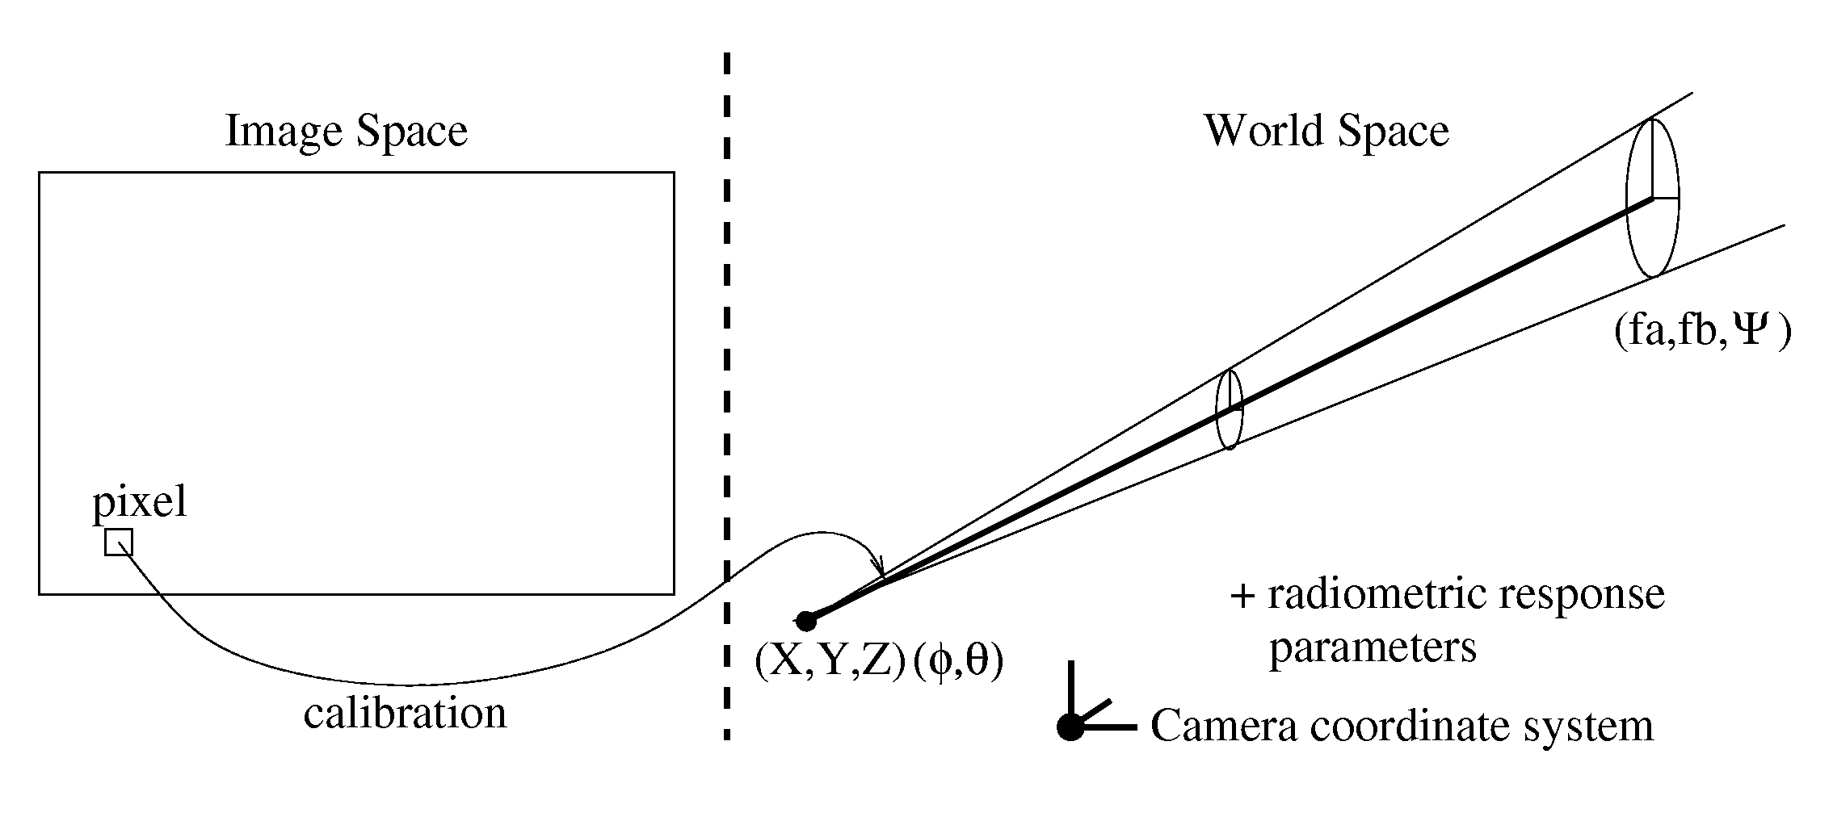
Generalized Imaging Model, Grossberg & Nayar 2001
…but I am concentrating on geometric relationships, so I will use just the center of the ray.

Slide 10
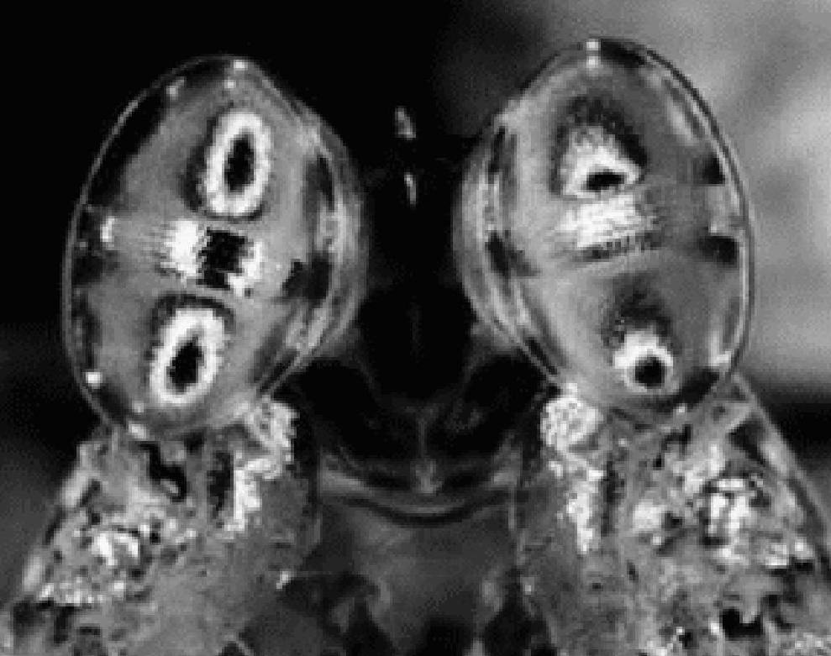
Modeling (bizarre) Natural Vision Systems
P
q
Plucker Vectors of a line are: (q,q’):
q: any vector in the direction of the line
q’ = P x q, for any point P on the line
q is direction vector
q’ is moment vector,
(q and q’ perpendicular, scale invariant)
All q’ are zero in pinhole camera model.
All q are identical in an orthographic camera
Stomatopod vision. Each compound eye has two hemispheres separated by a roughly cylindrical strip. Some points in the world are samples 6 times by this pair of eyes (the black spots are reflections of the camera in this image).
Facts about Plucker vectors
From Theoretical Kinematics, Bothema and Roth

Slide 11
Discrete Camera Motion
Corresponding points in two images implies that the rays meet in space.
q_{a}, q_{a}’
q_{b}, q_{b}’
R,T
How does the intersection of these rays constrain the transformation between the cameras?

Slide 12
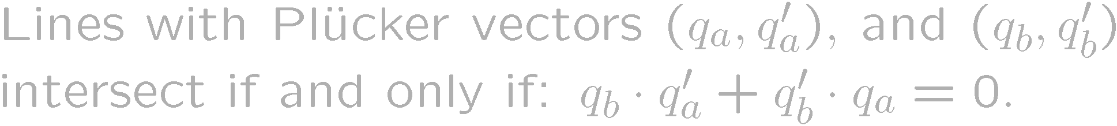
Discrete Motion Derivation
For a given rigid motion (R,T), the Plucker vectors change:
Substituting:
Essential Matrix

Slide 13
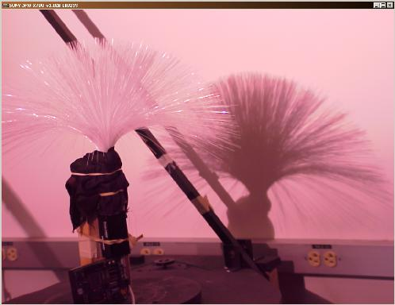
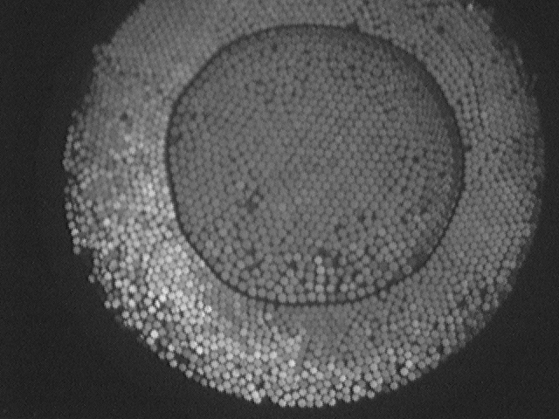
Conclusions / Future Work
For image analysis, don’t really need forward projection models --- The physical world does the projection for you.
Extend linearization tools for standard Essential matrix to generalized case.
Build / Test new camera designs.

Slide 14
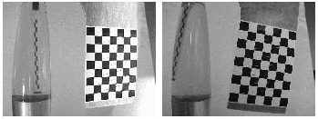
Discrete Motions II

