Slide 1
Lecture 8: Stereo

Slide 2
Depth from Stereo
Goal: recover depth by finding image coordinate x’ that corresponds to x
X
X
x
z
x
x’
x'
f
f
C
Baseline B
C’

Slide 3
Depth from Stereo
Goal: recover depth by finding image coordinate x’ that corresponds to x
Problems
Calibration: How do we recover the relation of the cameras (if not already known)?
Correspondence: How do we search for the matching point x’?
X
X
x
z
x
x’
x'
f
f
C
Baseline B
C’

Slide 4
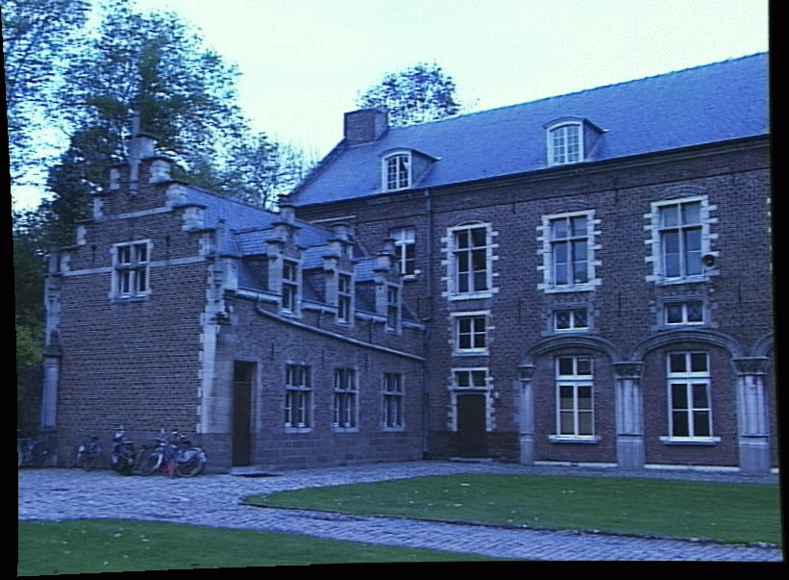
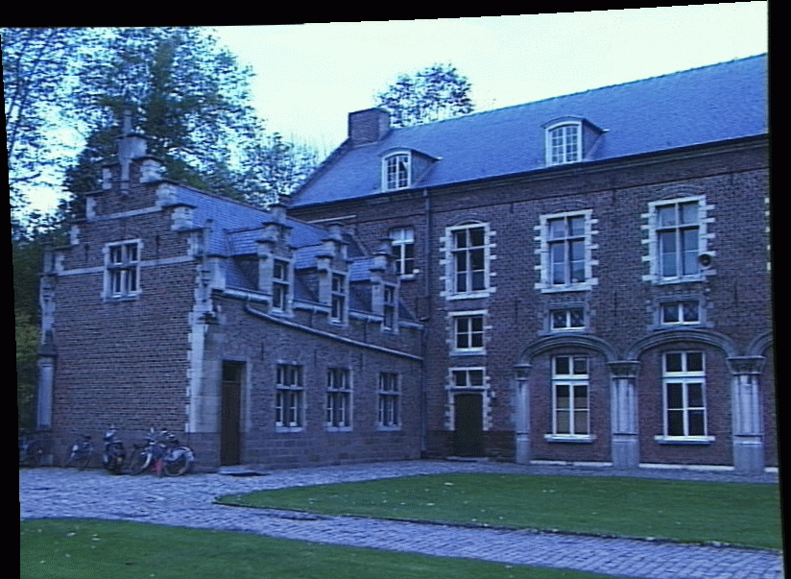
Correspondence Problem
We have two images taken from cameras at different positions
How do we match a point in the first image to a point in the second? What constraints do we have?

Slide 5
A pre-sequitor
Fun with vectors.
Let a and b be two vectors.
What is a (dot) b?
What is a (cross) b?
Quiz:
What is a (dot) a?
(what is the data type?)
What is a (cross) a?

Slide 6
Recap, Camera Calibration.
Projection from the world to the image:
Calibration
Rotation
Translation
Homogeneous equal, “equal up to a scale factor”

Slide 7
Idea of today…
Today we are going to characterize the geometry of how two cameras look at a scene… but perhaps a more complicated.
And by scene, we mean, at first, just one point.

Slide 8
Epipolar Constraint
There are 3 degrees of freedom in the position of a point in space; there are four DOF for image points in two planes… Where does that fourth DOF go?

Slide 9
Epipolar Lines
Potential 3d points
Red point - fixed
=> Blue point lies on a line
Each point in one image corresponds to a line of possibilities in the other.
“Epipolar Line”

Slide 10
Epipolar Geometry
=> Red point lies on a line
baseline
Blue point - fixed
An epipole is the image point of the other camera’s center.
All epipolar lines meet at the epipoles. Epipoles lie on the cameras’ baseline.
Is there other structure available among epipolar lines?

Slide 11

Another look (with math).
We have two images, with a point in one and the epi-polar line in the other. Lets take away the image plane, and just leave the image centers.

Slide 12
Another look (with math).

Slide 13

Another look (with math).
a translation vector defining where one camera is relative to the other.

Slide 14
Another look (with math).
a translation vector defining where one camera is relative to the other.

Slide 15
Another look (with math).
A point on one image lies on ray in space with direction

Slide 16
Another look (with math).
Which rays from, the second camera center might intersect ray p?

Slide 17
Another look (with math).
Those rays lie in the plane defined by the ray in space and the second camera center.

Slide 18
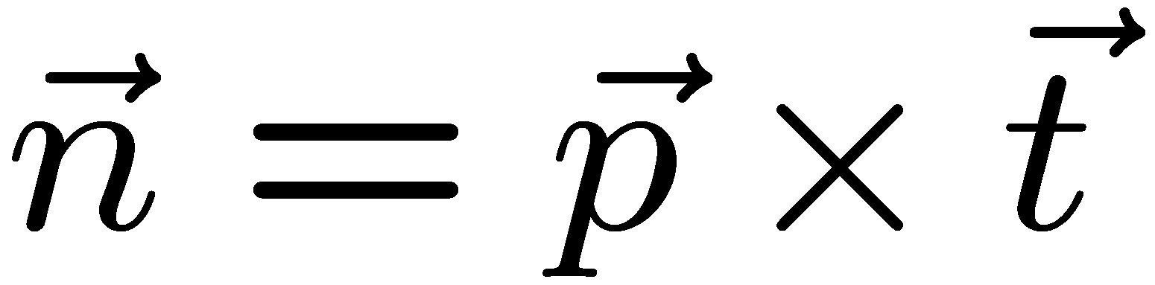

Another look (with math).
-
normal of the plane is perpendicular to both p and t.
Math fact: a x b is a vector perpendicular to a and b.

Slide 19
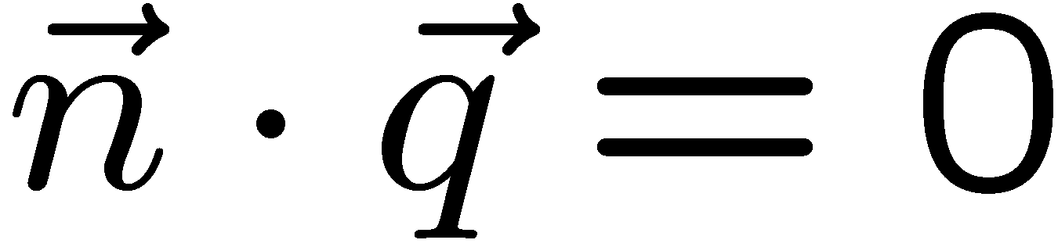
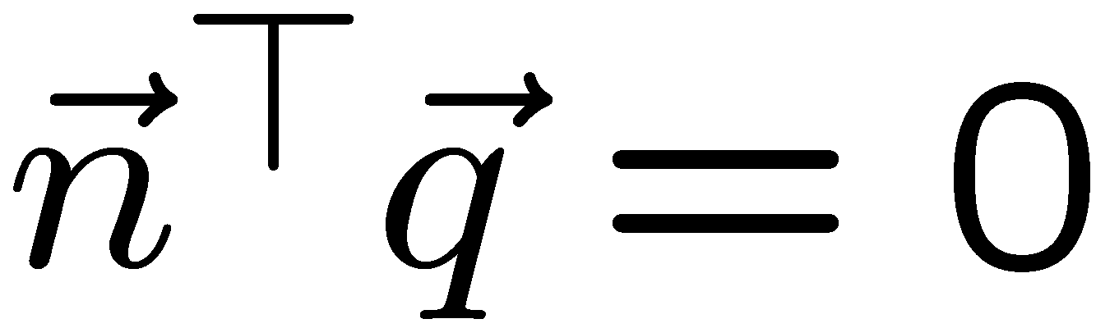

Another look (with math).
All lines in the plane are perpendicular to the normal to normal to the plane.
Math fact. a^{T}b = 0 if a is perpendicular to b

Slide 20
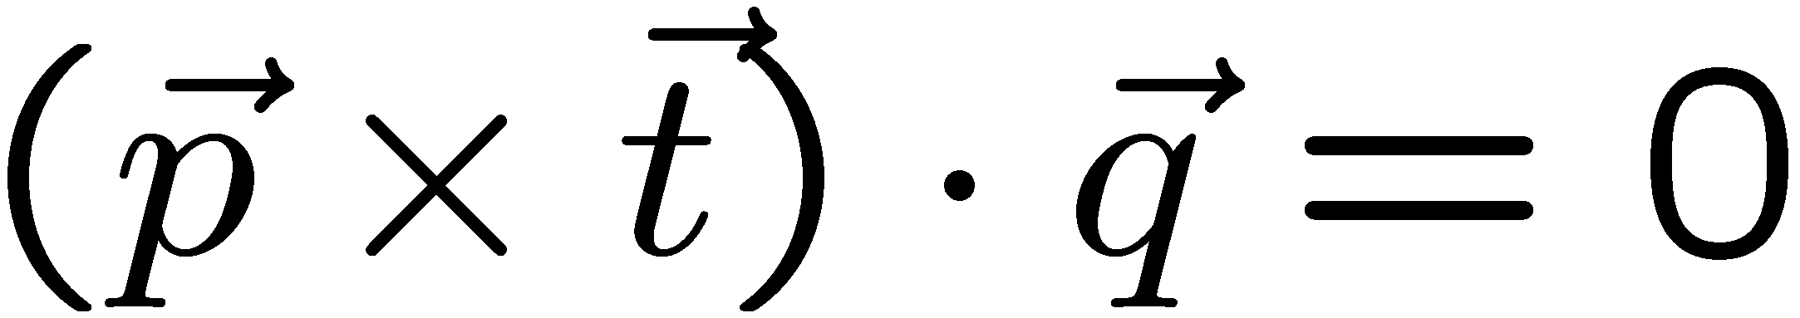
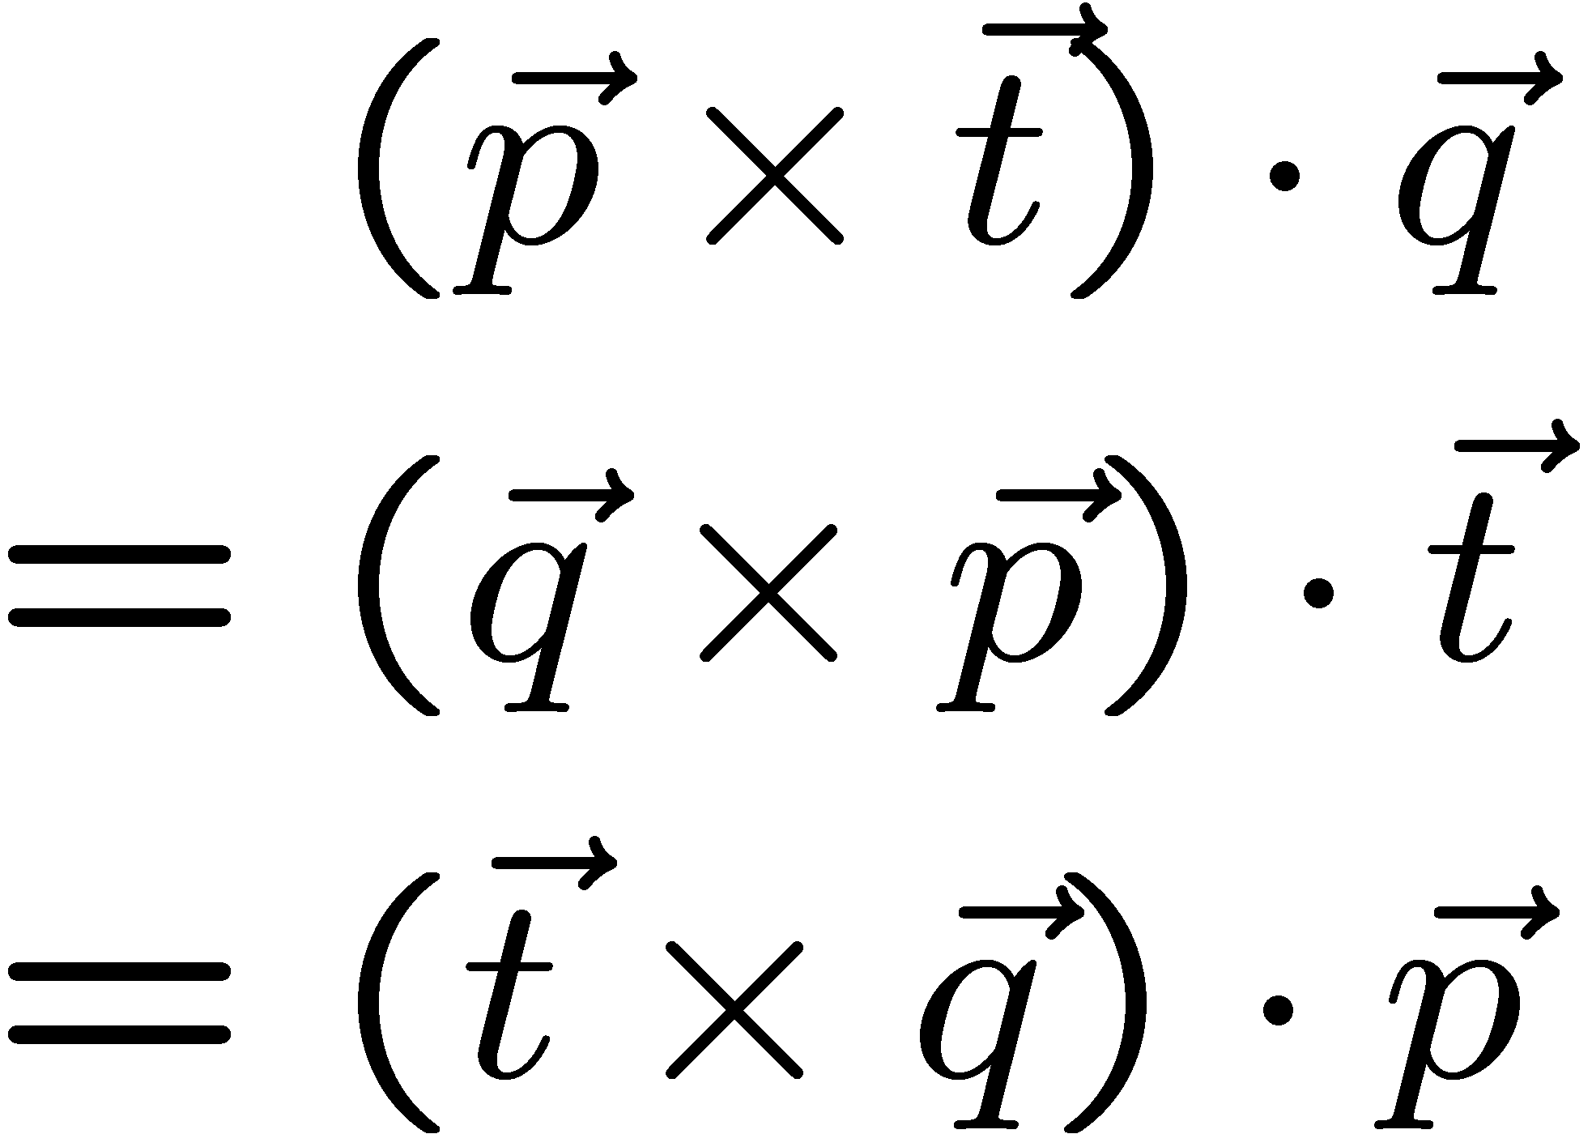
Putting it all together.
Fact:
Cameras separated by translation t
Ray from one camera center in direction p
Ray from second camera center q

Slide 21
Lets put the images back in.
y
x
P is relative to some coordinate system.

Slide 22
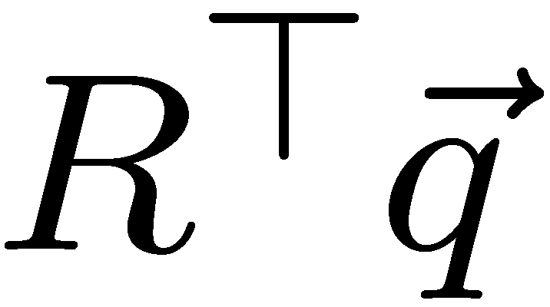
y
x
y
x
q is relative to some coordinate system, but that camera may have rotated.
So the q in the first coordinate system is some rotation times the q measured in the second coordinate system

Slide 23
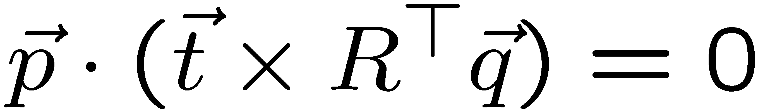
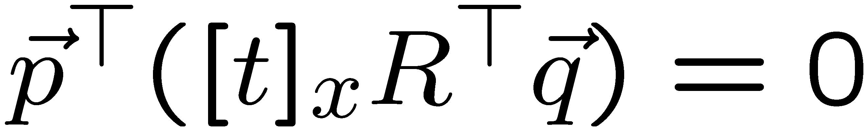
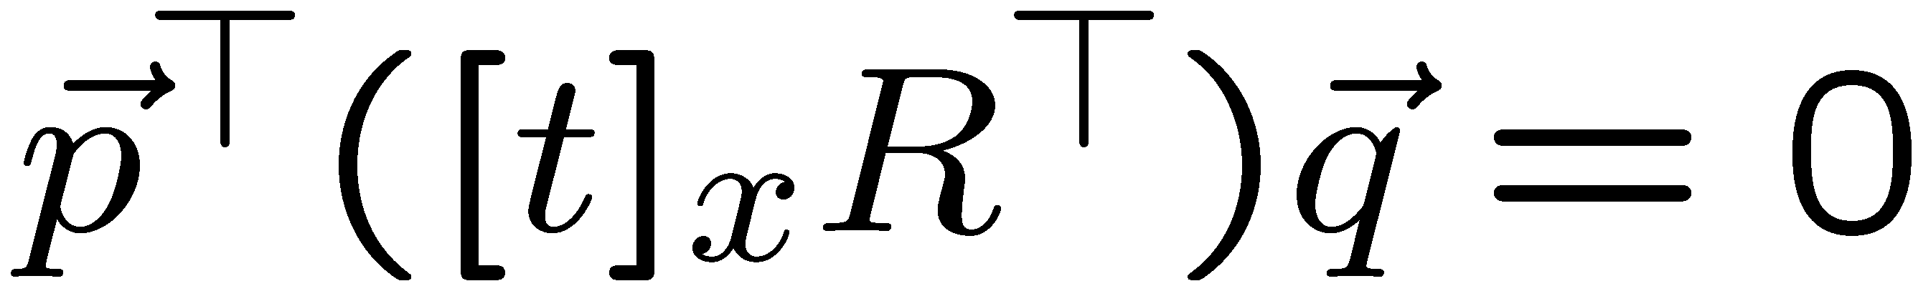
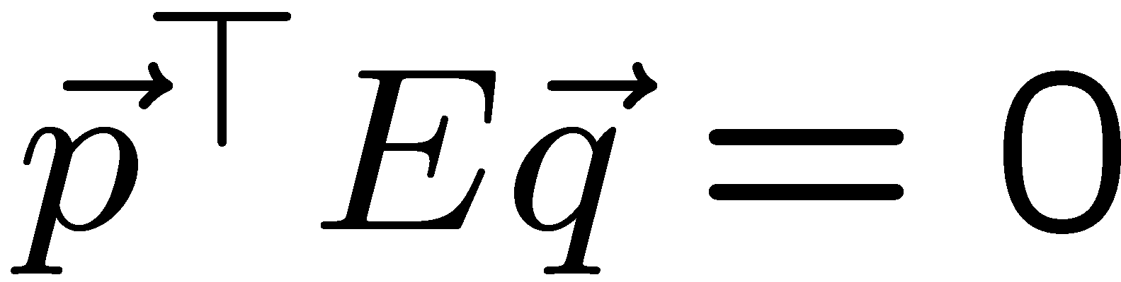

y
x
y
x
All three vectors in the same plane:

Slide 24
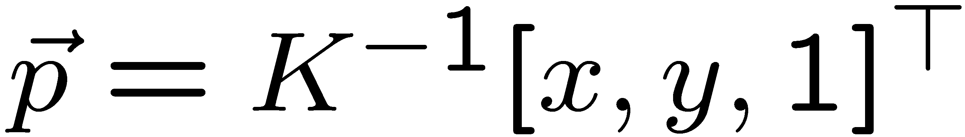
Put images even more back in.
(x,y)
K maps normalized coordinates onto pixel coordinates. Given pixel coordinates (x,y), K⁻¹ remaps those to a direction from the camera center.

Slide 25
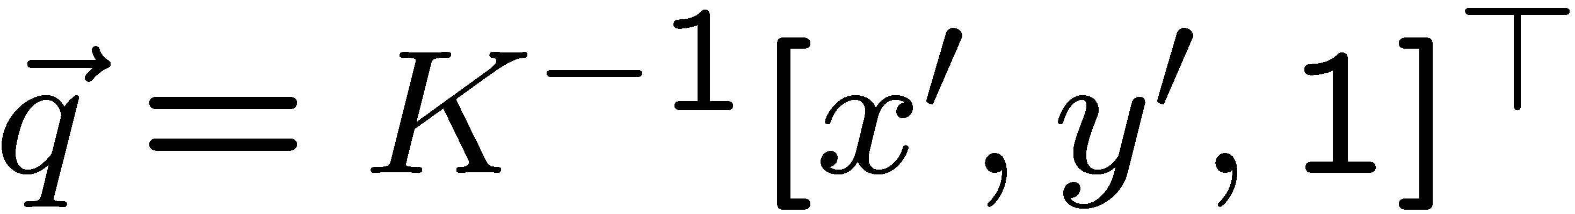
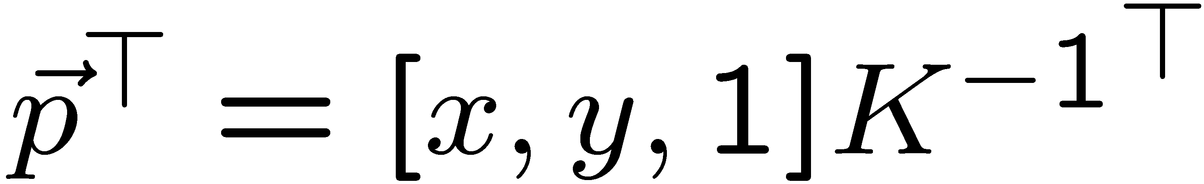
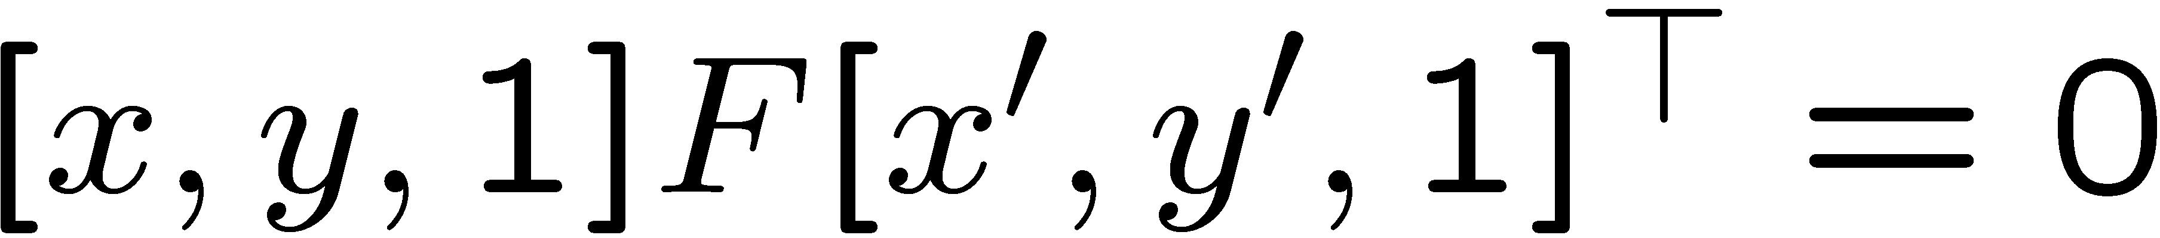
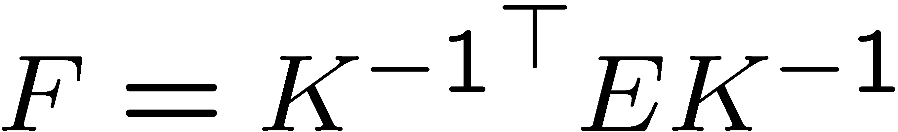
Normalized camera system, epipolar equation.
“Uncalibrated” Case, epipolar equation:
F is the “fundamental matrix”.

Slide 26
Using the equation…
Click on “the same world point” in the left and right image, to get a set of point correspondences:
(x,y) that correspond to (x’,y’).
Need at least 8 points (each point gives one constraint, F is 3x3, but scale invariant, so there are 8 degrees of freedom in F).

Slide 27
So what… how to use F
Potential 3d points
Red point - fixed
=> Blue point lies on a line
Given a point (x,y) on the left image, F defines the “Epipolar Line” and tells where the corresponding points must lie. How is that line defined? Only easy in homogenous coordinates!

Slide 28
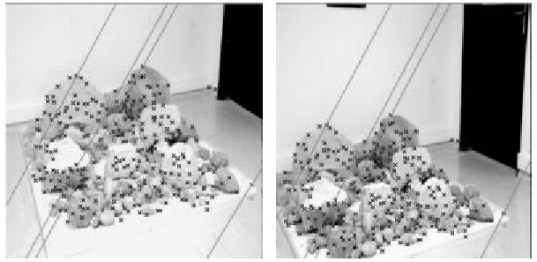
Examples
http://www-sop.inria.fr/robotvis/personnel/sbougnou/Meta3DViewer/EpipolarGeo.html

Slide 29
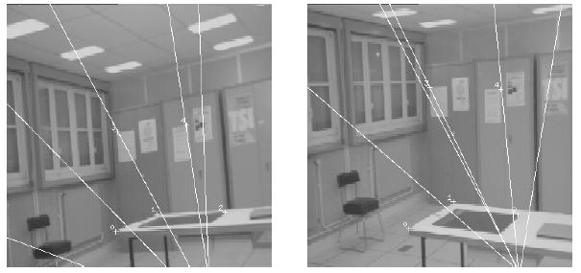
Examples

Slide 30
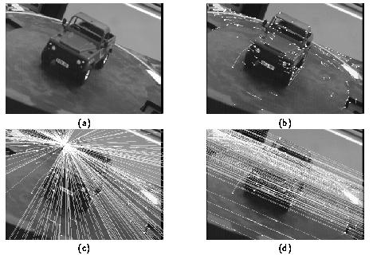
Examples
Geometrically, why do all epipolar lines intersect?

Slide 31
Estimating the Fundamental Matrix
8-point algorithm
Least squares solution using SVD on equations from 8 pairs of correspondences
Enforce det(F)=0 constraint using SVD on F
Minimize reprojection error
Non-linear least squares

Slide 32
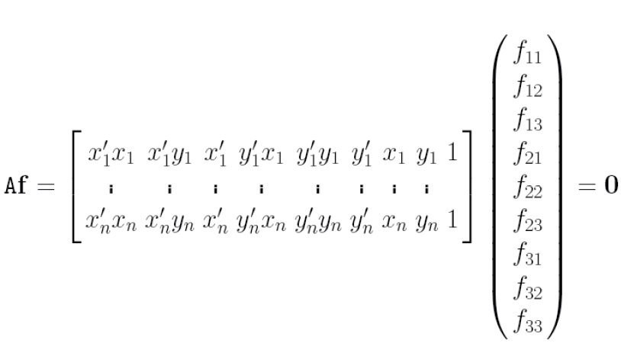
8-point algorithm
Solve a system of homogeneous linear equations
Write down the system of equations

Slide 33
8-point algorithm
Solve a system of homogeneous linear equations
Write down the system of equations
Solve f from Af=0 using SVD
Matlab:
[U, S, V] = svd(A);
f = V(:, end);
F = reshape(f, [3 3])’;

Slide 34
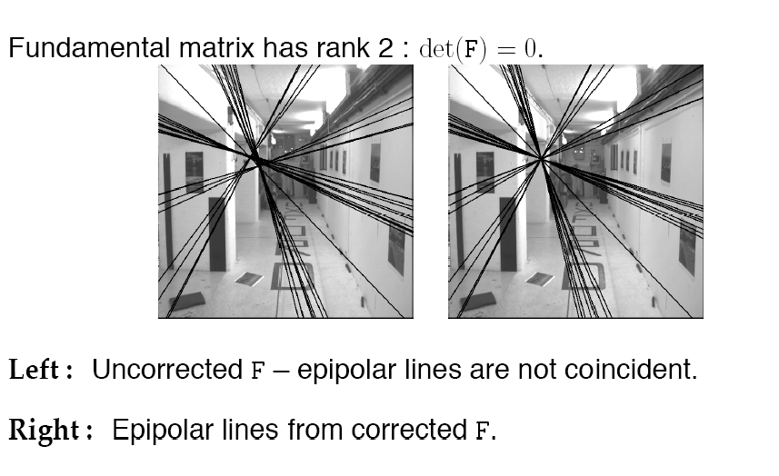
Need to enforce singularity constraint

Slide 35
8-point algorithm
Solve a system of homogeneous linear equations
Write down the system of equations
Solve f from Af=0 using SVD
Resolve det(F) = 0 constraint by SVD
Matlab:
[U, S, V] = svd(A);
f = V(:, end);
F = reshape(f, [3 3])’;
Matlab:
[U, S, V] = svd(F);
S(3,3) = 0;
F = U*S*V’;

Slide 36
8-point algorithm
Solve a system of homogeneous linear equations
Write down the system of equations
Solve f from Af=0 using SVD
Resolve det(F) = 0 constraint by SVD
Notes:
Use RANSAC to deal with outliers (sample 8 points)
Solve in normalized coordinates
mean=0
RMS distance = (1,1,1)
This also help estimating the homography for stitching

Slide 37
Comparison of homography estimation and the 8-point algorithm
Assume we have matched points x x’ with outliers
Homography (No Translation)
Fundamental Matrix (Translation)

Slide 38
Comparison of homography estimation and the 8-point algorithm
Assume we have matched points x x’ with outliers
Homography (No Translation)
Fundamental Matrix (Translation)
Correspondence Relation
RANSAC with 4 points

Slide 39
Comparison of homography estimation and the 8-point algorithm
Assume we have matched points x x’ with outliers
Homography (No Translation)
Fundamental Matrix (Translation)
Correspondence Relation
RANSAC with 4 points
Correspondence Relation
RANSAC with 8 points
Enforce by SVD

Slide 40
So
Given 2 images. Can find the relative translation and rotations of the cameras. How do we find depth?

Slide 41
Simplest Case: Parallel images
Image planes of cameras are parallel to each other and to the baseline
Camera centers are at same height
Focal lengths are the same
Then, epipolar lines fall along the horizontal scan lines of the images

Slide 42
Depth from disparity
X
z
x
x’
f
f
O
Baseline B
O’
Disparity is inversely proportional to depth.

Slide 43
Stereo image rectification

Slide 44
Stereo image rectification
Reproject image planes onto a common plane parallel to the line between camera centers
Pixel motion is horizontal after this transformation
Two homographies (3x3 transform), one for each input image reprojection
C. Loop and Z. Zhang. Computing Rectifying Homographies for Stereo Vision. IEEE Conf. Computer Vision and Pattern Recognition, 1999.

Slide 45
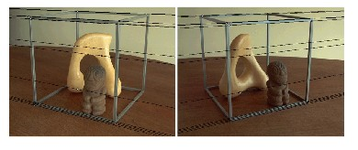
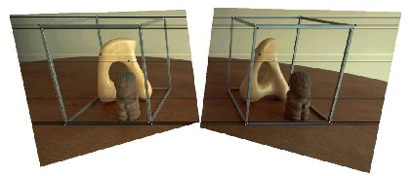
Rectification example

Slide 46
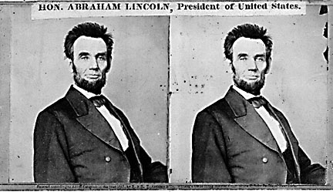
Basic stereo matching algorithm
If necessary, rectify the two stereo images to transform epipolar lines into scanlines
For each pixel x in the first image
Find corresponding epipolar scanline in the right image
Examine all pixels on the scanline and pick the best match x’
Compute disparity x-x’ and set depth(x) = fB/(x-x’)

Slide 47
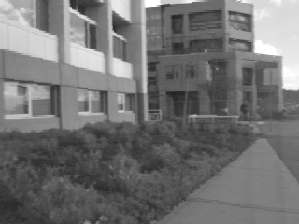
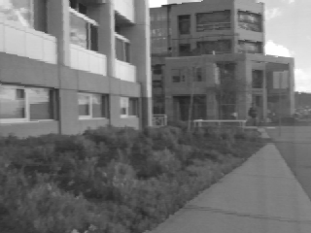
Correspondence search
Left
Right
scanline
Matching cost
disparity
Slide a window along the right scanline and compare contents of that window with the reference window in the left image
Matching cost: SSD or normalized correlation

Slide 48
Correspondence search
Left
Right
scanline
SSD

Slide 49
Correspondence search
Left
Right
scanline
Norm. corr

Slide 50
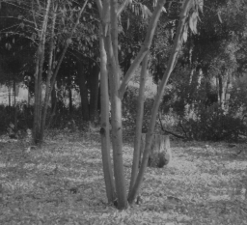
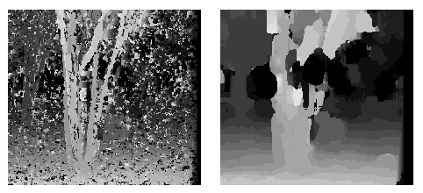
Effect of window size
W = 3
W = 20
Smaller window
+ More detail
More noise
Larger window
+ Smoother disparity maps
Less detail
Notes:
smaller window: more detail, more noise
bigger window: less noise, more detail

Slide 51

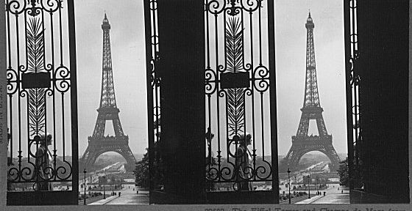
Failures of correspondence search
Textureless surfaces
Occlusions, repetition
Non-Lambertian surfaces, specularities

Slide 52
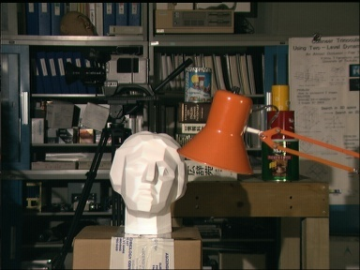

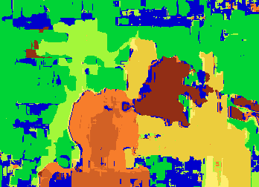
Results with window search
Data
Window-based matching
Ground truth

Slide 53
How can we improve window-based matching?
So far, matches are independent for each point
What constraints or priors can we add?

Slide 54
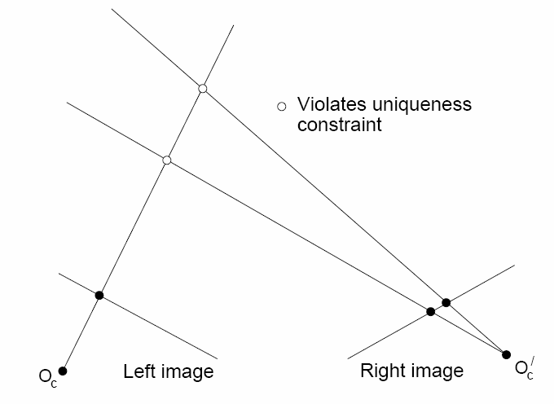
Stereo constraints/priors
Uniqueness
For any point in one image, there should be at most one matching point in the other image

Slide 55
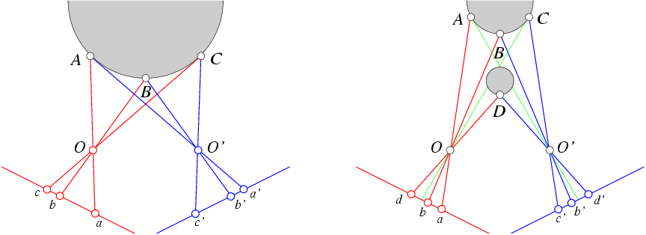
Stereo constraints/priors
Uniqueness
For any point in one image, there should be at most one matching point in the other image
Ordering
Corresponding points should be in the same order in both views

Slide 56
Stereo constraints/priors
Uniqueness
For any point in one image, there should be at most one matching point in the other image
Ordering
Corresponding points should be in the same order in both views
Ordering constraint doesn’t hold

Slide 57
Priors and constraints
Uniqueness
For any point in one image, there should be at most one matching point in the other image
Ordering
Corresponding points should be in the same order in both views
Smoothness
We expect disparity values to change slowly (for the most part)

Slide 58

Stereo matching as energy minimization
I₁
I₂
D
W₁(i )
W₂(i+D(i ))
D(i )
Energy functions of this form can be minimized using graph cuts
Y. Boykov, O. Veksler, and R. Zabih, Fast Approximate Energy Minimization via Graph Cuts, PAMI 2001

Slide 59

Many of these constraints can be encoded in an energy function and solved using graph cuts
Before
Graph cuts
Ground truth
Y. Boykov, O. Veksler, and R. Zabih, Fast Approximate Energy Minimization via Graph Cuts, PAMI 2001
For the latest and greatest: http://www.middlebury.edu/stereo/

Slide 60
Summary
Epipolar geometry
Epipoles are intersection of baseline with image planes
Matching point in second image is on a line passing through its epipole
Fundamental matrix maps from a point in one image to a line (its epipolar line) in the other
Can solve for F given corresponding points (e.g., interest points)
Can recover canonical camera matrices from F (with projective ambiguity)
Stereo depth estimation
Estimate disparity by finding corresponding points along scanlines
Depth is inverse to disparity

Slide 61
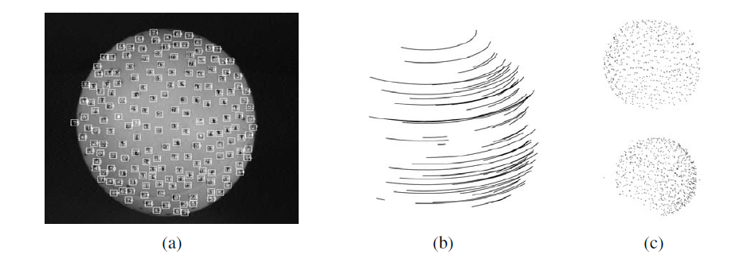
Next class: structure from motion

Slide 62
But first, Project 2.

