Slide 1
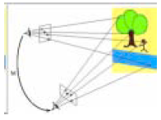
Lecture 11
our goal is to understand the process of multi-camera vision.
Last time, we studies the “Essential” and “Fundamental” Matrices, which describe where a point in one image may appear in a second image, and how to solve the stereo matching problem.
Computer Vision, Robert Pless

Slide 2
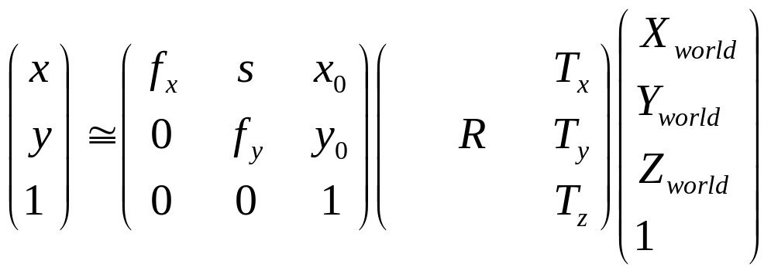
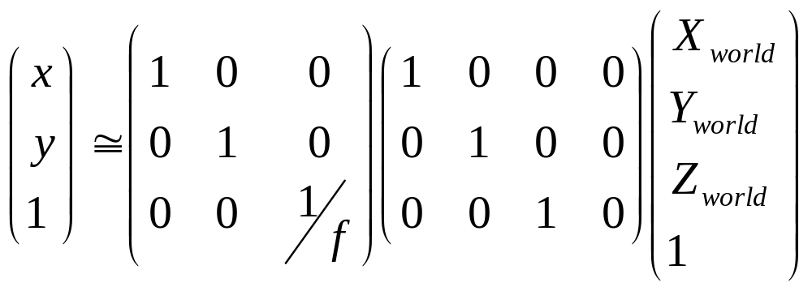
Projections one more time!
The “normalized camera” helps to simplify geometric properties.
Today, we consider what happens when points in the scene move. And a little bit of how to measure motion on an image.
Computer Vision, Robert Pless

Slide 3
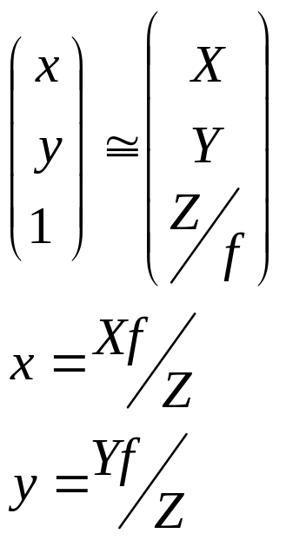
Simple form allows us to write:
Two reasons points might move:
1) The point is moving (it’s a bird, it’s a plane…)
2) The world is static, and the camera is moving
  (but if we define the coordinate system to be at the camera, then all the points move.)
Computer Vision, Robert Pless

Slide 4
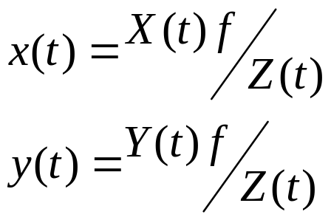
Points moving? How can we possible represent that?!?
And the instantaneous representation of motion is?
So how does the instantaneous world motion turn into instantaneous image motion?
Computer Vision, Robert Pless

Slide 5
So, how does the “apparent” speed (the image speed) of an object relate to:
  Its speed
  Its distance
Which points look like they aren’t moving?
Computer Vision, Robert Pless

Slide 6
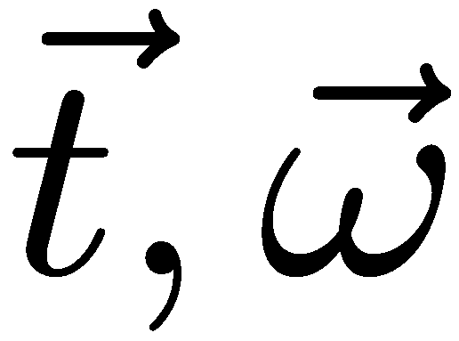
That was for one point moving.
Suppose we move the camera, *but continue to use it as the coordinate system*. Then all the points in the world move. How do they move, (instantaneously?).
Instantaneous motion of the camera can be written as a translational velocity and an angular velocity. Commonly, this is written as a pair of vectors:
Computer Vision, Robert Pless

Slide 7
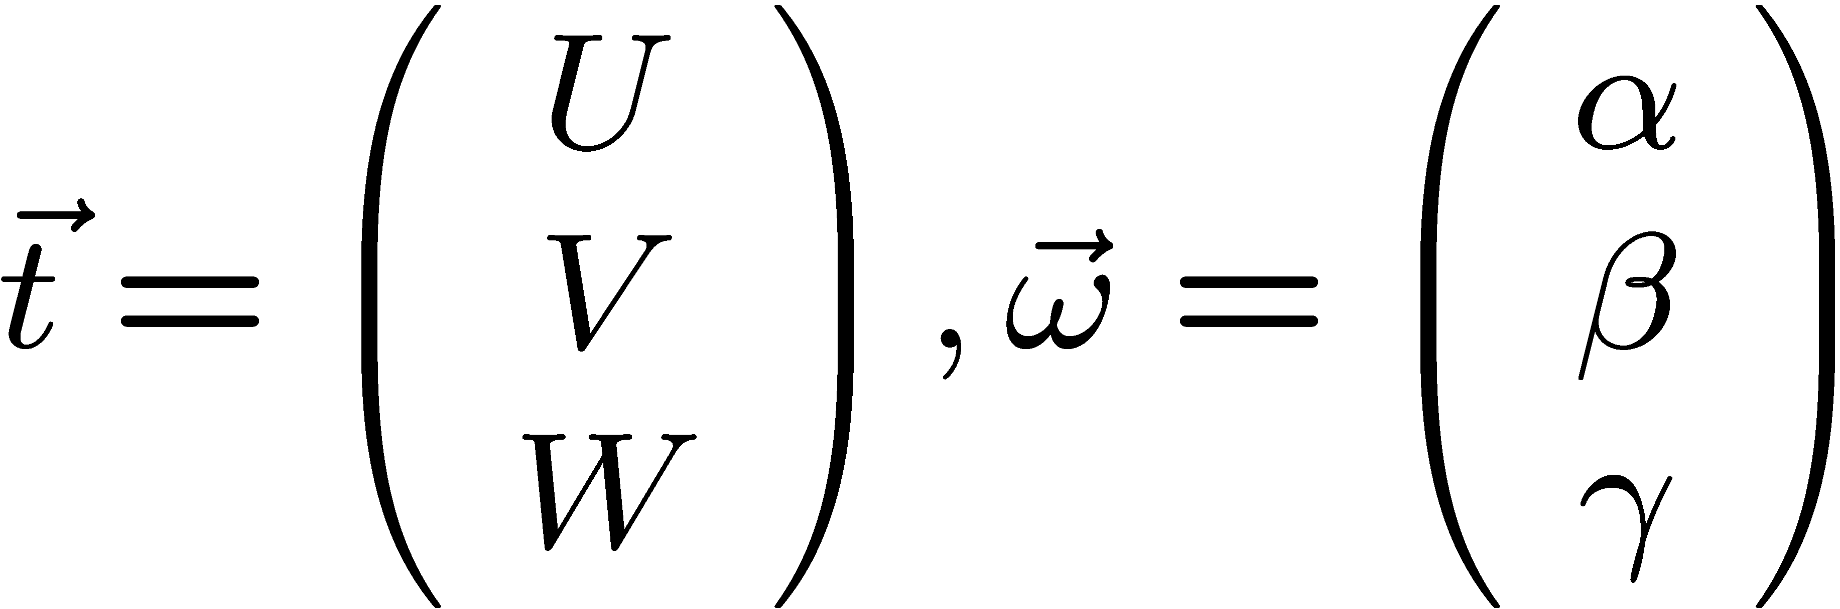
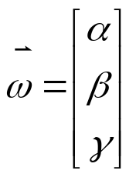

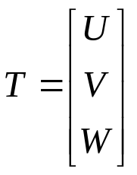
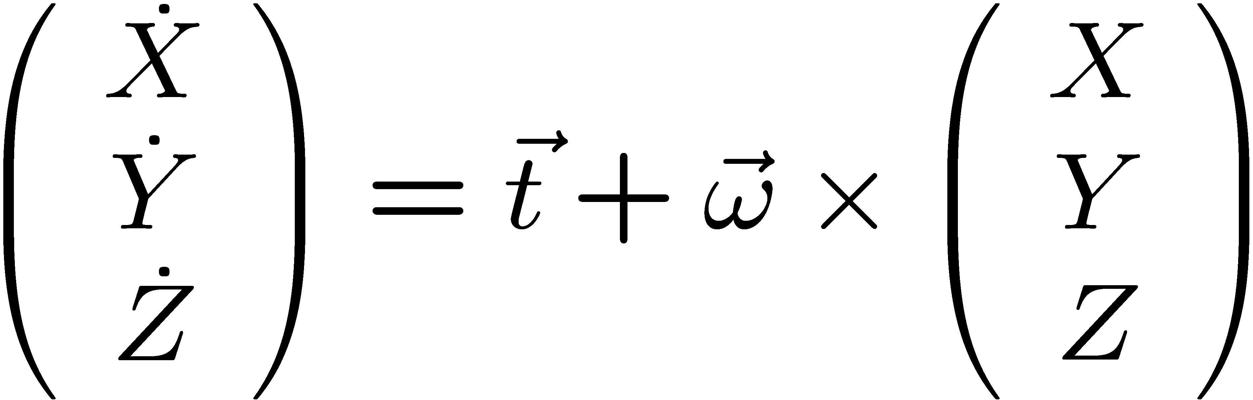
New variables…
Z
O
X
Y
Computer Vision, Robert Pless

Slide 8
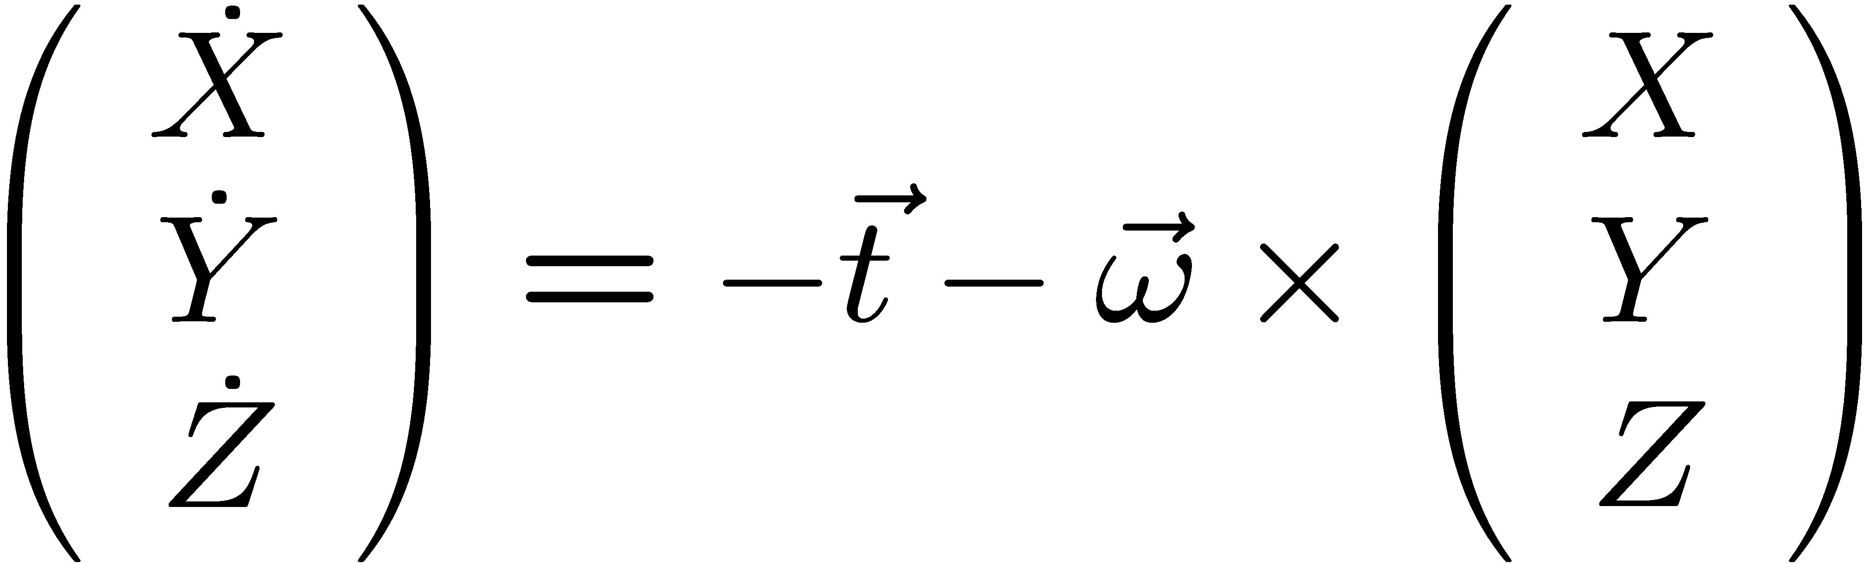
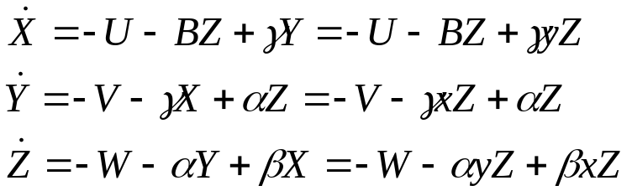
Calculating a cross product,
Substitute in, if x = X/Z, then
X = xZ
So, if the camera moves with t, ω, then the world points move as above.
How do the pixels move?
Computer Vision, Robert Pless

Slide 9
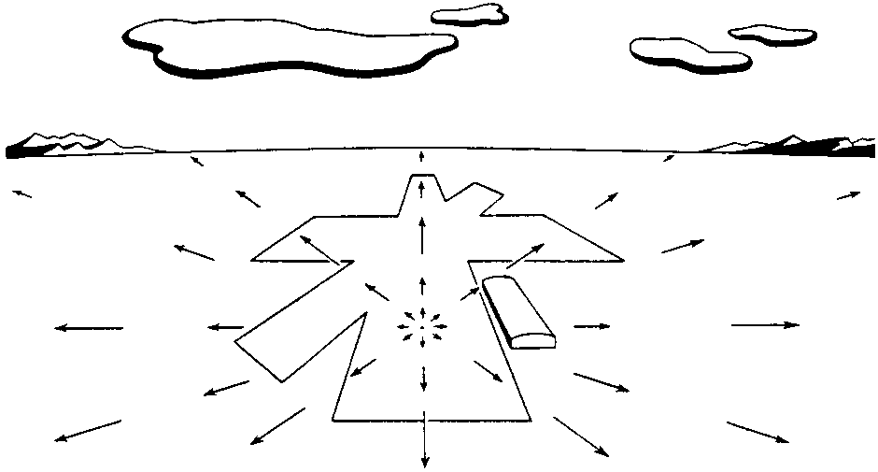
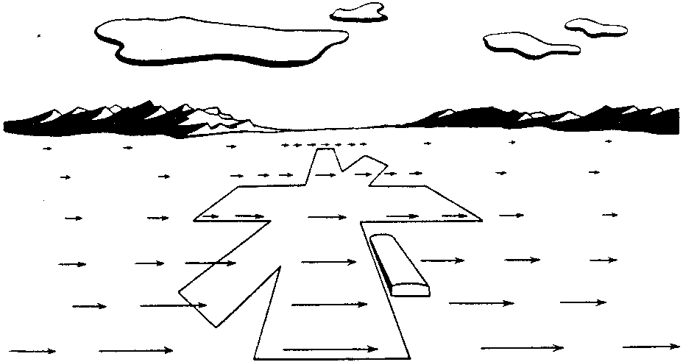
Pixel motion defines a vector field.
(a) (b)
(a) Motion field of a pilot looking straight ahead while approaching a fixed point on a landing strip. (b) Pilot is looking to the right in level flight.
Computer Vision, Robert Pless

Slide 10
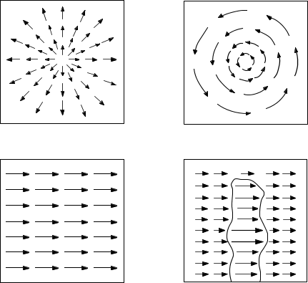
Examples of Vector Fields II
(a) (b)
(c) (d)
(a) Translation perpendicular to a surface. (b) Rotation about axis perpendicular to image plane. (c) Translation parallel to a surface at a constant distance. (d) Translation parallel to an obstacle in front of a more distant background.
Computer Vision, Robert Pless

Slide 11
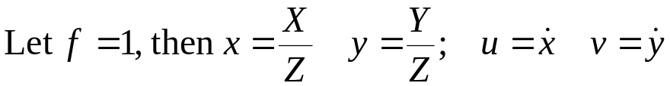
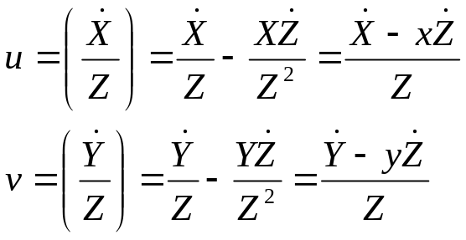
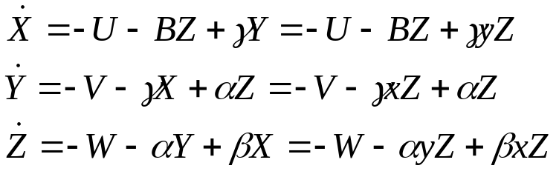
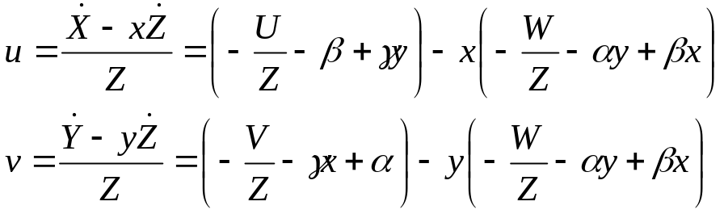
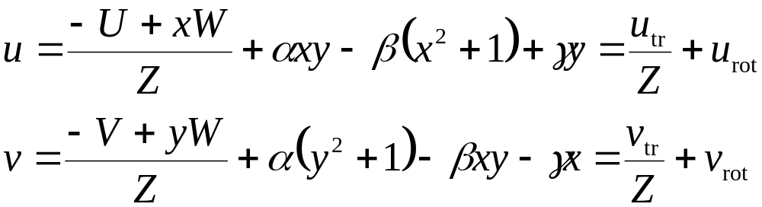
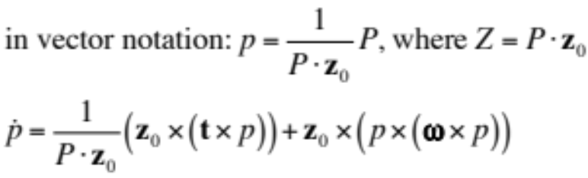
Image Flow due to Rigid Motion
Ambiguities?
Computer Vision, Robert Pless

Slide 12
So, if we can measure u,v (the local motion of pixels on an image),
Then we could solve for U,V,W, and the rotation.
The vector u,v is called “optic flow”
Solving for this vector field has long been considered a key first step in vision algorithms.
A good gyroscopic stabilizer makes the rotation part zero!
Computer Vision, Robert Pless

Slide 13
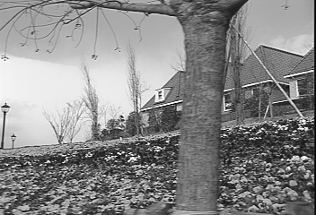
Grounding image.
(preview the matlab joys…)
Computer Vision, Robert Pless

Slide 14

Solving with small window, there is “The aperture problem”
Normal flow: Component of flow perpendicular to line feature.
Computer Vision, Robert Pless

Slide 15
But, but, but, the world isn’t just lines!?!
Let’s go backwards. Suppose you know the optic flow, u,v, at a pixel (x,y) at frame t. The intensity of that point is,
I(x,y,t).
What assumptions can you use to guess how the intensity will change in the next frame?
We can do a *first order taylor series expansion* of the intensity function at that image.
Computer Vision, Robert Pless

Slide 16
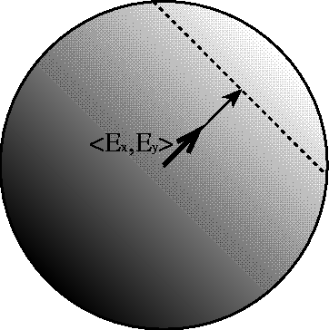
Optic flow is 2d vector on image (u,v)
Assuming:
  intensity only changes due to the motion.
  The derivitives are smooth
Then we get a constraint: I_{x} u + I_{y} v + I_{t} = 0
Defines line in velocity space
Require additional constraint to define optic flow.
Computer Vision, Robert Pless

Slide 17
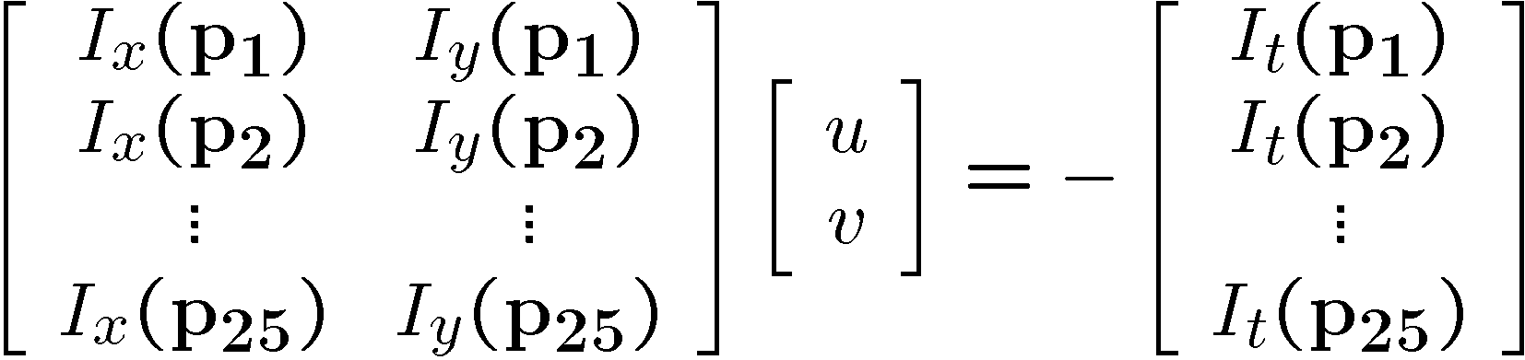

Solving the aperture problem
How to get more equations for a pixel?
  Basic idea: impose additional constraints
    most common is to assume that the flow field is smooth locally
    one method: pretend the pixel’s neighbors have the same (u,v)
      If we use a 5x5 window, that gives us 25 equations per pixel!
Computer Vision, Robert Pless

