Slide 1
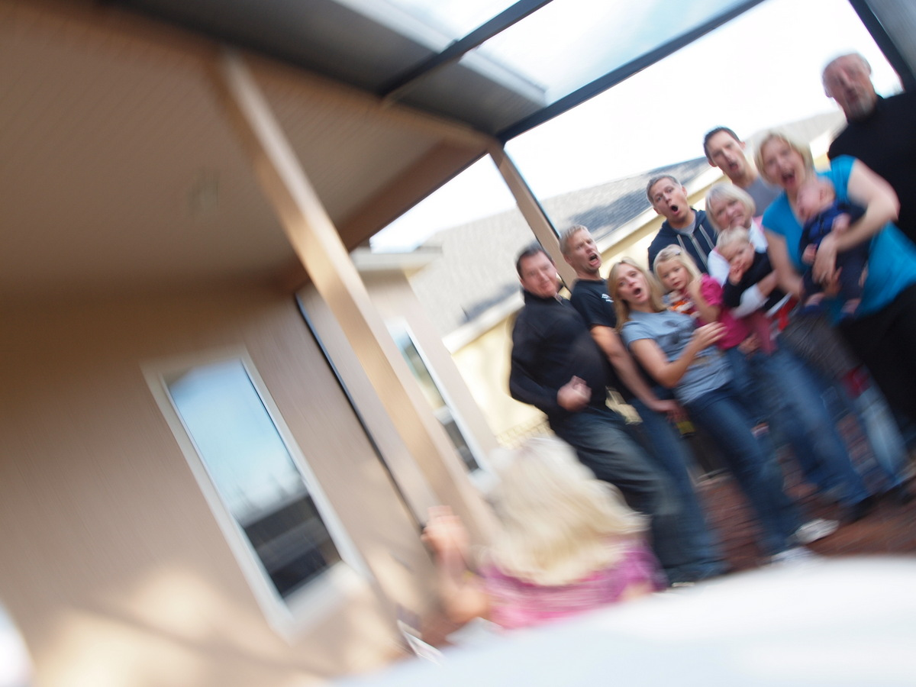
Egomotion estimation

Slide 2
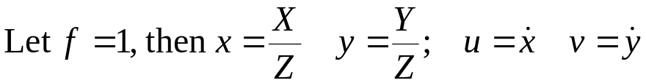
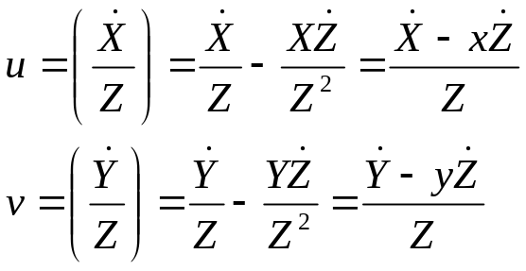
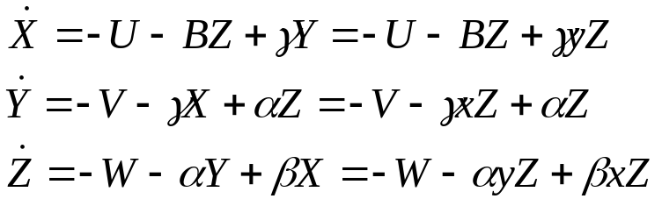
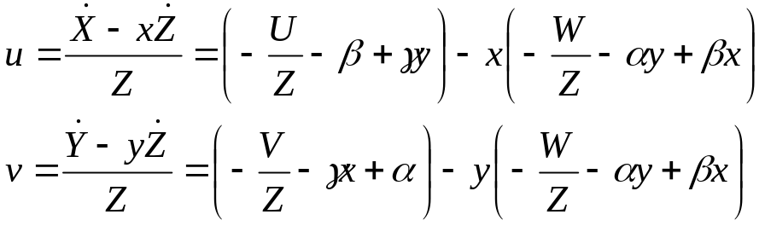
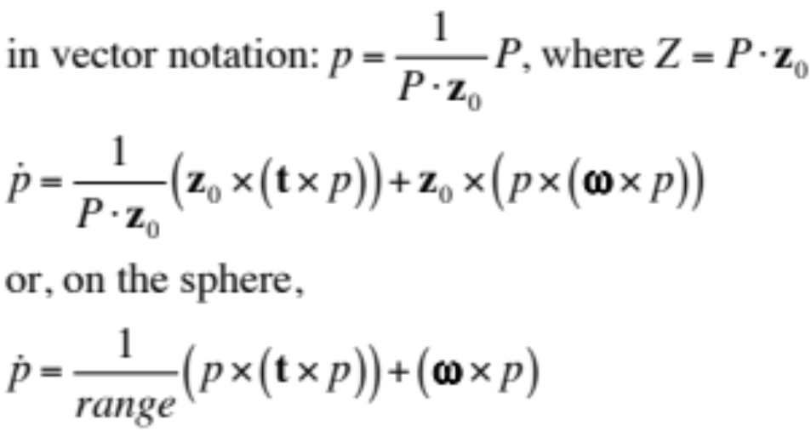
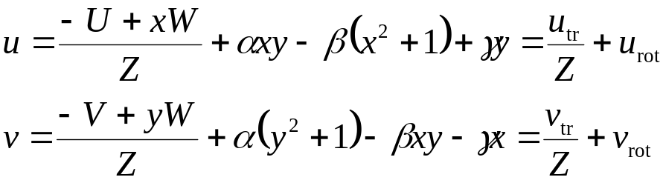
Image Flow due to Rigid Motion
Simplified camera model, u,v = velocity on the image
CAMERA translational velocity, U,V,W, rotating around axis (α,Β,γ)
Computer Vision, Robert Pless

Slide 3
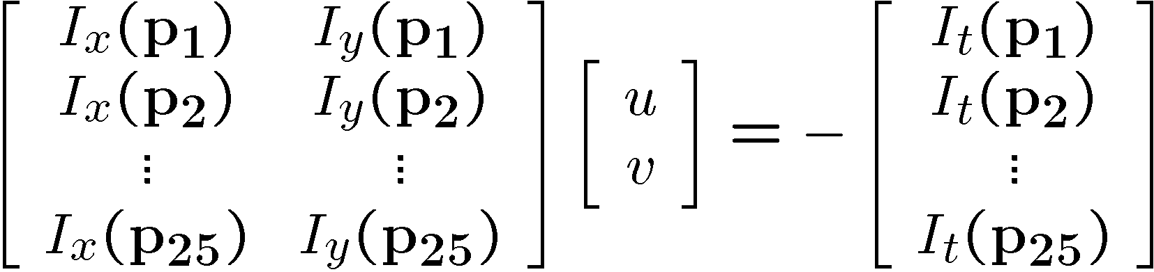

Can solve for (u,v) from image derivatives
Assume constant motion over small region of the image (e.g. 5x5 pixel window).
Computer Vision, Robert Pless

Slide 4
Today. Closing the loop.
Suppose you have measured u,v. At every pixel. What are the issues in trying to solve for:
U,V,W, α, Β, γ, Z?
Computer Vision, Robert Pless

Slide 5
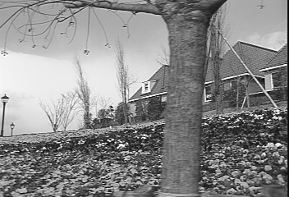
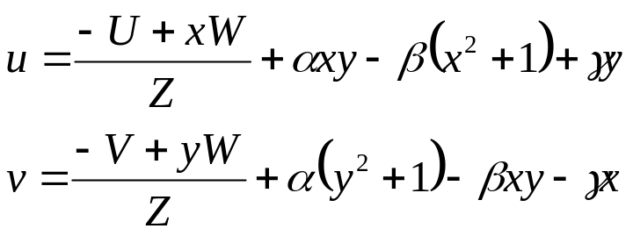
Camera Motion and Image Derivatives
Relationship between image motion and intensity derivatives:
I_{x} u + I_{y} v = - I_{t}
If motion is due to a camera motion in a static environment, then the optic flow is related to the camera motion and the depth of points in the scene:
Computer Vision, Robert Pless

Slide 6
Rearrange terms:
And remember that everything that isn’t colored is something that you measure…
So, at how many pixels do we need to measure the derivatives in order to estimate U,V,W, α, β, γ?
How many constraints do we get per pixel?
Do we introduce any new unknowns?
Computer Vision, Robert Pless

Slide 7
Before we get all carried away; are there any simple tricks?
We are working to find U,V,W,α,β,γ, and all the Z’s. Is there a cheap trick (ie. Special case?) to get some of these?
What happens when Z = infinity?
Then you get an equation that is linear in α,β,γ.
Where might you find locations in an image where Z is very very large?
What happens when U,V are 0?
Then near the center of the image, (where x,y are small), you get constraints that are linear in α,β,γ.
Computer Vision, Robert Pless

Slide 8
OK, let’s get all carried away. What assumptions can you make about Z?
Problem:
6 global unknowns about camera motion, one new unknown (Z) for each pixel.
Solutions:
Locally, pixels are often of similar depths.
  “Depth smoothness constraint”
For some (many?) choices of U,V,W,α,β,γ, when solving for Z, you get many negative values (which are not physically realizable).
  “Depth positivity constraint”
No linear way to optimize either constraint.
Depth positivity can be set up as a large “linear program”,
But if there is noise in estimation of I_{x}, I_{y}, I_{t}, then depth positivity doesn’t hold.
Computer Vision, Robert Pless

Slide 9
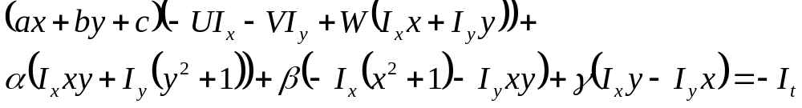
OK, let’s get all carried away. What assumptions can you make about Z?
Assumption 1. Locally constant depth. (scene is billboards facing you).
Assume, for a small block of pixels, that the depth is constant. That is, instead of a new unknown (1/Z) at each pixel, use the same unknown for each ? x ? sized block. (5x5? 10x10?).
Assumption 2. Locally linear depth. (assume the scene is a plane).
1 = aX + bY + cZ (equation of a 3D plane)
1 = axZ + byZ + cZ (converting X,Y in terms of image coordinates
1/Z = ax + by + c (divide by Z)
1/Z = (x,y,1) . (a,b,c) (express as a dot product).
How does this get incorporated into the equation, and what are the unknowns?
Computer Vision, Robert Pless

Slide 10
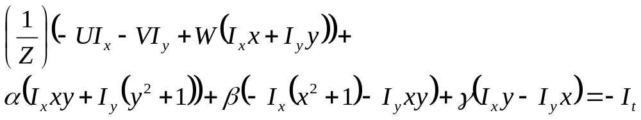
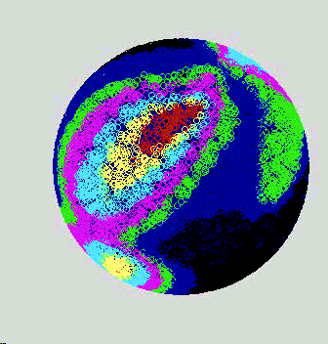
Both must be solved with “non-linear” optimization. (!)
Let’s first consider locally constant depth (each 10 x 10 block has same 1/Z)
Easiest “non-linear” optimization is brute force! (but some brute force is better than others…)
Guess all possible translations. For each translation, solve (using linear least squares) for best possible rotation and depth. Residual (error) in this solution is displayed as a color. Smallest error may be the best motion.
Error Magnitude
Low
High
Computer Vision, Robert Pless

Slide 11
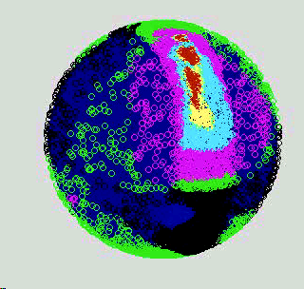
Ambiguous Error Surface
Sphere represents the set of all possible translations
The colors code for the residual error
Note the lowest errors (red) are not well-localized
Error Magnitude
Low
High
Result: All methods of finding the solution for camera motion, amount to minimizing an error function. For a conventional camera with restricted field of view, this function has a bad topography, that is, the minimum lies along valleys (instead of the bottom of a well). This is an illustration of the “translation/rotation ambiguity”.
Computer Vision, Robert Pless

Slide 12
Another approach, alternating minimization:
(1) guess some rotation and depth.
(2) solve for best fitting translation (given guesses).
(3) re-solve for best rotation and depth (using solution for translation)
(4) re-solve for best fitting translation (using solution for rotation)
(5) re-solve for best rotation and depth (using solution for translation)
.
Until solution doesn’t change anymore.
Can also do the same thing assuming locally planar (instead of constant) patches.
Computer Vision, Robert Pless

Slide 13
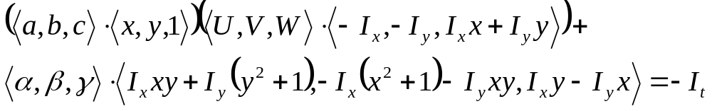
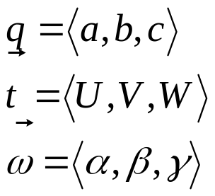
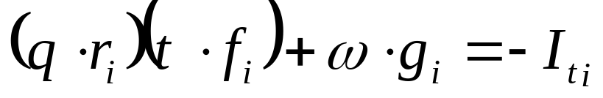
But, but, maybe the objects don’t fit along the patch boundaries?
We’re going to do crazier optimization, so let us first simplify the writing of the equation:
r,f,g are all things that we can measure at pixel i.
Computer Vision, Robert Pless

Slide 14
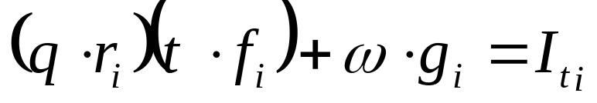
A quick matching game…
Rotational velocity of the camera.
Image measurements at pixel i related to translational velocity of the camera.
Image measurements at pixel i related to rotational velocity of the camera.
Translational velocity of camera.
Homogenous image coordinate of pixel i.
depth plane parameters.
Intensity derivative at pixel i.
Let’s assume the depth is “locally planar”.
And, let’s try to do better than assuming “small chunks” of the image fit a plane. What could be better?
Perhaps we can discover what chunks of the scene are co-planar?
Before we discover, we need to have a way to represent which parts of the scene are co-planar. This can be done with a labeling function:
Computer Vision, Robert Pless

Slide 15
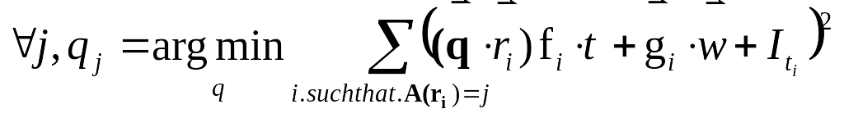
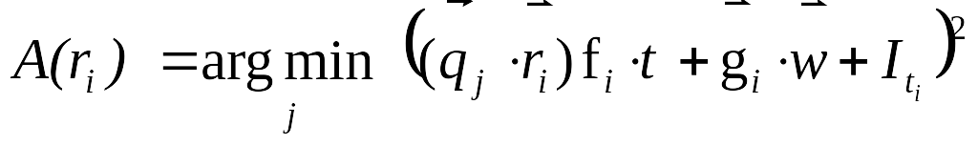
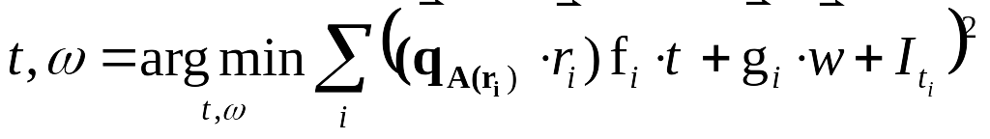
We are going to assume the scene fits “a couple” of depth planes.
Let A(r_{i}), assign pixel i to one scene regions
Now, how can we solve for both the depth/motion parameters and the scene segmentation?
More alternating minimization…
Guess t,w,A (assignment).
Iterate:
  Find best fitting set of planes q_{j} for assignment.
  Reassign Points:
  Solve for t,w
Computer Vision, Robert Pless

Slide 16
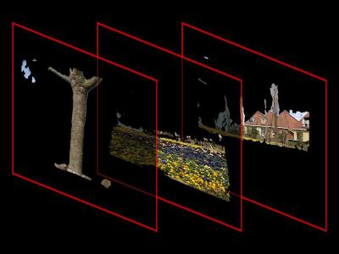
Computer Vision, Robert Pless

Slide 17
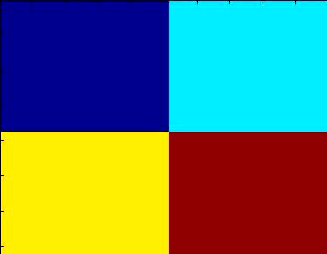
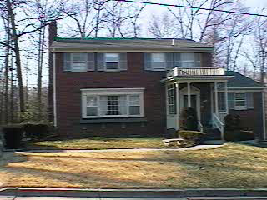
Segmentation, dirty tricks
On some objects, segmentation algorithm does not converge, or converges to a solution that does not correspond to depth discontinuities. The boundaries (of the badly segmented regions) still often indicate likely region boundaries.
Allowing only boundary pixels to change regions is a trick sometimes used to give better segmentation.
Computer Vision, Robert Pless

Slide 18
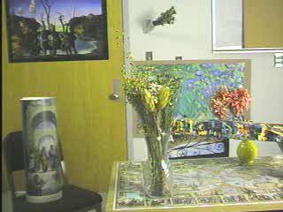
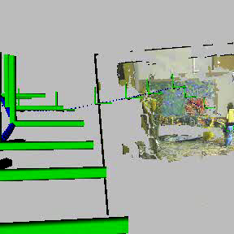
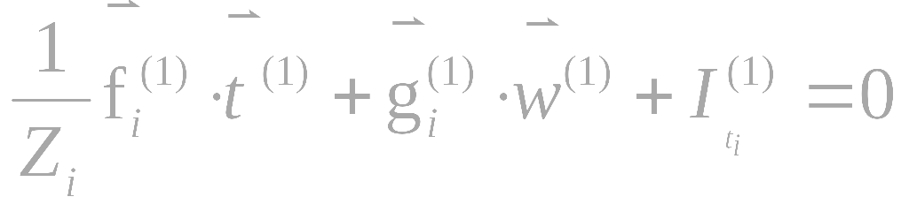
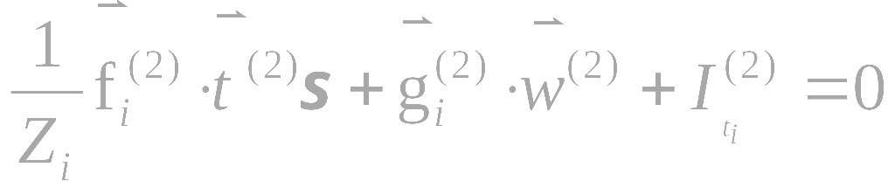
Full solution:
Solve for the best motion in each frame.
“Chaining” them together: requires solution for translation magnitude, why?
Computer Vision, Robert Pless

Slide 19
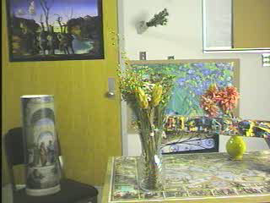
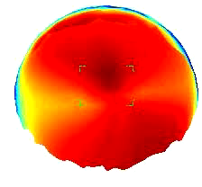
Ambiguities…
Linked Video
3D
Models
Scene
Structure
Camera
Motion
Image Processing
Images
Ambiguity is minimized if camera is moving towards a point in the field of view, when there are sharp depth discontinuities in the scene, and when the camera field of view is large.
Computer Vision, Robert Pless

Slide 20
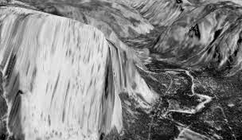
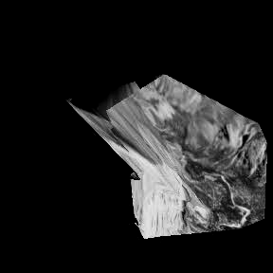
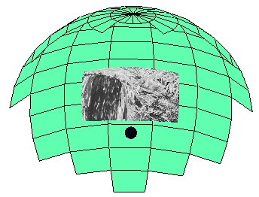
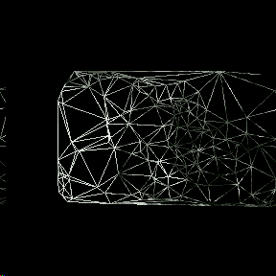
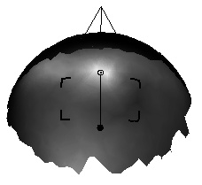
Other options (besides collection of planes). Could have connected triangular patches (a mesh).
Vertices are mesh control points
Pixel in a triangle has (1/Z) value which is weighted average (weights are barycentric coordinates) of triangle corners.
image
Computer Vision, Robert Pless

Slide 21
z₄
z₂
Vertices are mesh control points
Pixel in a triangle has (1/Z) value which is weighted average (weights are barycentric coordinates) of triangle corners.
z₁
z₃
image
For point above (1/Z) = 0.3z₁ + 0.3z₂+0.4z₃
For (new) point above (1/Z) = 0.6z₁ + 0.2z₂+0.2z₄
Before:
Still linear to solve for all the mesh control point depths simultaneously:
Bad notation… these are the barycentric (weighting coordinates of pixel i).
Computer Vision, Robert Pless

Slide 22
Recap
Solved the complete “structure from motion” problem, using only image derivatives (never have to compute optic flow).
Problem is non-linear in the depth and motion parameters (strictly speaking it is “multi-linear”), so we consider “alternating minimization” approaches.
We also consider representations of depth
  constant/planar patches,
  learning arbitrary shaped patches, and
  meshes.
This is the end of so much geometry, the next couple of classes will be more video analysis and less geometry.
Computer Vision, Robert Pless

