Slide 1
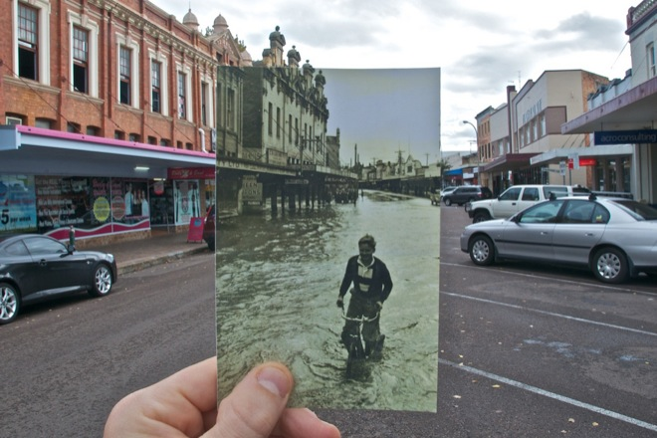
(slides largely from Noah Snavely)
Computational Photography
http://www.wired.com/gadgetlab/2010/07/camera-software-lets-you-see-into-the-past/

Slide 2
Project 3
Due Thursday April 8

Slide 3
Image Alignment Algorithm
Given images A and B
Compute image features for A and B
Match features between A and B
Compute homography between A and B using least squares on set of matches
What could go wrong?

Slide 4
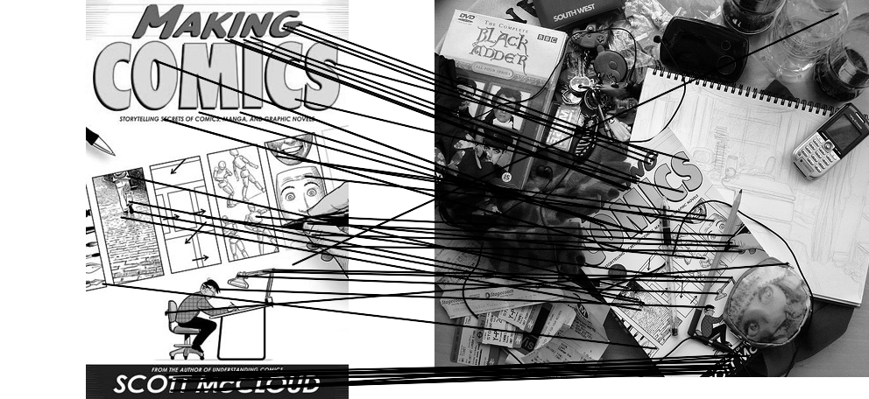
Outliers
outliers
inliers

Slide 5
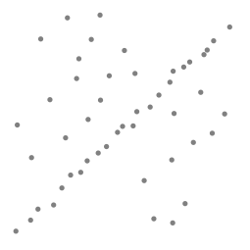
Robustness
Let’s consider a simpler example… linear regression
How can we fix this?
Problem: Fit a line to these datapoints
Least squares fit

Slide 6
We need a better cost function…
Suggestions?

Slide 7
Idea
Given a hypothesized line
Count the number of points that “agree” with the line
  “Agree” = within a small distance of the line
  I.e., the inliers to that line
For all possible lines, select the one with the largest number of inliers

Slide 8
Counting inliers

Slide 9
Counting inliers
Inliers: 3

Slide 10
Counting inliers
Inliers: 20

Slide 11
How do we find the best line?
Unlike least-squares, no simple closed-form solution
Hypothesize-and-test
  Try out many lines, keep the best one
  Which lines?

Slide 12
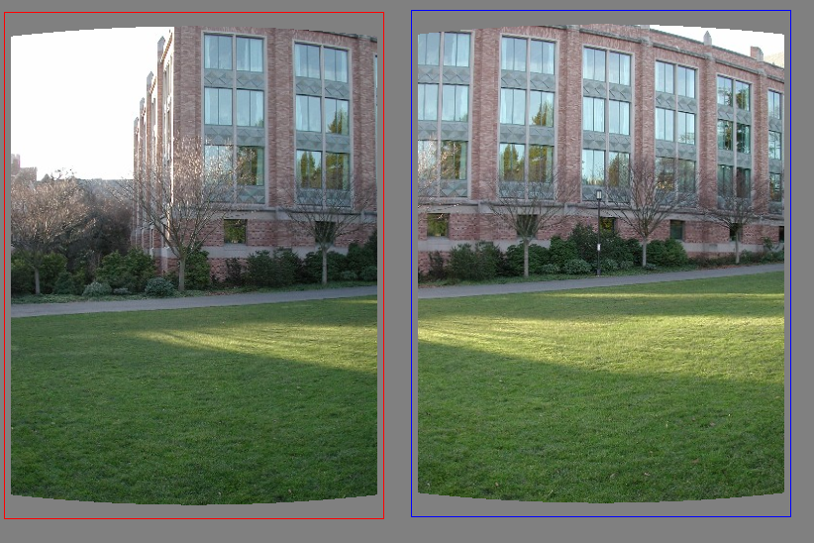
Translations

Slide 13
RAndom SAmple Consensus
Select one match at random, count inliers

Slide 14
RAndom SAmple Consensus
Select another match at random, count inliers

Slide 15
RAndom SAmple Consensus
Output the translation with the highest number of inliers

Slide 16
RANSAC
Idea:
  All the inliers will agree with each other on the translation vector; the (hopefully small) number of outliers will (hopefully) disagree with each other
    RANSAC only has guarantees if there are < 50% outliers
  “All good matches are alike; every bad match is bad in its own way.”
  – Tolstoy via Alyosha Efros

Slide 17
RANSAC
Inlier threshold related to the amount of noise we expect in inliers
  Often model noise as Gaussian with some standard deviation (e.g., 3 pixels)
Number of rounds related to the percentage of outliers we expect, and the probability of success we’d like to guarantee
  Suppose there are 20% outliers, and we want to find the correct answer with 99% probability
  How many rounds do we need?

Slide 18
RANSAC
y translation
set threshold so that, e.g., 95% of the Gaussian
lies inside that radius
x translation

Slide 19
RANSAC
Back to linear regression
How do we generate a hypothesis?
y
x

Slide 20
RANSAC
Back to linear regression
How do we generate a hypothesis?
y
x

Slide 21
RANSAC
General version:
  Randomly choose s samples
    Typically s = minimum sample size that lets you fit a model
  Fit a model (e.g., line) to those samples
  Count the number of inliers that approximately fit the model
  Repeat N times
  Choose the model that has the largest set of inliers

Slide 22
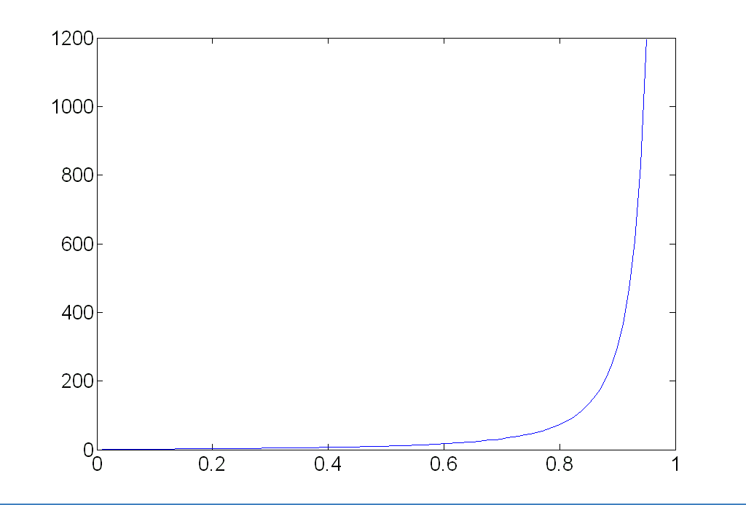
How many rounds?
If we have to choose s samples each time
  with an outlier ratio e
  and we want the right answer with probability p
 | proportion of outliers e
s | 5% | 10% | 20% | 25% | 30% | 40% | 50%
2 | 2 | 3 | 5 | 6 | 7 | 11 | 17
3 | 3 | 4 | 7 | 9 | 11 | 19 | 35
4 | 3 | 5 | 9 | 13 | 17 | 34 | 72
5 | 4 | 6 | 12 | 17 | 26 | 57 | 146
6 | 4 | 7 | 16 | 24 | 37 | 97 | 293
7 | 4 | 8 | 20 | 33 | 54 | 163 | 588
8 | 5 | 9 | 26 | 44 | 78 | 272 | 1177
p = 0.99
Source: M. Pollefeys

Slide 23
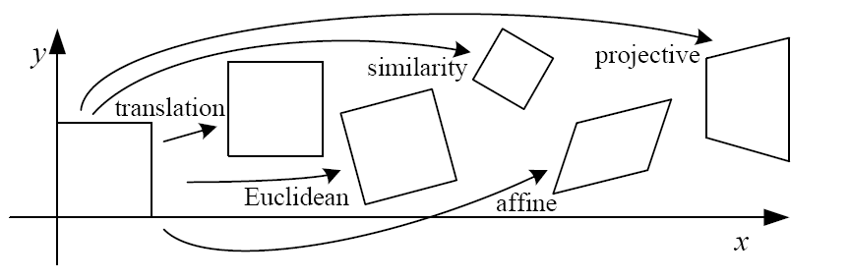
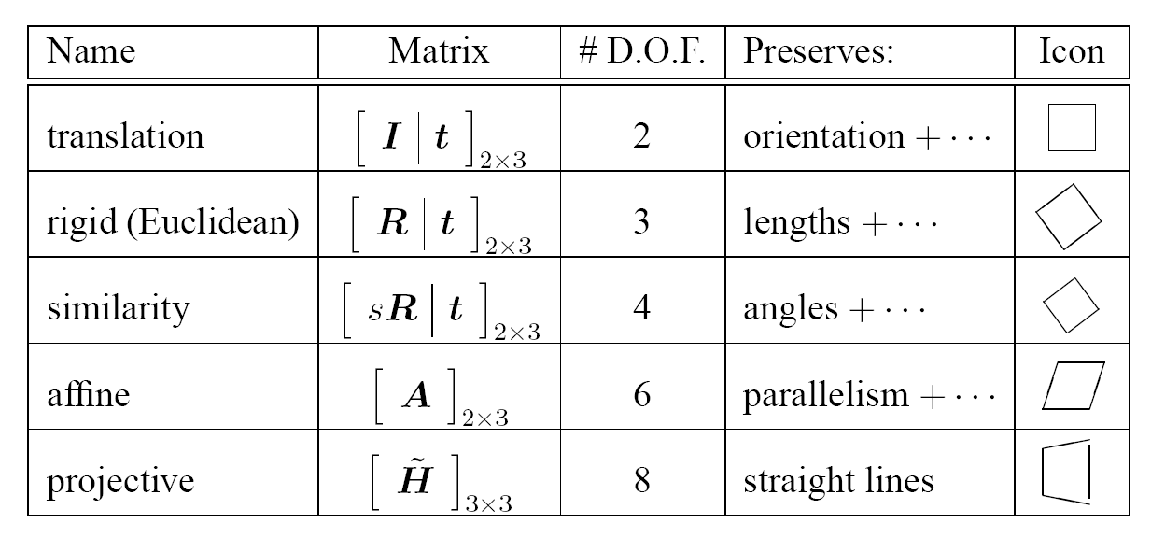
How big is s?
For alignment, depends on the motion model
  Here, each sample is a correspondence (pair of matching points)

Slide 24
RANSAC pros and cons
Pros
  Simple and general
  Applicable to many different problems
  Often works well in practice
Cons
  Parameters to tune
  Sometimes too many iterations are required
  Can fail for extremely low inlier ratios
  We can often do better than brute-force sampling

Slide 25
Final step: least squares fit
Find average translation vector over all inliers

Slide 26
RANSAC
An example of a “voting”-based fitting scheme
Each hypothesis gets voted on by each data point, best hypothesis wins
There are many other types of voting schemes
  E.g., Hough transforms…

Slide 27
Better than brute force sampling?
Problems even if you get all inliers?

