Slide 1
Growth & development of future capabilities

Slide 2
NeSI HPC Platforms in Summary

Slide 3



Customers

Slide 4
Pan, NeSI @ Auckland
iDataPlex Intel processor Cluster (IBM), large node memory + exotic hardware (i.e. GPGPUs)
Breadth and Capacity profiles
Optimised for Embarrassingly Parallel and Highly Scalable problems

Slide 5
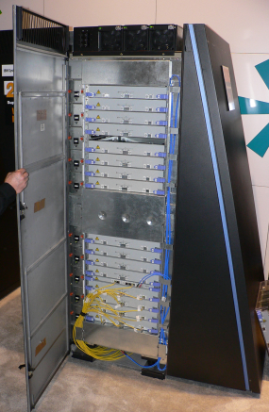
Foster, NeSI @ Canterbury
BlueGene/P Supercomputer (IBM)
Capability & Breadth profiles
Optimised for Embarrassingly
Parallel & Highly Scalable problems
+ startup systems
p755/POWER7 cluster
iDataPlex Visualisation Cluster

Slide 6
FitzRoy, NeSI @ NIWA
p575/POWER6 Supercomputer (IBM)
Capability profile
Optimised for tightly coupled (large) problems
Operational/production-RAS (i.e. support levels)

Slide 7
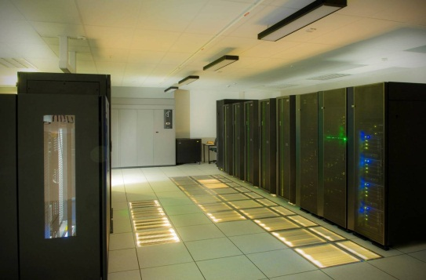
FitzRoy, NeSI @ NIWA
P575/POWER6 SUPER COMPUTER
CAPABILITY PROFILE
OPTIMISED FOR TIGHTLY COUPLED (LARGE) PROBLEMS
OPERATIONA/PRODUCTION-RAS (I.E. SUPPORT LEVELS)

Slide 8
Supporting, growing & developing capability

Slide 9
Joint planning for future infrastructure and skills
Sponsorship required by research leaders
Deep engagement required with research communities
Long term planning required to reach alignment between research needs and future infrastructure
Ongoing collaboration required to ensure performance of infrastructure and translation of skills
LET’S KEEP TALKING

Slide 10
