Slide 1
Build enhancements for EMOD3D
Alex Pletzer
Alexander.Pletzer@nesi.org.nz
May 23 2016

Slide 2
Using CMake to compile
Can still use Makefiles if desired (nothing removed)
Advantages of CMake
Easier to maintain (CMakeLists.txt files are shorter than Makefiles)
Stores configuration (can refine settings if desired)
Ensures consistent compilers and flags across executables
Integrates with unit testing
Can build out of source (e.g. Debug/Release using the same source)

Slide 3
Compiling EMOD3D on Fitzroy
$ module load cmake
$ mkdir build; cd build
$ make
Will choose automatically optimization flags “-O3 -qstrict -qmaxmem=-1 -qtune=pwr6 -qarch=pwr6 -qcache=auto -qhot -qsimd –qipa”
Same commands on Linux.

Slide 4
25% performance improvement through careful choice of compiler options on Fitzroy
Dec26 simulation 32 procs (58min on BG/P):
Default: 7m26s
Aggressive: 6m56s
LPSim-2010Sept4_v1_Cantv1_64-h0.100_v3.04_Test runs in 107m31s
8x faster on Fitzroy compared to BG/P (same proc count)

Slide 5
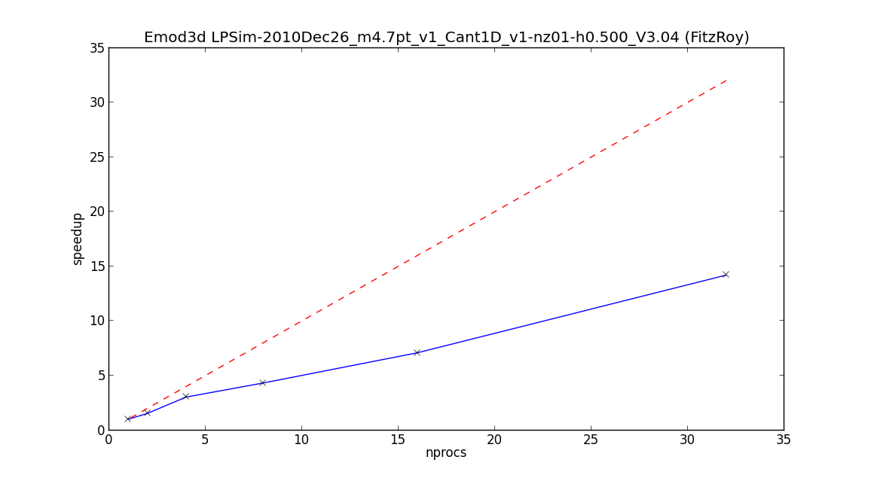
40% parallel efficiency in 1-32 proc range

Slide 6
Building with TAU instrumentation enabled
$ module load tau
$ cmake –D TAU_MAKEFILE=$TAU_MAKEFILE ..
The TAU compilers will be used to build EMOD3D. These will insert calls to instrumentation libraries. Run your experiments as you would normally. The run will spit out profile.X.Y.0 files where X is the MPI rank and Y the OpenMP thread ID.
Use either pprof or paraprof to analyse the results.

Slide 7
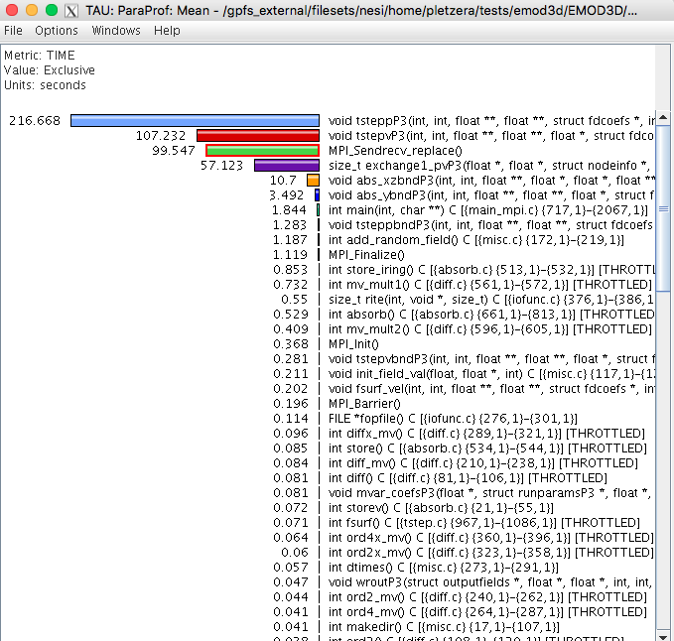
Most time is spent in tsteppP3 and tstepvP3

Slide 8
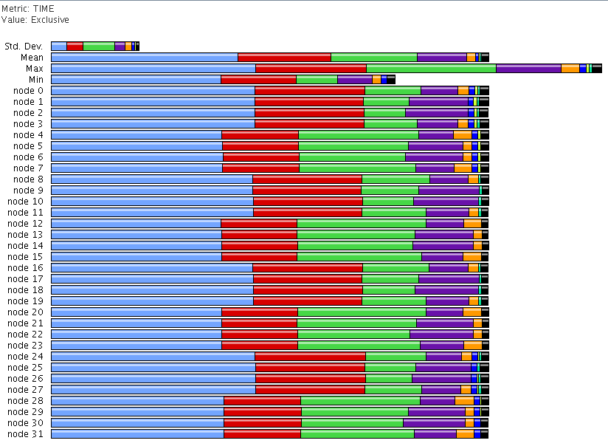
Some processes work harder than others
Light load
Heavy load

