Slide 1
Mapping a location on a bone to a corresponding location on a bone with a different size
Alexander Pletzer (pletzer@psu.edu)
Aug 30 2015

Slide 2
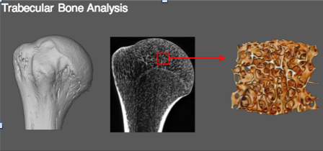
Analysis of bone structure requires selecting the same small area across multiple specimens
Bones differ in size, orientation, and shape
(diagram courtesy of Timothy Ryan, Penn State)

Slide 3
Idea: generate a unique coordinate system ρ(x, y) and θ(x, y)
Discussion focuses on 2D case for simplicity
Steps:
Choose two bones (reference and specimen) and a landmark point on the surface of each (e.g. look for max curvature). Also compute a middle point.
Solve a Laplace equation for ρ and θ. Solution ρ grows radially from 0 to 1 with 0/1 Dirichlet boundary conditions on the interior point and boundary, resp. Solution θ varies in the angle direction and requires 0/1 Dirichlet on the upper/lower side of the line connecting the interior point to the landmark and Neumann on the boundary
Choose point (x, y) on the reference bone and interpolate to get ρ and θ (interpolation)
Search for (x, y) on the specimen bone that give the above ρ and θ. This requires solving a nonlinear system iteratively (e.g. Newton’s algorithm)

Slide 4
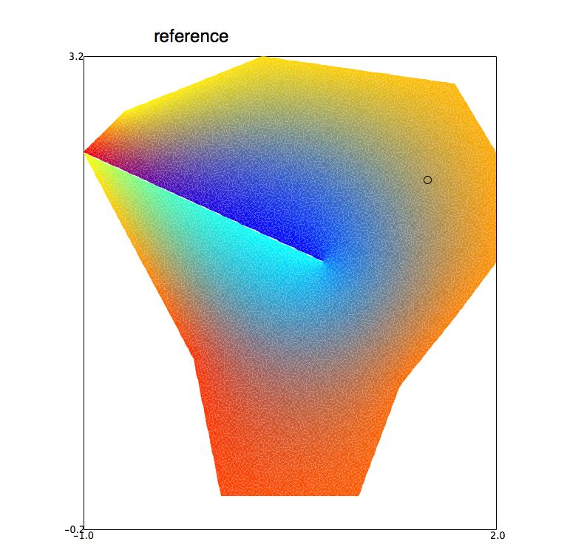
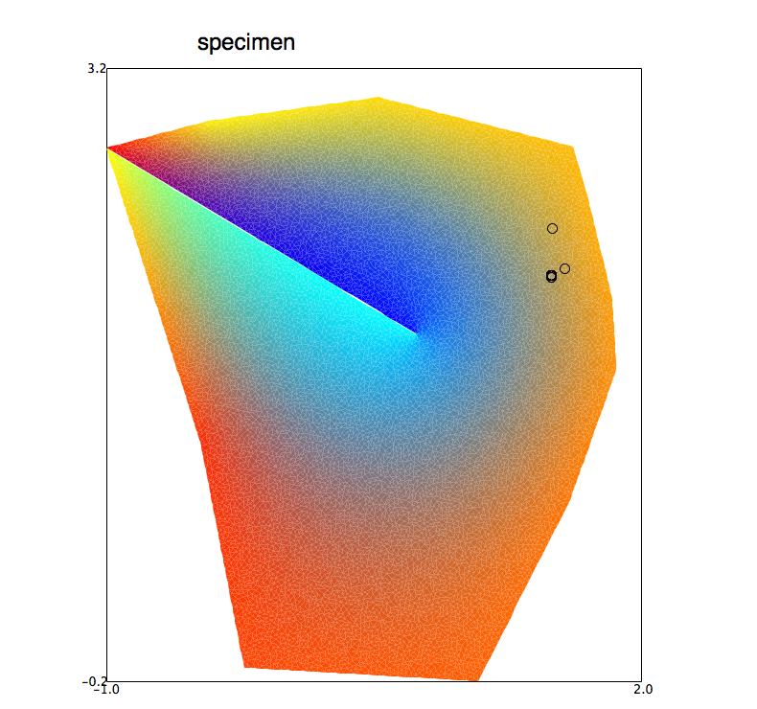
Toy problem involving significant morphological differences
Corresponding
location on
specimen
bone
Location on reference bone
landmark
Interior point
Color is coded by ρ and q. Each location has a unique color.
Goal is to find the specimen point that has the same color as
the color on the reference point

Slide 5
3D requires solving for 3 Laplace fields
Boundary becomes a surface
Tetrahedral mesh in the interior (different for each bone)
I think this requires two landmark points
Radial and two angle-like fields
Perhaps, may not need to solve for the two angle-like fields (can cook up angular fields)

