Slide 1
How to regrid a staggered vector field on a structured grid
Alexander Pletzer Dec 23 2016
Motivated by one of the questions asked during ESMF presentation 13 Dec 2016:
“Vector regridding: Will there be an algorithm to regrid vectors (winds), say, from lat-lon to cube-sphere? It involves rotation of vectors.”

Slide 2
Vector fields with staggered components
Examples:
Face centred (red)
Edge centred (green)
Questions:
F = Σ w_{i} F_{i} or Σ w_{i} F_{i}?
w_{i} is weight, F_{i} is field value on face or edge
Vector weights (basis functions) or vector values?
If using values, what components should we use?
Cartesian x, y, z?
Aligned to latitudes and longitudes?
How do the components change under coordinate transformations? Rotated pole?
What happen if the coordinates are locally non-orthogonal?
What happens to partially valid cells?

Slide 3
Example of non-orthogonal cell: corner of a cubed sphere grid
Not clear how to attach vector components to the faces?
120 deg

Slide 4
Proposed solution for face centred field
Attach flux integral values to each face of the cell
Target is a surface (not a point!). Identify the part of the target inside a cell
Interpolation weight = surface integral of vector basis function over the target
Add the contributions from all the faces

Slide 5



Mathematically speaking…
Flux interpolation on target surface
(defines interpolation)
Flux on face i
is given
Interpolation weight
needs to be computed
for each target
Vector basis function on face i

Slide 6

For a triangular target…
2
Use parametric representation of triangle
Weight then becomes
0
1
Still need to define the basis function

Slide 7
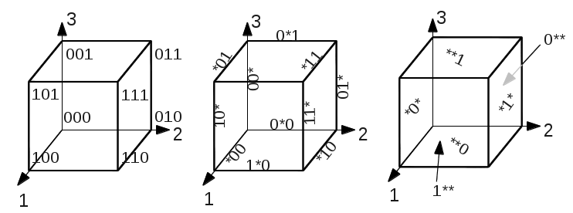
First: identify faces, edges, etc, forming a cell
So we can iterate over faces, edges etc.
Identify nodes, edges, faces and cell with with triplet in range {0, 1, *}
Node triplets have no *, edges have 1 *, faces have 2 *’s , cell has ***
Nodes
Edges
Faces

Slide 8
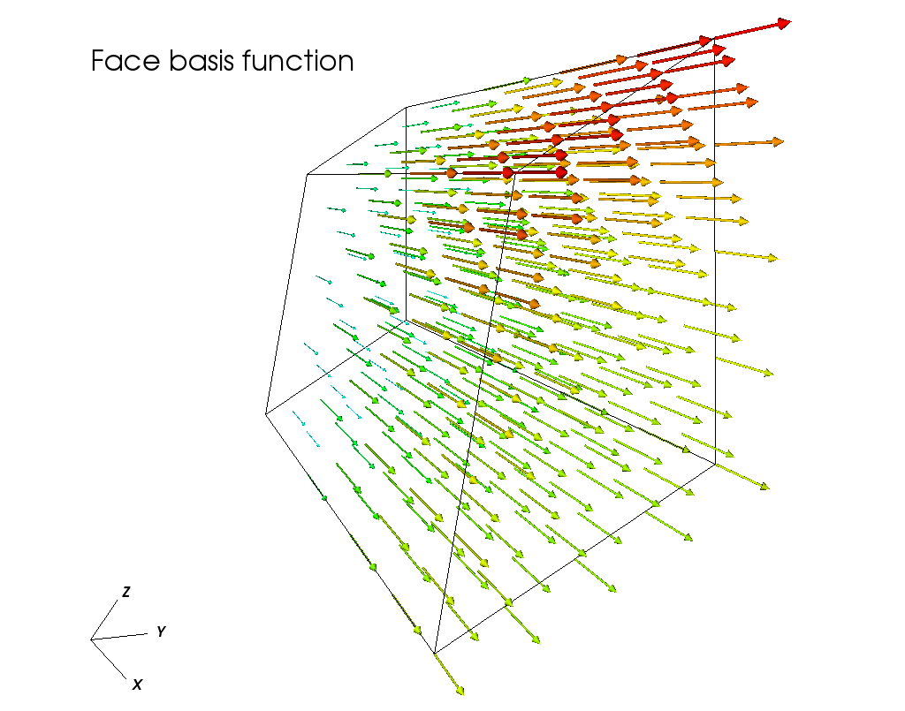





Second: look for basis functions that satisfy orthogonality condition
3
A possibility is:
Index 1
1
2
φ
*1*
Cell volume

Slide 9
Summary
Target is a surface element for a face centred field, a line element for a edge field…
Only compute things that are invariant with respect to coordinate transformations (ie scalars).
Ask the user to provide scale invariant fluxes and attach these to cell faces. (Can do if user provides vector fields and face elements.)
For partially valid cells, user should provide fluxes reduced by the amount of invalid face area. No further action is required (ie no need for masking, partial face ratios, etc)

