Slide 1
Welcome to ENGR 21: Probability and Statistics for Engineers I

Slide 2
Introduction to Statistics and Data Analysis
Chapter 1

Slide 3
Learning Objectives
Statistical Inference, Samples, Populations and the Role of Probability
Sampling Procedures; Collection of Data
Measures of Location: The Sample Mean and Median
Measures of Variability
Statistical Modeling, Scientific Inspection and Graphical Diagnostics

Slide 4
Introduction
Statistics helps us to make judgments and decisions when there is uncertainty
How?
  Methods for carrying out experiments
  Methods for organizing and analyzing experiment results
  Methods for interpreting data and making decisions
Variation
Variation
Variation
Collect Data
Organize Data
Analyze Data
Interpret Data & Make Decisions
Variation
Variation

Slide 5
Variability in Scientific Data
Example – Manufacturing
  Differences in the material from product to product
  Differences between batches
  Differences within batches
Another Example?

Slide 6
Populations & Samples
Population – All individuals or individual items of a particular type
If collect data on entire population – census
Normally, we only have a subset of the population – sample
Example:
Population – All widgets produced in Batch #34219
Sample – 5% of widgets produced in Batch #34219

Slide 7
Populations & Samples
Often, it’s important to collect the sample and data in a systematic way (experimental design)
Interested in the effect of certain characteristics (factors) on the widget
  Factor 1 – machine temperature (make observations at 3 different temps)
  Factor 2 – production shift (make observations on all shifts)
Sample – 5% of widgets produced in Batch #34219

Slide 8
The Role of Probability
Descriptive Statistics – summarize and describe important features of the sample data
Inferential Statistics – techniques for drawing conclusions about the population based on information from the sample
Variation
Variation
Variation
Collect Data
Organize Data
Analyze Data
Interpret Data & Make Decisions
Variation
Variation
Probability – bridge between descriptive and inferential statistics. Explains the uncertainty associated with the sample.
NOTE: Before we can understand what a particular sample tells us about the population, we need to understand the uncertainty associated with taking a sample from the population.

Slide 9
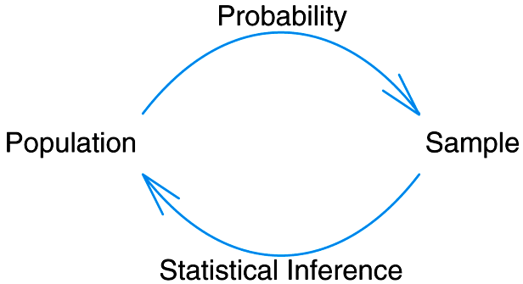
How do Probability & Statistical Inference Work Together?

Slide 10
Course Roadmap
Population
Sample
Descriptive Statistics
Chapter 1
Probability
Chapters 2 – 6
Inferential Statistics
Chapters 8 – 11, 13 – 14

Slide 11
Sampling / Data Collection
If data is not properly collected, then analysis can not be done with certainty
  Sample might not be representative of population
  Use entire population, choose a simple random sample, stratified sample, or design an experiment
Example – if entire sample of widgets is taken at one time, might not be representative of the entire batch

Slide 12
Samples
A sample is a subset of measurements selected from the population of interest
  Different Sampling methods:
  Simple random sample - n items and each is equally likely to be chosen
  Systematic random sample - take every m^{th} item
  Convenience sample - a sample population selected because it is readily available and convenient
  Stratified sample (subpopulation (stratum)) - take proportionally equally from m different groups

Slide 13
Measures of Location
Sample Mean
Median
Mode
Other measures of location that we will not cover:
  Trimmed Mean
  Quartiles & Percentiles
  Sample Proportions

Slide 14
Notation
Notation
  n – number of observations in sample (sample size)
  N – number of elements in population (if finite)
  x₁, x₂, x₃, … , x_{n} – individual observations

Slide 15
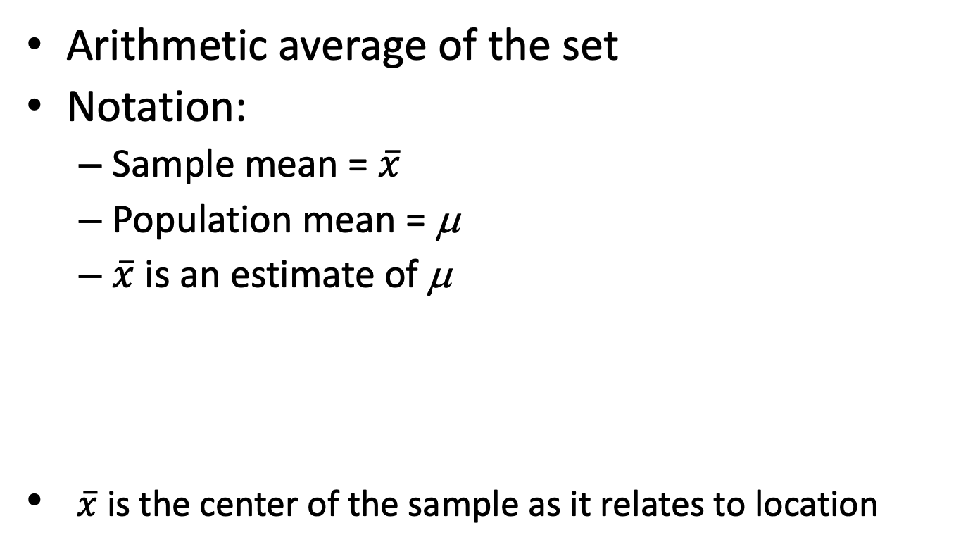
The Sample Mean
Arithmetic average of the set
Notation:
  Sample mean = $\overline{x}$
  Population mean = μ
  $\overline{x}$ is an estimate of μ
$\overline{x}$ is the center of the sample as it relates to location
Notes:
Greatly affected by outliers

Slide 16
Example - Mean
Grade point averages of 15 University of Pittsburgh Engineering Freshmen:
2.0 | 2.7 | 2.8
2.3 | 3.1 | 2.8
2.9 | 2.6 | 1.9
2.7 | 3.0 | 3.1
2.6 | 2.5 | 2.7
Notes:
Is this a sample mean or a population mean?

Slide 17
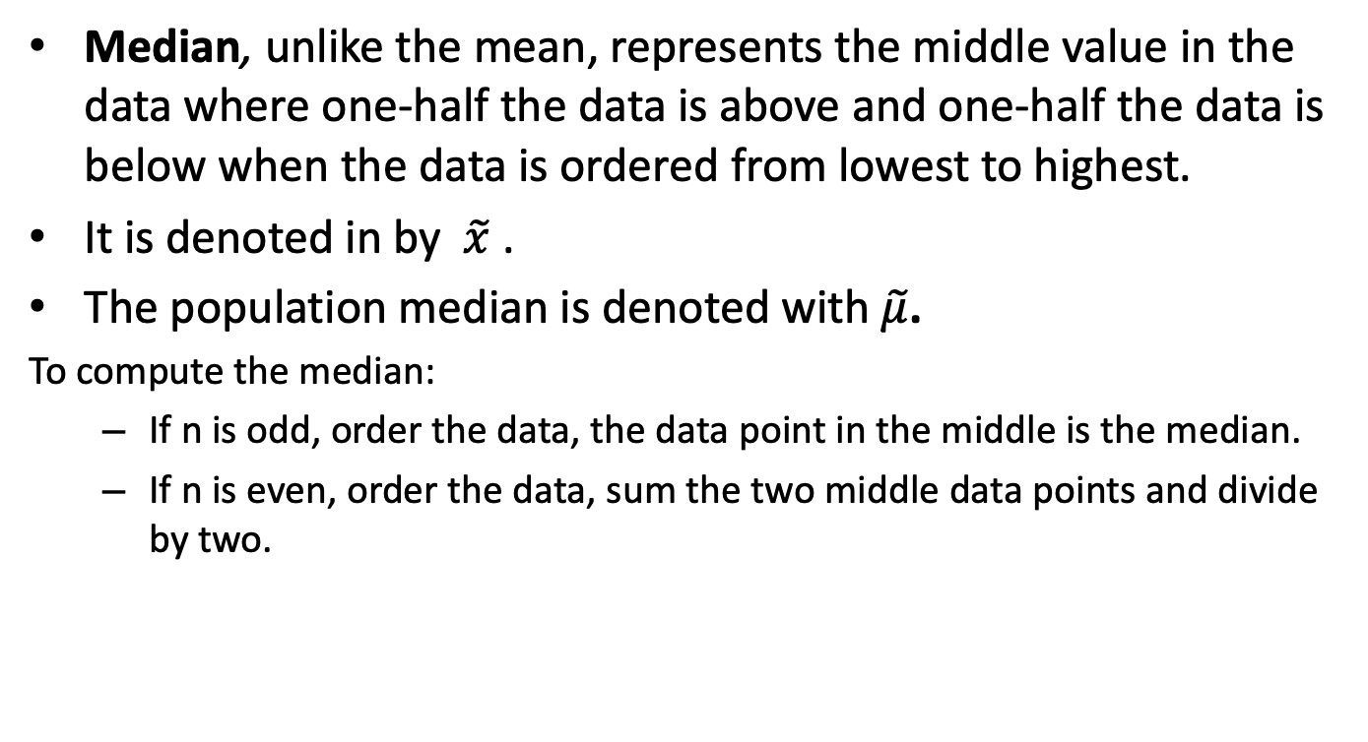
Measures of Location: The Sample Median
Median, unlike the mean, represents the middle value in the data where one-half the data is above and one-half the data is below when the data is ordered from lowest to highest.
It is denoted in by $\tilde{x}$ .
The population median is denoted with $\tilde{μ}$.
To compute the median:
  If n is odd, order the data, the data point in the middle is the median.
  If n is even, order the data, sum the two middle data points and divide by two.

Slide 18
Example - Median
Grade point averages of 15 University of Pittsburgh Engineering Freshmen:
First we order the numbers:
The median is
What is the median of the following sample? (n=14)
The median is
2.0 | 2.7 | 2.8
2.3 | 3.1 | 2.8
2.9 | 2.6 | 1.9
2.7 | 3.0 | 3.1
2.6 | 2.5 | 2.7
1.9 | 2.0 | 2.3 | 2.5 | 2.6 | 2.6 | 2.7 | 2.7 | 2.7 | 2.8 | 2.8 | 2.9 | 3.0 | 3.1 | 3.1
10 | 14 | 15 | 16 | 16 | 16 | 17 | 24 | 27 | 29 | 32 | 34 | 39 | 47

Slide 19
Measures of Central Tendency or Location
Mode, a third measure of central tendency, is the single value that occurs most often in the data.
Example: Determine the mode(s) in the GPA data.
2.0 | 2.7 | 2.8
2.3 | 3.1 | 2.8
2.9 | 2.6 | 1.9
2.7 | 3.0 | 3.1
2.6 | 2.5 | 2.7

Slide 20
Mean and Median – Sensitivity to Outliers
Grade point averages of 15 University of Pittsburgh Engineering Freshmen:
First we order the numbers:
Since n =15 is odd, the median is the {(n+1)/2}^{th} ordered value.
2.0 | 2.7 | 2.8
2.3 | 3.1 | 2.8
2.9 | 2.6 | 1.9
2.7 | 3.0 | 3.1
2.6 | 2.5 | 2.7
Mean
1.9 | 2.0 | 2.3 | 2.5 | 2.6 | 2.6 | 2.7 | 2.7 | 2.7 | 2.8 | 2.8 | 2.9 | 3.0 | 3.1 | 3.1

Slide 21
Mean and Median – Sensitivity to Outliers
Grade point averages of 15 University of Pittsburgh Engineering Freshmen:
First we order the numbers:
Since n =15 is odd, the median is the {(n+1)/2}^{th} ordered value.
2.0 | 2.7 | 2.8
2.3 | 3.1 | 2.8
2.9 | 2.6 | 1.9
2.7 | 3.0 | 33.1
2.6 | 2.5 | 2.7
Total | 39.7 + (33.1 – 3.1) = 39.7 + 30 = 69.7
Mean
1.9 | 2.0 | 2.3 | 2.5 | 2.6 | 2.6 | 2.7 | 2.7 | 2.7 | 2.8 | 2.8 | 2.9 | 3.0 | 3.1 | 33.1

Slide 22
Measures of Variability
In addition to measures of location, we need measures to tell us how spread out the data is:
  Range
  Variance
  Standard Deviation
Samples with identical measures of center but different amounts of variability

Slide 23
Measures of Variability
In addition to a measure of location, we need a measure that tells us how spread out the data is.
A simple measure of variability is range.
  Range = largest value - smallest value

Slide 24
Range
Simplest measure of variability
Range = largest value – smallest value
  When range is large, variability is high
  Limitation – only focuses on most extreme values
  We are more interested in the deviations of individual observations from the mean…

Slide 25
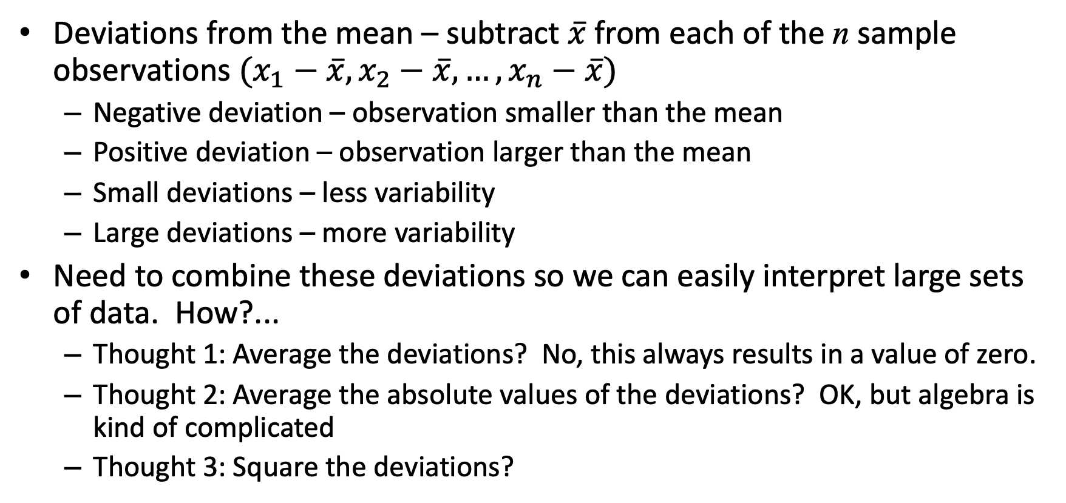
Variance
Deviations from the mean – subtract $\overline{x}$ from each of the n sample observations $(x_{1}−\overline{x}, x_{2}−\overline{x}, …,x_{n}−\overline{x})$
  Negative deviation – observation smaller than the mean
  Positive deviation – observation larger than the mean
  Small deviations – less variability
  Large deviations – more variability
Need to combine these deviations so we can easily interpret large sets of data. How?...
  Thought 1: Average the deviations? No, this always results in a value of zero.
  Thought 2: Average the absolute values of the deviations? OK, but algebra is kind of complicated
  Thought 3: Square the deviations?

Slide 26
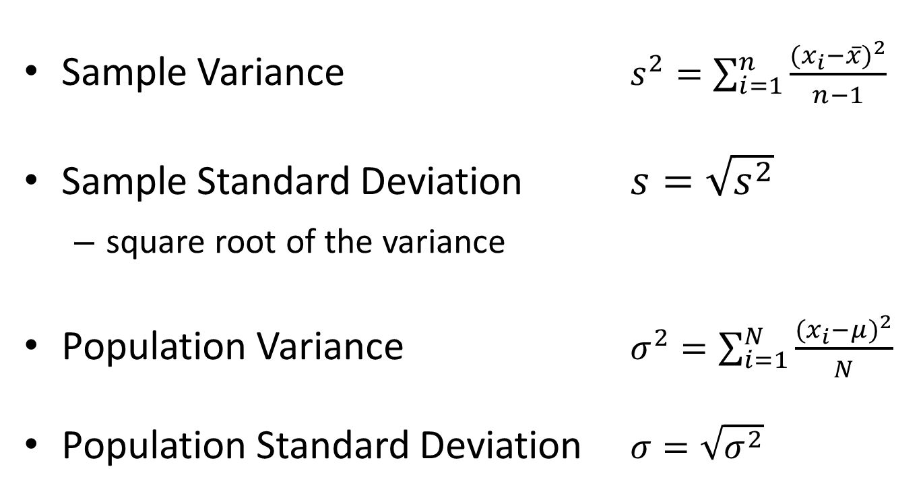
Variance & Standard Deviation
Sample Variance $s^{2}=\sum_{i=1}^{n}{\frac{{(x_{i}−\overline{x})}^{2}}{n−1}}$
Sample Standard Deviation $s=\sqrt{s^{2}}$
  square root of the variance
Population Variance $σ^{2}=\sum_{i=1}^{N}{\frac{{(x_{i}−μ)}^{2}}{N}}$
Population Standard Deviation $σ=\sqrt{σ^{2}}$

Slide 27
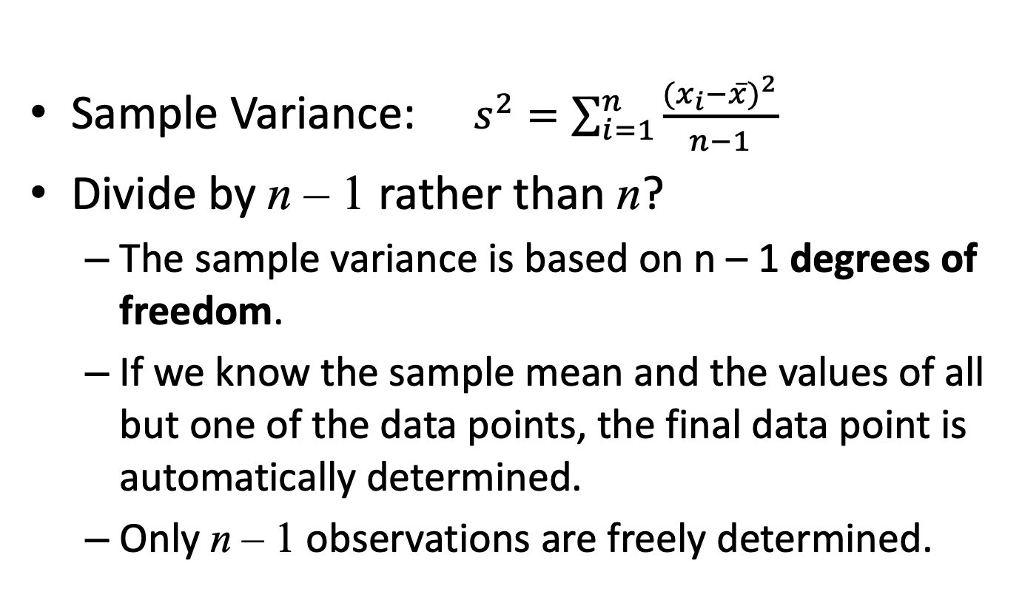
Why Divide by n-1?
Sample Variance: $s^{2}=\sum_{i=1}^{n}{\frac{{(x_{i}−\overline{x})}^{2}}{n−1}}$
Divide by n – 1 rather than n?
  The sample variance is based on n – 1 degrees of freedom.
  If we know the sample mean and the values of all but one of the data points, the final data point is automatically determined.
  Only n – 1 observations are freely determined.

Slide 28

Example 1
Observations: 4, 6, 9, 13, 18
Estimate $σ^{2} , σ$ ?

Slide 29

Example 2
Observations: 4, 5, 9, 17, 18
Estimate $σ^{2} , σ$ ?

Slide 30
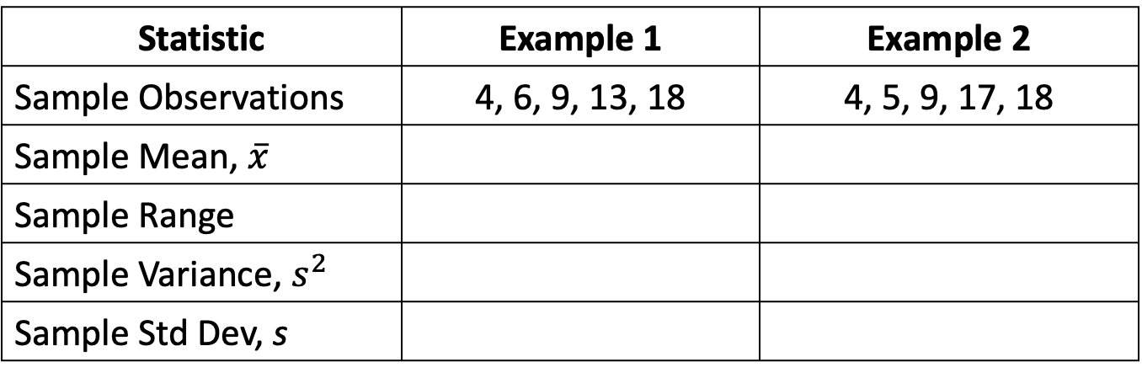
Compare Examples 1 & 2
Statistic | Example 1 | Example 2
Sample Observations | 4, 6, 9, 13, 18 | 4, 5, 9, 17, 18
Sample Mean, $\overline{x}$
Sample Range
Sample Variance, $s^{2}$
Sample Std Dev, s
What can we say about these 2 samples?

Slide 31
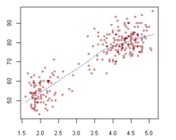
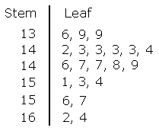

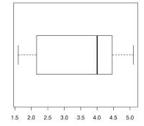
Statistical Modeling, Scientific Inspection and Graphical Diagnostics
Scatter Plot
Histograms
Stem-and-Leaf Displays
Box-and-Whisker Plot or Box Plot

Slide 32
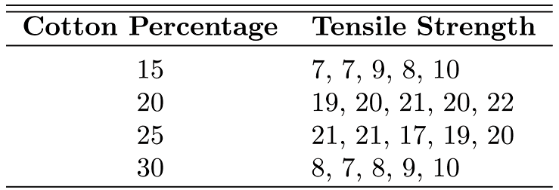
Scatter Plot
Example from p. 19
  Textile manufacturer produces cloth with various percentages of cotton
  How can graphics be used to determine distinction between samples?...
Table 1.3: Tensile strength

Slide 33
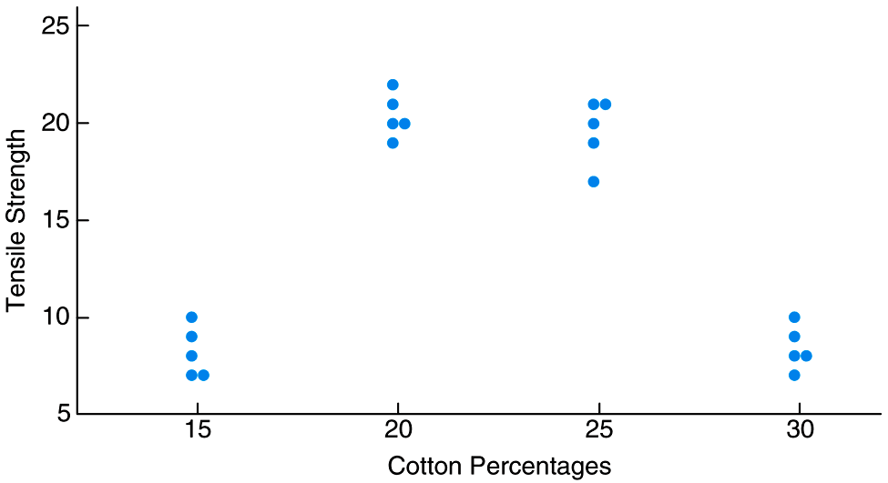
Example – Page 19
Figure 1.5 Scatter plot of tensile strength and cotton percentages

Slide 34
Stem-and-Leaf Displays
Quick way to get visual representation of data
How to make:
  Select one or more digits for stem values
  List stem values in vertical column
  Record leaf for each observation besides corresponding stem value
  Indicate units somewhere in display

Slide 35
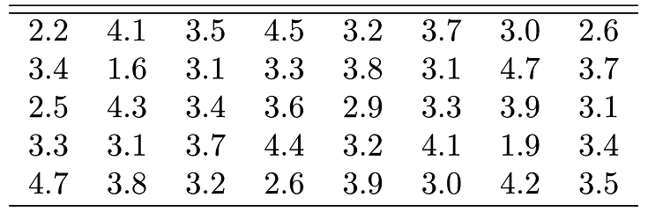
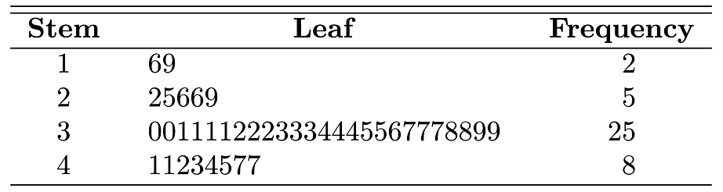
Table 1.5 Stem-and-Leaf Plot of Battery Life
Table 1.4 Car Battery Life

Slide 36
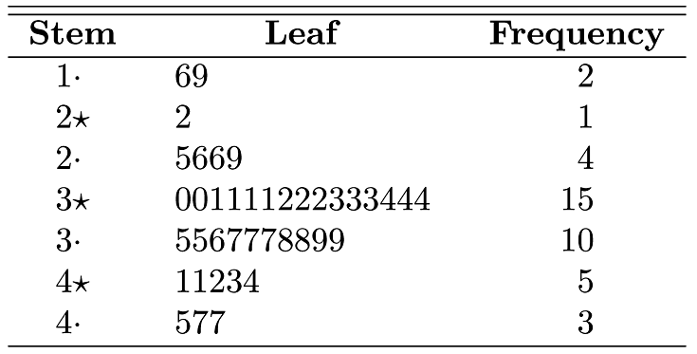
Table 1.6 Double-Stem-and-Leaf Plot of Battery Life

Slide 37
Example: Stem-and-Leaf Displays
Grade point averages of 15 University of Pittsburgh Engineering Freshmen:
2.0 | 2.7 | 2.8
2.3 | 3.1 | 2.8
2.9 | 2.6 | 1.9
2.7 | 3.0 | 3.1
2.6 | 2.5 | 2.7

Slide 38
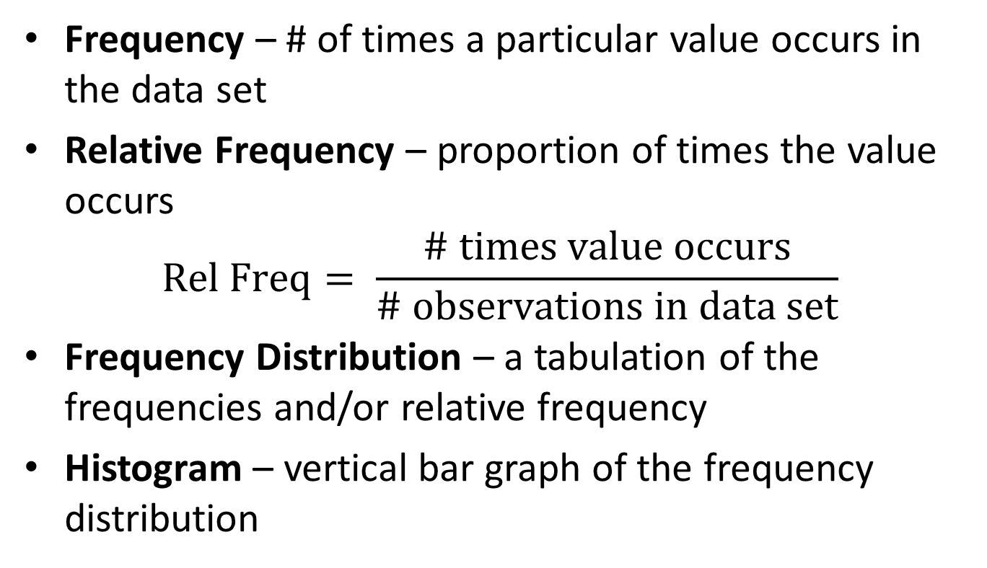
Frequency Distribution and Histograms
Frequency – # of times a particular value occurs in the data set
Relative Frequency – proportion of times the value occurs
$$Rel Freq= \frac{\# times value occurs}{\# observations in data set}$$
Frequency Distribution – a tabulation of the frequencies and/or relative frequency
Histogram – vertical bar graph of the frequency distribution

Slide 39
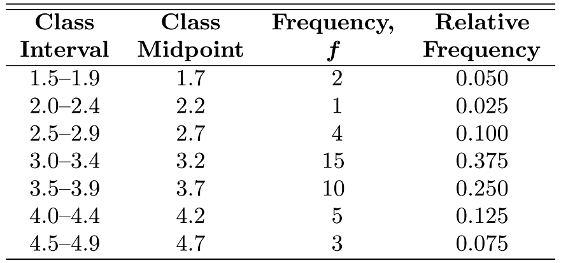
Example – page 21
Table 1.7 Relative Frequency Distribution of Battery Life

Slide 40
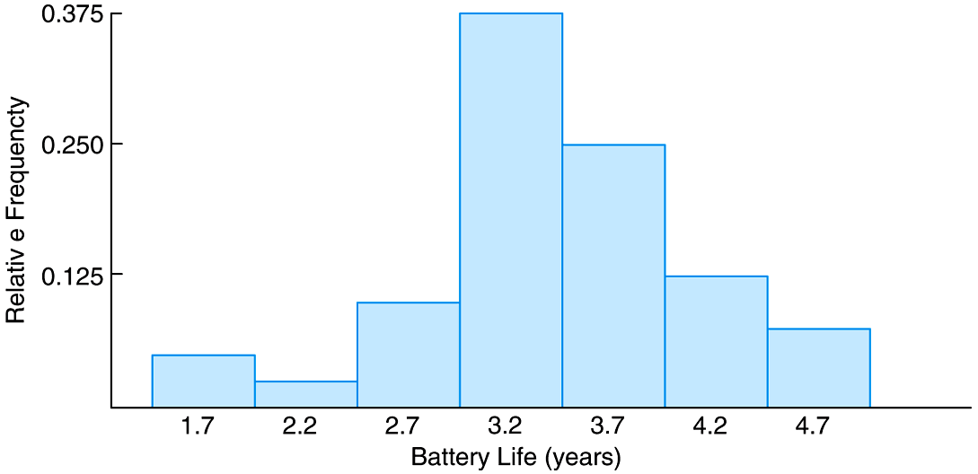
Example – page 21(cont.)
Figure 1.6 Relative frequency histogram

Slide 41
Example - Frequency Distribution and Histogram
Grade point averages of 40 University of Pittsburgh Engineering Freshmen:
We want a compact summary of data.
2.0 | 3.0 | 2.5 | 3.4 | 2.1
2.3 | 2.5 | 1.4 | 1.9 | 2.1
2.9 | 2.8 | 2.8 | 2.2 | 2.3
2.7 | 2.8 | 2.6 | 2.3 | 2.2
2.6 | 1.9 | 3.0 | 2.4 | 2.1
2.7 | 3.1 | 2.7 | 2.5 | 2.7
3.1 | 2.7 | 3.8 | 2.6 | 2.8
2.6 | 3.5 | 3.0 | 2.7 | 2.9

Slide 42
Example - Frequency Distribution and Histogram
2.0 | 3.0 | 2.5 | 3.4 | 2.1
2.3 | 2.5 | 1.4 | 1.9 | 2.1
2.9 | 2.8 | 2.8 | 2.2 | 2.3
2.7 | 2.8 | 2.6 | 2.3 | 2.2
2.6 | 1.9 | 3.0 | 2.4 | 2.1
2.7 | 3.1 | 2.7 | 2.5 | 2.7
3.1 | 2.7 | 3.8 | 2.6 | 2.8
2.6 | 3.5 | 3.0 | 2.7 | 2.9
Class | 1.0 - <2.0 | 2.0 - <3.0 | 3.0 - <4.0
Class | 1.0 - <2.0 | 2.0 - <3.0 | 3.0 - <4.0
Frequency
Class | 1.0 - <2.0 | 2.0 - <3.0 | 3.0 - <4.0
Frequency
Relative Frequency

Slide 43
Example - Frequency Distribution and Histogram
Frequency distribution - a grouped tabulation of data arranged according to size / a more compact summary of data than the original observations
Histogram - a vertical bar graph used to make a picture of the frequency distribution.
Class | 1.0 - <2.0 | 2.0 - <3.0 | 3.0 - <4.0
Frequency | 3 | 29 | 8
Relative Frequency | (%7.5) | (%72.5) | (%20)

Slide 44
Example - Frequency Distribution and Histogram
1 2 3 4

Slide 45
Frequency Distribution and Histogram
Steps for creating a frequency distribution and histogram:
Divide the relevant measurement scale into a collection of disjoint (non-overlapping) equal size intervals such that each observation in the data can be placed into one of the intervals.
Once these class intervals (classes) have been chosen, list along the left margin.
Count the number of observations that fall into each class (frequencies).
Determine the relative frequency by dividing the frequencies by n.
Draw a horizontal line (x-axis) to represent the measurement scale and mark the boundaries of the adjacent class intervals.
Draw a vertical line (y-axis) to represent the relative frequencies.
Draw the bars to represent the relative frequency in each class.

Slide 46
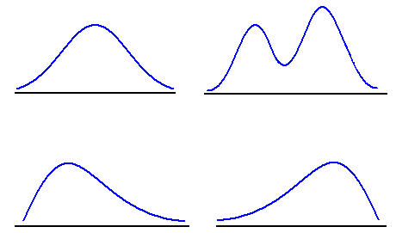
Histogram Shapes
symmetric unimodal
bimodal
positively skewed
negatively skewed
Peaks: A histogram may be unimodal, bimodal, or multimodal
Skewness: Looking at a histogram or a stem and leaf diagram helps us to determine if data are symmetric, positively skewed (skewed right), or negatively skewed (skewed left)
Outliers: These graphs also show outliers

Slide 47



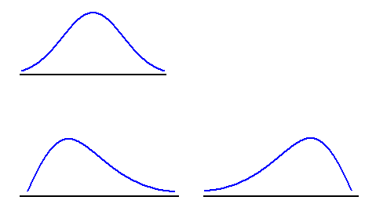
Three Different Shapes for a Population Distribution
symmetric
negative skew
positive skew

Slide 48
Boxplots
We want a pictorial summary which describes the most important features of the data set, e.g., central tendency, variability, symmetry, outliers.
Also, we want this summary to not be too sensitive to the presence of a few outliers.
Reminder: median is not much sensitive to outliers!
We want the pictorial summary to give us some information about the spread as well, but median only divides the data into two parts.

Slide 49
Boxplots
Pictorial summaries of several important features
Lower Fourth
upper fourth
Whisker
Whisker
Extreme outliers
Mild Outliers
Median

Slide 50
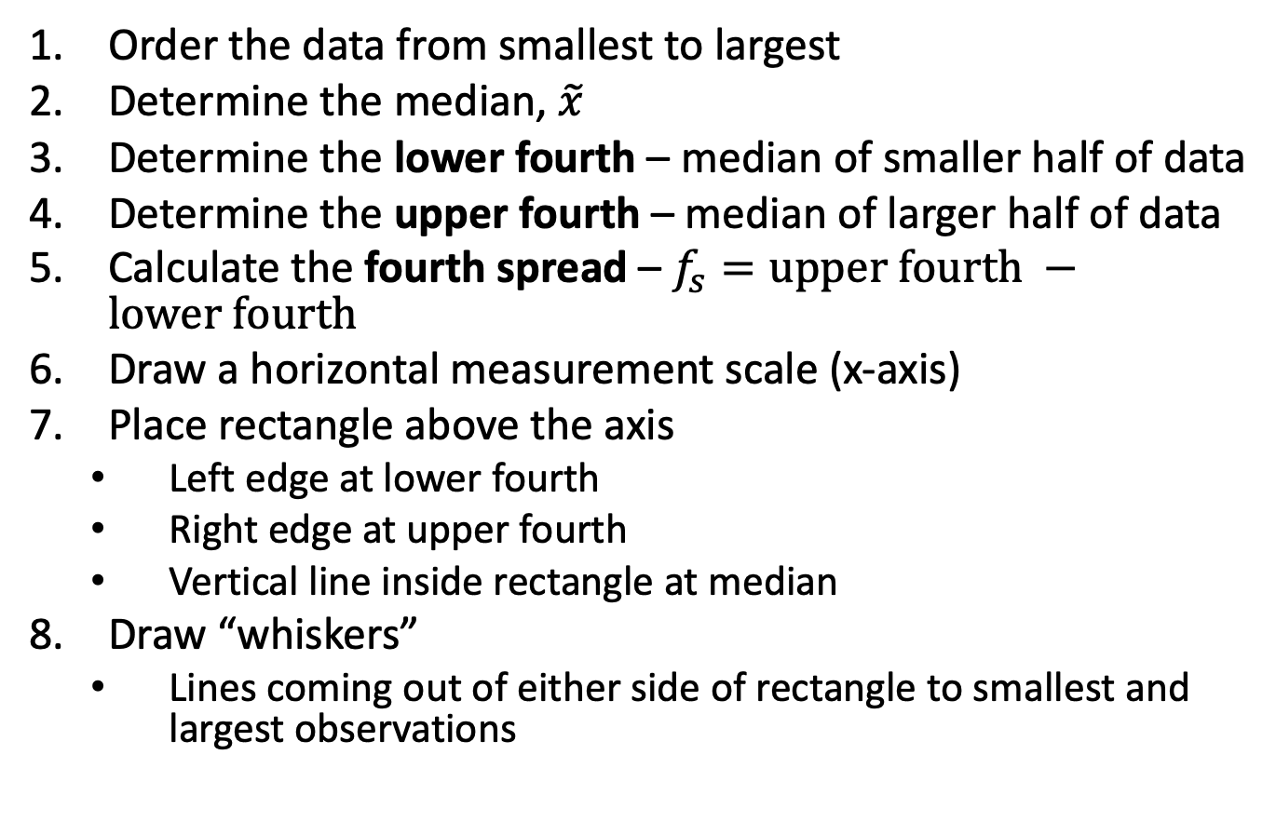
Constructing a Box Plot
Order the data from smallest to largest
Determine the median, $\tilde{x}$
Determine the lower fourth – median of smaller half of data
Determine the upper fourth – median of larger half of data
Calculate the fourth spread – $f_{s}=upper fourth −lower fourth$
Draw a horizontal measurement scale (x-axis)
Place rectangle above the axis
  Left edge at lower fourth
  Right edge at upper fourth
  Vertical line inside rectangle at median
Draw “whiskers”
  Lines coming out of either side of rectangle to smallest and largest observations

Slide 51
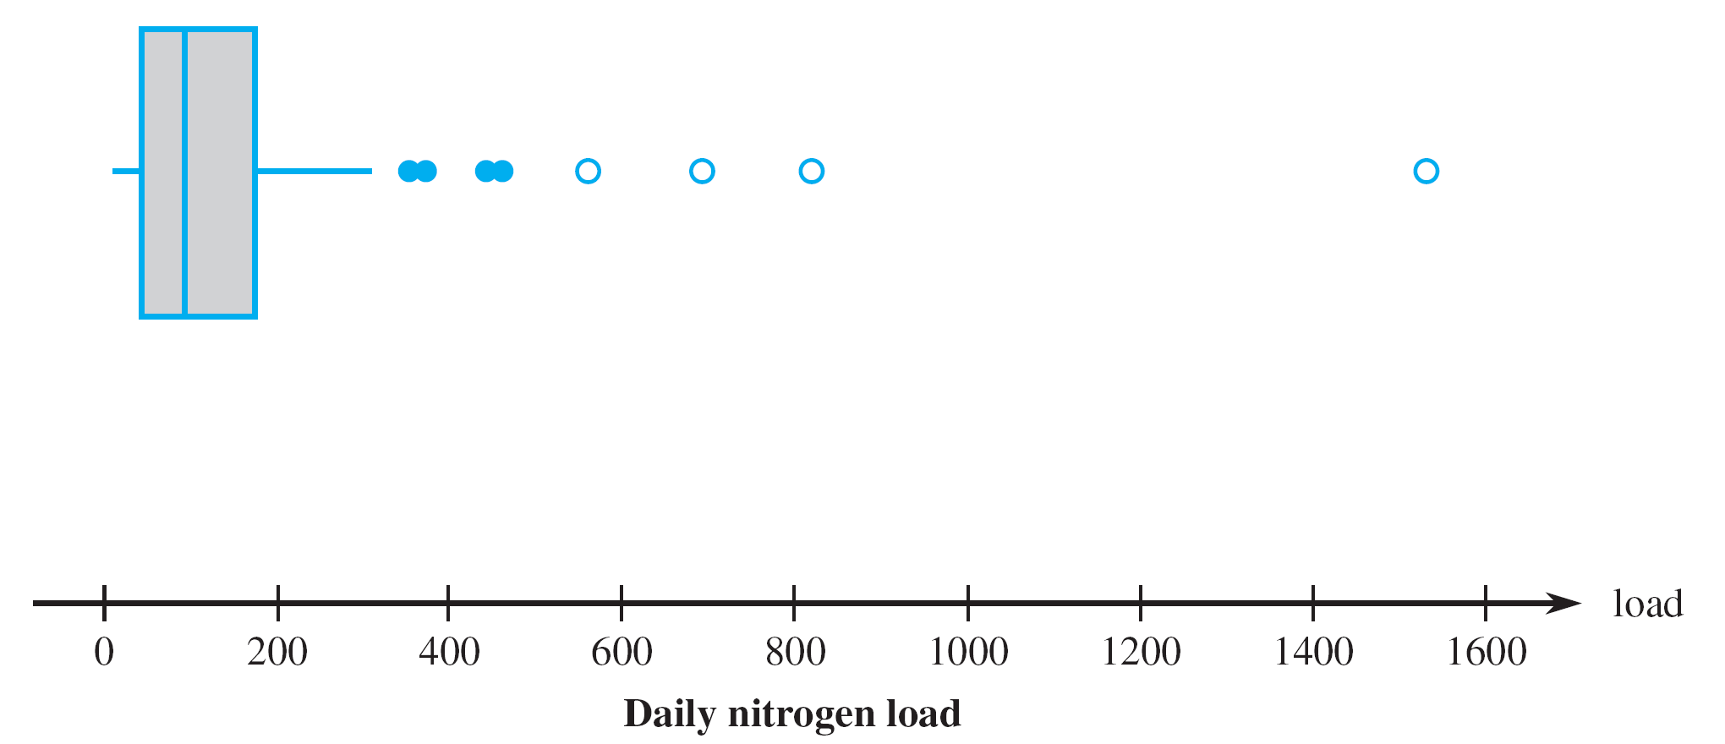

Boxplots with Outliers
Values farther than ${1.5f}_{s}$ from either the upper or lower fourth are mild outliers
  Indicated on boxplot with
Values farther than ${3.0f}_{s}$ from either the upper or lower fourth are extreme outliers
  Indicated on boxplot with

Slide 52
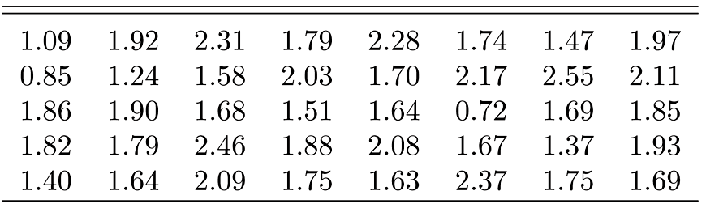
Example 1.5 – Page 25
Table 1.8 Nicotine Data for Example 1.5

Slide 53
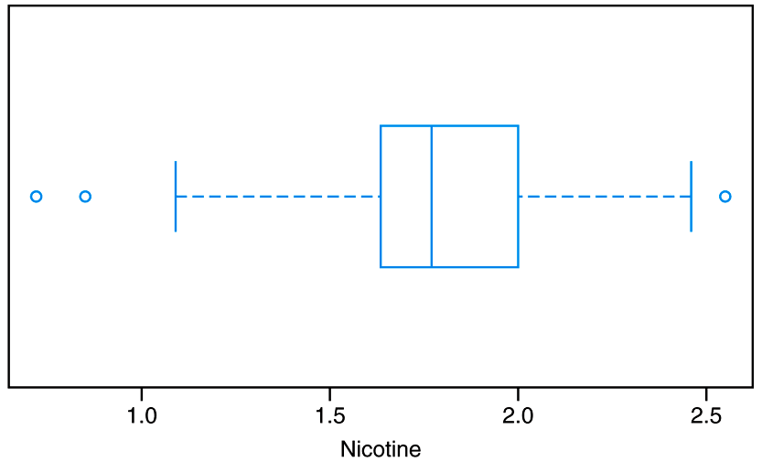
Example 1.5 – Page 25
Figure 1.9 Box-and-whisker plot for Example 1.5

Slide 54
Example: Box Plot
Grade point averages of 15 University of Pittsburgh Engineering Freshmen:
2.0 | 2.7 | 2.8
2.3 | 3.1 | 2.8
2.9 | 2.6 | 1.9
2.7 | 3.0 | 3.1
2.6 | 2.5 | 2.7

Slide 55
Summary
We have talked about several graphical display techniques.
  Scatter plot
  Stem-and-Leaf plot
  Histogram
  Box plot
Much easier for human to see patterns, understand the data and identify problems.
Need to know how to construct = How to interpret the plots
Data Viz or Data visualization is an extremely important subject within the field of statistics and data analysis
  Python package: matplotlib and seaborn
  Interactive Data Viz Packages
  Plotly

