Slide 1
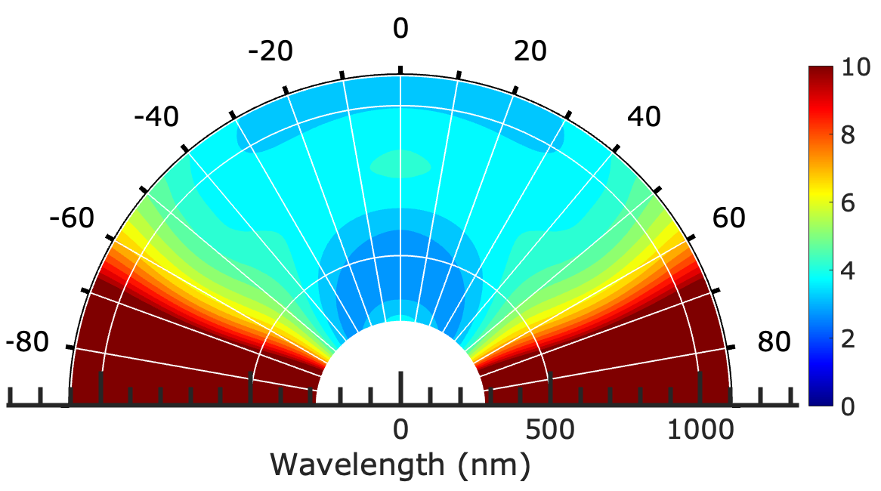
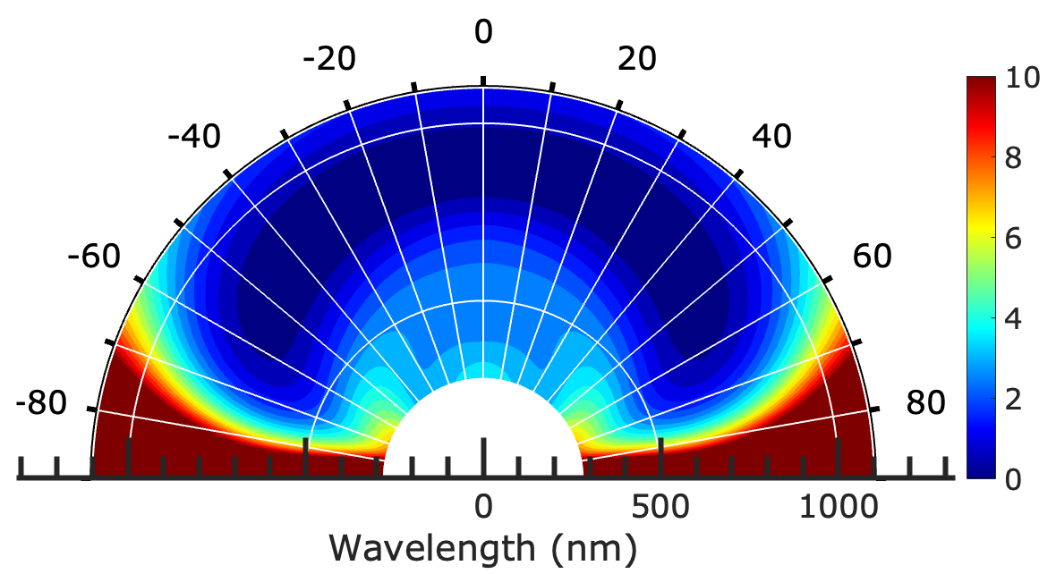
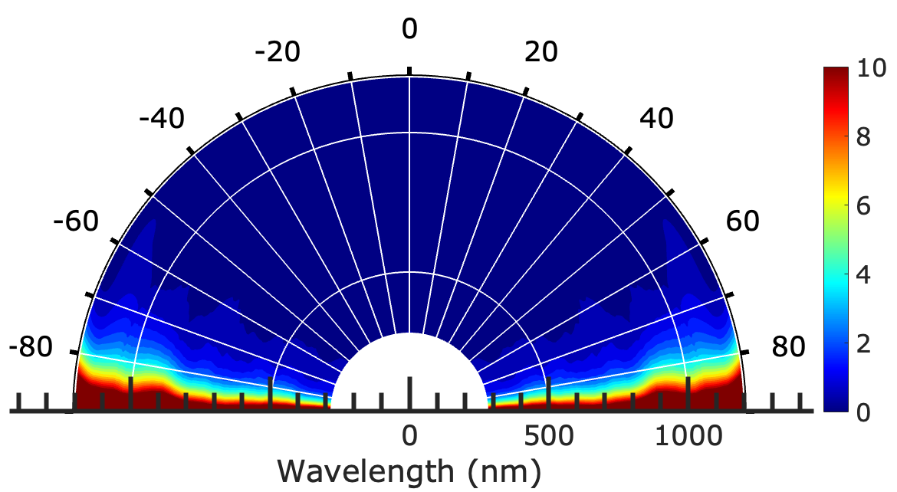
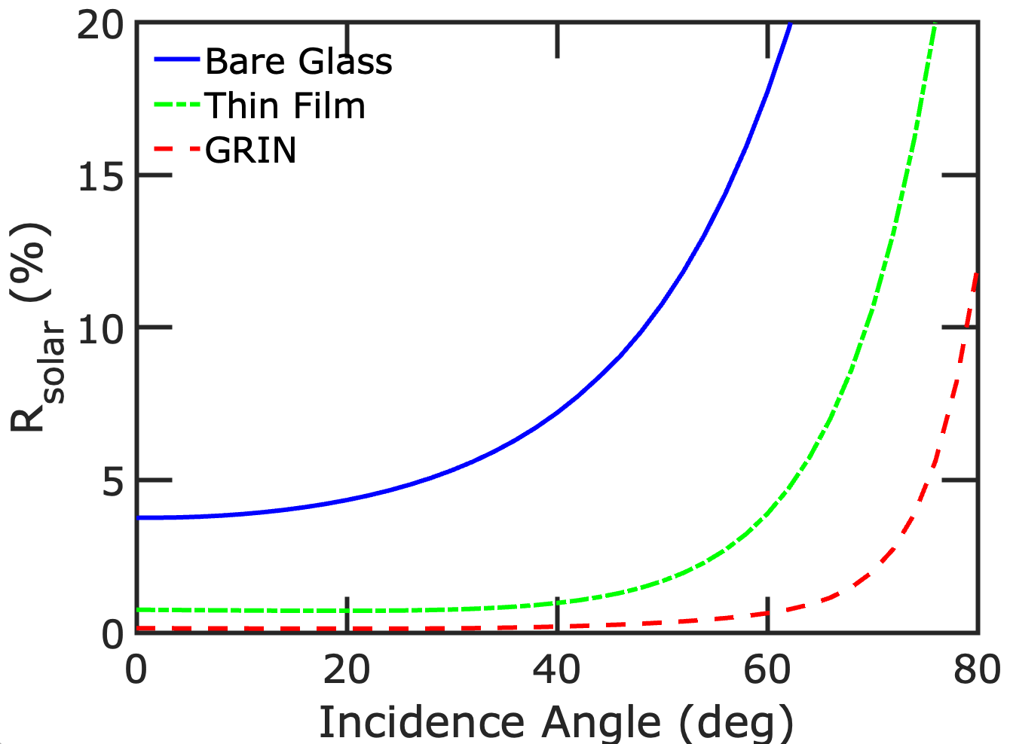
280 to 1100 nm
(a)
(b)
(c)
(d)

Slide 2
Angle | Bare Glass | Thin Film | GRIN
0 | 3.762 | 0.7451 | 0.14262
5 | 3.7871 | 0.736 | 0.13747
10 | 3.8813 | 0.7246 | 0.13324
15 | 4.0642 | 0.71594 | 0.12982
20 | 4.3432 | 0.71311 | 0.1274
25 | 4.7528 | 0.72318 | 0.12868
30 | 5.3192 | 0.75529 | 0.13772
35 | 6.1157 | 0.82907 | 0.15878
40 | 7.2038 | 0.9689 | 0.19459
45 | 8.7193 | 1.2308 | 0.24865
50 | 10.781 | 1.6839 | 0.32576
55 | 13.702 | 2.4999 | 0.44415
60 | 17.716 | 3.8921 | 0.63381
65 | 23.385 | 6.3747 | 1.0304
70 | 31.181 | 10.611 | 1.9855
75 | 41.898 | 18.133 | 4.7628
80 | 53.055 | 30.031 | 11.995
85 | 76.545 | 65.032 | 51.681
90 | 100 | 100 | 100

Slide 3
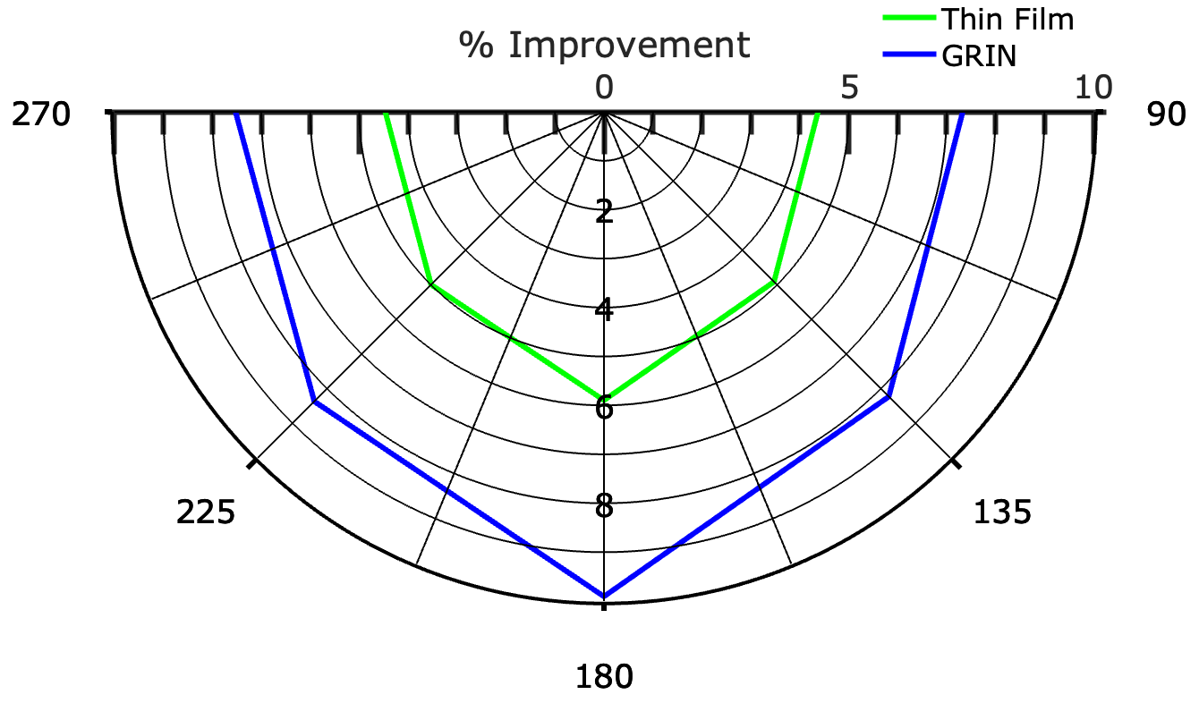
Chennai
(a)

Slide 4
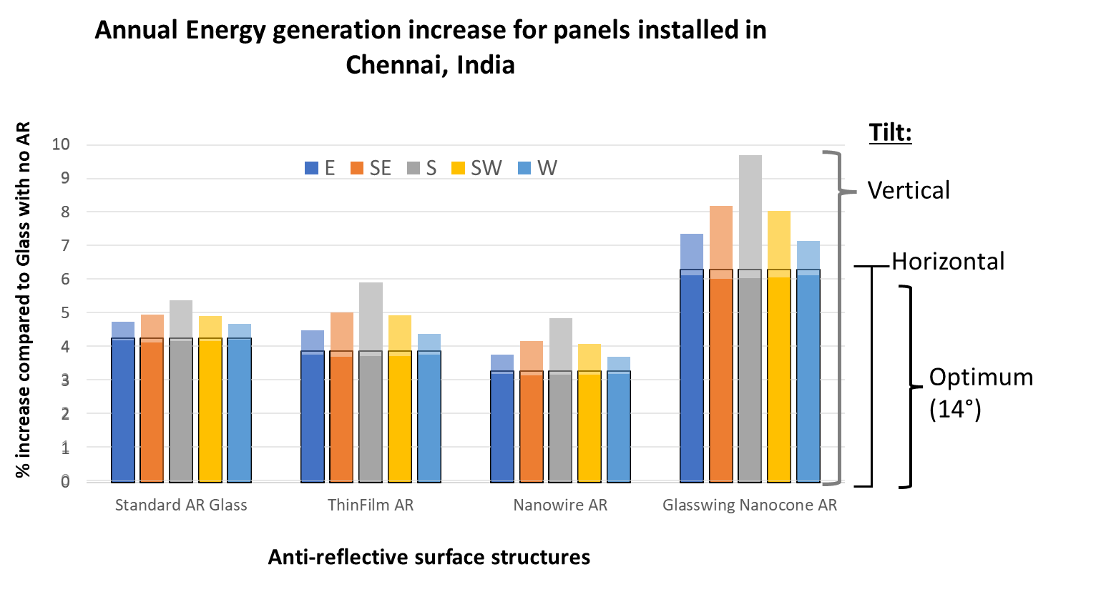

Slide 6
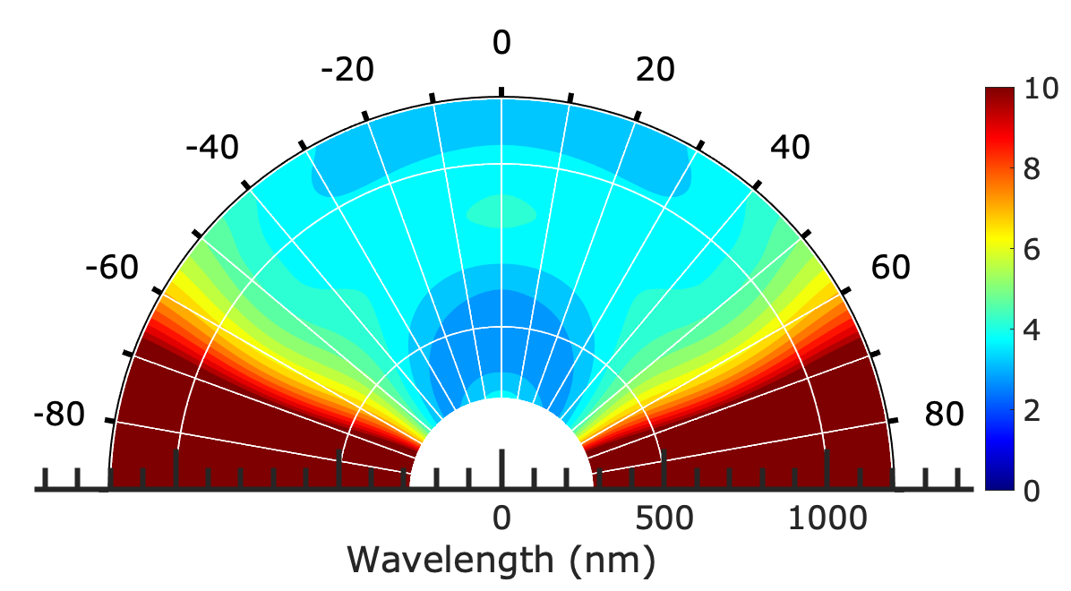
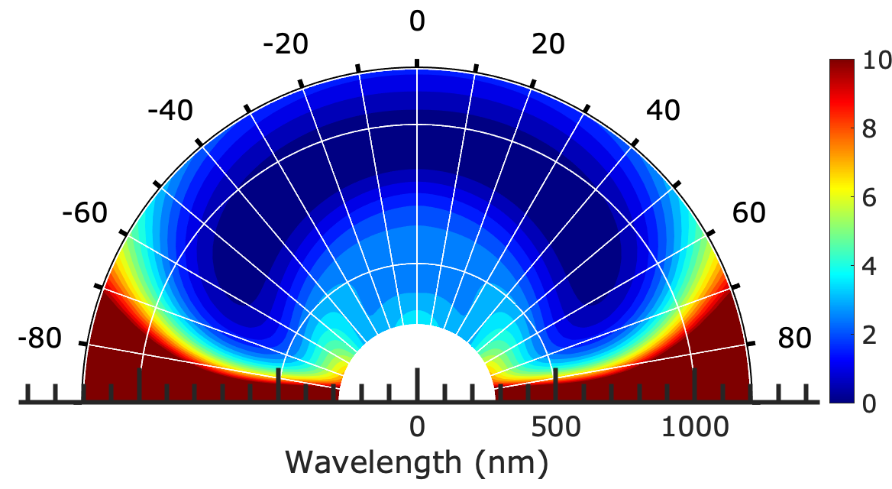
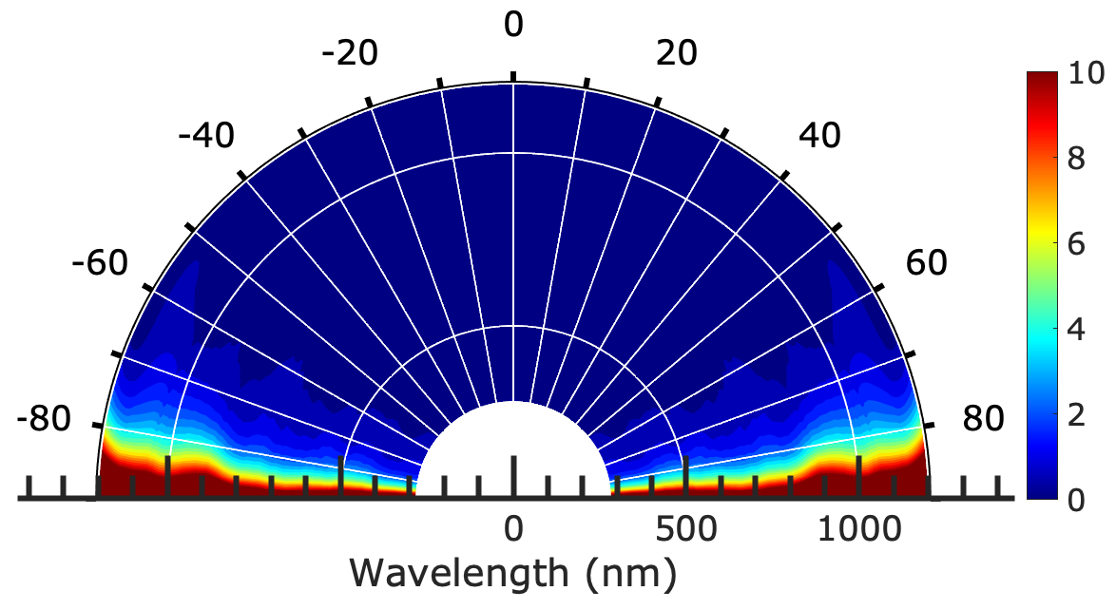
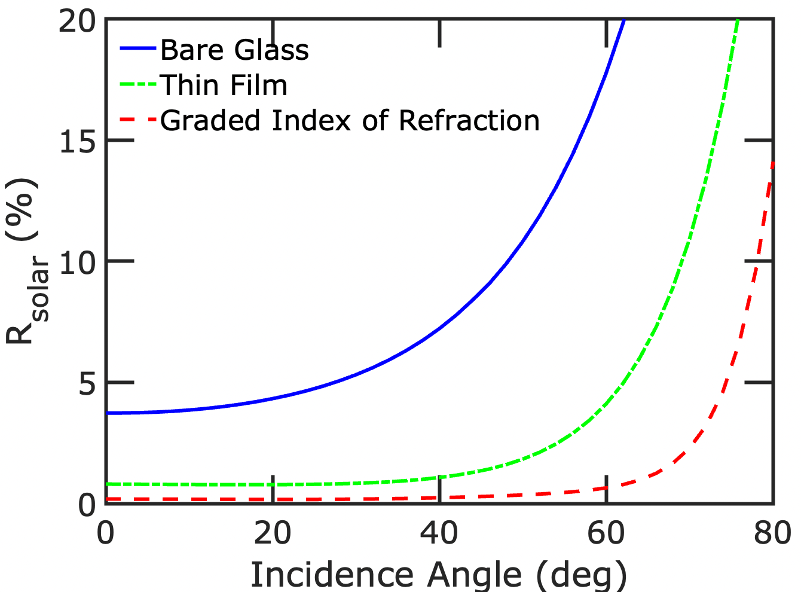
(a)
(b)
(c)
(d)

