Slide 1
Data Analytics Mozilla Project
Data Analysis by: Patrick Leung

Slide 2
Content
FireFox Market Position Analysis
Explore Pilot Test Data
Business Question
How to Grow Users
Assumptions
Business Assumptions & Validation
Customer Segments
Target Market
Optimization with Bookmarks or Tabs?
Conclusion
Notes:
Market Analysis: Review Current(2010) Firefox Market Position

Slide 3
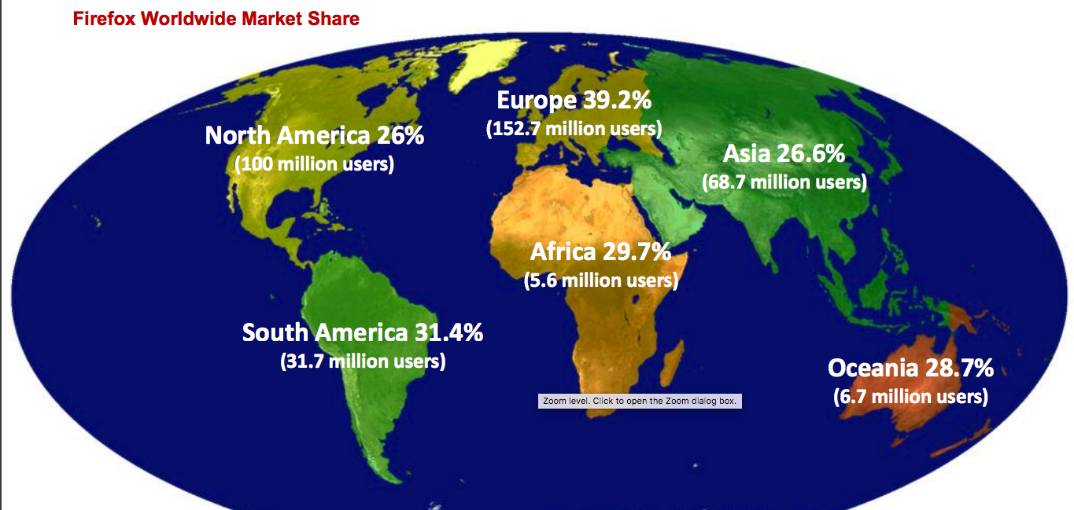
Firefox Market Position Analysis
During Q1 2010:
Firefox’s worldwide market share hovering near 30%
Reference: wiki.mozilla.org/images/e/ed/Analyst_report_Q1_2010.pdf

Slide 4
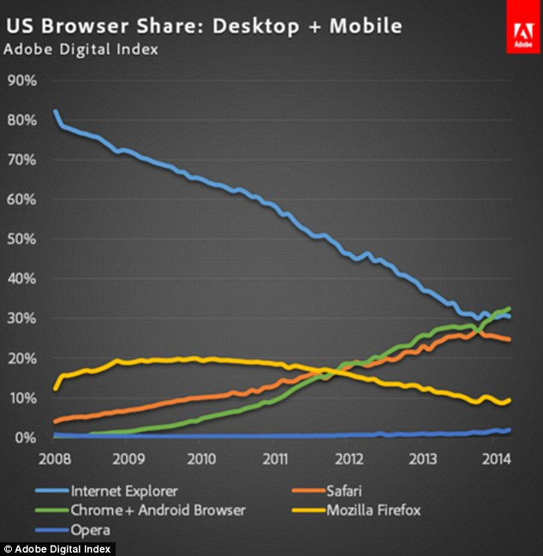
Firefox Market Position Analysis
2010: Firefox was the second most used browser
Predicting into the future, Firefox has lost most of its market share to Chrome and Safari towards 2014

Slide 5
Business Questions
Business Goal: How do we grow our Users and obtain more market share?
What are the macro data for internet users?
Business Assumptions:
Base on macro data and test pilot data, optimizing either tabs or bookmark feature could uplift user experience and gain back market share
Business Validation:
Is it tabs or bookmarks that we need to improve?

Slide 6
Explore Test Pilot Data Set

Slide 7
Explore Test Pilot Data Set

Slide 8
Explore Test Pilot Data Set

Slide 9
Explore Test Pilot Data Set

Slide 10
Explore Test Pilot Data Set

Slide 11
Business Goal: How do we grow our Users and obtain more market share?
-> We will be comparing our data with macro market research data
Notes:
Remember: What ever we decide to do next, we need to revolve it around our Business Goal…
In order to do that… We will be comparing our Test Pilot Data with Macro Market Research Data.

Slide 12
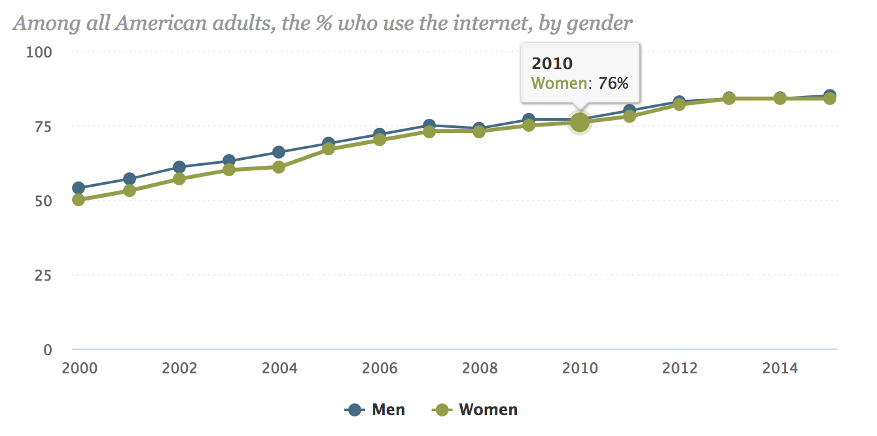
Comparing User-base by Gender
Reference: http://www.pewinternet.org/2015/06/26/americans-internet-access-2000-2015/

Slide 13
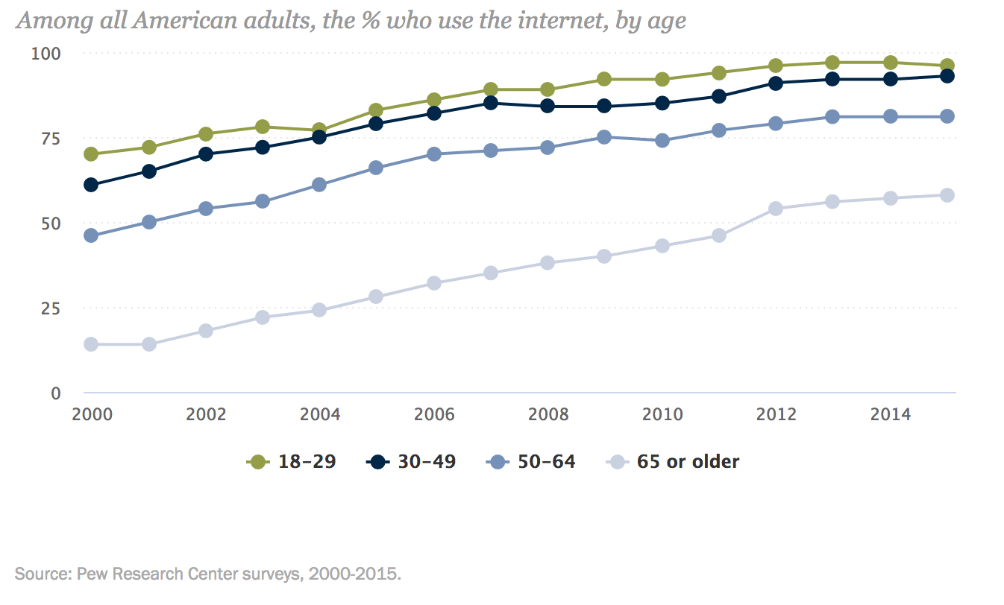
Comparing User-base by Age
Notes:
- Our product has targeted the right age segment having the top 3 age groups similar to Market Research Data

Slide 14
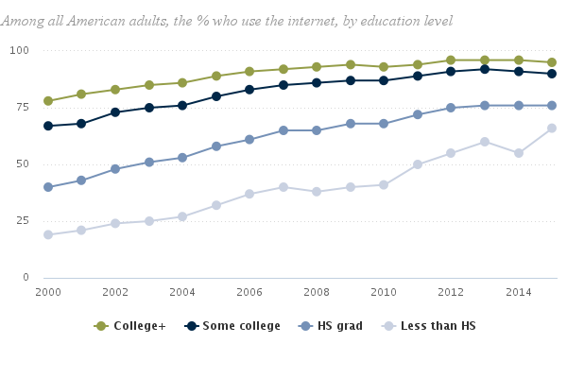
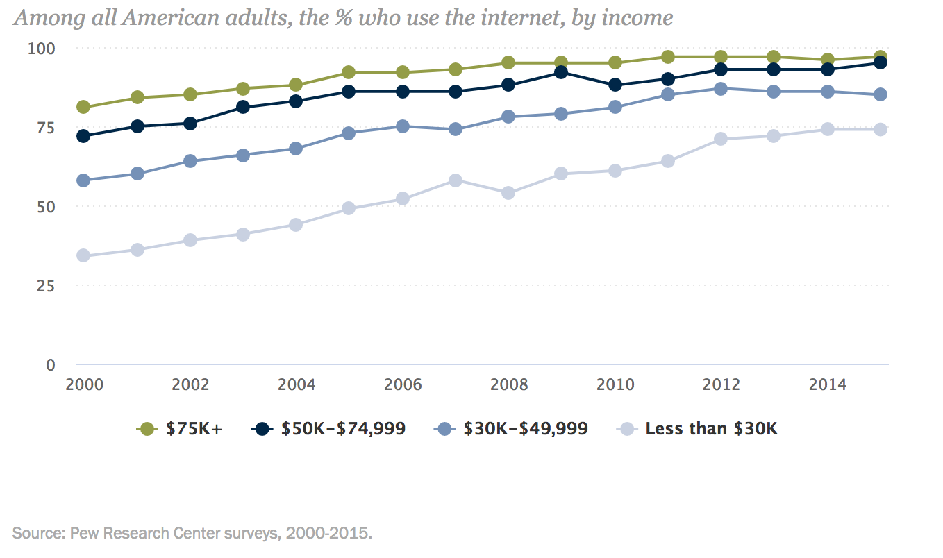
Majority Market User Skill Level:
<- Education Level
Income Level
Notes:
Also Assuming there is a correlation within skills for Education Level and Household income based on the market research… Firefox has also targeted the right segment of higher educated and income level users with marjority users self-rating their skill level.

Slide 15
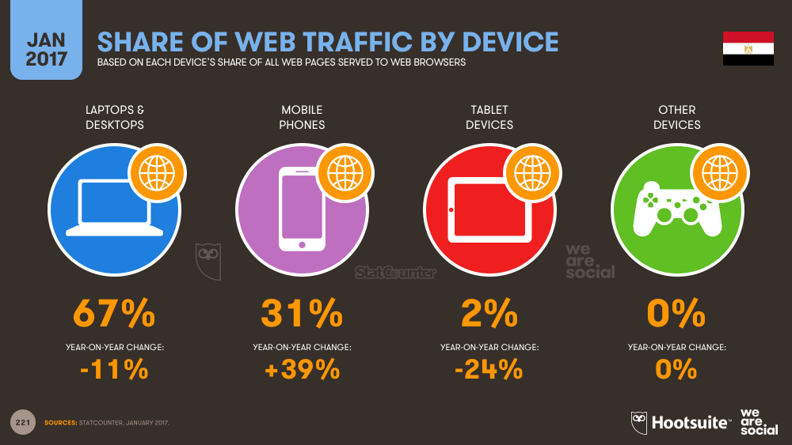
Comparing Users by Access Points
Notes:
Focusing on the right market share but we should really consider mobile access point as the next dominant segment if we were to obtain future market share.

Slide 16
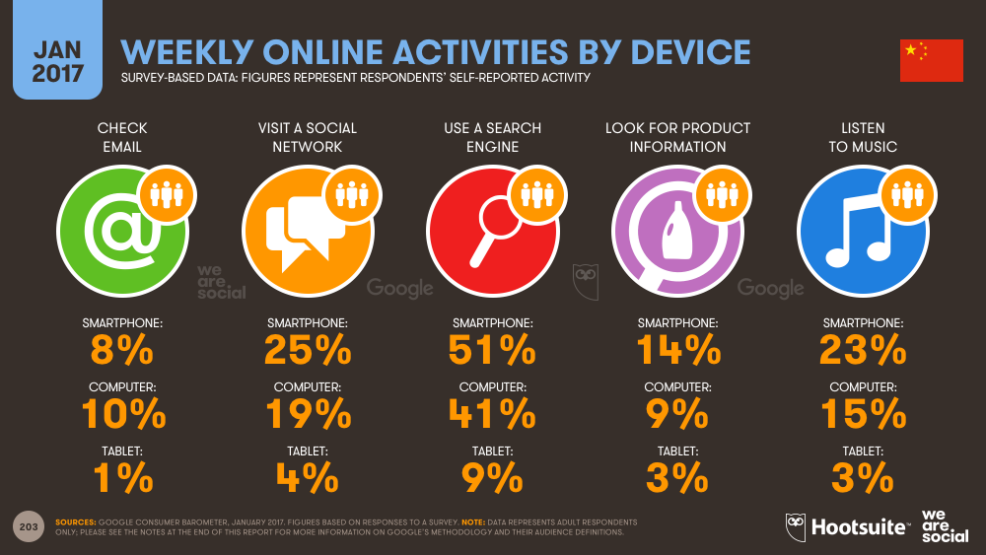
Comparing Users by Activity & Reasons
Notes:
Will explain this comparisons in the next slide’s conclusion…

Slide 17
How do we grow our Users and obtain more market share?
Conclusion:
Priority: Need growth in Female Internet Users!
Have obtain the majority segment of Age group and Skill Level User
Firefox is does not need to simplify features and technology
Should still focus majority resources in desktop/laptop browser optimization
Should start consider the growth of mobile and develop features to obtain market share
Firefox User behavior do fit with using Search Engine Most compare to global behavior
Other than searching, Global internet research has user’s with: Socializing ^{1st} and Music (entertainment) 2nd in most web activity. Communication comes in 3rd.
Firefox Users has entertainment 1st, Communication 2nd, and socializing 3rd
Notes:
Need growth in Female Internet Users!
- When we have as much male using the internet as much as female… Only 6% of Firefox user survey feedback are female is an embarrassing statistic.
Firefox Data Survey has hit spot on on the following data metrics with Age Group, Skill Level User, Access Point and User behavior compare to Global inter user market research reports
But other than Search Engine features:
- Firefox should focus more on features for Users in the Area of: Socializing (since the growth of social media) and Entertainment (making the features entertaining)
- Communications is no longer the major priority in today’s internet activity

Slide 18
Business Validation: Bookmarks or Tabs

Slide 19
Bookmarks or Tabs?
Whatever resources we dump into optimizing Bookmark or tabs, the GOAL is to increase our user and gain market share!
What Women Want? (3W question)
What are their tab behavior like?
What are their bookmark behavior like?
What Web activities do they focus on?
Our Queries will focus on the majority web user group by female gender: 1) Female 2)Ages 18-45 3) Skills from 8-10
WHERE event_code = n AND s.q5::Integer=1 AND(s.q6::integer=1 OR s.q6::integer=2 OR s.q6::integer=3) AND (s.q8::integer>=8)
Notes:
Before we answer this question bookmarks or tabs? (point 1)
Revolving with what we concluded just now… we should ask this question instead…(point 2)
In Order to get these answers we will focus our queries on… (point 3)

Slide 20
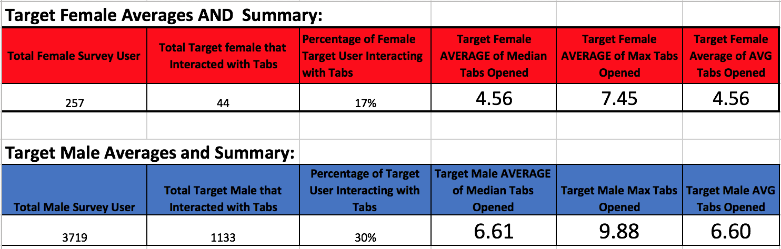
Tab Behavior for Users
Tabs are recorded every 15 mins (recorded in 24 hr. event)

Slide 21
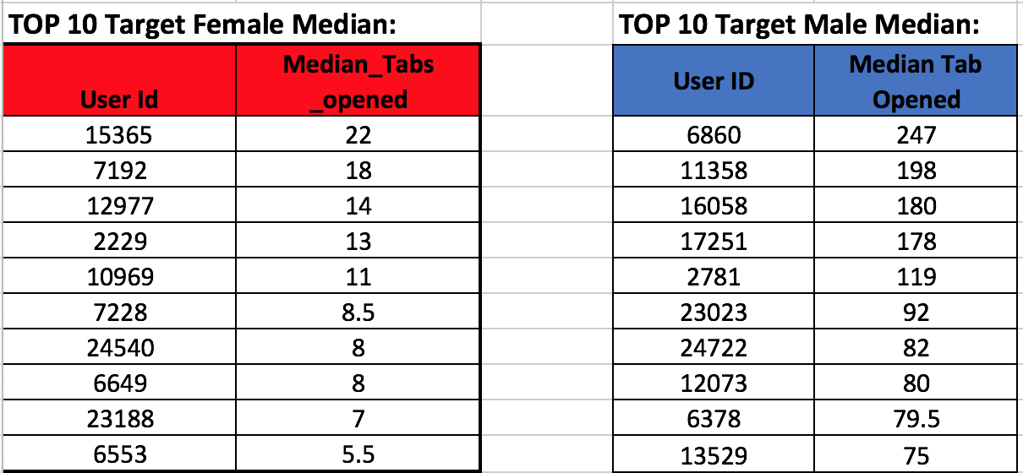
Tab Behavior for Target Users (Median Opened)

Slide 22
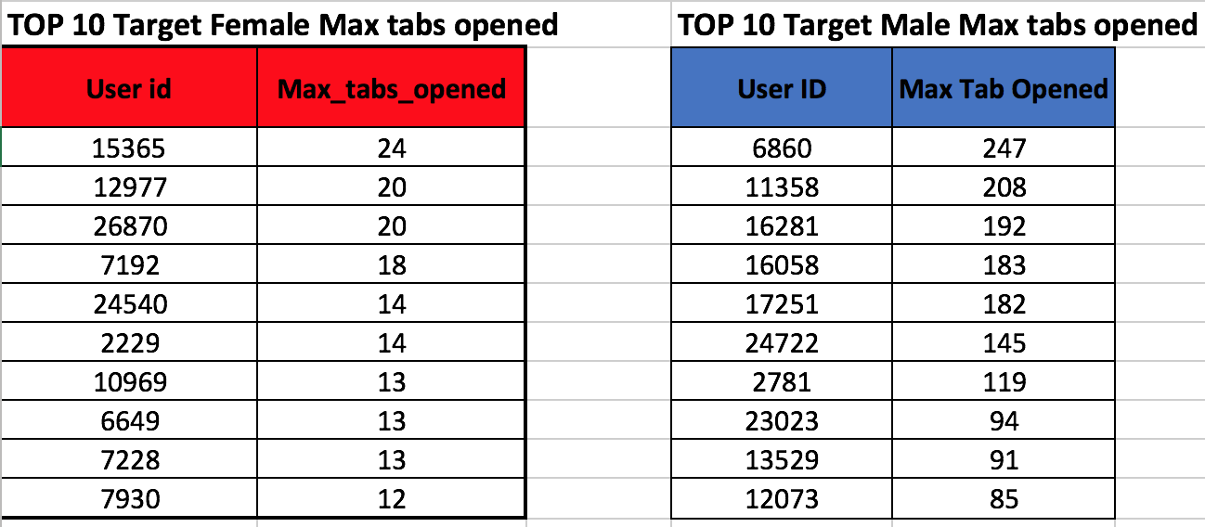
Tab Behavior for Target User (Max tabs Opened)

Slide 23
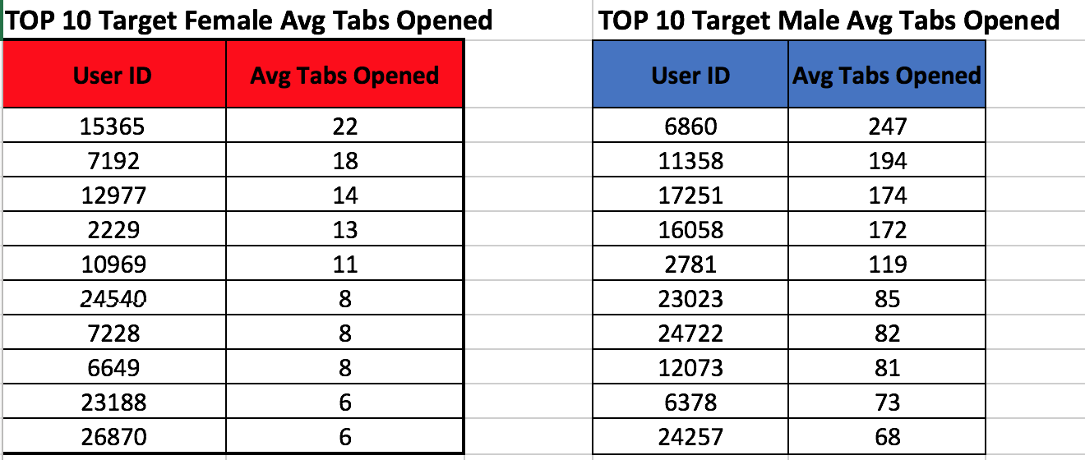
Tab Behavior for Target User (Average tabs Opened)

Slide 24
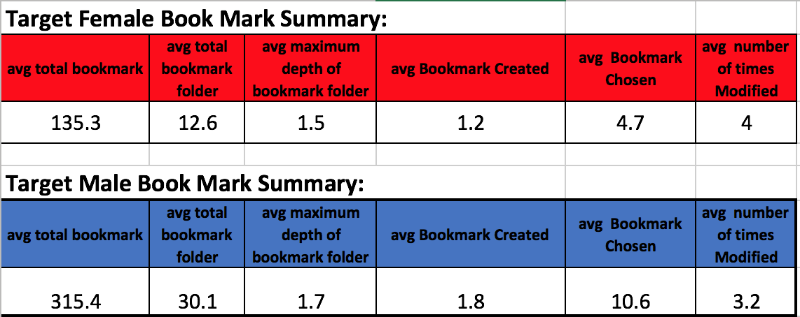
Bookmark Behavior for Users
Notes:
Female bookmark events user: 30 (11% of total female users)
Male bookmark events user: 697(18% of total male users)

Slide 25
Bookmarks or Tabs?
Notes:
Now We can ask the Question…
- To summarize this decision, we compare the Target User data one last time based on Purposes and Browsing Behavior

Slide 26
Target Users Internet Purposes
Notes:
Personal Life Assistance stat is worth looking at

Slide 27
Target User Browsing Behavior

Slide 28
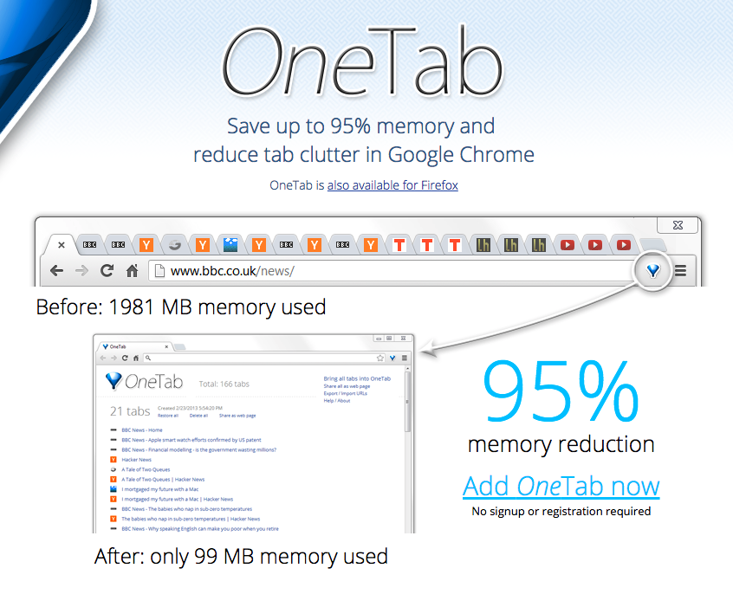
Business Validation: Tabs or Bookmark
Target Market Female User Don’t Open as much tabs…
Reasons? Maybe like don’t like it messy OR doesn’t use tech SaVy tools Such as Tab Handlers (ie. One Tab)?
Notes:
(talk about points first)
As we see in our Survey… Male Target Users has chosen more on Work Coding Related at the survey compare to female target users. More of them may be more tech sensitive to features… and will know how to use addons
Next ACTION: Will need more Female Target User Data to validate this finding further…
Suggestions: create survey to validate if any additional addons User uses for tabs to validate.

Slide 29
Business Validation: Tabs or Bookmark
Based on Bookmarks:
Male Target Users have twice as many bookmark and bookmark interactions compare to female Target Users…
Reason? Action: need to obtain more Female Target User data to make further validations…
Notes:
(After Point 1)
Of course we could go deeper into our findings with how long did they use Firefox for… but since they are both genders Target Users with highly skilled.. May not affect our business assumption…
GO TO(Point 2)

Slide 30
Validated Learning Assumptions
Female Target User Behavior:
Less tech SaVy
Don’t Code as much as male user
More focused on browser purpose compare to Male Target User in:
Personal Life Assistance duties
Communication
Socializing
This Can Validate above from a higher average when they choose to browse Social networking sites, webmail, online banking, and shopping
These usage could also mean the higher need of Personal Life Assistance
Notes:
(After all the points)
Online Banking, Shopping and Webmail does the personal Life assistance:
Perhaps they do most of the grocery shopping for the house holds… paying the bills… and communicating for parenting reasons (plays the more Caring role in life). Job specs wise Women could play more a communication/PA role such as Administration or HR.

Slide 31
Actionable Iteration for Validated Learning
Business Suggestions for next optimization:
Create Tab Features or Welcoming tab when opening Firefox, which focuses on 1) Social Media 2) Webmail 3) Online Banking 4) Shopping
Create Default bookmarks that could recognize the 4 major online purposes for Target Female User
Query shows: Only 6 Users created bookmark out of 80 Target Female Users Also shows that its mostly 1 time created… (max: 2 time created)
Create more Personal Life Assistance features (can be bookmark or tab features)
Notes:
(Points 1 first)
(After Point 2 support)
- 7% of target Female User creates a bookmark in that 1 day.
- Although its 4% for male users their created bookmark can go up to 16 times max
- This could be a A/B Test
Go To (Point 3)

