Slide 1
Figure 1. Changes in plasma viral RNA copies and T cells in peripheral blood mononuclear cells (PBMC), bronchoalveolar lavage (BAL), and peripheral lymph node (pLN) over time. A) Plasma viral RNA copies (reported as mean and standard deviation) among Mtb/SIV co-infected animals are shown. B) Peripheral CD4 T cells within Mtbα/CD4 animals are more severely reduced compared to Mtb/SIV co-infected animals with latent infection. C) Total absolute CD4 and CD8 T cell counts and frequencies were measured in BAL cells. D) CD4 and CD8 T cell frequencies were measured in pLN. Changes in absolute CD4 and CD8 T cell counts (Abs Counts) and frequencies after SIV_{mac251} infection (green line, Mtb/SIV, n = 8), αCD4 depletion antibody (purple line, Mtb/αCD4, n = 7) and controls (grey line, Mtb-only control, n = 6) are shown. Statistics reported are Steel tests comparing Mtb/SIV and Mtb/αCD4 at each time point (adjusted for comparing Mtb-only controls to Mtb/SIV [green stats marker] and Mtb/αCD4 to Mtb/SIV [purple stats marker]). For B-D, medians are shown with error bars representing interquartile range. * p < 0.05, # p < 0.10.
Notes:
Lines are median and error bars represent IQR.
Stats reported are Wilcoxon-exact tests comparing SIV and anti-CD4 at each time point (not adjusted for multiple tests).
**** p < .0001
*** p < .001
** p < .01
* p < .05
# p < .10

Slide 2
Figure 2. Subclinical reactivation of Mtb/SIV NHP results in greater total thoracic burden but not in Mtb/αCD4 NHP. Non-reactivators (blue) and reactivators (red) from Mtb only (control, grey), Mtb/SIV co-infected (n = 8), and CD4 depletion (Mtb/αCD4, n = 7) NHP are shown. Individual monkeys are identified by different shapes. A) Necropsy and extrapulmonary (EP) scores are based on gross pathology at time of necropsy. B) Total thoracic burden (quantitative sum of Mtb from excised tissues within the thoracic cavity) and lung and thoracic lymph nodes are shown. C) A greater percentage of granulomas with Mtb growth is observed in reactivated Mtb/SIV NHP. P-values reported from Kruskal-Wallis test with Dunn’s multiple comparisons adjustments, adjusted for the following (4) comparisons: reactivators vs non-reactivators within treatments and non-reactivators and reactivators between treatments. P-values < 0.10 are shown. Each dot represents an animal. Mtb-only controls are shown for reference, but not included in the statistical analysis.
Notes:
P values reported represent Dunn’s test, adjusted for the following (4) comparisons: reactivators vs non-reactivators within treatments and non-reactivators and reactivators between treatments.

Slide 3
Figure 3. SIV-induced reactivation is characterized by more new granulomas that are permissive to Mtb growth compared to CD4 depletion. A) The number of newly formed granulomas identified by PET CT during subclinical reactivation, among Mtb/SIV (green, ranging from 13 to tntc) and Mtb/αCD4 (purple, ranging from 1 to tntc) NHP. TNTC = too numerous to count and was set at 100 (Mann-Whitney, P = 0.1270). Individual monkeys are identified by different shapes. B) Mtb growth from new granulomas of Mtb/SIV and Mtb/αCD4 NHP are shown. Points that fall within the grey bar were sterile. Numbers on x-axis represent individual monkey identification numbers. Lines represent medians. In A), each shape represents an individual animal; in B), each shape represents an individual granuloma.
Notes:
No stats done on (A). (B) Mann-Whitney Test, p = .8889.

Slide 4
Figure 4. Frequencies of CD4 T cells are severely reduced by CD4 depletion but SIV markedly increases the total number of T cells within granulomas. Non-reactivators (blue) and reactivators (red) from Mtb only (control, grey), Mtb/SIV co-infected, and CD4 depletion (Mtb/αCD4) NHP are shown. A) and B) CD4 and CD8 T cell frequencies from lung granulomas within individual monkeys (shapes) are shown. C) and D) Total number of CD4 and CD8 T cells within the granuloma are shown. Kruskal-Wallis test with Dunn’s multiple comparisons adjusted p-values are shown. P-values < 0.10 are shown. Lines represent medians. (6 Mtb control, n = 46 granulomas; 8 Mtb/SIV NHP, n = 110; and 7 Mtb/αCD4 NHP, n = 86; within Mtb/SIV NHP, non-reactivators = 25 granulomas, reactivators = 85; and within Mtb/αCD4 non-reactivators = 20, reactivators = 66).
Notes:
Kruskal-Wallis test.
In first 4 graphs (panels 1 and 2), Dunn’s multiple comparison corrected p-values reported for comparisons among all 3 groups.
P values reported represent Dunn’s test, adjusted for the following (4) comparisons: reactivators vs non-reactivators within treatments and non-reactivators and reactivators between treatments.

Slide 5
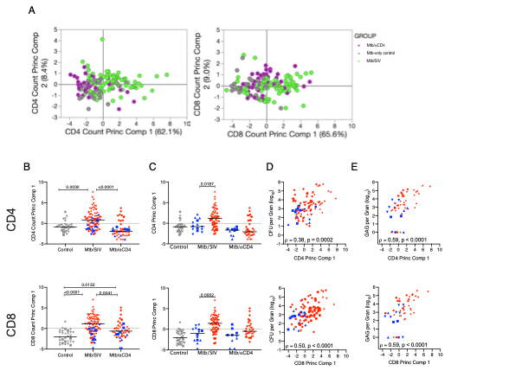
Figure 5. Principal component analysis demonstrates that SIV is associated with greater widespread T cells immune activation within the granuloma. A) Biplots are shown for the first two principal components. Each dot represents a granuloma. (Purple dots= granulomas from Mtb/αCD4 NHP, green dots = Mtb/SIV NHP, and grey dots = granulomas from Mtb-only NHP. B) Median scores of principal component 1 (includes total numbers of CD4 and CD8 T cells producing IFN-α, IFN-γ, TNF, IL-2, IL-17, IL-10, IL-4 and Granzyme B are compared across treatment groups. Non-reactivators (blue) and reactivators (red) from Mtb/SIV co-infected and Mtb/αCD4 NHP are shown. Individual monkeys are identified by different shapes. All treatment groups were compared using Kruskal-Wallis test with Dunn’s multiple comparison adjusted p-values reported. C) Median scores of principal component were compared between non-reactivators and reactivators within each treatment group. (Kruskal-Wallis Test with Dunn’s multiple comparison adjusted p-values reported.) D) The relationship between the CFU per granuloma (log₁₀) and the first principal component was tested using Spearman’s ρ for all treatment groups. E) In Mtb/SIV NHP, the relationship between granuloma viral RNA quantification and the first principal component was tested using Spearman’s ρ. Each group contains the following number of granulomas: 30 Mtb-only Control, 43 Mtb/αCD4, 83 Mtb/SIV.

Slide 6
Figure 6. SIV replication within the granuloma is associated with reactivation status, greater bacterial burden and growth with less bacterial killing. A) Comparison between plasma SIV RNA copies/ml from SIV-only (black, n = 4) and Mtb/SIV co-infected (green, n = 8) NHP. Symbols represent means and error bars represent standard deviations. B) Differences in SIV RNA replication within lung granulomas from Mtb/SIV co-infected NHP by Mtb burden (Mtb growth [CFU+, n = 51] and sterile [CFU-, n = 27]) and outcome (reactivators [red, n = 59] and non-reactivators [blue, n = 19]). Each symbol is a granuloma. C) Bacterial growth (presented as chromosomal equivalents, CEQ) is greater within among Mtb/SIV granulomas with detectable SIV RNA (SIV-, n = 11; SIV+, n = 35). D) Within Mtb/SIV NHP granulomas, less bacterial killing (represented as CFU/CEQ ratio) is observed when SIV RNA is present (SIV-, n = 11; SIV+, n = 35) and during reactivation (reactivators [red, n = 56] and non-reactivators [blue, n =23]). CFU was transformed by adding 1 to reflect sterile lung granulomas with CEQ. Dotted line at Y = 1 defines no killing. Two points above Y = 1 represent the higher CEQ threshold (1000) compared to CFU’s lower threshold (10). Each shape represents an individual NHP. Individual t tests were utilized to determine significant differences (P < 0.05) between SIV-only and Mtb/SIV NHP. The Mann-Whitney test was used to determine significance between groups in granulomas. Lines represent medians in B-D.
Notes:
Figure 6.

Slide 7
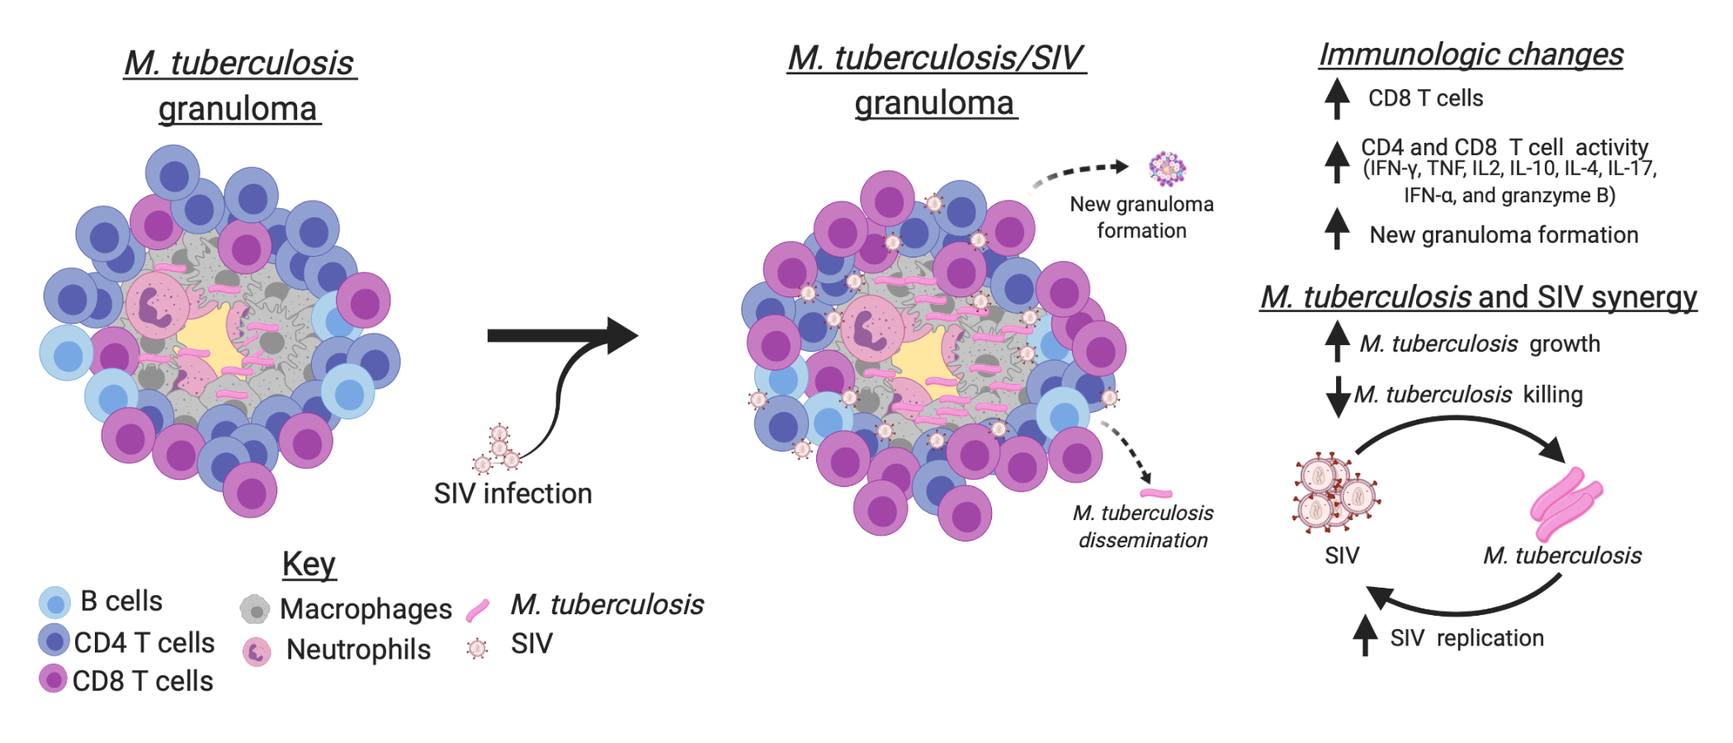
Figure 7. SIV changes immunological functions within Mtb lung granulomas, increases Mtb growth, and reduces Mtb killing. A) An example Mtb caseous granuloma contains T cells, macrophages, neutrophils, and Mtb. B) Mtb/SIV co-infected granulomas contain more CD8 T cells and an increase in overall production of Th1 cytokines, granzyme B, IL-17, IL-10, IL-4, and IFN-α by CD4 and CD8 T cells. SIV also increases the probability of causing new granulomas to form, Mtb growth and dissemination. SIV has been linked to increases in Mtb growth and a reduction in Mtb killing during reactivated disease, while Mtb growth correlates to increases in SIV replication. This suggests that lung granulomas are sites that support a synergistic relationship between SIV replication and Mtb growth. Image created by BioRender.com.

