Slide 1

KLSZ Faloda
Food Delivery Platform
Kocsis Szabolcs Ernő
Kuti Levente Bánk
Pásztor Kevin

Slide 2
Meet the Team
Pásztor Kevin
Kuti Levente
Kocsis Szabolcs
Project Manager & Backend Developer
Database Developer
Frontend Developer
Java EE service layer
MySQL database
HTML/CSS/JS development
Security implementation (BCrypt)
76 stored pocedures (CRUD)
Bootstrap 5 responsive design
Postman testing (120+ cases)
10 tables
API integration (fetch calls)
WildFly deployment & configuration
Foreign key relationships
Pixel perfect
Email service integration
Testing documentation
Page implementation

Slide 3
What is KLSZ Faloda?
Simple
Platform Overview
Connects customers with local restaurants in Pécs for browsing menus, placing orders, and tracking deliveries.
Owners & admins manage users, orders, and payments
Cheap
Fast
Best

Slide 4




Why Did We Build This?
Fragmented Market
Full Of Fees
No Centralized Management
Our Solution
Notes:
Fragmented market: No unified digital presence for local restaurants
Full Of Fees: users have to pay for service fee and delivery fees.
No Centralized Management: Owners struggle to manage and deliver orders.
Our solution: One responsive platform with role-based access & real-time orders.

Slide 5










Technology Stack

Slide 6
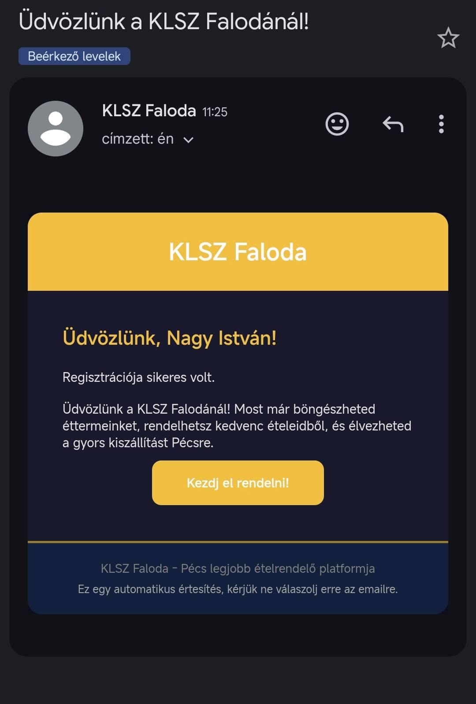
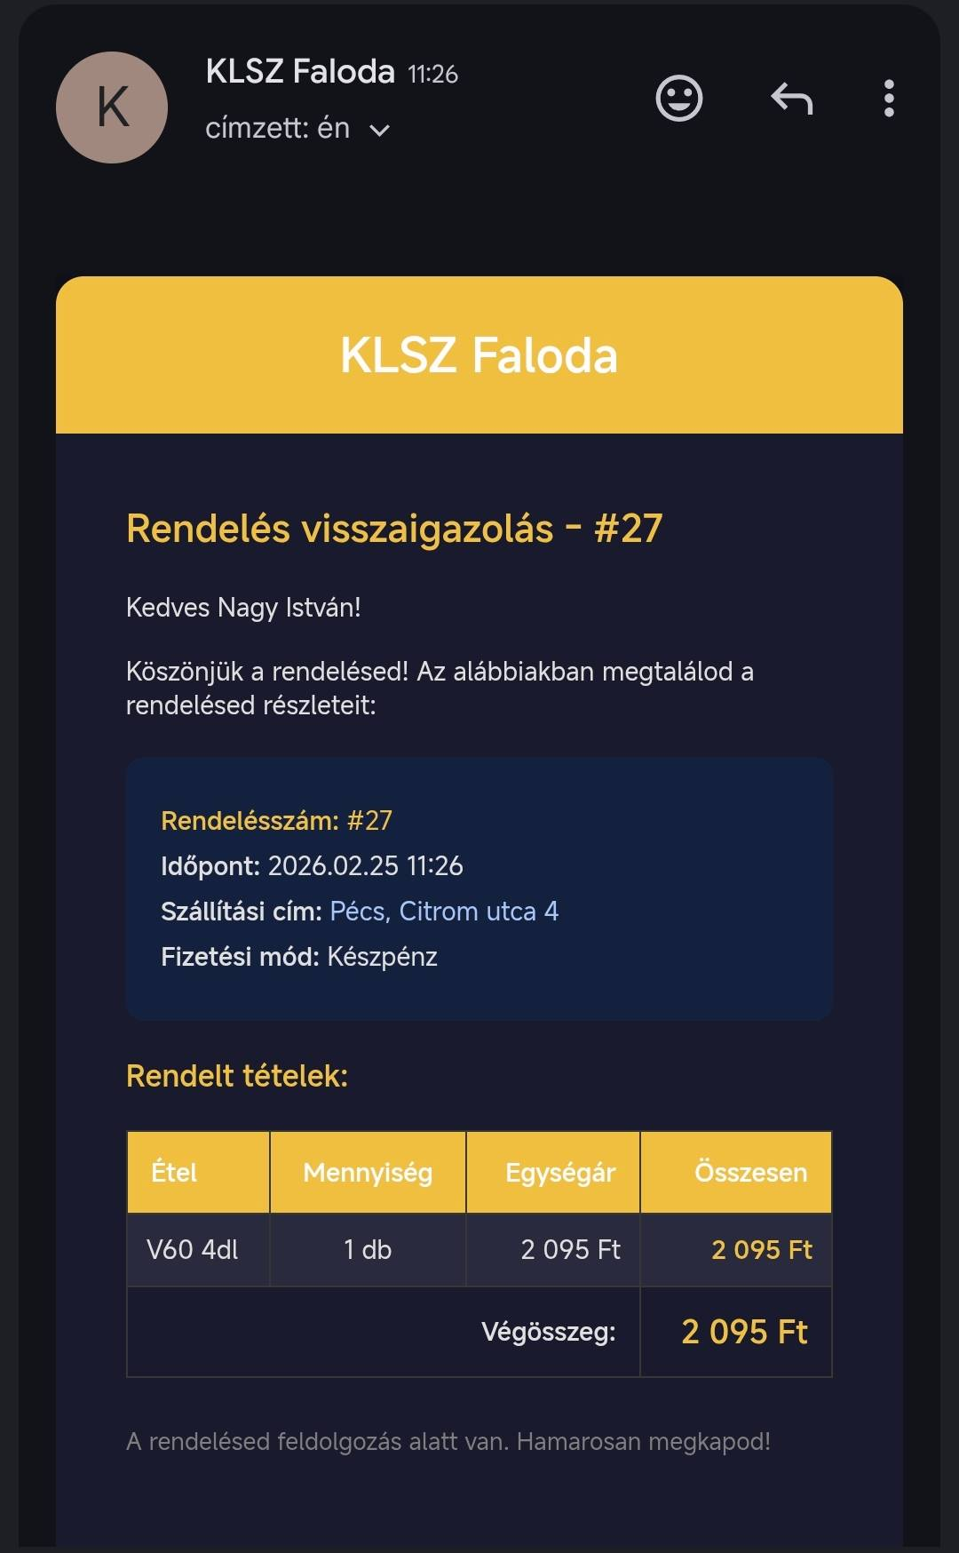
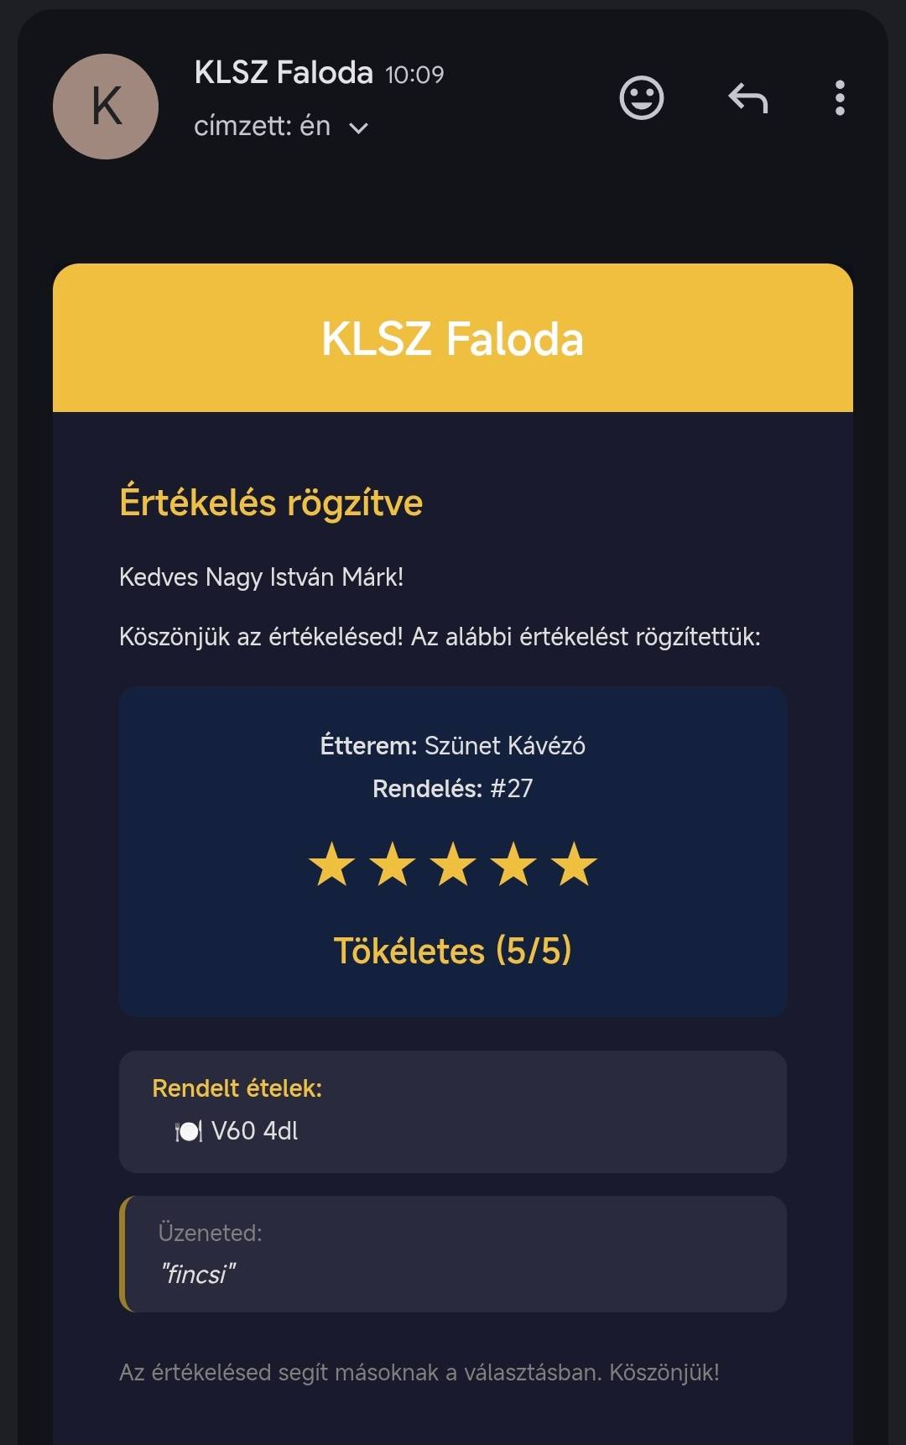
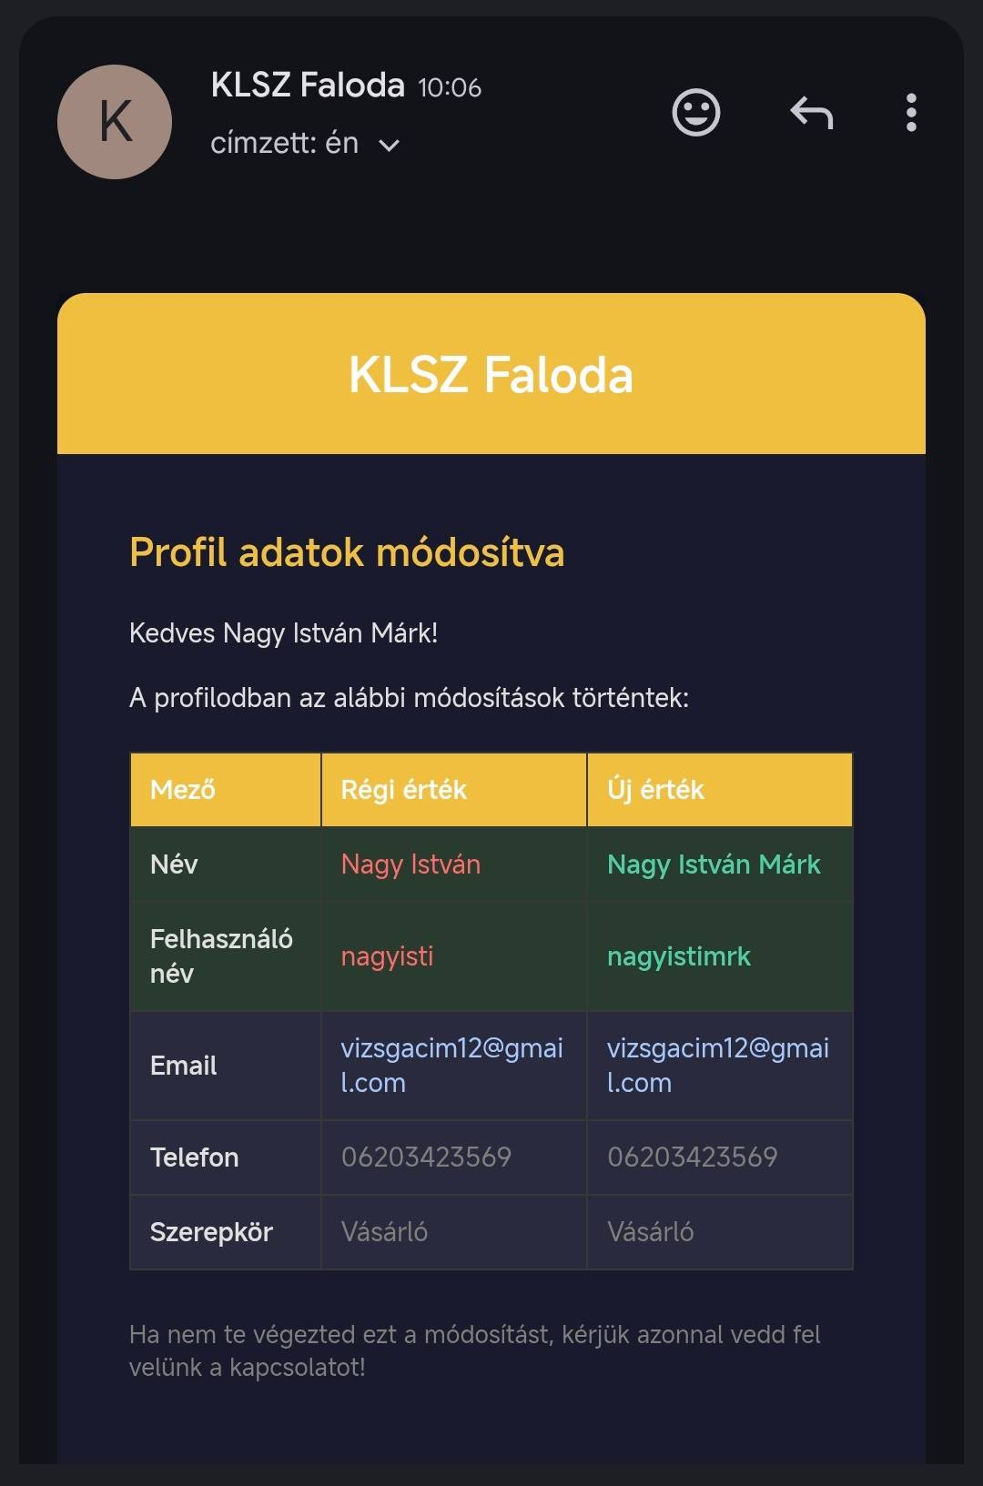
Email Confirmations

Slide 7
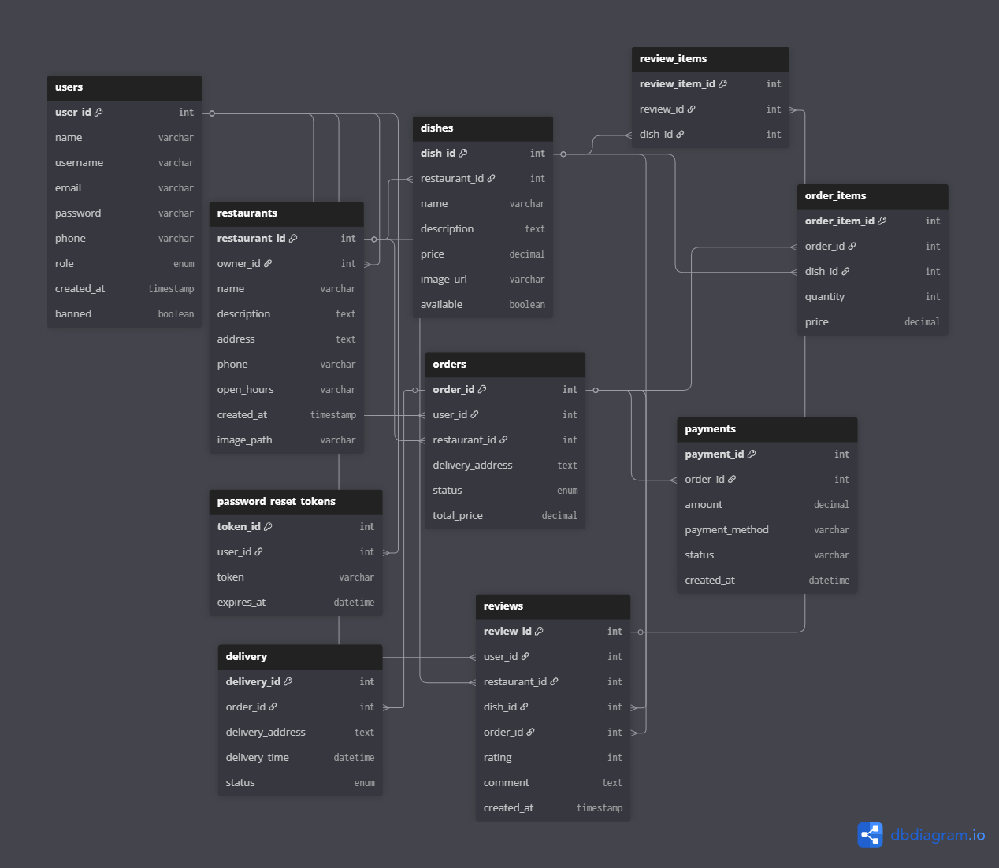
Architecture & Database Design
Backend Architecture
Database Design
Controller Layer
JAX-RS REST Endpoints
Service Layer
@Stateless EJB · Business Logic
Model Layer
Model Classes · Java Objects
Config Layer
CorsFilter · JWT
Notes:
Controller: Rest Endpoint: Defines the REST API endpoints that handles the http requests
Service: Stateless: Contains business logic that processes data and executes operations
Model: Defines the data structures that represents entitites like users, orders etc..
Config: Enables cross-origin requests and handles user auth with tokens

Slide 8



Three-Role Access System
Customer
Administrator
Restaurant Owner
Weakest Role
Intermediate Role
Strongest Role
Notes:
1)Customer: -Browse menus and restaurants
-Place and track orders
-Manage cart
-Write reviews per order
-Profile changes
-Email confirmation of orders profile changes and written reviews
2)Admin: -Manage all customers and update customers profiles
-Full order oversight
-System wide monitoring
-See analitycs
3)Restaurant owner: -Do all things that admins can
- manage own restaurant profile
- add/edit/delete menus

Slide 9








Key Features
Auth & Security
Order Management
Card
PayPal
Cash
Payment System
Email Notifications
Admin Dashboard
Review System
REST API (120+ Tests)
Notes:
1) Auth & security: BCrypt · JWT sessions
2)Email: SMTP HTML templates for orders & profiles
3) Review: Star ratings per completed order
4)Order managemant: Platform oversight · user management
5) Admin Dashboard: Cart · status tracking · owner workflow
6) Rest API: JAX-RS · Postman tested · CORS

Slide 10


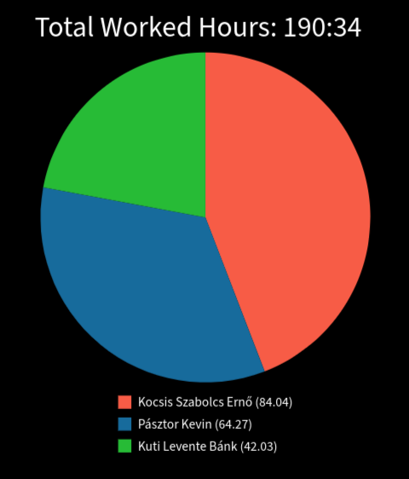
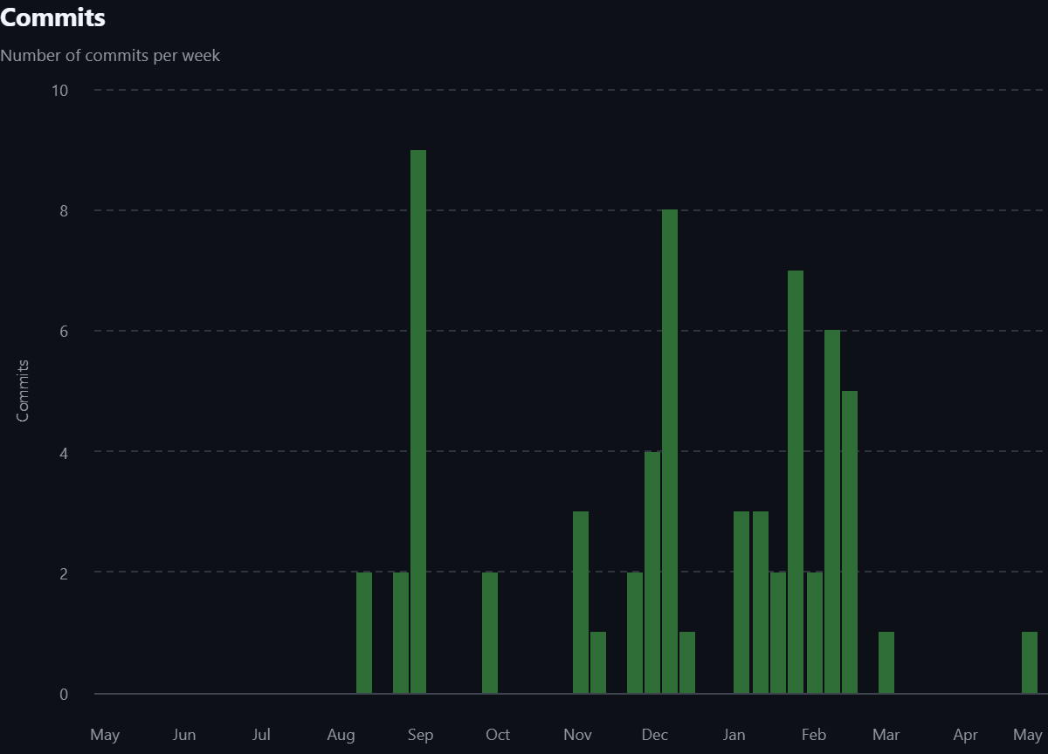
Project Management
GitHub – Version Control
Jira – Time Tracking
4 branches (1 per member + main)
Notes:
Github: 1 branch for each person and 1 main
Jira: Each task reported
Time spent on tasks tracked by Clockwork
Total worked hours: 190hours

Slide 11
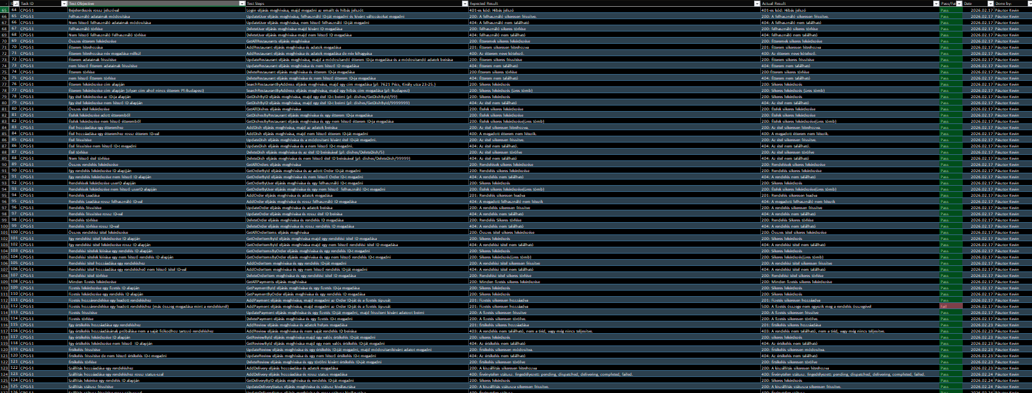
Testing & Quality Assurance
450+
93%
3
Test Cases
Succes Rate
Auth Levels Tested

Slide 12






Future Development Plans
Real Online Payment
Native Mobile App
Real-Time Order Tracking
Analytics Dashboard
SMS Notifications
AI Recommendations
Notes:
Real online payment: Stripe/Barion integration for card payments
React Native or Flutter application for iOS and Android with push notifications.
WebSocket-based live order status updates and map-based delivery tracking
Advanced sales analytics, peak hours, revenue reports for restaurant owners.
Twilio integration for SMS order confirmations and delivery alerts
Machine learning based restaurant and dish recommendations per user preferences.

Slide 13
Thank You!
Next: Live Demo
KLSZ Faloda – Food Delivery Platform

