Slide 1
Imaging Shapes of Atomic Nuclei in High-Energy Nuclear Collisions
Parker Lewis
Ohio University
October 28, 2025

Slide 2
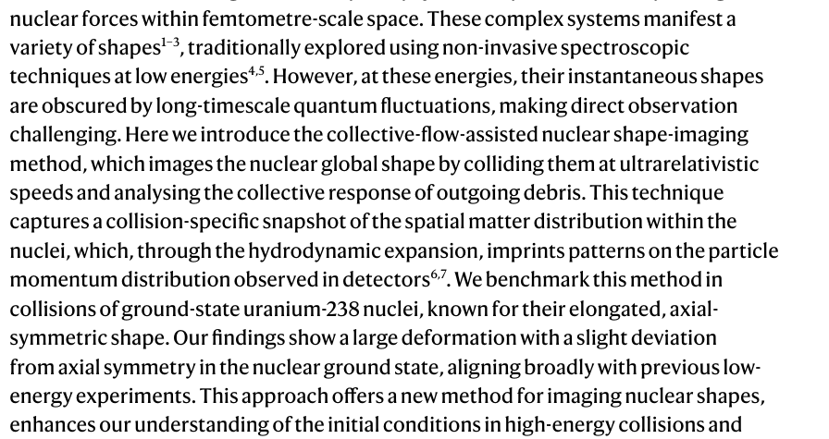
Abstract and General Idea

Slide 3
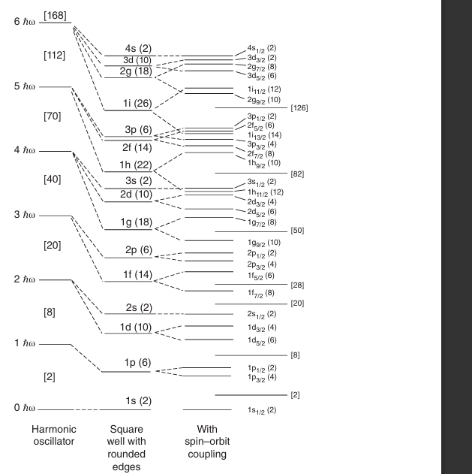
Low Energy Theory & Methods: Shell Model to Collective
Shell Model Framework: Describes nucleons moving in discrete energy levels; successfully explains magic numbers and near-spherical nuclei.
Collective Motion Emergence: Correlated nucleons generate collective excitations—rotations, vibrations, and deformations—linking microscopic shell behavior to macroscopic nuclear shapes.

Slide 4
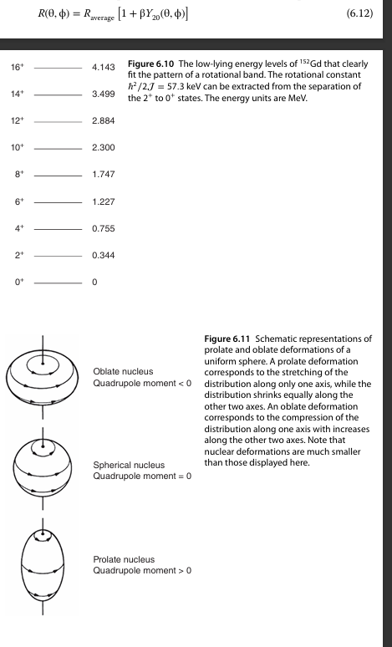


- Triaxial limits around for
left and right bounds correspond to either prolate or oblate shapes
- Electron scattering has orientation limits, and spectroscopy can only see the superposition of wave functions.

Slide 5
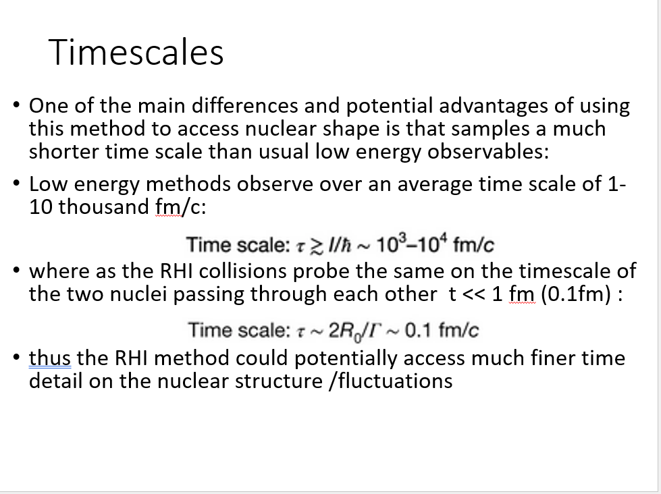

Slide 6
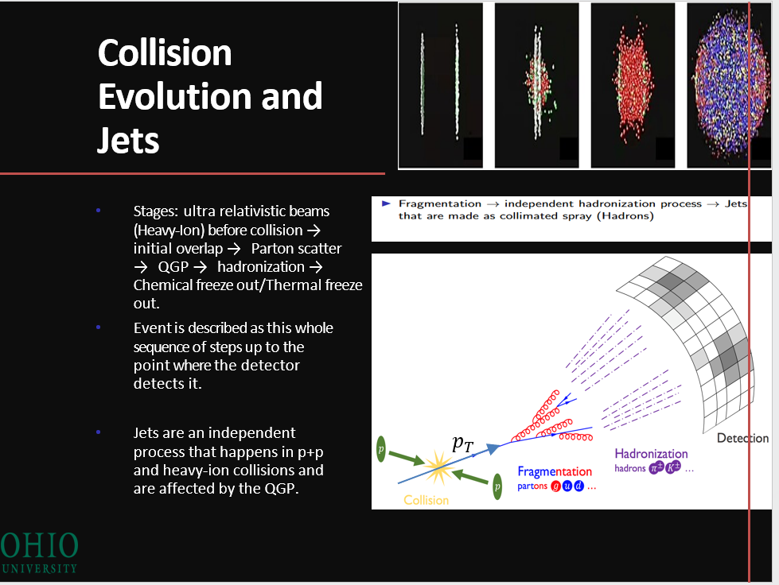
QGP Event Evolution and Probes

Slide 7
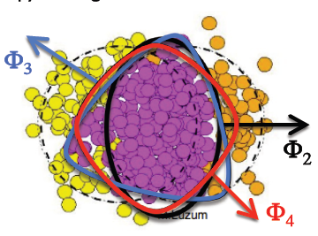
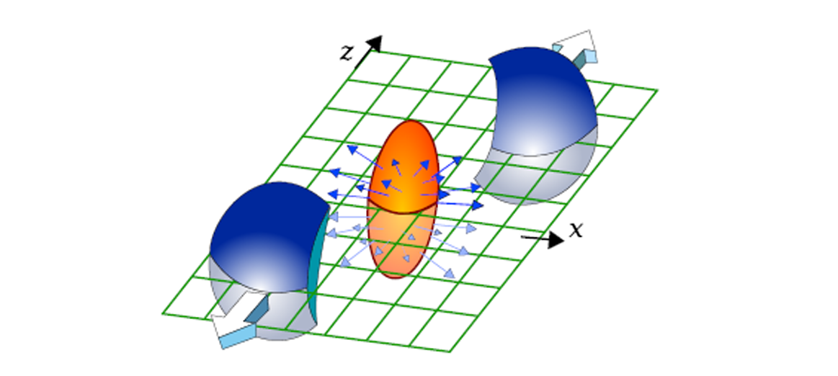
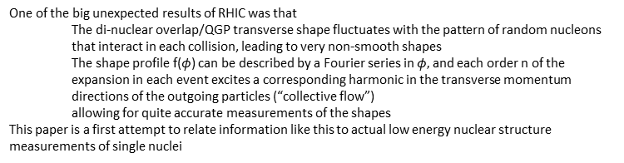
Context of the paper
“Participant”
Event Planes Φ_{n}
One of the big unexpected results of RHIC was that
  The di-nuclear overlap/QGP transverse shape fluctuates with the pattern of random nucleons that interact in each collision, leading to very non-smooth shapes
  The shape profile f($φ$) can be described by a Fourier series in $φ,$and each order n of the expansion in each event excites a corresponding harmonic in the transverse momentum directions of the outgoing particles (“collective flow”)
  allowing for quite accurate measurements of the shapes
This paper is a first attempt to relate information like this to actual low energy nuclear structure measurements of single nuclei

Slide 8
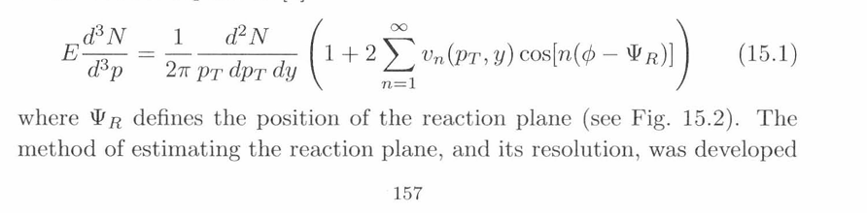
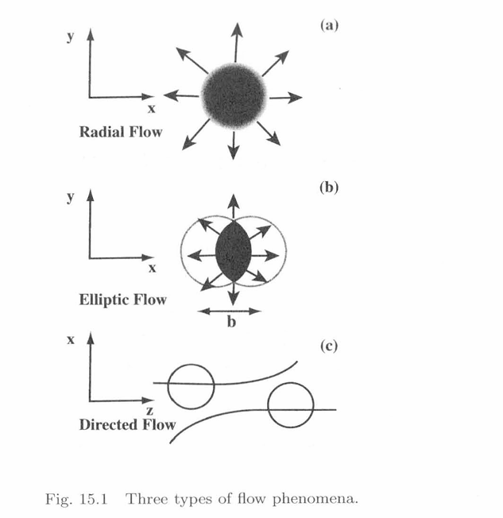
Hydrodynamics and Collective Flow Probes of QGP
The paper only focuses on collective flow probes. Flow represents the expansion of QGP during the cool-off stage (pressure gradients)
The Main Important property of QGP is perfect fluid (viscosity = 0)

Slide 9
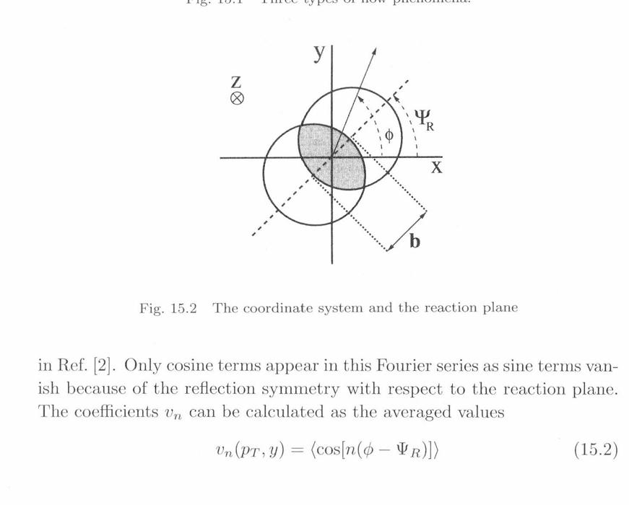

Slide 10
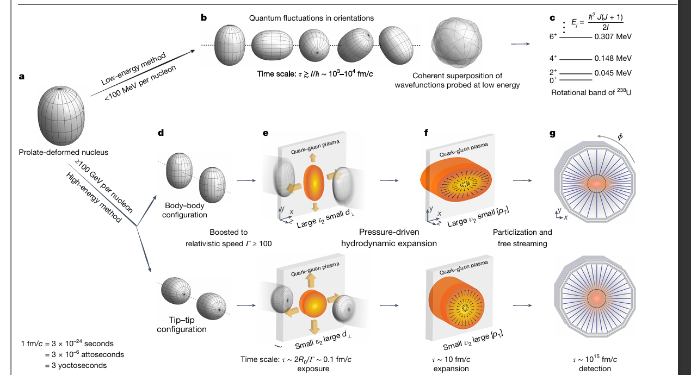
Figure 1

Slide 11
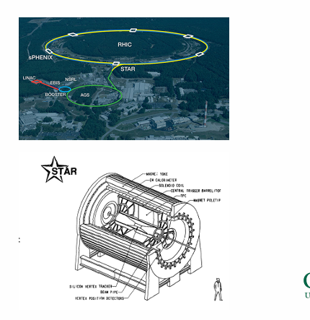
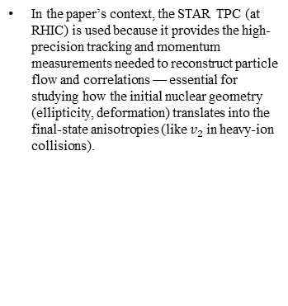
RHIC, STAR, & TPC.
In the paper’s context, the STAR TPC (at RHIC) is used because it provides the high-precision tracking and momentum measurements needed to reconstruct particle flow and correlations — essential for studying how the initial nuclear geometry (ellipticity, deformation) translates into the final-state anisotropies (like $v_{2}$ in heavy-ion collisions).

Slide 12

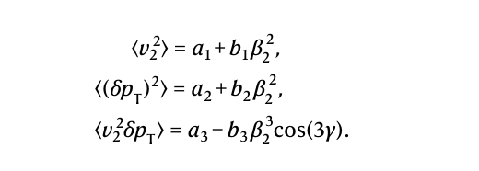
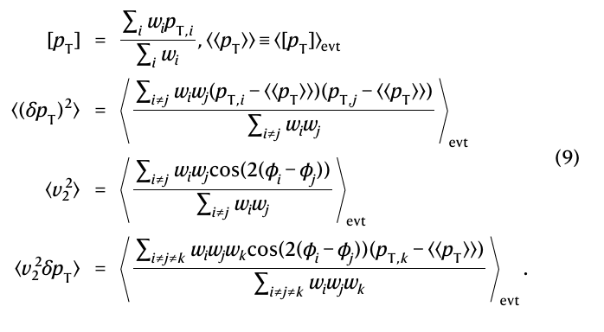
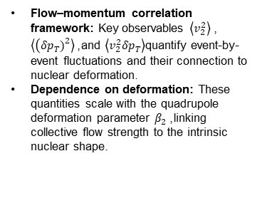
Important Equations and Sequence of Flow Measurements
Flow–momentum correlation framework: Key observables $\left\langle v_{2}^{2}\right\rangle$, $\left\langle \left(δp_{T}{\left.)\right.}^{2}\right\rangle \right.$, and $\left\langle v_{2}^{2}δp_{T}\right\rangle$quantify event-by-event fluctuations and their connection to nuclear deformation.
Dependence on deformation: These quantities scale with the quadrupole deformation parameter $β_{2}$, linking collective flow strength to the intrinsic nuclear shape.

Slide 13
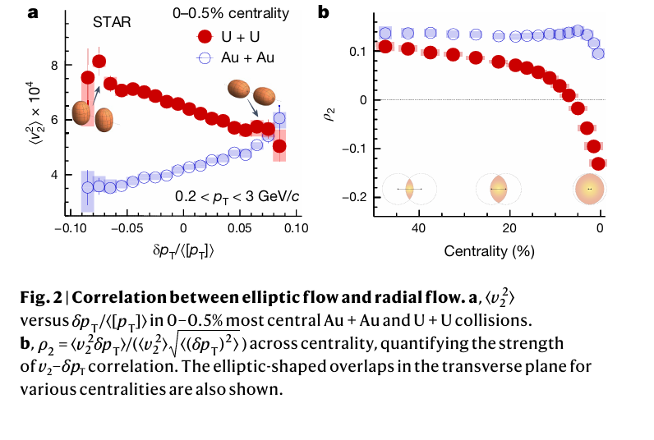
Figure 2

Slide 14
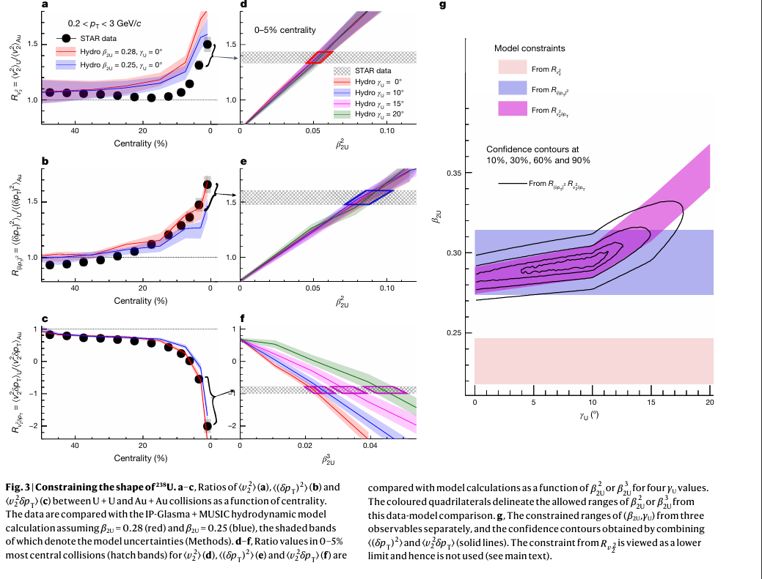
Figure 3:

Slide 15
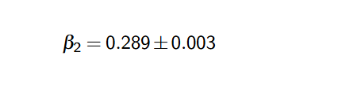
Compare and Contrast of Low Energy to High Energy β₂ and γ
Both values only account for GS U-238.
From High Energy Approach:
From Low Energy (NUDAT):

Slide 16
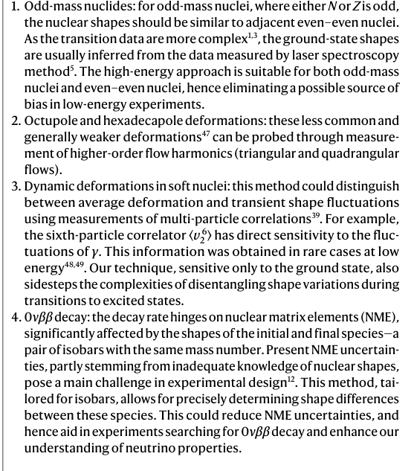
Applications

Slide 17
Conclusion
The approach of using high-energy collisions from heavy ions for U-238 gave decent agreement from low-energy measurements. Summary of method follows to use STAR TPC event information to derive flow parameter in conjunction with hydrodynamic models (deformed Woods-Saxon) to estimate the deformation parameters and triaxiality that matches with data.

