Slide 1


Help! I’ve Fallen into sPHENIX Analysis and I Can’t Get Up!
Valerie Wolfe
February 10th, 2026

Slide 2

Goals of this Talk !!
Teach new students the basics of Fun4All
Give experienced collaborators a new tool for explaining Fun4All
Provide a general introduction to KFParticle
KNOW WHAT FUN4ALL IS

Slide 3
Disclaimer !!
This talk is not intended to teach highly technical computer skills.
I will not teach you how Fun4All works—I will teach you how to use it.
Please use the information presented here in conjunction with other, more correct sources.
Recommended sources:
Talk by Chris Pinkenburg The sPHENIX wiki The sPHENIX GitHub
(Chris Pinkenburg, please don’t look at this talk. You will be disappointed in me.)

Slide 4
Background !!
Computers, working environment, and analysis structure

Slide 5
Assumptions !!
You know what a subsystem is/the basic structure of sPHENIX
You know what “macro” means
You have some basic coding skills (including how to use ROOT)

Slide 6
Basic Analysis Setup !!
Source code
File examples: myModule.cc , myModule.h, + other necessary files (MakeFile.am, etc.)
Data
File examples: DST_TRKR_TRACKS_run2pp_ana506_2024p023_v001-00053652-00000.root
Libraries
File examples: libmyModule.so, libmyModule.la
Macro
File examples: Fun4All_runMyModule.C
Output
File examples: myModuleOutput.root

Slide 7
Source Code ??
Code that defines classes to be called in a macro
  You do not directly run source code!
Usually grouped into “modules”
  Example: the sPHENIX KFParticle module is made up of many classes
    KFParticle_tools, KFPartcile_container, etc.
Additional files needed: Makefile.am and autogen.sh
Class A
Class B
Module
Class C
Class D

Slide 8
Libraries ??
Compiled code that the computer uses to “do stuff”
  “Compiled” meaning the computer can directly read and use it
“Local” (also called “private”) libraries:
  Code you compile yourself
  Can refer to entirely custom modules, as well as local versions of existing sPHENIX modules
“Global” libraries:
  Pre-compiled, common to everyone in sPHENIX

Slide 9
Ana Build ??
A stable version of sPHENIX’s code base, which is compiled into global libraries
Builds are indexed with a number: ana517, ana518, etc.
You should keep track of what build you use in your analysis

Slide 10
New Build ??
The newest build of the sPHENIX codebase changes daily
Changes are made LOCALLY (i.e. collaborators make private libraries), then are pushed to our github
Once approved, these changes are merged with the sPHENIX code base as part of the “new” build
The new build should be used for development only
  Research work should use stable ana builds

Slide 11
Working Environment Setup !!
When you log into SDCC, you should source two setup scripts, in this order:
  sphenix_setup.sh
  setup_local.sh
Ideally, this is done with one script that automatically runs when you log in (i.e. .bashrc)
These scripts do lots of things, but in particular they tell the computer…
  where to look for the global libraries (AKA the ana build)
  where your local libraries are located
  to use global libraries only if there is no local version for a given module

Slide 12
sphenix_setup.sh
Function: Sets up working environment so you load the libraries belonging to a specified ana (or the new) build
Practical meaning: When creating an object defined in the sPHENIX software, Fun4All will use the version belonging to the ana build you specify
Code in .bashrc file:
source /opt/sphenix/core/bin/sphenix_setup.sh -n new
Note: You can load ana builds by substituting “new” with any of the supported builds (i.e. “ana509”). New just loads the newest ana build.
Tip: See current supported builds by running
ls /cvmfs/sphenix.sdcc.bnl.gov/alma9.2-gcc-14.2.0/release/release_ana/

Slide 13
setup_local.sh
Function: Sets up your environment so you load your local libraries before (or, instead of) the global version of that same class.
Practical meaning: Imagine you have compiled a local version of KFParticle. If you create a KFParticle object in a macro, the computer will use your local version of the KFParticle library INSTEAD of the ana build version to create the object.
Code in .bashrc file:
export MYINSTALL=/sphenix/user/USERNAME/install # Set USERNAME to your SDCC username
export LD_LIBRARY_PATH=$MYINSTALL/lib:$LD_LIBRARY_PATH
export ROOT_INCLUDE_PATH=$MYINSTALL/include:$ROOT_INCLUDE_PATH
source /opt/sphenix/core/bin/setup_local.sh $MYINSTALL
Note: Not running this script ensures that you only use global libraries.

Slide 14
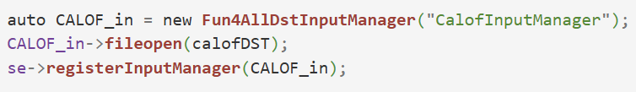
Misc. Vocab !!
DST
“Data storage tape”
The type of data files you will most often use when running Fun4All
Extension is .root
Loaded at the macro level
Example (loading a DST_CALOFITTING file):
Node Tree
All the data types available to an individual Fun4All server
If you are loading a “node” then you are loading a specific data structure
You do this at the source code level, not at the macro-level
Example (loading an SVTXTrackMap):
Note: The node tree (all the data types available to Fun4All when your macro ran) should print out in the terminal when you run a macro that uses Fun4All

Slide 15
Basic Analysis Setup !!
Source code
File examples: myModule.cc , myModule.h, + other necessary files (MakeFile.am, etc.)
Build libraries
Data
File examples: DST_TRKR_TRACKS_run2pp_ana506_2024p023_v001-00053652-00000.root
Libraries
File examples: libmyModule.so, libmyModule.la
Load libraries in macro
Load data in macro
Macro
File examples: Fun4All_runMyModule.C
Fun4All does its thing
Output
File examples: myModuleOutput.root

Slide 16

Fun4All !!
learn about Fun4All

Slide 17


What is Fun4All ??
In the least technical terms possible:
Fun4All is a robot that cooks a delicious meal.

Slide 18

WAIT

Slide 19

I know that sounds ridiculous

Slide 20

Just walk with me here, I promise this will help some of you

Slide 21










THE RECIPE
INGREDIENTS
EQUIPMENT
AKA the macro
AKA the data
AKA modules
INSTRUCTIONS
DELICIOUS MEAL
THE ROBOT
AKA libraries and header files
AKA the output
(TTrees, histograms, etc.)
AKA Fun4All

Slide 22








Give the robot instructions for the tools by including header files and loading libraries.
CHEF FUN4ALL
Node Tree
Turn the robot on by creating a Fun4All server.
sPHENIX data
Give the robot necessary ingredients by registering DSTs to the server.
Include Statements
Server
The Macro
The ana build
SDCC
Give the robot necessary tools+recipes by registering modules and setting selections.
Custom modules
Output
User
Run the macro with ROOT to create your delicious meal.

Slide 23
A Few Notes !!
Much like a regular recipe, order matters
  Don’t tell the robot to scramble the eggs before you’ve cracked them
  Don’t tell TrackFittingQA to run before you’ve loaded in tracks

Slide 24
Alternative Explanation: Code Snippets !!
Test module built to look at 5x5 cells in the EMCal
Found at: /gpfs/mnt/gpfs02/sphenix/user/vwolfe/Tutorials/TestModule
Note: this module does not create a file as output

Slide 25


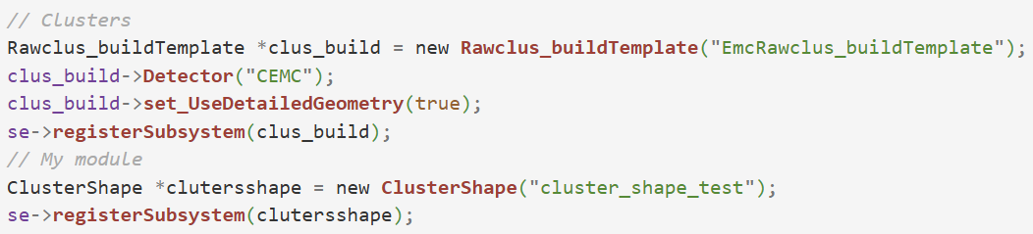

Give the robot instructions for the tools by including header files and loading your private libraries.
Turn the robot on by creating a Fun4All server in your macro.
Give the robot necessary ingredients by registering DSTs to the server.
Give the robot necessary tools+recipes by registering modules and setting selections.
Main function
Tell the robot how many events to run over. Shut off the server. Enjoy.

Slide 26
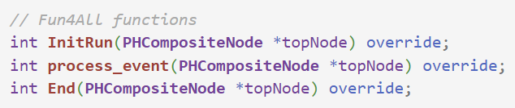
From Fun4All’s Perspective…
Fun4All has a few pre-determined functions, including:
Initiate run.
Run all module registered to the server – repeats this until all data are processed.
Fun4All calls these functions whenever you tell Fun4All to run.
End the run.
*There are other functions – Please look at the subsysreco documentation for more info!!

Slide 27
Module Structure !!
To use Fun4All, a module must tell Fun4All what it should do when running these functions:
This is what the override is for – that bit of code tells Fun4All that it should run your module’s version of InitRun, process_event, and End, rather than the default versions!!

Slide 28

How ??
This is possible because sPHENIX modules (those that interface directly with Fun4All) all inherit from the “SubsyReco” class:
Aaaand that’s where this talk runs out of technical details about Fun4All.
Please see recommended resources for more information.

Slide 29
Tools Available to You !!
CreateSubsysRecoModule
  Create a Fun4All shell!
MyOwnTTree
  Learn how to use Fun4All to make a TTree as output

Slide 30

KFParticle !!

Slide 31
KFParticle (KFP) ??
Analysis package used in sPHENIX to reconstruct mass resonances
  One of the tools we can give Fun4All to cook a delicious meal
Input: tracks and your decay of choice
Output: mother and corresponding daughter candidate info in a Ttree
(KFParticle has some other options for output, please see Cameron’s talk for more info)

Slide 32

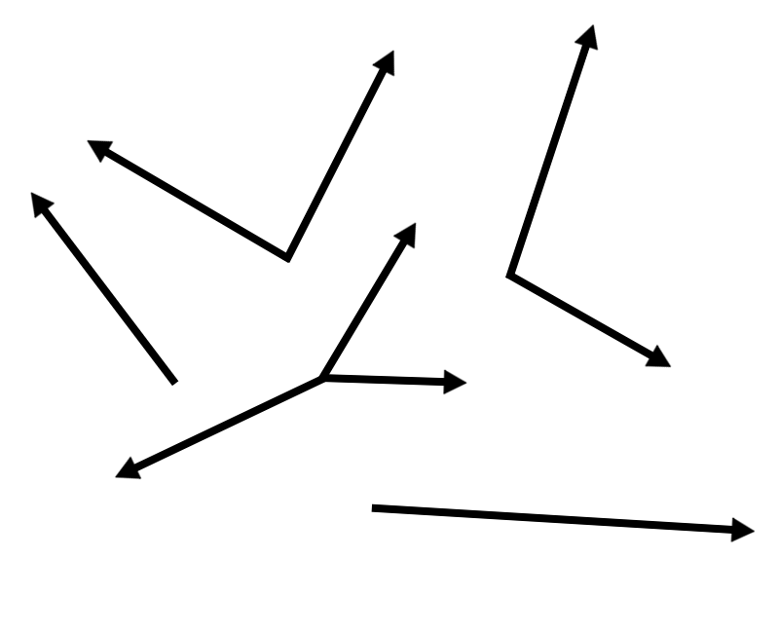

Decay
$$Y→ⅇ^{+}+ⅇ^{−}$$
upsilon_pt
track_1_pt
track_2_pt
etc…
Track map
KFParticle

Slide 33
Optional Tree Branches !!
dE/dx
  DST_TRKR_CLUSTER
  get_dEdx_info()
Primary vertex info
  DST_CALOFITTING for MBD or DST_TRKR_CLUSTER for SVTX
  getAllPVInfo()
Trigger info
  DST_CALOFITTING
  getTriggerInfo()
EMCal cluster information
  DST_CALOFITTING
  Additional code in macro (next slide)
Tracking detector info
  DST_TRKR_CLUSTER
  getDetectorInfo(), or
  GetDetailedTracking()
Helpful documentation here.

Slide 34
Chef Fun4All Analogy !!
KFParticle libraries
KFParticle module
.root file containing a TTree with any additional data selected by the user (vertex info, etc.)
Track map, optional data types

Slide 35
Loading a Track Map !!
KFP needs an SvtxTrack map (the output of ACTS)
Easiest option: DST_TRKR_TRACKS files
Other options:
  DST_TRKR_SEED or DST_TRKR_CLUSTER files
  Important—you must create SvtxTracks before running KFP if using these DSTs
    Example using ACTS here
Note: for dE/dx information, you must load in DST_TRKR_CLUSTER files
  You don’t need to run any tracking if you load in DST_TRKR_TRACKS as well

Slide 36
Loading EMCal Clusters !!
Need to build clusters based on either MBD or SVTX vertex:
RawClusterBuilderTemplate *CB = new RawClusterBuilderTemplate("clus_bld");
CB->Detector("CEMC");
CB->set_UseDetailedGeometry(true);
CB->set_threshold_energy(0.070);
std::string emc_prof = getenv("CALIBRATIONROOT");
emc_prof += "/EmcProfile/CEMCprof_Thresh30MeV.root";
CB->LoadProfile(emc_prof);
CB->set_UseTowerInfo(1);
se->registerSubsystem(CB);

Slide 37
Track-Calo Matching !!
Must create and register the projection:
auto projection = new PHActsTrackProjection("CaloProjection");
float new_cemc_rad = 100.70;
projection->setLayerRadius(SvtxTrack::CEMC, new_cemc_rad);
se->registerSubsystem(projection);
Must tell your KFP object that you want the calorimetry info:
kfparticle->getCaloInfo(true);
There are many matching selections you can set. See track-calo matching software here.

Slide 38
Example Code !!
Path: /sphenix/user/vwolfe/Tutorials/PhotonConversion_Tutorial
Contains macro, DSTs, and a readme.txt
No source code – uses the standard KFParticle ana build!

Slide 39
Acknowledgments !!
Thank you to Cameron Dean, Tristan Protzman, Jaebeom Park, and Rosi Reed!
Shoutout to Charles Hughes for consulting on slideshow design
  Me: hey charles do you think all words in a title should be capital?
  Charles: yes, and also bolded, with two exclamation points

