Slide 1
NASA Ames Research Center
Autonomous Systems and Robotics
Planning and Scheduling Group
PLEXIL Workshop
An Introduction to PLEXIL and the Universal Executive
Part 1: Overview
Copyright © 2008 USRA This presentation was developed in Open Office Impress. Template courtesy of Chih-Hao Tsai (technology.cstsai.org/impress).

Slide 2
Outline
Background
Plexil plan structure
Plexil execution

Slide 3
What is a Plan?
A Plan is a course of action to achieve a set of goals.
The course of action may differ depending on the initial state the world is in.
Each action in a plan may only work properly when certain conditions are met.
When actions are executed, they may have certain effects.

Slide 4
What is PLEXIL?
PLEXIL is a language for expressing plans.

Slide 5
PLEXIL Design Goals
Simple, small, uniform
Efficient
Well-defined
Expressive
  Sequences, branches, loops, concurrency
  Time-driven, event-driven, condition-driven
Enables verification and validation
  Pre conditions, post conditions, invariants
Deterministic

Slide 6
What is the Universal Executive?
The Universal Executive (UE):
  Receives PLEXIL plans from the Planner or User.
  Sends plan execution status to the Planner or User.
  Sends commands to the System.
  Receives state information from the System.
Planner
UE
System
User

Slide 7
Implementation Details
The UE is written in C++.
The UE can interface to devices via:
  C++ code
  Sockets / TCP
  CORBA
  NASA Collaborative Infrastructure

Slide 8
Plexil Syntax
Plexil has three interchangeable syntaxes:
  Plexil XML (.plx)
  Standard Plexil (.ple)
  PlexiLisp (.pli)
The UE executes Plexil XML.
  PlexiLisp and Standard Plexil translate to XML.
  PlexilLisp is written in Emacs Lisp.
  Standard Plexil is written in Java.
  Neither is needed for plan execution.

Slide 9
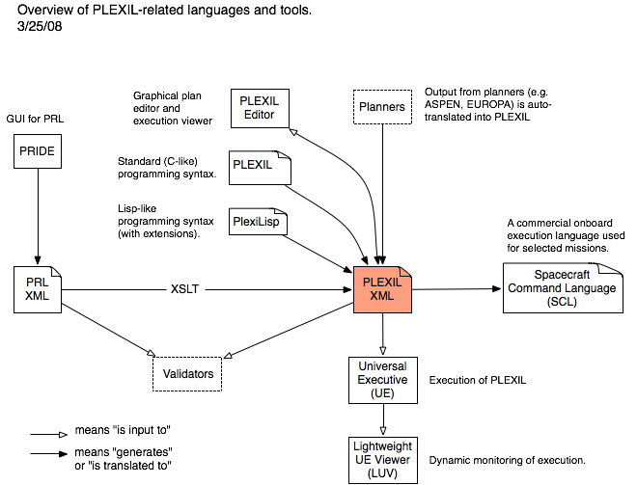
Tools Overview

Slide 10
Current Applications
PLEXIL is being used for:
  ISS power system procedures
  K10 Rover control
  Earth science drilling executive
  Rotorcraft system architecture (SIRCA)
  PRL execution

Slide 11
Future Applications
Robotics
Unmanned vehicles and habitats
Systems and simulations
Intelligent software agents

Slide 12
How to Get Plexil
To download source and binary for Linux or Mac:
  Visit http://plexil.sourceforge.net
  Click on Download tab
To download source only:
  svn co https://plexil.svn.sourceforge.net/svnroot/plexil/trunk plexil
To build, Plexil requires:
  GNU C/C++ 3.3.3 or newer
  Java SDK 1.4 or newer
  Jam build tool 2.5 or newer

Slide 13
Plexil Community
Visit the PLEXIL wiki at:
  http://plexil.wiki.sourceforge.net
For help, problems, or bugs, send mail to:
  plexil-support@lists.sourceforge.net
For general Plexil discussion:
  plexil-discussion@lists.sourceforge.net
To join plexil-discussion, visit
  Visit http://plexil.sourceforge.net
  Click on the mailing lists tab.

Slide 14
Outline
Background
Plexil plan structure
Plexil execution

Slide 15
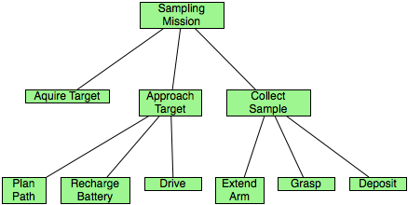
Plan Topology
A Plexil plan is a tree of nodes:

Slide 16
Node Types
Interior nodes:
  List
Leaf nodes:
  Assignment
  Command
  Empty
  Library call
  Function call
  Update

Slide 17
Node Actions
For now, only three are important:
  List – contains other nodes
  Assignment – assigns a value to a variable
  Command – controls the System

Slide 18
Gate Conditions
Each node has four gate conditions:
  Start
  End
  Repeat
  Skip
These control when a node executes.

Slide 19
Check Conditions
Each node has three check conditions:
  Pre
  Post
  Invariant
If any of these fail, the node fails.

Slide 20
Start vs Pre
Start condition x < 10
  Node starts if x < 10 and parent has started.
Pre condition x < 10
  If node starts, and x >= 10, then node immediately fails, without executing its body.

Slide 21
Outline
Background
Plexil plan structure
Plexil execution

Slide 22
Plans are State Machines
A Plexil plan is a state machine.
A plan has plan state or internal state.
The world has world state or external state.
The plan responds to changes in world state.
The plan responds to one change at a time.

Slide 23
Plan State
A plan has two kinds of state:
  Node state
  Variable state

Slide 24
Node States
Inactive
Waiting
Executing
Finishing
Iteration_Ended
Failing
Finished

Slide 25
Node States
Inactive
Waiting
Executing
Finishing
Iteration_Ended
Failing
Finished - outcome:
  Skipped
  Success
  Failure

Slide 26
Node States
Inactive
Waiting
Executing
Finishing
Iteration_Ended
Failing
Finished - outcome:
  Skipped
  Success
  Failure – failure type:
    Pre condition failed
    Post condition failed
    Invariant condition failed
    Parent failed

Slide 27
World State
The world has two kinds of state:
  Variable state
  Command execution state

Slide 28
Events are State Changes
Lookup(X)
  Returns the value of X in the current state.
LookupOnChange(X)
  Returns the value of X in the current state.
  Subscribes the plan to changes in X.

Slide 29
Main Loop
Plexil's main loop:
  Read the new external state.
  Execute assignments and commands.
Read new
external state
Execute assignments and commands

Slide 30
Nodes are State Machines
Each node is a state machine.
All nodes execute in parallel.
All nodes execute synchronously.
The plan state machine is the synchronous parallel combination of the node state machines.

Slide 31
Node State Machine
Inactive
Execute Cmd
/ Assignment
Executing
F
Invariant?
Parent executing?
F
T
T
End?
Waiting
F
T
Post?
Skip?
T
F
T
F
Failure
Success
Start?
F
IterationEnded
T
T
Pre?
F
Reset
T
Repeat?
F
Skipped
Finished
Reset
T
Parent waiting?
F

Slide 32
Starting and Stopping
Execution starts with all nodes INACTIVE.
Execution stops when no node can transition.

Slide 33
Execution Loops
Plan execution has three nested loops:
Loop for each external state change {
Read external state;
Loop until no node can transition {
Loop for all nodes in parallel {
Process one transition;
}
}
}

Slide 34
Example Plan
SafeDrive: {
Integer pictures = 0;
NodeList:
Loop: {
RepeatCondition: ! LookupOnChange(WheelStuck) &&
pictures < 10;
NodeList:
OneMeter: {
Command: Drive(1);
}
TakePic: {
StartCondition: OneMeter.state == FINISHED;
Command: TakePicture();
}
Counter: {
Assignment: pictures = pictures + 1;
}
}
}

Slide 35
Example Plan Execution
SafeDrive Loop OneMeter TakePic Counter pict WS
------------- ------ ------------- ----------- ---------- ----- -----
Inactive Inactive Inactive Inactive Inactive ---- F
Waiting Inactive Inactive Inactive Inactive ---- F
Waiting Waiting Inactive Inactive Inactive 0 F
Executing Executing Inactive Inactive Inactive 0 F
Executing Executing Waiting Waiting Waiting 0 F
Executing Executing Executing Waiting Executing 1 F
Executing Executing IterE Waiting IterE 1 F
Executing Executing Finished Waiting Finished 1 F
Executing Executing Finished Executing Finished 1 F
Executing Executing Finished IterE Finished 1 F
Executing Executing Finished Finished Finished 1 F
Executing IterE Finished Finished Finished 1 F
Executing Waiting Finished Finished Finished 1 F
Executing Executing Inactive Inactive Inactive 1 F
...
Executing IterE Finished Finished Finished 10 F
Executing Finished Finished Finished Finished 10 F
IterE Finished Finished Finished Finished 10 F
Finished Finished Finished Finished Finished 10 F

Slide 36
Example Plan Execution
SafeDrive Loop OneMeter TakePic Counter pict WS
------------- ------ ------------- ----------- ---------- ----- ------
Inactive Inactive Inactive Inactive Inactive ---- F
Waiting Inactive Inactive Inactive Inactive ---- F
Waiting Waiting Inactive Inactive Inactive 0 F
Executing Executing Inactive Inactive Inactive 0 F
Executing Executing Waiting Waiting Waiting 0 F
Executing Executing Executing Waiting Executing 1 F
Executing Executing IterE Waiting IterE 1 F
Executing Executing Finished Waiting Finished 1 F
Executing Executing Finished Executing Finished 1 F
Executing Executing Finished IterE Finished 1 T
Executing Executing Finished Finished Finished 1 T
Executing IterE Finished Finished Finished 1 T
Executing Finished Finished Finished Finished 1 T
IterE Finished Finished Finished Finished 1 T
Finished Finished Finished Finished Finished 1 T

