Slide 1
Building Node-RED Node and Interfacing Arduino with Node-RED
CS5590/490-IOT/Cognitive Robot Programming

Slide 2
Agenda
Introduction to JavaScript
Creating your own node on Node-RED
Creating flows using Arduino Nodes

Slide 3

JavaScript
https://www.w3schools.com/js/default.asp

Slide 4
JavaScript
JavaScript is a highly used scripting language to program the behavior
JavaScript is Case Sensitive
JavaScript is also characterized as dynamic, weakly typed

Slide 5
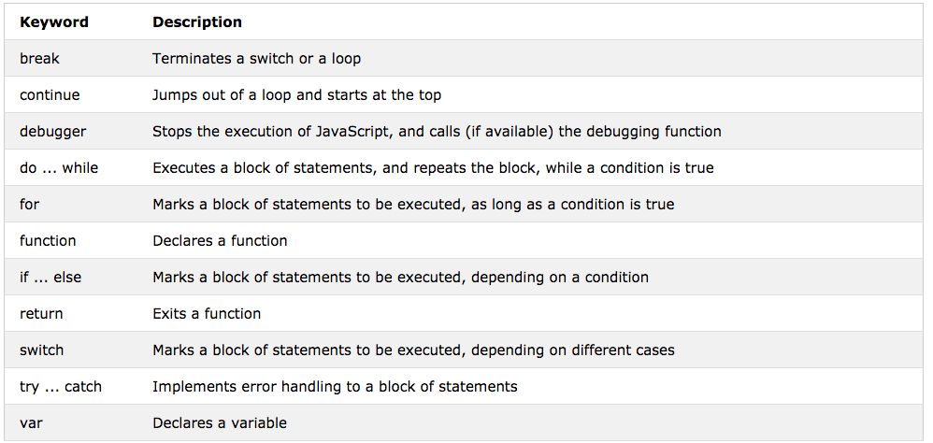

Slide 6
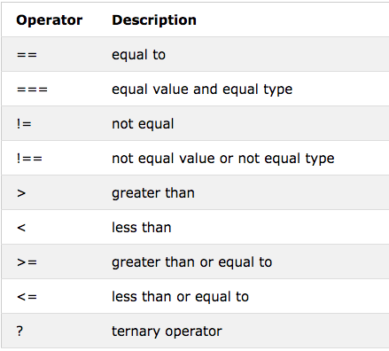
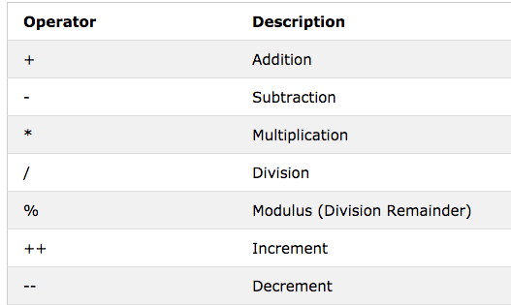
Operators

Slide 7
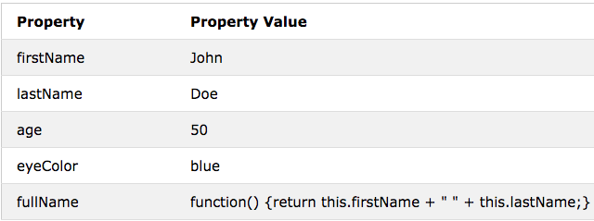
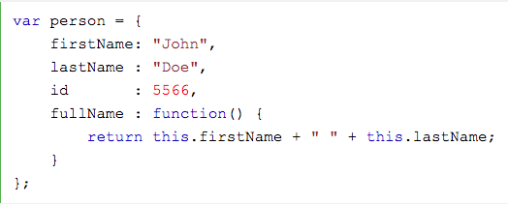
JavaScript Function & Object
Code to define function
function name(parameter1, parameter2, parameter3) { code to be executed }
Code to define Object

Slide 8
Creating Node-RED Node https://nodered.org/docs/creating-nodes/

Slide 9
Node Properties
Some general principles to follow when creating new nodes
Nodes should
be well-defined in their purpose
be simple to use, regardless of the underlying functionality
be forgiving in what types of message properties it accepts
be consistent in what they send
sit at the beginning, middle or end of a flow - not all at once
catch errors

Slide 10
Creating Node
Nodes typically consist of a pair of files;
A JavaScript file that defines what the node does,
An HTML file that defines the node’s properties
edit dialog and
help text
Finally package.json file is used to package it all together as an npm module.

Slide 11
Building Node
Now we will see how to create a node that converts message payloads to all lower-case characters
Create a directory where you will develop your code. Within that directory, create the following files:
package.json
lower-case.js
lower-case.html

Slide 12
Package.json
This is a standard file used by Node.js modules to describe their contents.
To generate a standard package.json file you can use the command
npm init
This will ask a series of questions to help create the initial content for the file, using sensible defaults where it can.
When prompted, give it the name
node-red-contrib-<yourname>-lower-case

Slide 13
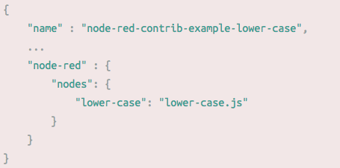
Edit Package.json
Once generated, you must add a node-red section:
This tells the runtime what node files the module contains

Slide 14
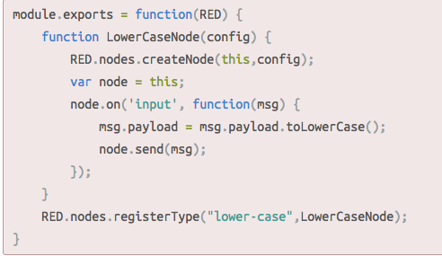
Edit lowercase.js

Slide 15
Creating Lowercase Node
The Lowercase node is wrapped as a Node.js module
The node is defined by a function, LowerCaseNode that gets called whenever a new instance of the node is created.
The function calls the RED.nodes.createNode function to initialize the features shared by all nodes
In the instance
The node registers a listener to the input event
Within this listener, it changes the payload to lower case then
calls the send function to pass the message on in the flow
Note:
If the node has any external module dependencies, they must be included in the dependencies section of its package.json file

Slide 16
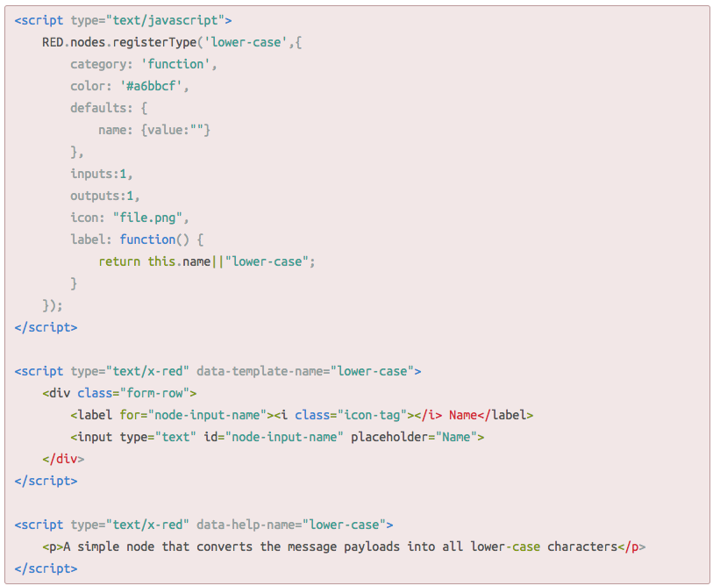
Lowercase.html
A node’s HTML file provides the following things:
the main node definition
the edit template
the help text

Slide 17
Testing your node in Node-RED
For example on Mac OS or Linux
cd ~/.node-red
npm install ~/dev/node-red-contrib-example-lower-case
For example on Windows
cd C:\Users\my_name\.node_red
npm install C:\Users\my_name\Documents\GitHub\node-red-contrib-example-lower-case

Slide 18
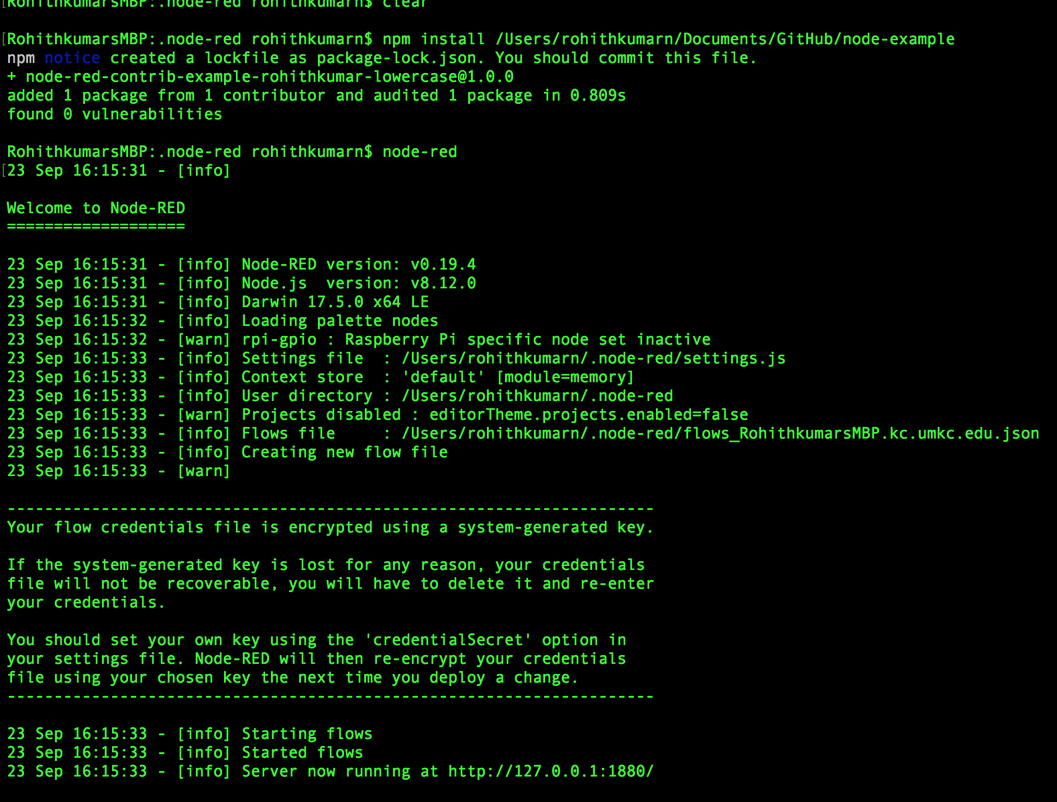

Slide 19
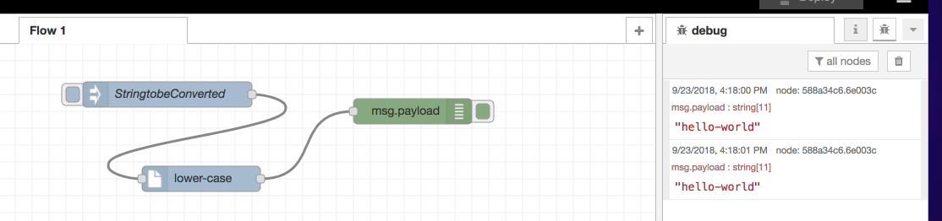
Trying out Created Node

Slide 20
Assignment
Create Celsius/Centigrade to Fahrenheit converter node

Slide 21
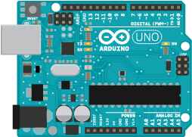
Arduino Board
https://nodered.org/docs/hardware/arduino

Slide 22
Interfacing Arduino
Arduino can be connected to the host computer via USB serial connection
Note:
You can’t use both the Arduino IDE and the Arduino nodes at the same time as they will conflict

Slide 23
Installation
First you need to load the default Firmata sketch onto the Arduino using the standard Arduino IDE
This is usually found in the Arduino IDE under the menu:
Files -> Examples -> Firmata ->Standard Firmata
You then need to install the Node-RED Arduino nodes into the palette
Note:
Please check that `npm -v` is at least version 2.x - if not - update it using sudo npm i -g npm@2.xhash -r

Slide 24
Adding Arduino Nodes to Node-RED
Change directory to your Node-RED user directory, this is normally ~/.node-red
cd ~/.node-red
Then install the Arduino nodes
npm install node-red-node-arduino
Finally restart Node-RED, and reload the editor in the browser.
There should now be two new Arduino nodes in the palette

Slide 25
Arduino Nodes Capabilities
The Arduino output node currently supports three modes of operation:
Digital - 0 or 1
Analogue - 0 to 255
Servo - 0 to 180
The Arduino input node can support both Digital and Analog pins. The input will send a message whenever it detects a change.
Digital inputs are fairly stable

Slide 26
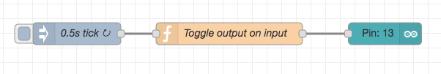
Checking Arduino Nodes

Slide 27
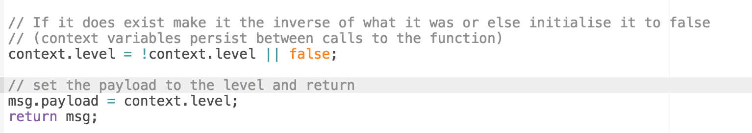
Toggle function

Slide 28
Source Code
// If it does exist make it the inverse of what it was or else initialise it to false
// (context variables persist between calls to the function)
context.level = !context.level || false;
// set the payload to the level and return
msg.payload = context.level;
return msg;

Slide 29
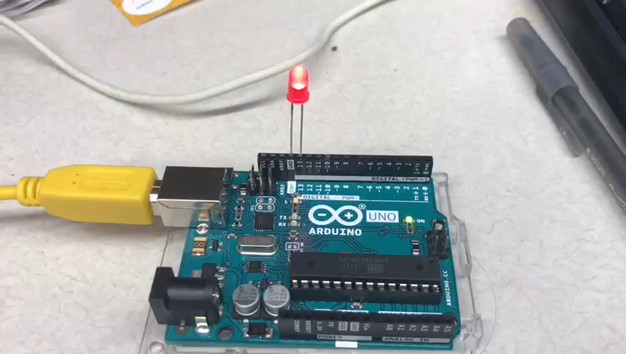
Blinker

Slide 30
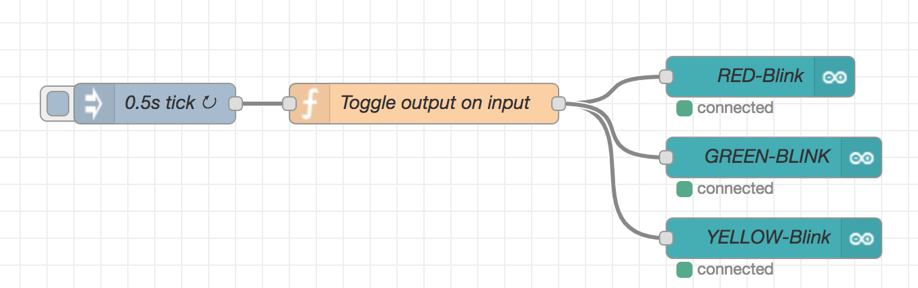
Use case-Traffic Blinker

Slide 31
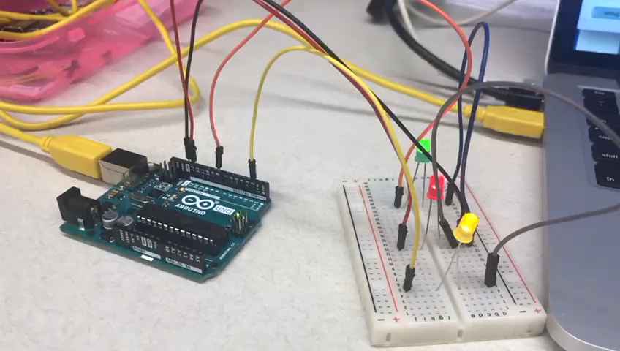
Modified Traffic Blinker

Slide 32
In class Exercise
Create a flow to Switch On/Off the LED from the dashboard
Extend the flow to simulate traffic signal

