Slide 1
PLFS: Parallel LFS
John Bent, et al.
Los Alamos National Labs

Slide 2
Parallel Apps do Parallel IO
Periodic checkpoint writes
Visualization writes
Writes are synchronized
Tens of thousands of synchronized writes can be difficult for the file system
Two most common write patterns
N-1 where N procs write to 1 shared file
N-N where N procs write to N non-shared files

Slide 3
N-N File IO
N-1 File IO

Slide 4
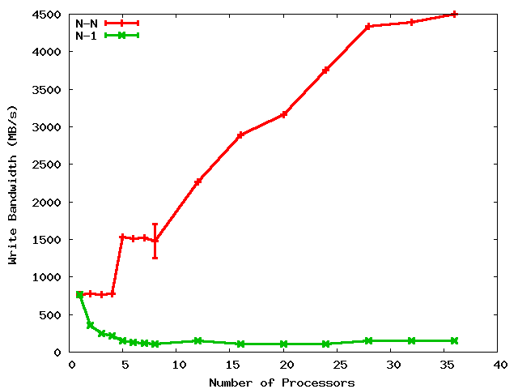
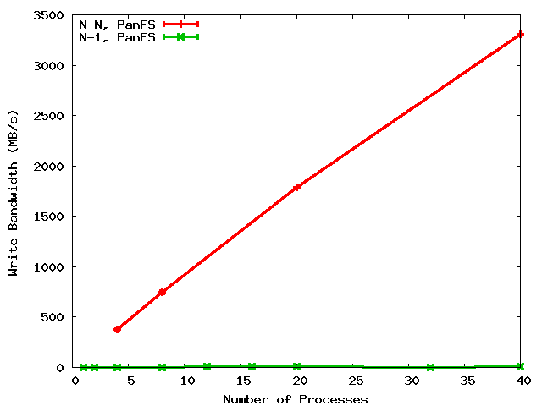
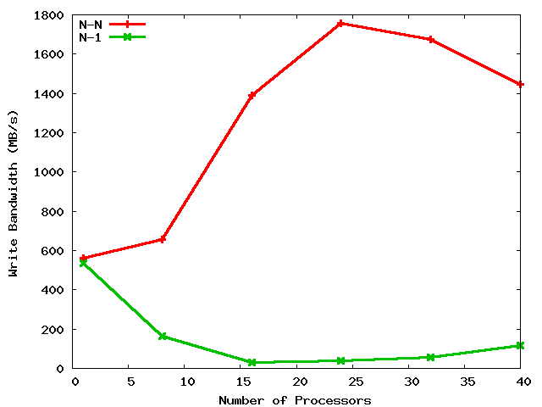
A Shared File is a Shared Problem
4.5 GB/s
LANL
PanFS
3.3 GB/s
LANL
GPFS
45X
330X
100 MB/s
10 MB/s
N-N
N-1
PSC
Lustre
1.8 GB/s
90X
Cross graph comparisons not meaningful
20 MB/s
Notes:
When discussing this for DOE HQ, discuss why PanFS is slower for N-1.

Slide 5
Potential storage implications of N-to-1 strided
Process 1
Process 2
Process 3
Process 4
14
23
44
11
12
13
21
22
24
31
32
33
34
41
42
43
Parallel file
RAID Group 1
RAID Group 2
RAID Group 3

Slide 6
N-1 is prominent
Several old LANL codes use N-1 (over 50% of cycles)
Newly written codes still choosing N-1
2 of 8 open science applications on Roadrunner
NetCDF and HDF5 formatting libraries
N-1 also prominent elsewhere
At least 10 of 23 on the PIO benchmarks page are N-1
BTIO, FLASH IO, Chombo IO, QCD, etc.

Slide 7
Obvious solution: Convert N-1 into N-N
But many applications won’t do it
Archiving, mgmt, visualization, non-uniform restart
Developers are aware of the N-1 problems
But are loathe to change to N-N
One app wrote 10K lines of code, bulkio, to try to improve N-1
If the apps won’t do it, interposition can
Desirable characteristics
Low overhead (performance and resource)
User transparency (i.e. NO CODE REWRITING)
Portable and maintainable
Our contribution: PLFS

Slide 8
Decouples Logical from Physical
131
132
279
281
132
148
host1
host2
host3
PLFS Virtual Layer
/foo
/foo/
host1/
host2/
host3/
data.131
data.132
data.279
data.281
data.132
data.148
indx
indx
indx
Physical Underlying Parallel File System
Notes:
8

Slide 9
Thoroughly Tested
File Systems
GPFS
Lustre
Panfs
Synthetic Checkpoint Benchmarks
LANL MPI-IO test
NERSC Pattern-IO
Applications and IO Kernels
LANL1, LANL2, LANL3
Office of Science
FLASH-IO benchmark with HDF5
Chombo-IO benchmark with HDF5
QCD QIO
NASA BT-IO benchmark

Slide 10
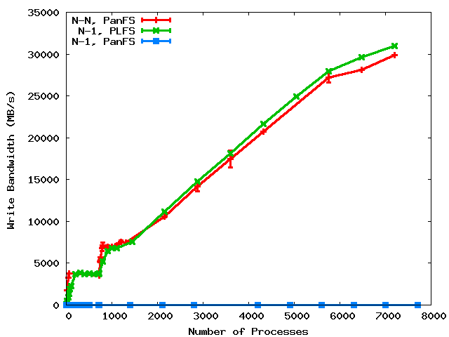
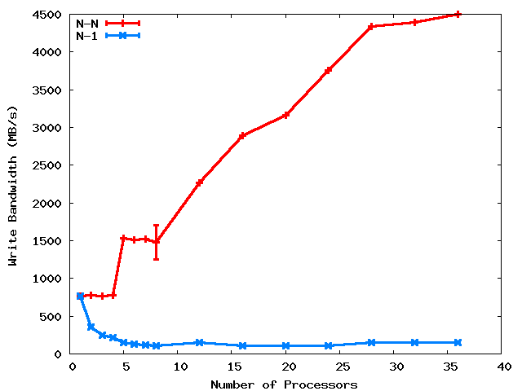
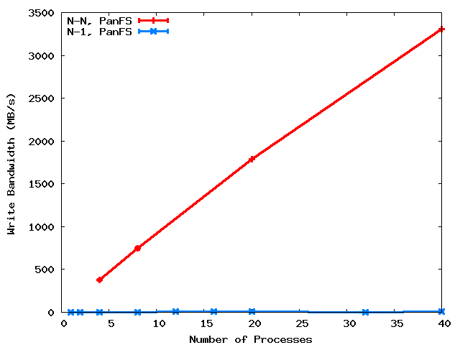
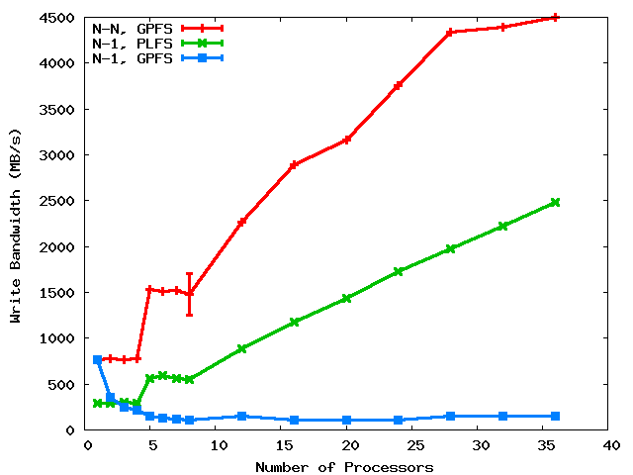
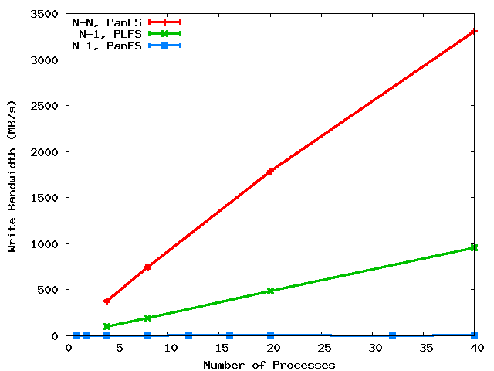

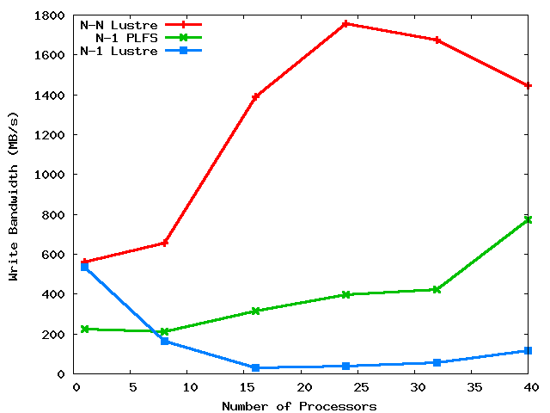
PLFS on three major HPC PFS’s
31 GB/s
LANL
PanFS
GPFS
25X
100X
3000X
at scale
PSC
Lustre
8X
Notes:
We compare to N-N because that’s the best we know how to do. Although it’s our goal, not achieving does not mean failure. Rather success is defined as beating N-1.

Slide 11
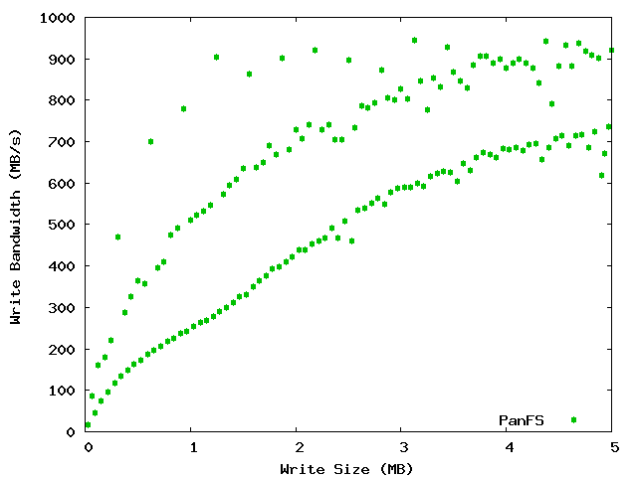
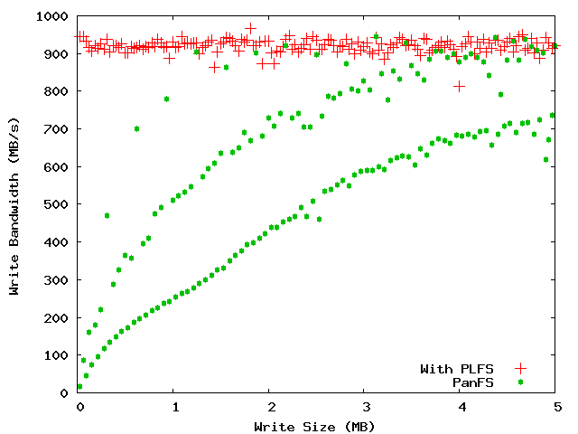
LBNL PatternIO benchmark
With PLFS
Without
PLFS
Unaligned
64k block aligned
Stripe aligned
PLFS makes alignment and blocksize irrelevant!

Slide 12
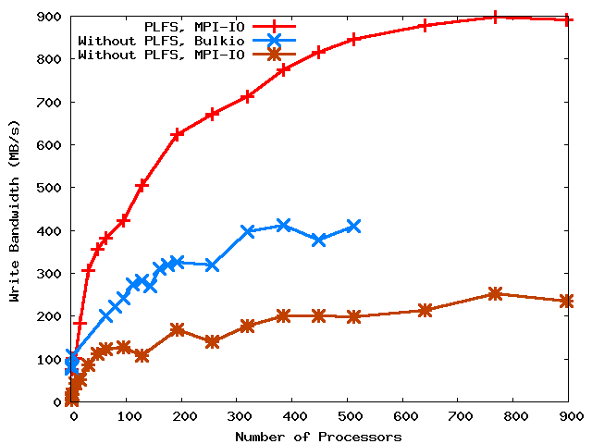
LANL 1
2X
4X

Slide 13
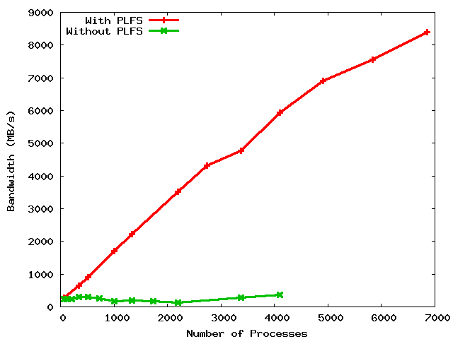
LANL3
8.5 GB/s
6.0 GB/s
28X ?
20X
300 MB/s
???

Slide 14
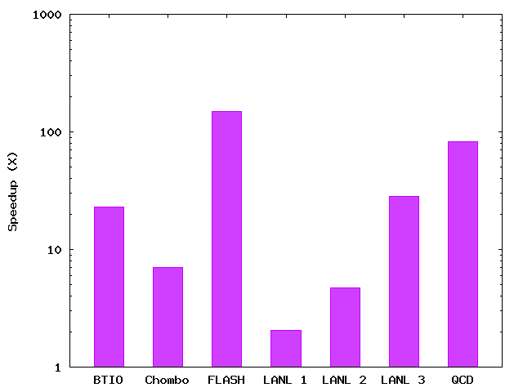
PLFS Checkpoint BW Summary
150X
83X
28X
23X
7X
5X
2X
Notes:
The height of the bars is roughly sorted by the scale of the experiment. The larger the scale, the larger the speedup. We expect comparable results as a function of scale (i.e. With more scale, all results will be like FLASH).

Slide 15
Other approaches
 | Interpostion Technique Used | No Extra Resources Used During | No Extra Resources Used After | Maintains Logical Format | Works with Unmodified Applications | Data Immediately Available
ADIOS | Library | Yes | Yes | Yes | No | Yes
stdck | FUSE | No (LD) | No (LD,N) | Yes | Yes | Yes
Neighbor | FUSE | No (M) | No (M,N) | Yes | Yes | No
Diskless | Library | No (M) | No (M) | No | No | Yes
ZEST | FUSE | No (RD) | No (RD) | No | No | No
PLFS | FUSE | Yes | Yes | Yes | Yes | Yes
KEY: LD = local disk, M = memory, N = network, RD = remote disk
Notes:
15

Slide 16
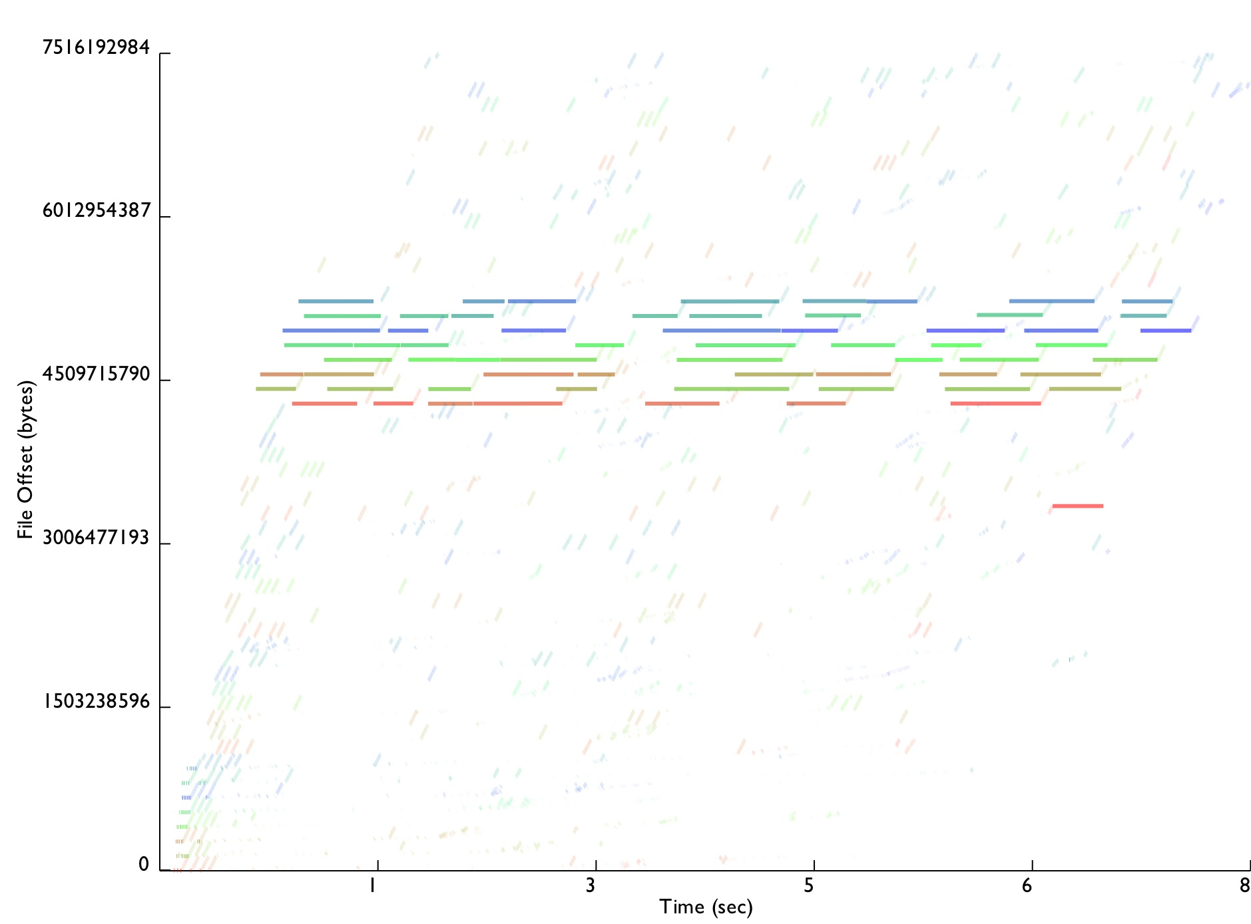
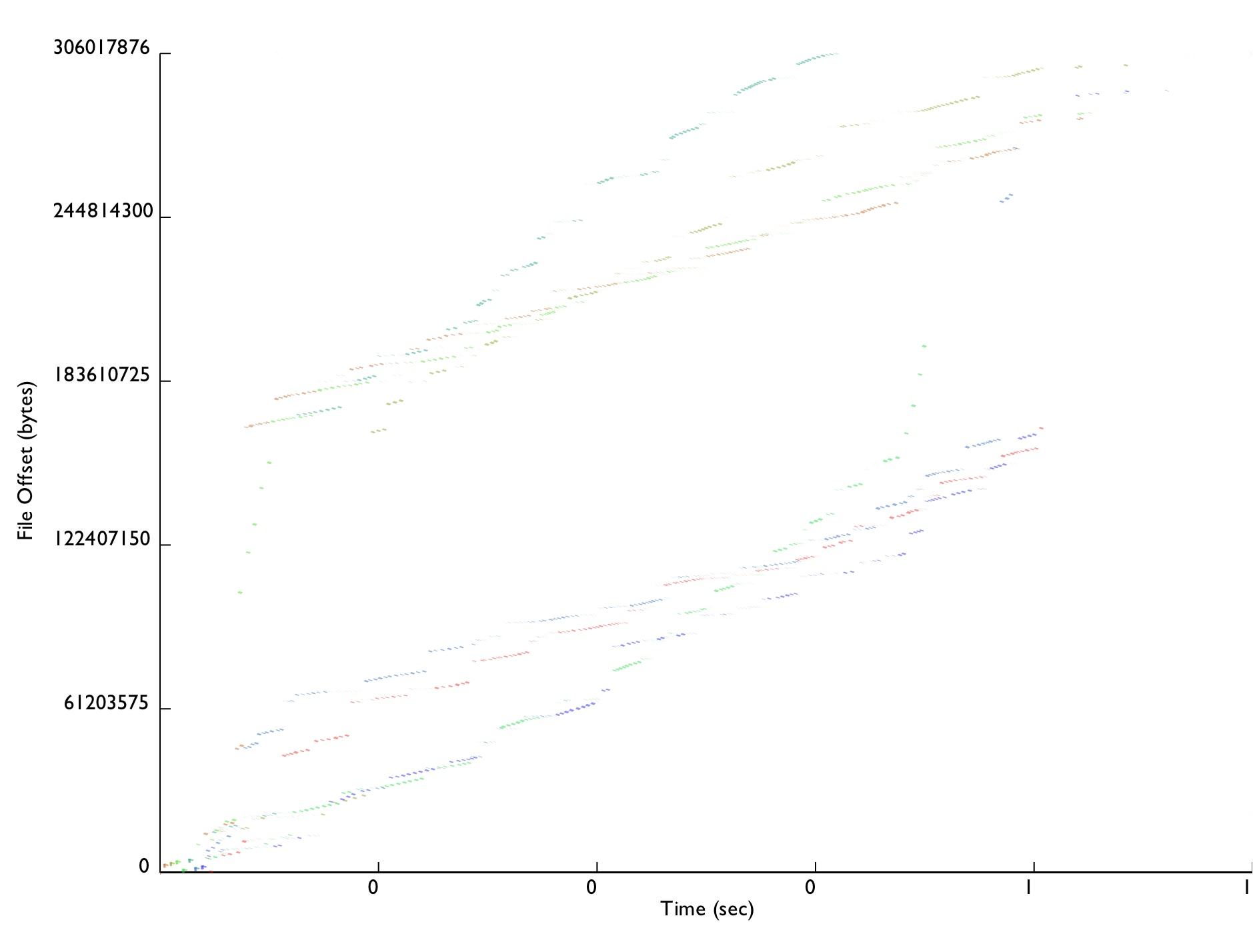
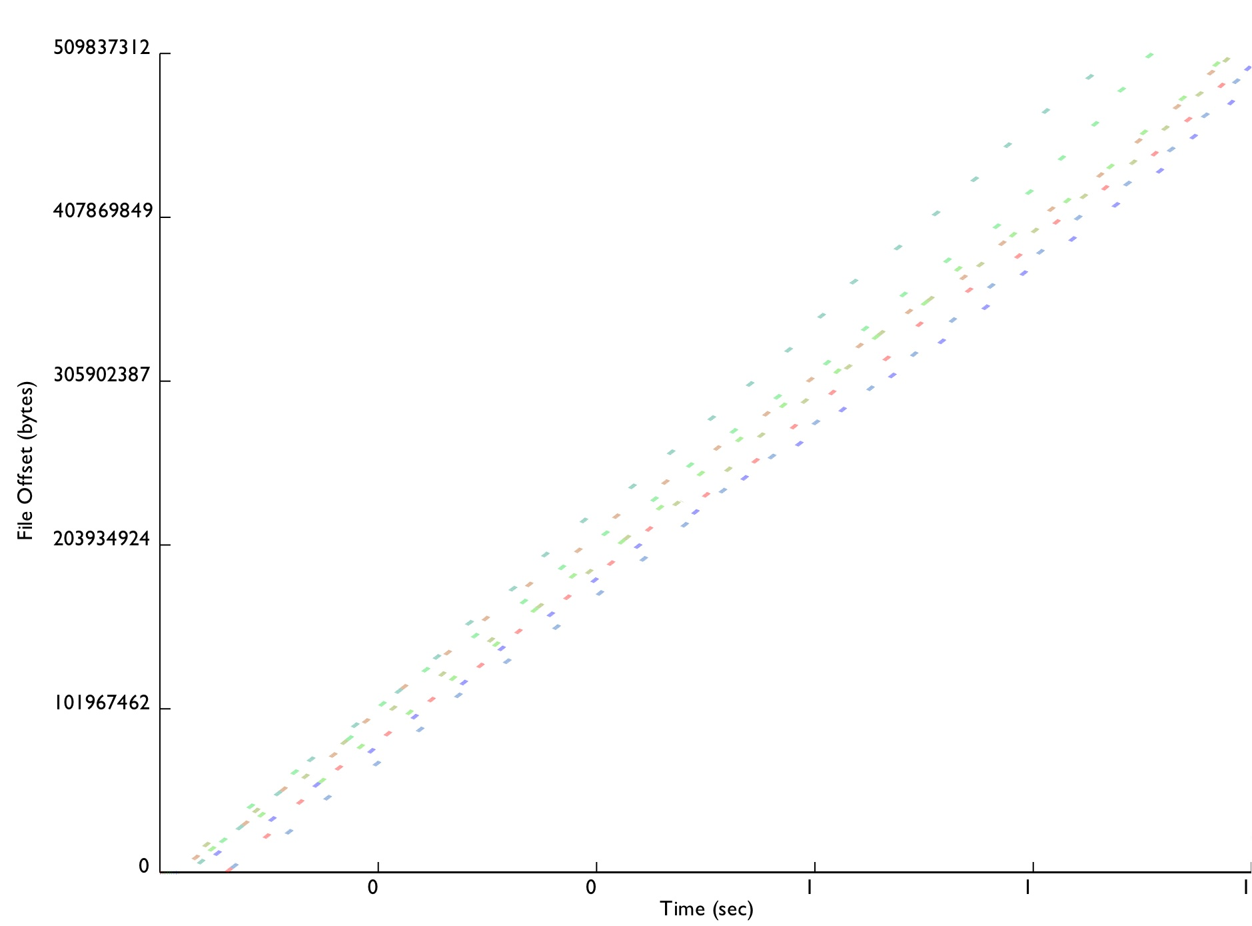
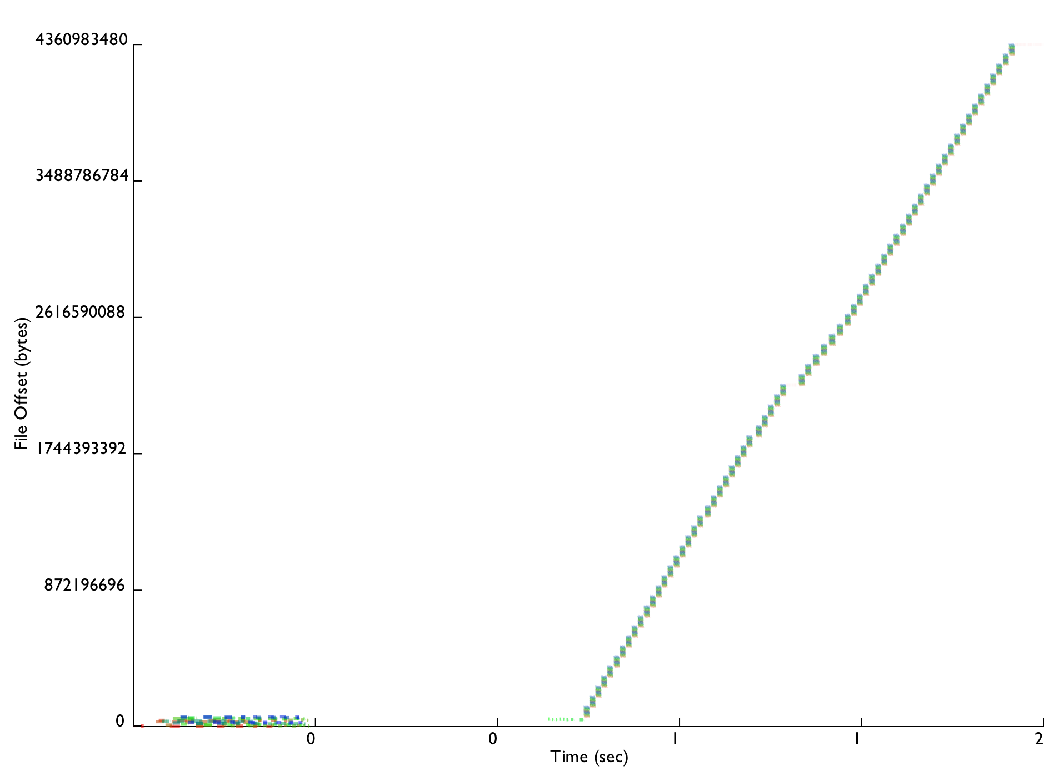
Conclusion
3000 lines of (soon to be open-source) C++
Installed on Roadrunner for Open Science
Moving onto other production machines next DST
Improves reads, does not slow down lookups
Enables easy tracing
Traces from all studied benchmarks now published
Every real app tested significantly improved up to 300X
ORNL, LBNL, and PNNL very interested
LANL1
Chombo IO
FLASH IO
LANL2
http://www.pdsi-scidac.org/research/plfs.html

Slide 17
Trade-offs
Small file bandwidth due to open overhead
Single node bandwidth due to FUSE/PLFS overhead
Small job performance due to single node bandwidth
Reads in read-write mode
Possible reduction in read BW for strange read patterns
Overlapping writes are not ordered
Shift complexity to N-N challenge

Slide 18
Other Operations
Amdahl’s Law
Writes are much better but
Overall only improved if other ops not much much worse
Reads are actually also better
Read all index files, aggregate into a global index
Logical offsets are mapped to a physical offset
File lookups are about the same
Uses cached data for closed files
Stats the data files for files opened for writing
PLFS actually improves reads as well and doesn’t adversely affect file lookups!

Slide 19
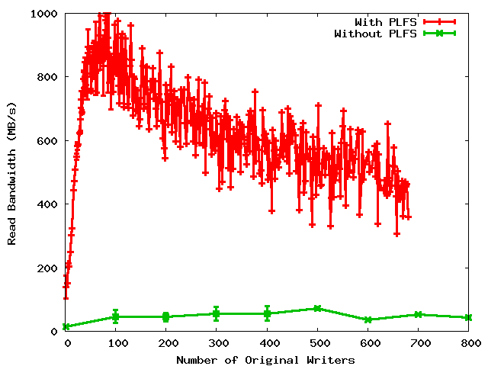
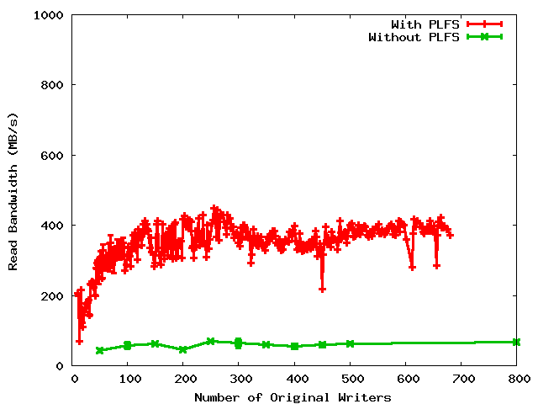
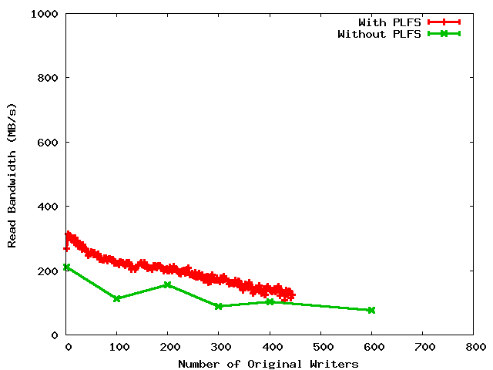
Read Bandwidths
Non-uniform restart
Uniform restart
Archiving

Slide 20
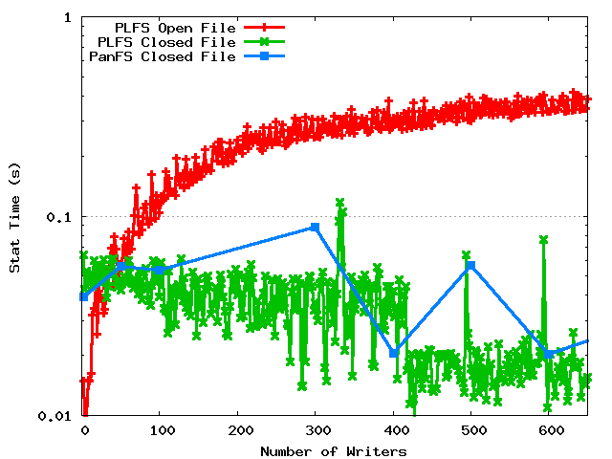
Metadata rates

Slide 21
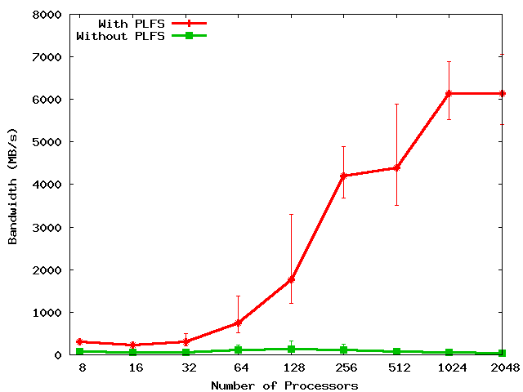
FLASH IO
150X
Notes:
Includes open and close times.
Set problem to do constant IO from each proc: From 0.5 GB to 62 GB.

