Slide 1
PLFS: Parallel LFS
John Bent, Gary Grider, James Nunez
Los Alamos National Labs

Slide 2
N-1 Strided
Application logical view matches PanFS organization
PanFS

Slide 3
N-1 Strided can be Slow
Concurrency on files, objects, RAID groups can slow down N-1 access patterns
N-N or RAID type can help

Slide 4
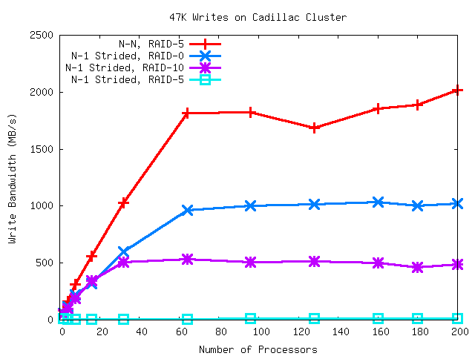
RAID type, IO pattern

Slide 5
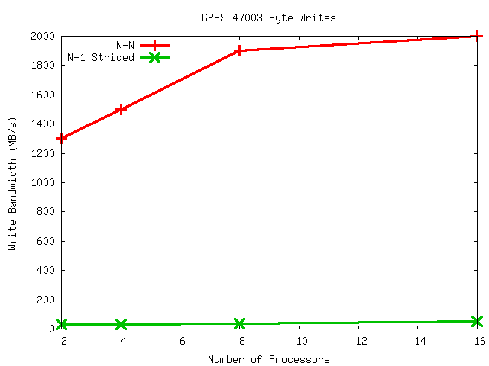
PLFS / GPFS

Slide 6
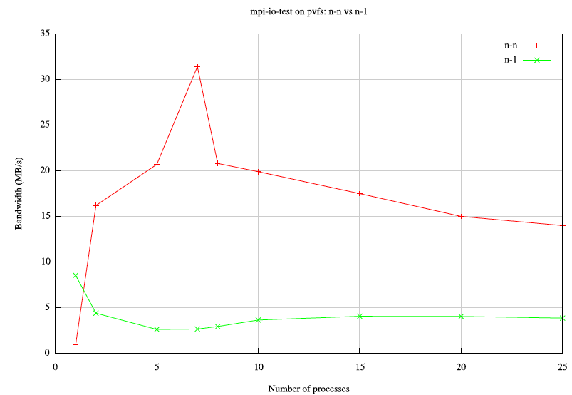
And PVFS
Only 7 client nodes.
N-N
N-1 strided
Milo’s graph: 3 minutes of 47K writes on 7 clients and 3 servers

Slide 7
PLFS converts N-1 to N-N
A FUSE file system interposed between app and PanFS
Maintains apps view of a single file
Reorganizes data on PanFS into multiple files, one per pid
All writing is log-structured (i.e. append only)
An index per file maps physical offsets to logical
Reads consult indices to locate data

Slide 8
PLFS / PanFS
131
132
279
281
132
148
host1
host2
host3
Application logical view matches PLFS virtual view
PLFS
/foo
/foo/
host1/
host2/
host3/
data.131
data.132
data.279
data.281
data.132
data.148
indx
indx
indx

Slide 9
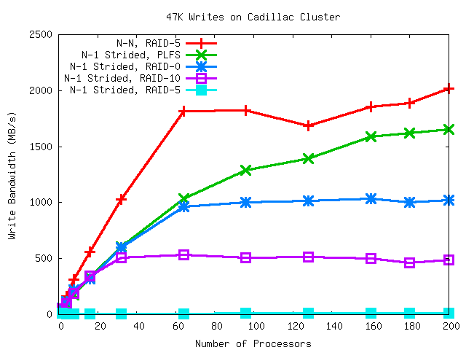
PLFS/PanFS on Caddy (3.2.3)

Slide 10
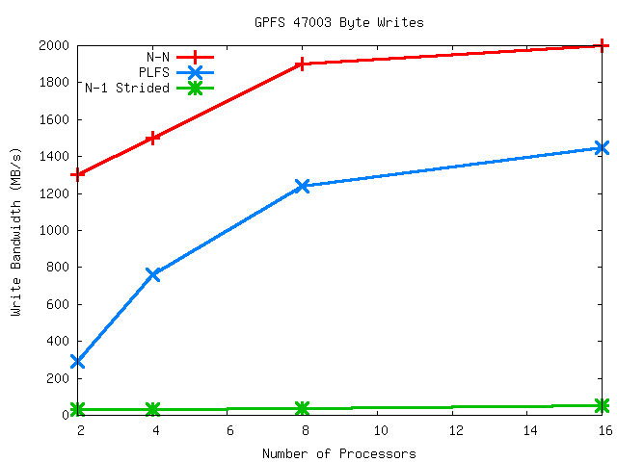
PLFS / GPFS

Slide 11
Application Study, Rage
A multiphysics hydrodynamics code
This problem is a 3d simulation of an asteroid hitting the earth, killing lots of dinosaurs
Does horrible N-1 pattern
Developers are aware of N-1 performance issues
However, they will never change to N-N
They have developed bulk-io
Fusion of MPI-IO collective and Dache
One proc per node aggregates and caches
Flushes every 10 MB

Slide 12
Rage IO Pattern
0: 22448- 22455 (8)
0: 22456- 22463 (8)
0: 22464- 22471 (8)
0: 22472- 26575 (4104)
0: 26576- 26903 (328)
0: 26904- 156439 (129536)
0: 156440- 287511 (131072)
0: 287512- 418583 (131072)
0: 418584- 526935 (108352)
1: 526936- 655303 (128368)
1: 655304- 786375 (131072)
1: 786376- 917447 (131072)
1: 917448- 1026967 (109520)
4: 1026968- 1155255 (128288)
4: 1155256- 1286327 (131072)
4: 1286328- 1417399 (131072)
4: 1417400- 1526999 (109600)
2: 1527000- 1656503 (129504)
2: 1656504- 1787575 (131072)
2: 1787576- 1918647 (131072)
2: 1918648- 2027031 (108384)
500,032
500,032
500,032
500,032

Slide 13
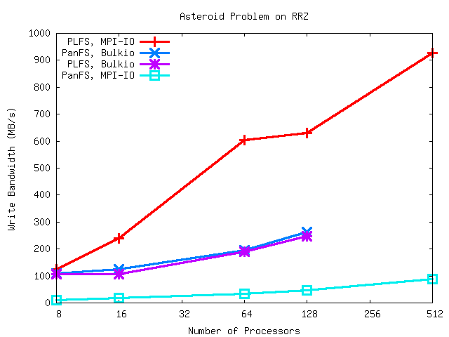
Asteroid Problem Bandwidth

Slide 14
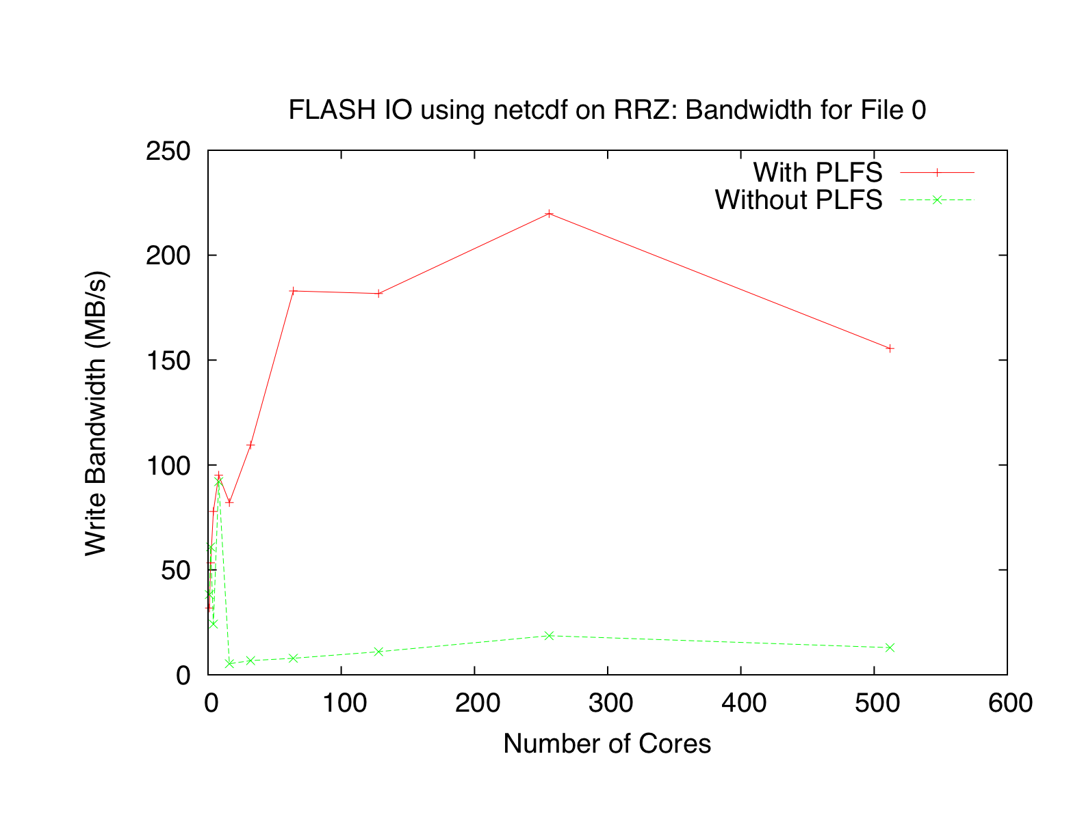
FLASH IO using pNetCDF
The performance dropoff is because we ran with an unrealistically small filesize and the open overhead is becoming increasingly significant.

Slide 15
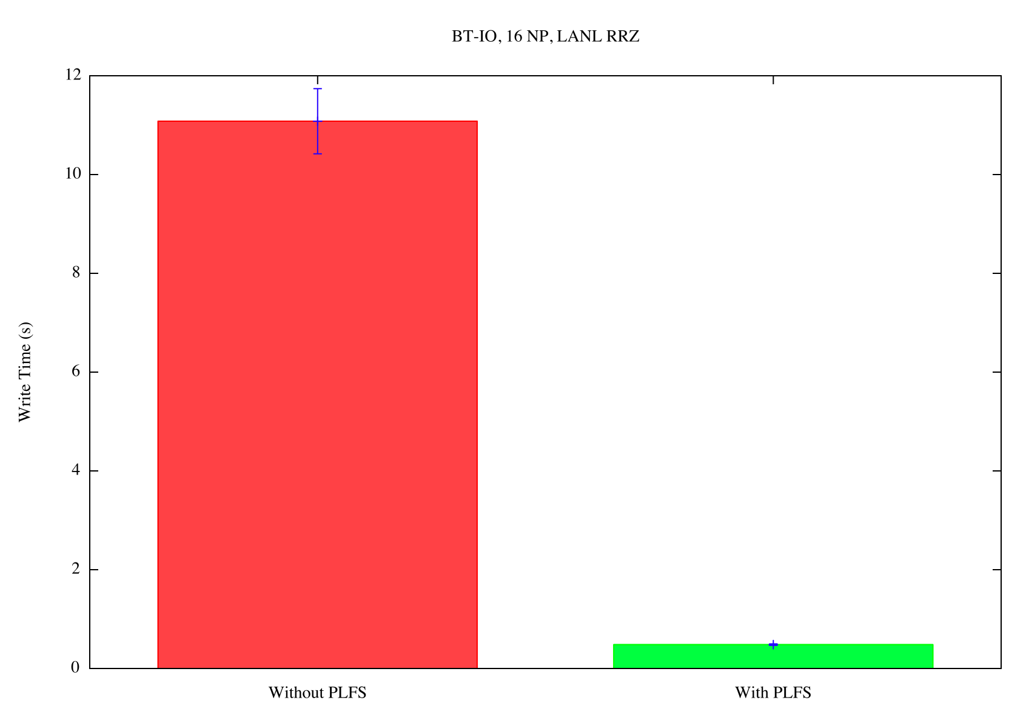
NASA’s BT-IO
Notes:
Using time and not bandwidth because it’s such a small amount of IO that the bandwidths are really low: 1.7 MB/s for PLFS and 0.08 for without.

Slide 16
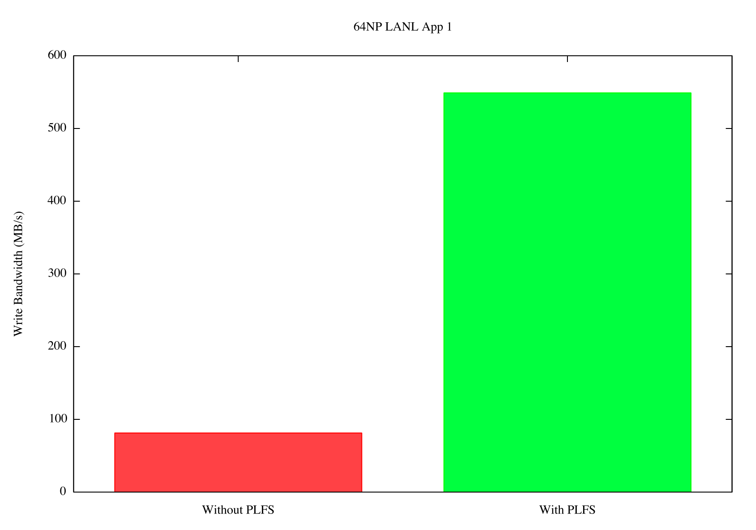
LANL Open Science App

Slide 17
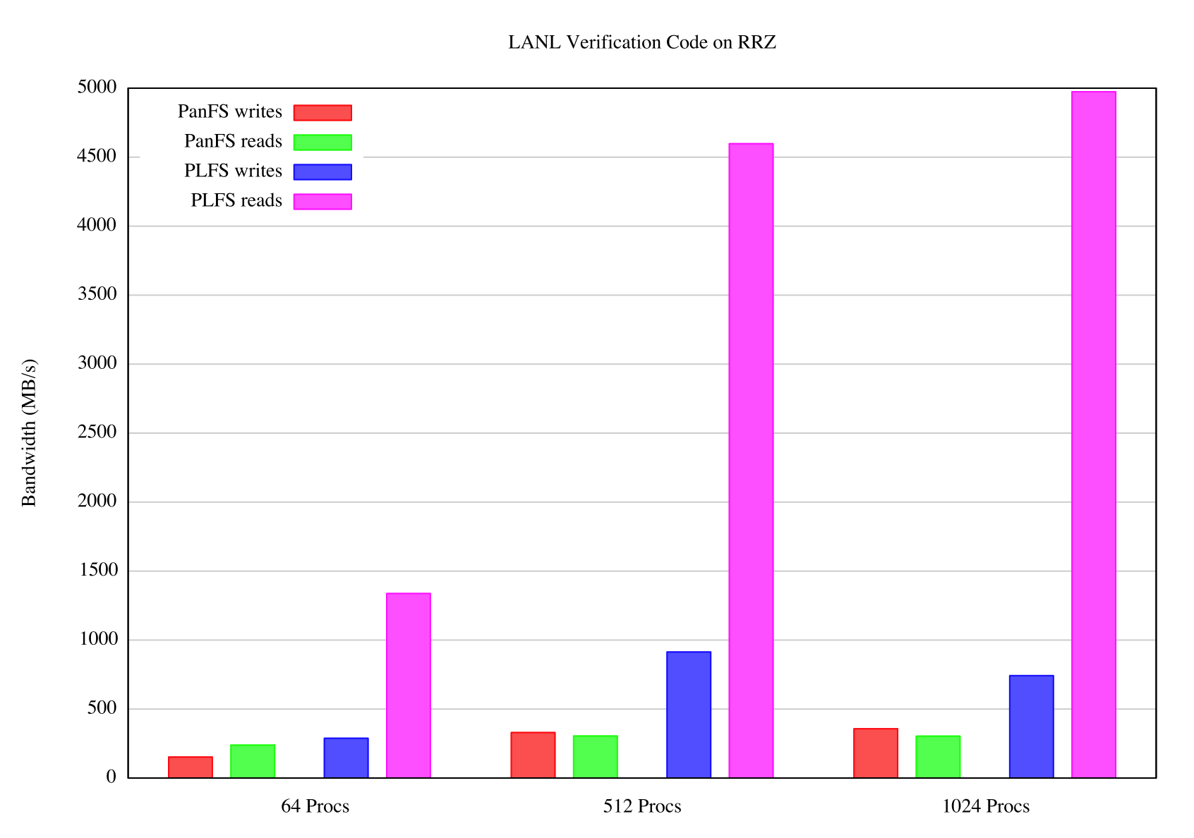
PLFS can Help Reads Too
Notes:
Slowdown on writes is that the file size is very small only about 4 GB’s total. Reads are improved so much because caching works better.

Slide 18
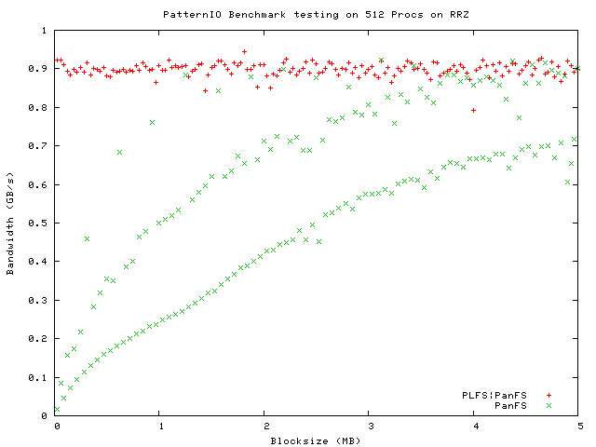
LBNL PatternIO benchmark
With PLFS
Without
PLFS
Unaligned
4k block aligned
Stripe aligned
PLFS makes alignment and blocksize irrelevant!

Slide 19
Reads and Stats
Reads
Read all index files, aggregate into a global index
Logical offsets are mapped to a physical offset within a data file
Stats
Read all index files to find last offset and total bytes
Index files may not be available if they’re being buffered
Stat the data files and guess
May not be 100% accurate for files opened with O_WRONLY but at least it will continue to grow for the anxious ‘ls –l user.

Slide 20
Complexity for faster stats
131
132
279
281
132
148
host1
host2
host3
PLFS
/foo
/foo/
host1/
host2/
host3/
data.131
data.132
data.279
data.281
data.132
data.148
indx
indx
indx

Slide 21
Complexity for faster stats
131
132
279
281
132
148
host1
host2
host3
PLFS
/foo
/foo/

Slide 22
Complexity for faster stats
131
132
279
281
132
148
host1
host2
host3
PLFS
/foo
/foo/
access
metadata/
openhosts/
host1.last_offset.num_blocks.timestamp
host2.last_offset.num_blocks.timestamp
host3.last_offset.num_blocks.timestamp

Slide 23
PLFS Status
SLOC: 3000 lines of C++
Tested for reads and writes with synthetic and real codes
Helper app to print chunk map
Runs as normal user with that user’s permissions
Runs as root for multiple users
Not extensively tested

Slide 24
PLFS Status
Opens with O_RDWR or O_WRONLY
Create one container per file
Container is a directory with S_ISUID
Creating container is easy for multiple pids on a node - pthreads
Creating container is hard across multiple nodes
Mkdir ignores S_ISUID though so can’t be atomic
Each node stats container, creates temp if not there, then rename
Set of hostdirs to hold data files and indices
One data file per pid
One index per node
Index is buffered and combines contiguous if O_WRONLY
Opens with O_RDONLY create a single aggregated index
Open is slow, subsequent reads are fast
O_RDWR forces aggregated index creation on each read

Slide 25

PLFS / PanFS
Application logical view matches PLFS virtual view
PLFS
PLFS rearranges data on PanFS to emulate N-N IO pattern
PanFS

Slide 26
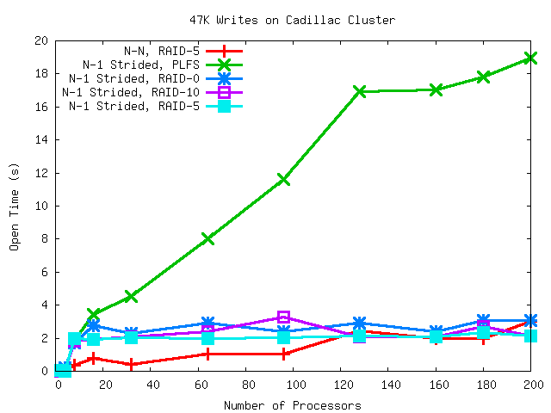
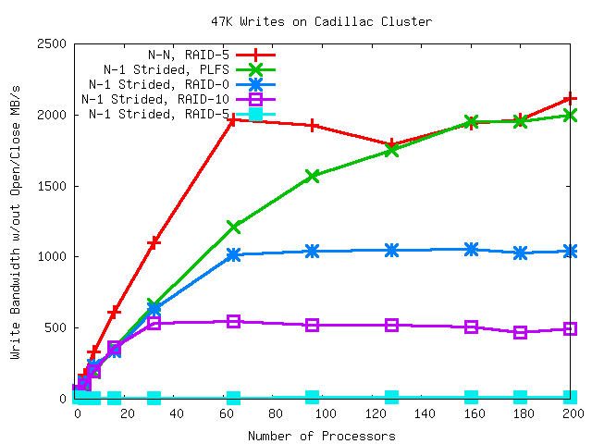
Not quite as good as N-N

Slide 27
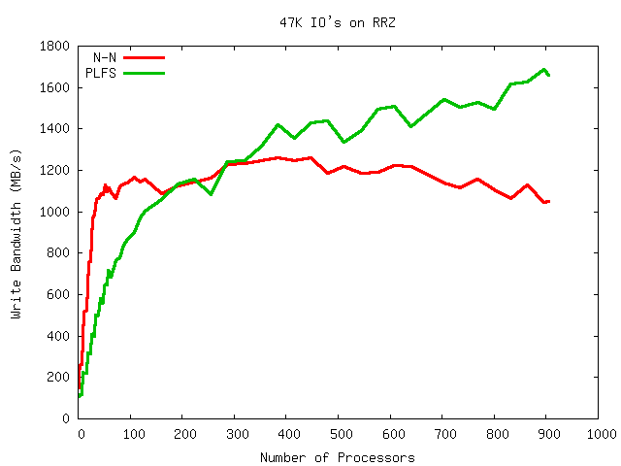
PLFS/PanFS on RRZ (3.2.3a)
PLFS might be artificially high here because this is data from before we moved the close from release to flush.
Notes:
Before we switched the close to flush instead of release.

Slide 28
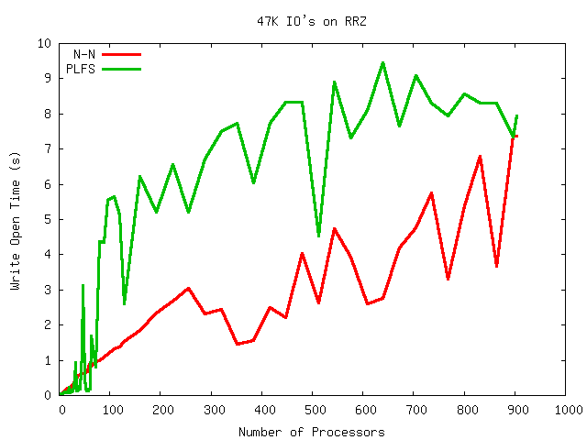
PLFS/PanFS on RRZ (3.2.3a)
PLFS open times not bad!
Only slightly worse than N-N.
Notes:
Before we switched the close to flush instead of release.

Slide 29
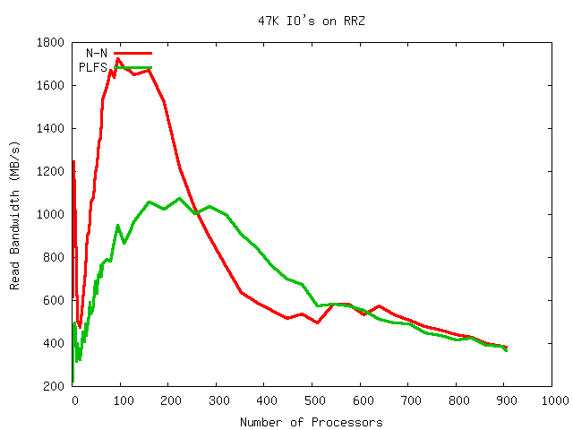
PLFS/PanFS on RRZ (3.2.3a)
Reading is very comparable. RRZ has a small storage system so lots of procs thrash storage and break read-ahead.
Cache avoidance technique only works on multiple nodes.
Notes:
Before we switched the close to flush instead of release.

Slide 30
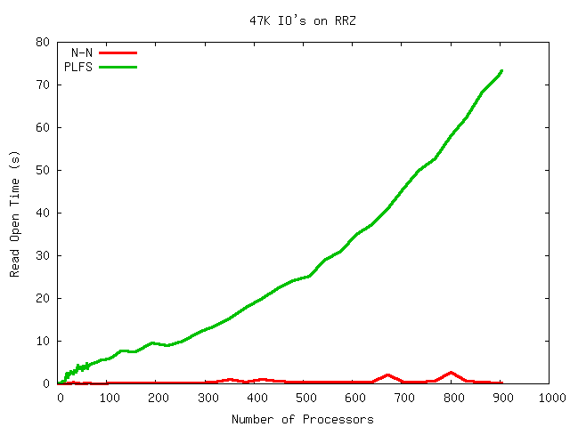
PLFS/PanFS on RRZ (3.2.3a)
Read open scales linearly.
Notes:
Before we switched the close to flush instead of release.

Slide 31
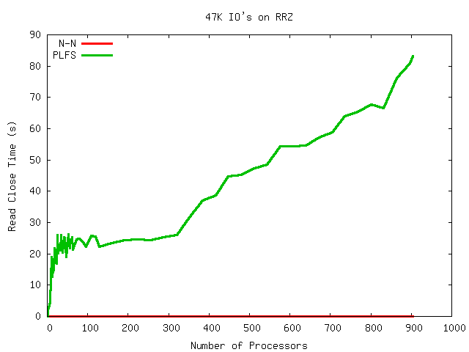
PLFS/PanFS on RRZ (3.2.3a)
Read close does a lot of work also. Closes any open chunk files, cleans up data structures.
Notes:
Before we switched the close to flush instead of release.

Slide 32
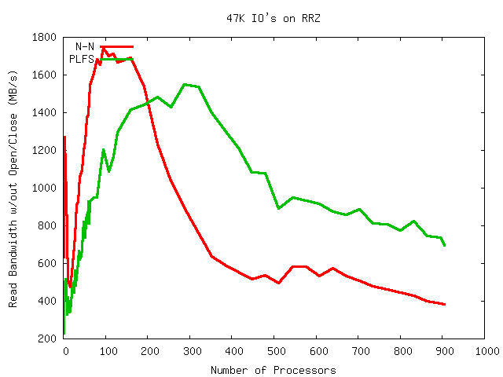
PLFS/PanFS on RRZ (3.2.3a)
Excluding open and close times, PLFS reads faster than N-N for large proc counts.
Notes:
Before we switched the close to flush instead of release.

