Slide 1
PLFS: Parallel LFS
John Bent
Los Alamos National Labs

Slide 2
Parallel Apps do Parallel IO
Periodic checkpoint writes
Visualization writes
Writes are synchronized
Tens of thousands of synchronized writes can be difficult for the file system
Two most common write patterns
  N-1 where N procs write to 1 shared file
  N-N where N procs write to N non-shared files

Slide 3
N-N File IO
N-1 Strided File IO
N-1 Segmented File IO

Slide 4
Checkpoint Patterns
N-N
  Writes and reads easy for file system
  Opens can be hard
  Hard for application and user
    Archiving, non uniform restart, viz, etc.
N-1 Segmented
  Writes and reads slightly harder for FS
  Opens easier
  A little easier for the application and user
  Rare in practice
N-1 Strided
  Writes and reads very hard
  Easy for application and user
  Common pattern at LANL and elsewhere

Slide 5
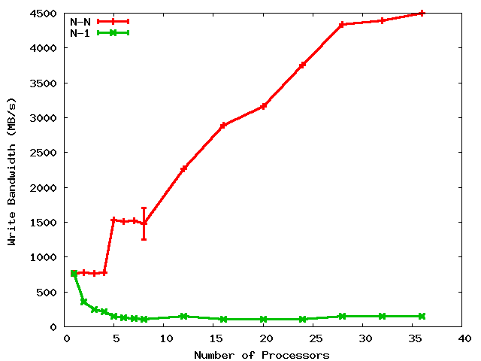
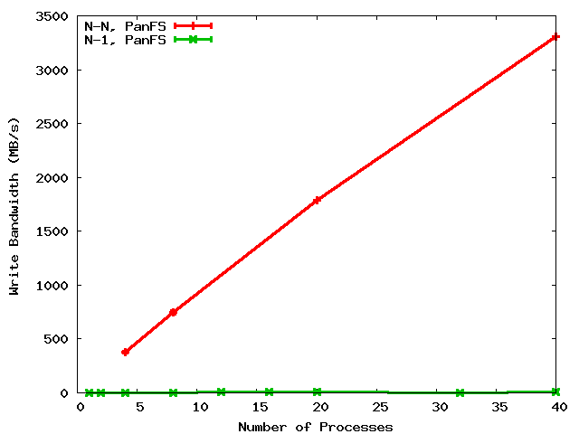
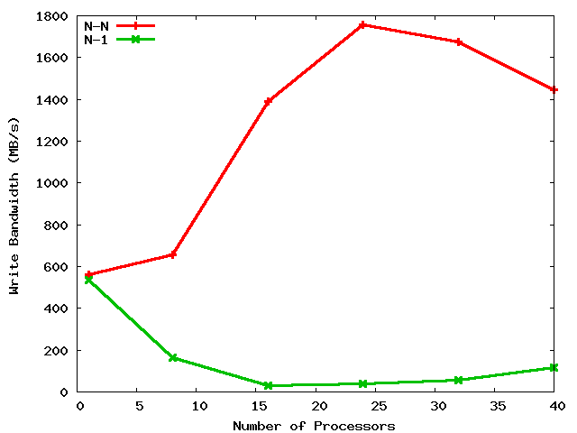
A Shared File is a Shared Problem
4.5 GB/s
LANL
PanFS
3.3 GB/s
LANL
GPFS
45X
330X
100 MB/s
10 MB/s
N-N
N-1
PSC
Lustre
1.8 GB/s
Cross graph comparisons not meaningful
Lustre slow due to lock contention¹
1) Exploiting Lustre File Joining for Effective Collective IO. Yu, Vetter, Canon, Jiang.
90X
20 MB/s
Notes:
When discussing this for DOE HQ, discuss why PanFS is slower for N-1. When discussing this for ORNL, say “You know the problem in Lustre; you discussed it in your Exploiting paper. It’s locks. Also alignment is a problem. Locks are also the problem in GPFS. Panasas also has “locks,” they call them capabilities, but they allow you to turn them off. So what’s the problem in PanFS?” Next slide.

Slide 6
Potential PanFS storage implications of N-1 strided
Process 1
Process 2
Process 3
Process 4
14
23
44
11
12
13
21
22
24
31
32
33
34
41
42
43
Parallel file
RAID Group 1
RAID Group 2
RAID Group 3
Notes:
Also, alignment and locking are problems. The problem in PanFS is client parity. Client parity is a good thing for scalable rebuild and therefore availability. But it makes N-1 strided hard.

Slide 7
N-1 is prominent
Several old LANL codes use N-1 (over 50% of cycles)
Newly written codes still choosing N-1
  2 of 8 open science applications on Roadrunner
  NetCDF and HDF5 formatting libraries
N-1 also prominent elsewhere
  At least 10 of 23 on the PIO benchmarks page are N-1
  BTIO, FLASH IO, Chombo IO, QCD, etc. (GTC?)

Slide 8
Obvious solution:
Convert N-N into N-1
But many applications won’t do it
  Archiving, mgmt, visualization, non-uniform restart
  Developers are aware of the N-1 problems
    But are loathe to change to N-N
    One app wrote 10K lines of code, bulkio, to try to improve N-1
If the apps won’t do it, interposition can
  Desirable characteristics
    Low overhead (performance and resource)
    User transparency (i.e. NO CODE REWRITING)
    Portable and maintainable
  Our contribution: PLFS

Slide 9
Outline
Introduction
PLFS Design and Implementation
Evaluation
  Writes
  Reads
  Stats
  Overhead
Trade-offs
Related Work
Future Work and Conclusions

Slide 10
PLFS:
Parallel Log-structured FS
Virtual interposition file system using FUSE
Transparently rearranges N-1 checkpoints into N files
  Very similar to Lustre Split Writing
Two main optimizations
  Decouples concurrent access
  Append-only writing

Slide 11
Decouples Logical from Physical
131
132
279
281
132
148
host1
host2
host3
PLFS Virtual Layer
/foo
/foo/
host1/
host2/
host3/
data.131
data.132
data.279
data.281
data.132
data.148
indx
indx
indx
Physical Underlying Parallel File System
Notes:
11

Slide 12
Data Reorganization in PLFS
All processes open file, foo
  Each PLFS mkdir’s foo
  Each PLFS mkdir’s foo/hostN
Processes start writing to file
  PLFS opens a data file per process and appends write data to them
  PLFS opens an index file per node and appends metadata to them
131
132
279
281
PLFS (FUSE)
PLFS (FUSE)
“PLFS Container”
/foo/
/host1/
/host2/
/data.131
/data.132
/index
/data.279
/data.281
/index
Physical Underlying Parallel File System
Notes:
12

Slide 13
PLFS Index Record
Data ID
Phys Off
Len
TS Begin
TS End
???
Sort records by physical offsets
  Lookup map
Sort records by timestamps
  IO Trace

Slide 14
Other operations in PLFS
Amdahl’s Law
  Writes are much better but
  Overall only improved if other ops not much much worse
Reads
  Construct a global index by aggregating all the index files
  Map logical offsets to a physical offset within a data file
  Overlapping writes are undefined
Chmods, Chowns, Chgrps, Utimes, etc.
  Use a container/access file
Stats
  Pull permissions, ownership from access file
  Construct a global index to get file capacity and file size
!!!! Constructing a global index can be SLOW !!!!

Slide 15
PLFS Optimizations
Reads
  When possible (i.e. O_RDONLY), construct global index on the open, reuse for each read call
Stats
  On close, create a container/metadata/host.B.L.T
    B = blocks of capacity
    L = last offset (i.e. file size)
    T = timestamp of last write
  Stat can be implemented with a readdir
  (Also use container/openhosts/ to invalidate)

Slide 16
Thoroughly Tested
File Systems
  GPFS
  Lustre
  Panfs
Synthetic Checkpoint Benchmarks
  LANL MPI-IO test
  NERSC Pattern-IO
Applications and IO Kernels
  LANL1, LANL2, LANL3
  Office of Science
    FLASH-IO benchmark with HDF5
    Chombo-IO benchmark with HDF5
    QCD QIO
  NASA BT-IO benchmark

Slide 17
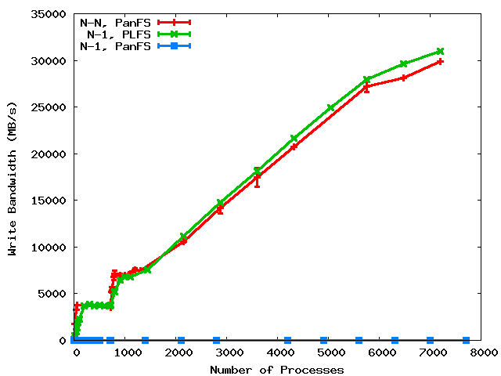
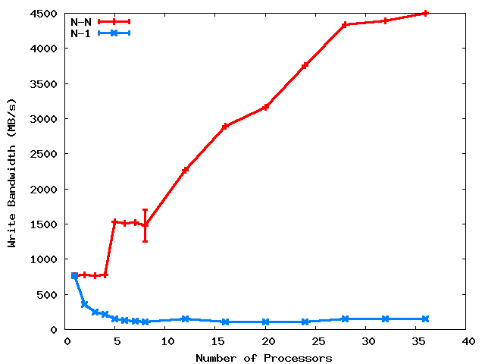
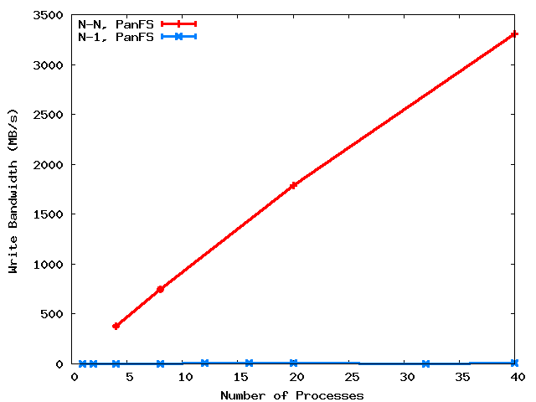
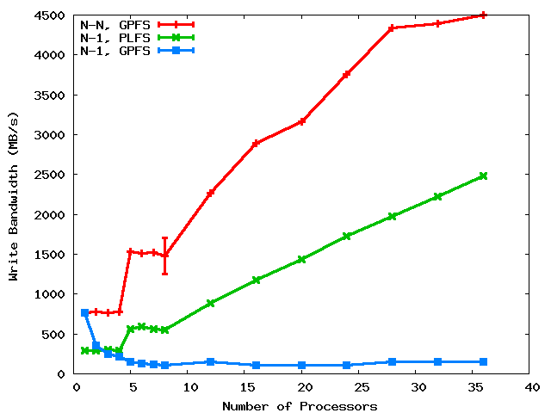
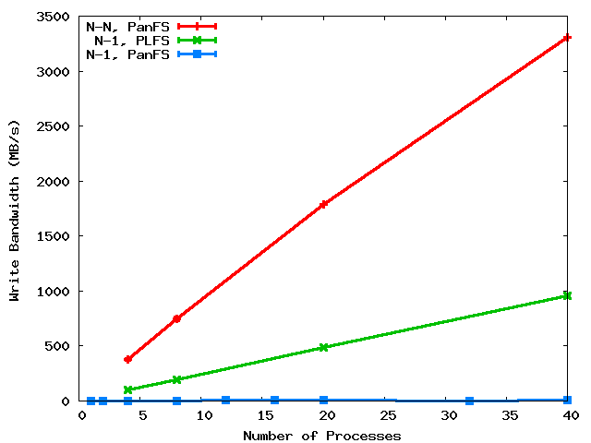
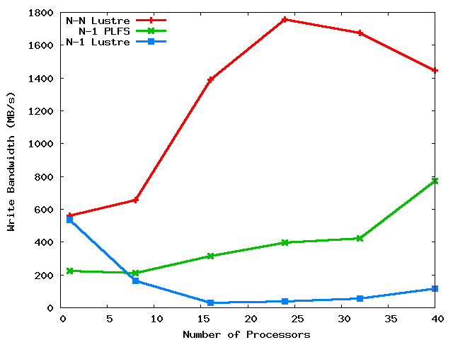
PLFS on three major HPC PFS’s
31 GB/s
LANL
PanFS
GPFS
25X
100X
3000X
at scale
PSC
Lustre
8X
Notes:
We compare to N-N because that’s the best we know how to do. Although it’s our goal, not achieving does not mean failure. Rather success is defined as beating N-1.

Slide 18
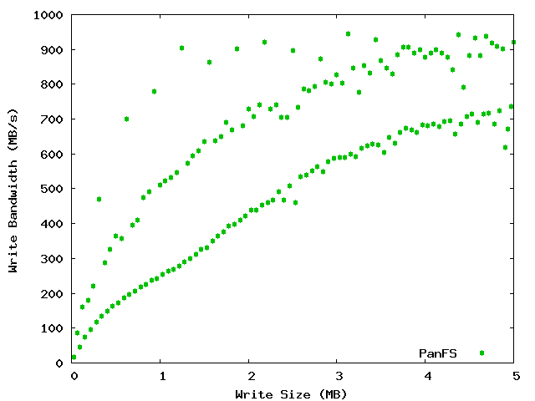
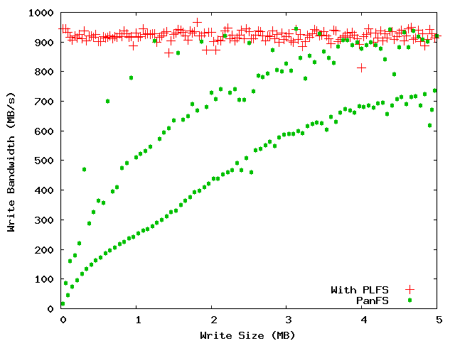
LBNL PatternIO benchmark
With PLFS
Without
PLFS
Unaligned
64k block aligned
Stripe aligned
PLFS makes alignment and blocksize irrelevant!

Slide 19
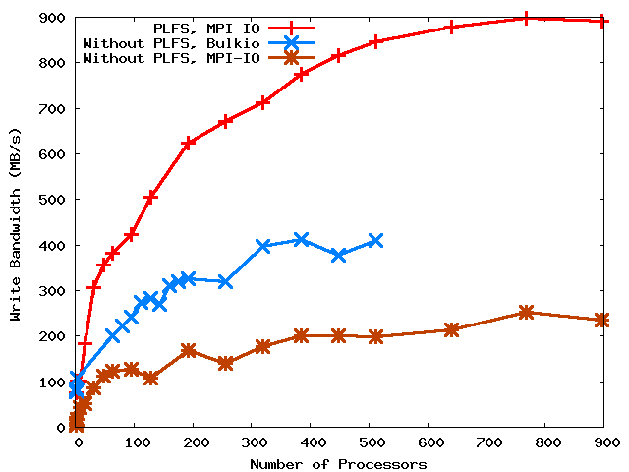
LANL 1
2X
4X

Slide 20
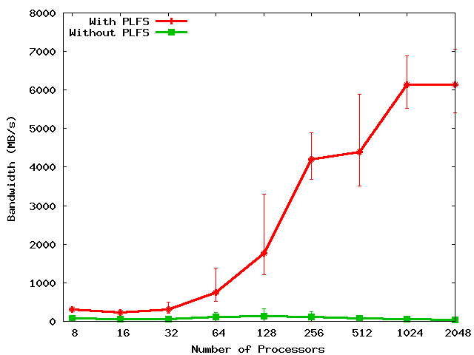
FLASH IO
150X
Notes:
Includes open and close times.
Set problem to do constant IO from each proc: From 0.5 GB to 62 GB.

Slide 21
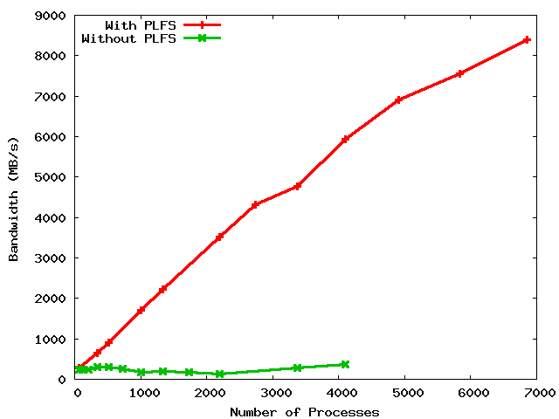
LANL3
8.5 GB/s
6.0 GB/s
28X ?
20X
300 MB/s
???

Slide 22
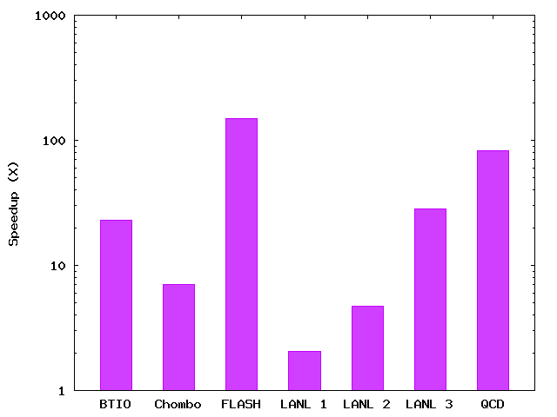
PLFS Checkpoint BW Summary
150X
83X
28X
23X
7X
5X
2X
Notes:
The height of the bars is roughly sorted by the scale of the experiment. The larger the scale, the larger the speedup. We expect comparable results as a function of scale (i.e. With more scale, all results will be like FLASH).

Slide 23
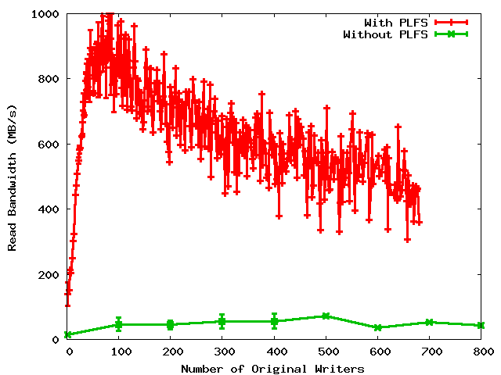
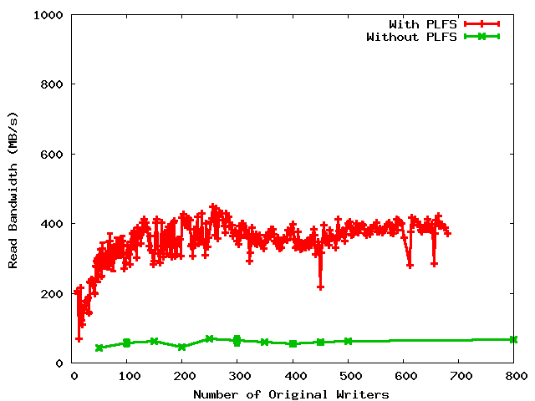
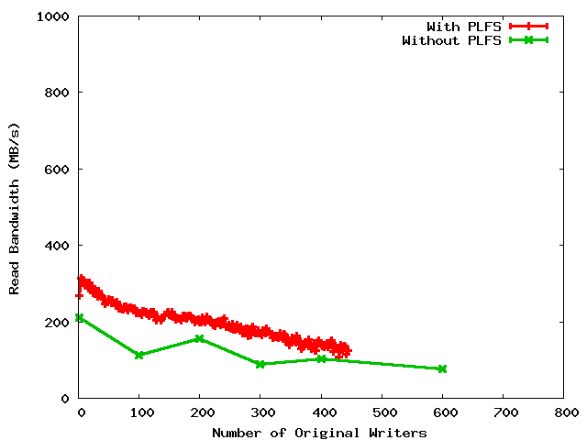
Read Bandwidths
Non-uniform restart
Uniform restart
Archiving

Slide 24
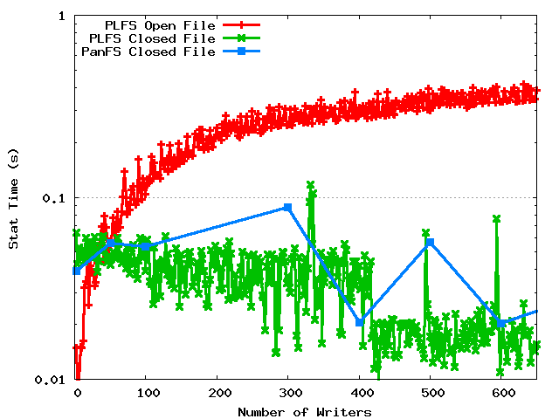
Metadata rates

Slide 25
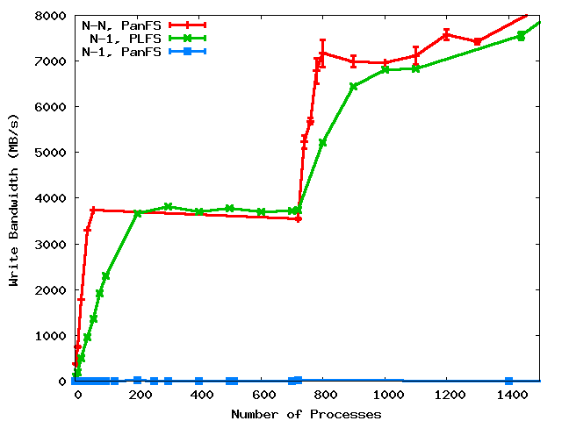
PLFS/FUSE Overhead
Notes:
We compare to N-N because that’s the best we know how to do. Although it’s our goal, not achieving does not mean failure. Rather success is defined as beating N-1.

Slide 26
Trade-offs
Small file bandwidth due to open overhead
Single node bandwidth due to FUSE/PLFS overhead
  Small job performance due to single node bandwidth
Reads in read-write mode
Possible reduction in read BW for strange read patterns
Overlapping writes are not ordered
Shift complexity to N-N challenge

Slide 27
Current and Future Work
Directory striping to ameliorate N-N parallel open
Overhead graph shows
  Problem for small jobs
  Lots of idle CPU for large jobs . . .
    Add compression to index record
    Add checksums to index record
    Add extensible metadata to index record
Data ID
Phys Off
Len
TS Begin
TS End
???

Slide 28
 | Interpostion Technique Used | No Extra Resources Used During | No Extra Resources Used After | Maintains Logical Format | Works with Unmodified Applications | Data Immediately Available | Parallel Filesystem Agnostic
ADIOS | Library | Yes | Yes | Yes | No | Yes | Yes
stdck | FUSE | No (LD) | No (LD,N) | Yes | Yes | Yes | Yes
Neighbor | FUSE | No (M) | No (M,N) | Yes | Yes | No | Yes
Diskless | Library | No (M) | No (M) | No | No | Yes | Yes
ZEST | FUSE | No (RD) | No (RD) | No | No | No | No
Lustre Split Writ | Library | Yes | Yes | No/Yes | Yes | Yes | No
PLFS | FUSE | Yes | Yes | Yes | Yes | Yes | Yes
KEY: LD = local disk, M = memory, N = network, RD = remote disk
Notes:
28

Slide 29
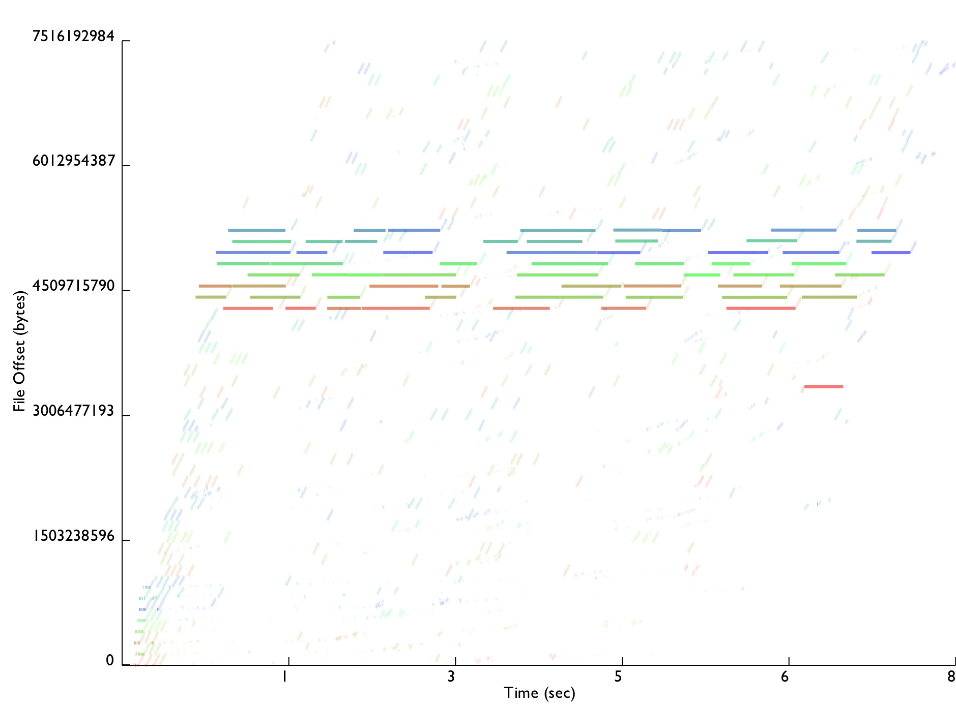
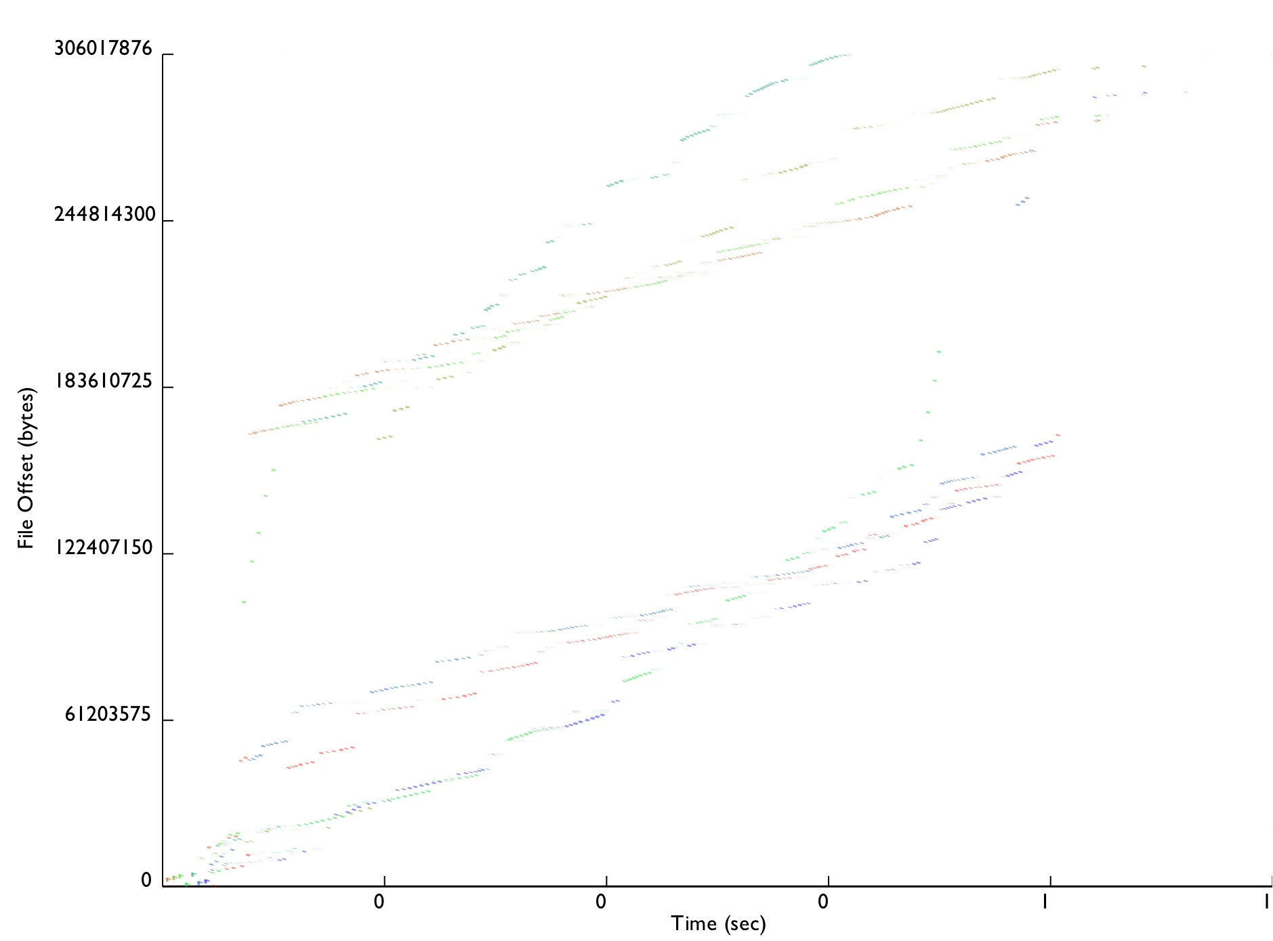
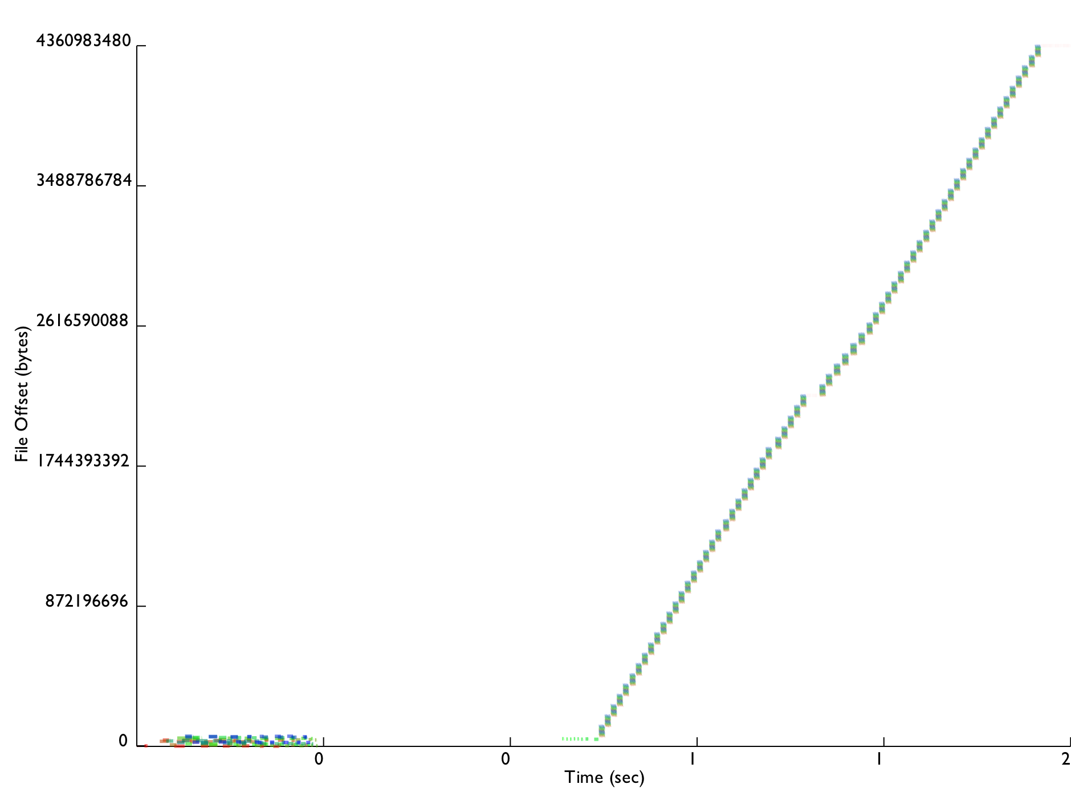
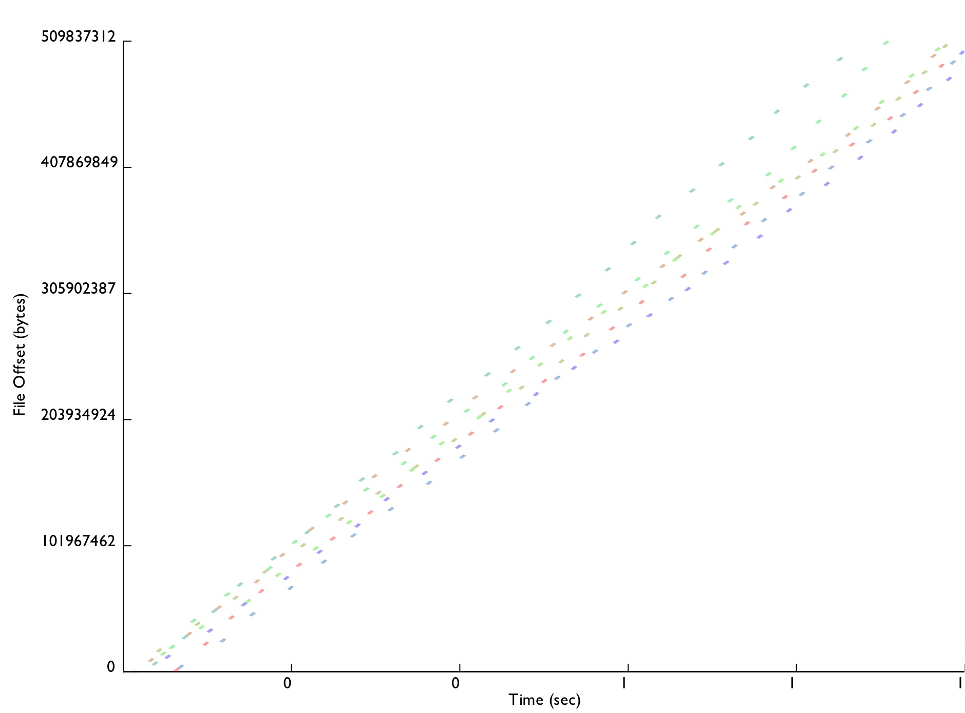
Conclusion
3000 lines of (soon to be open-source) C++
  Installed on Roadrunner for Open Science
  Moving onto other production machines next DST
Improves reads, does not slow down lookups
Enables easy tracing
  Traces from all studied benchmarks now published
Every real app tested significantly improved up to 300X
Hope to do at-scale Lustre testing
  If anyone happens to know of a large Lustre installation…..
LANL1
Chombo IO
LANL2
FLASH IO

Slide 30
Questions?
johnbent@lanl.gov
Technical Report
  http://institutes.lanl.gov/plfs

