Slide 1
PLFS for workloads other than N-1 writes
John Bent, et al.
Los Alamos National Labs

Slide 2
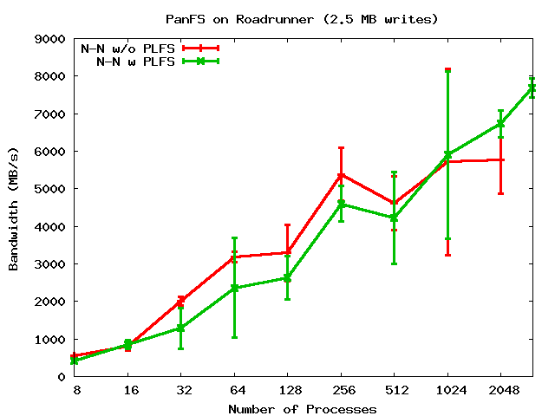
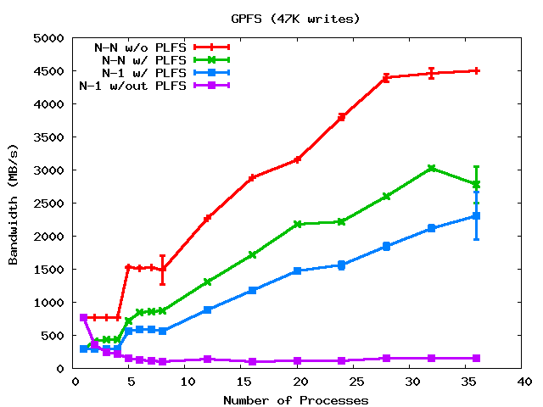
N-N Write Bandwidths
PanFS
Synthetic LANL MPI-IO test
PanFS was 2.5MB writes
GPFS was 47K writes
GPFS
Notes:
PanFS is w/ 2.5 MB writes. GPFS is the same 47K writes.

Slide 3
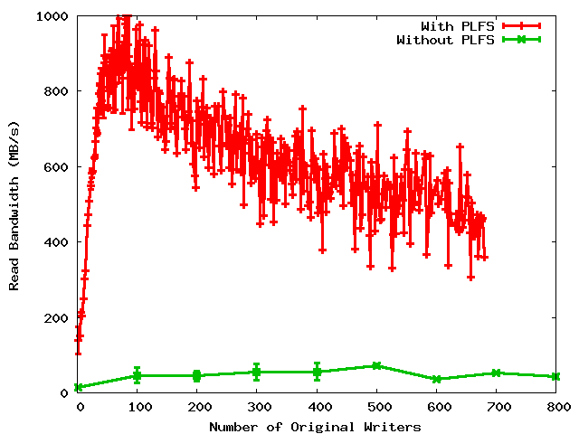
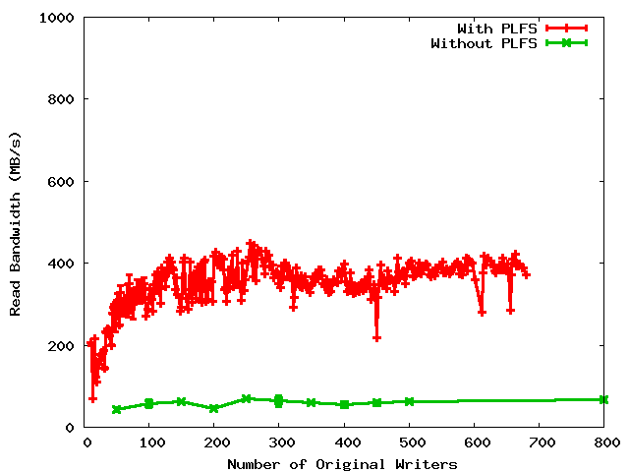
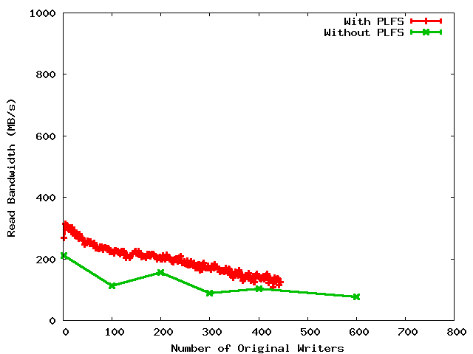
Read Bandwidths
Non-uniform restart
Uniform restart
Archiving

Slide 4
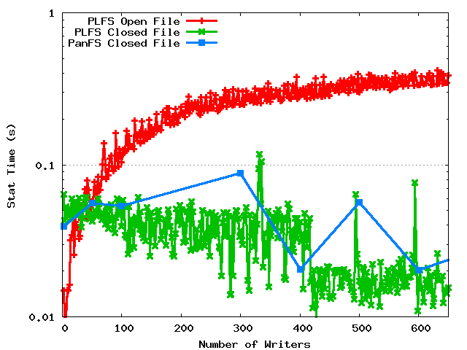
Metadata Rates

