Slide 1
PLFS: Parallel LFS
John Bent, et al.
Los Alamos National Labs

Slide 2
Parallel Apps do Parallel IO
Periodic checkpoint writes
Visualization writes
Writes are synchronized
Tens of thousands of synchronized writes can be difficult for the file system
Two most common write patterns
  N-1 where N procs write to 1 shared file
  N-N where N procs write to N non-shared files

Slide 3
N-N File IO
N-1 File IO

Slide 4
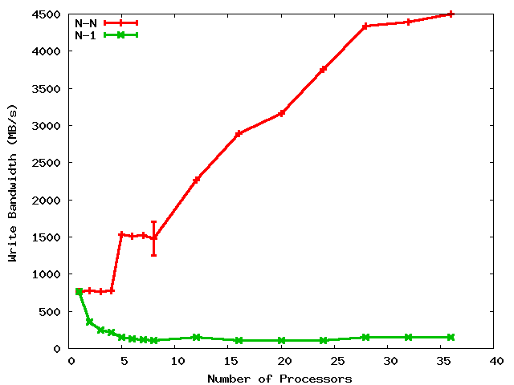
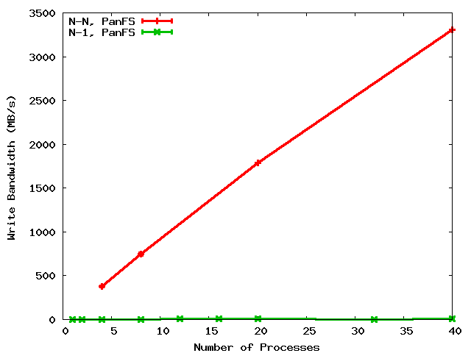
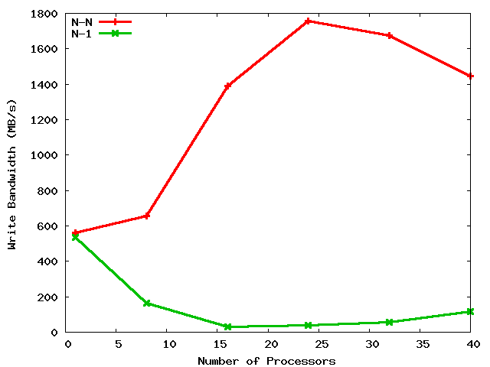
A Shared File is a Shared Problem
4.5 GB/s
LANL
PanFS
3.3 GB/s
LANL
GPFS
45X
330X
100 MB/s
10 MB/s
N-N
N-1
PSC
Lustre
1.8 GB/s
90X
Cross graph comparisons not meaningful
20 MB/s
Notes:
When discussing this for DOE HQ, discuss why PanFS is slower for N-1.

Slide 5
Potential storage implications of N-to-1 strided
Process 1
Process 2
Process 3
Process 4
14
23
44
11
12
13
21
22
24
31
32
33
34
41
42
43
Parallel file
RAID Group 1
RAID Group 2
RAID Group 3

Slide 6
N-1 is prominent
Several old LANL codes use N-1 (over 50% of cycles)
Newly written codes still choosing N-1
  2 of 8 open science applications on Roadrunner
  NetCDF and HDF5 formatting libraries
N-1 also prominent elsewhere
  At least 10 of 23 on the PIO benchmarks page are N-1
  BTIO, FLASH IO, Chombo IO, QCD, etc.

Slide 7
Obvious solution:
Convert N-N into N-1
But many applications won’t do it
  Archiving, mgmt, visualization, non-uniform restart
  Developers are aware of the N-1 problems
    But are loathe to change to N-N
    One app wrote 10K lines of code, bulkio, to try to improve N-1
If the apps won’t do it, interposition can
  Desirable characteristics
    Low overhead (performance and resource)
    User transparency (i.e. NO CODE REWRITING)
    Portable and maintainable
  Our contribution: PLFS

Slide 8
Decouples Logical from Physical
131
132
279
281
132
148
host1
host2
host3
PLFS Virtual Layer
/foo
/foo/
host1/
host2/
host3/
data.131
data.132
data.279
data.281
data.132
data.148
indx
indx
indx
Physical Underlying Parallel File System
Notes:
8

Slide 9
Thoroughly Tested
File Systems
  GPFS
  Lustre
  Panfs
Synthetic Checkpoint Benchmarks
  LANL MPI-IO test
  NERSC Pattern-IO
Applications and IO Kernels
  LANL1, LANL2, LANL3
  Office of Science
    FLASH-IO benchmark with HDF5
    Chombo-IO benchmark with HDF5
    QCD QIO
  NASA BT-IO benchmark

Slide 10
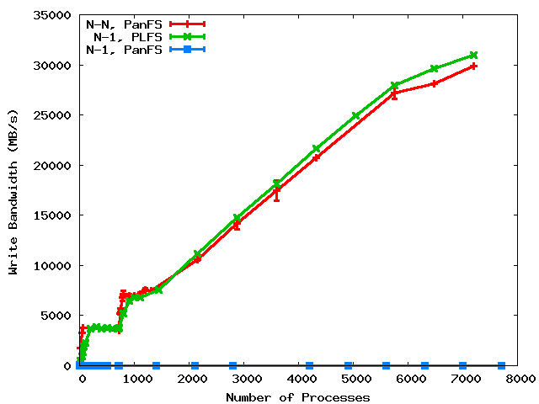
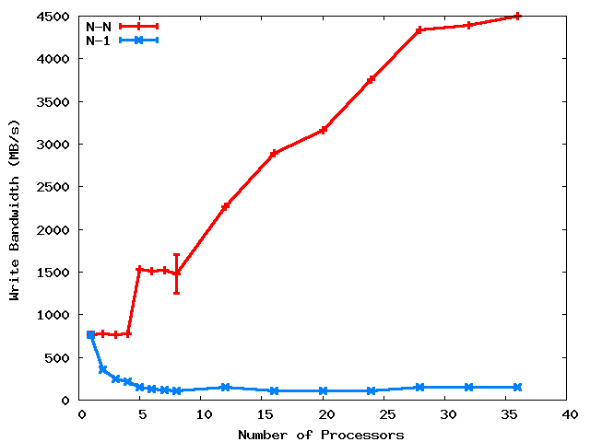
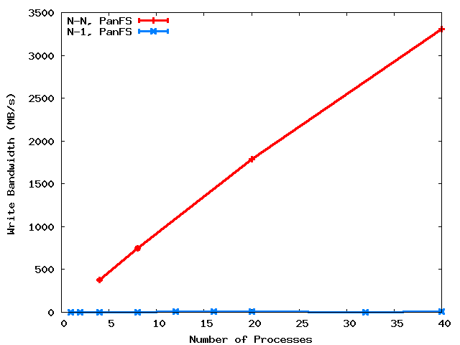
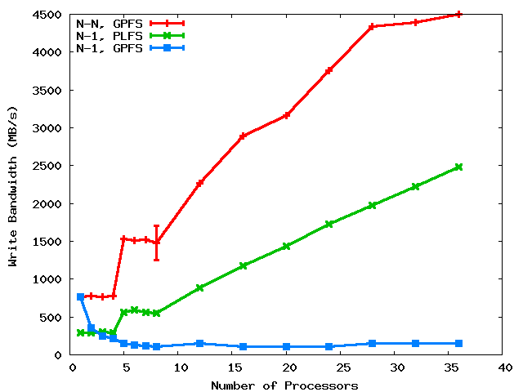
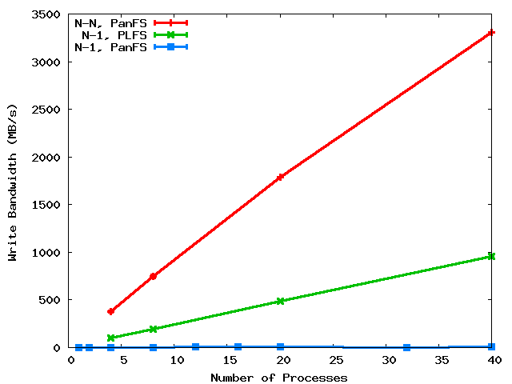
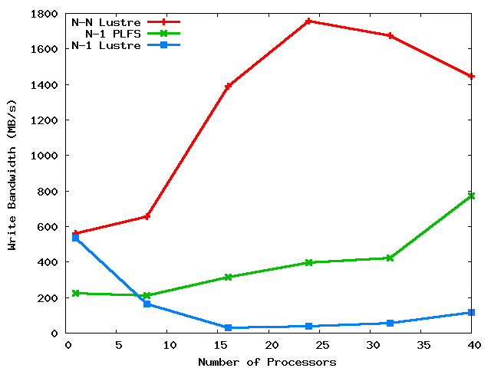
PLFS on three major HPC PFS’s
31 GB/s
LANL
PanFS
GPFS
25X
100X
3000X
at scale
PSC
Lustre
8X
Notes:
We compare to N-N because that’s the best we know how to do. Although it’s our goal, not achieving does not mean failure. Rather success is defined as beating N-1.

Slide 11
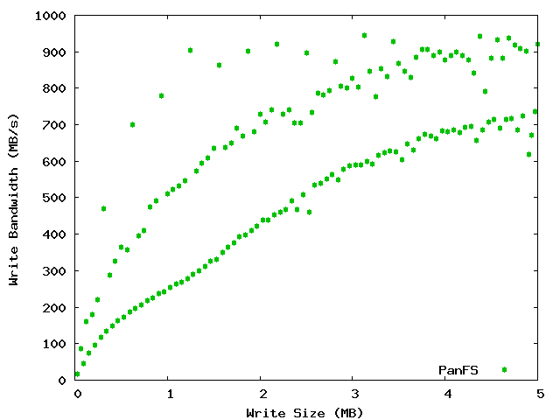
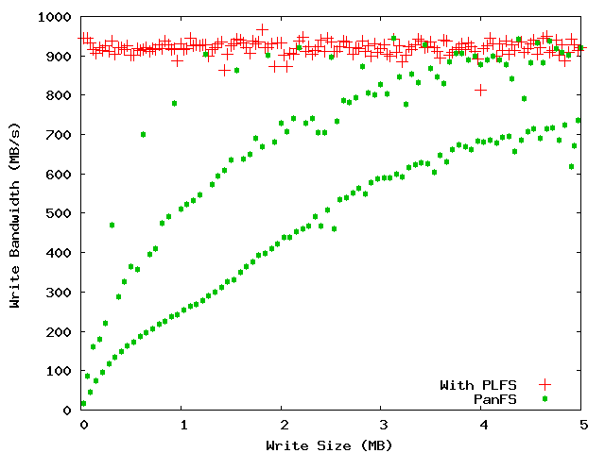
LBNL PatternIO benchmark
With PLFS
Without
PLFS
Unaligned
64k block aligned
Stripe aligned
PLFS makes alignment and blocksize irrelevant!

Slide 12
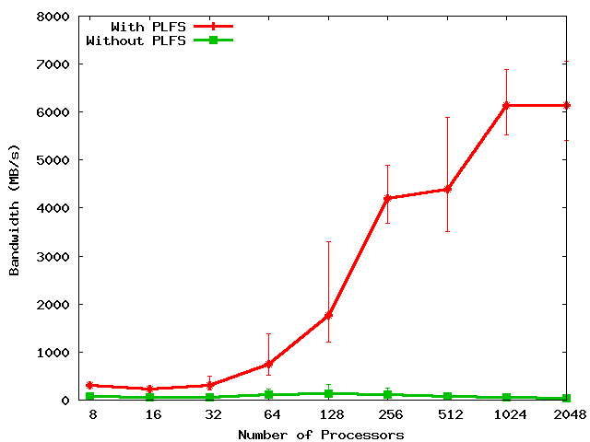
FLASH IO
150X
Notes:
Includes open and close times.
Set problem to do constant IO from each proc: From 0.5 GB to 62 GB.

Slide 13
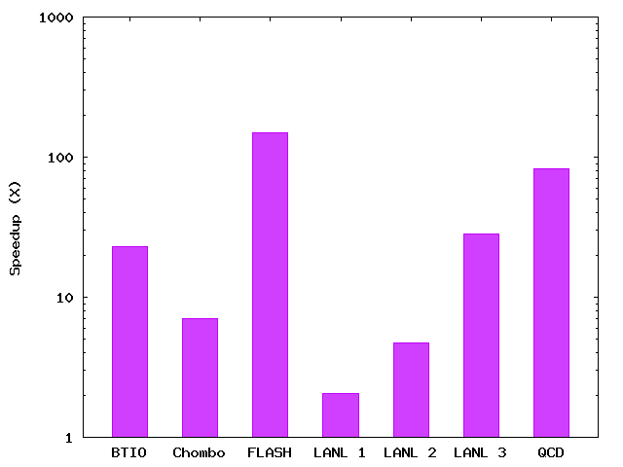
PLFS Checkpoint BW Summary
150X
83X
28X
23X
7X
5X
2X
Notes:
The height of the bars is roughly sorted by the scale of the experiment. The larger the scale, the larger the speedup. We expect comparable results as a function of scale (i.e. With more scale, all results will be like FLASH).

Slide 14
Other approaches
 | Interpostion Technique Used | No Extra Resources Used During | No Extra Resources Used After | Maintains Logical Format | Works with Unmodified Applications | Data Immediately Available
ADIOS | Library | Yes | Yes | Yes | No | Yes
stdck | FUSE | No (LD) | No (LD,N) | Yes | Yes | Yes
Neighbor | FUSE | No (M) | No (M,N) | Yes | Yes | No
Diskless | Library | No (M) | No (M) | No | No | Yes
ZEST | FUSE | No (RD) | No (RD) | No | No | No
PLFS | FUSE | Yes | Yes | Yes | Yes | Yes
KEY: LD = local disk, M = memory, N = network, RD = remote disk
Notes:
14

Slide 15
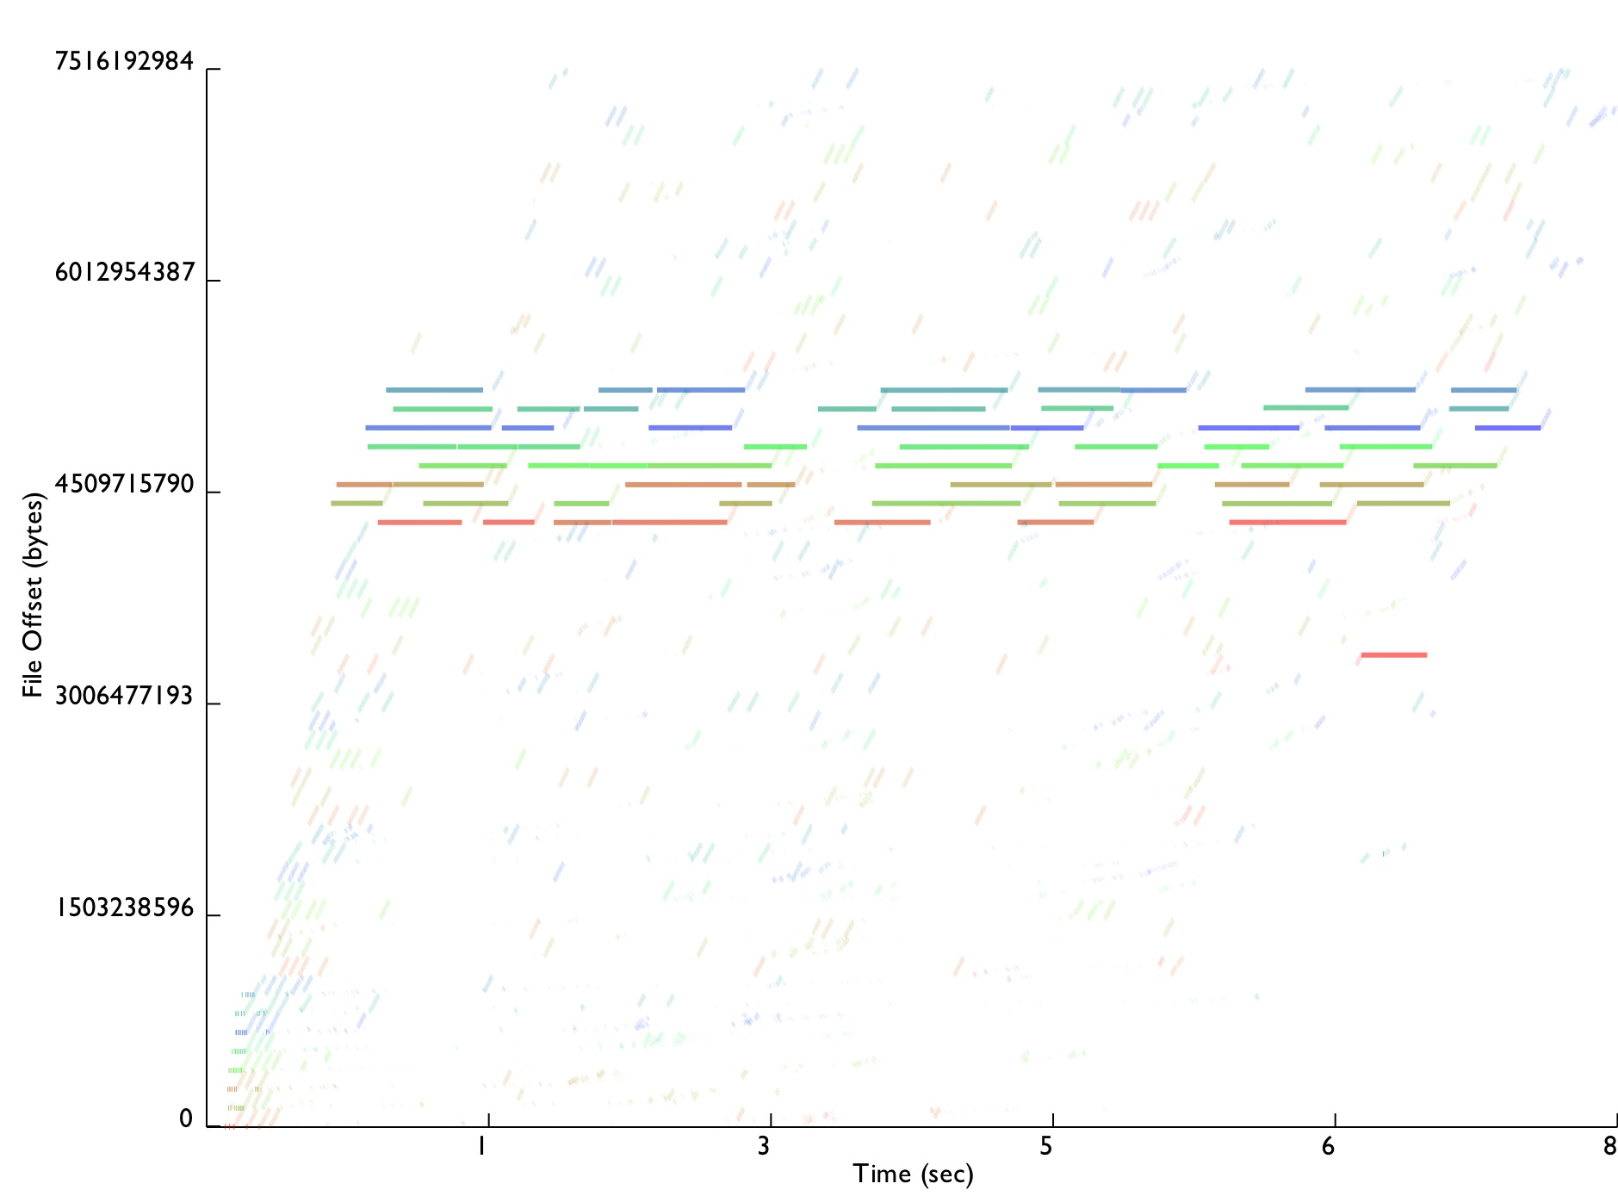
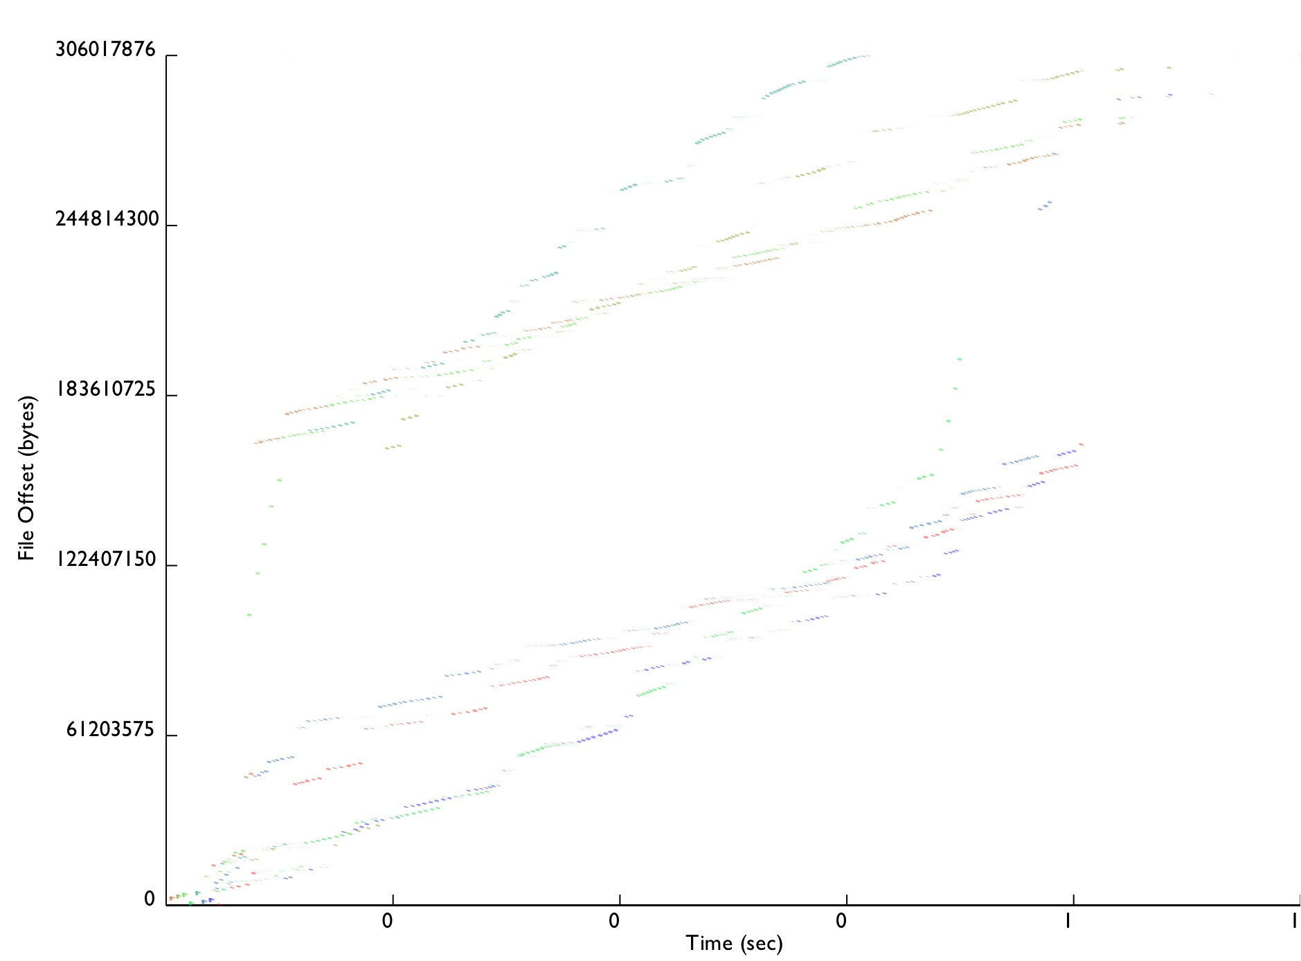
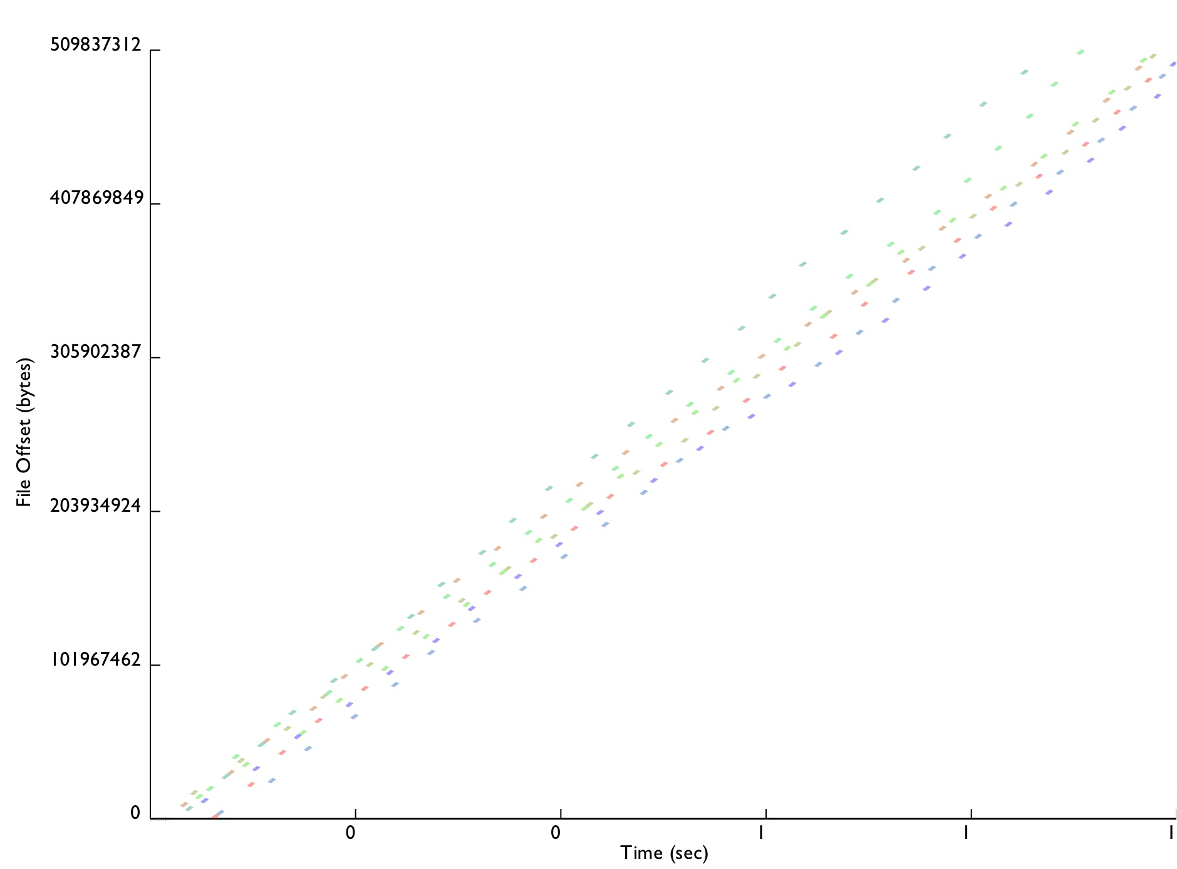
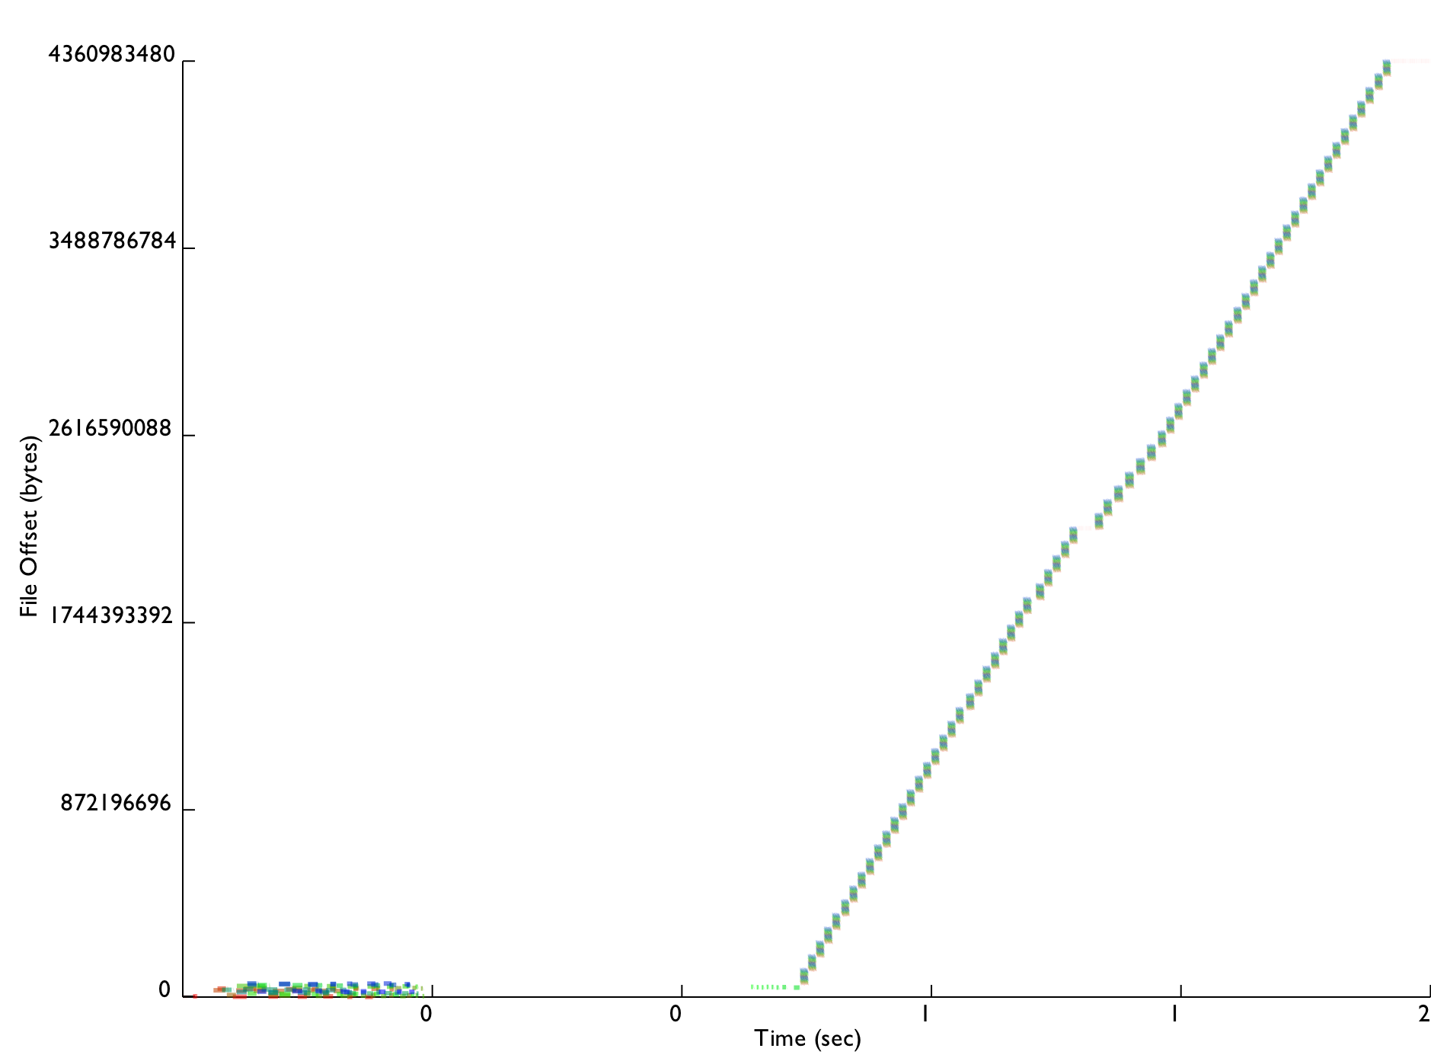
Conclusion
3000 lines of (soon to be open-source) C++
  Installed on Roadrunner for Open Science
  Moving onto other production machines next DST
Improves reads, does not slow down lookups
Enables easy tracing
  Traces from all studied benchmarks now published
Every real app tested significantly improved up to 300X
ORNL, LBNL, and PNNL very interested
LANL1
Chombo IO
FLASH IO
LANL2
http://www.pdsi-scidac.org/research/plfs.html

Slide 16
Trade-offs
Small file bandwidth due to open overhead
Single node bandwidth due to FUSE/PLFS overhead
Small job performance due to single node bandwidth
Reads in read-write mode
Possible reduction in read BW for strange read patterns
Overlapping writes are not ordered

Slide 17
Other Operations
Amdahl’s Law
  Writes are much better but
  Overall only improved if other ops not much much worse
Reads are actually also better
  Read all index files, aggregate into a global index
  Logical offsets are mapped to a physical offset
File lookups are about the same
  Uses cached data for closed files
  Stats the data files for files opened for writing
PLFS actually improves reads as well and doesn’t adversely affect file lookups!

Slide 18
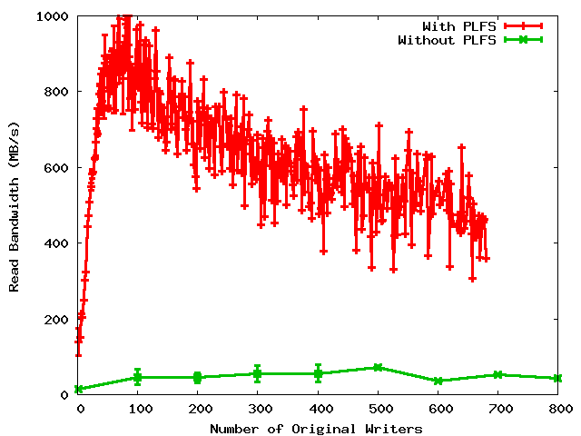
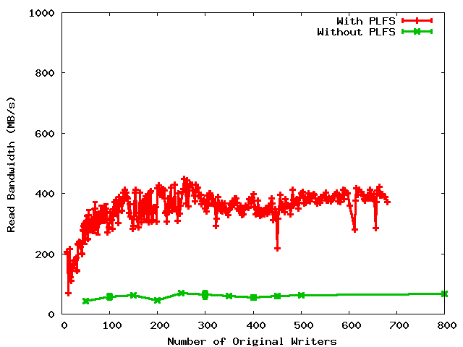
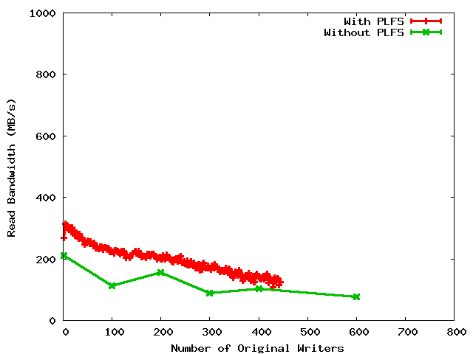
Read Bandwidths
Non-uniform restart
Uniform restart
Archiving

Slide 19
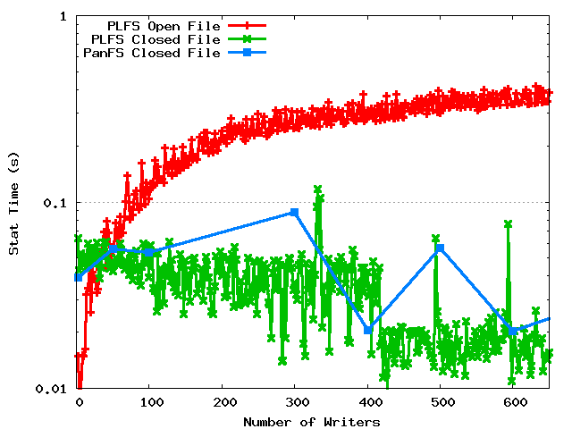
Metadata rates

Slide 20
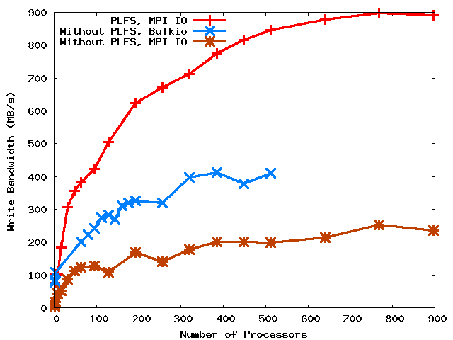
LANL 1
2X
4X

Slide 21
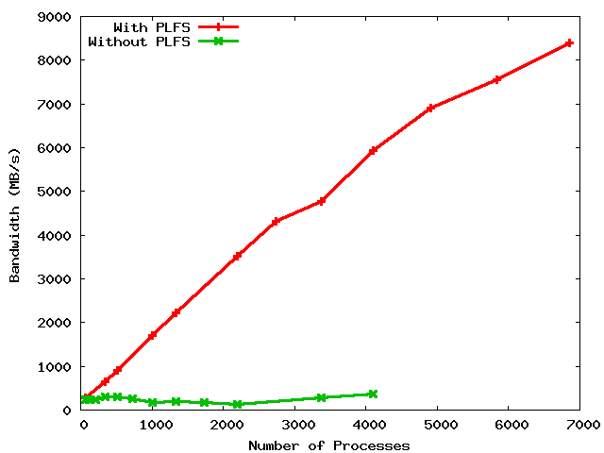
LANL3
8.5 GB/s
6.0 GB/s
28X ?
20X
300 MB/s
???

