Slide 1
PLFS: Parallel LFS
John Bent
Los Alamos National Labs

Slide 2
Parallel Apps do Parallel IO
Periodic checkpoint writes
Visualization writes
Writes are synchronized
Tens of thousands of synchronized writes can be difficult for the file system
Two most common write patterns
N-1 where N procs write to 1 shared file
N-N where N procs write to N non-shared files

Slide 3
N-N File IO

Slide 4
N-1 File IO

Slide 5
N-1 or N-N?
N-1 can be slow
Concurrency on files, objects, RAID groups can slow it down
Small and unaligned IO’s are particularly problematic
N-N much easier for the file-system
No concurrency at the file system (after the open)
Many fewer seeks
But N-1 does have some advantages
Archiving, managing
N-M restart
Visualization

Slide 6
Potential storage implications of N-to-1 strided
Process 1
Process 2
Process 3
Process 4
14
23
44
11
12
13
21
22
24
31
32
33
34
41
42
43
Notice every write is possibly a read/update/write since each write is a partial parity update. Notice that processes are serializing on their writes as well.
Parallel file
RAID Group 1
RAID Group 2
RAID Group 3

Slide 7
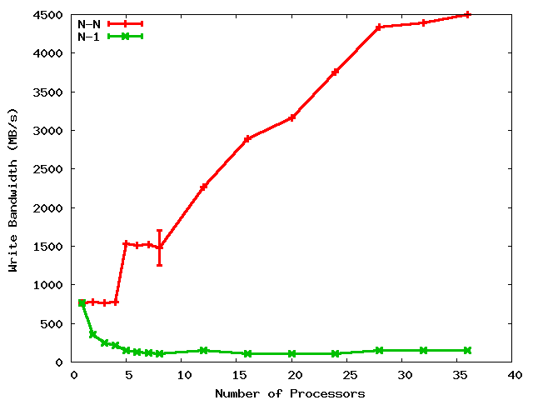
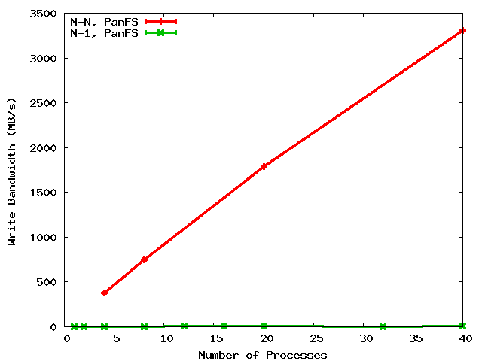
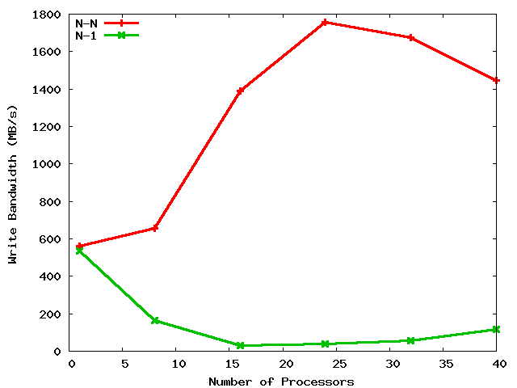
A Shared File is a Shared Problem
4.5 GB/s
LANL
PanFS
3.3 GB/s
LANL
GPFS
45X
330X
100 MB/s
10 MB/s
N-N
N-1
PSC
Lustre
1.8 GB/s
N-N cross graph comparisons not meaningful
N-1 on PanFS a little slower due to client parity which is a Good Thing
90X
20 MB/s

Slide 8
N-1 prominent at LANL
Several old codes use N-1 (over 50% of cycles)
Newly written codes still choosing N-1
2 of 8 open science applications on Roadrunner
NetCDF and HDF5 formatting libraries
Developers are aware of the N-1 problems
But are loathe to change to N-N
One application wrote 10K lines of code, bulkio, to try to improve N-1
N-1 also prominent elsewhere
At least 10 of 23 on the PIO benchmarks page are N-1
BTIO, FLASH IO, Chombo IO, QCD, etc.

Slide 9
Obvious solution
The problem?
Applications prefer N-1 but file systems prefer N-N
The solution?
Use interposition to convert N-1 to N-N
The challenge?
Low overhead (performance and resource)
User transparency (i.e. NO CODE REWRITING)
Portability
Our contribution? PLFS

Slide 10
PLFS converts N-1 to N-N
A FUSE file system interposed between app and PanFS
Maintains apps/users view of a single file
Reorganizes data on PanFS into multiple files, one per pid
All writing is log-structured (i.e. append only)
An index per file maps physical offsets to logical
Reads consult indices to locate data
The only difference visible to the app is that the write time goes way down!

Slide 11
PLFS / PanFS
131
132
279
281
132
148
host1
host2
host3
Application logical view matches PLFS virtual view
PLFS
/foo
/foo/
host1/
host2/
host3/
data.131
data.132
data.279
data.281
data.132
data.148
indx
indx
indx
Notes:
11

Slide 12
PLFS Evaluation
File Systems
GPFS
Lustre
Panfs
Synthetic Checkpoint Benchmarks
LANL MPI-IO test
NERSC Pattern-IO
Applications and IO Kernels
LANL1, LANL2, LANL3
Office of Science FLASH-IO benchmark with HDF5
Office of Science Chombo-IO benchmark with HDF5
NASA BT-IO benchmark
SciDAC QCD-QIO

Slide 13
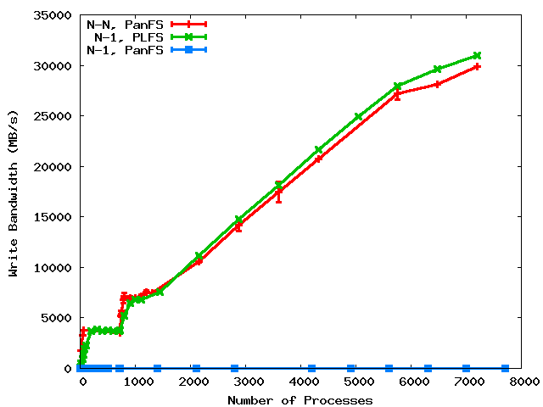
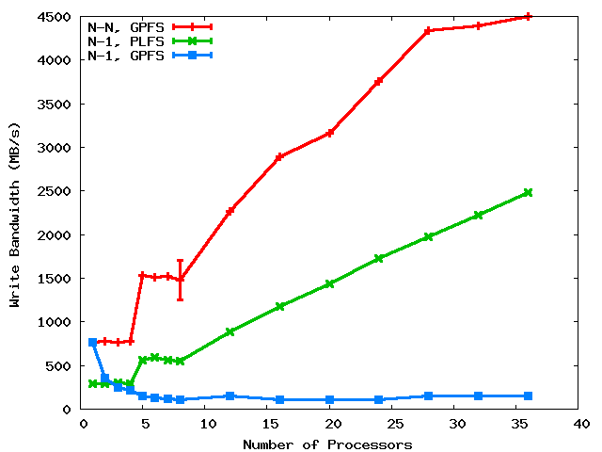
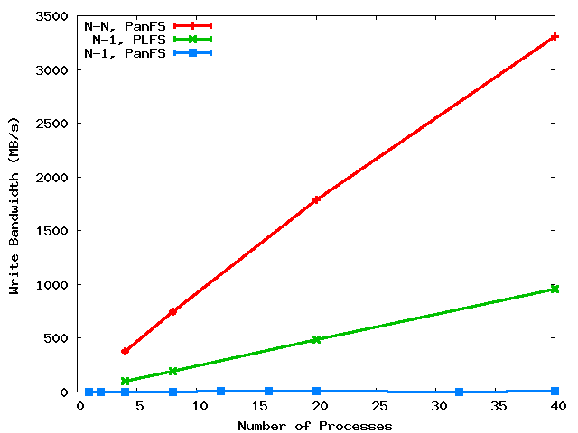
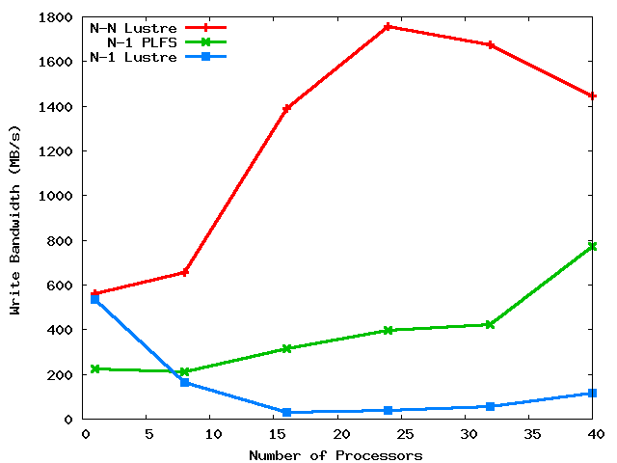
PLFS on three major HPC PFS’s
31 GB/s
LANL
PanFS
GPFS
25X
100X
3000X
at scale
PSC
Lustre
8X

Slide 14
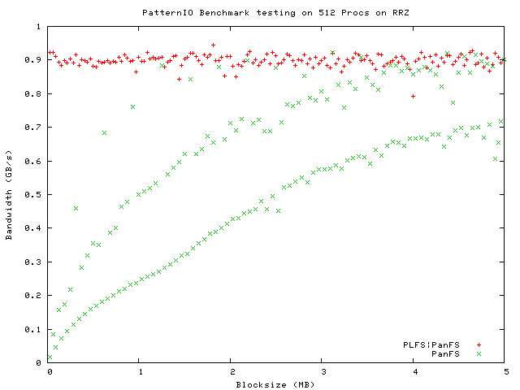
LBNL PatternIO benchmark
With PLFS
Without
PLFS
Unaligned
4k block aligned
Stripe aligned
PLFS makes alignment and blocksize irrelevant!

Slide 15
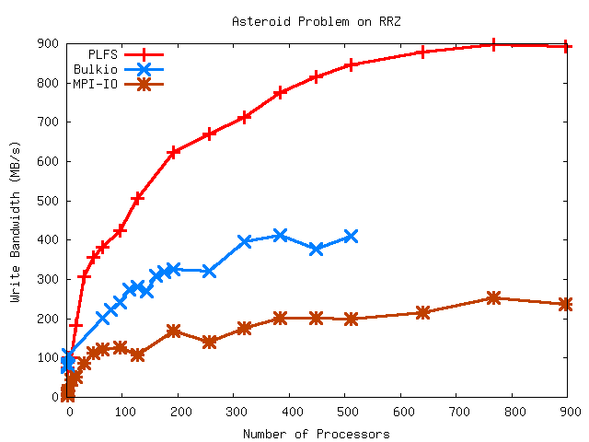
LANL2

Slide 16
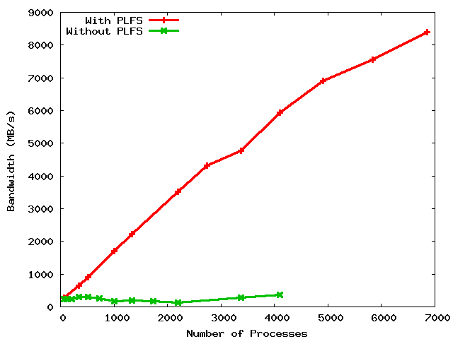
LANL3 on Roadrunner
8.5 GB/s
6.0 GB/s
28X ?
20X
300 MB/s
???

Slide 17
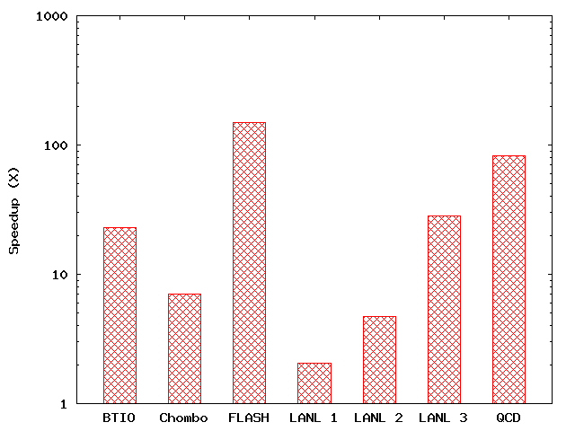
PLFS Checkpoint BW Summary
150X
83X
28X
23X
7X
5X
2X

Slide 18
Other Operations
Amdahl’s Law
Writes are much better but
Overall only improved if other ops not much much worse
Reads are actually also better
Read all index files, aggregate into a global index
Logical offsets are mapped to a physical offset
File lookups are about the same
Uses cached data for closed files
Stats the data files for files opened for writing
PLFS actually improves reads as well and doesn’t adversely affect file lookups!

Slide 19
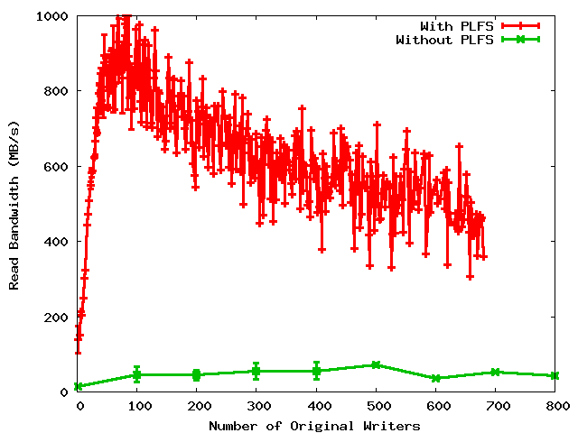
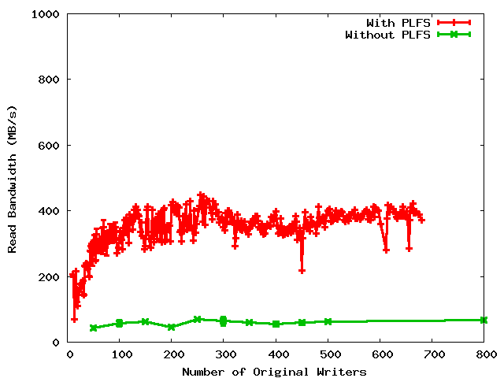
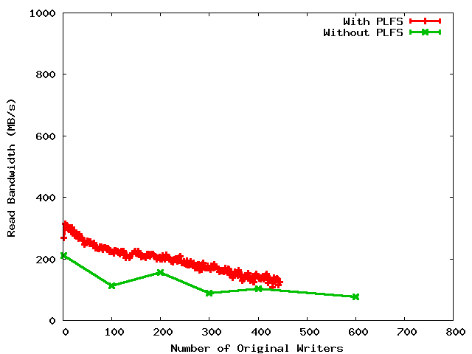
Read Bandwidths
Non-uniform restart
Uniform restart
Archiving

Slide 20
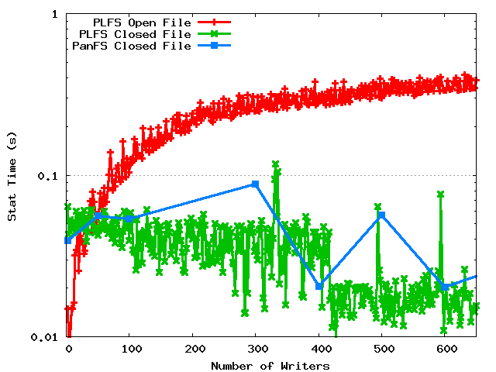
Metadata rates

Slide 21
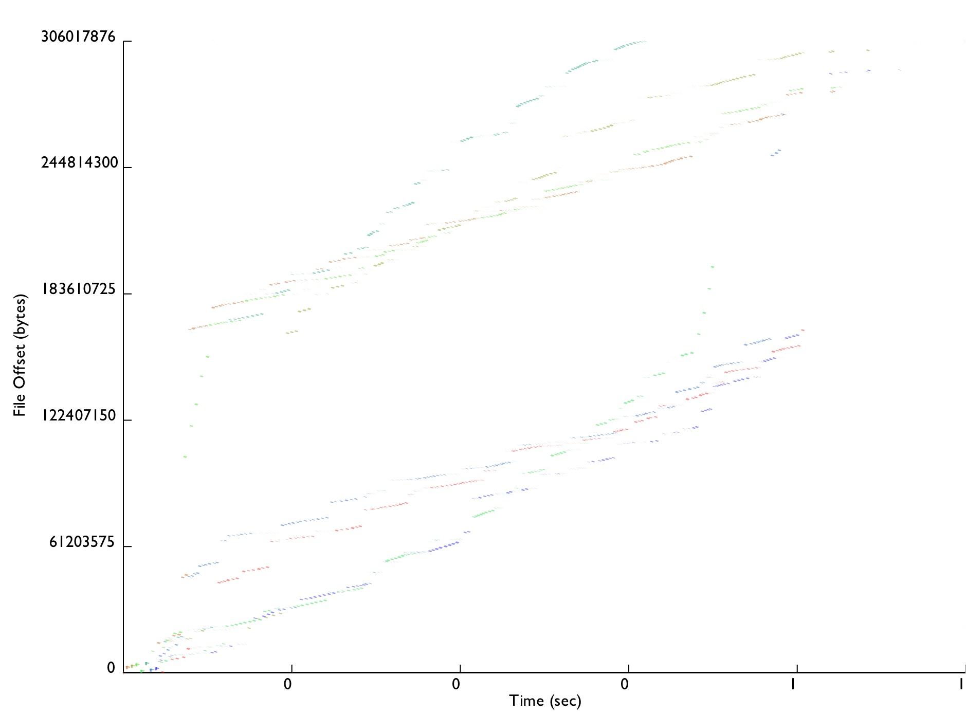
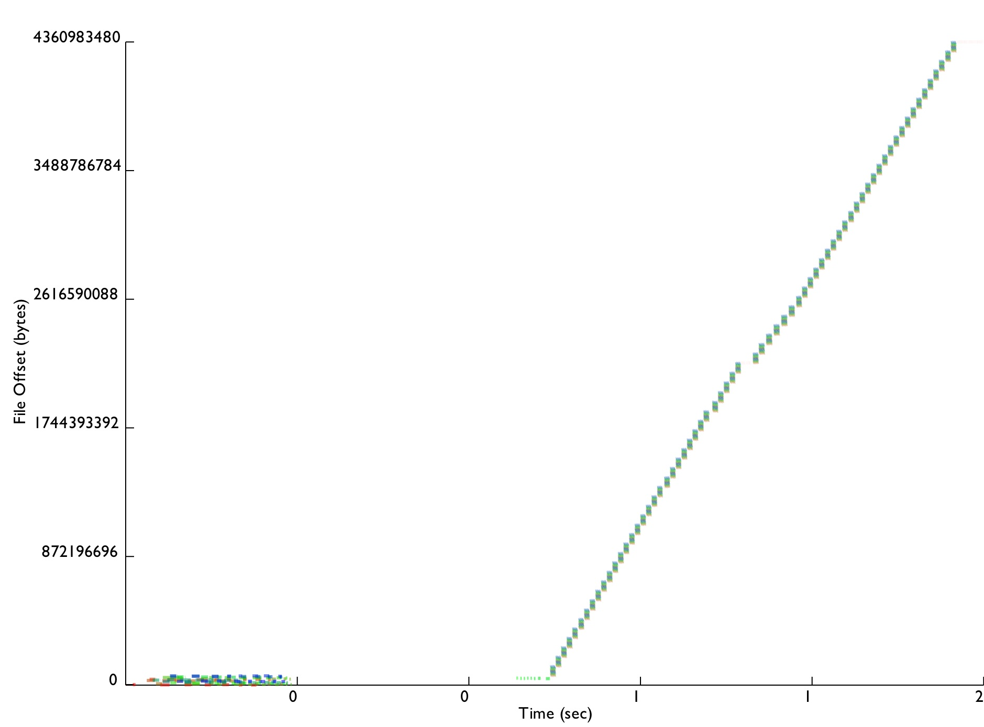

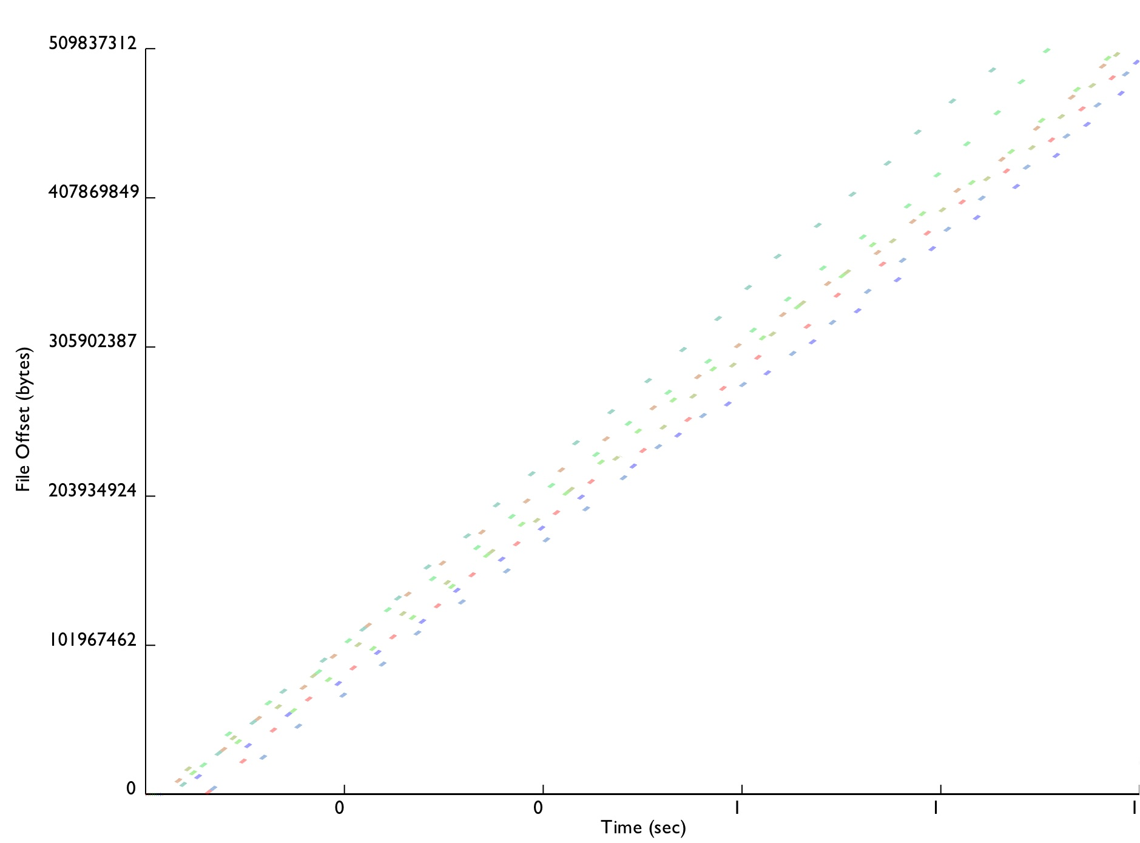
Conclusion
3000 lines of C++
Awaiting LANL permission to open-source
Installed on Roadrunner for Open Science
Moving onto other production machines next DST
PLFS also enables easy tracing
Traces from all studied benchmarks now published
Everything tested significantly improved up to 300X
ORNL, LBNL, and PNNL very interested
Chombo IO
LANL2
LANL1
FLASH IO

Slide 22
Related Work
 | Interpostion Technique Used | No Extra Resources Used During | No Extra Resources Used After | Maintains Logical Format | Works with Unmodified Applications | Data Immediately Available
ADIOS | Library | Yes | Yes | Yes | No | Yes
stdck | FUSE | No (LD) | No (LD,N) | Yes | Yes | Yes
Neighbor | FUSE | No (M) | No (M,N) | Yes | Yes | No
Diskless | Library | No (M) | No (M) | No | No | Yes
ZEST | FUSE | No (RD) | No (RD) | No | No | No
PLFS | FUSE | Yes | Yes | Yes | Yes | Yes
KEY: LD = local disk, M = memory, N = network, RD = remote disk
Notes:
22

Slide 23
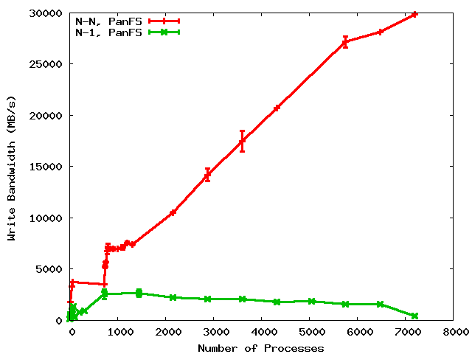
A Shared File is a Shared Problem
4.5 GB/s
LANL
PanFS
30 GB/s
GPFS
45X
300X
100 MB/s
100 MB/s
PSC
Lustre
1.8 GB/s
N-N is constant time to checkpoint
N-1 is about 8 seconds per node
Full system checkpoint on Roadrunner
N-N is half an hour
N-1 is 6 hours
18X
100 MB/s

