Slide 1
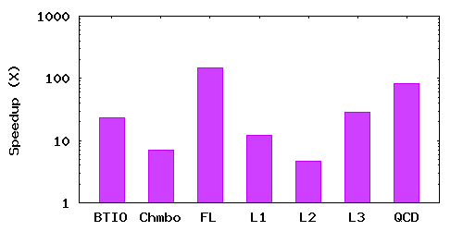
PLFS
150X
Decouples concurrency
App thinks N-1
Actually N-N on UPFS
Works with unmod’d apps
83X
23X
28X
12X
7X
5X
host1
host2
host3
PLFS Virtual
Layer
index
Physical Underlying Parallel File System
Notes:
1) Currently extending PLFS to address parallel open problem of N-N as well.
2) All benchmarks have traces available at http://institutes.lanl.gov/plfs/maps/.

