Slide 1
PLFS: Parallel LFS
John Bent, PhD University of Wisconsin 2005
currently at Los Alamos National Labs
Notes:
Last time I gave a talk at Wisconsin was for my defense so I’m expecting to be harassed and interrupted.

Slide 2
LANL Computational Science
Lots of tightly coupled parallel simulations
Weapons design and verification
Bioscience
Astrophysics
Require large computers w/ low latency interconnects
Currently at a petaflop
Simulations always want MORE resolution
Already designing exaflop machines
Notes:
Simulations would like to run on a single machine but would take forever so they split up problem and distribute across parallel machines

Slide 3
Roadrunner
LANL’s petaflop supercomputer
First to petaflop! (sort of)
3060 compute nodes
Quad-core opterons with cell accelerators
Low latency infiniband for IPC
High bandwidth ethernet for data storage
5 miles and multiple tons of networking cables
Notes:
The choice of cell accelerators was due to LANL being a one off market which therefore does not get its own R&D. Have to piggyback R&D for other markets – choose the biggest market out there – gaming. Cell accelerators make programming much harder. Relatively skinny pipe to move data into the cell chips so have to carefully identify which code sections are worth accelerating. Misprediction can actually slow down code performance.

Slide 4
Parallel Apps do Parallel IO
Large distributed systems are not free
Some component is always about to fail
Periodic checkpoint writes
Also visualization writes
Writes are synchronized
Tens of thousands of synchronized writes can be difficult for the file system
Two most common write patterns
N-1 where N procs write to 1 shared file
N-N where N procs write to N non-shared files

Slide 5
N-N File IO
N-1 Strided File IO
N-1 Segmented File IO

Slide 6
Checkpoint Patterns
N-N
Writes and reads easy for file system
Opens can be hard
Hard for application and user
Archiving, non uniform restart, viz, etc.
N-1 Segmented
Writes and reads slightly harder for FS
Opens easier
A little easier for the application and user
Rare in practice
N-1 Strided
Writes and reads very hard
Easy for application and user
Common pattern at LANL and elsewhere

Slide 7
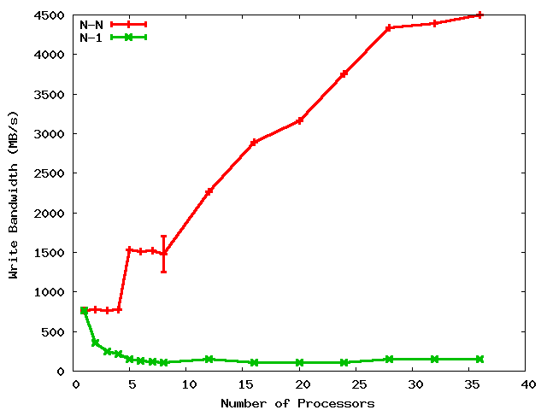
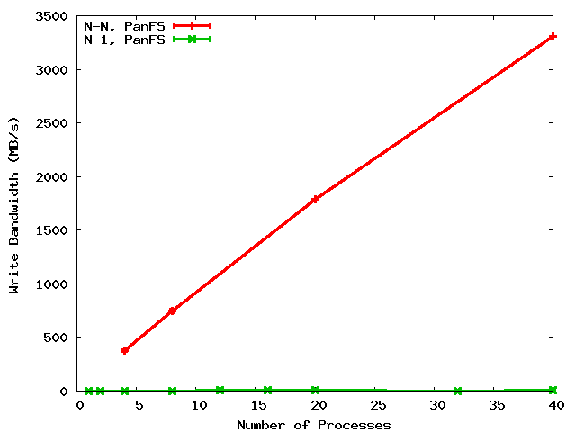
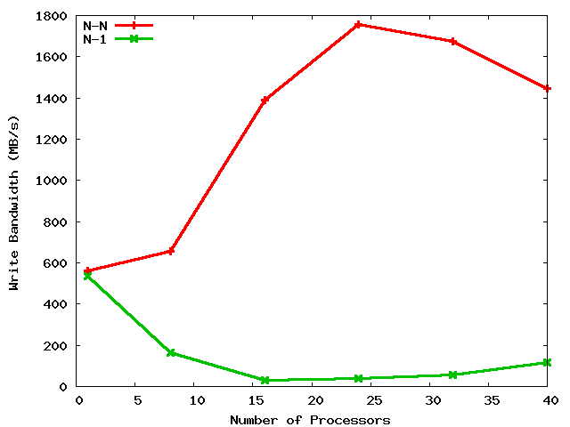
A Shared File is a Shared Problem
4.5 GB/s
LANL
PanFS
3.3 GB/s
LANL
GPFS
45X
330X
100 MB/s
10 MB/s
N-N
N-1
PSC
Lustre
1.8 GB/s
Cross graph comparisons not meaningful
90X
20 MB/s
Notes:
When discussing this for DOE HQ, discuss why PanFS is slower for N-1. When discussing this for ORNL, say “You know the problem in Lustre; you discussed it in your Exploiting paper. It’s locks. Also alignment is a problem. Locks are also the problem in GPFS. Panasas also has “locks,” they call them capabilities, but they allow you to turn them off. So what’s the problem in PanFS?” Next slide.

Slide 8
Potential PanFS storage implications of N-1 strided
Process 1
Process 2
Process 3
Process 4
14
23
44
11
12
13
21
22
24
31
32
33
34
41
42
43
Parallel file
RAID Group 1
RAID Group 2
RAID Group 3
Notes:
Also, alignment and locking are problems. The problem in PanFS is client parity. Client parity is a good thing for scalable rebuild and therefore availability. But it makes N-1 strided hard.

Slide 9
N-1 is prominent
Several old LANL codes use N-1 (over 50% of cycles)
Newly written codes still choosing N-1
2 of 8 open science applications on Roadrunner
NetCDF and HDF5 formatting libraries
N-1 also prominent elsewhere
At least 10 of 23 on the PIO benchmarks page are N-1
BTIO, FLASH IO, Chombo IO, QCD, etc. (GTC?)

Slide 10
Obvious solution: Convert N-N into N-1
But many applications won’t do it
Archiving, mgmt, visualization, non-uniform restart
Developers are aware of the N-1 problems
But are loathe to change to N-N
One app wrote 10K lines of code, bulkio, to try to improve N-1
If the apps won’t do it, interposition can
Desirable characteristics
Low overhead (performance and resource)
User transparency (i.e. NO CODE REWRITING)
Portable and maintainable
Our contribution: PLFS

Slide 11
Outline
Introduction
PLFS Design and Implementation
Evaluation
Trade-offs
Related Work
Future Work and Conclusions
Other outstanding problems in HPC

Slide 12
PLFS: Parallel Log-structured FS
Virtual interposition file system using FUSE
Transparently rearranges N-1 checkpoints into N files
Very similar to Lustre Split Writing
Two main optimizations
Decouples concurrent access
Append-only writing

Slide 13
Decouples Logical from Physical
131
132
279
281
132
148
host1
host2
host3
PLFS Virtual Layer
/foo
/foo/
host1/
host2/
host3/
data.131
data.132
data.279
data.281
data.132
data.148
indx
indx
indx
Physical Underlying Parallel File System
Notes:
13

Slide 14
Data Reorganization in PLFS
All processes open file, foo
Each PLFS mkdir’s foo
Each PLFS mkdir’s foo/hostN
Processes start writing to file
PLFS opens a data file per process and appends write data to them
PLFS opens an index file per node and appends metadata to them
131
132
279
281
PLFS (FUSE)
PLFS (FUSE)
“PLFS Container”
/foo/
/host1/
/host2/
/data.131
/data.132
/index
/data.279
/data.281
/index
Physical Underlying Parallel File System
Notes:
14

Slide 15
PLFS Index Record
Data ID
Phys Off
Len
TS Begin
TS End
???
Sort records by physical offsets
Lookup map
Sort records by timestamps
IO Trace

Slide 16
Other operations in PLFS
Writes are much better but
Overall only improved if other ops not much much worse
Reads
Construct a global index by aggregating all the index files
Map logical offsets to a physical offset within a data file
Overlapping writes are undefined
Chmods, Chowns, Chgrps, Utimes, etc.
Use a container/access file
Stats
Pull permissions, ownership from access file
Construct a global index to get file capacity and file size
!!!! Constructing a global index can be SLOW !!!!

Slide 17
PLFS Optimizations
Reads
When possible (i.e. O_RDONLY), construct global index on the open, reuse for each read call
Stats
On close, create a container/metadata/host.B.L.T
B = blocks of capacity
L = last offset (i.e. file size)
T = timestamp of last write
Stat can be implemented with a readdir
Invalidate cache on subsequent re-opens

Slide 18
Thoroughly Evaluated
File Systems
GPFS
Lustre
Panfs
Synthetic Checkpoint Benchmarks
LANL MPI-IO test
NERSC Pattern-IO
Applications and IO Kernels
LANL1, LANL2, LANL3
Office of Science
FLASH-IO benchmark with HDF5
Chombo-IO benchmark with HDF5
QCD QIO
NASA BT-IO benchmark

Slide 19
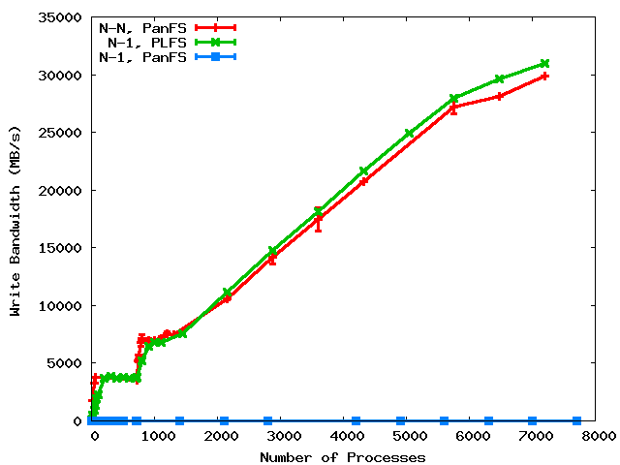
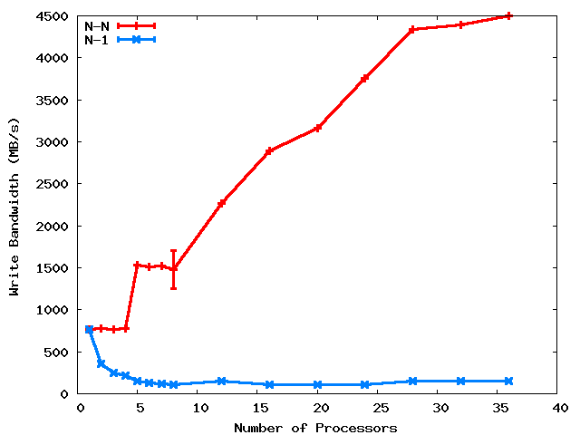
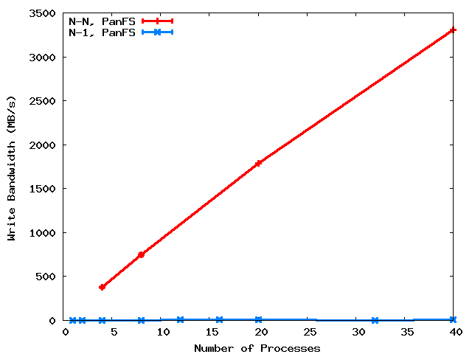
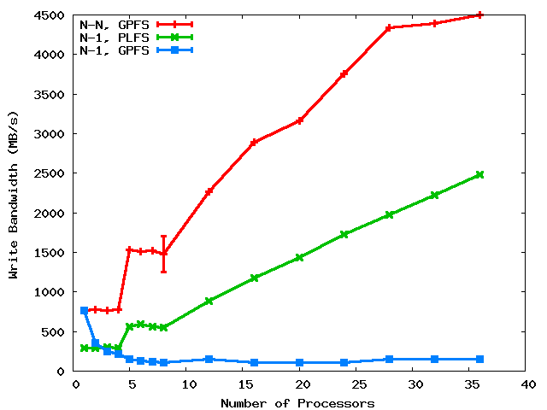
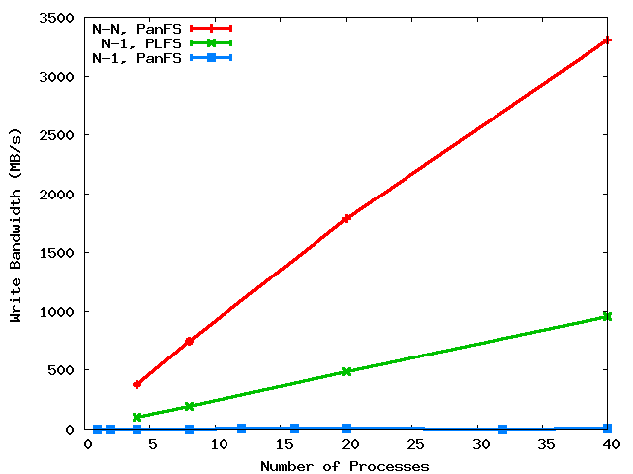

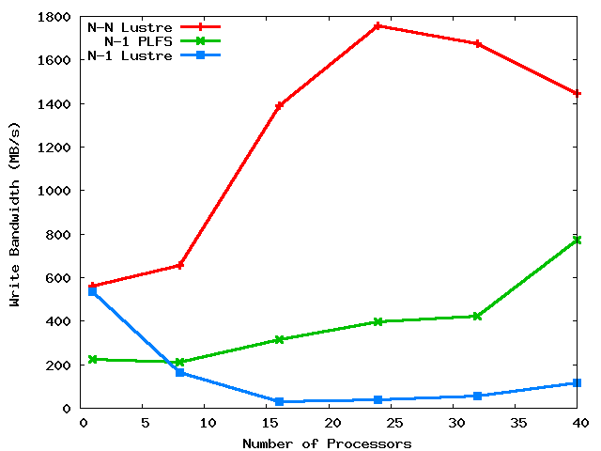
PLFS on three major HPC PFS’s
31 GB/s
LANL
PanFS
GPFS
25X
100X
3000X
at scale
PSC
Lustre
8X
Notes:
We compare to N-N because that’s the best we know how to do. Although it’s our goal, not achieving does not mean failure. Rather success is defined as beating N-1.

Slide 20
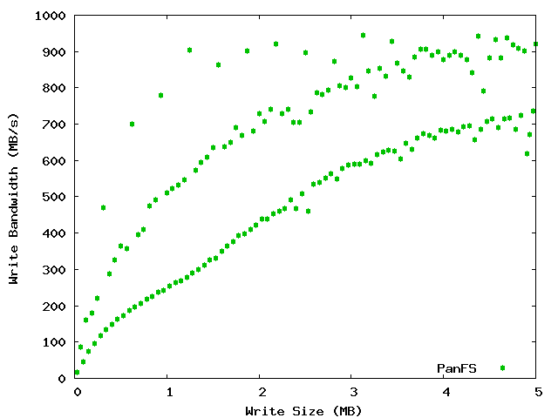
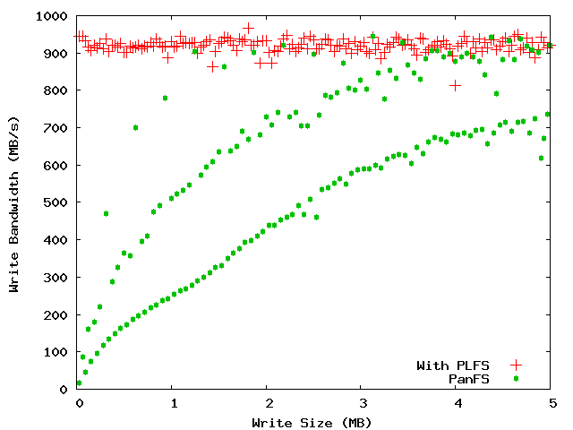
LBNL PatternIO benchmark
With PLFS
Without
PLFS
Unaligned
64k block aligned
Stripe aligned
PLFS makes alignment and blocksize irrelevant!

Slide 21
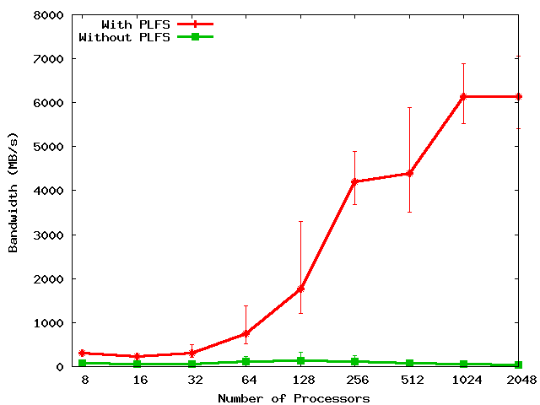
FLASH IO
150X
Notes:
Includes open and close times.
Set problem to do constant IO from each proc: From 0.5 GB to 62 GB.

Slide 22
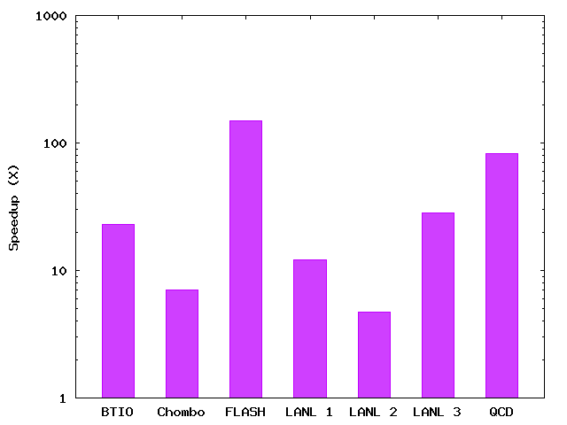
PLFS Checkpoint BW Summary
150X
83X
28X
23X
12X
7X
5X
Notes:
The height of the bars is roughly sorted by the scale of the experiment. The larger the scale, the larger the speedup. We expect comparable results as a function of scale (i.e. With more scale, all results will be like FLASH).

Slide 23
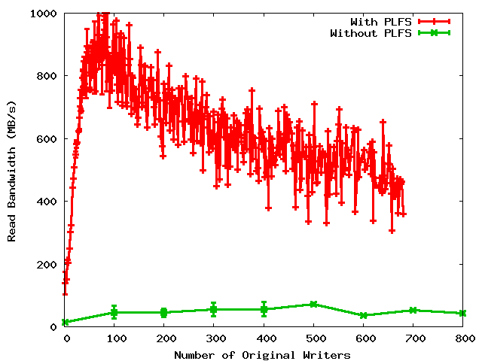
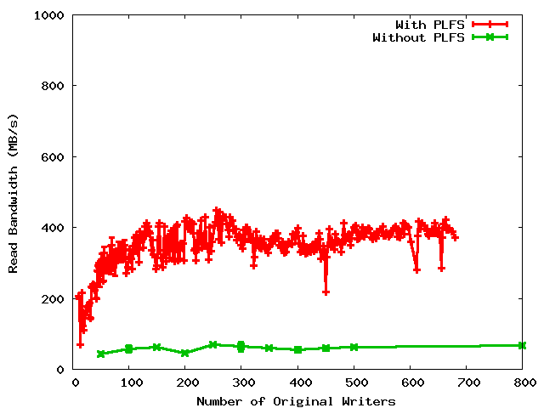
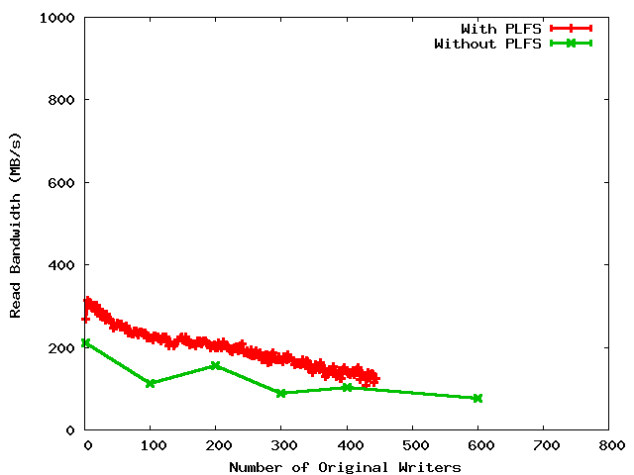
Read Bandwidths
Non-uniform restart
Uniform restart
Archiving

Slide 24
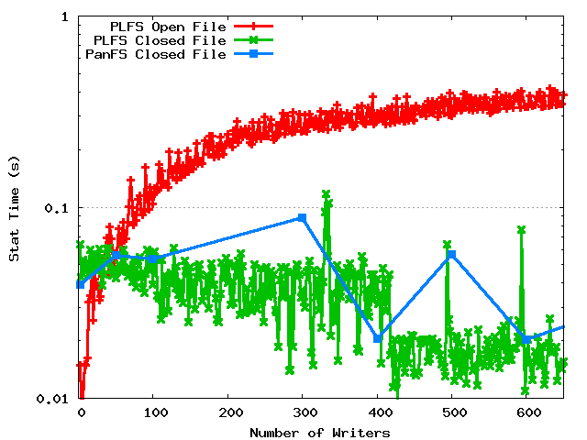
Metadata rates

Slide 25
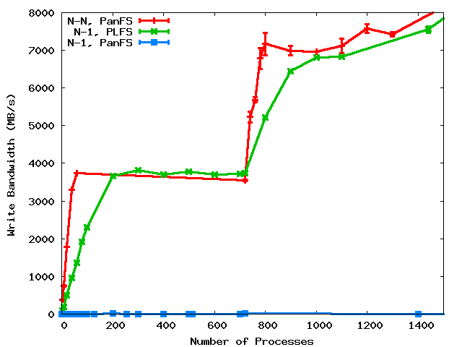
PLFS/FUSE Overhead
Notes:
We compare to N-N because that’s the best we know how to do. Although it’s our goal, not achieving does not mean failure. Rather success is defined as beating N-1.

Slide 26
Trade-offs
Small file bandwidth due to open overhead
Single node bandwidth due to FUSE/PLFS overhead
Small job performance due to single node bandwidth
Reads in read-write mode
Possible reduction in read BW for strange read patterns
Overlapping writes are not ordered
Shift complexity to N-N challenge

Slide 27
Current and Future Work
Directory striping to ameliorate N-N parallel open
Overhead graph shows
Problem for small jobs
Lots of idle CPU for large jobs . . .
Add compression to index record
Add checksums to index record
Add extensible metadata to index record
Data ID
Phys Off
Len
TS Begin
TS End
???

Slide 28
 | Interpostion Technique Used | No Extra Resources Used During | No Extra Resources Used After | Maintains Logical Format | Works with Unmodified Applications | Data Immediately Available | Parallel Filesystem Agnostic
ADIOS | Library | Yes | Yes | Yes | No | Yes | Yes
stdck | FUSE | No (LD) | No (LD,N) | Yes | Yes | Yes | Yes
Neighbor | FUSE | No (M) | No (M,N) | Yes | Yes | No | Yes
Diskless | Library | No (M) | No (M) | No | No | Yes | Yes
ZEST | FUSE | No (RD) | No (RD) | No | No | No | No
Lustre Split Writ | Library | Yes | Yes | No/Yes | Yes | Yes | No
PLFS | FUSE | Yes | Yes | Yes | Yes | Yes | Yes
KEY: LD = local disk, M = memory, N = network, RD = remote disk
Notes:
28

Slide 29
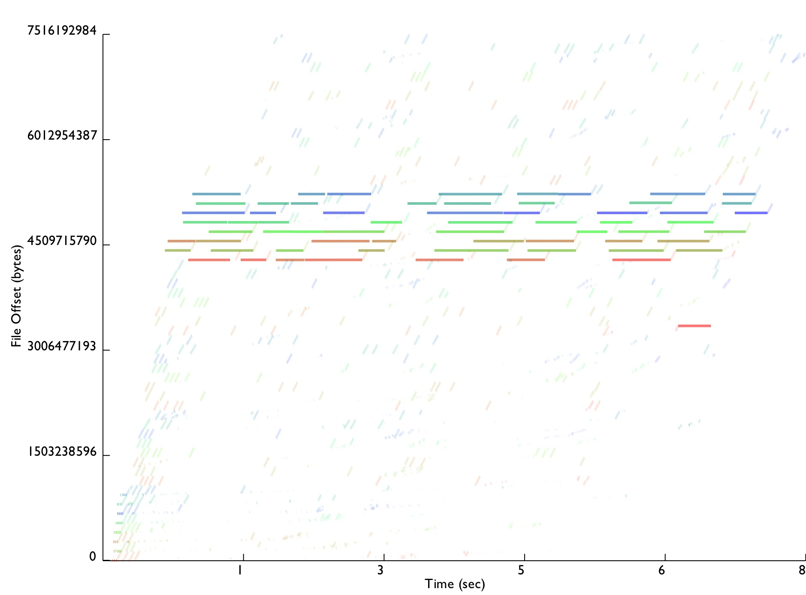
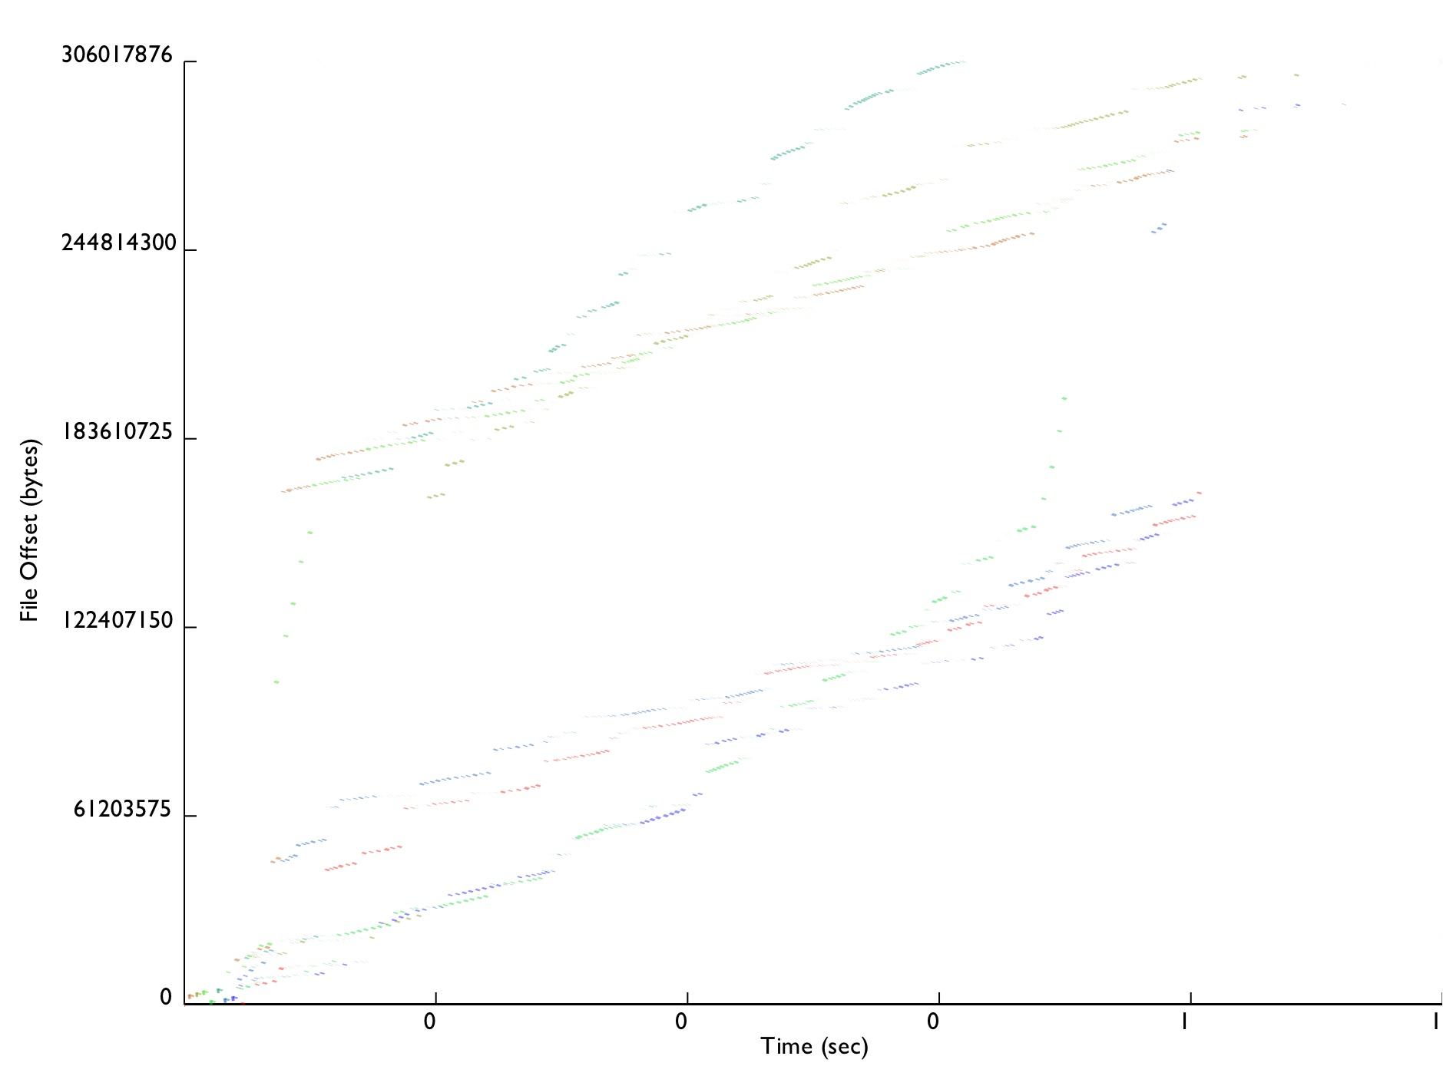
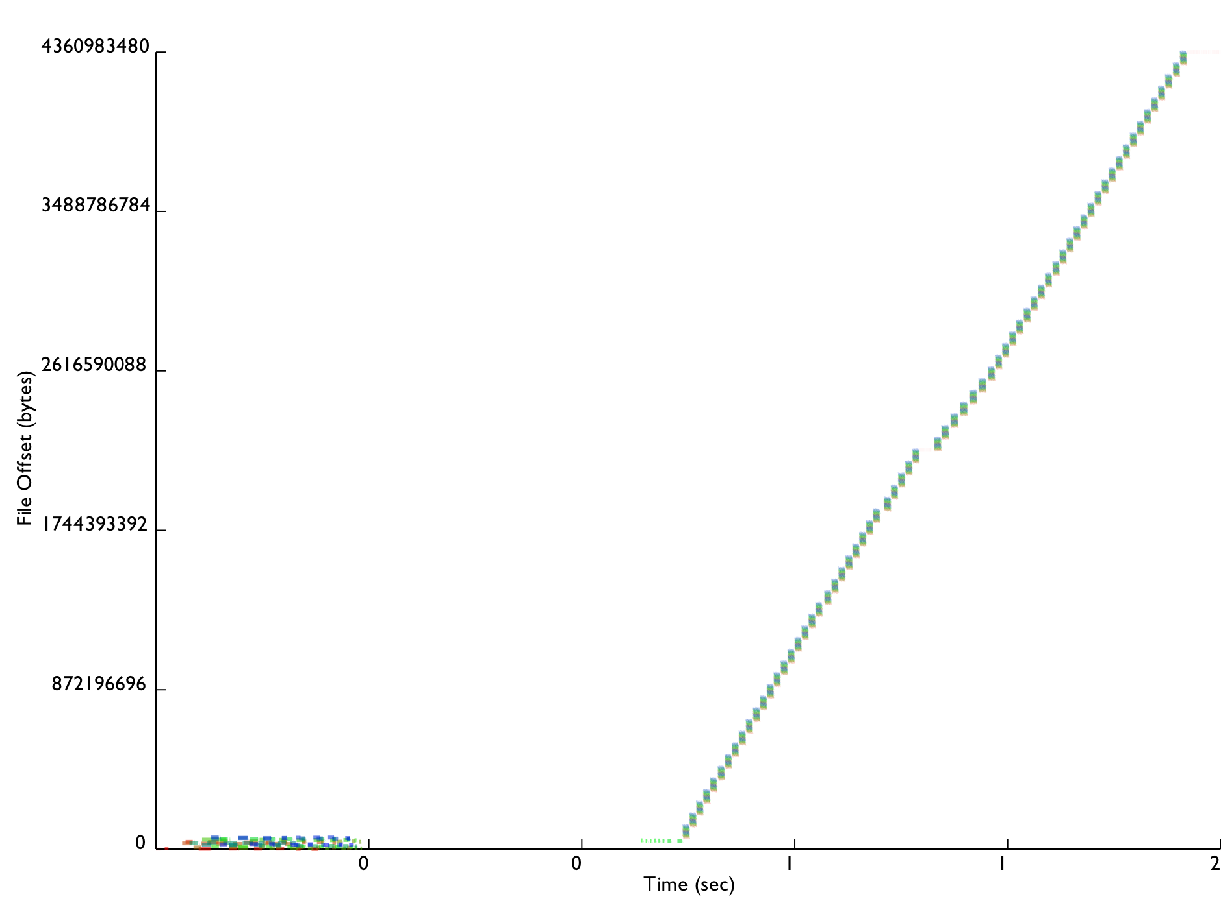
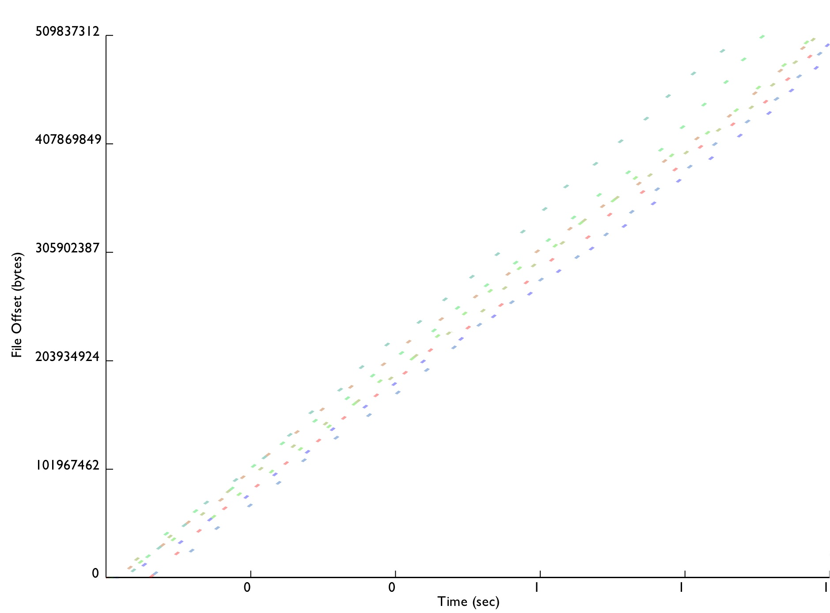
PLFS Conclusion
3000 lines of (soon to be open-source) C++
Installed on Roadrunner for Open Science
Moving onto other production machines next DST
Improves reads, does not slow down lookups
Enables easy tracing
Traces from all studied benchmarks now published
Every real app tested significantly improved up to 300X
Full paper available at http://institutes.lanl.gov/plfs
LANL1
Chombo IO
LANL2
FLASH IO

Slide 30
Outstanding HPC Problems
Parallel open
Resiliency
Schedulers
Scalable IO and MPI initialization
Silent data corruption
Programming models
johnbent@lanl.gov

