Slide 1

Map reduce vs Apache spark

Slide 2
Map Reduce
MapReduce is a programming model and framework for processing large datasets in parallel on a cluster of computers.
It was originally developed by Google to support large-scale distributed computing over thousands of servers.
MapReduce divides the processing of data into two main stages: the Map stage and the Reduce stage.
In the Map stage, data is read from an input source and transformed into a key-value pair format.
The key-value pairs generated by the Map stage are then shuffled and sorted by key, and grouped into partitions.
In the Reduce stage, each partition is processed independently by a reducer function that aggregates the key-value pairs for that partition.
MapReduce provides fault tolerance by automatically replicating data across multiple nodes, and re-executing failed tasks on other nodes.
MapReduce is designed to be highly scalable, and can handle petabytes of data by distributing the processing across multiple nodes.

Slide 3
Apache Spark
Apache Spark is an open-source, distributed computing system used for processing large amounts of data.
Spark provides a unified platform for batch processing, stream processing, machine learning, and graph processing.
Spark is built on top of Hadoop Distributed File System (HDFS) and can also integrate with other data sources like Cassandra, HBase, and Amazon S3.
The main programming interface for Spark is in Scala, but it also supports Java, Python, and R.
Spark provides a high-level API for data processing called Spark SQL, which allows for SQL-like querying of data stored in Spark.
Spark's main abstraction is the Resilient Distributed Dataset (RDD), which allows for parallel processing of data across a cluster of computers.
Spark provides a variety of machine learning libraries, including MLlib, which can be used for tasks such as classification, regression, clustering, and collaborative filtering.
Spark also has a graph processing library called GraphX, which can be used for analyzing graph-structured data.
Spark provides a cluster manager called Spark Standalone, but can also integrate with other cluster managers like Apache Mesos and Hadoop YARN.
Spark is known for its fast processing speed due to its ability to cache data in memory and perform computations in parallel across a cluster.

Slide 4
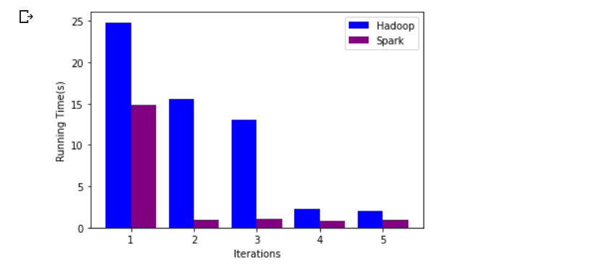
Analysis
Plot Running time comparison with respect to iterations Yearwise carrier delay from 2003-2010

Slide 5
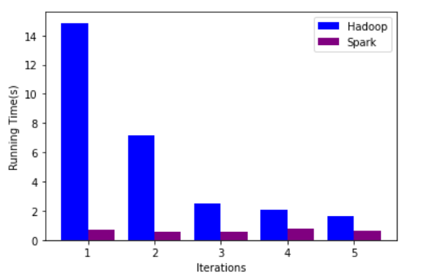
Plot Running time comparison with respect to iterations Yearwise NAS delay from 2003-2010

Slide 6
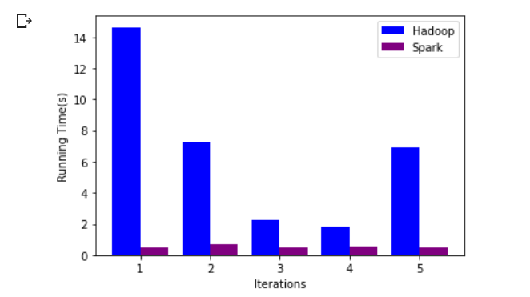
Plot Running time comparison with respect to iterations Yearwise Weather delay from 2003-2010

Slide 7
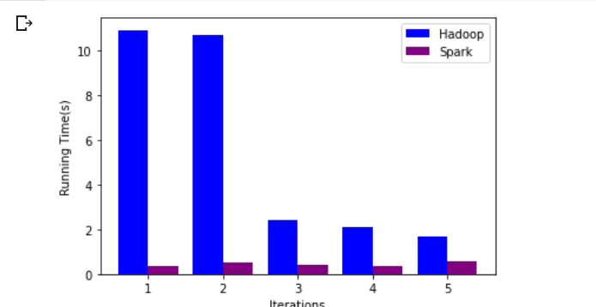
Plot Running time comparison with respect to iterations Yearwise late aircraft delay from 2003-2010

Slide 8
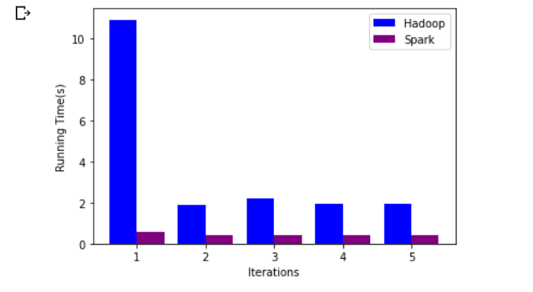
Plot Running time comparison with respect to iterations Yearwise security delay from 2003-2010

Slide 9
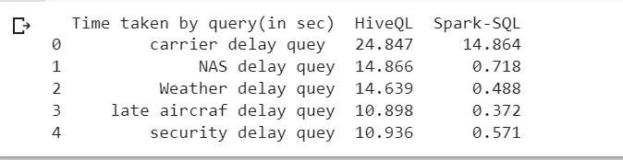
data frame for 1st iteration time for different queries in both HiveQL and Spark-SQL

Slide 10
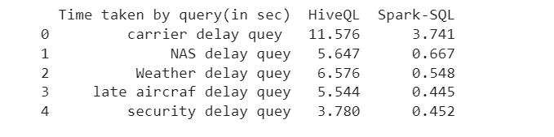
data frame for average time taken in iterations for different queries in both HiveQL and Spark-SQL

Slide 11
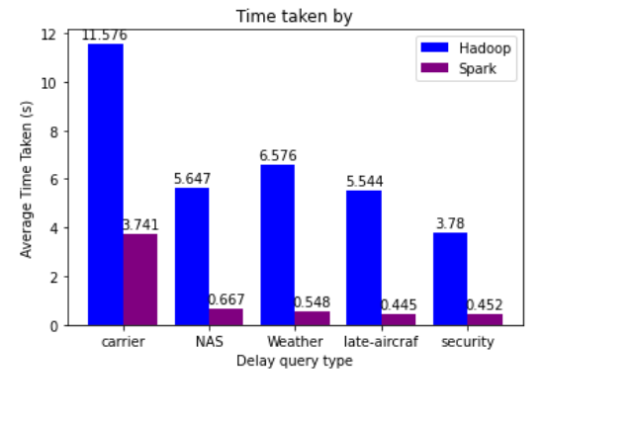
Clustered chart for average time taken in iterations for different queries in both HiveQL and Spark-SQL

Slide 12
Comparison based on “Ease of Use” and “Fast Process”
Framework | Ease of Use | Fast Processing
HiveQL and Hadoop Map reduce. | We have to create a table for every dataset csv/text file to do the queries. Need to write to disk. | slow for iterative processing
Spark SQL and Apache Spark | No need to do that. Spark-SQL stores the data in memory while processing | Efficient for both batch and iterative processing due to in-memory data processing model

Slide 13
Conclusion
. Spark-SQL + Apache Spark is way faster and easy to use compared to HiveQL + Hadoop MapReduce :
In-Memory Processing: Spark-SQL stores the data in memory while processing, whereas HiveQL writes intermediate results to disk. This allows Spark-SQL to perform operations faster and more efficiently.
Distributed Processing: Spark-SQL uses distributed processing, which allows it to process data in parallel across multiple nodes. HiveQL, on the other hand, is designed for batch processing and cannot perform parallel processing as efficiently.
Execution Engine: Spark-SQL uses a faster execution engine than HiveQL. It uses a DAG (Directed Acyclic Graph) engine, which optimizes queries and executes them more efficiently.
Caching: Spark-SQL allows caching of data, which means that frequently accessed data can be stored in memory for faster access. This is not possible with HiveQL.
Overall, Spark-SQL is designed to be faster and more efficient than HiveQL, particularly for processing large amounts of data.

