Slide 1
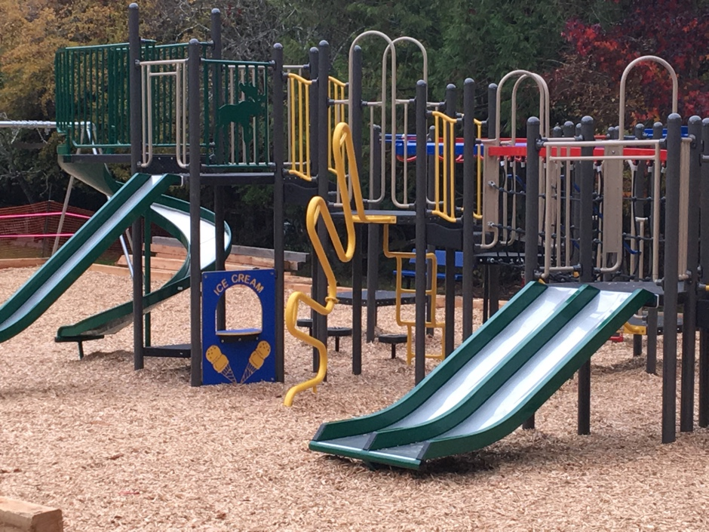
Saturna Island Parks and Recreation Commission (SIPRC) Community Survey

Slide 2
Saturna Island Parks and Recreation Commission (SIPRC) Community Survey
SIPRC Mandate
The SIPRC is funded by the CRD (with your tax dollars) and is responsible for planning and supporting recreation programs as well as acquiring, developing, operating and maintaining community parks on Saturna Island. Included in the SIPRC mandate is responsibility to construct, maintain and operate buildings, park trails and playgrounds on community park land. SIPRC provides funding support to many local groups (‘non-profit’ or ‘for-profit’) who organize and deliver recreational programming. SIPRC also organizes and delivers some recreation events directly.

Slide 3
SIPRC Survey
SIPRC Strategic Plan
The SIPRC recently passed a motion to develop a Five Year Strategic Plan to guide its work in the near future. Previous plans have been developed and this plan will build upon these efforts. As part of this planning process the SIPRC would like to have significant input from the community as we construct this five year strategy. Our Commissioners are guided by principles of transparency, inclusiveness and effective and efficient use of existing funds. A recreation needs survey is one of the ways that we are collecting community input. A meeting to present findings and secure more input will follow. Input demonstrates support for SIPRC parks and recreation programs and services. You are also welcome to talk directly with any Commission Member or make a presentation to the Commission. Written comments or submissions to the Commission are also most welcome.

Slide 4
SIPRC Survey
The Strategic Plan will set: 1. A VISION (What we see as the future for community parks and recreation programs and services); 2. The MANDATE (What we are funded and mandated to do by the CRD and taxpayers); 3. CHALLENGES (What are the obstacles and challenges that the Commission may face); 4. OPERATING PRINCIPLES and VALUES (Like transparency, responsible spending of taxpayers dollars, inclusiveness and partnership approaches); 5. GOALS (Possible examples: maintain existing parks and paths; acquire new community parks with trails, build playgrounds, establish weekly recreation programs for seniors, youth and the middle-aged, establish long term partnerships, develop bike trails, etc); 6. WORKPLAN (A detailed plan with steps, a schedule, responsibility, resources required, partners, etc.)

Slide 5
SIPRC Survey
We are hoping to have the Strategic Plan developed early in the new year.

Slide 6
Community Survey - TOTAL RESPONDENTS
130
98 on Survey Monkey
32 on Paper

Slide 7
Question 1
What is your age?

Slide 8
Question 2
Were you aware that the CRD collects taxes and funds Parks and Recreation programming on Saturna Island?

Slide 9
Question 3
SIPRC currently oversees two parks - Thomson Park and East Point Park. We also own the 'Creek House' property. Are you in favour of SIPRC acquiring (with existing or lower taxation levels) more land for community parks, trails and/or playgrounds?

Slide 10
Question 4
If SIPRC formed a partnership with existing property owners, would you support the development of a community park and/or playground and /or trails around Rec Centre and Fire Hall properties - ‘Central Park Concept’.

Slide 11
Question 5
Would you support the development of a community park and/or playground and /or trails in East Point Area?

Slide 12
Are there other areas where you think that we should develop a community park or playground or trails? IDENTIFY OTHER AREAS?
(If a similar comment was made more than once the number of similar comments is represented by a multiplication sign plus the number of similar responses, i.e. x 9)
Question 6
The wetlands at East Point off Cliffside should be preserved as a nature park with trails for access. X 9
Beside the main fire hall, towards Moneys' orchard.
The Russell Reef area definitely needs trails around the Group of Thirty Picnic Area there are often people running across to the beach and walking with no shoulder when a car comes.
Those new Winter Cove Trails could use some signage.
Walking trails where you can, and as much as you can. There is so much National Park Reserve lands that only the Feds can develop.
Could you form a partnership with Old Point Farm and be able to develop a park there - or be able to use their trails?

Slide 13
Are there other areas where you think that we should develop a community park or playground or trails? IDENTIFY OTHER AREAS?
Question 6
The school has a new playground. The tennis court is in poor shape needs work. Why not work around what we already have and improve. Too much traffic at rec centre and fire hall for a playground. Why do we need two playgrounds?
The Community park Winter Cove area - you have view, bathrooms, parking - great spot for a playground if in fact a new one is needed. X5
No.
No - develop what you have!!!
Trails up Warburton Pike to Brown Ridge. X 3
All First Nations territory.
Trails yes, parks no.
I would support trails. Not more park land. We already have a lot of park space but no trails.

Slide 14
Are there other areas where you think that we should develop a community park or playground or trails? IDENTIFY OTHER AREAS?
Question 6
I'd like to see Saturna's first off leash dog trails anywhere on the island. X3
Thompson Park could be improved with playground equipment. X3
Boot Cove - trails, playground, improved water access. X3
Over half the island is a park. We really do not need any more parklands.
At the school. X2
Tenting sites at the beach access between the Group of Thirty beach house & the Lower Hawks.
From Lyall Creek over the ridge. (Old School Trail)
Saturna needs more trails, not anymore parks. Parks and Rec should work with Parks Canada to develop trails.

Slide 15
Are there other areas where you think that we should develop a community park or playground or trails? IDENTIFY OTHER AREAS?
Question 6
BUILD TRAILS FROM NARVEZ BAY TO EAST POINT FIDDLERS COVE AND IMPROVE TRIALS TO MUDER POINT.
I think we are well supplied with options. However a connection trail of some kind (mountain bike, walking) between Cliffside and Narvaez Bay Rd might have merit.
Boot Cove; Thompson Park - how about a swimming platform not far from shore at Thompson Park or Partner with Parks Canada for some good hiking trails. The old horseback trail that used to go from Lyall Harbour up over Mt. David to E. Point.
Trails along the water.

Slide 16
Are there other areas where you think that we should develop a community park or playground or trails? IDENTIFY OTHER AREAS?
Question 6
More than 1/2 the Island is parks under various levels of government. Enough! An operating budget of approximately half of the current spending should focus on what we have for parks now. Recreation should be expanded, if anything.
I'd like to see a trail through the reserve from the top point at which a trail goes down to Fiddlers Cove through to a connection somewhere on Narvaez Bay rd. Don't know if SIPRC can fund trails on the reserve though.
With Parks Canada , developed bike trails to cross Saturna i.e. alternate paths for bikes to go from Pt a to b avoiding some of the roads.
Mountain bike trails under the power line on Warburton Pike.

Slide 17
Are there other areas where you think that we should develop a community park or playground or trails? IDENTIFY OTHER AREAS?
Question 6
Behind the community hall; so that people who stay at that campground have some accessible trails that they can use. Perhaps a couple of those large swing seats that adults can enjoy for relaxing along with a play set that children can use would improve things for tenters who need to stay there . Also, after events it would be nice to stroll along a short trail and look out over Lyall harbour.
A proper trail along Lyall Creek from East Pt Rd to Waveney Rd beach access. Currently the new beach access at the end of Waveney leads to mud.
Pub.
East Point has the GINPR and Heritage Centre but this park needs the Moby Doll Trail to CRD Park completed!
Trail from ferry dock to Saturna General Store.

Slide 18
Are there other areas where you think that we should develop a community park or playground or trails? IDENTIFY OTHER AREAS?
Question 6
Work with school to support development of their Playground, Tennis Courts, garden.
Perhaps an expansion of Winter Cove Park.
Park at East Point by Light House and Gary Oak forest. Work with Parks Canada.
Trails, Lyall Creek to Narvaez Bay.
Trails up to Mount David.

Slide 19
Question 7
Are you in favour of SIPRC supporting (with existing or lower taxation levels) outdoor recreation (Tennis/ Basketball/ Volleyball/ Pickleball) at the basketball/tennis court site near the School?

Slide 20
Question 8
Are you in favour of SIPRC developing (with existing or lower taxation levels) more trails on National Park Lands if partnership can be developed with Parks Canada?

Slide 21
Are you in favour of SIPRC developing (with existing or lower taxation levels) an outdoor Seniors Fitness circuit?
Question 9

Slide 22
SIPRC funds many recreation and cultural events on Saturna. Which of the following Recreation Programs should SIPRC Support? Check the ones that you think SIPRC should support.
Question 10

Slide 23
Question 10

Slide 24
SIPRC funds many recreation and cultural events on Saturna. Which of the following Recreation Programs should SIPRC Support? Check the ones that you think SIPRC should support.
Question 10
I am aware that SIPRC already provides support for a number of the activities listed above. It would be helpful to have more specific info re what they already fund or support in part, prior to expanding this list. Also: general comment simple yes, no options are difficult to respond to without further background info.
There should not be pickle ball lines on both tennis courts. It is very distracting to play tennis with extra lines.
Sponsor getting a swimming pool or lap pool.

Slide 25
SIPRC funds many recreation and cultural events on Saturna. Which of the following Recreation Programs should SIPRC Support? Check the ones that you think SIPRC should support.
Question 10
I would love more water accesses developed. I also want to support the wetlands project.
Swimming pool - dreaming right?
It is time to stop funding "food" costs at PRC sponsored events!!!!
Ciné-Club Saturna
Communal weed smoking area
Really no objection to any of the above. Just a matter of priorities...
Question 10

Slide 26
SIPRC funds many recreation and cultural events on Saturna. Which of the following Recreation Programs should SIPRC Support? Check the ones that you think SIPRC should support.
Question 10
Indoor soccer at the rec centre.
I find it interesting that the largest and most active group on island isn't represented here. What about the baseball team and improvements down at the ball field.
Taylor Point hike, paddle, row.
I don’t have a dog but an off leash park would allow for enforcement of “not off leash” elsewhere.

Slide 27
Question 10
SIPRC funds many recreation and cultural events on Saturna. Which of the following Recreation Programs should SIPRC Support? Check the ones that you think SIPRC should support.
Haven't checked Pickle Ball as it is already established nicely.
Educational related to island life (solar, fire safety, ...).
I love the outdoor fitness circuit idea...much like the one in Sidney near the library.
Dance classes, not dances. Cooking classes, not dinners.
I decided everything is important. I don't know anything about attendance stats so its kind of hard to say what should be funded.

Slide 28
SIPRC funds many recreation and cultural events on Saturna. Which of the following Recreation Programs should SIPRC Support? Check the ones that you think SIPRC should support.
Question 10
Hold Disk Golf Tournament.
Host 5 or 10 KM Run.
Host a Chille Cook-off.
PCOC Training for Boaters.
Host an outdoor music event with several bands.
Sell the Portable Grill.

Slide 29
Question 10
SIPRC funds many recreation and cultural events on Saturna. Which of the following Recreation Programs should SIPRC Support? Check the ones that you think SIPRC should support.
Cross cultural activities with our Tsawout neighbours.
Create an educational focus on the Creek House Property.
Support an ecological reserve in the inner triangle between Cliffside and Tumbo Channel Road (Children can play in natural areas, perhaps rope swings).
Saturna Oyster Catchers Ball Team.
Winter Cove Park Ballfield.

Slide 30
Question 10
SIPRC funds many recreation and cultural events on Saturna. Which of the following Recreation Programs should SIPRC Support? Check the ones that you think SIPRC should support.
It would be nice to have kayak access campsites at Winter Cove / Thomson Park/ Taylor Point.
Maintain Existing benches.
Yoga Classes.
First Nations Partnership.
A pool would be great.

Slide 31
More Comments
Thank you for offering this survey. Not much input has been sought in the recent past.
I always appreciate the Commission being more budget conscious and responsible with tax dollars.
It will be difficult to formulate a plan based on this survey because questions #3, 4 & 5 contain three options (community parks, trails and playgrounds) and a y/n response does not permit respondents to differentiate a specific choice. The committee will be left with little of the guidance that it purports to be seeking because the input gathered will validate all three options and support any plan. The committee will be none the wiser about what people really wish them to work on.
More Cross-community representation on Board needed. Elected not appointed.
No duplication or Rec Centre programs.

Slide 32
More Comments
Don’t like junk in woods, signs etc.
Outdoor fitness circuit for non-seniors as well as seniors. Build it near the school.
Support for Rec Centre programs should have caveat that non-members can attend as well.
SIPRC funds must be allocated fairly to benefit as many community members as possible.
More programs for children and families. Fitness programs/classes, art classes, etc.
So excited for the possibility for more trails. Would suggest more ‘beginner” level low incline trails – excellent for families and seniors.

Slide 33
More Comments
Build facilities that will attract tourists and help the island’s economy.
Advertise for people to attend Mushroom walk etc.
Trails and circuit training stations for different levels of fitness.
Support heritage and history projects – First Nations and Settlers.
Trail from ferry dock to upper store.
Bird Type sign with photos or drawings to encourage bird watching.
More published info on tides, fun facts, baseball schedule, school events, etc.
Don’t lower taxes.

Slide 34
More Comments
Please continue to ask for public input.
Don’t rule out buying a small piece of land for more SIPRC projects.
Tax dollars spent on SIPRC projects benefits all community members.
Not all beach access areas are shown where visitors can get to the waterfront without trespassing on private property. If visitors are directed to proper areas there will be less risk of fire, etc.
If a ‘central park’ is built, don’t take down any trees.
More educational programs with Parks Canada.

Slide 35
More Comments
All of the suggestions are good but some would not need much or any financial support. Dinner and dances are usually fund raisers so I don’t understand including that one.
I’m just thinking – don’t spread the money too thin so that more fund raisers will pop up.
I am impressed with your approach - polling the community. Thanks for the opportunity.

Slide 36
The End

