Slide 1
Thesis Presentation Machine Learning-Based Data-Driven Traffic Flow Estimation from Mobile Data
Pei-Lun Hsu
11.05.2021

Slide 2
Contents
Introduction
Backgrounds
Datasets and Methodology
Results
Discussion
Conclusion and Future work

Slide 3
Introduction

Slide 4
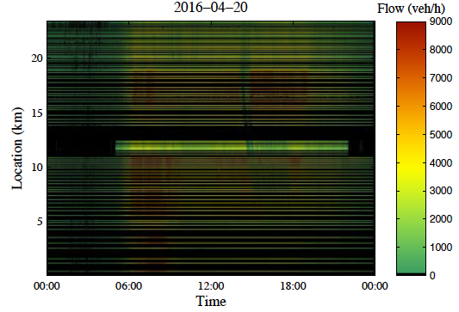
Background & Problems
Comprehensive information on traffic flow is essential for traffic control and vehicular emission monitoring.
However, traffic flow information is not observable everywhere and anytime on the road because of high installation costs and malfunctions of stationary sensors, e.g., radar or inductive loop detector.
Figure: Traffic flow data from stationary detectors.
Reprinted from N. Tsanakas, Emission estimation based on traffic models and measurements. Linköping University Electronic Press, 2019, vol. 1835. ISBN 9176850927 [2]

Slide 5
Goal and Purpose
To compensate for stationary sensors’ weakness, this thesis proposes and analyses an approach for inferring traffic flows from mobile data provided by INRIX, a commercial crowd-sourced traffic dataset with wide spatial coverage and high quality.
The idea is to develop Artificial Neural Network (ANN)-based models to automatically extract relations between traffic flow and INRIX measurements from historical data considering temporal and spatial dependencies.
Provides a highly automated means to process sensor data and build estimation models for Intelligent Transport Systems (ITS) in the context of the Internet of Things (IoT) and Big Data.

Slide 6
Backgrounds

Slide 7
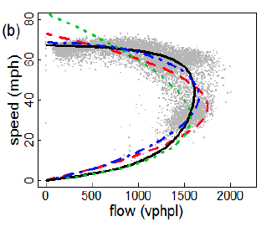
Traffic State Variables
Three traffic state variables are widely used to describe the traffic flow conditions on the highway.
Traffic Flow (veh/h): The number of vehicles traveling through a particular point on the road per unit of time.
Speed (km/h): Average speed of vehicles.
Density (veh/km): The number of vehicles per unit of distance.
Figure: Example of flow-speed relation.
Reprinted from K. Anuar, F. Habtemichael, and M. Cetin, “Estimating traffic flow rate on freeways from probe vehicle data and fundamental diagram,” in 2015 IEEE 18th International Conference on Intelligent Transportation Systems. IEEE, 2015, Conference Proceedings. ISBN 1467365963 pp. 2921–2926.

Slide 8
Sensor Data Types
The traffic measurement data can be grouped into two categories based on the ways they are collected.
Stationary Data:
Collected by fixed-location sensors installed on highways, e.g., inductive loop and radar detector.
Can provide measures of traffic flow and speed at the same time.
Mobile Data:
Collected by on-vehicle sensors, e.g., GPS-enabled smartphones and navigation systems.
Has broader spatial coverage but cannot provide direct measures of traffic flow.

Slide 9
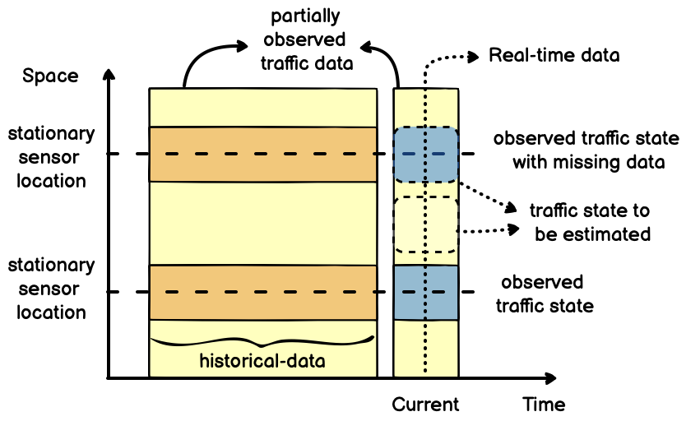
Traffic State Estimation (TSE) and Imputation
TSE aims to estimate the unobserved traffic state variables using partially observed and noisy traffic data in regions where stationary sensors are absent.
Imputation aims to impute traffic datasets collected from locations where the traffic states are observed but suffer from missing or corrupted data.
Figure: Relation between traffic data and traffic states in the space-time domain.

Slide 10
Related Works
Previous TSE approaches using mobile data:
Used static and/or univariate traffic flow relationships (usually flow-speed relation) → time- and space-varying and depends on multiple factors
Required functional form selection and model parameter calibration by human experts → not automated and hence not scalable solution
Previous approaches for traffic flow imputation:
Did not utilize alternative data sources to impute the missing or corrupted traffic flow data.

Slide 11
Datasets and Methodology

Slide 12
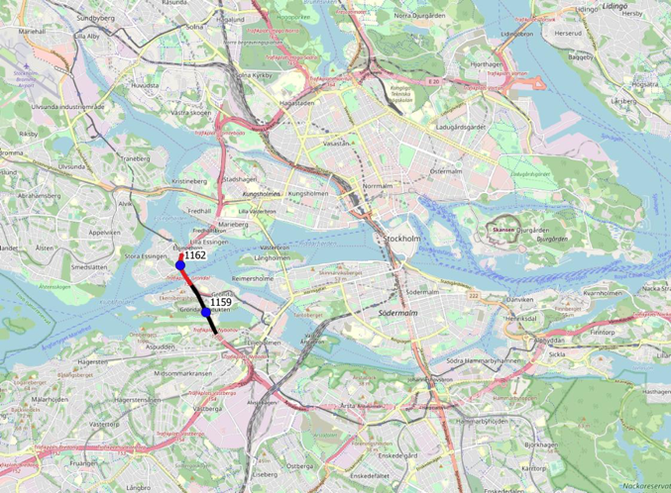
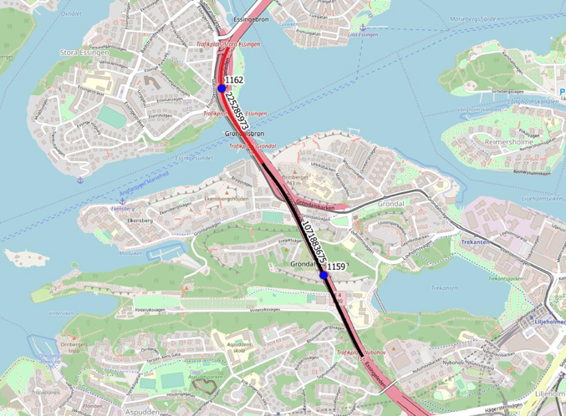
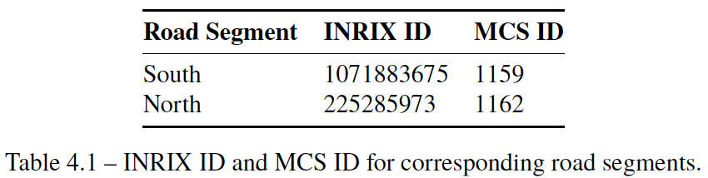
Datasets
The data were collected from INRIX (mobile) and MCS (radar) sensors on two consecutive road segments on the E4 highway, in Stockholm from 01.10.2018 to 28.10.2018.

Slide 13
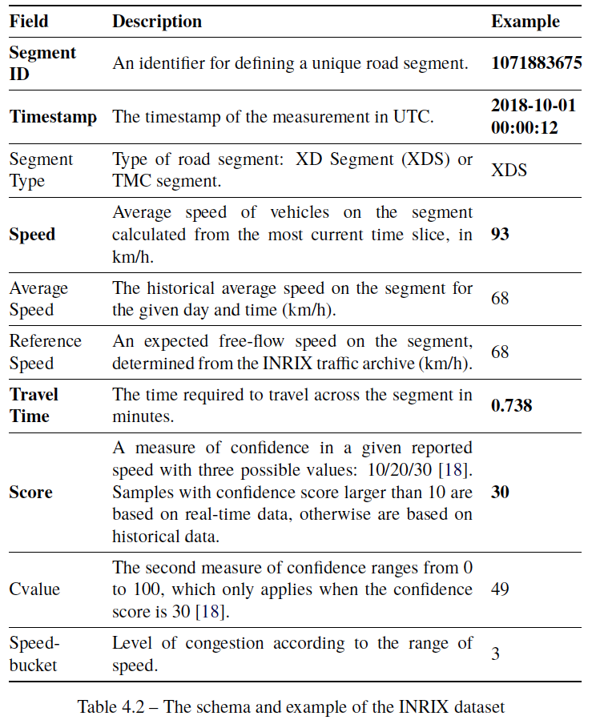
Mobile Data: INRIX
Crowd-sourced data platform provides traffic information every minute based on data collected from GPS-enabled vehicles and smartphones.

Slide 14
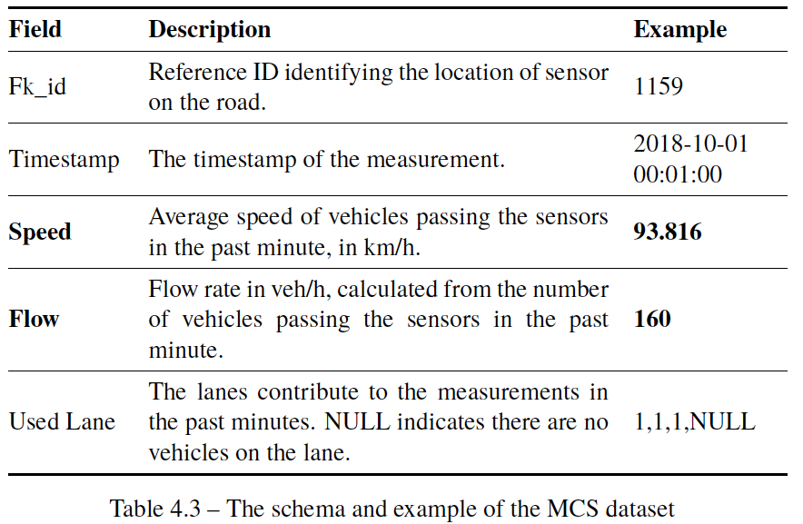
Stationary Data: Motorway Control System (MCS)
Radar sensor system installed on gantries on roads in Stockholm for monitoring traffic by the Swedish transport administration (Trafikverket).
MCS delivers information on traffic flow and speed every minute.

Slide 15
Training & Test Datasets
Training set: Data from the south road segment, 1st to 21st Oct
A special training set only for the spatial-temporal ANN model: Data from both north and south segments, 1st to 21st, Oct
Test set: Data from both north and south segments, 22nd to 28th Oct
Technology Set: Python, pandas, scikit-learn, Keras/TensorFlow, Jupyter-Notebook, Google Colab, Google Cloud AI Platform

Slide 16
Data Preparation
Following data processing methods are adopted for preparing the training and test datasets:
Filtering: Remove the data points with a low confidence score (10) in INRIX datasets.
Smoothing: Use moving average with a window width of 30 time-steps to remove noise in the measures of traffic variables, i.e., flow and speed, in INRIX and MCS datasets.
Shifting: Shift the INRIX time-series data by 360 sec to eliminate the latency of speed observed in INRIX data compared with the MCS speed.

Slide 17
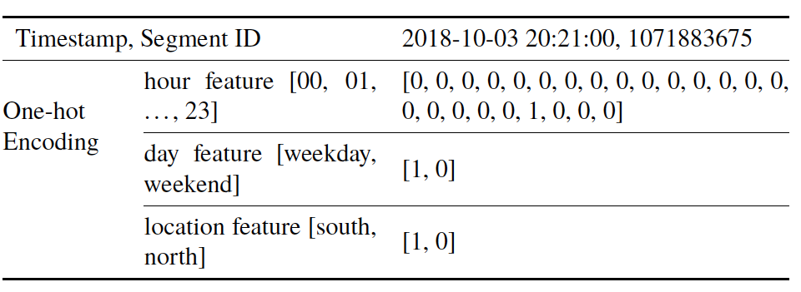
Feature Engineering: One-hot Encoding
One-hot encoding is used to convert timestamps and segment IDs into numerical time and space features for training ANN models:
hour feature: "hour" in the timestamp is converted into a 24-bit one-hot code, representing the hour of a day.
day feature: "day" in the timestamp is converted into a 2-bit one-hot code, representing the day of a week, i.e., weekdays or weekends.
location feature: "segment ID" is converted into a 2-bit one-hot code, representing the location of the road segment, i.e., the south or north segment.

Slide 18
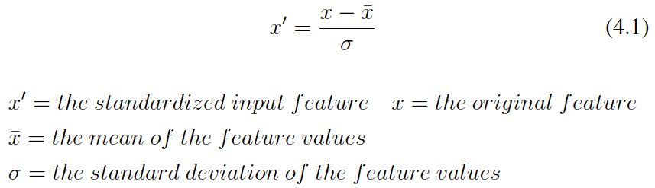
Feature Scaling: Standardization
Machine learning algorithm requires its input features to have a similar scale to perform correctly.
Standardization is a common method to scale the numerical attributes because it is less affected by the outliers in datasets.

Slide 19
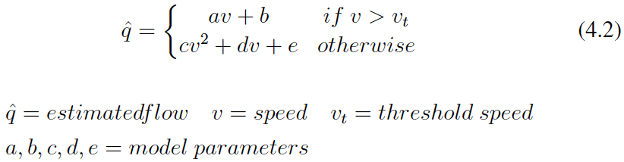
Baseline Model
A multi-regime baseline model is built to capture the classic flow-speed relationship using different functional forms in different traffic conditions.
The Baseline model will be used to compare with the ANN models.
Note: Threshold speed of 70 km/h separates the samples into free-flow and non-free-flow conditions.

Slide 20
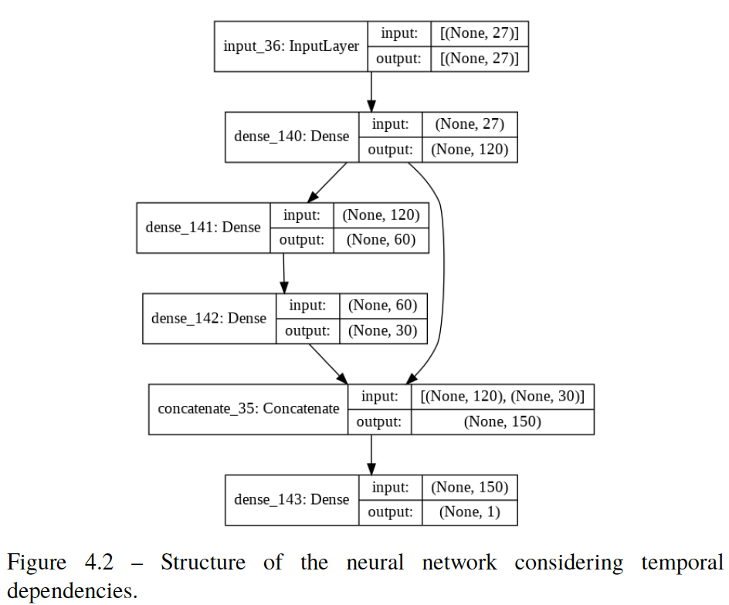
ANN Model Structure
ANN is a data-driven/non-parametric machine learning method with the following advantages:
Adaptive to data
Good in learning nonlinear relationships in high-dimensional data

Slide 21
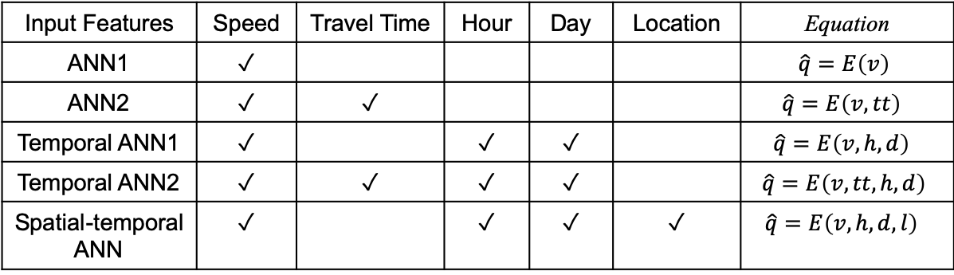
ANN Models
Five ANN models are developed to extract:
Static flow-speed relationship
Flow-speed relationships considering temporal and spatial dependencies.
Traffic flow relationship between multiple input variables in a multivariate setting.
Input Features | Speed | Travel Time | Hour | Day | Location | Equation
ANN1 | ✓ |  |  |  |  | $$\hat{q}=E\left(v\right)$$
ANN2 | ✓ | ✓ |  |  |  | $$\hat{q}=E\left(v, tt\right)$$
Temporal ANN1 | ✓ |  | ✓ | ✓ |  | $$\hat{q}=E\left(v, h,d\right)$$
Temporal ANN2 | ✓ | ✓ | ✓ | ✓ |  | $$\hat{q}=E\left(v, tt, h,d\right)$$
Spatial-temporal ANN | ✓ |  | ✓ | ✓ | ✓ | $$\hat{q}=E\left(v, h,d, l\right)$$

Slide 22
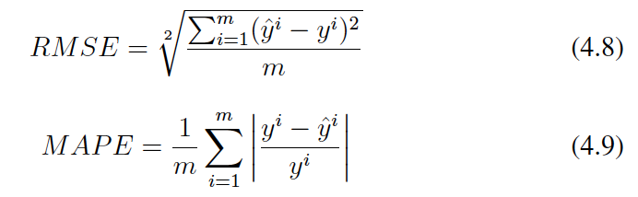
Performance Evaluation
The root mean squared error (RMSE) and the mean absolute percentage error (MAPE) are used to evaluate the models' accuracy.

Slide 23
Results

