Slide 1
Noise

Slide 2
Ambient Noise
Source | Typical Frequency (Hz)
Computers | 350
Printers | 270-540
Air Conditioning | 31.5-62
Talking | 125
Vehicles | 1000

Slide 3
Waveform Interactions
Constructive and Destructive Interference
Beats

Slide 4
Filtering Signals
FFT
Passive Filters
Active filters

Slide 5
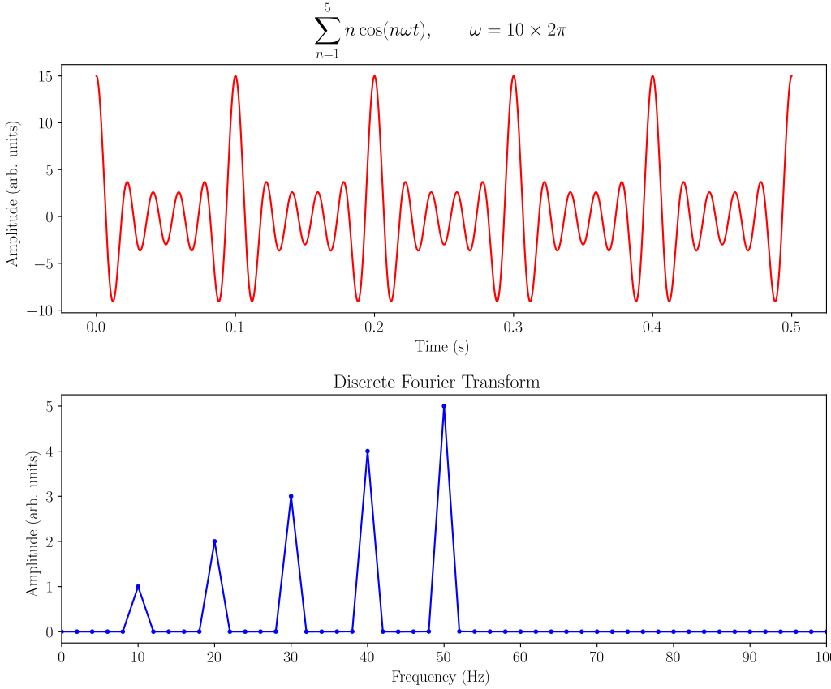
FFT
Fast Fourier Transform
Separates frequencies into Individual components

Slide 6
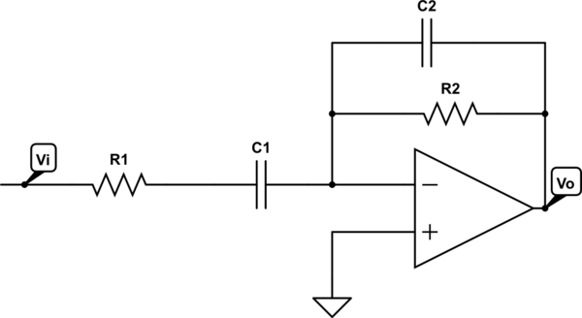
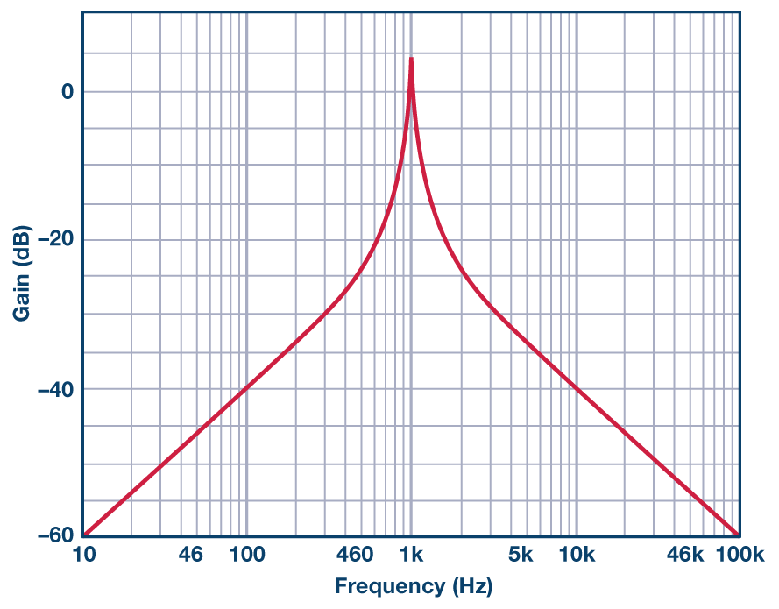
Bandpass Filters
Filter used to isolate a certain Frequency Band

Slide 7
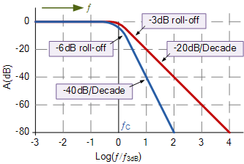
Second Order and First Order
Second Order filters : Sallen Key Filter
Higher dB/decade roll-off

Slide 8
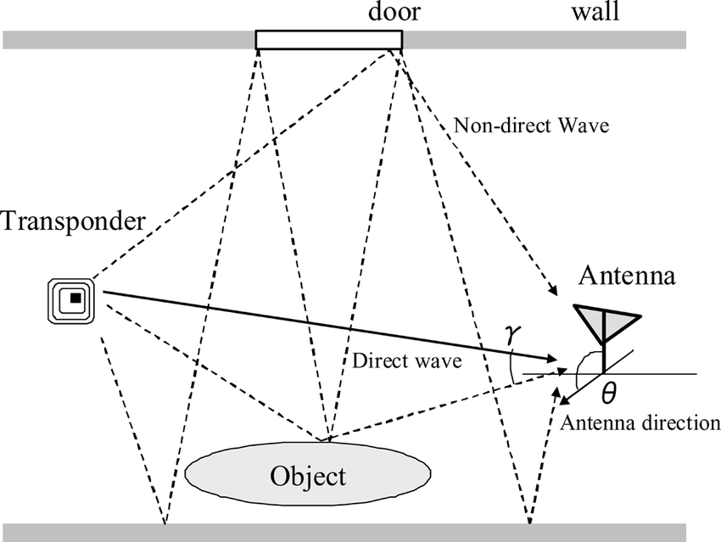
Multipath
Multiple receptions of the same wave
Due to reflections and absorptions

