Slide 1
Sound

Slide 2

Measurement
Sound is measured in dB
More convenient due to large variations in pressure, intensity and power
SPL is the Sound Pressure Level.
$SPL=20\log_{10}\left(\frac{ρ}{ρ_{ref}}\right)$

Slide 3
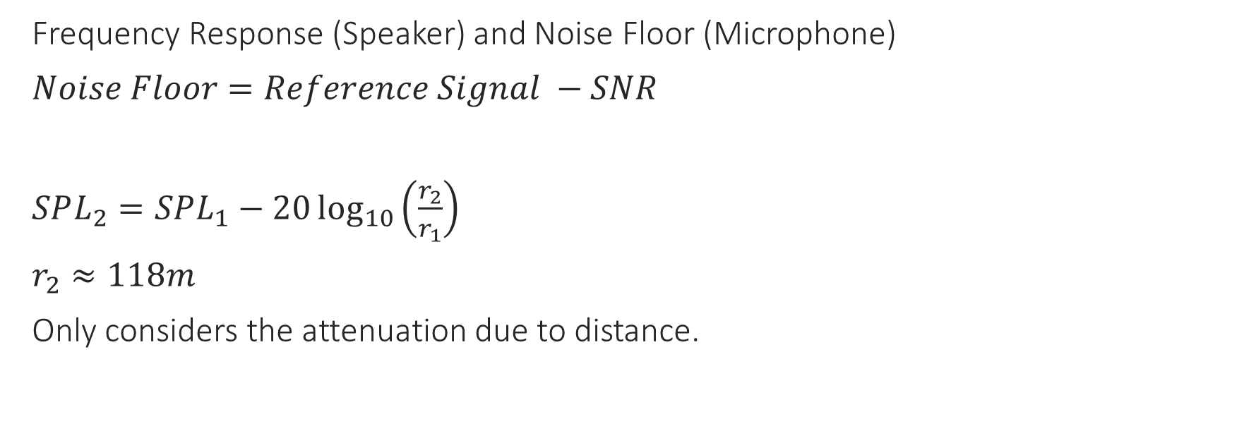
Maximum Distance
Frequency Response (Speaker) and Noise Floor (Microphone)
$Noise Floor=Reference Signal −SNR$
$SPL_{2}=SPL_{1}−20\log_{10}\left(\frac{r_{2}}{r_{1}}\right)$
$r_{2}≈118m$
Only considers the attenuation due to distance.

Slide 4
Attenuation
Attenuation is the loss of energy as the a soundwave passes through a medium
3 main concerns
Sound attenuation through the air
Sound absorption via barriers
Sound transmission loss via barriers

Slide 5
Attenuation in the Air
Sound energy dissipated as heat as soundwave travels
Higher frequency have more oscillations and attenuate quicker
Temperature and Humidity
Proportionality table
Parameter | Relationship with attenuation (in Air)
Frequency | Proportional
Temperature | Inversely Proportional
Humidity | Inversely Proportional
Distance | Proportional

Slide 6
Absorption
Absorptive
Reflective
Drapes, carpets
Porous materials with airflow
More attenuation as frequency rises.
Plywood, plaster, concrete
Little airflow
More attenuation as frequency falls

Slide 7
Sound Transmission Loss
Sound energy loss when travelling through a barrier
Very large in most cases
STC, Sound transmission class
Standardized measurement averaged across multiple frequencies

Slide 8
Considerations
Chosen frequency must be chosen with the following in mind
Distance between devices
Humidity and temperature of environment
Types of barriers present in environment
Considerations still need to be looked into:
Noise
Noise filtering

