Slide 1
High availability and scalability on GNU/Linux clusters
Pieter Libin

Slide 2
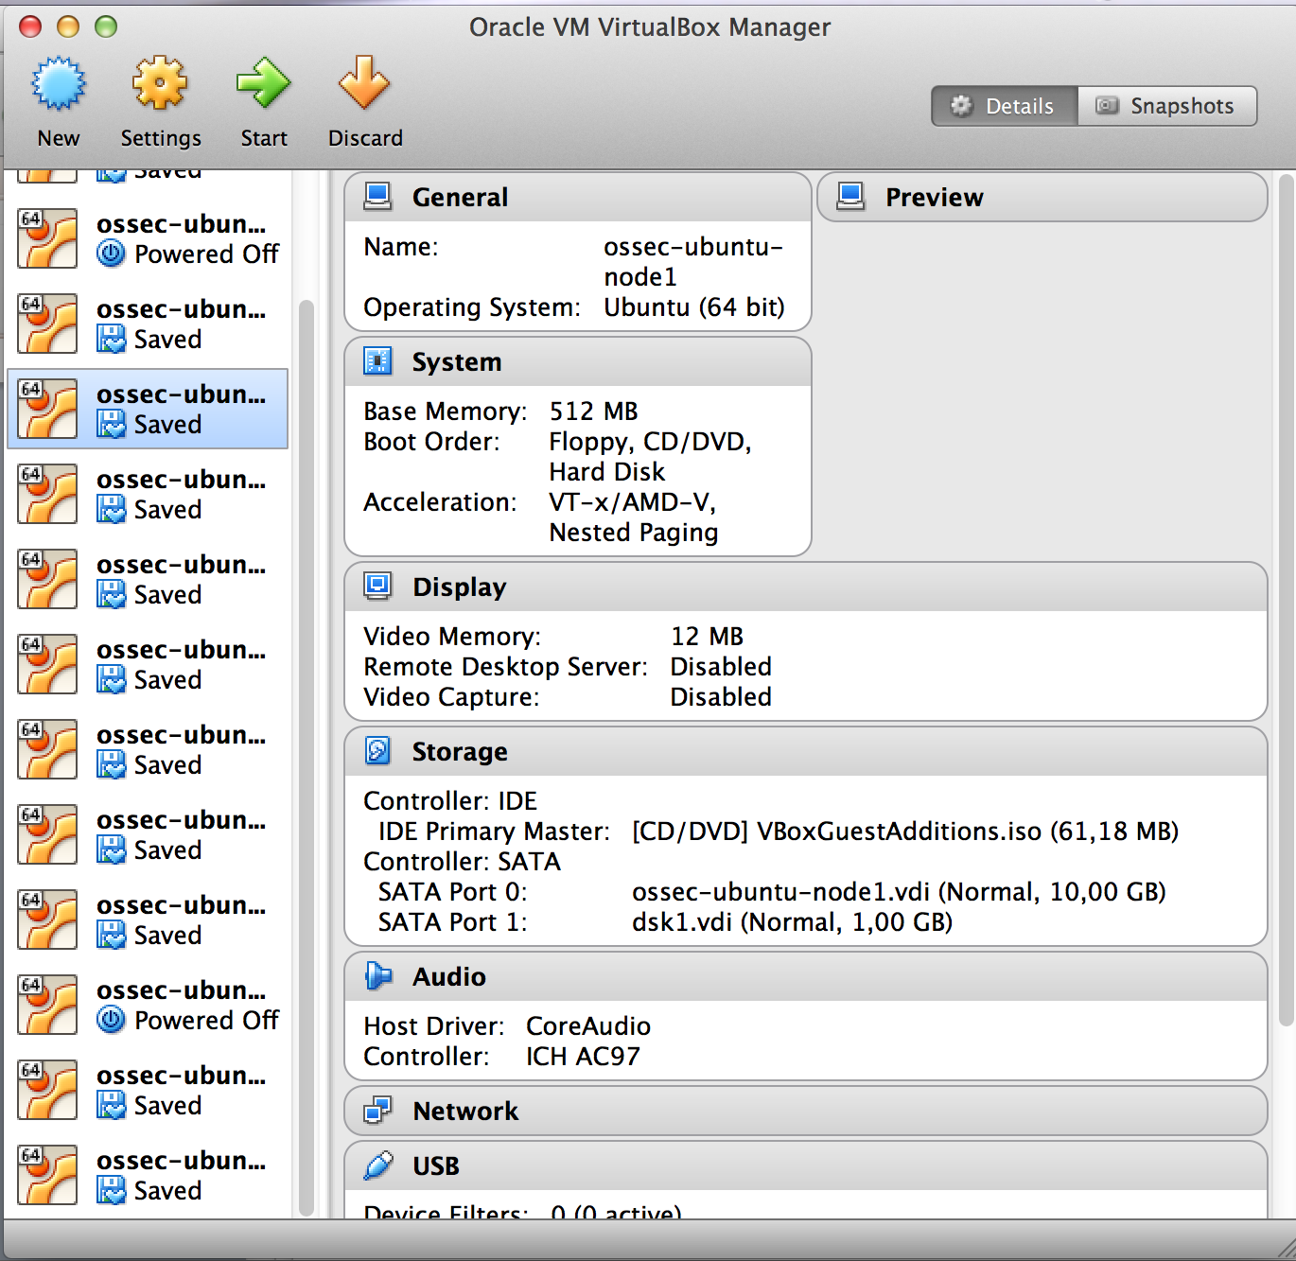
Simulated environment

Slide 3
Experiments
Ganglia: distributed monitoring system
DRBD: network based RAID-1
MySQL replication

Slide 4
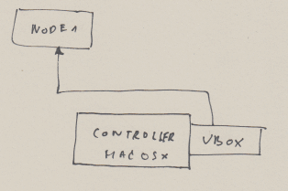
Nagios experiment

Slide 5
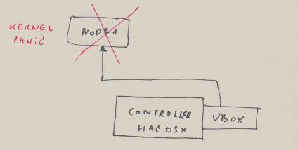
Nagios experiment

Slide 6
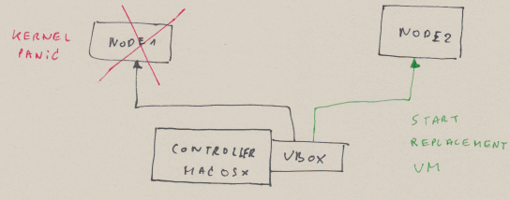
Nagios experiment

Slide 7
Nagios experiment
https://www.youtube.com/watch?v=Hwzlyl_FoZM

Slide 8
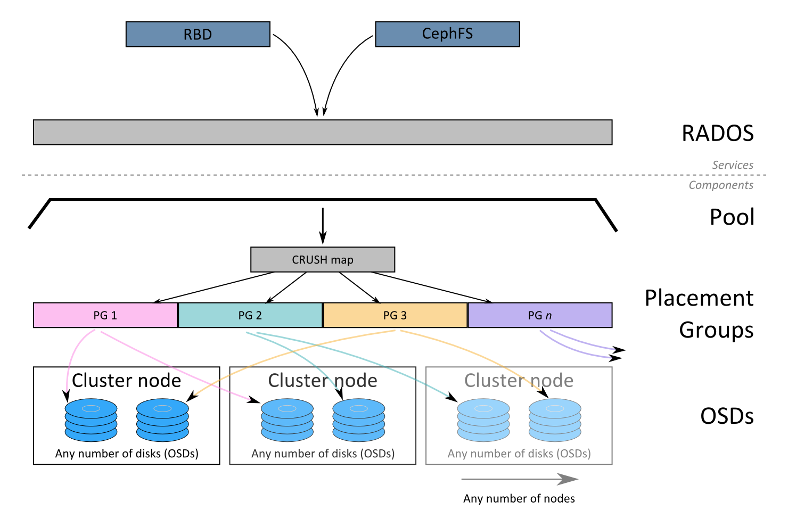
Ceph: distributed object storage

Slide 9
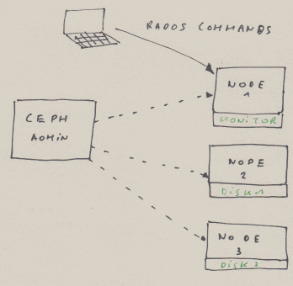
Ceph experiment

Slide 10
Ceph experiment
https://www.youtube.com/watch?v=HjfILFBWRwA

Slide 11
Ceph experiment
https://www.youtube.com/watch?v=1WV9o9CoIIM

Slide 12
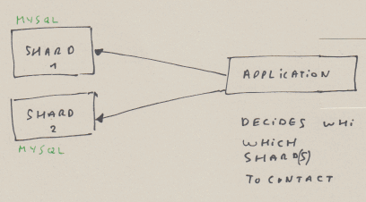
Shards experiment

Slide 13
Shards experiment
https://www.youtube.com/watch?v=XDcDdGzdWaA

Slide 14
Shards experiment
https://www.youtube.com/watch?v=--DLZnS6ykg

Slide 15
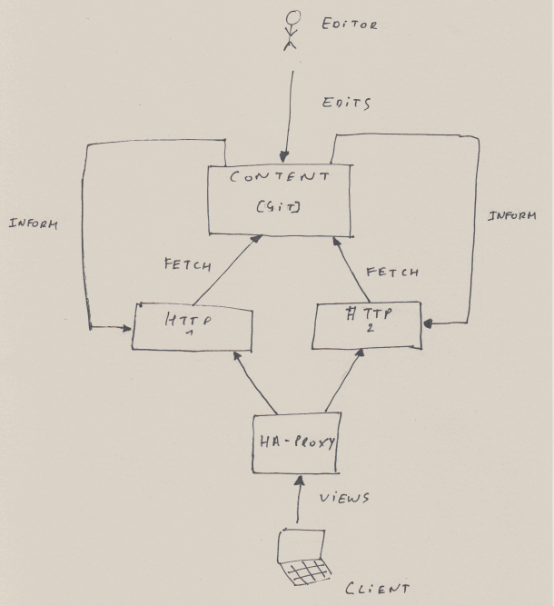
Wikipedia clone: architecture

Slide 16
Wikipedia clone
https://www.youtube.com/watch?v=zk-Ny046kuw

Slide 17
Wikipedia clone
https://www.youtube.com/watch?v=T-_baLRBBfE

Slide 18
HAProxy fail experiment
https://www.youtube.com/watch?v=hrjdLpFLEDM

