Slide 1
WIS project Drinking Buddies
Tom De Bie
Pieter Libin
Ingrid Nijs
29/10/2013

Slide 2
General idea
Social platform where friends can share information about bars and beers

Slide 3
General idea
Buddies

Slide 4
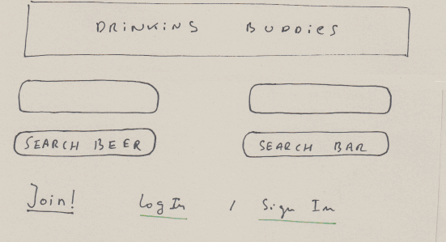

Slide 5
Autocompletion

Slide 6
Registration (Facebook via OAuth)

Slide 7
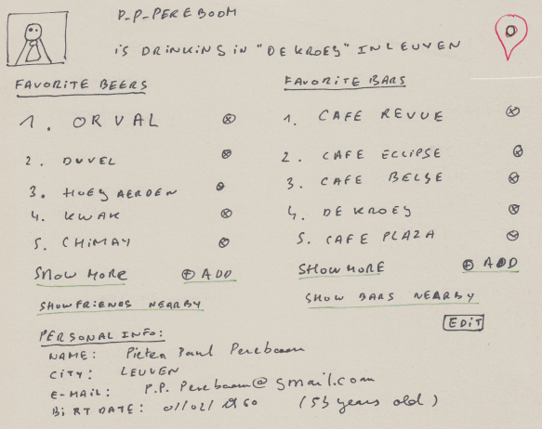
Read and update of the user database entity
URL: /user/p_p_pereboom

Slide 8
Location sharing via HTML5 geolocation

Slide 9
Validation
(client/server)

Slide 10
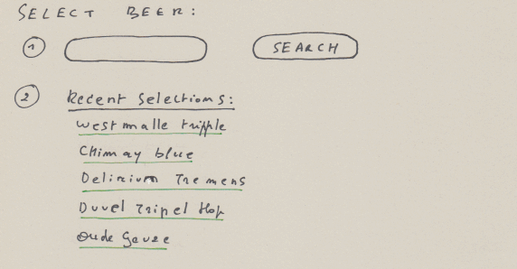
Adding beers will also be possible here
URL: /beers/

Slide 11
Autocompletion

Slide 12
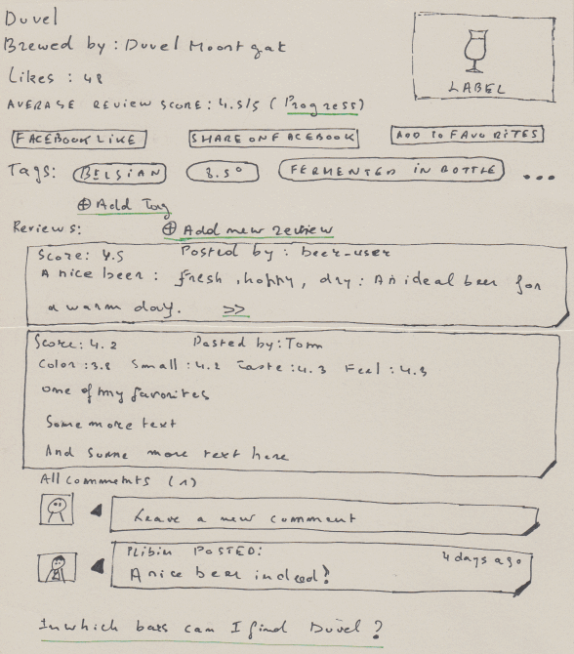
URL: /beers/duvel

Slide 13
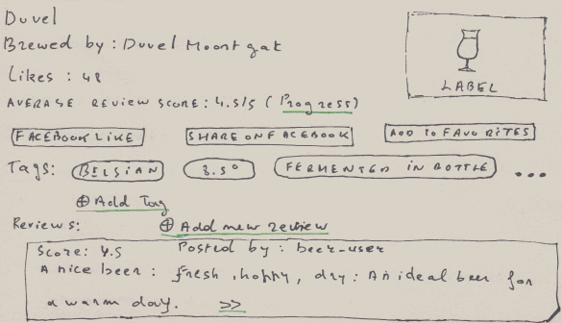
Information collected via a webservice

Slide 14
Facebook like/share
(via Facebook web service API)

Slide 15
User favorites

Slide 16
Tags:
add beer to a new or an existing tag

Slide 17
A list of summarized reviews (score, first sentence of the text)
Can be expanded using the “>>” link.

Slide 18
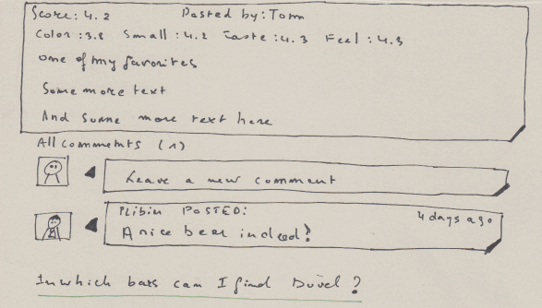
Example of and expanded review (score details, full text)

Slide 19
Expanded reviews can be commented on

Slide 20
Locate all bars where we can find “Duvel”

Slide 21
CRUD / validation
beer
rags
reviews
comments
social

Slide 22
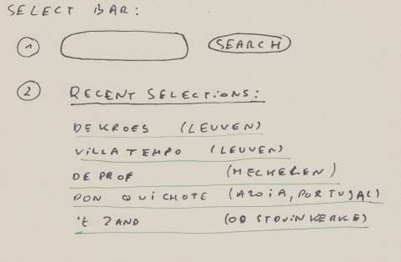
Adding bars will also be possible here
URL: /bars/

Slide 23
Autocompletion

Slide 24
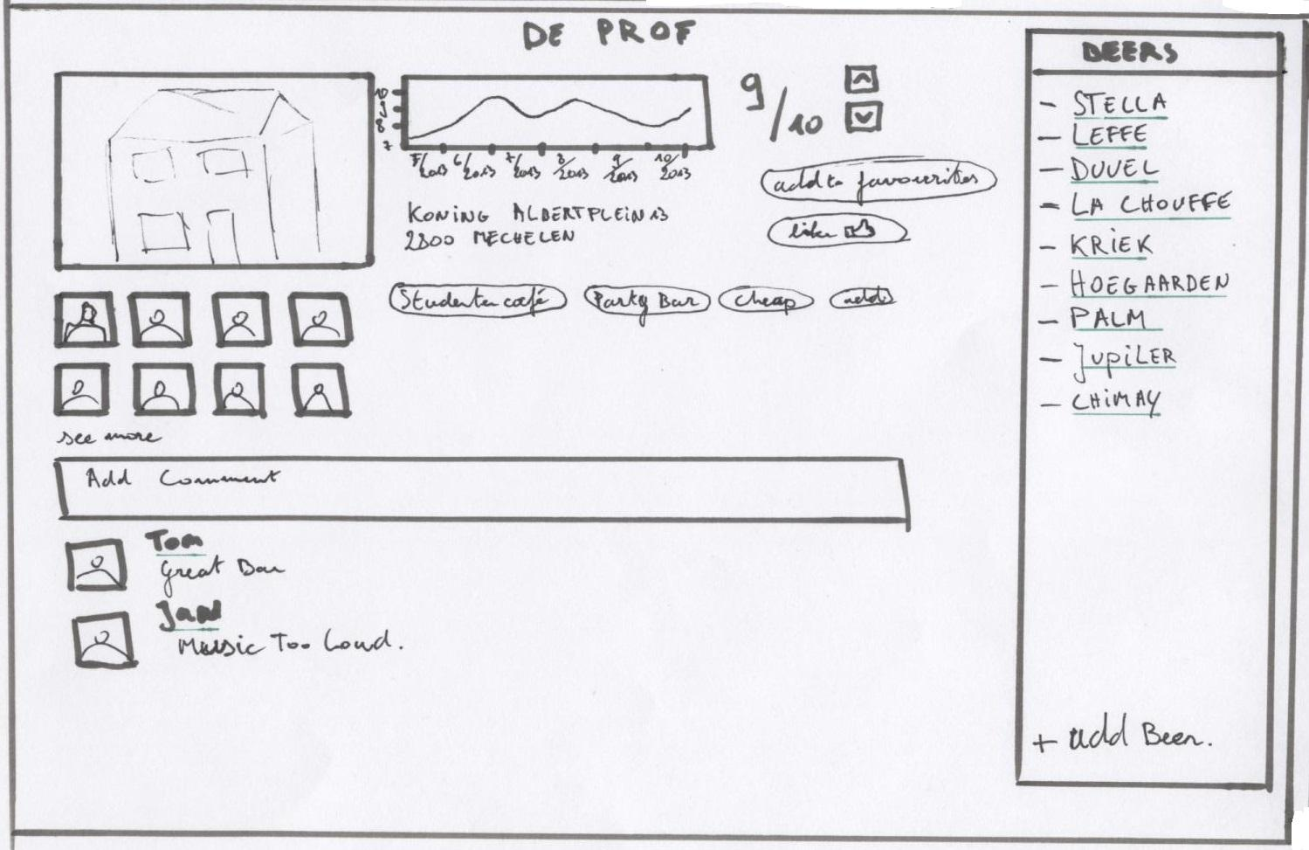
Read and update of the user database entity
URL: /bars/de_prof

Slide 25
Leave comments on the bar

Slide 26
View the beers available in the bar
Add other beers to the bar

Slide 27
Rating of the bar + evolution of the rating (using HTML5 canvas)

Slide 28
Users that are at this bar

Slide 29
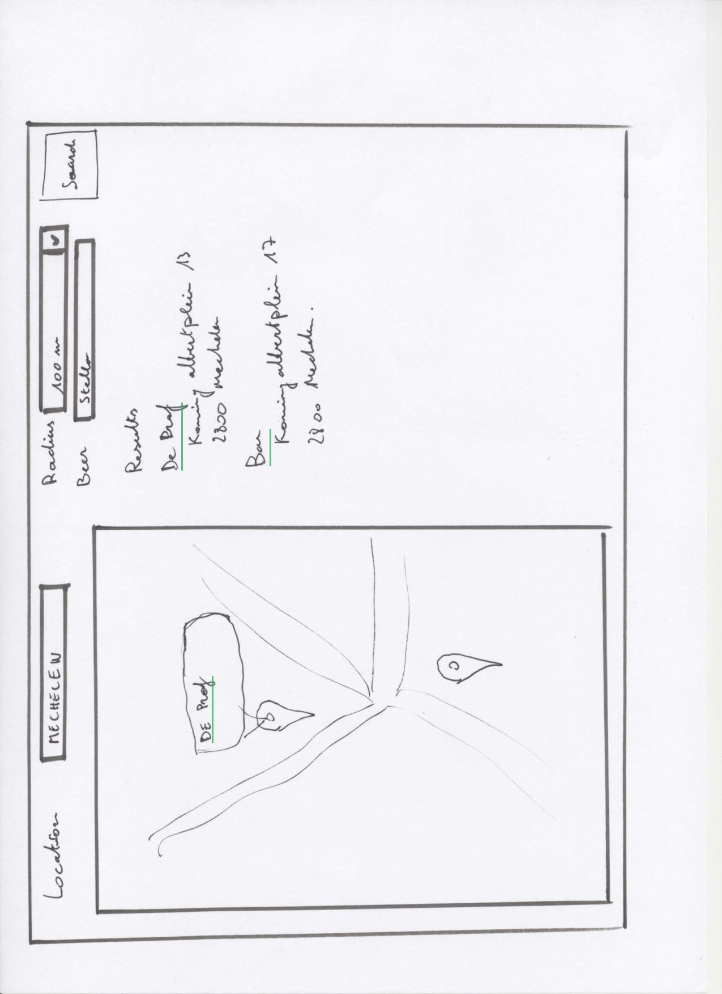
Search bars by location. Location field is filled in using HTML5 geolocation

Slide 30
Use google maps to visualize the results

Slide 31
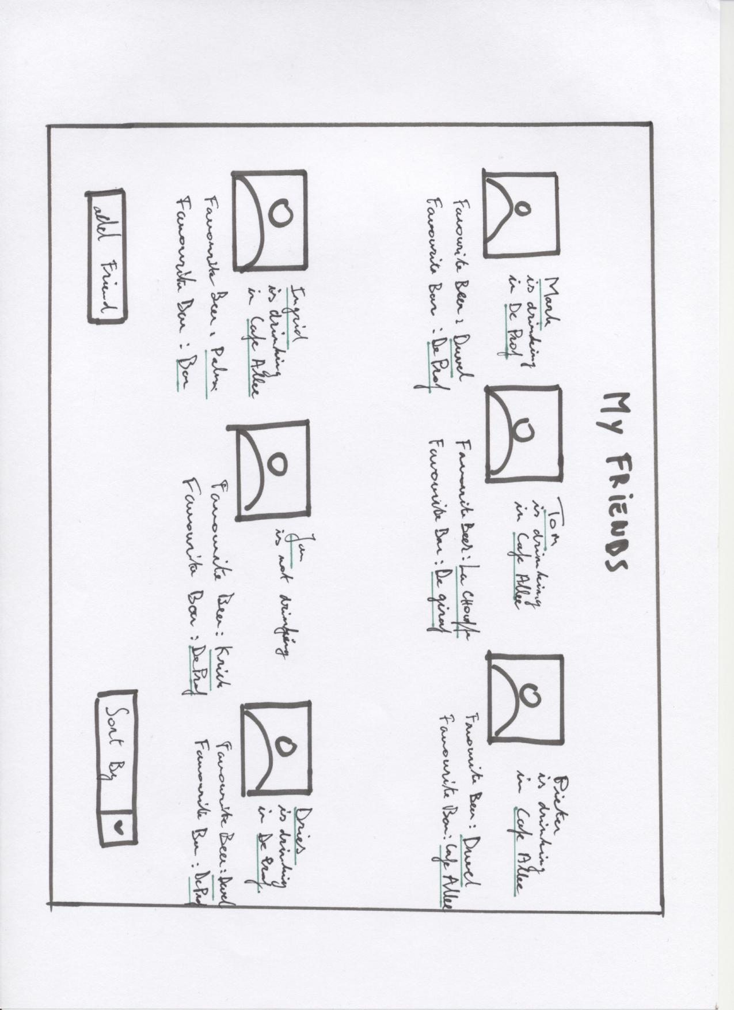
Friends location is shared
Friends are imported using Facebook API

Slide 32
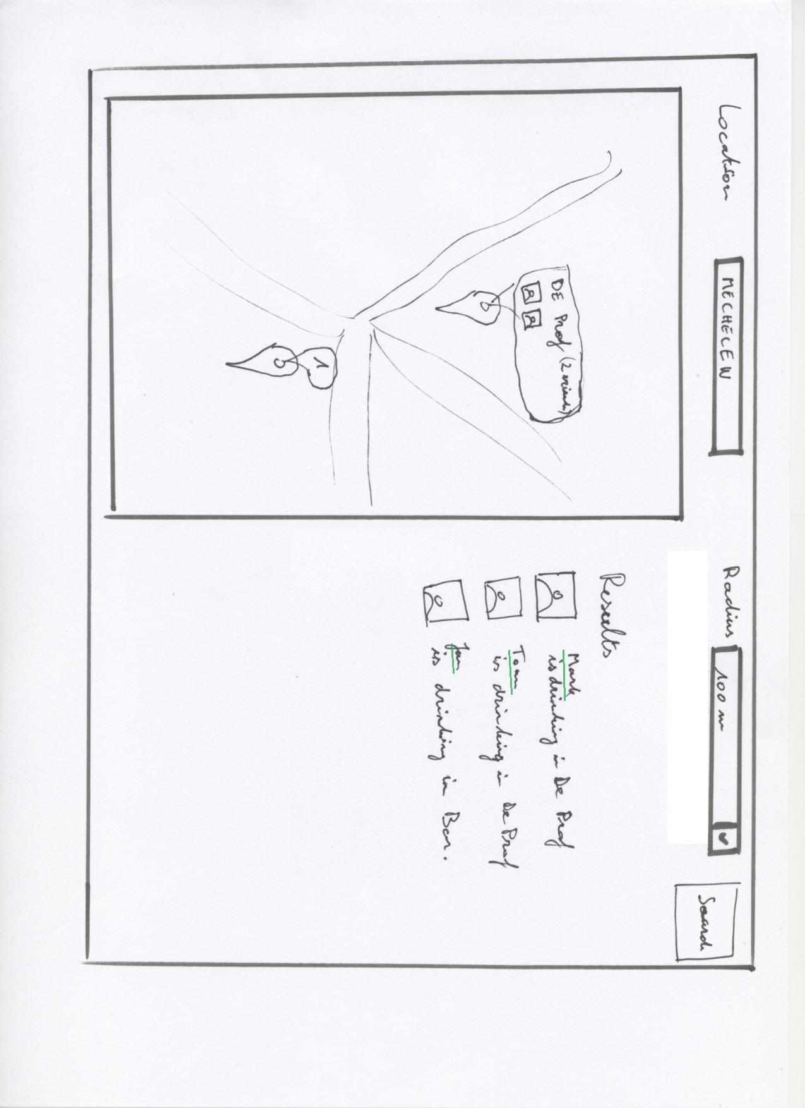
Search friends by location

Slide 33
Publishing data as a WS
We will provide a RESTful interface for:
our bars and their reviews
our beer reviews

Slide 34
Technology inventory
webtoolkit.eu/jwt
AJAX-enabled Java web application development library
JOOQ.org
active record library for Java
sqlite
git / github.com

Slide 35
Technology inventory
connecting to REST web-services
client side: jQuery
server side: google-gson
publish data as a web service
JAXWS
???

