Slide 1
WIS project Drinking Buddies
Tom De Bie
Pieter Libin
Ingrid Nijs
29/10/2013

Slide 2
General idea
Social platform where friends can share information about bars and beers

Slide 3
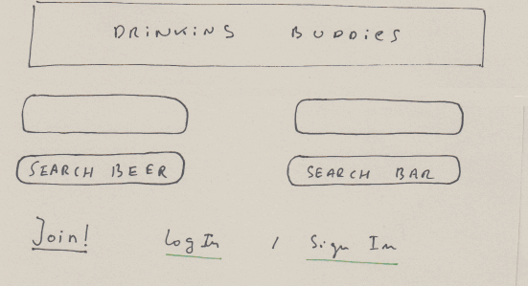

Slide 4
Autocompletion

Slide 5
Registration (Facebook via OAuth)

Slide 6
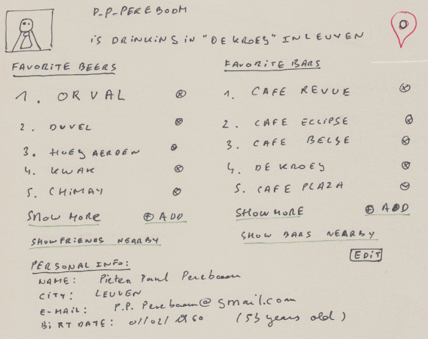
Read and update of the user database entity
URL: /user/p_p_pereboom

Slide 7
Location sharing via HTML5 geolocation

Slide 8
Validation
(client/server)

Slide 9
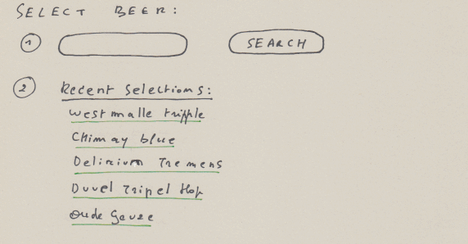
URL: /beers/

Slide 10
Autocompletion

Slide 11
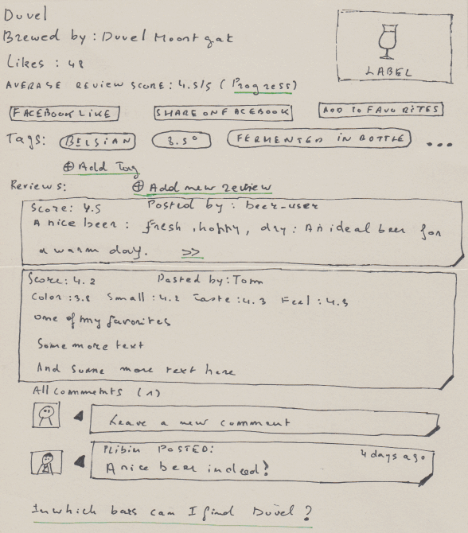
URL: /beers/duvel

Slide 12
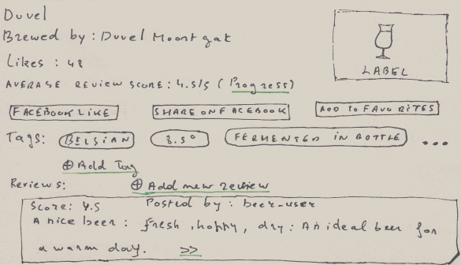
Information collected via a webservice

Slide 13
Facebook like/share
(via Facebook web service API)

Slide 14
User favorites

Slide 15
Tags:
add beer to a new or an existing tag

Slide 16
A list of summarized reviews (score, first sentence of the text)
Can be expanded using the “>>” link.

Slide 17
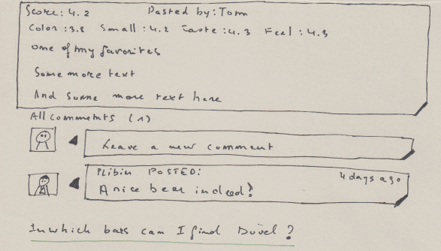
Example of and expanded review (score details, full text)

Slide 18
Expanded reviews can be commented on

Slide 19
Locate all bars where we can find “Duvel”

Slide 20
CRUD / validation
beer
tags
reviews
comments
social

Slide 21
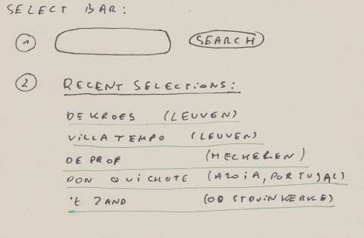
Adding bars will also be possible here
URL: /bars/

Slide 22
Autocompletion

Slide 23
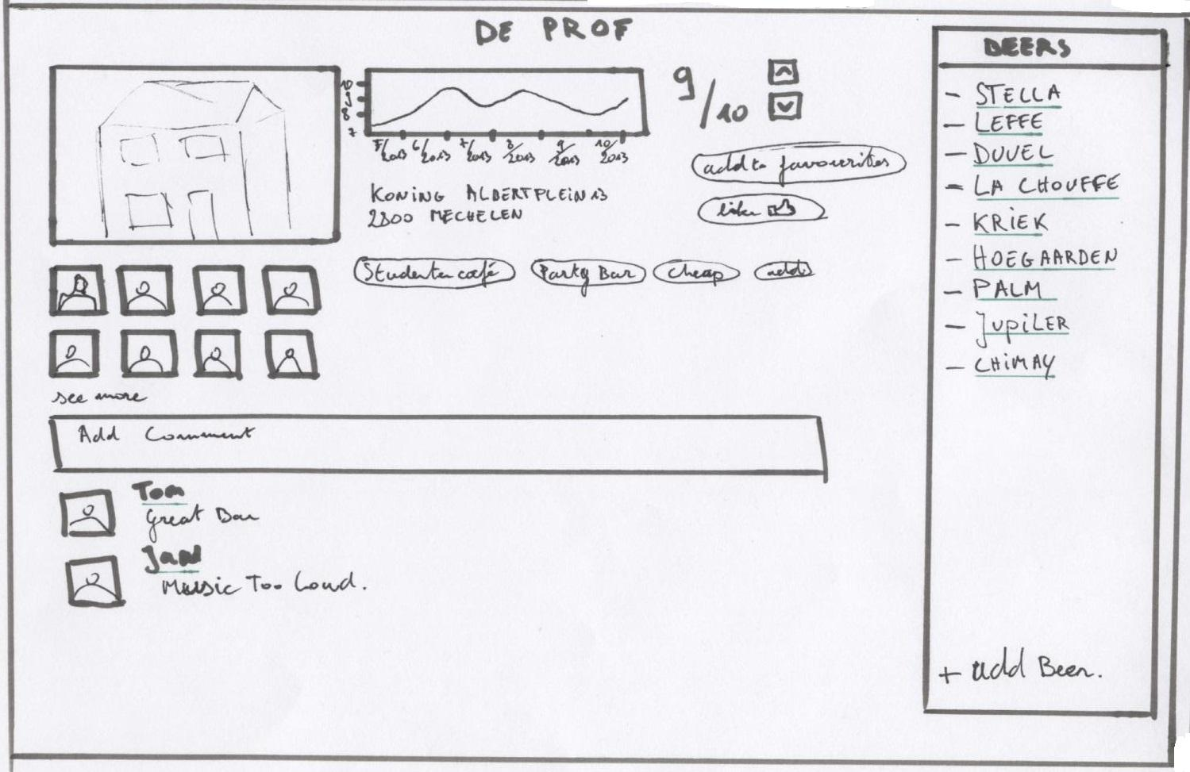
Read and update of the bar database entity
URL: /bars/de_prof

Slide 24
Leave comments on the bar

Slide 25
View the beers available in the bar
Add other beers to the bar

Slide 26
Rating of the bar + evolution of the rating (using HTML5 canvas)

Slide 27
Users that are at this bar

Slide 28
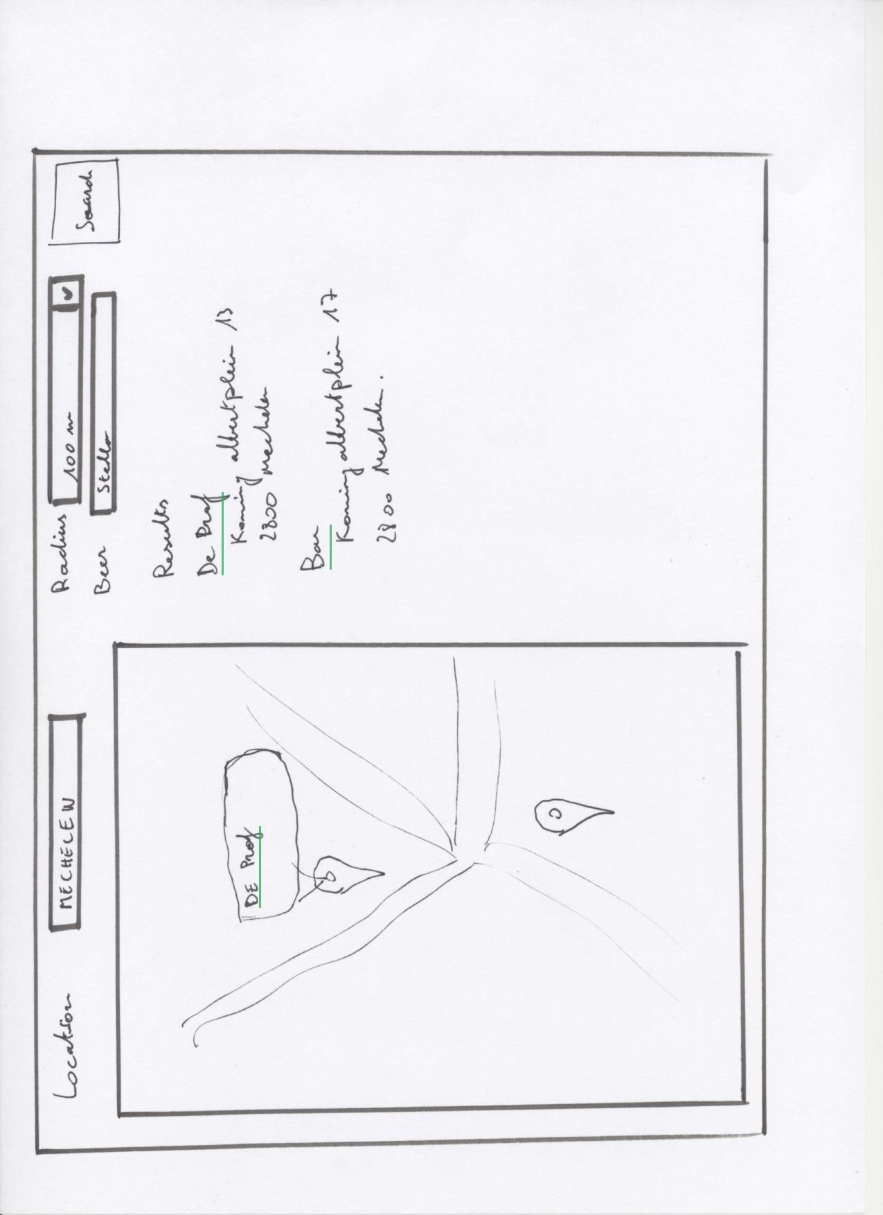
Search bars by location. Location field is filled in using HTML5 geolocation

Slide 29
Use google maps to visualize the results

Slide 30
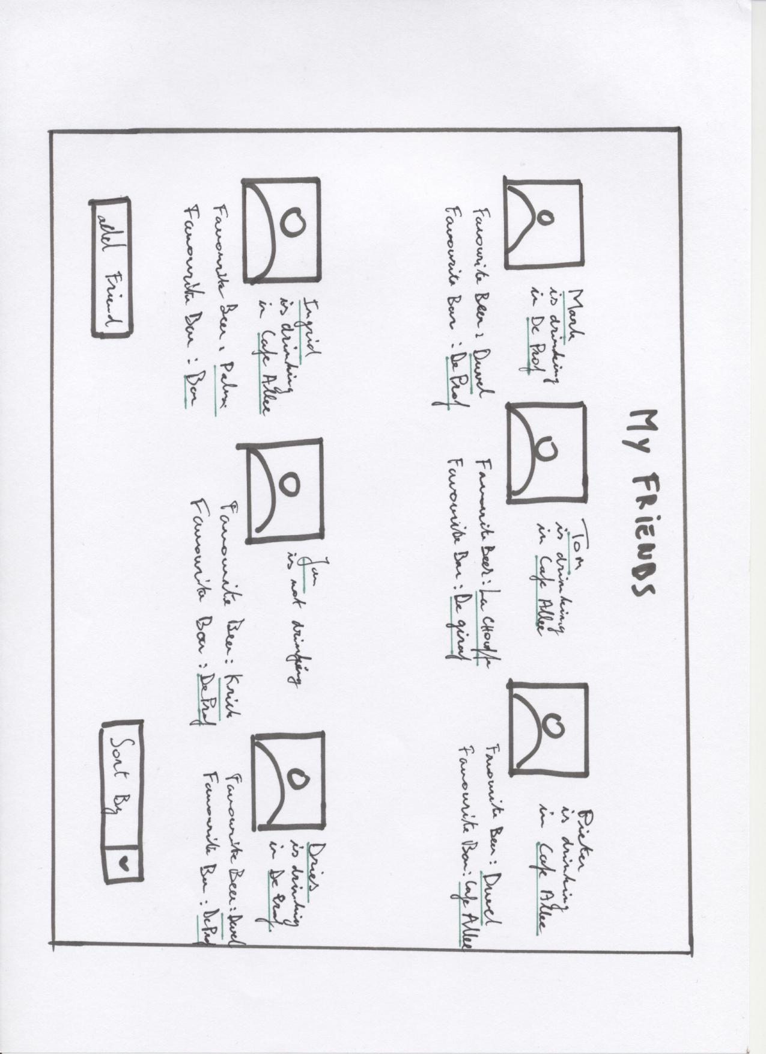
Friends location is shared
Friends are imported using Facebook API

Slide 31
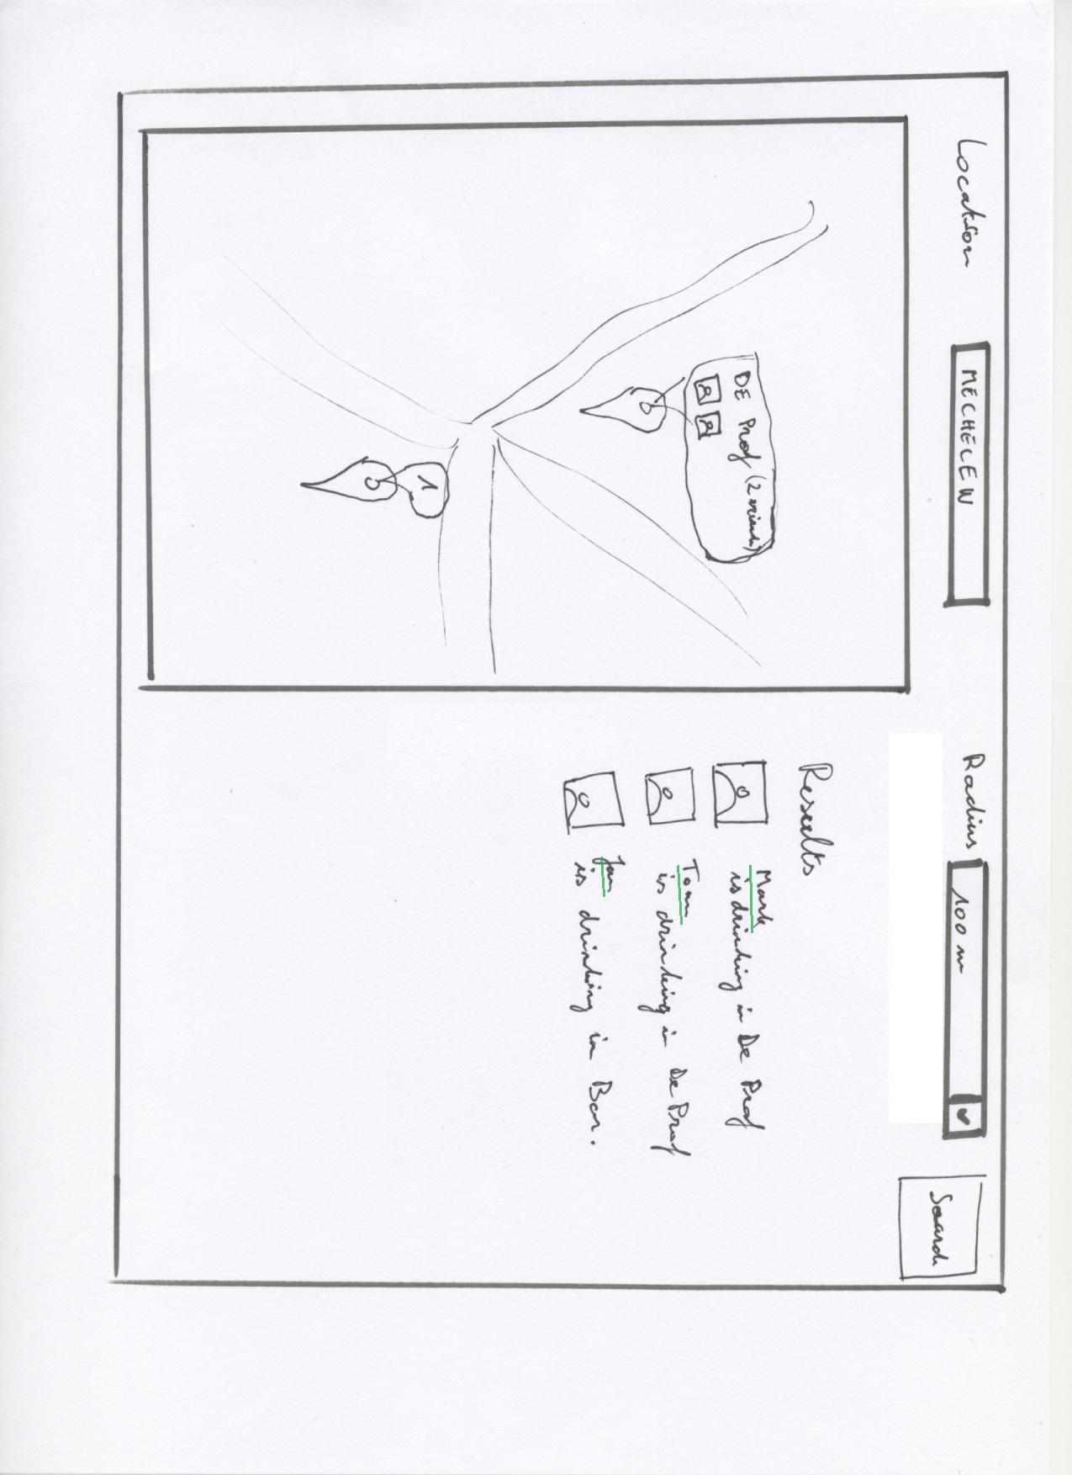
Search friends by location

Slide 32
Publishing data as a WS
We will provide a RESTful interface for:
our bars and their reviews
our beer reviews

Slide 33
Technology inventory
webtoolkit.eu/jwt
AJAX-enabled Java web application development library
Single Page Application
SEO friendly
Bootstrap
JOOQ.org
active record library for Java
sqlite
git / github.com

Slide 34
Technology inventory
connecting to REST web-services
client side: jQuery
server side: google-gson
publish data as a web service
JAXWS
???

