Slide 1
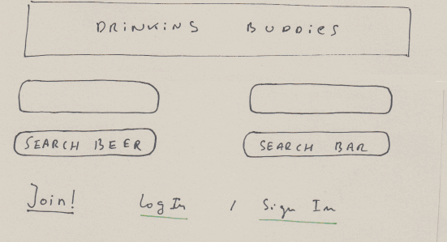

Slide 2
Autocompletion

Slide 3
Registration (Facebook via OAuth)

Slide 4
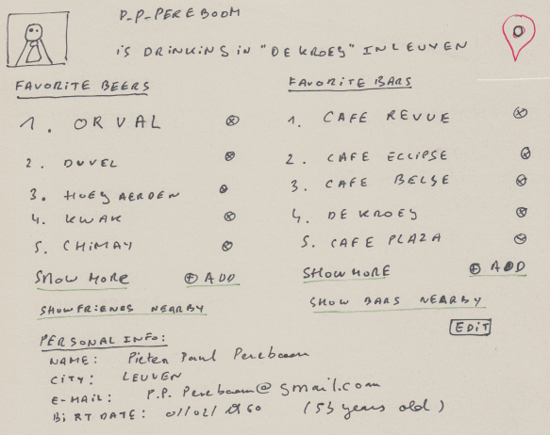
Read and update of the user database entity
URL: /user/p_p_pereboom

Slide 5
Location sharing via HTML5 geolocation

Slide 6
Validation
(client/server)

Slide 7
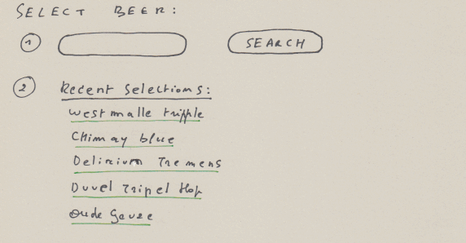
Adding beers will also be possible here
URL: /beers/

Slide 8
Autocompletion

Slide 9
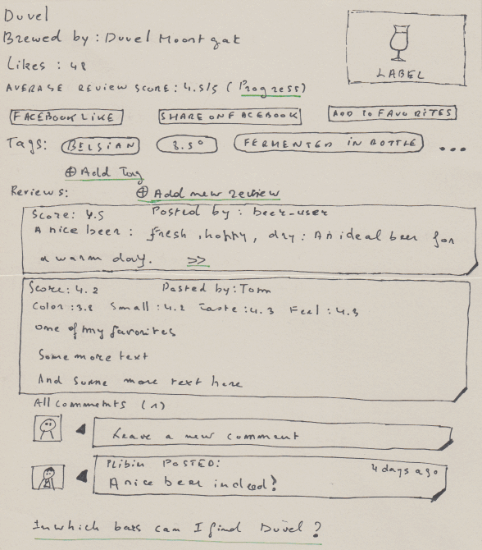
URL: /beers/duvel

Slide 10
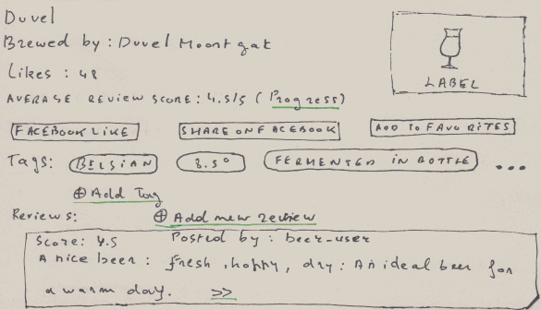
Information collected via a webservice

Slide 11
Facebook like/share
(via Facebook web service API)

Slide 12
User favorites

Slide 13
Tags:
add beer to a new or an existing tag

Slide 14
A list of summarized reviews (score, first sentence of the text)
Can be expanded using the “>>” link.

Slide 15
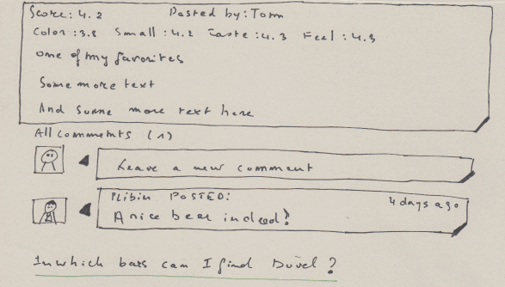
Example of and expanded review (score details, full text)

Slide 16
Expanded reviews can be commented on

Slide 17
Locate all bars where we can find “Duvel”

Slide 18
CRUD / validation
beer
rags
reviews
comments
social

Slide 19
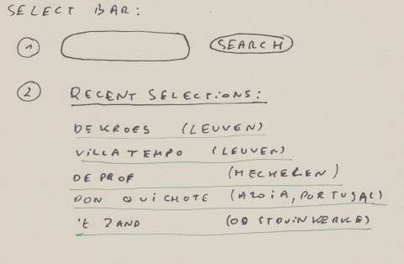
Adding bars will also be possible here
URL: /bars/

Slide 20
Autocompletion

Slide 21
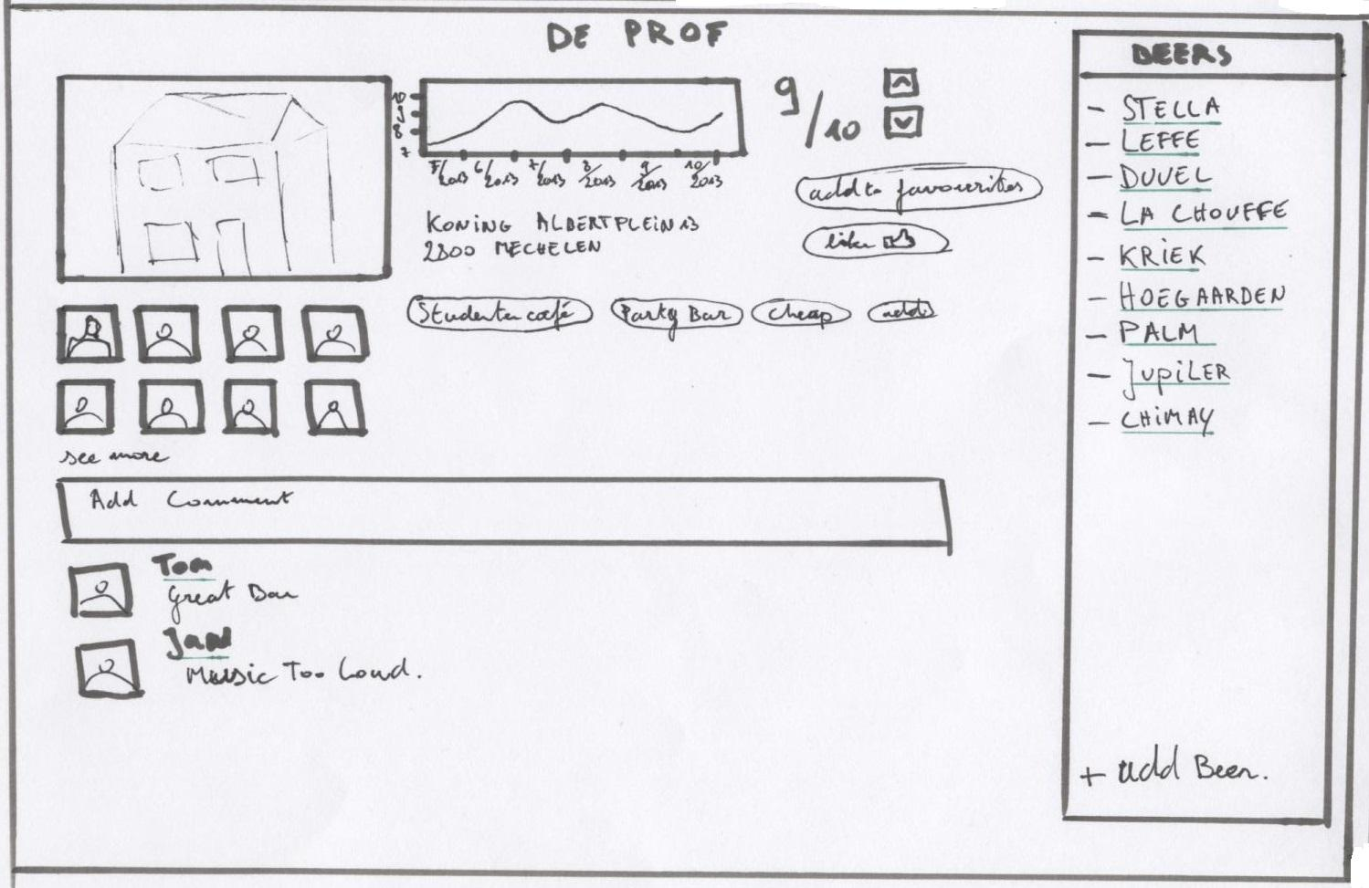
Read and update of the user database entity
URL: /bars/de_prof

Slide 22
Leave comments on the bar

Slide 23
View the beers available in the bar
Add other beers to the bar

Slide 24
Rating of the bar + evolution of the rating (using HTML5 canvas)

Slide 25
Users that are at this bar

Slide 26
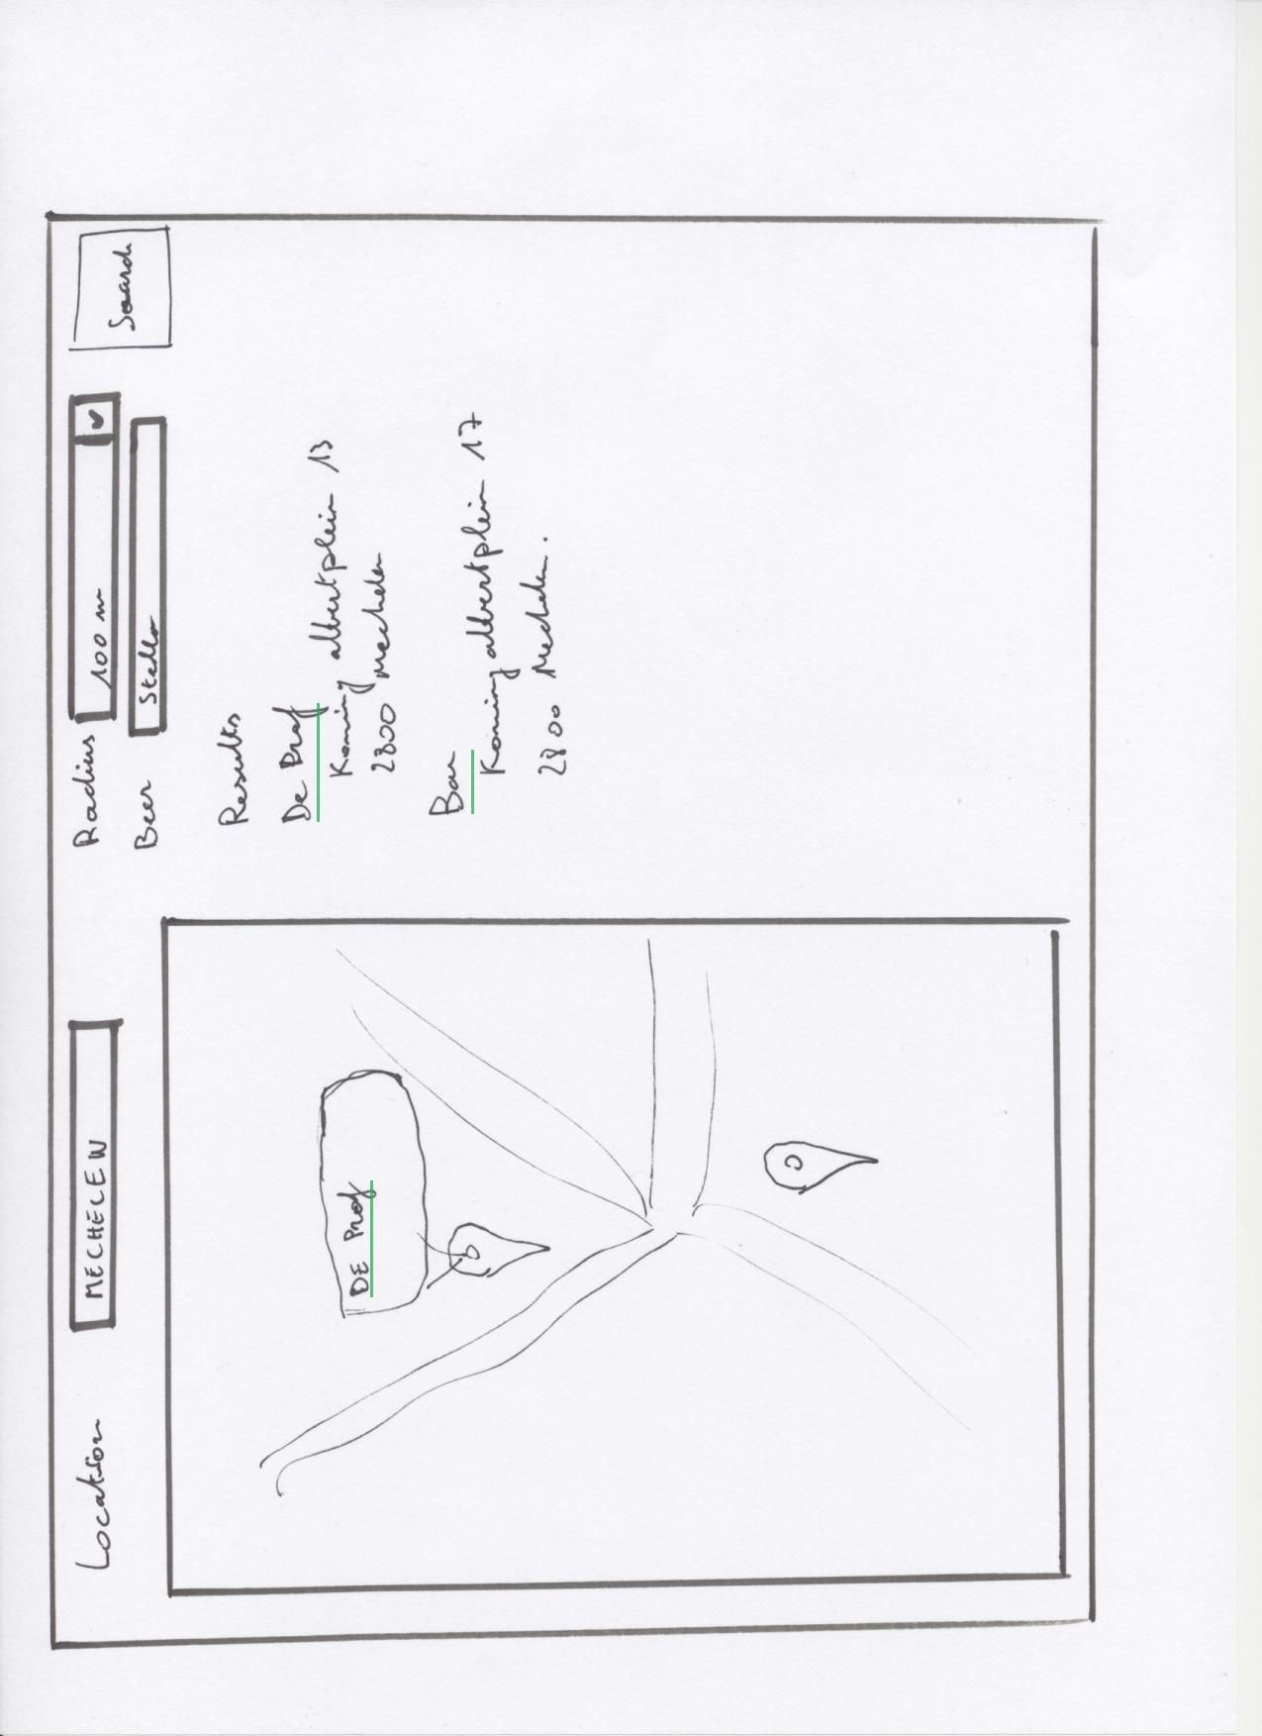
Search bars by location. Location field is filled in using HTML5 geolocation

Slide 27
Use google maps to visualize the results

Slide 28
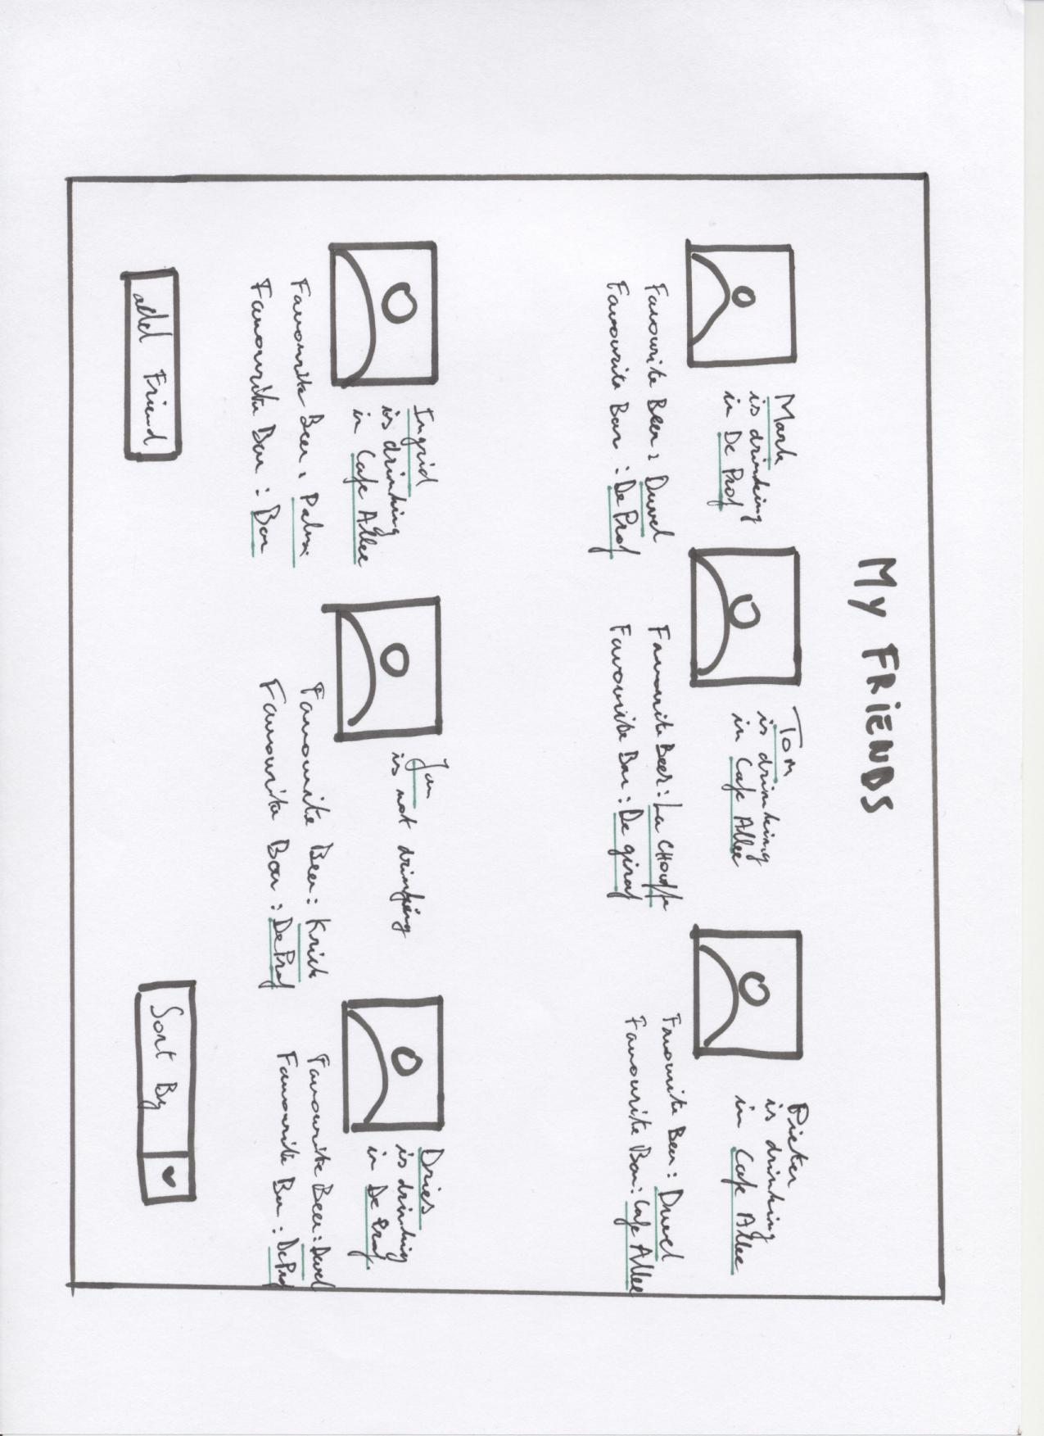
Friends location is shared
Friends are imported using Facebook API

Slide 29
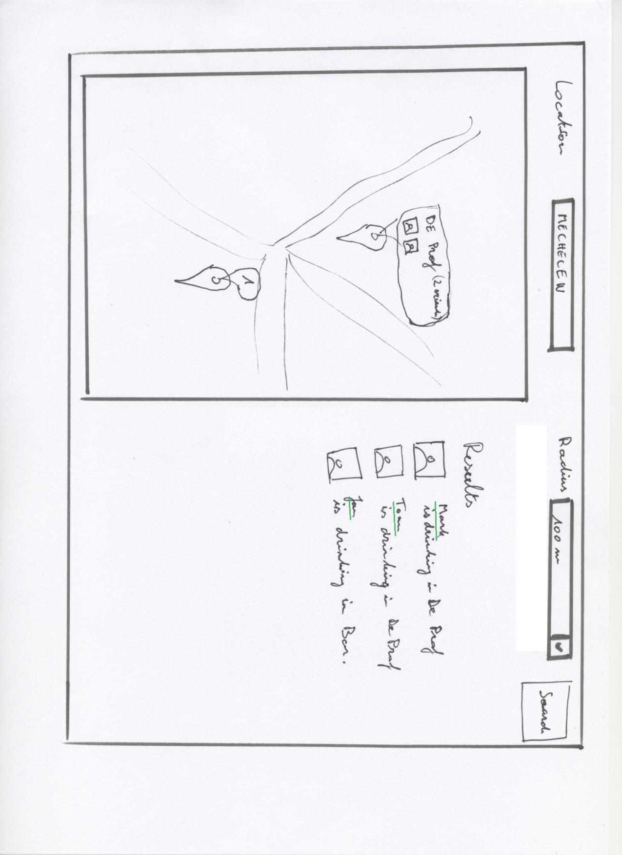
Search friends by location

Slide 30
Publishing data as a WS
We will provide a RESTful interface for:
our bars and their reviews
our beer reviews

Slide 31
Technology inventory
webtoolkit.eu/jwt
AJAX-enabled Java web application development library
JOOQ.org
active record library for Java
sqlite
git / github.com

Slide 32
Technology inventory
connecting to REST web-services
client side: jQuery
server side: google-gson
publish data as a web service
JAXWS
???

