Slide 1
BLURB ABOUT MYSELF

Slide 2
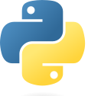
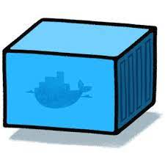
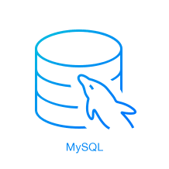


Application structure
Instance
Container
Instance
Instance
Instance
Instance
Python App ‘Daemon’
Python App ‘Daemon’
Python App ‘Daemon’
<data>
MySQL DB
Python 3.8.**
MySQL 8.0.**
aws-cli V2 2.9.**
JVM
Jenkins slave?
<data>
Python App ‘Processor’
Static HTML

Slide 3


GitHub Repo Structure
/
/
/
/
the_daemon
<code>
/
the_converter
<code>
/
mysql_schema
<DDL>
/
Jenkins_config
<JCasC>

Slide 4



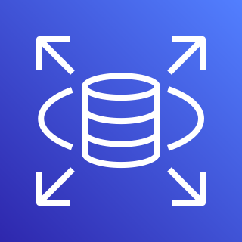
Project configuration
<Sources>
Environment 1
Dev
Environment 2
Prod
Control
host
ON PREM
<images>
CLOUD
(+ + …)
OR: ?

Slide 5

Pipeline
DEV ENV
git push
TEST
<Sources>
deploy to dev env
git pull
git pull
<Devs>
webhook
git pull
OK
build
deploy to prod env
OK
PROD ENV
Docker image -> Docker Hub

Slide 6
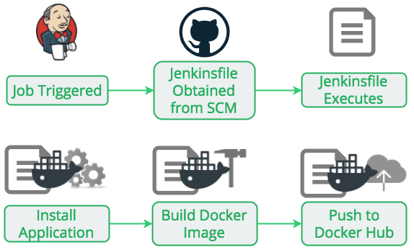

Slide 7
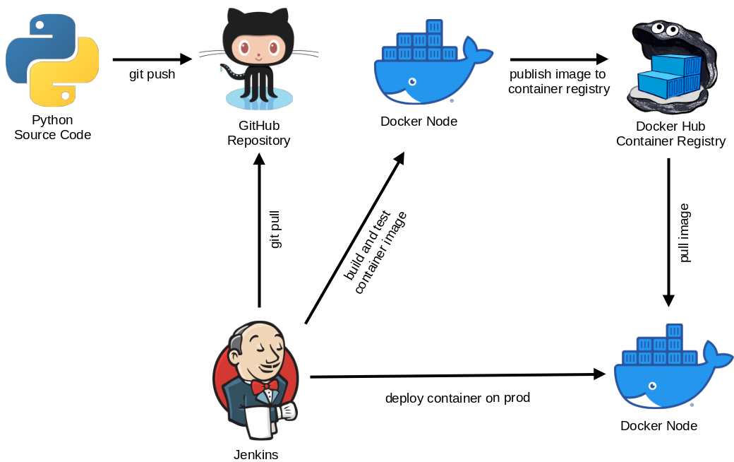

Slide 8


