Slide 1
Advanced git topics
Philip Lijnzaad
Princess Maxima Center for Pediatric Oncology May 2017

Slide 2
General
git helps you develop grow software collaboratively
talking face to face is also very effective!
When contributing to existing projects: stick to their coding style!
Reformatting just clutters the history
Use a graphical user interface
git is complex …
Commit messages: first line < 60 characters, then empty line, then details (line breaks at ~ 72 characters)
Don’t commit broken code: commit-hooks

Slide 3
Pre-commit hooks
Fork (or clone) https://github.com/plijnzaad/advanced-git
Inside the working copy, copy (or symlink) file git-pre-commit-hook.sh to ./.git/hooks/pre-commit
make sure it is executable: chmod a+x thatfile
Add a script with an error, or introduce a deliberate error in the R script, and try to commit it

Slide 4
Pull Requests
Very useful for collaborations with remote projects
Within one room: commit to the same repo
A Pull Requeset (’PR’) is essentially asking for peer review
Your code, and your commit history should be clean
if not, it will reduce the chances of your improvements being accepted
How to achieve that clean history?
by modifying it before pushing
Cheating? No: let’s you get rid of all useless commits
‘typo’, ‘oops’, ‘off-by-one’, ‘missing semi’

Slide 5
Getting clean commits to start with
Do your edits until you’re happy
Next: don’t commit everything, but pick out the changes that ‘belong together’, by interactively staging them:
git add –p
Commit only staged changes
git commit # without any filename!
After this, continue with git add –p
or the equivalent in your graphical client
Don’t yet push anything!

Slide 6
Branching
A branch is just a pointer to a commit
it moves automatically to the new commit
Branches are cheap!
They help organize the flow of development
Use topic branches to implement ‘new stuff’
aka ’feature branches’
Use the master branch for integrating …
don’t commit to master
… and for releasing
e.g. $ git branch ‘release2.1’

Slide 7
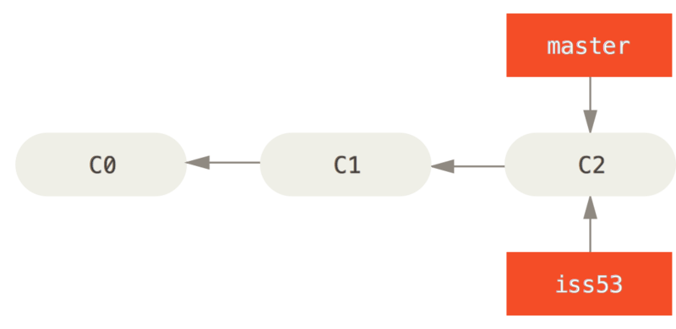
Create a branch:
$ git branch iss53 # HEAD still at master $ git checkout –b iss53 # HEAD now on iss53

Slide 8
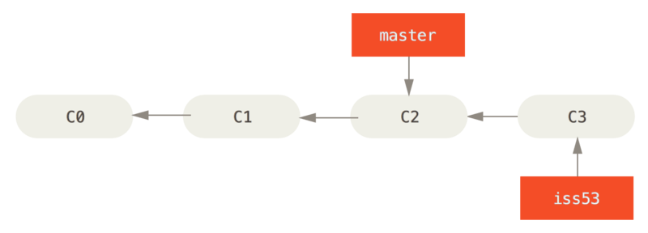
After commit:

Slide 9
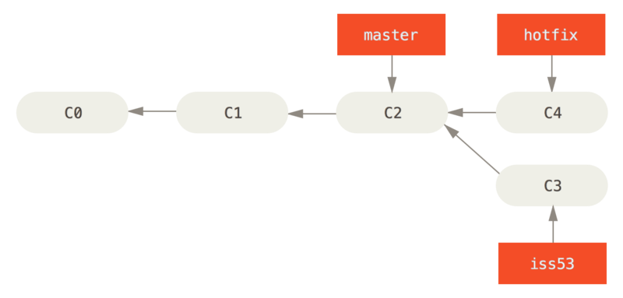
Bad bug discovered!
Now fix the bugs on the hotfix branch $ git checkout hotfix Make edits, then merge them into master: $ git checkout master
$ git merge hotfix

Slide 10
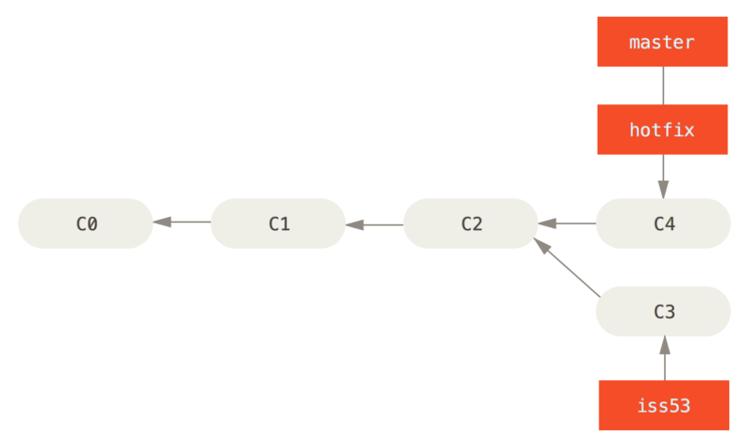
# the hotfix branch should be deleted now:
$ git branch –d hotfix

Slide 11
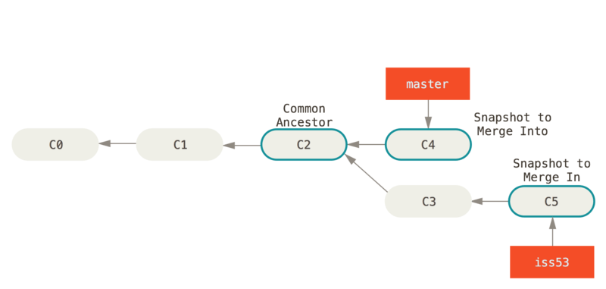
Meanwhile, work on iss53 has progressed
Merge:
$ git checkout master
$ git merge iss53

Slide 12
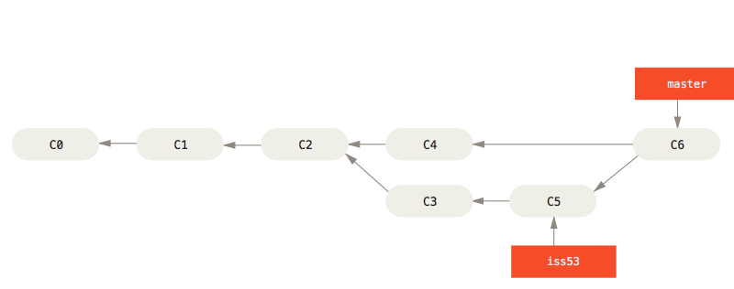
Result:
# the iss53 branch can be deleted now:
$ git branch –d iss53 # seeing all branches: $ git branch -a -vv

Slide 13
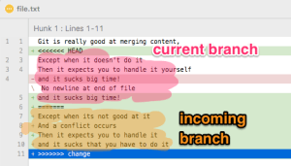
Conflicts
Can happen occasionally
git will warn you
Search for markers <<<<<<<, ======= and/or >>>>>>>
Select/edit the text you want, and get rid of the markers
Then git add the changes and commit: $ git add thefile-with-conflicts $ git commit

Slide 14
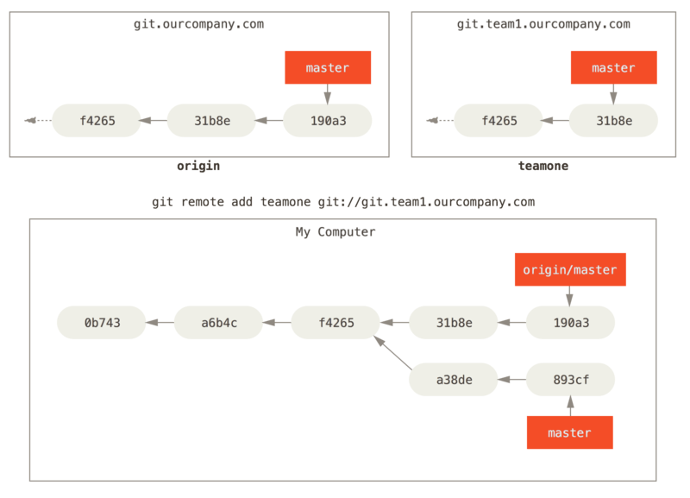
Remote branches
Collect remote changes:
$ git fetch
Collect and merge remote changes:
$ git pull Send local changes:
$ git push

Slide 15
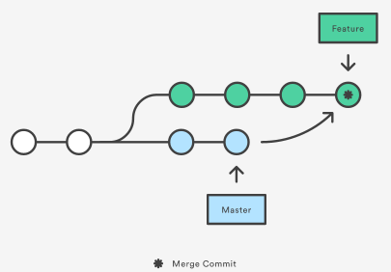
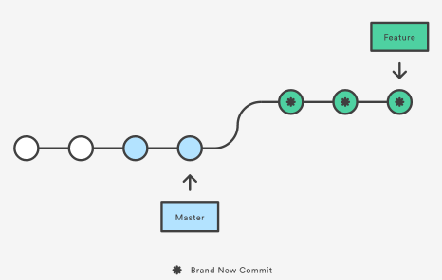
Rebasing: ’transplant’ changes onto the other branch
Merge
Rebase

Slide 16
Why rebase?
Simplifies history by making it linear
Rebase rewrites the commits
NEVER REBASE anything with a public history!
i.e.: only rebase local changes
typical example: getting in the latest upstream changes
configure git to use rebase when pulling: git config --global pull.rebase true

Slide 17
Advanced cleaning: interactive rebase
$ git rebase –i
Reorder, join or split commits
Only local commits!
Determine from where you want to start changing history, e.g. $ git rebase –i HEAD~4
Next, use your editor to tell git what to do: pick; reword; edit, drop, squash, fixup.
You can also reorder the lines to change the order (top to bottom)

Slide 18
git rebase –i: splitting commits
To split a commit that is too big, use edit
allows you to change history in more sophisticated manner
Lands you in the command line, where you first must do $ git reset HEAD^1
After this, reshape existing changes into separate commits, e.g. using a series of $ git add –p ; $ git commit # commit without filename
Once ready, issue $ git rebase –continue

Slide 19
Branching models
Use topic branches to implement ‘new stuff’
aka ’feature branches’
Use the master branch for integrating …
Don’t commit to master
… and for releasing
e.g. $ git branch ‘release2.1’
On local branch, integrate upstream changes using $ git rebase
often, but certainly before merging into master
When merging into master, avoid fast-forwards $ git co master $ git merge –no-ff mytopicbranch $ git push
This keeps clear who did what when: there is always a ‘merge commit’

