Slide 1
BSDS 200 · Final Project · Spring 2026
Measuring the Unmeasurable
A Beer Data Story
Plinio Durango · Zachary M
Beer Reviews Dataset · BeerAdvocate + BJCP Style Guide

Slide 2
PART ONE
The Origin Story
How did a group of students turn taste into numbers —
and why does that matter?

Slide 3
How Do You Turn a Review into a Number?
The flavor profile columns are word counts — scanned across up to 25 reviews per beer
Example review — Alaskan Amber (American Amber Ale)
Resulting flavor profile
"Richly malty and long on the palate, with just enough hop backing to make this beautiful amber-colored beer notably well balanced. The sweet caramel notes blend with a bitter finish. Full body, malty backbone throughout."
Malty
111
Hoppy
57
Sweet
74
→
Bitter
47
Body
32
↑ highlighted words are matched against the Beer Descriptors dictionary
Sour
33
This is repeated across up to 25 reviews per beer — counts accumulate
Salty
0
Why this matters for our filter: beers with fewer than 25 reviews have incomplete profiles — their word counts are based on fewer inputs and are not comparable to fully profiled beers. Filtering to number_of_reviews > 25 guarantees every beer in the analysis has a complete flavor profile.

Slide 4
Where Did the Data Come From?
The author combined two separate Kaggle datasets into one — this is what the notebook documents
Source 1
Source 2
Beer Tasting Profiles Dataset
1.5 Million Beer Reviews
Contains beer metadata and tasting profiles:
beer name, brewery, style, ABV, IBU range,
and the 11 flavor word-count columns
(Hoppy, Malty, Sweet, Bitter, etc.)
kaggle.com/ruthgn/beer-profile-and-ratings-data-set
+
Contains user review data from BeerAdvocate:
review scores for aroma, appearance,
palate, taste, overall — and the
number of reviews per beer.
kaggle.com/rdoume/beerreviews
↓
Problem: the two datasets use different beer names and brewery names — they cannot be joined with a simple exact match. The author needed a smarter approach to link 3,197 beers across both sources.

Slide 5
The Joining Problem — Solved with FuzzyWuzzy
Exact string matching fails when names differ slightly — fuzzy matching finds the best fit
Why a normal JOIN fails
What FuzzyWuzzy does
Source 1 name
Source 2 name
FuzzyWuzzy computes a similarity score (0–100) between two strings based on edit distance — how many character changes are needed to turn one into the other.
token_sort_ratio sorts words alphabetically before comparing, making it robust to word-order differences.
Alaskan Amber
Alaskan Brewing Amber
Dogfish Head 60 Minute IPA
60 Minute IPA (Dogfish Head)
Three Floyds Dark Lord
Dark Lord Russian Imperial Stout
Same beer — different string. SQL ON b1.name = b2.name gives no match.
Example: scoring beer name candidates for 'Alaskan Amber'
91
72
55
23
Alaskan Brewing Amber
Alaskan Pale
Amber Ale (Some Brewery)
Sierra Nevada Pale Ale
✓ score ≥ 90 → accepted as a match
✗ score < 90 → rejected
The result: 3,197 beers successfully matched across both sources — producing our final clean_file.csv dataset.

Slide 6
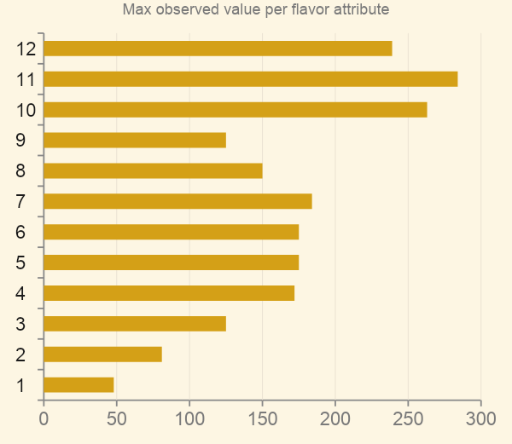
The Problem: Not All Scales Are Equal
The 11 flavor columns are raw word counts, not ratings.
Each column has a completely different natural ceiling because some flavor words appear far more often in beer writing than others.
This makes direct comparison between attributes meaningless.
Malty reaches 239 · Salty reaches only 48
So Hoppy = 60 ≠ Malty = 60

Slide 7
The German Tank Problem
A WWII statistical insight — applied to beer
During WWII, Allied analysts needed to estimate Germany's total tank production. They only had captured serial numbers — a small sample.
Their insight: if you observe n tanks with serial numbers up to M (the max in your sample), the best unbiased estimate of the true total N is:
Applied to our dataset
M = max word count observed for each flavor attribute
n = number of beers in our filtered sample (> 25 reviews)
N_est = estimated 'true maximum' for that attribute
Normalized score = raw score ÷ N_est
Result: all 11 attributes mapped to a fair 0–1 scale
N_estimated = M x (n + 1) / n
Inspired by a lesson from our Statistics professor — and a spark from Nate's presentation

Slide 8
German Tank Results: Estimated True Maximums
n = 2,340 beers with > 25 reviews, valid ABV and IBU
Attribute | Observed Max | Tank Estimate | Scale Factor
Astringency | 77 | 77.03 | 0.01298
Body | 175 | 175.07 | 0.00571
Alcohol | 126 | 126.05 | 0.00793
Bitter | 150 | 150.06 | 0.00666
Sweet | 219 | 219.09 | 0.00456
Sour | 241 | 241.10 | 0.00415
Salty | 48 | 48.02 | 0.02082
Fruits | 165 | 165.07 | 0.00605
Hoppy | 172 | 172.07 | 0.00581
Spices | 178 | 178.08 | 0.00561
Malty | 239 | 239.10 | 0.00418
Scale factor = 1 / Tank Estimate · Multiply raw score by this to normalize to 0–1

Slide 9
PART TWO
The Findings
6 visualizations — what the data tells us about beer quality

Slide 10
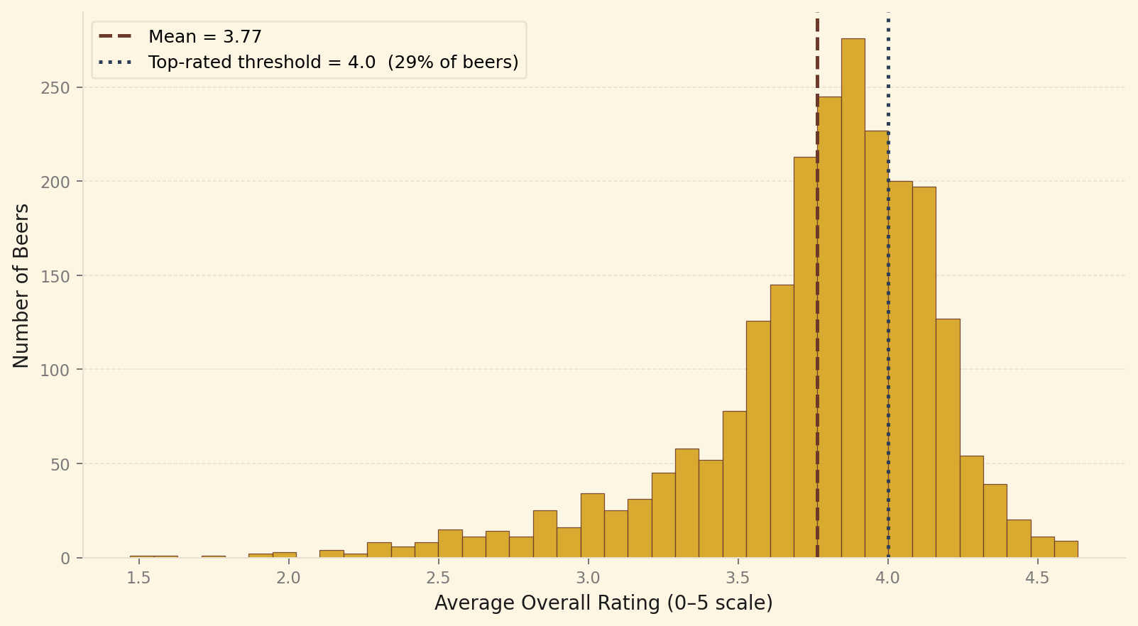
Figure 1 — What Does a 'Good Beer' Look Like?
Most craft beers cluster between 3.7 and 4.0 · Mean = 3.77 · 2,340 beers analyzed · 29% score ≥ 4.0

Slide 11
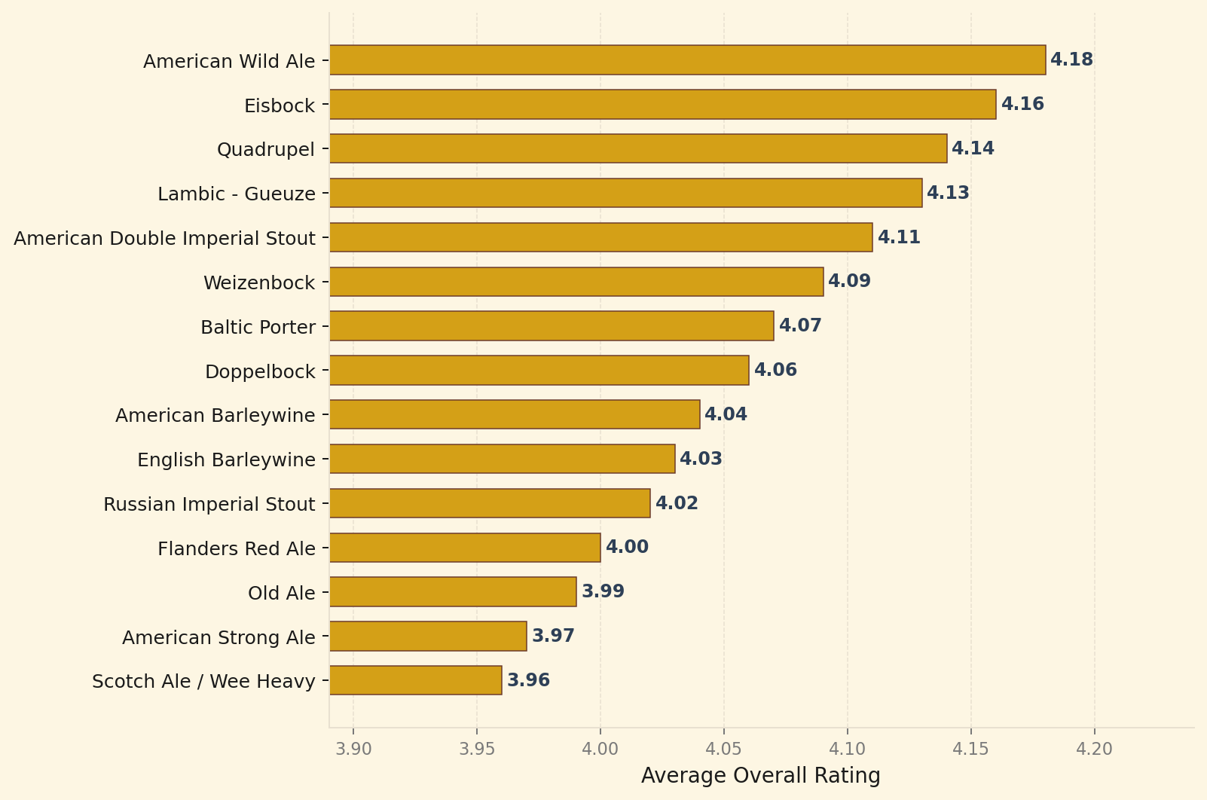
Figure 2 — Which Beer Styles Win?
Top 15 styles by average overall rating · styles with ≥ 5 beers and > 25 reviews each
Specialty and complex styles dominate — confirming that the reviewer base skews toward craft enthusiasts.

Slide 12
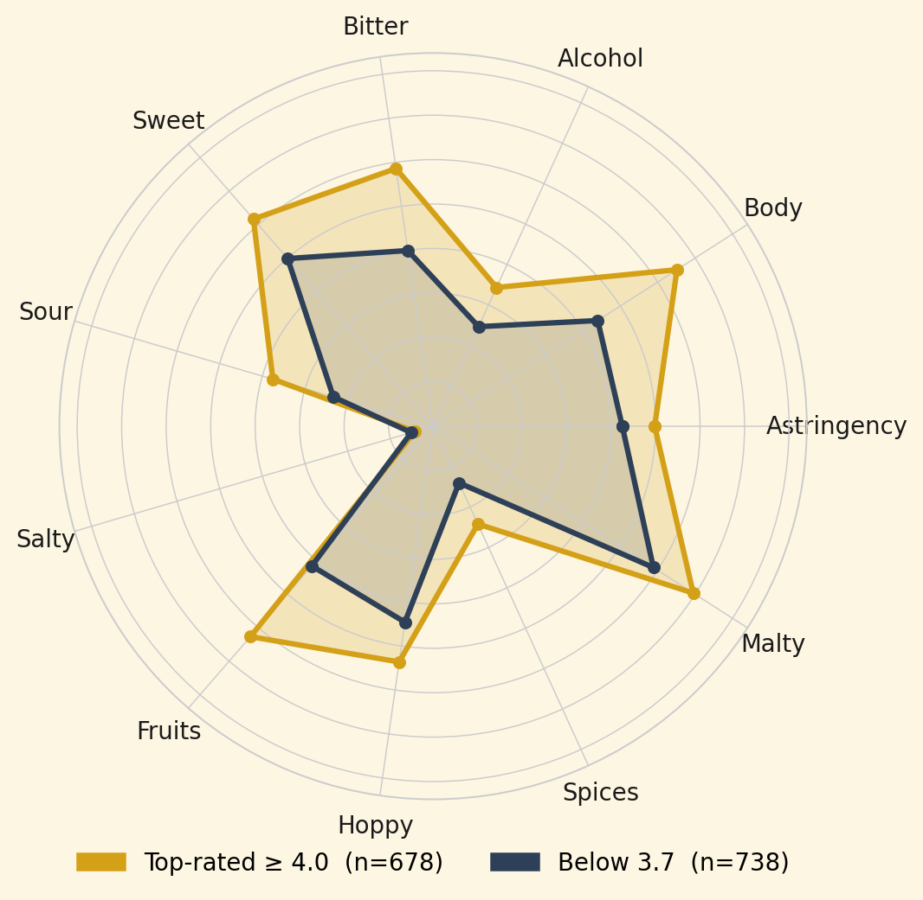
Figure 3 — Flavor DNA of Great vs. Average Beers
German Tank normalized scores (0–1 scale) · Top-rated ≥ 4.0 vs. Below 3.7
Key Insight
Top-rated beers score consistently higher across ALL 11 dimensions — not just one or two.
The biggest gaps (top vs. below 3.7):
Spices (+72%)
Sour (+61%)
Fruits (+51%)
Body (+48%)
Bitter (+47%)
Salty is the only attribute where top-rated beers score lower (-17%) — great beers are rarely described as salty.

Slide 13
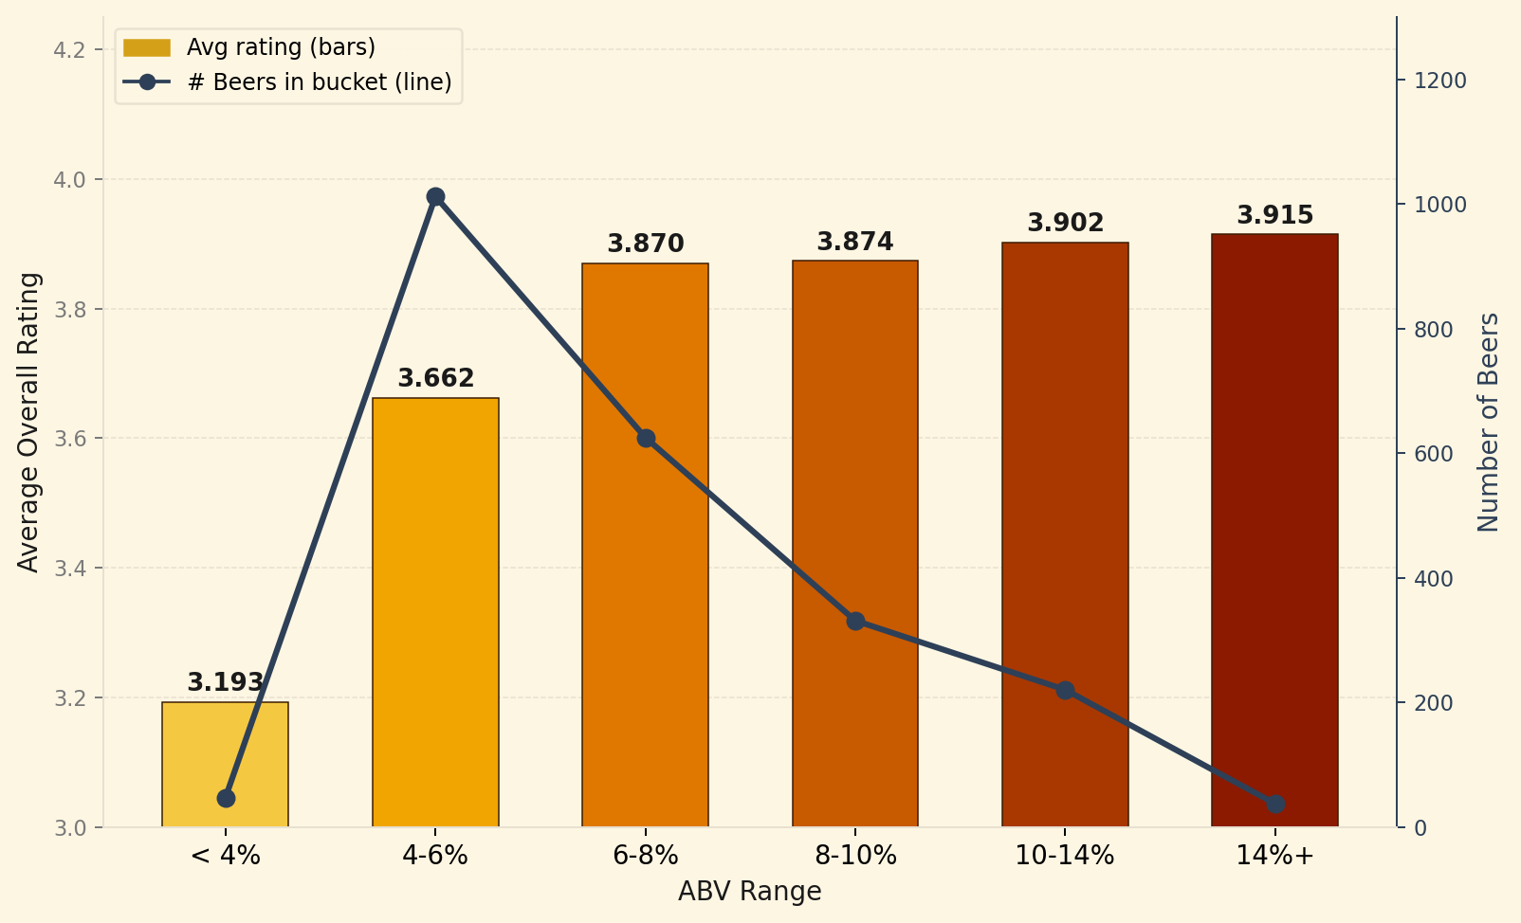
Figure 4 — Does Stronger Mean Better?
Bars rise with ABV — but the line shows data gets thin above 10%, so treat those buckets with caution

Slide 14
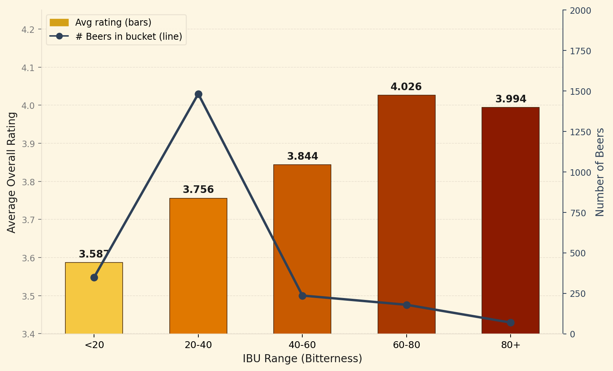
Figure 5 — Does a More Bitter Beer Mean a Better Beer?
IBU (International Bitterness Units) bucket vs. average rating · bars = avg rating · line = number of beers
Unlike ABV, bitterness has a sweet spot — ratings peak at 60–80 IBU then dip slightly above 80.

Slide 15
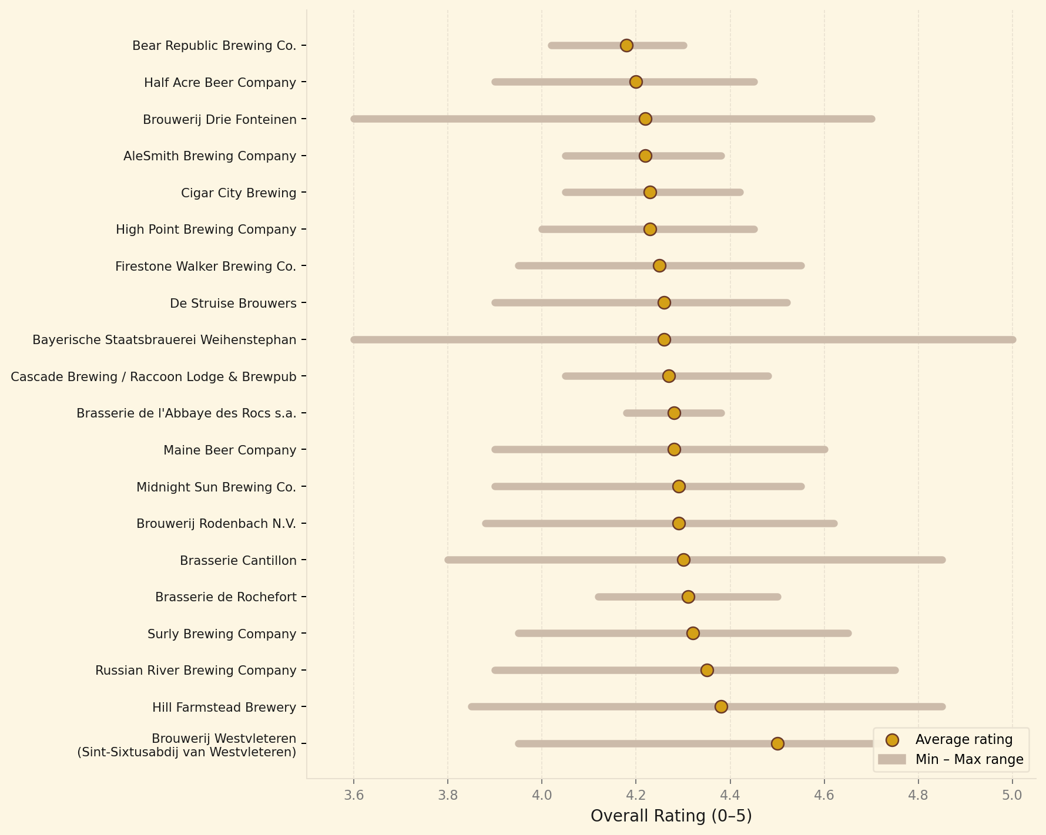
Figure 6 — Which Breweries Are Reliably Excellent?
Top 20 breweries by avg rating · gold dot = average · grey bar = full min–max range · shorter bar = more consistent

Slide 16
What We Learned
01
Great beers are complex — not extreme
03
Style is the strongest predictor
Top-rated beers score higher across all 11 flavor attributes. The biggest gaps are Spices (+72%), Sour (+61%), and Fruits (+51%). Salty is the only attribute where top-rated beers score lower.
Specialty styles (Wild Ales, Quadrupels, Imperial Stouts) dominate top ratings, reflecting both genuine complexity and reviewer selection bias.
02
Both ABV and IBU predict ratings — up to a point
04
The German Tank correction works
Ratings rise with ABV across all buckets. For bitterness (IBU) there is a sweet spot at 60–80 IBU — above 80 IBU ratings dip slightly, suggesting extreme bitterness is penalized.
Normalizing the 11 flavor columns to a common 0–1 scale made cross-attribute comparison valid for the first time in this dataset.

Slide 17
Thank You
Plinio Durango · Zachary M
BSDS 200 · Applied Data Science Methods · Spring 2026
Data: Kaggle Beer Reviews Dataset + BJCP 2015 Style Guide
Method: German Tank Problem normalization + BeerAdvocate review scores

